Slide 1
TDAL_DISP

Slide 2
TDAL_DISP Overview
Control video display output stage of a set-top-box/OBM at video presentation level.
Manage Layers and Blenders:
  A variable number of Layers are available depending on the hardware capabilities. Each Layer contains a video image (video, graphics or OSD, still-picture, …).
  A Blender is responsible for mixing several Layers with a possible configurable z-list order depending on the hardware capabilities.

Slide 3
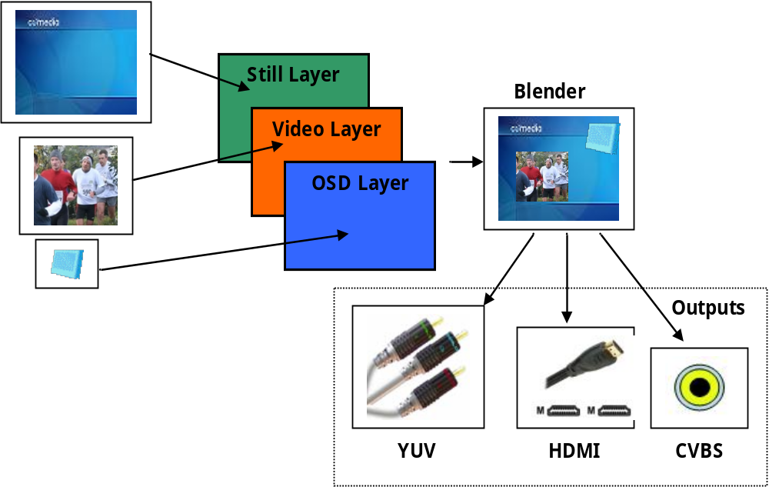
TDAL_DISP Example
Still/Video/OSD Layer blending on YUV/HDMI/CVBS outputs

Slide 4
TDAL_DISP Blender Identifiers
The blender identifier tTDAL_DISP_BlenderId is the way used by an application to access in a single way a specific blender in the list of available blenders.
  typedef enum
  {
  eTDAL_DISP_BLENDER_ID_0, /* Blender identifier 0 */
  eTDAL_DISP_BLENDER_ID_1, /* Blender identifier 1 */
  eTDAL_DISP_BLENDER_ID_2, /* Blender identifier 2 */
  eTDAL_DISP_BLENDER_ID_3, /* Blender identifier 3 */
  }tTDAL_DISP_BlenderId;

Slide 5
TDAL_DISP Layer Identifiers
The layer identifier tTDAL_DISP_LayerId is the way used by an application to access in a single way a specific layer in the list of available layers.
The layer identifier itself holds its own type (video, graphics, still-picture, cursor).
  typedef enum
  {
  eTDAL_DISP_LAYER_VIDEO_ID_0, /* Layer video identifier 0 */
  eTDAL_DISP_LAYER_VIDEO_ID_1, /* Layer video identifier 1 */
  eTDAL_DISP_LAYER_VIDEO_ID_2, /* Layer video identifier 2 */
  eTDAL_DISP_LAYER_GFX_ID_0, /* Layer graphics identifier 0 */
  eTDAL_DISP_LAYER_GFX_ID_1, /* Layer graphics identifier 1 */
  eTDAL_DISP_LAYER_GFX_ID_2, /* Layer graphics identifier 2 */
  eTDAL_DISP_LAYER_STILL_ID_0, /* Layer still-picture identifier 0 */
  eTDAL_DISP_LAYER_STILL_ID_1, /* Layer still-picture identifier 1 */
  eTDAL_DISP_LAYER_CURSOR_ID_0, /* Layer cursor identifier 0 */
  eTDAL_DISP_LAYER_CURSOR_ID_1, /* Layer cursor identifier 1 */
  }tTDAL_DISP_LayerId;

Slide 6
TDAL_DISP Layer Z-Ordering
In order to have flexibility, TDAL_DISP defines the concept of blender layer Z-order list. It is an array of layer identifiers. The size of the array depends on the capabilities of the blender. The 1st layer identifier in the array (at index 0) represents the layer which is furthest from the viewer. Subsequent layer identifiers represent layers more and more near to the viewer.
The TDAL_DISP client can have the list of layer Z-order list combinations by getting the possible indexes that a layer can take in the Z-order list array of a blender.
If an unique layer can be set in different blender Z-order lists, it is not possible to set this layer in more than one blender Z-order list at the same time.

Slide 7
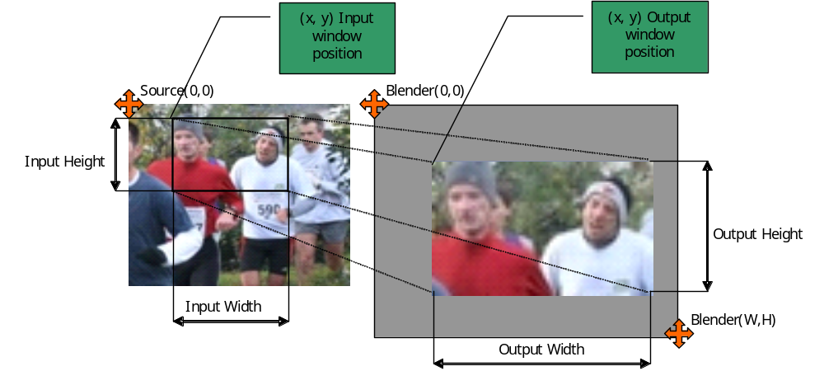
TDAL_DISP Layer Windowing (1/2)
Adjust input and output windows of a layer

Slide 8
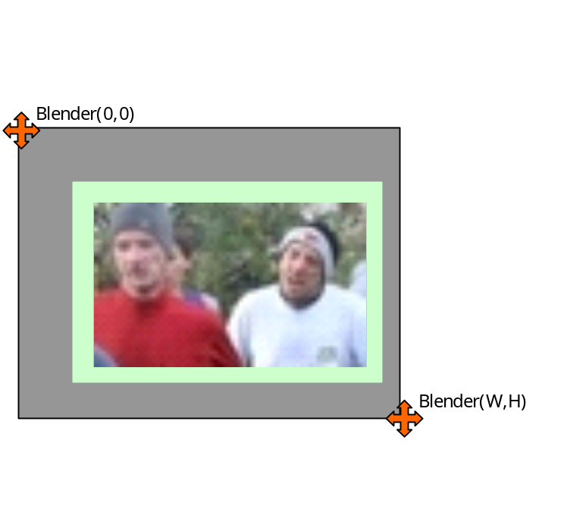
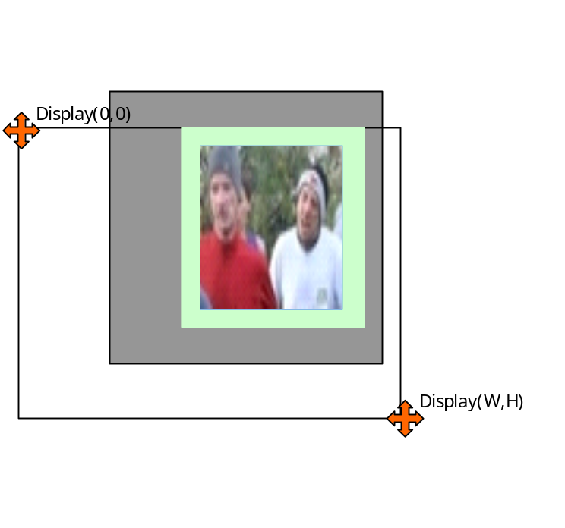
TDAL_DISP Layer Windowing (2/2)
OSD Layer + Video Layer = Blender
Blender windowing on output

Slide 9
TDAL_DISP Video Layer Aspect Ratio
For video layers and because all manufacturers do not want to follow ETSI TR 101 154 and DTG Implementation documents, the choice is let to TDAL_DISP implementers to do or not the window output resize calculation depending on:
  video input size,
  video aspect ratio,
  video AFD code,
  aspect ratio conversion mode (full screen, 16/9 letter box, …).
This ability is indicated in layer capabilities.

Slide 10
TDAL_DISP dependency with TDAL_AV and TDAL_GFX
TDAL_AV needs an access to the layers to indicate in which video layers, the video decoding result must be sent.
TDAL_GFX needs an access to the layers to indicate in which graphics layers a region is created.
The layer handle is an unique opaque value that is used as accessor to a specific layer.
This handle is used transversely between the different TDAL modules in order to authorize a TDAL module to access the low level driver that manages the layers.
TDAL_DISP_LayerHandleGet(-) is used to get an opaque unique handle on a layer.

Slide 11
TDAL_DISP Generic
Function List:
Function | Description
TDAL_DISP_Init(-) | Initialize the TDAL_DISP module
TDAL_DISP_Term(-) | Terminate the TDAL_DISP module
TDAL_DISP_CapabiltyGet(-) | Get the capabilities of the current implementation of TDAL_DISP module
TDAL_DISP_APIRevisionGet(-) | Get API revision
TDAL_DISP_PlatformRevisionGet(-) | Get Platform revision

Slide 12
TDAL_DISP Blender
Function List:
Function | Description
TDAL_DISP_BlenderCapabilityGet(-) | retrieve the capabilities of each available blender
TDAL_DISP_BlenderBackgroundColorSet(-) | set a background colour on a blender
TDAL_DISP_BlenderDimensionsGet(-) | get the current dimensions of a blender
TDAL_DISP_BlenderDimensionsSet(-) | set the dimensions of a blender
TDAL_DISP_BlenderDisable(-) | disable a blender
TDAL_DISP_BlenderEnable(-) | enable a blender
TDAL_DISP_BlenderZOrderPositionsGet(-) | get the possible Z-order positions of the layers in a blender
TDAL_DISP_BlenderZOrderListSet(-) | set the Z-order list of layers in a blender
TDAL_DISP_BlenderDimensionsOutputSet(-) | Set Blender window coordinates

Slide 13
TDAL_DISP Layer
Function List:
Function | Description
TDAL_DISP_LayerCapabilityGet(-) | retrieve the capabilities of each available layer
TDAL_DISP_LayerGlobalTransparencySet(-) | set global transparency value of a layer
TDAL_DISP_LayerHandleGet(-) | get an opaque unique handle on a layer
TDAL_DISP_LayerIOWindowsAdjust(-) | adjust the input/output windows of a layer
TDAL_DISP_LayerIOWindowsAspectRatioParamsSet(-) | set the aspect ratio input information and the conversion mode of the input/output windows of a layer
TDAL_DISP_LayerIOWindowsGet(-) | retrieve the current input/output windows of a layer
TDAL_DISP_LayerIOWindowsSet(-) | set the input/output windows of a layer
TDAL_DISP_LayerDisable(-) | disable a layer
TDAL_DISP_LayerEnable(-) | enable a layer

Slide 14
TDAL_DISP documentation
Let’s go now deeper in “TDAL_DISP Specification.doc”

