Slide 1
Mstar eCos application
Jerry-HT Hsieh
2013.12.16

Slide 2
Agenda
Tool chain and Source tree
Program the boot loader (MBoot)
Build the application
Run the application
From USB flash disk
From SPI without Mboot
From SPI with MBoot

Slide 3
Tool chain and Source tree (1/2)
Build Server Path
>>export PATH = /tools/mipsisa-3.4.4/bin:$PATH
Sync Code Path
//THEALE/Uranus/Keltic/DDI_Package/ddi_pkg_ecos/
//THEALE/Uranus/DDI_MISC/

Slide 4
Tool chain and Source tree (2/2)
Source Tree
boot : boot loader dependence source code
bsp
Include : utopia header file
lib : utopia library
cus_mstar : DDI main source code
ecos : ecos kernel library
verify : verify command sample script

Slide 5
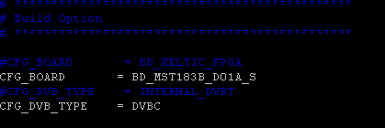
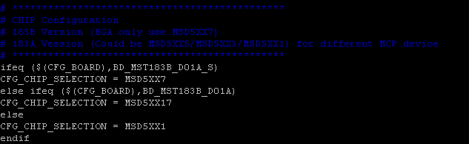
Board Configurations
Build options (cus_mstar/project/mstar_demo/config)
Select correct board option
Select correct chip part name

Slide 6
Build the application → make
cd ../ddi_pkg_ecos/cus_mstar/project/mstar_demo
Edit the file “config”
Select the CFG_BOARD and CFG_DVB_TYPE
make clean;make
Application → bin/keltic_ecos.bin
Packed Application and Boot Code →
DDI_Package\ddi_pkg_ecos\boot\mboot\out\flash.bin

Slide 7
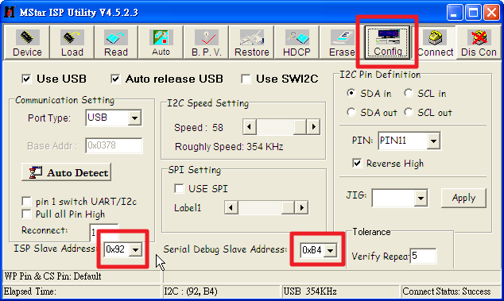
1. Start to flash Boot Code to SPI
Config

Slide 8
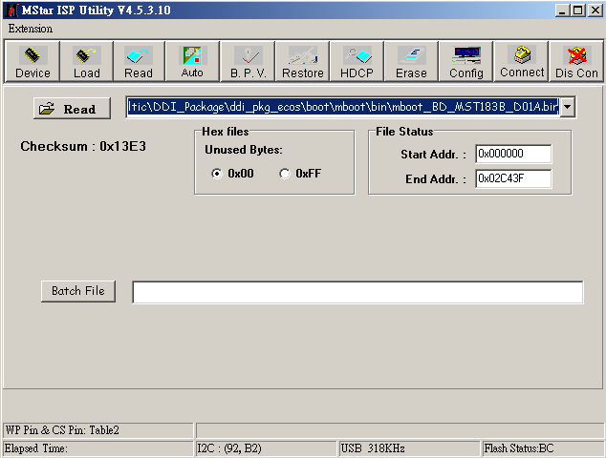
2. Load Binary with ISP TOOL
Read Correct Mboot binary

Slide 9
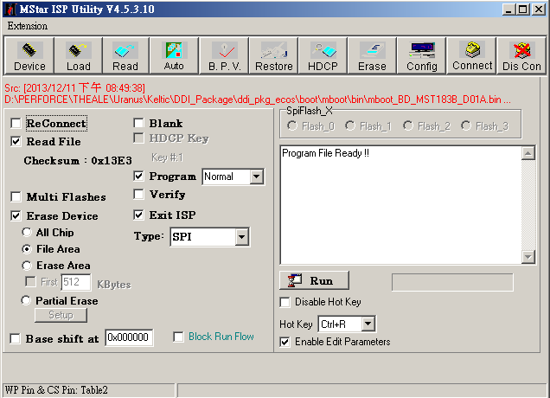
2. Flash Binary to SPI with ISP TOOL
Click run to flash binary to SPI

Slide 10
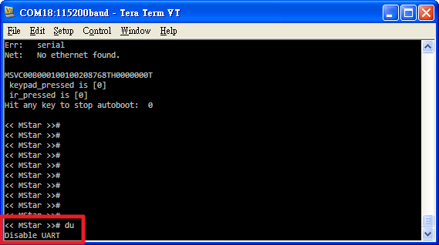
1. Run the application from USB
If connect or write flash fail, please perform the following steps
Press down the “Enter” while booting
Execute the command “du”
<< MStar >># du
Un-Check the Re-Connect check box in ISP tool
Repeat the procedure again (1~5)
10

Slide 11
1. Run the application from USB
Execute the following command in the boot loader
<< MStar >># setenv bootcmd ‘usb start ; fatload usb 0 0x80000180 keltic_ecos.bin; go 0x80000224
<< MStar >># saveenv
Copy the bin/keltic_ecos.bin to USB disk and plug to the board
Reset the board
11

Slide 12
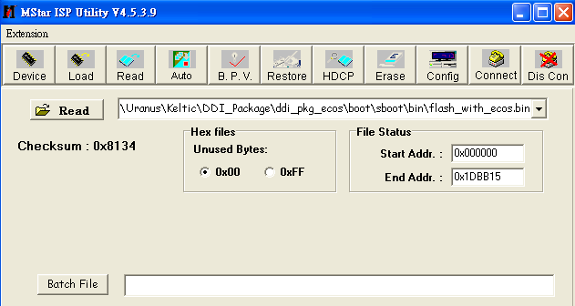
2. Run the app+sboot from SPI
Flash image
…/ddi_pkg_ecos/boot/sboot/flash_with_ecos.bin
This will Run the app with Sboot

Slide 13
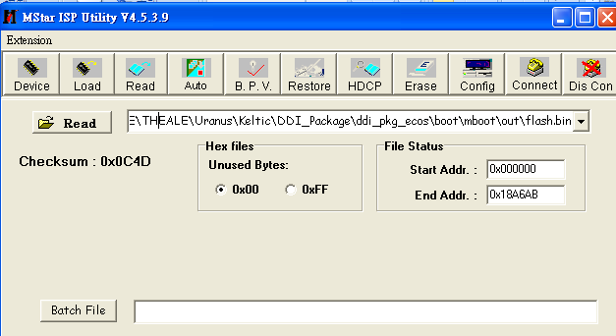
2. Run the app + mboot from SPI
Flash image only first time
…/ddi_pkg_ecos/boot/mboot/out/flash.bin
This will Run the app with mboot

Slide 14
2. Run the app + mboot from SPI
After first time flash.bin already booting to DDI
We can just place the flash.bin to USB directly and reboot for auto updating FW

Slide 15
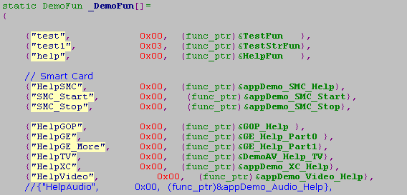
Add verify/demo code (1/3)
../cus_mstar /app/demo/appDemo.c
Command
Input Mask
Function

Slide 16
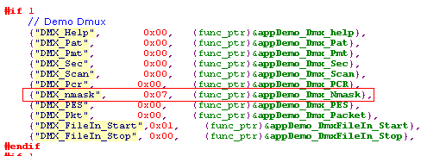
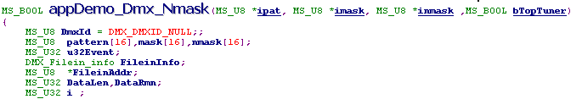
Add verify/demo code (2/3)
Input Mask
1: input string(MS_U8*), 0: input (MS_U16*);
These argument are string type

Slide 17
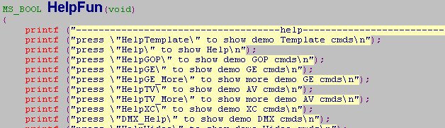
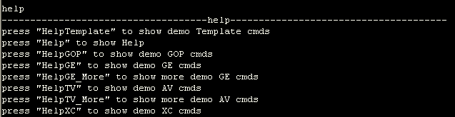
Add verify/demo code (3/3)
Ex : Help Function
>> help

Slide 18
Q & A

