Slide 1

Near field communication (NFC)
Ecma/TC32-TG19/2005/013
(supersedes 2004/028)
Rue du Rhône 114- CH-1204 Geneva - T: +41 22 849 6000 - F: +41 22 849 6001 - www.ecma-international.org

Slide 2

Near Field Communication
  Easy to use wireless communication interface for the last few centimeters
  Easy to use target selection, by simply holding two devices close to each other
NFC is as easy as….
… a touch
Rue du Rhône 114 - CH-1204 Geneva - T: +41 22 849 6000 - F: +41 22 849 6001 - www.ecma-international.org <number>

Slide 3
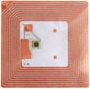
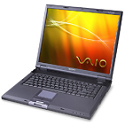

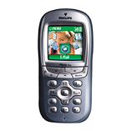
NFC - Technical Basics
Wireless Short Range Communication Technology
  Based on RFID technology at 13,56 MHz
  Operating distance typical up to 10 cm
  Compatible with today’s field proven contactless RFID technology
  Data exchange rate today up to 424 kilobits/s
RFID object
13,56MHz RF Link
NFC
NFC
Rue du Rhône 114 - CH-1204 Geneva - T: +41 22 849 6000 - F: +41 22 849 6001 - www.ecma-international.org <number>

Slide 4
Near Field Communication
Wireless short range communication technology
  NFC is designed for short distance wireless communication
  Allows intuitive initialization of wireless networks
  NFC is complementary to Bluetooth and 802.11 with their long distance capabilities
  NFC also works in dirty environment
  NFC does not require line of sight
  Easy and simple connection method
  Provides communication method
  to non-self powered devices
Rue du Rhône 114 - CH-1204 Geneva - T: +41 22 849 6000 - F: +41 22 849 6001 - www.ecma-international.org <number>

Slide 5

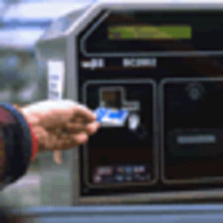
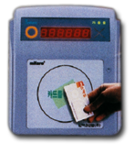

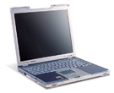

Near Field Communication Applications
Smart Key
- for mobile local payment
payment
Peer to Peer
communication,
Virtual Connector
- either directly or by
establishing wireless links
NFC
NFC
NFC
Low cost solution to distribute info / services
e.g. by passive loops
embedded in paper media
NFC enables a unique blend of valued applications
Rue du Rhône 114 - CH-1204 Geneva - T: +41 22 849 6000 - F: +41 22 849 6001 - www.ecma-international.org <number>

Slide 6
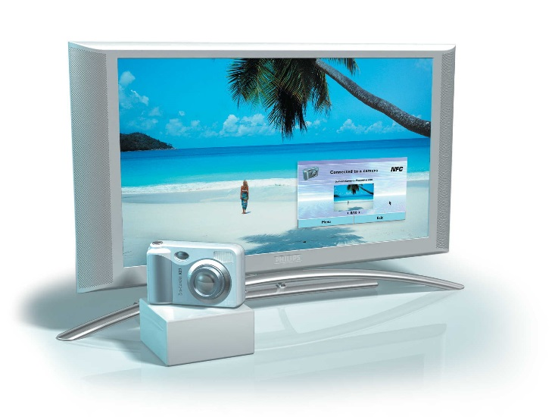
Finalised NFC work items
ECMA-340: NFCIP-1 Interface and protocol
(ISO/IEC 18092)
Key points:
  The NFC communication is based on an
  inductive RF link on 13.56 MHz
  Active and passive NFC mode at different
  transfer speeds from 106 to 424 kbps
  Backward compatibility with RFID systems
  Allows communication between
    Two powered devices
    Powered and non self-powered devices
  Standardization of
    Communication signal interface
    General protocol flow
Rue du Rhône 114 - CH-1204 Geneva - T: +41 22 849 6000 - F: +41 22 849 6001 - www.ecma-international.org <number>

Slide 7
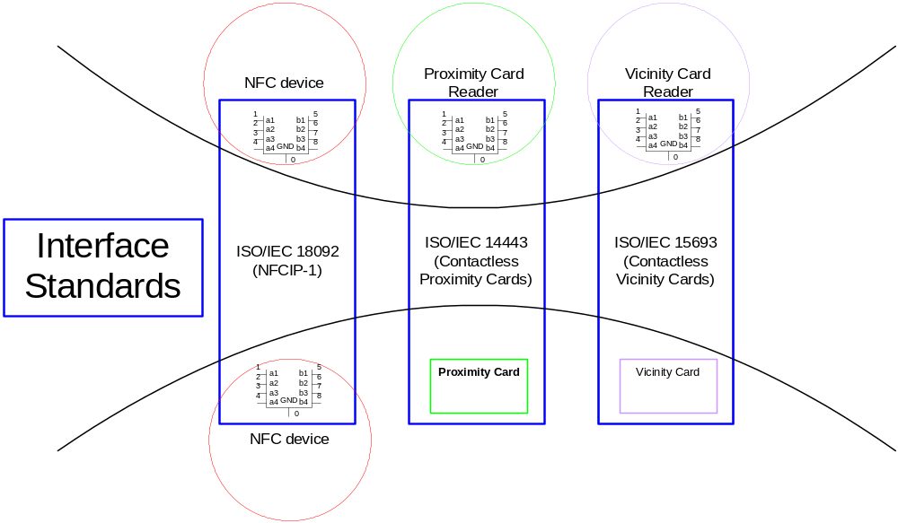
Finalised NFC work items
ECMA-352: NFCIP-2 Interface and protocol
(ISO/IEC 21481)
Key points:
Gateway between
  ECMA-340
  ISO/IEC 14443
  PCD mode
  ISO/IEC 15693
  VCD mode
Rue du Rhône 114 - CH-1204 Geneva - T: +41 22 849 6000 - F: +41 22 849 6001 - www.ecma-international.org <number>

Slide 8
Current NFC work items
ECMA-356: NFCIP-1 – RF interface Test Methods (ISO/IEC 22536)
Key points:
  Basic standard to ensure interoperability on the RF interface for ECMA-340 devices
  Description of test equipment and procedures to perform interoperability tests on the RF interface
  Description of the tests to be performed on Initiator and Target side
Rue du Rhône 114 - CH-1204 Geneva - T: +41 22 849 6000 - F: +41 22 849 6001 - www.ecma-international.org <number>

Slide 9
Current NFC work items
ECMA-362: NFCIP-1 - Protocol Test Methods
(ISO/IEC 23917)
Key points:
  Basic standard to ensure interoperability of ECMA-340 devices for:
    the initialization
    the single device detection
    the transmission protocol
  Description of test equipment and procedures to perform tests
  Description of the tests to be performed on Initiator and Target side
Rue du Rhône 114 - CH-1204 Geneva - T: +41 22 849 6000 - F: +41 22 849 6001 - www.ecma-international.org <number>

Slide 10
Future NFC work items
  A mapping of NFC to other communication protocols including the Internet Protocol (IP), GSM and Bluetooth
    Advanced Logical Link Control with addressing and segmentation support
  Support for Data Link and end-to-end security and key management
  Air-to-wired interface specification
  Application extensions in NFCIP-1
    Power control as an example application extension
Rue du Rhône 114 - CH-1204 Geneva - T: +41 22 849 6000 - F: +41 22 849 6001 - www.ecma-international.org <number>

Slide 11
TC32-TG19 membership
The following Ecma International member companies have nominated representatives to TC32-TG19:
  Avaya-Tenovis, Ericsson, Hitachi/Mitsubishi Electric, Hewlett Packard, Innovision, Philips, Samsung, Siemens, Sony, Texas Instruments
Convenor: Reinhard Meindl , Philips Semiconductors
Rue du Rhône 114 - CH-1204 Geneva - T: +41 22 849 6000 - F: +41 22 849 6001 - www.ecma-international.org <number>

Slide 12

Rue du Rhône 114
CH-1204 Geneva
T: +41 22 849 6000
F: +41 22 849 6001
www.ecma-international.org
Rue du Rhône 114 - CH-1204 Geneva - T: +41 22 849 6000 - F: +41 22 849 6001 - www.ecma-international.org <number>

