Slide 1
CYP6P4 I236 mutation in Uganda.
Non-synonymous I > M mutation occurs exclusively in Eastern Uganda
Associated with selective sweep, therefore candidate marker for insecticide resistance

Slide 2
CYP6P region
Total 10 genes including insecticide metabolizers CYP6P3 and CYP6P4
9 P450 (incl AGAP002864)
One Carboxylase
One transposable element (TE)
One 73 bp deletion
Wide variety of mutations define the Haplotype
Deletion
Insertion
Duplication
Point mutation

Slide 3
The Zanzibar transposon

Slide 4
Complete Gypsy/Ty3 structure
GAG
Aspartic
proteinase
Reverse
Transcriptase
Rnase H
Integrase
Long
Terminal
Repeat
(LTR)
Long
Terminal
Repeat
(LTR)
CYP6P cluster Zanzibar (Zanzibar-6P) is partial transposable element (TE) that lacks characteristic components of Gypsy/Ty3
Does not have open reading frames (ORFs)
Classified as Zanzibar by sequence similarity with Zanzibar in genbank
Zanzibar-6P does however have a target site duplication (TSD) and terminal inverted repeats (TIRs), the footprints of non-autonomous TE insertion.

Slide 5
The #405 subsequence ( 405-604) of the query sequence 1 is strong enhancer sequence.

Slide 6
dirstribution barrier
(arabiensis only)
M absent in coastal Kenya

Slide 7
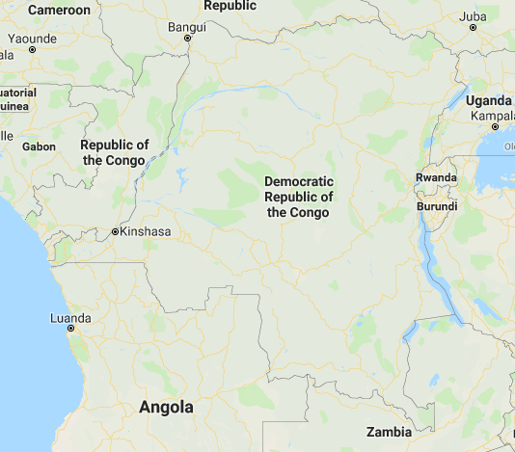
2017-2018
2017-2018
2013-2018
2017-2018
2016-2018
2013-2018
2014-2018
2014-2018
2016-2018
2017-2018
2013-2015
2014-2015
2013-2018

Slide 8
Is AA1 dup the exclusive driving force behind the sweep?
No because the haplotype increased in frequency already before the duplication

Slide 9
Theoretical and observed haplotype combinations
3
The most recent version of the haplotype (ZZB + AA1dup + P4 236M / ) is spreading
Uganda 2012
Tanzania 2015 - 2018
DRC 2016
1
2
3
 | del | zzb | aa1 | p4
del | X | 1 | 0.698 | 0.9802
zzb |  | X | 0.698 | 0.9802
aa1 |  |  | X | 0.6931
Allele association in Uganda 2012

Slide 10
Old haplotype (ZZB only) nearly extinct
Uganda 2012
Tanzania 2015 - 2018
DRC 2016
1
2
3

Slide 11
Intermediate haplotype (ZZB + P4)
Uganda 2012
Tanzania 2015 - 2018
DRC 2016
1
2
3
Intermediate Haplotype is hardly observed outside Kenya and Uganda

Slide 12
Uganda 2012
Tanzania 2015 - 2018
DRC 2016
1
2
3
Latest haplotype
(ZZB + AA1dup + P4)

Slide 13
Uganda 2012
Tanzania 2015 - 2018
DRC 2016
1
2
3
recombinants

Slide 14
Uganda 2012
Tanzania 2015 - 2018
DRC 2016
1
2
3
Possibly error
ZZB and P4 heterozygote
AA1 dup homozygote

Slide 15
Uganda 2012
Tanzania 2015 - 2018
DRC 2016
1
2
3
Wild Type appears to be the most abundant haplotype, but is in fact composed of multiple haplotypes.
I.E. There is not a single WT haplotype. Mutant haplotypes are more abundant.

Slide 16
genotype-phenotype association
Kenya and Uganda no association because alleles near fixation
Tanzania no phenotypes?
DRC
Year | Species | Insecticide | Region | Odds ratio | p | 236M frequency
2016 | Gambiae | Deltamethrin | Combined-DRC | 2.2814 | 0.002666 | 0.608870968
2016 | Gambiae | permethrin | Combined-DRC | 1.1655 | 0.5959 | 0.613445378
2016 | gambiae | Pbo-perm | Combined-DRC | 0.8708 | 0.75402 | 0.579545455
2016 | gambiae | Permanet 3.0 | Combined-DRC | 5 | 0.030477 | 0.666666667

Slide 17
To be done:
DRC temporal data
Monitor the spread of neutral markers vs the haplotype
Metabolic activity of AA1, P4, ZZB in Drosophila
Metabolic activity in insect cell lines
Bednet stuff

