Slide 1
Feature Selection
SECTION 3

Slide 2
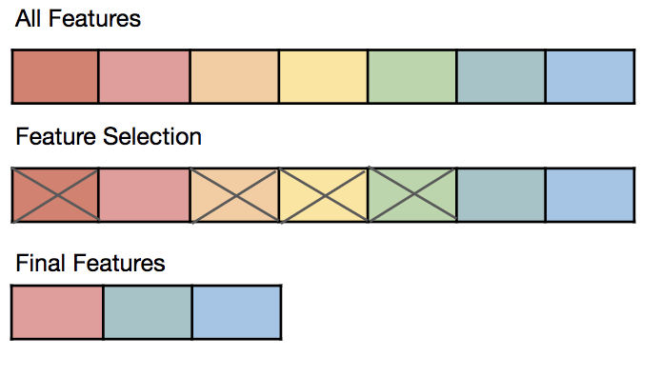
Feature Selection contd.
Feature Engineering
Reduce number of features - Input set has a total of 271 features after transforming numerical variables and one hot encoding the categorical variables.
Random Forest Classier is used to derive the most important features from the full set of input features.
The top features from the F-test, Chi-squared test and the Decision trees ensemble classifier are to a large extent similar.
TopFeatureSelector custom class can be used to get the indices of the top features which can directly be fed into a pipeline.
Pipeline with feature selection and the estimator is created to test with different inputs for number of features to be used in the final model.

Slide 3
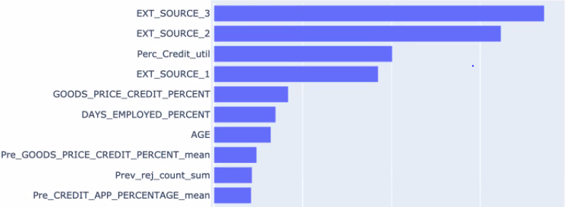
Feature Selection – Top 10 important features
Feature Selection

Slide 4
Model Comparision
Model Comparision
Baseline Model with 150 Important Features - Logistic Regression
Significance test with Random search Hyperparameter tuning
XGBClassifier
GradientBoostingClassifier
Support Vector
Stochastic GD
RandomForest

Slide 5
Model Comparision
Best Model: XGBClassifier
Best Parameters:
colsample_bytree: 0.8 gamma: 1
max_depth: 4 min_child_weight: 1
subsample: 0.6
2. T-test
train AUC: 0.7325
p-value: 0.0016

