Slide 1
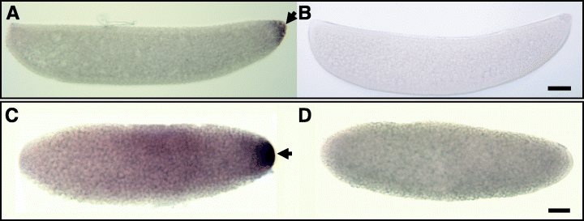
oskar gene expression in the vector mosquitoes, Anopheles gambiae and Aedes aegypti
Insect Molecular Biology Volume 15, Issue 3, pages 363-372, 31 MAY 2006 DOI: 10.1111/j.1365-2583.2006.00655.x http://onlinelibrary.wiley.com/doi/10.1111/j.1365-2583.2006.00655.x/full#f5
Notes:
Hybridizations in situ of Anga osk and Aeae osk RNA probes to whole‐mount An. gambiae and Ae. aegypti embryos. Embryos are orientated with anterior on the left. An. gambiae embryos (A,B) shown have reached cellular blastoderm with pole cells indicated by an arrow. Ae. aegypti embryos (C,D) shown are in the preblastoderm stage. Strong staining is exclusive to the posterior pole cells (A) and posterior end (C) (arrows), when compared with embryos of the same stage, determined by DAPI staining (not shown), probed with Anga and Aeae osk sense RNA probes (B,D). Bar = 50 µm.
© This slide is made available for non-commercial use only. Please note that permission may be required for re-use of images in which the copyright is owned by a third party.

