Slide 1
Deploying Your First Serverless Application
CSC4160 Fall ‘24 Lab
CUHKSZ
By: Juan Albert Wibowo

Slide 2
Intros
Goal:
Hands-on lab to get started with Serverless
Agenda:
Deploying Your First Serverless Application
Assignment Introduction

Slide 3
About these slides
Slides are adapted from COMP4651 Fall 2021 Lab Slides at HKUST

Slide 4
Create and test function in AWS Lambda

Slide 5
Create function
Let's create an addition function using AWS Lambda.
To create the addition function:
Navigate to the AWS Lambda console and click "Create function.“
Select "Author from scratch," name your function, choose Python 3.12 as the runtime, and select the LabRole execution role from the list of existing roles.
Implement the addition function within the provided lambda_function.py template.
Deploy the function.
The addition function is provided in the next slide.

Slide 6
Our addition function
import json
def lambda_handler(event, context):
json_input = event
if 'body' in event: # it can be an external request via API gateway
json_input = json.loads(event['body'])
if 'a' in json_input and 'b' in json_input:
a = int(json_input['a'])
b = int(json_input['b'])
return a + b
else:
return "No input found"

Slide 7
Code explanation
def lambda_handler(event, context):: The lambda_handler is the entry point for any AWS Lambda function.
event: This parameter contains the input data for the function. This data is sent to the function when it's invoked.
context: This parameter provides information about the invocation, function, and execution environment.
if 'body' in event:: This checks if the event dictionary contains a key named body. This is crucial because AWS API Gateway (a common way to trigger Lambda functions) often sends data within a body key.

Slide 8
Configure test event
Let’s test our function:
Click "Test," then "Create new event."
Name the event.
Add JSON event data:
{
"a": 5,
"b": 10
}
Invoke.

Slide 9
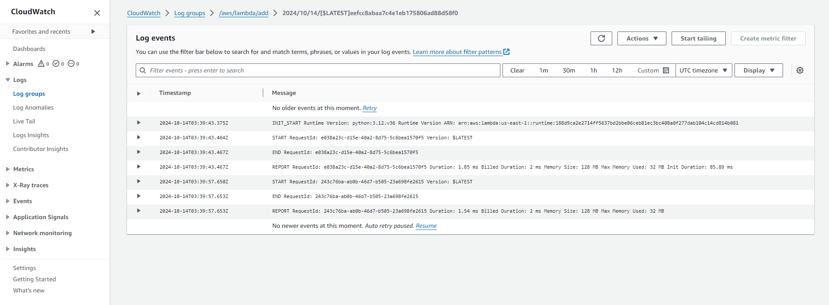
Heads-up: CloudWatch logs
Here is the CloudWatch log event for our invocation:
Notes:
Your assignment requires you to show the CloudWatch logs from your function invocation.

Slide 10
Configure endpoint

Slide 11
Add trigger
To add an API Gateway trigger:
Go to your function's overview page and click "Add trigger.“
Select "API Gateway" as the trigger source.
Create a new API: choose "HTTP API" as the API type and "Open" as the security setting.
Click "Add.“

Slide 12
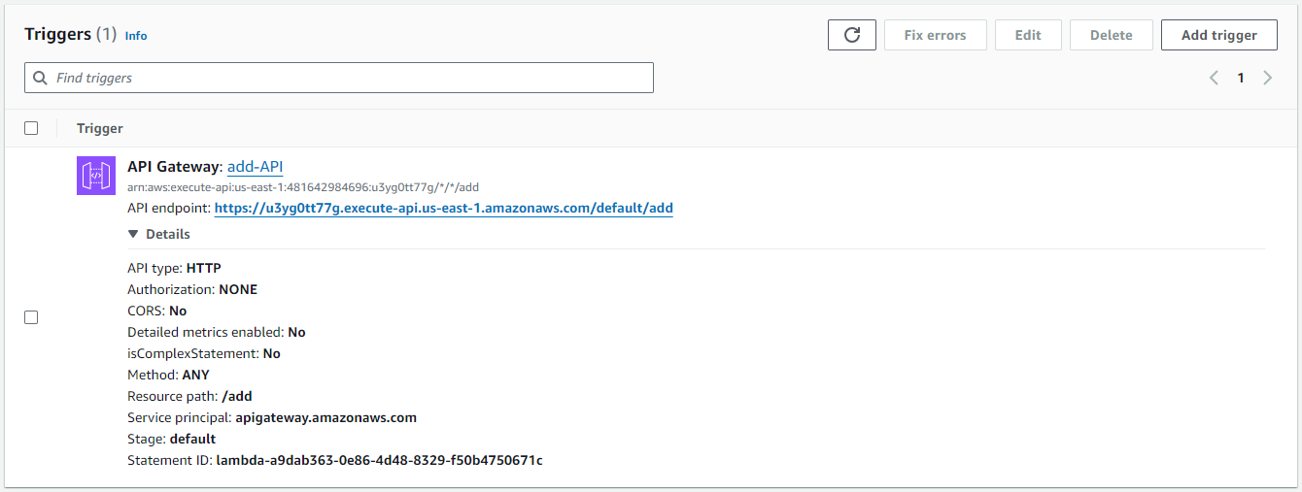
Check API endpoint

Slide 13
Invoke function via API

Slide 14
Invoke function via API
Send POST requests
curl --header "Content-Type: application/json" --request POST --data "{\"a\": \"2\", \"b\": \"3\"}" <API endpoint>
Expected response:
5

Slide 15
Oops…
What we got:
{"message":"Internal Server Error"}
Why is this? AWS Lambda functions that are triggered by API Gateway must return a specific structure, including statusCode and body. Without this structure, the API Gateway may return a 500 Internal Server Error.
Let’s modify our response format!

Slide 16
Modifying our response format
import json
def lambda_handler(event, context):
# Initialize response
response = {
'statusCode': 200,
'body': ''
}
json_input = event
if 'body' in event: # it can be an external request via API gateway
json_input = json.loads(event['body'])
if 'a' in json_input and 'b' in json_input:
a = int(json_input['a'])
b = int(json_input['b'])
result = a + b
response['body'] = json.dumps({'result': result})
return response
else:
response['body'] = json.dumps({'error': 'No input found'})
return response

Slide 17
Refining it further
Comprehensive Error Handling: Introduced try-except blocks to catch and handle different errors (JSON parsing, missing parameters, and unexpected errors).
More Informative Error Responses: Specific error messages for different failure scenarios.

Slide 18
Assignment Introduction
Model Serving with AWS Lambda and Cold Start Performance Analysis

Slide 19
Overview
What we’ll do:
Develop a Lambda function for simple ML model inference.
Deploy a machine learning model as a serverless application using AWS Lambda and API Gateway.
Analyze the cold start phenomenon associated with serverless functions.
Environments used:
Local machine
AWS console
Google Colab

Slide 20
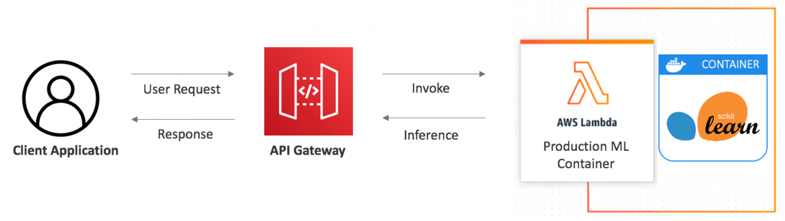
Serverless architecture for ML inference
Notes:
Image source: https://aws.amazon.com/blogs/compute/deploying-machine-learning-models-with-serverless-templates/

Slide 21
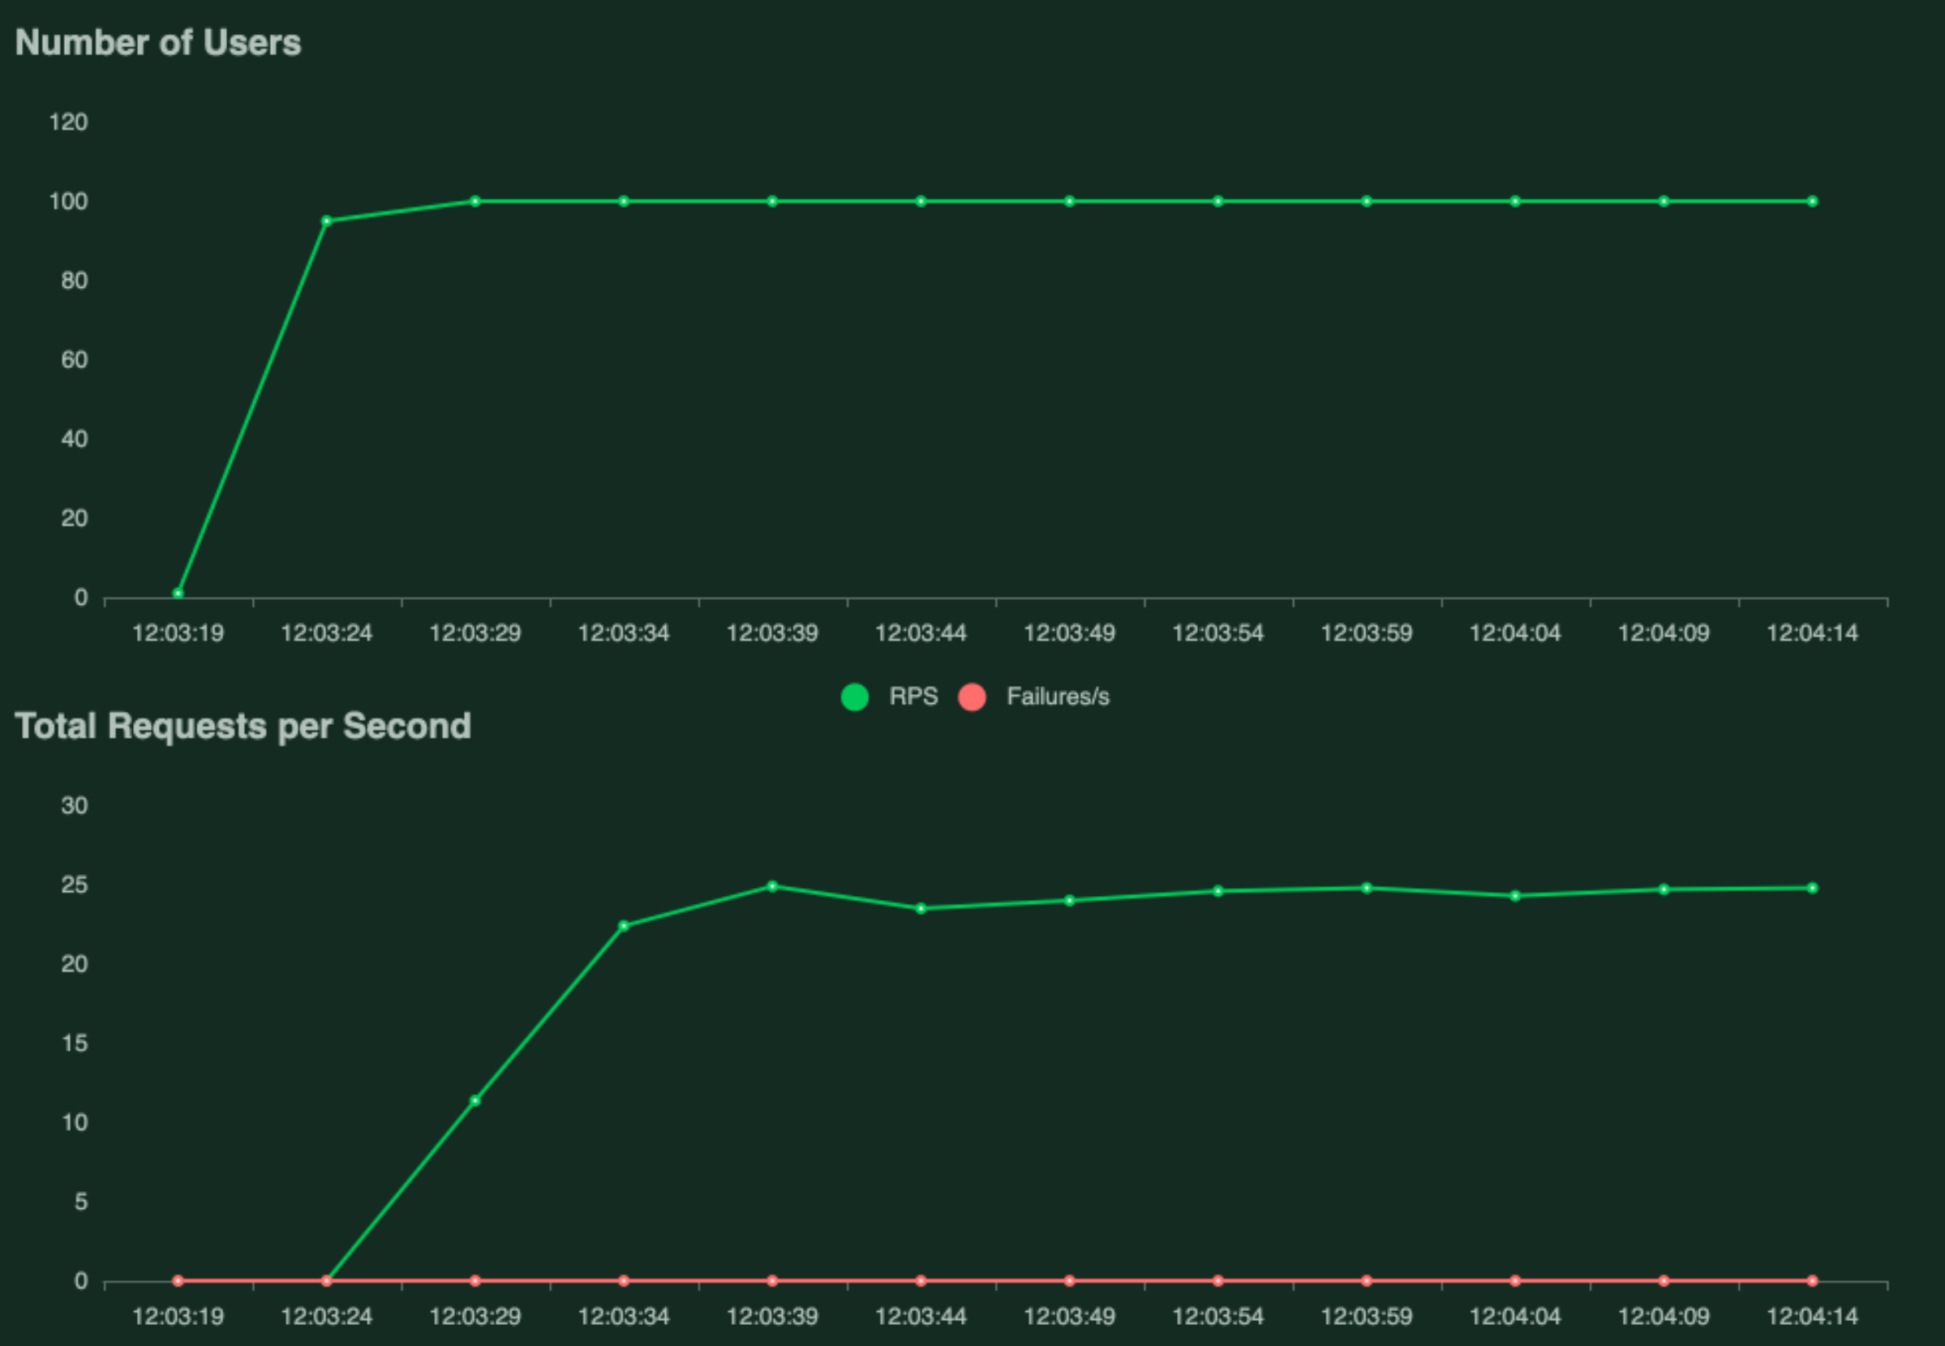
Locust for load testing
Notes:
Image source: https://ianwhitestone.work/serverless-ml-deployments/

Slide 22
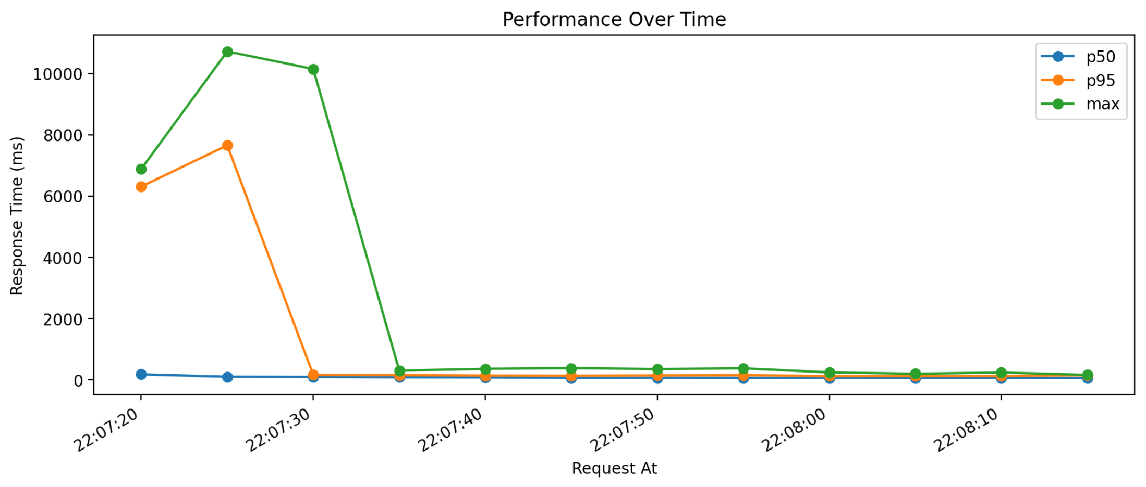
Cold start phenomenon
Requests made during cold start
Warm requests
Notes:
Image source: https://ianwhitestone.work/serverless-ml-deployments/

Slide 23
Logistics
Deadline: October 24, 2024, 23:59
Assignment details can be found in our GitHub repo: https://github.com/CUHKSZ-CSC4160-Fall24/Assignment-3

