Slide 1
COMP4160 (FALL 2024)
Measuring the Performance of EC2 instances
Slides adapted from Dr. Hong Xu’s slides for CS 4296/5296 in CityU

Slide 2
Outline
Measure of computing performance.
Measure of networking performance.

Slide 3
Outline
Measure of computing performance.
Measure of networking performance.

Slide 4
What to measure?
Computing performance
CPU: a crucial component for many apps
Memory: crucial, especially for data-intensive apps
File I/O
Networking performance
Bandwidth, throughput, round-trip time (RTT)

Slide 5
EC2 instance
Use Ubuntu server 24.04 LTS (HVM)
Small, medium, and large instances of different types: https://aws.amazon.com/ec2/instance-types/
t2.small instance 2 GB Memory 1 vCPU low network performance | t3.medium instance 4 GB Memory 2 vCPU medium network performance | m4.large instance 8 GB Memory 2 vCPU medium network performance

Slide 6
Benchmarking Compute
Benchmarks provide a method to assess performance of computer hardware, such as CPU and memory
Running CPU/Memory/IO intensive tasks to stress these compute components
Perform these tasks on specific types of EC2 instances

Slide 7
Choice of benchmarking tool
SPECjvm2008
SysBench, or any other open-source tools
A modular, cross-platform and multi-threaded benchmarking tool
https://github.com/akopytov/sysbench

Slide 8
SysBench installation
Ubuntu has a nice software installation manager, apt-get
SSH to your instance
Update the package source lists:
sudo apt-get update
Install SysBench:
sudo apt-get install sysbench

Slide 9
SysBench
Go through the docs online carefully (or man sysbench). SysBench can benchmark CPU, memory, and file I/O
CPU test:
Calculation of prime numbers up to a specified value
e.g.: sysbench --test=cpu --num-threads=4
--cpu-max-prime=10000 run

Slide 10
Question
What’s the compute performance of specific types of instances (small, medium, large)?
Does the performance increase commensurate with resource increase?

Slide 11
Memory benchmarking
Read/write
sysbench --test=memory --num-threads=4 -- memory-total-size=10G --memory-oper=write
--memory-scope=global run

Slide 12
File I/O
I/O operations: sequential write/read/rewrite, random read/write, combined random read/write
Three stages: 1.prepare, 2.run, 3.cleanup, e.g.
sysbench --test=fileio --file-total- size=3G prepare
sysbench --test=fileio --file-total- size=3G --file-test-mode=rndrw --num- threads=16 run
sysbench --test=fileio cleanup

Slide 13
Try it yourself!
SysBench will be used as the first question in your assignment to measure, and compare compute performance of various EC2 instances
The exact question will be announced later. But make sure you know how to use it now.

Slide 14
Outline
Measure of computing performance.
Measure of networking performance.

Slide 15
Measurement Tools
iPerf / iPerf3 (http://iperf.fr)
Network testing tool to measure the network throughput between end hosts
Ping ("Packet InterNet Groper")
Network testing tool to measure the packet round-trip time (RTT) between end hosts

Slide 16


iPerf / iPerf3
Installation in Ubuntu
sudo apt-get install iperf
Client-server model
Data flow
Server
Client
Listener
Sender

Slide 17
iPerf / iPerf3
TCP/UDP measurement
TCP: connection-oriented, reliable transportation protocol
UDP: connectionless, unreliable transportation protocol
Tunable parameters
TCP window size, UDP buffer size and sending rate

Slide 18
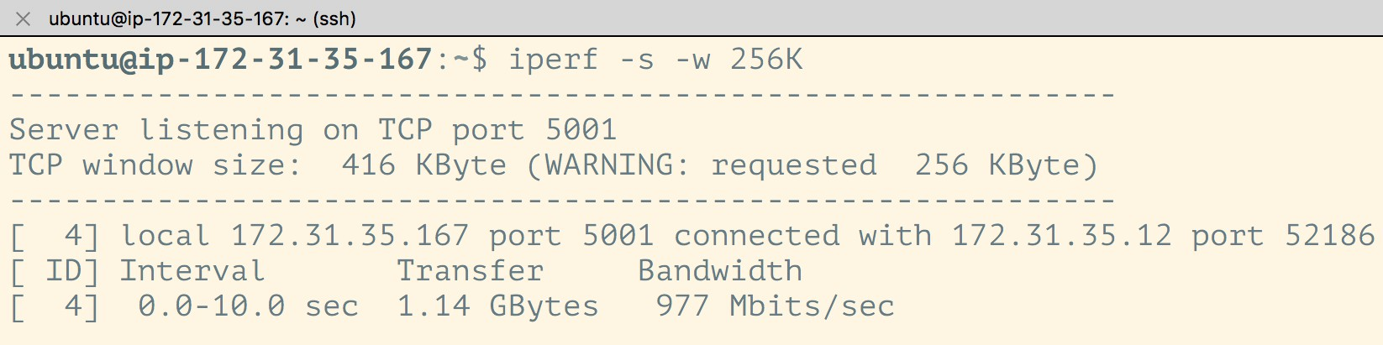
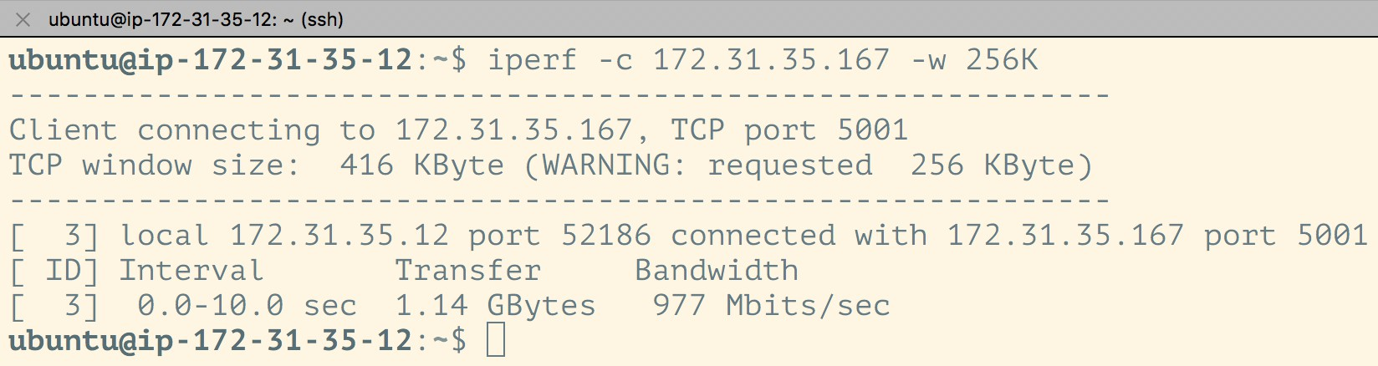
iPerf TCP test
-s: Run as the server; -c: Run as the client.
-w: Set the window size (of TCP by default)
Server ip: 172.31.35.167
On Client, put Server’s ip after -c

Slide 19
iPerf TCP test
By default, iPerf listens on TCP port 5001. This can be changed with “-p port_number”
Double check the EC2 security group to ensure that the TCP port has been enabled

Slide 20
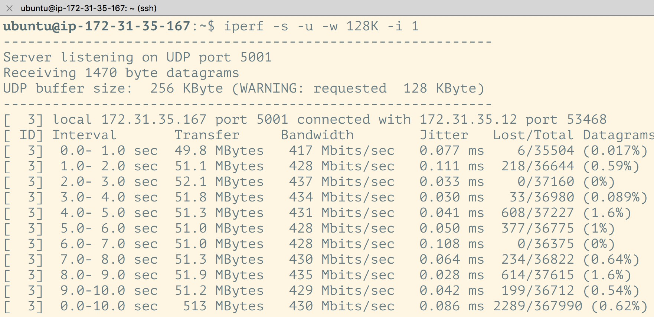
iPerf UDP test
-u: use UDP rather than TCP
-w: UDP buffer size
-i: the interval time (in sec) between two periodic reports
Server

Slide 21
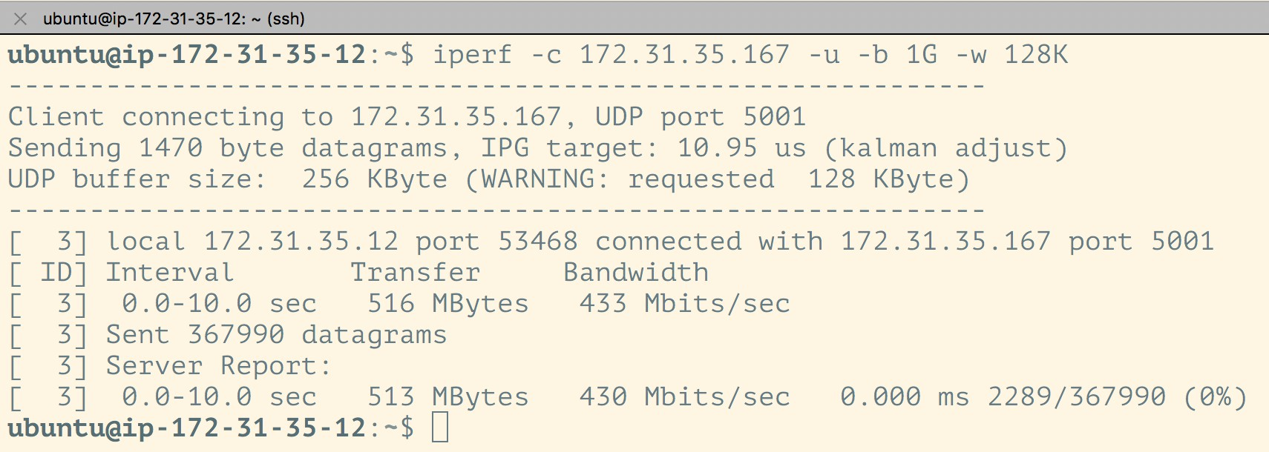
iPerf UDP test
-b: the UDP sending rate, in bits/sec
Client

Slide 22
A more detailed tutorial is available at
https://aws.amazon.com/premiumsupport/knowledge- center/network-throughput-benchmark-linux-ec2/

Slide 23
Questions
What network performance is experienced between instances of the same type? Different types? Different zones?
Is network performance consistent over time (e.g., time of day, different pairs of instances, etc.)?

Slide 24

TCP/UDP Bandwidth
Small - Medium Small - Large
...
(Mbps)
Throughput
Think what it will be like
Morning
Afternoon
Evening
Night

Slide 25
Network Latency
Intra-region Inter-region
...
(ms)
RTT
Think what it will be like
Morning
Afternoon
Evening
Night

