Slide 1
Getting Started With Kubernetes
CSC4160 Fall ‘24 Lab
CUHKSZ

Slide 2
Intros
Goal:
Hands-on lab to cover the basics of Kubernetes
Understand Kubernetes concepts along the way
Agenda:
Getting Started with Kubernetes
Assignment Introduction

Slide 3

Extra details
This slide has a magnifying glass in the top right corner
This magnifying glass indicates slides that provide extra details
Feel free to skip them if:
you are in a hurry
you are new to this and want to avoid cognitive overload
you want only the most essential information
You can review these slides another time if you want, they'll be waiting for you

Slide 4
About these slides
Slides are adapted from Jérôme Petazzoni’s container training available in GitHub: https://github.com/jpetazzo/container.training

Slide 5
Getting Started with Kubernetes
Containerization and Kubernetes intro

Slide 6
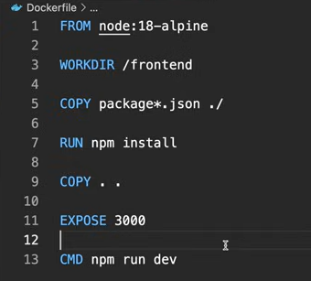
Containerization
“A standard unit of software that can package up your code and all its dependencies so the application runs quickly and reliably from one computing environment to another.” – Docker.com
Notes:
Example:
Here is a default Next.js app.
We create a blueprint of how app would run and use docker engine to build blueprint into image.
The blueprint explained: Grab node, create directory called frontend, copy package.json and package lock into that directory, run npm install, copy all of the code into it, expose port 3000, and run npm run dev.
Run docker build and tag it with a name results with an image.
Anyone with the image can run it as a container housing the application.
No more “it works on my machine” because it has everything it needs to run on its own.
In DockerHub we have thousands of pre-made images we can pull and use in our container.
Now:
What if the machine we run our container on crashes?
What if we want to containerize our front end separately from our back end and have multiple containers?
What if there is a sudden traffic spike and we want to quickly spin up five more instances to evenly distribute behind a load balancer and then when the game is over kill three of those instances so that we can scale back?
How do we orchestrate this process of deploying, managing, automating, and scaling containerized applications?

Slide 7
Kubernetes
Kubernetes is a container management system
It runs and manages containerized applications on a cluster
What does that really mean?

Slide 8
Basic things we can ask Kubernetes to do
Start 5 containers using image atseashop/api:v1.3
Place an internal load balancer in front of these containers
Start 10 containers using image atseashop/webfront:v1.3
Place a public load balancer in front of these containers
It's Black Friday (or Christmas), traffic spikes, grow our cluster and add containers
New release! Replace my containers with the new image atseashop/webfront:v1.4
Keep processing requests during the upgrade; update my containers one at a time

Slide 9
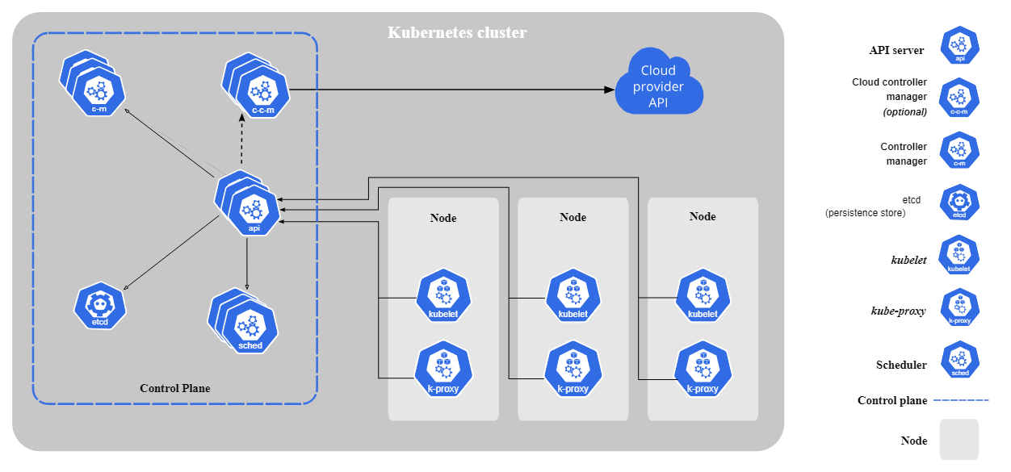
Kubernetes overview
Notes:
Every Kubernetes cluster has a control plane, i.e., master node, which is its own Linux environment and can be either a physical or a virtual machine.
It’s the central point of your cluster and it contains all the system components that make K8s work:
The API server exposes K8s API to us
The ETD KV store for our cluster data
The scheduler
The controller manager
Etc.
Control plane makes global decisions about the cluster. We don’t normally want our applications running on this master node. It’s reserved for system components.
Instead, we deploy your applications on worker nodes which are just additional Linux machines.
Each worker has a kubelet, which listens for instructions from the kube API server.
It serves to deploy and destroy containers among other things.
Each node has a Kube proxy, which allows services to talk to other containers on other nodes.

Slide 10
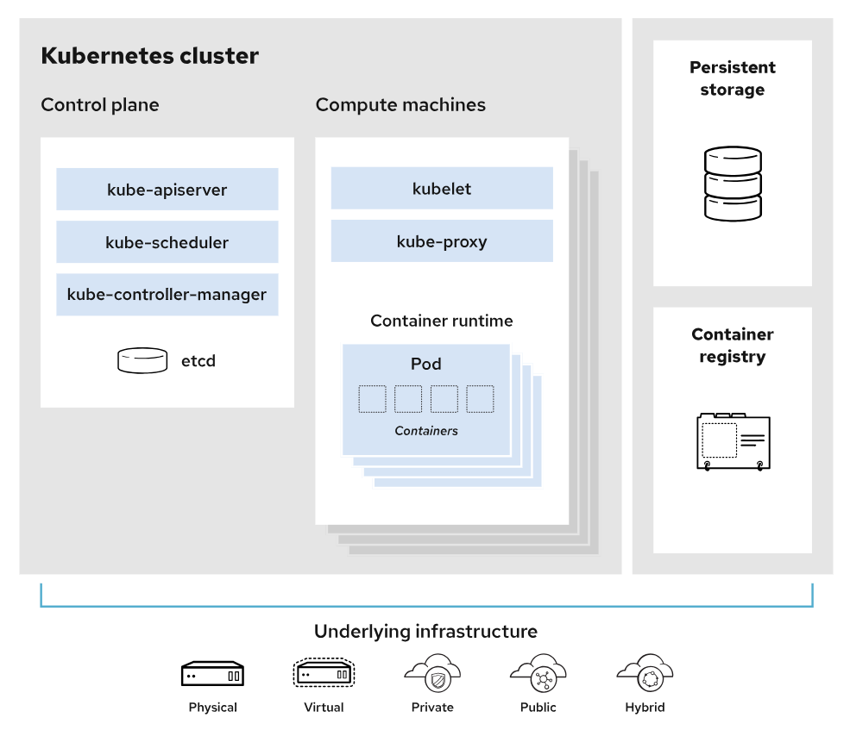
Kubernetes overview
Notes:
When we want to deploy an application it runs as a pod on the Node and inside of that pod is your container or multiple containers if that's how you want to set it up but usually there's one container in a pod and depending on the size and compacity of your machine or node you can have many many applications running on it and then when that one gets maxed out you can update the cluster to deploy a second worker node and a third worker node however many you need and finally you can interact with the Kubernetes cluster by talking to the API server and the easiest way to do this is to install the cube cuddle CLI.

Slide 11
Getting Started with Kubernetes
Environment setup

Slide 12
Launch EC2 instance
Launch an EC2 instance in AWS console.
Instance summary:
AMI: Ubuntu Server 24.04 LTS (HVM), SSD Volume Type
Instance type: m4.large
Security group: All traffic
Configure storage: 30 GiB gp2

Slide 13
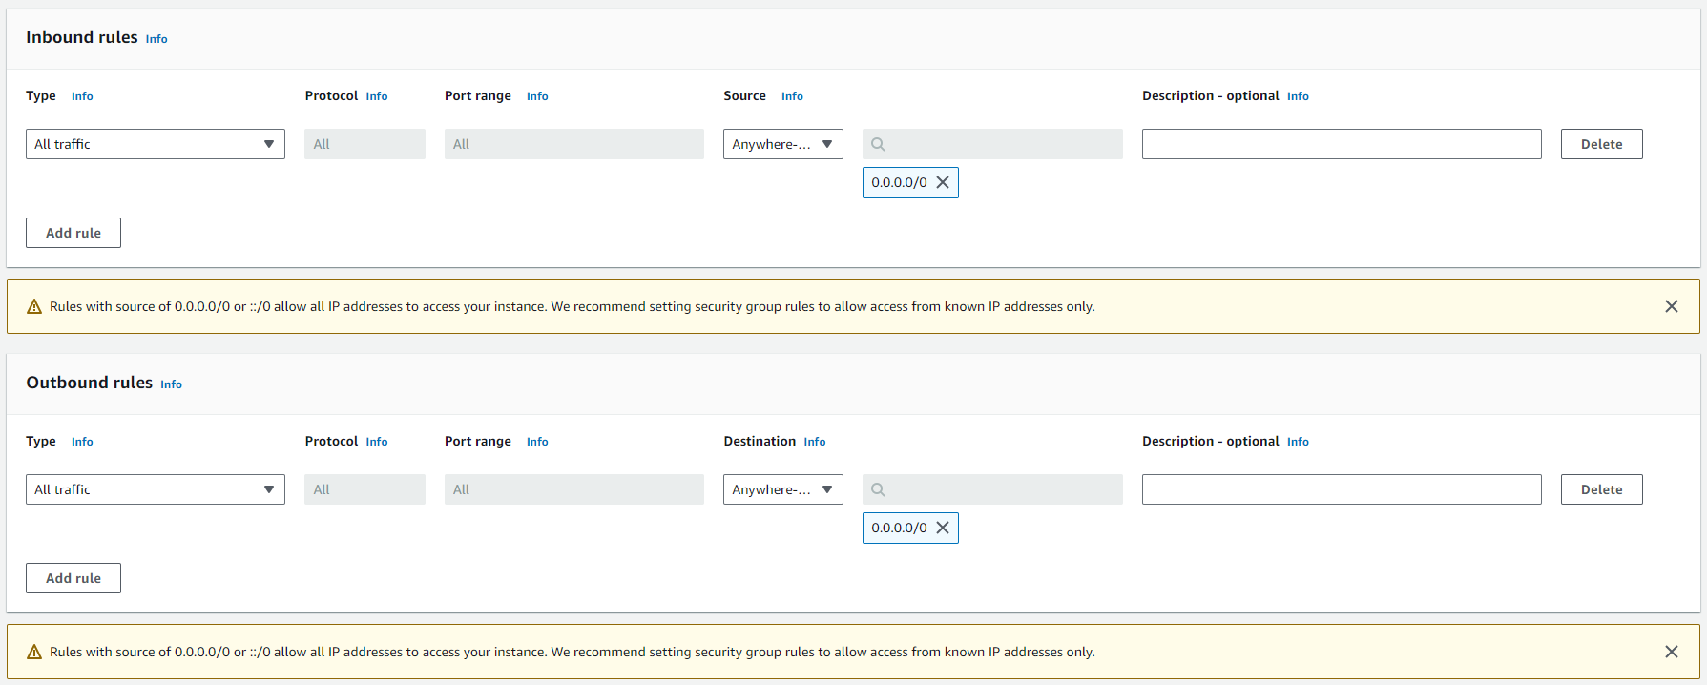
Launch EC2 instance
Security group: All traffic

Slide 14
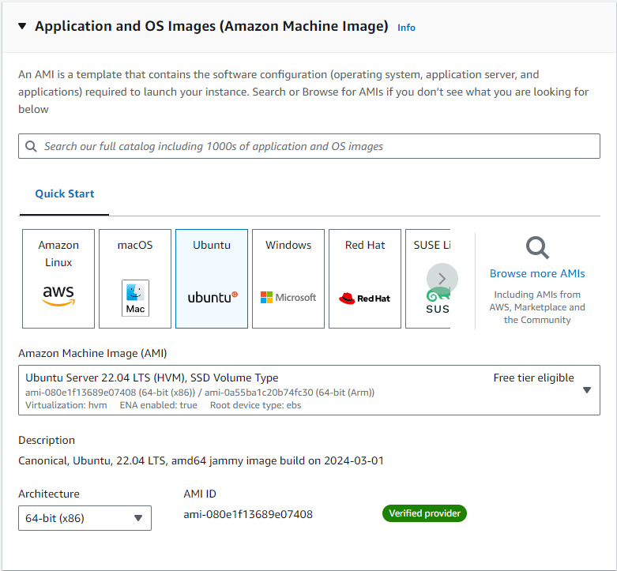
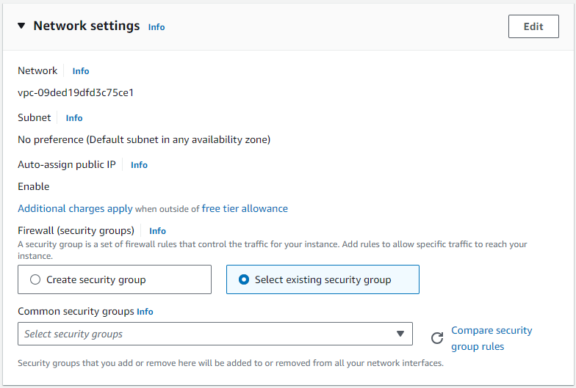
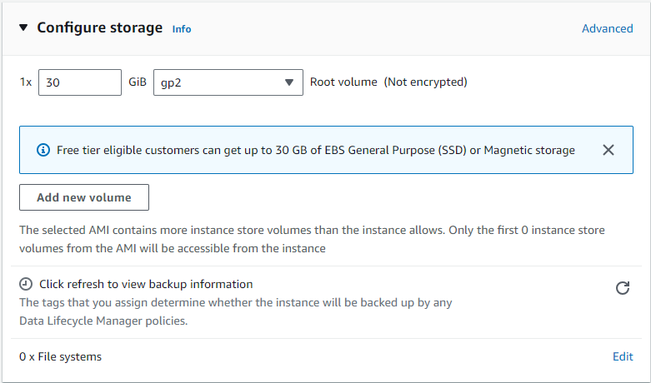
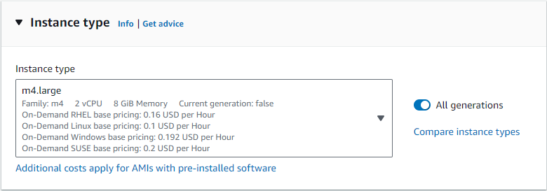
Launch EC2 instance

Slide 15
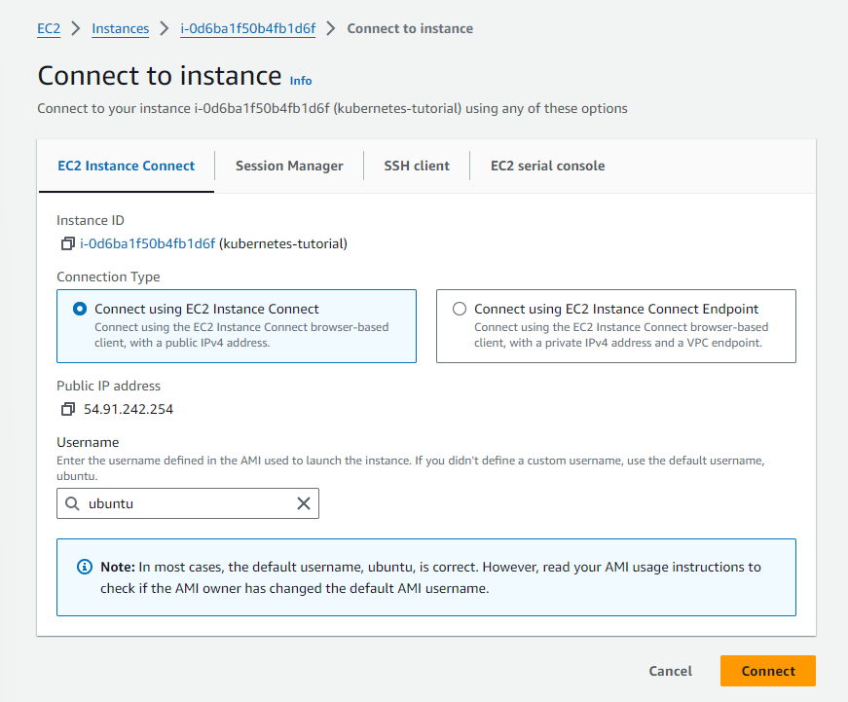
Connect to EC2 instance

Slide 16
Set up Minikube
In this lab, we will use Minikube, a tool that lets us run Kubernetes locally.
Install Minikube:
$ curl -LO https://storage.googleapis.com/minikube/releases/latest/minikube-linux-amd64
$ sudo install minikube-linux-amd64 /usr/local/bin/minikube

Slide 17
Install kubectl
The Kubernetes command-line tool, kubectl, allows us to run commands against our Kubernetes clusters:
Deploy applications
Inspect and manage cluster resources
View logs
Install kubectl:
$ curl -LO "https://dl.k8s.io/release/$(curl -L -s https://dl.k8s.io/release/stable.txt)/bin/linux/amd64/kubectl"
$ sudo install -o root -g root -m 0755 kubectl /usr/local/bin/kubectl

Slide 18
Install Docker
We use Docker, a container engine, with Minikube.
Install Docker:
$ sudo apt-get update && sudo apt-get install docker.io --y
Add user to “docker” group and switch primary group
$ sudo usermod -aG docker $USER && newgrp docker
Notes:
This command sequence performs two actions:
1. `sudo usermod -aG docker $USER`: This command adds the current user to the "docker" group. The `-aG` options are used to append the user to the specified group without removing them from their existing groups. Adding a user to the "docker" group allows them to run Docker commands without needing to use `sudo` for each command.
2. `newgrp docker`: This command switches the user's primary group to "docker". By switching to the "docker" group, any new files or directories created by the user will have the group ownership set to "docker", which is useful when working with Docker-related files.
In summary, this command sequence grants the current user permission to run Docker commands without `sudo` and ensures that any new files they create in the Docker context are owned by the "docker" group.

Slide 19
Run Minikube
Finally!
$ minikube start

Slide 20
Getting Started with Kubernetes
Running our first containers on Kubernetes

Slide 21
Running our first containers on Kubernetes
First things first: we cannot run a container
Containers are manipulated through pods
A pod is a group of containers:
running together (on the same node)
sharing resources (RAM, CPU; but also network, volumes)
We are going to run a pod, and in that pod there will be a single container
In that container in the pod, we are going to run a simple ping command
Then we are going to start additional copies of the pod

Slide 22
Starting a simple pod with kubectl create deployment
We need to specify at least a name and the image we want to use
Let’s ping 1.1.1.1, Cloudflare’s public DNS resolver:
$ kubectl create deployment pingpong --image=alpine -- ping 1.1.1.1

Slide 23
Various ways of creating resources
kubectl create <resource>
explicit, but lacks some features
can't create a CronJob
can't pass command-line arguments to deployments
kubectl create -f foo.yaml or kubectl apply -f foo.yaml
all features are available
requires writing YAML
Notes:
Explore the second method in assignment

Slide 24
Behind the scenes of kubectl create deployment
Let’s look at the resources that were created by kubectl create deployment
List most resource types:
$ kubectl get all
We should see the following things:
deployment.apps/pingpong (the deployment that we just created)
replicaset.apps/pingpong-xxxxxxxxxx (a replica set created by the deployment)
pod/pingpong-xxxxxxxxxx-yyyyy (a pod created by the replica set)

Slide 25
What are these different things?
A deployment is a high-level construct
allows scaling, rolling updates, rollbacks
multiple deployments can be used together to implement a canary deployment
delegates pods management to replica sets
A replica set is a low-level construct
makes sure that a given number of identical pods are running
allows scaling
rarely used directly
A replication controller is the (deprecated) predecessor of a replica set

Slide 26
Our pingpong deployment
kubectl create deployment created a deployment, deployment.apps/pingpong
That deployment created a replica set, replicaset.apps/pingpong-xxxxxxxxxx
That replica set created a pod, pod/pingpong-xxxxxxxxxx-yyyyy

Slide 27
Viewing container output
Let’s use the kubectl logs command
We will pass either a pod name, or a type/name (E.g. if we specify a deployment or replica set, it will get the first pod in it)
Unless specified otherwise, it will only show logs of the first container in the pod.
Stream logs of our ping command in real time:
$ kubectl logs deploy/pingpong --tail 1 --follow
Notes:
kubectl logs options:
-f/--follow to stream logs in real time
--tail to indicate how many lines you want to see (from the end)
--since to get logs only after a given timestamp
What’s with pingpong?
Send ping command to 1.1.1.1 to check the network connectivity and round-trip time.
Default is process continues until we stop it.

Slide 28
Scaling our application
We can create additional copies of our container (I mean, our pod) with kubectl scale
Scale our pingpong deployment:
$ kubectl scale deploy/pingpong --replicas 8
Or: $ kubectl scale deployment pingpong --replicas 8
Note: what if we tried to scale replicaset.apps/pingpong-xxxxxxxxxx?
We could! But the deployment would notice it right away, and scale back to the initial level.

Slide 29
Resilience
The deployment pingpong watches its replica set
The replica set ensures that the right number of pods are running
What happens if pods disappear?
In a separate window, list pods, and keep watching them:
$ kubectl get pods -w
Destroy a pod:
$ kubectl delete pod pingpong-xxxxxxxxxx-yyyyy

Slide 30
Getting Started with Kubernetes
Exposing containers

Slide 31
Exposing containers
kubectl expose creates a service for existing pods
A service is a stable address for a pod (or a bunch of pods)
If we want to connect to our pod(s), we need to create a service
Once a service is created, CoreDNS will allow us to resolve it by name (i.e. after creating service hello, the name hello will resolve to something)
There are different types of services, detailed on the following slides: ClusterIP, NodePort, LoadBalancer, ExternalName

Slide 32
Basic service types
ClusterIP (default type)
a virtual IP address is allocated for the service (in an internal, private range)
this IP address is reachable only from within the cluster (nodes and pods)
our code can connect to the service using the original port number
NodePort
a port is allocated for the service (by default, in the 30000-32768 range)
that port is made available on all our nodes and anybody can connect to it
our code must be changed to connect to that new port number
These service types are always available.
Under the hood: kube-proxy is using a userland proxy and a bunch of iptables rules.

Slide 33
More service types
LoadBalancer
an external load balancer is allocated for the service
the load balancer is configured accordingly (e.g.: a NodePort service is created, and the load balancer sends traffic to that port)
available only when the underlying infrastructure provides some "load balancer as a service" (e.g. AWS, Azure, GCE, OpenStack...)
ExternalName
the DNS entry managed by CoreDNS will just be a CNAME to a provided record
no port, no IP address, no nothing else is allocated

Slide 34
Running containers with open ports
Since ping doesn't have anything to connect to, we'll have to run something else
We are going to use jpetazzo/httpenv, a tiny HTTP server written in Go
jpetazzo/httpenv listens on port 8888
It serves its environment variables in JSON format
The environment variables will include HOSTNAME, which will be the pod name (and therefore, will be different on each backend)

Slide 35
Creating a deployment for our HTTP server
In another window, watch the pods (to see when they will be created):
$ kubectl get pods -w
Create a deployment for this very lightweight HTTP server:
$ kubectl create deployment httpenv --image=jpetazzo/httpenv
Scale it to 10 replicas:
$ kubectl scale deployment httpenv --replicas=10

Slide 36
Exposing our deployment
We'll create a default ClusterIP service
Look at the services we have initially:
$ kubectl get service
Expose the HTTP port of our server:
$ kubectl expose deployment httpenv --port 8888
Look up which IP address was allocated:
$ kubectl get service

Slide 37
Testing our service
Use port forwarding to access the service from our local machine:
$ kubectl port-forward service/httpenv 8888:8888
Send a few requests:
curl http://localhost:8888/
Too much output? Filter it with jq:
curl -s http://localhost:8888/ | jq .HOSTNAME
Notes:
Suspend the process by pressing Ctrl + Z. This will stop the process and put it in the background.
Use the bg command to resume the process in the background
To bring the process back to the foreground later, you can use the fg command.

Slide 38
Services and endpoints
A service has a number of "endpoints“ that are maintained and updated automatically by Kubernetes
Each endpoint is a host + port where the service is available
Check the endpoints that Kubernetes has associated with our httpenv service:
$ kubectl describe service httpenv
In the output, there will be a line starting with Endpoints: that lists a bunch of addresses in host:port format.
When we have many endpoints, our display commands truncate the list
$ kubectl get endpoints
Notes:
FAQ
What do Cluster IP and ports mean?
Cluster IP: Internal IP for service communication within the cluster.
Ports: 80:30860/TCP means service listens on port 80 internally and is accessible externally via NodePort 30860.
What does port-forwarding mean?
Port forwarding allows access to a pod's service from your local machine, using either the pod's name or a service's NodePort.
Is port 80 in different services the same?
No, each service can have its own internal port configuration, even if they share the same port number.
What does kubectl port-forward do?
It forwards a local port to a pod or service, allowing access to the specified port.
Why can we access a NodePort service without port forwarding?
NodePort exposes the service externally via the node's IP and allocated port, allowing direct access.
From where can we access a Cluster IP?
Cluster IP is accessible only from within the cluster, specifically from other pods. It cannot be accessed externally.

Slide 39
Assignment Introduction
Hands-on with a sample application

Slide 40
What’s this application?
It is a DockerCoin miner! 💰🐳📦🚢
No, you can't buy coffee with DockerCoins
How DockerCoins works:
generate a few random bytes
hash these bytes
increment a counter (to keep track of speed)
repeat forever!
DockerCoins is not a cryptocurrency (the only common points are "randomness", "hashing", and "coins" in the name)

Slide 41
DockerCoins in the microservices era
DockerCoins is made of 5 services:
rng = web service generating random bytes
hasher = web service computing hash of POSTed data
worker = background process calling rng and hasher
webui = web interface to watch progress
redis = data store (holds a counter updated by worker)
These 5 services are visible in the application's Compose file, dockercoins.yaml

Slide 42
How DockerCoins works
worker invokes web service rng to generate random bytes
worker invokes web service hasher to hash these bytes
worker does this in an infinite loop
every second, worker updates redis to indicate how many loops were done
webui queries redis, and computes and exposes "hashing speed" in our browser
(See diagram on next slide!)

Slide 43
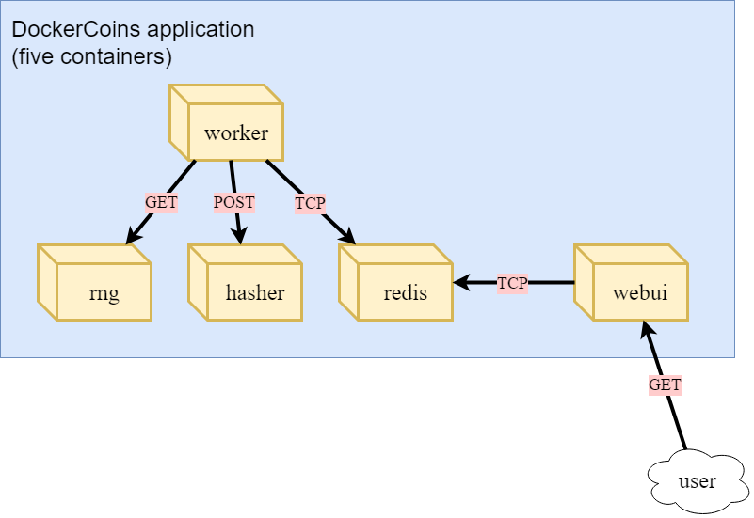

Slide 44
What we’ll do
Deploy DockerCoins
Try to find its bottlenecks when scaling
Use HPA (Horizontal Pod Autoscaler) to scale the application

Slide 45
Time to do Assignment 2 ✨
Follow the instructions carefully
Try to understand what you’re doing
Try to understand more Kubernetes concepts

Slide 46
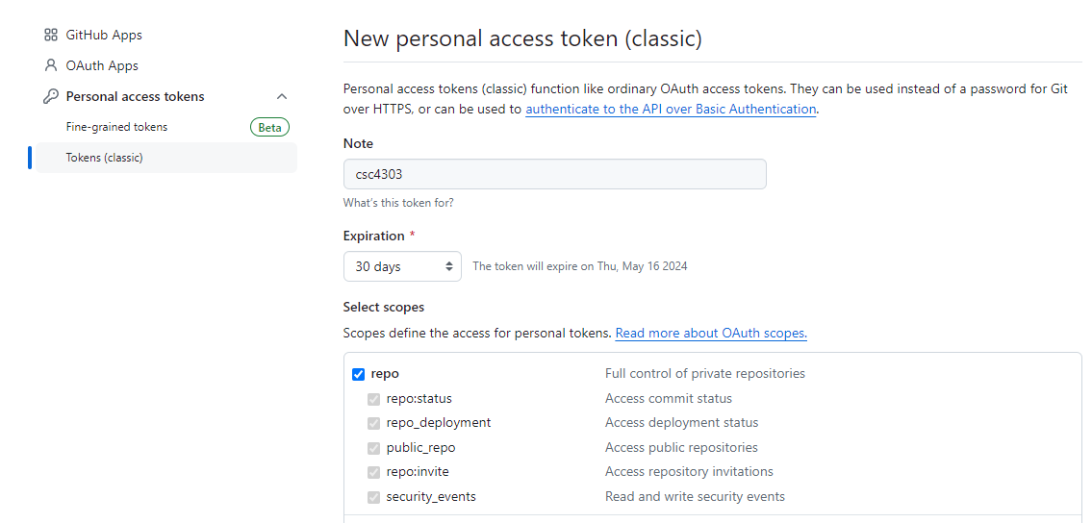
Heads-up: Git clone assignment repo
git clone your assignment repo
$ git clone https://<token>@github.com/cuhksz-csc4160-24f/<repo>.git
<token> is your personal access token
Go to Settings > Developer Settings > Personal access tokens > Tokens (classic)
Generate new token

Slide 47
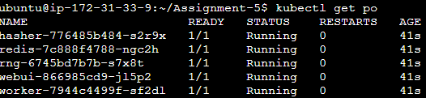
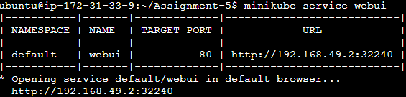
Heads-up: Port forwarding
Forward a local port to webui pod
$ kubectl port-forward --address 0.0.0.0 <webui pod name> <local port>:<pod port>
<local port> is any number
Access from browser
http://<Public IPv4 address>:<local port>
<webui pod name>
<pod port>

Slide 48
Some reminders
When you finish the assignment, remember to check the following things:
Answer these questions described in README.md
Don’t forget to terminate the instance in AWS!

