Slide 1



ECE 4016 - Tutorial
Assignment 2 Intro
Lecturer: Zhicheng LIANG

Slide 2
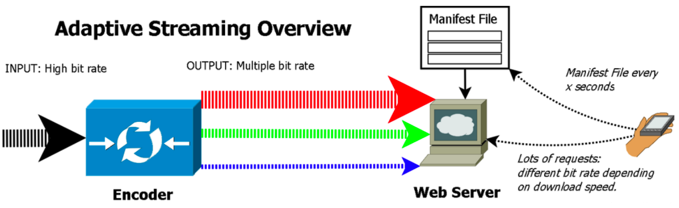
Preliminary
Adaptive Bit Rate (ABR) Video Streaming: Refer to Tutorial 04.
1. multiple versions of video files are created and encoded to fit a variety of network
conditions.
2. based on factors like bandwidth and device type, the video player selects the
highest-quality file that the device can play with the smallest amount of buffering possible.

Slide 3
ABR Architecture
Video Encoding and Transcoding
- Resizing the video frame rate – or resolution – to accommodate different screens.
- Changing the bitrate of the decompressed file to accommodate different connection speeds. This can include changing the frame rate or the resolution.

Slide 4
ABR Architecture
Video Encoding and Transcoding
- Resizing the video frame rate – or resolution – to accommodate different screens.
- Changing the bitrate of the decompressed file to accommodate different connection speeds. This can include changing the frame rate or the resolution.
Video Segmenting (chunked encoding, or chunking)
streaming data is separated into a series of non-overlapping segments before being sent to the playback device. Each chunk typically ranges in length from 2 to 10 seconds.

Slide 5
ABR Architecture
Initial Startup
Before streaming begins, the playback device downloads a manifest that describes all the available chunks and bitrates.

Slide 6
ABR Architecture
Initial Startup
Before streaming begins, the playback device downloads a manifest that describes all the available chunks and bitrates.
Video Playback
After each segment, the playback device recalibrates and requests the next segment based on the new information. For example,
the first segment was likely a much lower bitrate than necessary. The device will then request a higher bitrate for the next segment.
If the bandwidth lessens or the device struggles to play a segment, it will adjust downward when requesting the next one.

Slide 7
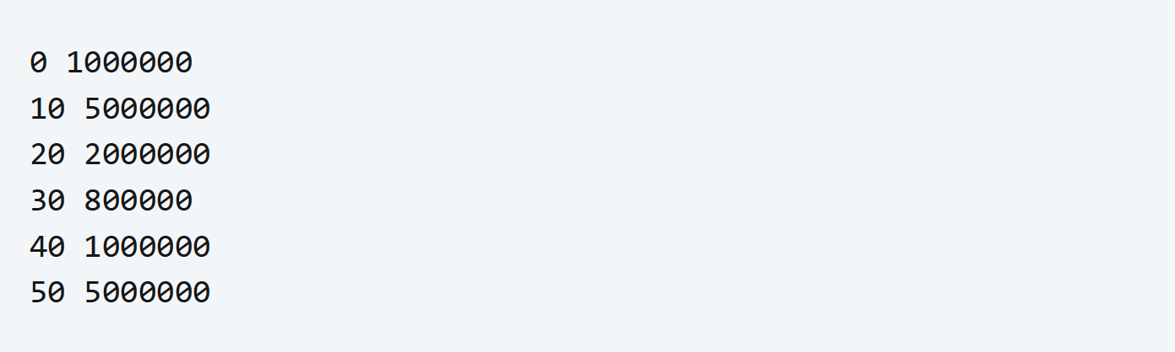
ABR Architecture
Trace Files
The trace file dictates the bandwidth throughout a test run. On each line the 1st value represents the Video Time threshold where a bandwidth switch occurs and the 2nd value represent the bandwidth value it will switch to.

Slide 8
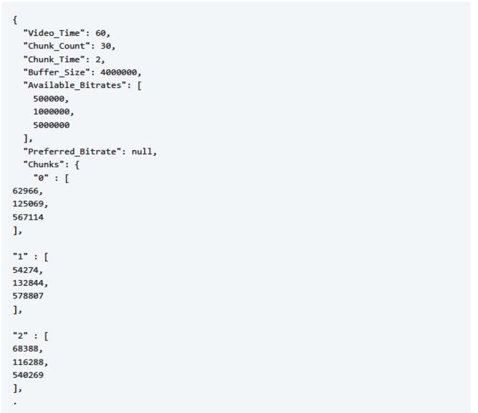
ABR Architecture
Manifest
The manifest file dictates other parameters such as chunks information, available bitrate, buffer size, and much more.

Slide 9
ABR Architecture
Manifest
The manifest file dictates other parameters such as chunks information, available bitrate, buffer size, and much more.
1. Video_Time: This indicates the total duration of the video, in seconds. Here, it is 60 seconds.
2. Chunk_Count: This indicates how many `Chunks` or `segments` the video has been divided into.
3. Chunk_Time: This indicates the duration of each `Chunk` or `segment`, in seconds.

Slide 10
ABR Architecture
Manifest
The manifest file dictates other parameters such as chunks information, available bitrate, buffer size, and much more.
4. Buffer_Size: This is the size of the buffer that the client should maintain, in bytes. Here, the value is 4,000,000 bytes, or 4MB.
5. Available_Bitrates: This is an array listing the different bitrates of `Chunks` available for the client to choose from. In adaptive streaming, the client can choose different bitrates for download and playback depending on the network condition. Here, three bitrates (bits/sec) are provided: 500,000 bps (0.5 Mbps), 1,000,000 bps (1 Mbps), and 5,000,000 bps (5 Mbps).

Slide 11
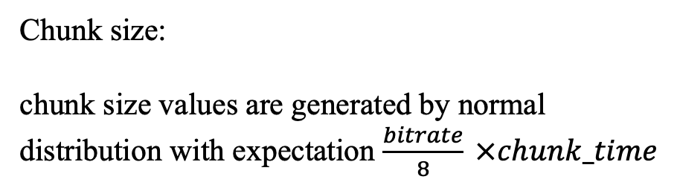
ABR Architecture
Manifest
The manifest file dictates other parameters such as chunks information, available bitrate, buffer size, and much more.
Chunk size:
chunk size values are generated by normal distribution with expectation $\frac{bitrate}{8} ×chunk_time$

Slide 12
Entry
1. Start the listener
python studentComm.py
2. Start the simulator
python simulator.py inputs/traceHD.txt inputs/manifestHD.json

Slide 13
Evaluation
Run the grader script to generate a overall performance of the algorithm under all testcases in the folder “tests”:
python grader.py
To further validate the performance, you can also generate more testcases by setting different hyperparameters in rand_sizes.py: available bitrates, buffer size, etc.
python rand_sizes.py
Create the manifest file using the output.

Slide 14
Task
Develop a python script studentcode_{id}.py that implement an ABR algorithm
Write a report to analyze the proposed algorithm.

Slide 15
Thanks

