Slide 1
Exploring Lambda Functions
CSC4160 Fall ‘24 Lab
CUHKSZ
By: Juan Albert Wibowo

Slide 2
Intros
Agenda:
The AWS Educate account issue
Understanding Lambda concurrency
Example serverless applications
Q&A session

Slide 3
About these slides
For reference materials and additional information, please consult the notes section of this slide.

Slide 4
What happened last week…

Slide 5
Account deactivation
Some students who have finished Assignment 3 reported account deactivation.
Issue: AWS Educate Account Restrictions
We sincerely apologize…

Slide 6
AWS Educate account limitations

Slide 7
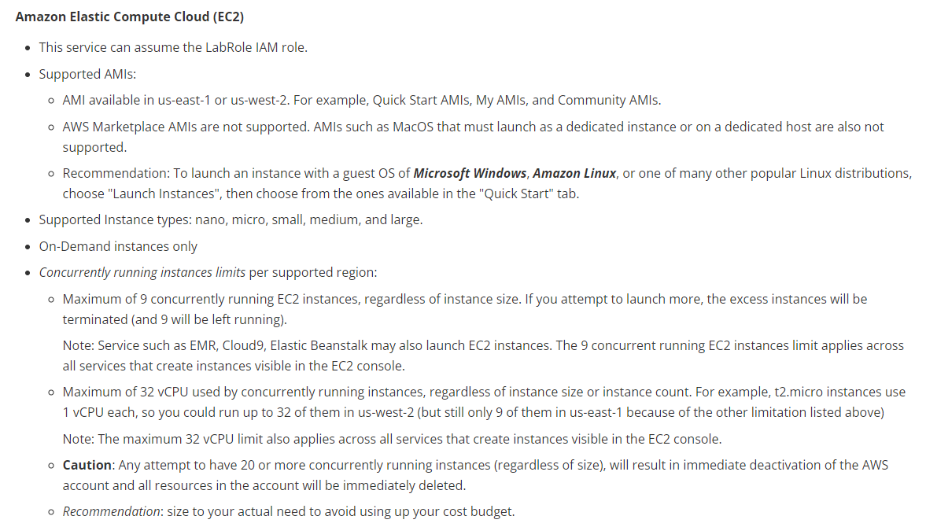
EC2 restriction

Slide 8
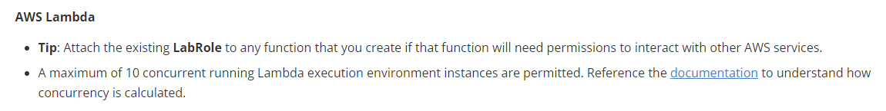
Lambda restriction

Slide 9
Pinpointing our issue
Understanding Lambda concurrency
Notes:
Source: https://docs.aws.amazon.com/lambda/latest/dg/lambda-concurrency.html

Slide 10
Pinpointing our issue
Our Locust load test spawned 100 users.
We are allowed 10 concurrent running Lambda execution environment instances.
The number of Locust users is equivalent to concurrency.
Concurrency differs from requests per second.
Locust adjusts request per second to match concurrency.
Formula:
Concurrency = (average requests per second) * (average request duration in seconds)

Slide 11
Calculating concurrency for a function
Concurrency = (average requests per second) * (average request duration in seconds)
Example:
Function receives 100 requests per second on average. Average request duration is one second.
Concurrency = (100 requests/second) * (1 second/request) = 100
Average request duration is 500 ms.
Concurrency = (100 requests/second) * (0.5 second/request) = 50
Concurrency = (100 requests/second) / (2 requests/second) = 50

Slide 12
Understanding concurrency
Concurrency is the number of in-flight requests that your AWS Lambda function is handling at the same time.
For each concurrent request, Lambda provisions a separate instance of your execution environment.
Lambda automatically handles scaling the number of execution environments until you reach your account's concurrency limit.

Slide 13
Understanding concurrency
Lambda invokes your function in a secure and isolated execution environment.

Slide 14
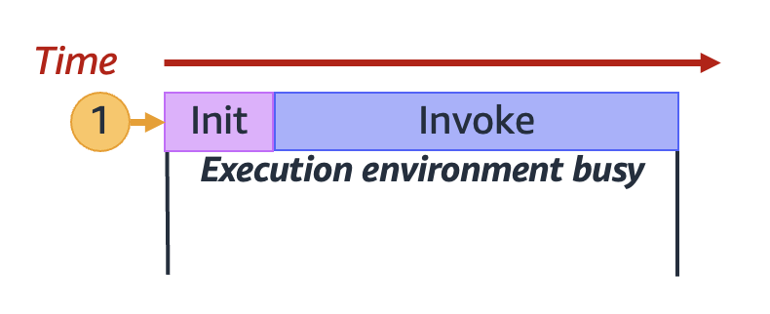
Understanding concurrency
When your function receives its very first request, Lambda creates a new execution environment and runs the code outside your main handler during the Init phase. Then, Lambda runs your function's main handler code during the Invoke phase. During this entire process, this execution environment is busy and cannot process other requests.

Slide 15
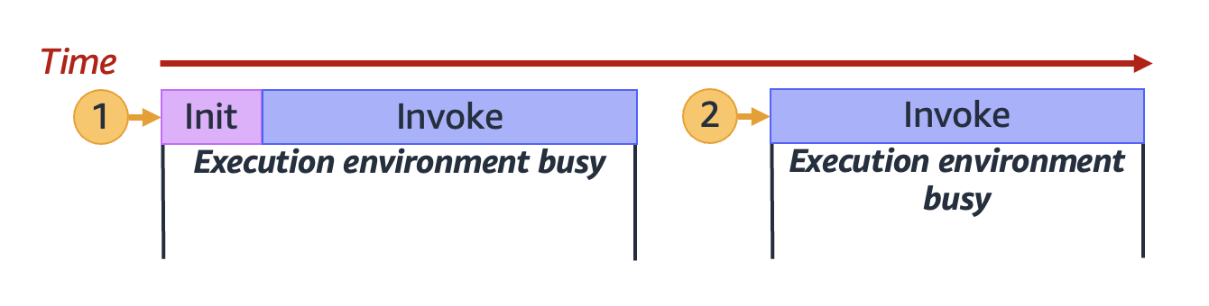
Understanding concurrency
When Lambda finishes processing the first request, this execution environment can then process additional requests for the same function. For subsequent requests, Lambda doesn't need to re-initialize the environment.

Slide 16
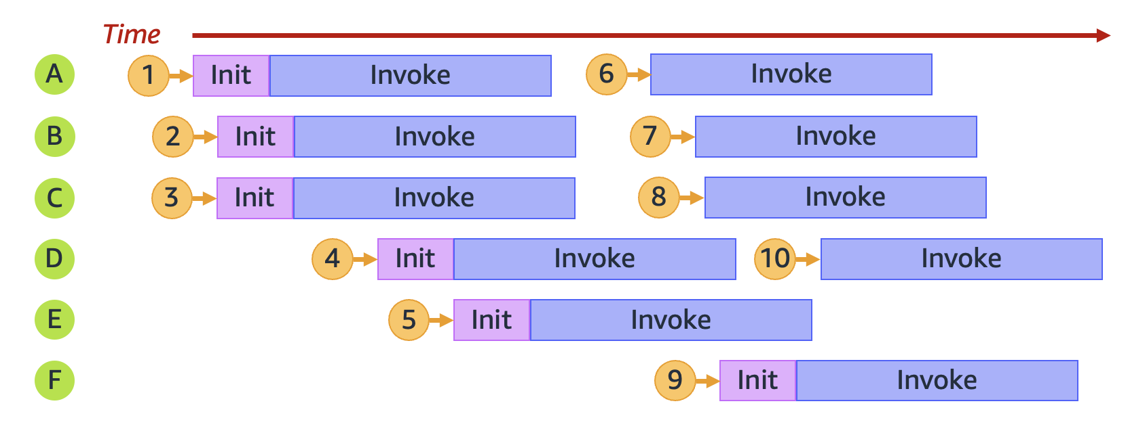
Understanding concurrency

Slide 17
A popular serverless app
Extract, transform, and load (ETL)

Slide 18
What is ETL?
Extract, transform, and load (ETL) is the process of combining data from multiple sources into a large, central repository called a data warehouse.
ETL uses a set of business rules to clean and organize raw data and prepare it for storage, data analytics, and machine learning (ML).
Notes:
Source: https://aws.amazon.com/what-is/etl/

Slide 19
Reference architecture
GitHub repository: https://github.com/aws-samples/aws-lambda-etl-ref-architecture
Overview:
This solution processes the global air quality data, OpenAQ available in the AWS registry for open data.
It generates the minimum, maximum and average ratings for air quality measurements on a daily basis.
The ETL workflow will have to be triggered manually but this can be easily scheduled on a recurring basis using Amazon EventBridge rule.
Once the transformation completes, you will be notified over email of the S3 location to the summarized data.

Slide 20
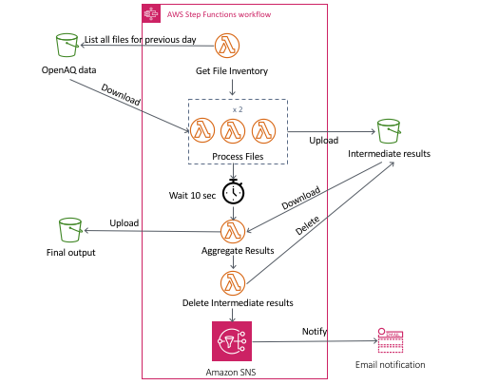
Reference architecture
States:
Extract phase
Transform phase
Load phase
Cleanup phase
Notification

Slide 21
AWS SAM
AWS SAM is an open-source framework built on top of CloudFormation.
It provides a simplified syntax for defining serverless applications.
Use AWS SAM templates to quickly provision Lambda functions, APIs, databases, and event sources with just a few lines of YAML.
Discover more: Check out the template.yaml
Notes:
Source: https://docs.aws.amazon.com/lambda/latest/dg/foundation-iac.html

Slide 22
Components of the template
The template.yaml file in AWS SAM serves as a blueprint for serverless infrastructure, while the actual code resides in Lambda functions. Key components of the template include:
Transform: Enables serverless capabilities.
Resources: Manages resource provisioning, such as defining Lambda functions.
Properties: Specifies details like code location, handler function, and triggering events.
Events: Defines triggers for Lambda functions, such as API Gateway events.
Outputs: Generates values after resource creation, like API Gateway endpoint URLs.
This structure allows developers to define their serverless application's infrastructure and event triggers in a concise YAML format, separating infrastructure concerns from the actual function code.
The template facilitates quick provisioning of resources and easy management of serverless applications.

Slide 23
Assignment Q&A
Model Serving with AWS Lambda and Cold Start Performance Analysis

Slide 24
Reminder
Deadline: October 24, 2024, 23:59
Assignment details can be found in our GitHub repo: https://github.com/CUHKSZ-CSC4160-Fall24/Assignment-3

