Slide 1

Handwritten Digit and Signal Recognition for Children
EIE4512 2023-24 Summer
2024/7
Group 1
Boshi Xu Yuhang Huang Yiwei Huang

Slide 2
01
Part1
Motivation
PART 01

Slide 3

“
In today's digital age, the cost of labor is becoming more and more expensive, the digitalization of education for younger children has been the trend, in order to allow parents and teachers do not have to spend energy on a lot of simple homework correction, we would like to design a project that can check the answers to children’s simple handwritten calculations.
Motivation
”
Notes:
运用到智能系统的子系统
有如下优点：
1、对生命体具有更好的识别能力
因为红外利用热辐射成像，任何高于绝对零度（-273℃）的生命体都会散发热量，所以能够呈现更清晰的图像。它弥补了“雷达+摄像头”依赖形状识别的不足，更好地保护行人。
2、夜间成像能力强
上文提到，因为红外技术是通过物体发出的热辐射来成像，并不依赖光成像，所以不管白天黑夜，它都能工作，可以弥补可见光成像夜间探测能力差的弊端。
3、雨雾等恶劣天气下，抗干扰能力强
因为红外辐射波的波长较长，所以其穿透力更好，因此即便是在沙尘、雾霾等恶劣的天气条件下，红外图像的成像效果依旧比较好，即红外图像的抗干扰能力较强。
4、无惧眩光
红外只接收中长波信息，不接收可见光波段信息，夜晚会车等强弱光交替场景仍能清晰成像，感知功能不会受到影响。这也是夜间使用比较常见的一个场景。
总结一下

Slide 4
02
Part2
Goal and
Methodology
PART 02

Slide 5
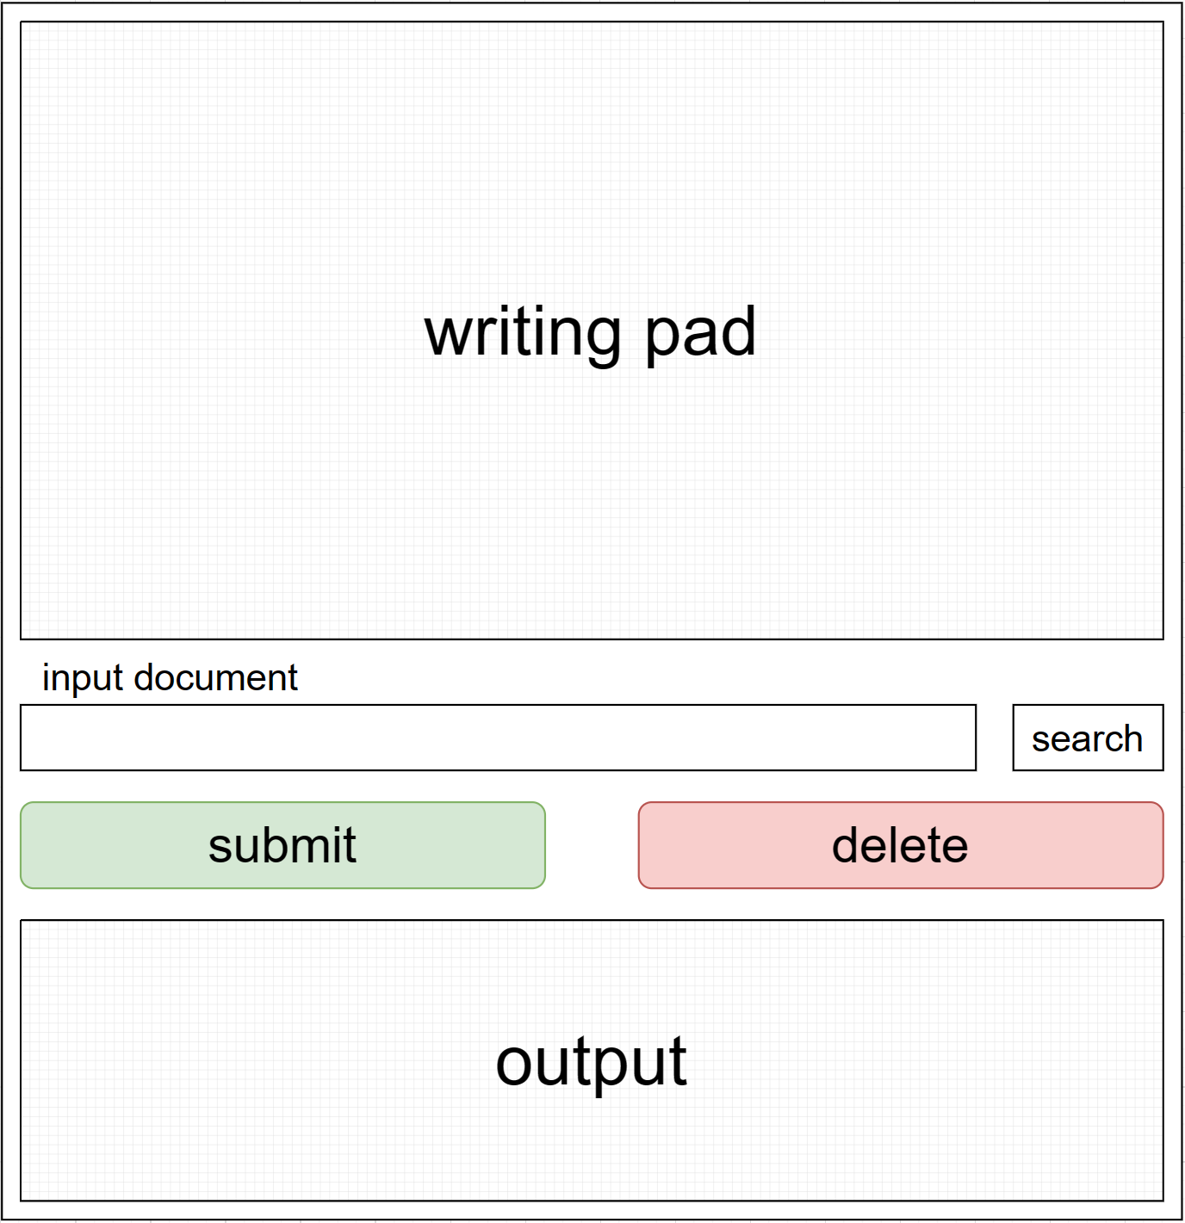
02 Goal and Methodology
Goal
The goal is to create a simple and easy-to-understand front-end interaction, including:
handwriting board
optional file input
final text result output

Slide 6
02 Goal and Methodology
Plan of Action
Use the texture-plus-depth images from Middlebury Stereo Dataset and synthesize novel views
Use 2 different algorithms – Markov Random Fields and convolutional neural networks – to inpaint the missing regions
Evalute with ground truth views

Slide 7
03
Part3
Dataset and
Initial Results
PART 03

Slide 8
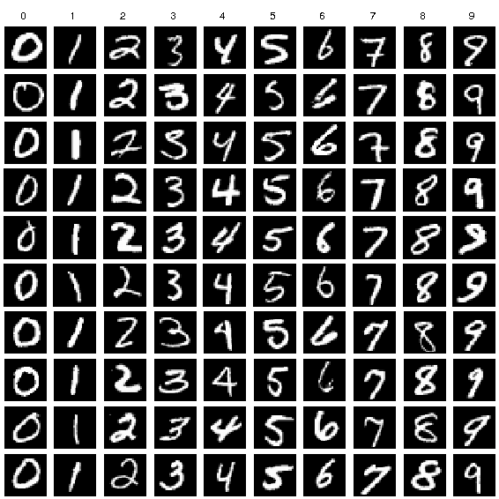
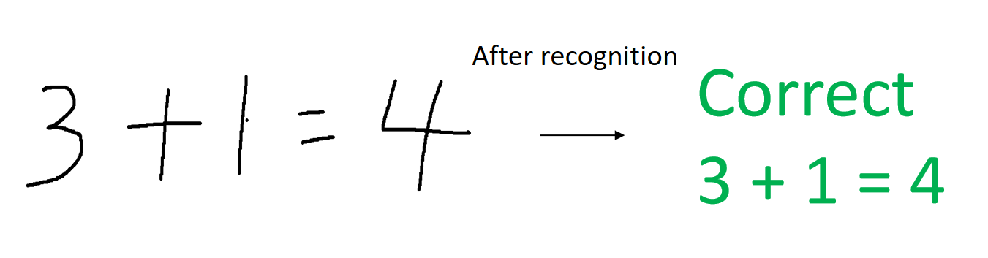
03 Dataset and Initial Results
“
MNIST Dataset:
60,000 training images and 10,000 test images
”

Slide 9
04
Part4
Strategy
PART 04

Slide 10
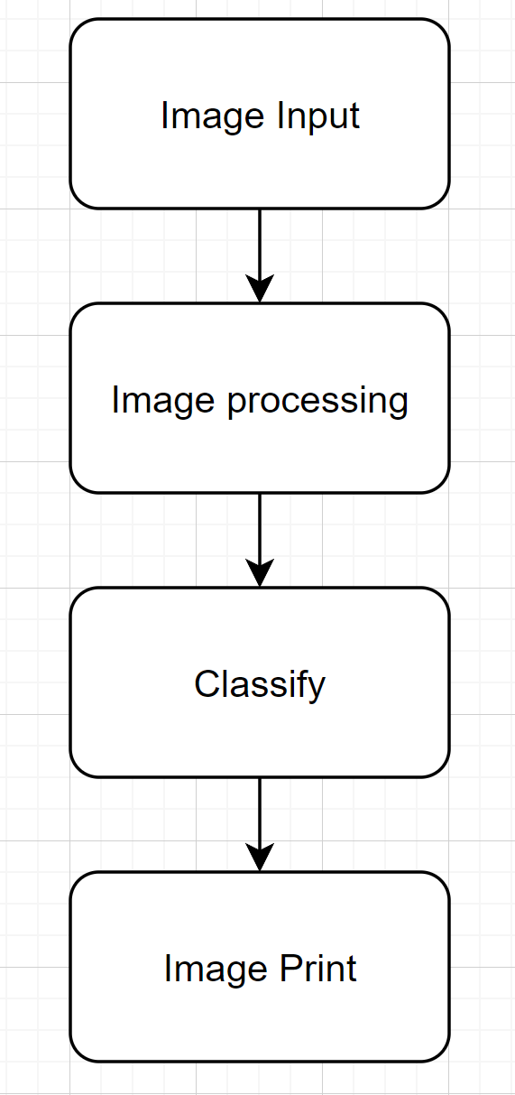
04 Strategy
“
The initial algorithms consists of the
following 4 steps.
”

Slide 11
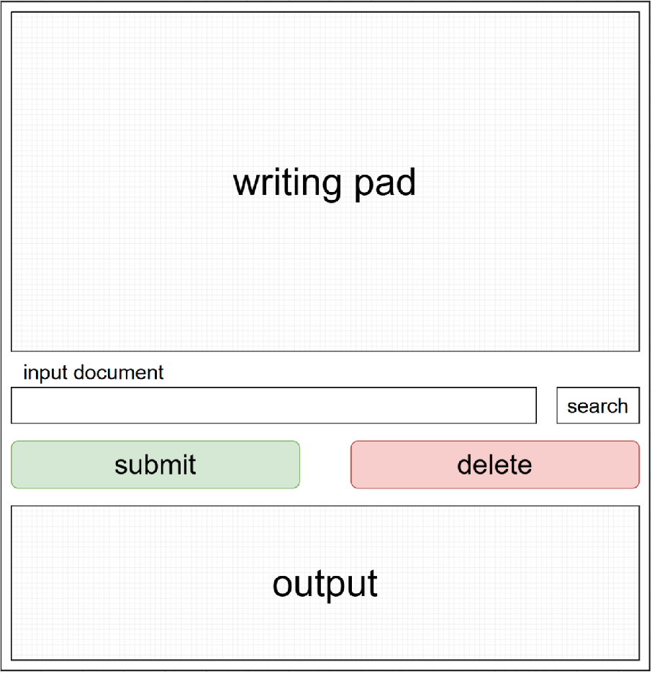
04 Strategy
“
Step 1
Read the image from the frontend's handwriting board.
”

Slide 12

04 Strategy
“
Step 2 Image Detection
”
Image Pre-processing
Contour Detection

Slide 13
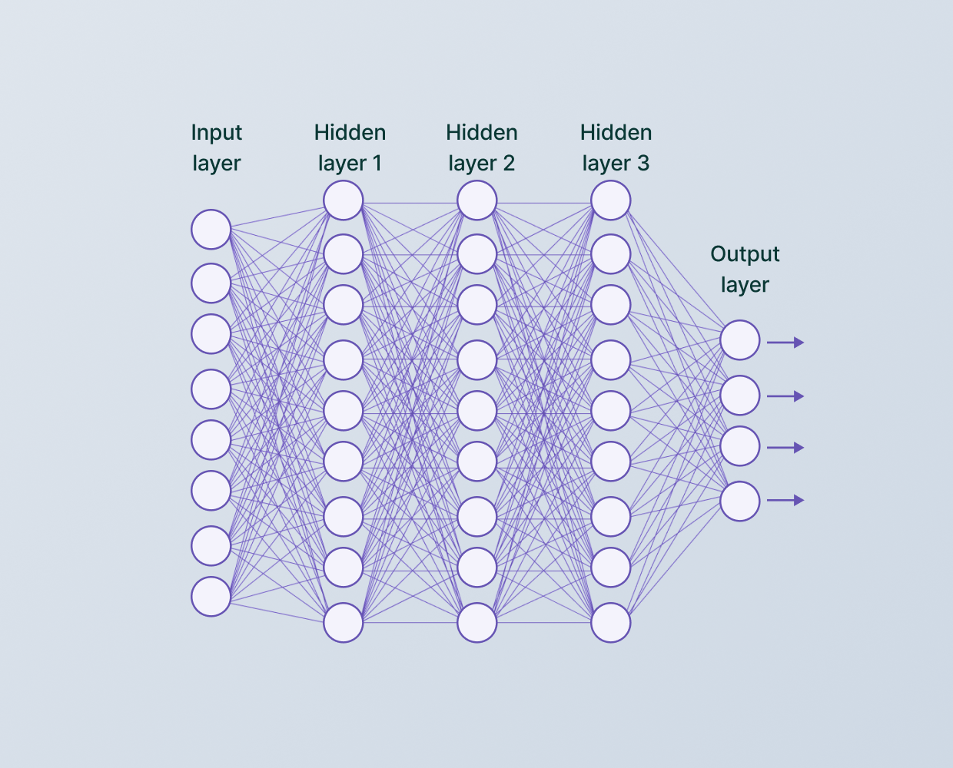
04 Strategy
“
Step 3
Use the pre-trained CNN model to classify the extracted image regions
”

Slide 14
04 Strategy
“
Step 4
Output the recognition results to the frontend for display.
”

Slide 15
Thank you for Watching

Slide 16
Appendix: Reference
NA

