Slide 1

04
Part 4
Strategy
PART 04

Slide 2

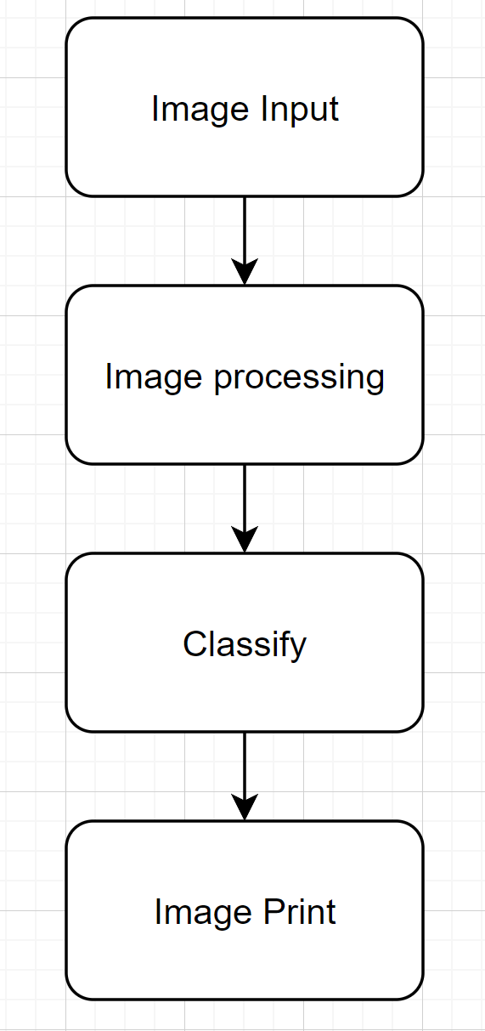
04 Strategy
“
The initial algorithms consists of the
following 4 steps.
”

Slide 3
04 Strategy
插图！
“
Step 1
Read the image from the frontend's handwriting board.
”

Slide 4

04 Strategy
“
Step 2 Image Detection
”
Image Pre-processing
Contour Detection

Slide 5
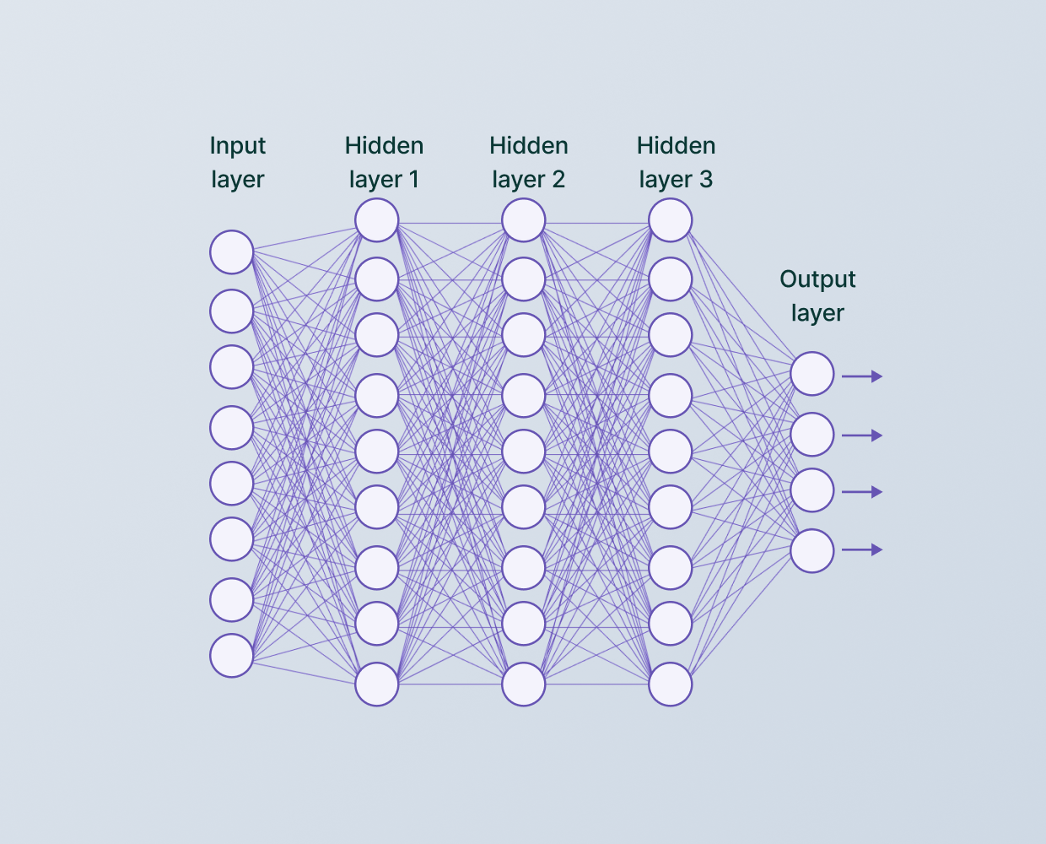
04 Strategy
“
Step 3
Use the pre-trained CNN model to classify the extracted image regions
”

Slide 6
04 Strategy
“
Step 4
Output the recognition results to the frontend for display.
插图
”

