Slide 1
LucidVR
Executive thesis
Efficient Video Super-Resolution for Real Degraded Inputs
Generic video generators are useful baselines, but can hallucinate identity/object changes.
A VSR production model needs fidelity, temporal stability, and predictable latency.
Strategy: reproduce the FlashVSR efficiency path, then adapt it to internal video/image data and realistic degradations.
FlashVSR provides a strong blueprint; LucidVR adds internal-data adaptation and reproducible training.
April 30, 2026

Slide 2
Motivation: VSR is not video re-generation
The first slide with visual evidence should show where SeedVR is strong but misaligned with restoration fidelity.
LQ input
SeedVR output
LucidVR target
Decision framing
SeedVR remains a valuable perceptual baseline.
real degraded frame
may change face / object
faithful restoration
However, hallucination is unacceptable for many VSR use cases.
LucidVR optimizes for restoration fidelity and speed rather than unconstrained generation.
Success criterion: a model that improves sharpness and perceptual quality while preserving content identity, motion, and frame-rate consistency.
LucidVR / executive draft
02

Slide 3
Blueprint from FlashVSR, adapted for LucidVR
FlashVSR shows a practical route from high-quality diffusion VSR to streaming one-step inference.
FlashVSR paper blueprint
LucidVR adaptation
What is different from a direct reproduction
Wan2.1-1.3B backbone + LoRA rank 384
Internal Yubari / Takano video sources
The hardest part is not only model code: it is data + degradation + latent alignment.
Three-stage training pipeline
Internal high-res image sources
Stage 1: video-image joint teacher
Aliyun-style realistic degradation
Multiple early branches were deprecated after exposing loss, memory, or motion-quality issues.
Stage 2: sparse-causal adaptation
Corrected LQ projector / VAE temporal alignment
Current Stage 1 is a corrected teacher path designed to connect cleanly to Stage 2.
Stage 3: one-step distillation
Multi-node B200 training and utilization monitoring
Reported: ~17 FPS at 768×1408 on A100
LucidVR / executive draft
03

Slide 4
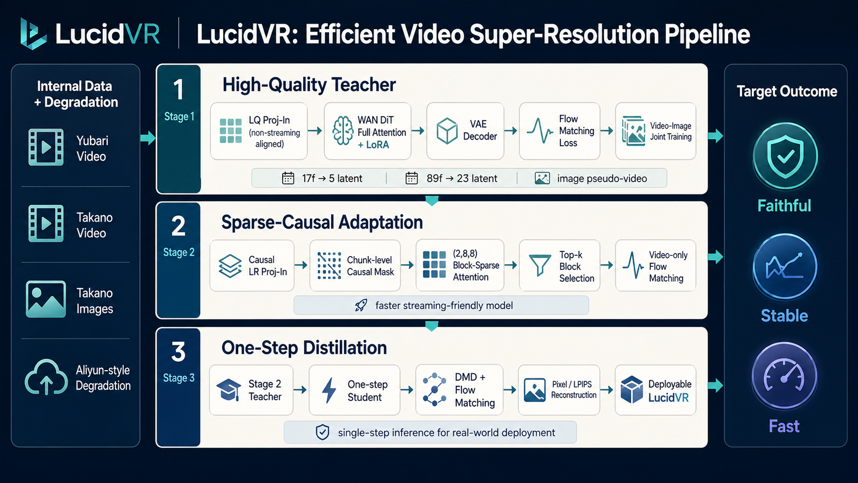
LucidVR technical architecture
Training and inference are organized around a faithful Stage 1 teacher and a sparse-causal acceleration path.
LQ Proj-In non-streaming aligned
WAN DiT Teacher full attention + LoRA
VAE decoder
Stage 1 teacher quality anchor
Internal data Yubari / Takano / Images
Realistic degradation Aliyun-style LQ synthesis
Corrected alignment: 17f→5 latent, 89f→23 latent; video/image branches pass VAE/projector separately and merge at token level.
Causal LR Proj-In 4-frame groups + cache
Sparse-Causal DiT (2,8,8) blocks + top-k
Streaming path video only
Stage 2 model faster inference
Stage 2 v6: official chunk-level mask, local_num window, block-sparse attention, video-only flow matching.
Stage 2 teacher
One-step student DMD + FM
Pixel / LPIPS reconstruction
Deployable LucidVR
LucidVR / executive draft
04

Slide 5
Engineering progress: experiments converged to a cleaner Stage 1 path
The current setup is the result of debugging data, degradation, projector initialization, temporal alignment, and multi-node utilization.
Branch
Purpose
Outcome
v4
Multi-source data + packed attention + Aliyun degradation
Exposed slow convergence and sample-definition issues; not kept as final line
v5.1 / v5.2
Grouped image samples with different loss weighting
Deprecated: too much padding/shape logic and memory pressure
v5.3
Author-style paired video + image pseudo-video
Kept as the clean joint-training structure
v5.3.5
89f Stage1, non-streaming aligned projector
Current long-frame teacher candidate on 48 GPUs
v5.3.6
17f Stage1, same rules as 5.3.5
Current short-frame teacher candidate on 16 GPUs
v6
Stage2 sparse-causal training code
Designed; waiting for smoke test
Current confidence point: the latest Stage 1 runs no longer use the old streaming projector mismatch; LQ tokens and DiT tokens are aligned before continuing training.
LucidVR / executive draft
05

Slide 6
Data and evaluation plan
The evaluation package should make quality and speed comparable across LucidVR, FlashVSR, and SeedVR.
Training data
Degradation
Evaluation
Yubari video tar stream
Aliyun-style video degradation
Synthetic degraded test clips
Takano video tar stream
Compression / blur / noise artifacts
Real challenging videos
Takano image tar / manifest
Original RealBasicVSR-style branch kept for comparison
Same input FPS / output FPS
Video-image paired Stage1 sampling
Fixed synthetic test set for repeatability
Runtime, VRAM, model size
Video-only Stage2 adaptation
Visual inspection: identity, motion, detail
LucidVR / executive draft
06

Slide 7
Stage 2 v6: what changes technically
Stage 2 is not just a mask; it replaces the self-attention path with sparse-causal block attention while making LR conditioning causal.
Causal LR Proj-In
Sparse-causal self-attention
Why this matters
LQ frames processed in 4-frame groups
Chunk-level causal mask, not token-level lower triangle
Reduces redundant attention cost
Previous group cache is carried forward
First three chunks form a full-attention start window
Enables streaming-friendly adaptation
For 89 frames: LQ projector outputs 22 latent-time steps
Official local_num window controls history length
Keeps Stage1 weights transferable
Aligns with Stage2 target after dropping first GT latent
(2,8,8) blocks = 128 tokens per sparse block
Provides a path to fast one-step distillation
Top-k block pairs selected via Q/K pooled features
LucidVR / executive draft
07

Slide 8
Results slide: use a small number of high-signal examples
Recommended: one SeedVR failure case and one LucidVR/FlashVSR improvement case, each with runtime numbers.
Input LQ
SeedVR
FlashVSR
LucidVR
Reference
Runtime metrics
real degraded
content drift / slow
official baseline
internal-data adapted
if available
sec / clip
FPS
VRAM
model size
Input LQ
SeedVR
FlashVSR
LucidVR
Reference
Decision readout
motion case
may redraw details
speed baseline
quality target
if available
fidelity
temporal stability
speed trade-off
LucidVR / executive draft
08

Slide 9
Current status and open gaps
The project is past basic reproduction; the main remaining work is selecting the teacher and validating sparse-causal acceleration.
Current status
Main risks
Needs / decisions
Corrected Stage1 teacher runs are active
Stage1 teacher quality must be selected carefully
2-GPU test node for v6 smoke
48-GPU 89f run: high utilization observed
Stage2 sparse-causal smoke may reveal kernel/shape constraints
Final benchmark clips and runtime protocol
16-GPU 17f run: stable utilization with workers
Image-video data improves detail but can hurt motion if misaligned
Decision on preferred teacher checkpoint
v6 Stage2 code and mask design are ready for smoke
Speed comparisons require fixed benchmark and FPS policy
Author confirmation for Stage2 training details
LucidVR / executive draft
09

Slide 10
Roadmap to a usable LucidVR model
Now
Finish Stage 1 teacher selection
Executive ask
Continue corrected 17f/89f runs, evaluate checkpoints on fixed synthetic and real sets.
Maintain multi-GPU windows for teacher and Stage2 runs
Use fixed benchmark clips for quality and speed tracking
Next
Validate Stage 2 v6
Allow short iteration cycles while Stage2 is being verified
Run 2-GPU smoke for official chunk mask, block-sparse top-k, causal LR projector.
Then
Train sparse-causal model
Use selected Stage1 teacher initialization; measure quality loss vs speed gain.
Final
Distill to one-step LucidVR
DMD + flow matching + pixel/LPIPS losses for faster inference and detail preservation.
Expected outcome: a fast, streaming-friendly VSR model adapted to internal data distribution, with stronger restoration fidelity than generic video generation baselines.
10

