Slide 1
LucidVR | Video SR
LucidVR
Efficient Video Super-Resolution for Real Degraded Inputs
Executive thesis
Target outcome
Generic video generators can hallucinate identity or object changes.
A production VSR model needs faithful restoration, temporal stability, and predictable latency.
LucidVR follows the FlashVSR efficiency path, then adapts it to internal data and realistic degradations.
Faster than general generative baselines for short VSR clips.
Stable identity and object preservation under real degradation.
Three-stage path: teacher quality, sparse-causal acceleration, one-step distillation.
Stage 1
Stage 2
Stage 3
teacher adaptation active
v6 smoke passed
distillation plan next
April 30, 2026

Slide 2
LucidVR | Video SR
Why generic video generation is not enough
The first comparison should establish the restoration requirement: output must improve detail without changing content.
LQ input
SeedVR output
LucidVR target
Drop visual example here
Drop visual example here
Drop visual example here
real degraded frame
strong generation, possible drift
faithful restoration
Decision criterion for VSR
The model should preserve identity, objects, camera motion, and temporal continuity.
Visual quality is not enough if the output becomes a newly generated video.
This motivates a VSR-specialized model instead of using a general video generator directly.

Slide 3
LucidVR | Video SR
Target system: fast, faithful, predictable VSR
LucidVR is positioned as a restoration system, not an open-ended video generator.
Input
LucidVR
Output
Low-res / degraded video 8 fps test protocol
VSR-specialized diffusion model internal-data adaptation
Higher-resolution video content-preserving
Fidelity
preserve faces, text, objects
Stability
no frame-to-frame generation drift
Latency
practical inference path via FlashVSR stages
Control
reproducible degradation and fixed test sets

Slide 4
LucidVR | Video SR
Technical blueprint: FlashVSR three-stage path
The project uses FlashVSR as the efficiency blueprint, while adapting the teacher to internal data and realistic degradation.
Foundation
Stage 1
Stage 2
Stage 3
Wan2.1-1.3B backbone LoRA adaptation
Full-attention teacher video-image joint SR
Sparse-causal DiT causal LR Proj-In
One-step distillation pixel-level loss
LucidVR adaptation focus
Stage 1 teacher quality is adapted on Yubari / Takano / image data with controlled degradation.
Stage 2 is treated as an acceleration adaptation, not a replacement of the teacher objective.
Stage 3 aims to recover speed while preserving temporal consistency and pixel-level details.

Slide 5
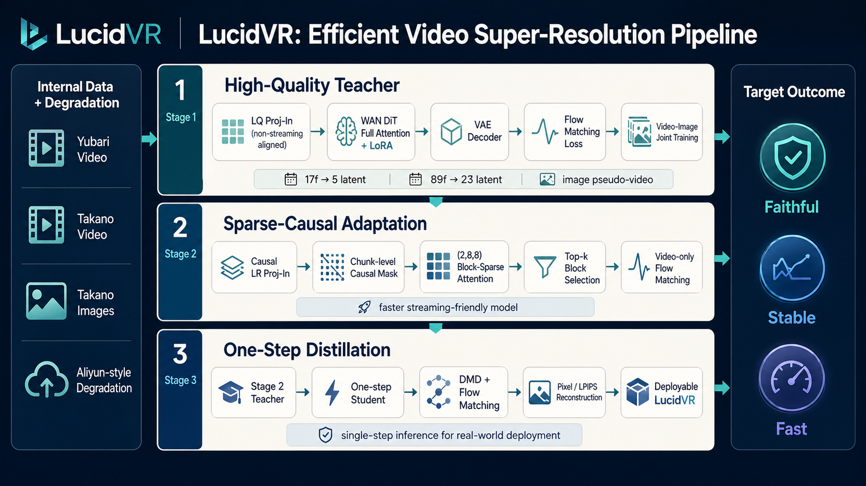
LucidVR | Video SR
Stage 1 architecture: internal-data teacher adaptation
The current clean Stage 1 path aligns LQ conditioning and DiT tokens before moving to sparse-causal Stage 2.
Key implementation choices
Non-streaming aligned LR Proj-In for Stage 1: first frame is compressed into the first latent block instead of being dropped.
Video branch and image pseudo-video branch are kept separated until latent/token packing.
Aliyun-style degradation generates 1/4 LQ, then inference uses x4 bicubic input upscale.
Color correction is enabled in current inference comparisons.
Current correct Stage 1 runs: v5.3.6 17f and v5.3.5 89f aligned non-streaming projector.

Slide 6
LucidVR | Video SR
Stage 1 experiment matrix: what each branch tests
The naming looks complex, but the comparison is now organized around a small number of controlled hypotheses.
Branch
Question
Setting
Status
v5.3
Full-source teacher
Yubari + Takano + image, full Aliyun degradation
main Stage 1 teacher line
v5.3.1
Degradation ablation
same data, half Aliyun degradation
tests whether degradation is too strong
v5.3.2
Image source ablation
Yubari video + Yubari frame-image
faster; tests external image bottleneck
v5.3.6
Temporal alignment fix
17f, random projector, non-streaming aligned LQ
current comparison checkpoint
v6
Stage 2 path
video-only, chunk-causal block sparse
2-GPU smoke passed
Main lesson
The critical fixes were not just model scale: data format, degradation strength, LQ projector initialization, and temporal alignment materially changed early learning behavior.

Slide 7
LucidVR | Video SR
Evaluation package: fixed inputs, comparable outputs
The comparison is organized by dataset first, then by method, so visual examples can be selected quickly for the final report.
Synthetic light-degradation set
Real challenging set
10 clips: 5 Takano + 5 Yubari.
LQ 320x192, GT 1280x768, 17 frames, 8 fps.
Aliyun-style light degradation without final bicubic restore.
11 real clips from challenging_test_lxh.
Resize-cover + center crop to 320x192, 17 frames, 8 fps.
No GT; only input and model outputs are included.
input_lq
input
gt
synthetic only
flashvsr_official
FlashVSR
seedvr3b
SeedVR-3B
seedvr2_3b
SeedVR2-3B
v5.3.6 step-2300
LucidVR
Clean comparison directory: compare_clean_light_x4_real320_step2300_20260430

Slide 8
LucidVR | Video SR
Stage 2 v6: sparse-causal acceleration path
Stage 2 changes the attention behavior and LR conditioning; KV cache and local-range inference tricks are not part of the first training smoke.
Stage 1 teacher full attention
Chunk-level causal mask
Current v6 status
1
2
3
4
5
6
7
1
2-GPU smoke passed with block_sparse_chunk_causal.
topk_ratio=2.0 fixed in training.
video-only Stage 2 dataset path is wired.
Next: validate quality drop against Stage 1 teacher checkpoints.
Causal LR Proj-In 4-frame groups
2
3
4
Chunk-causal mask chunk-level causality
5
6
Block-sparse top-k (2,8,8) blocks
7
First three chunks are full; later chunks see current and past history according to the official local_num window.

Slide 9
LucidVR | Video SR
Current status and open gaps
The project is past basic reproduction; the remaining work is selecting the teacher and validating sparse-causal acceleration.
Completed / stable
Active experiments
Open risks
Fixed 320x192 evaluation package
Stage 1 non-streaming aligned inference
v6 2-GPU smoke passes
17f/89f Stage 1 teacher checkpoints
degradation strength ablations
random vs initialized projector behavior
Stage 2 quality drop after causal sparse adaptation
SeedVR comparisons require careful fixed-size protocol
teacher selection still depends on visual inspection
Near-term decision: pick the strongest Stage 1 teacher checkpoint before investing in longer Stage 2 / Stage 3 runs.

Slide 10
LucidVR | Video SR
Next milestones and support needed
A consistent, short-term plan for moving from current teacher checkpoints to a usable LucidVR prototype.
1
Teacher selection
Finish visual comparison on fixed synthetic + real sets.
1–2 days
2
Stage 2 validation
Run v6 sparse-causal training from selected teacher and compare quality / speed.
next week
3
Stage 3 distillation
Add one-step distillation with pixel-level loss and temporal consistency checks.
after Stage 2
Resource ask
Stable multi-node GPU windows for teacher continuation and Stage 2 ablation.
Expected deliverable
A LucidVR prototype with fixed test-set comparison against FlashVSR and SeedVR.

