Slide 1
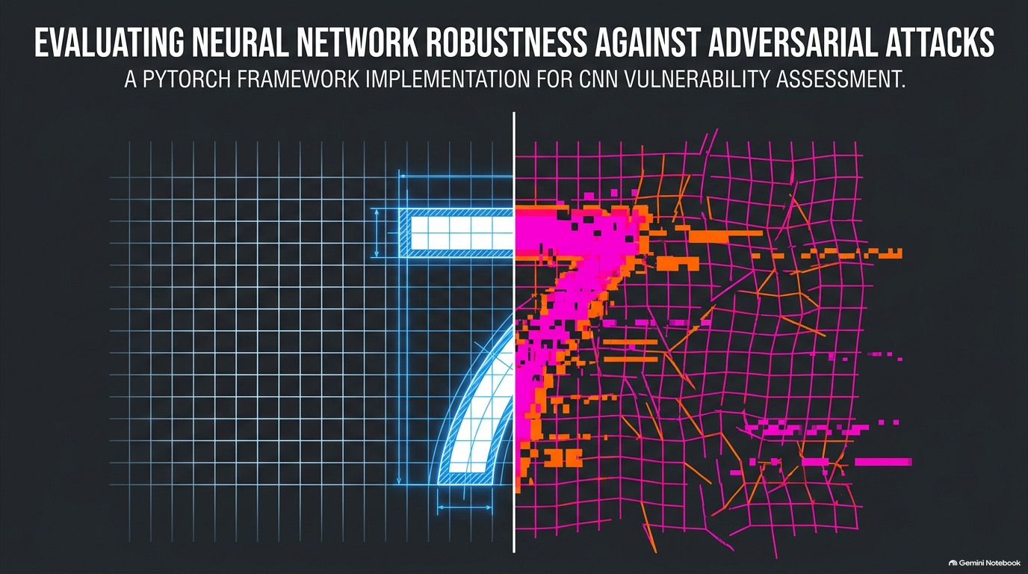
Notes:
"Hey everyone. Today we're looking at neural network security—specifically, how easy it is to trick a standard convolutional neural network on MNIST using PyTorch."

Slide 2
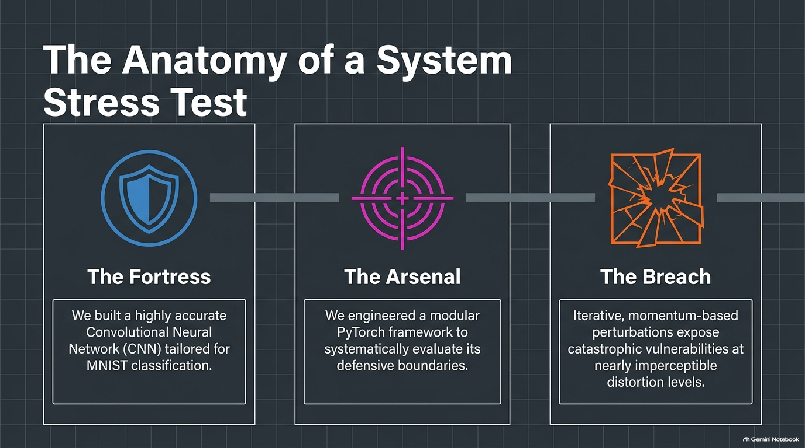
Notes:
"We can think of this study in three parts. First, The Fortress—our highly accurate model. Second, The Arsenal—the framework we built to test it. And third, The Breach—how those attacks actually break our defenses."

Slide 3
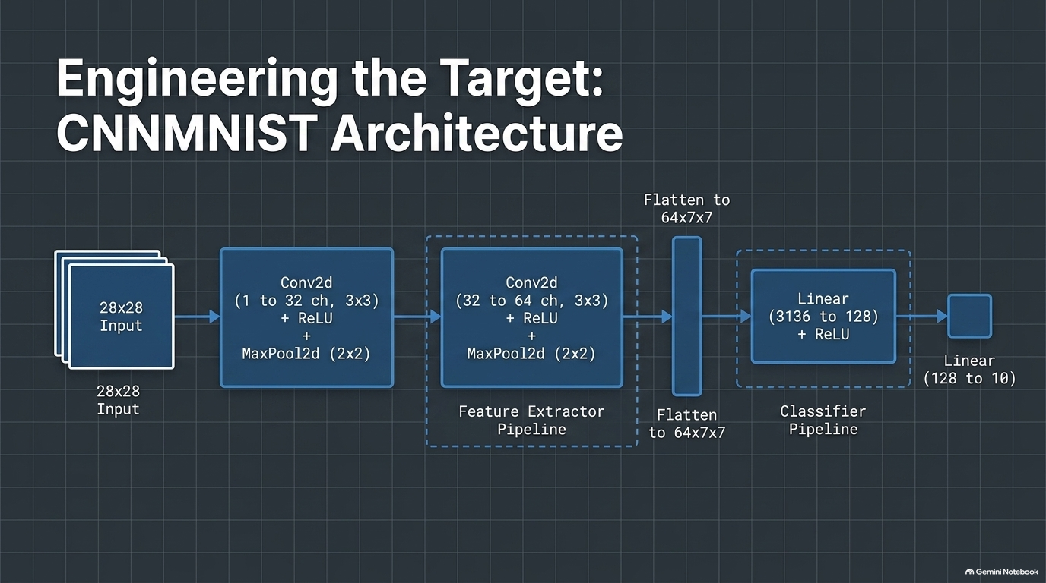
Notes:
"Here’s the model we're attacking. It’s a standard PyTorch CNN with two convolutional blocks to extract features, which we then flatten and feed into a basic two-layer classifier."

Slide 4
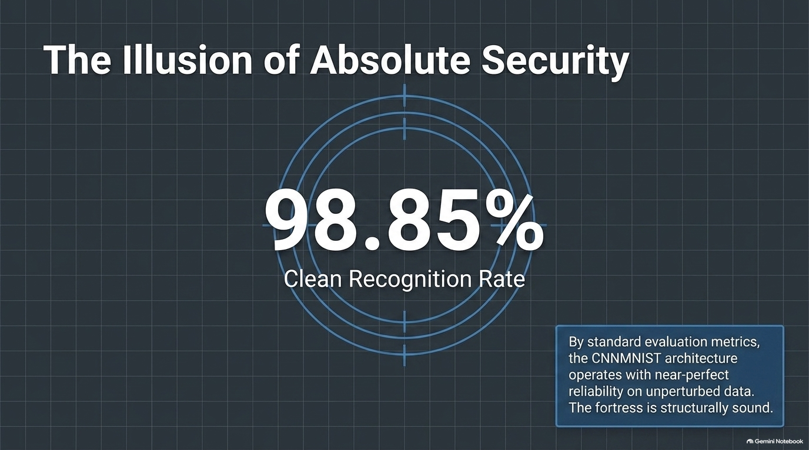
Notes:
On normal, clean data, this model is a 98.85% recognition rate. It feels safe, but as we're about to see, that security is actually pretty fragile."

Slide 5
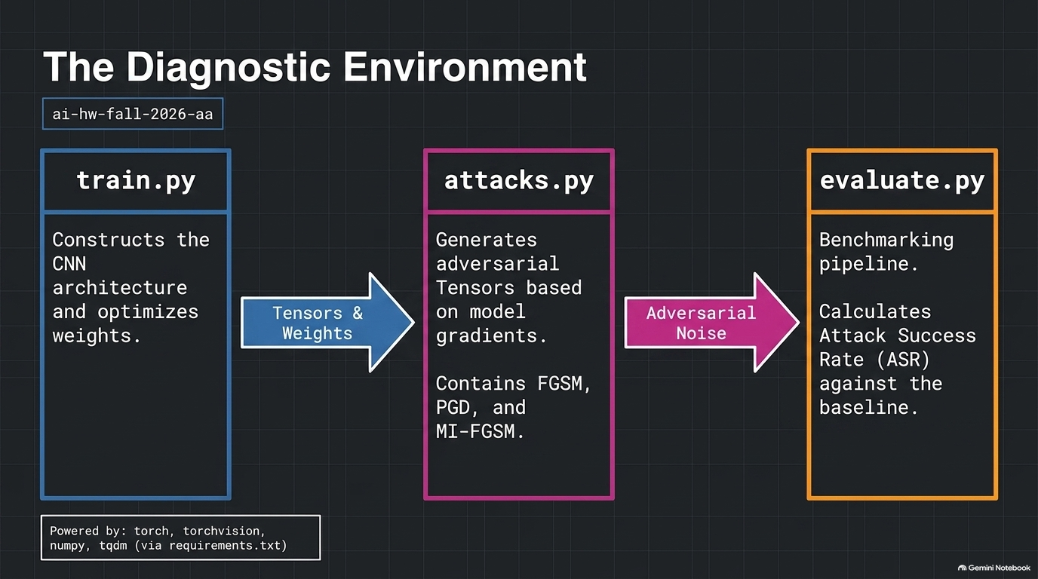
Notes:
Our codebase is super clean and split into three core scripts. train.py builds the network, attacks.py generates the adversarial noise, and evaluate.py runs our final benchmarks."

Slide 6
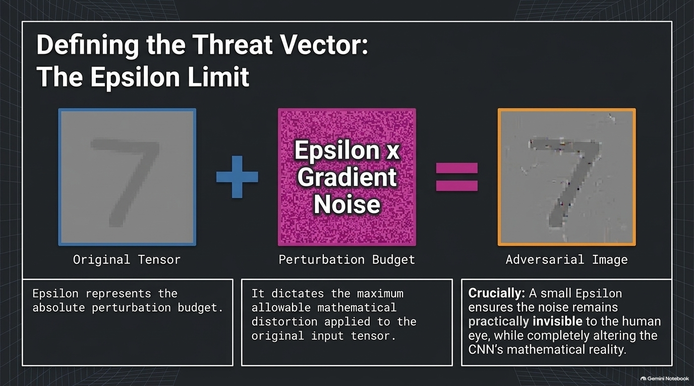
Notes:
"To make the attack realistic, we restrict our noise budget using a parameter called epsilon. The goal is to keep the mathematical changes small enough that humans can't see them, but big enough to completely confuse the model."

Slide 7
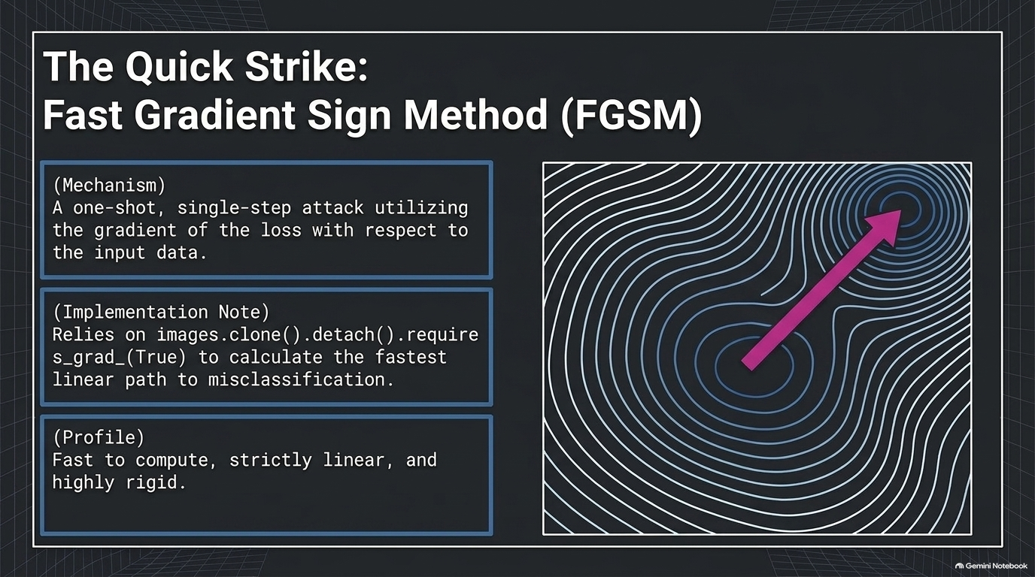
Notes:
First up is FGSM. This is a quick, one-shot attack. It just calculates the gradient of our loss function once, takes the sign, and shifts the pixel values in that direction. Fast, but simple."

Slide 8
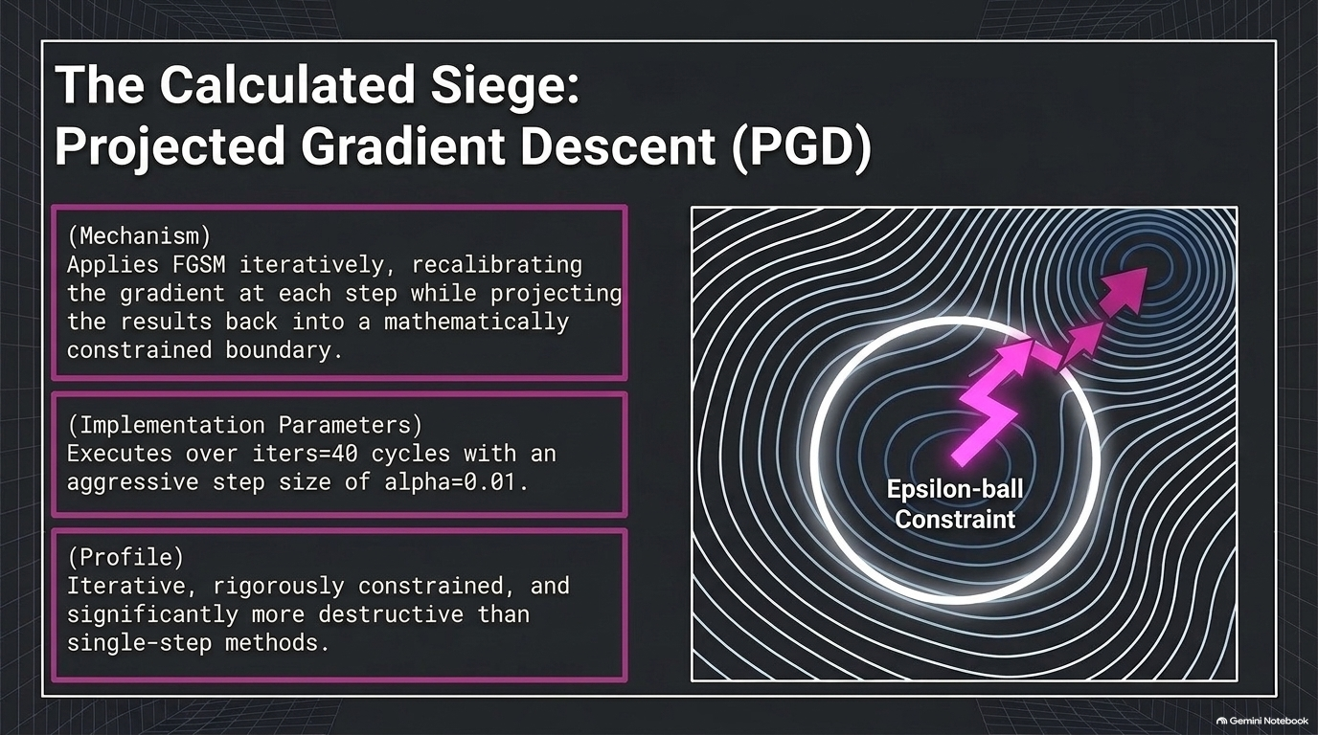
Notes:
"PGD is much more aggressive. Instead of one big jump, it takes 40 small steps of size 0.01, checking the gradient at each step and projecting the image back to stay within our epsilon boundary."

Slide 9
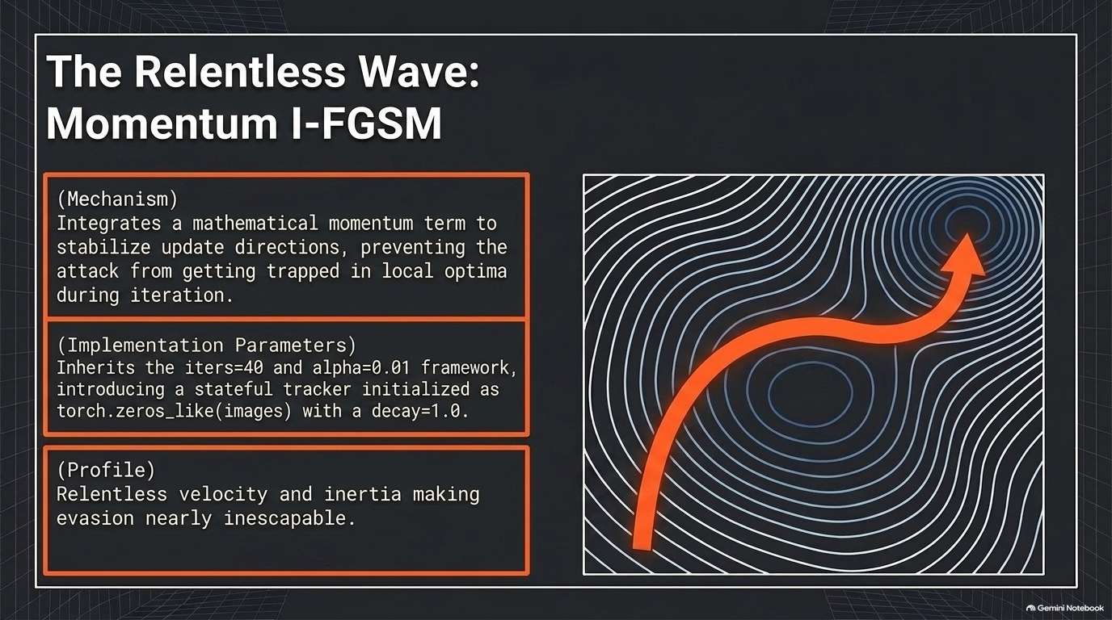
Notes:
"MI-FGSM takes the iterative PGD approach and adds a momentum term. This keeps the optimization from getting stuck in local traps, giving the attack a lot more momentum to break the model's classifications."

Slide 10
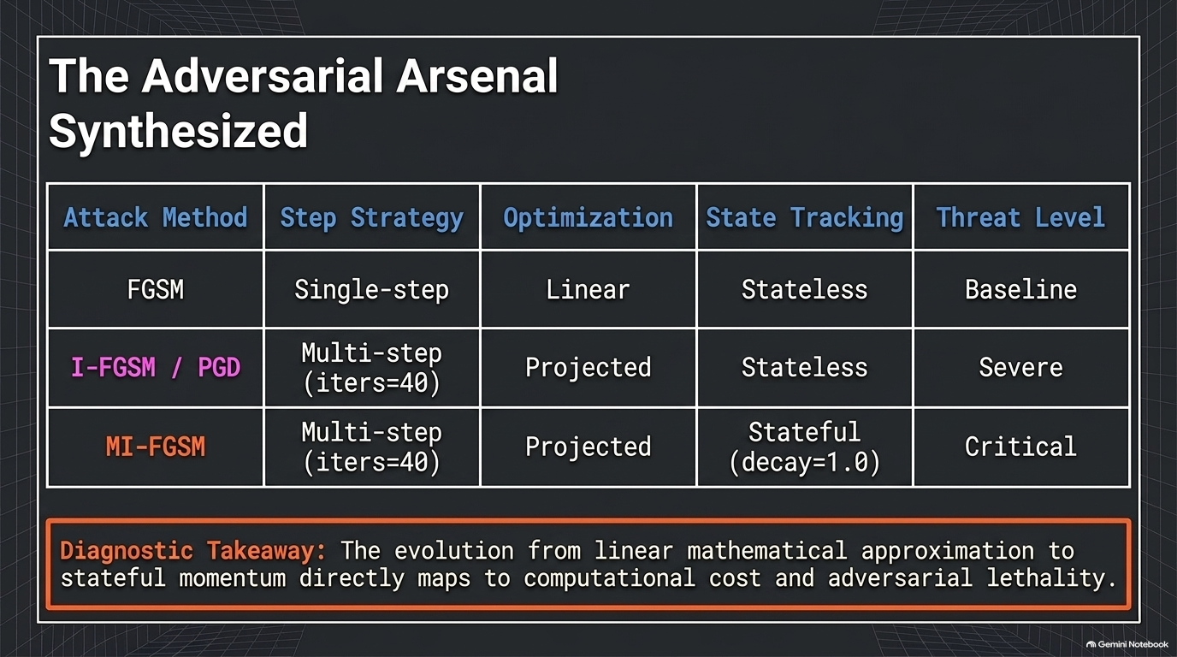
Notes:
"To sum up our tools: FGSM is simple and fast. PGD and MI-FGSM are iterative, taking 40 steps to systematically break down our network. As complexity goes up, so does the threat level."

Slide 11
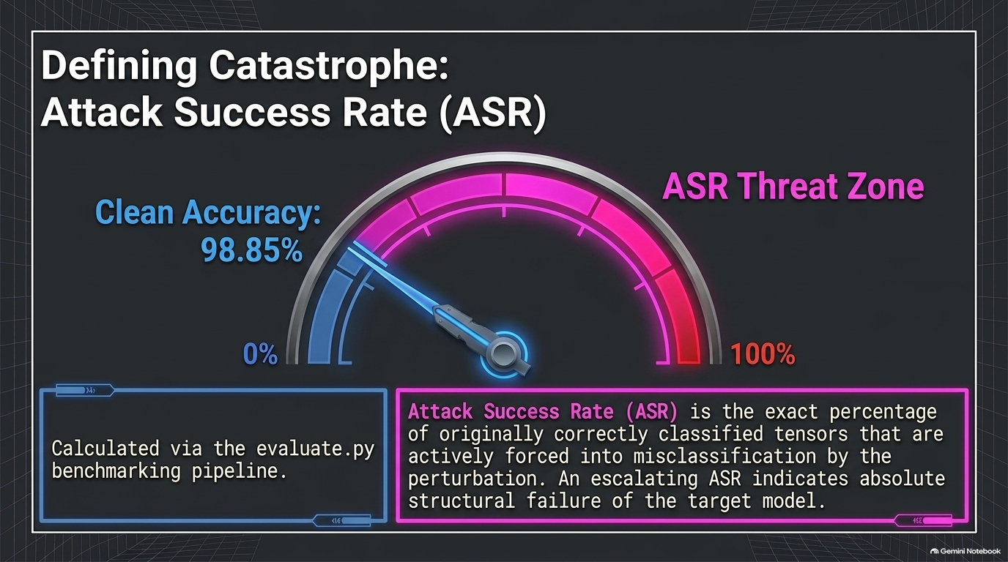
Notes:
We measure how successful our attacks are using Attack Success Rate (ASR). Basically, of the images the model originally got right, how many can we force it to get wrong?"

Slide 12
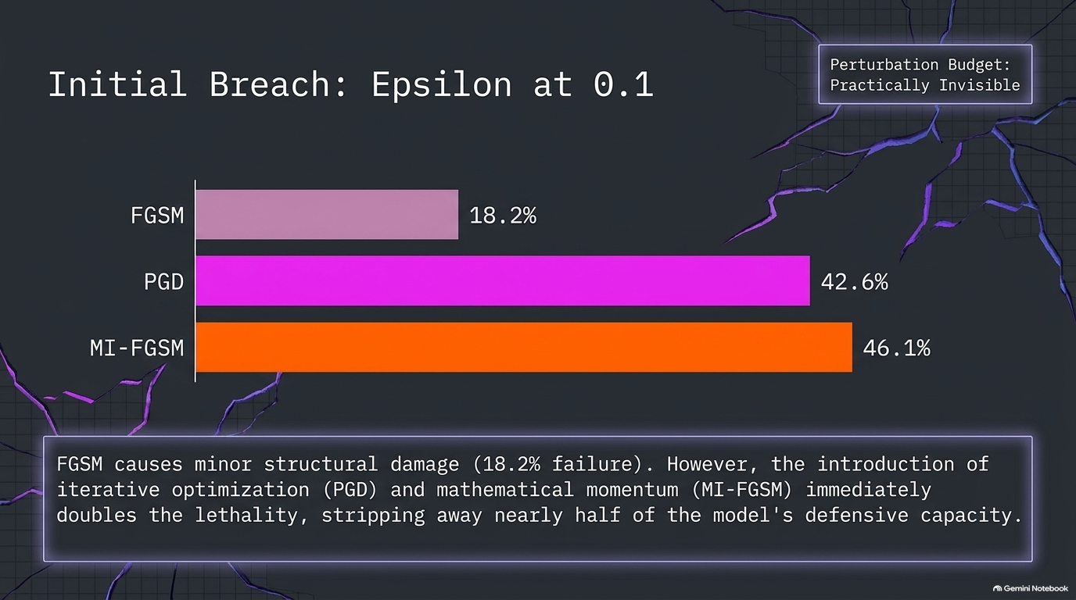
Notes:
Even with a tiny, barely visible epsilon of 0.1, the network starts to crack. FGSM gets an 18.2% success rate, but the iterative attacks immediately jump up to over 40% success."

Slide 13
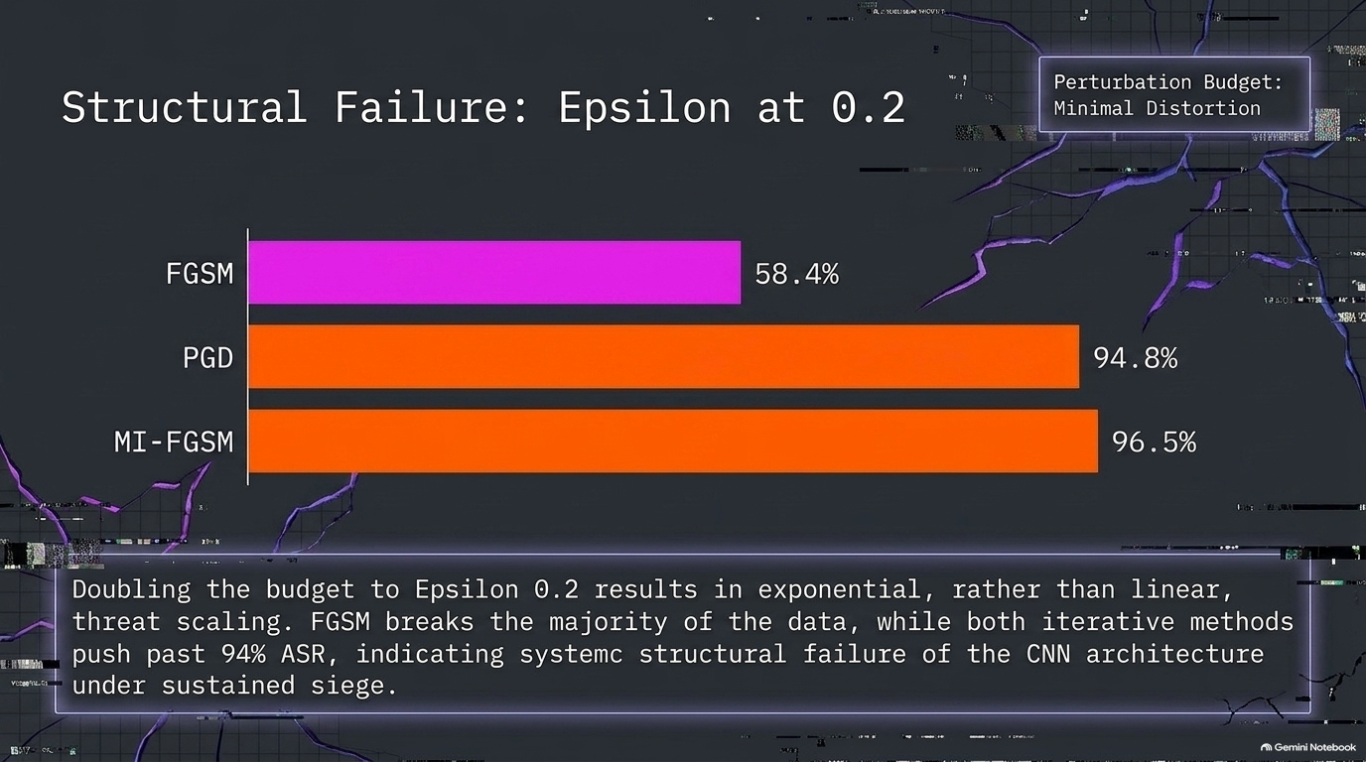
Notes:
"At an epsilon of 0.2, it's a massive failure. FGSM crosses 58%, while our two iterative attacks—PGD and Momentum FGSM—bypass our defenses over 94% of the time."

Slide 14
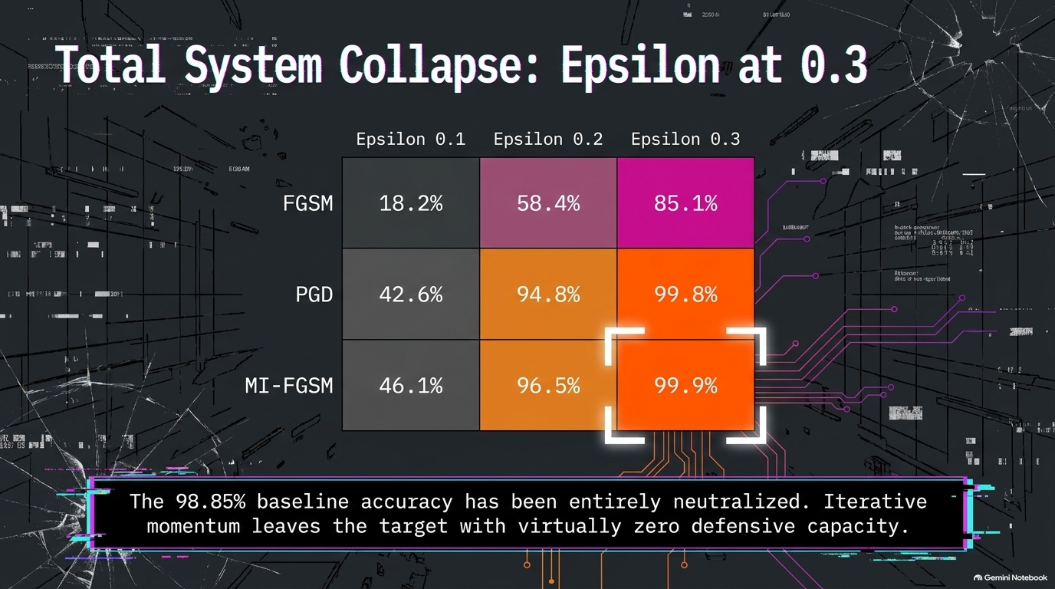
Notes:
"By the time we hit epsilon 0.3, the network is completely defeated. PGD and Momentum FGSM hit 99.8% and 99.9% success rates. Our 98.85% baseline accuracy has been completely neutralized."

