Slide 1


PKI and card issuance
EJBCA.org
SignServer.org
Tomas Gustavsson
http://www.primekey.se
tomas@primekey.se
Notes:
Feel free to ask questions...

Slide 2
EJBCA
- Open Source Enterprise PKI
EJBCA PKI
  Central Certificate Authority
  Integrates with standard protocol and WS
EJBCA OCSP
  Online certificate status validation
SignServer
  Modular server-side signature and validation
  PDF, XML, ODF, OOXML signing
  MRTD Document Signer
  Time Stamp Authority
  …
Enterprise PKI built on JEE technology.

Slide 3
Certificate Lifecycle Mgmt
Certificate Lifecycle Management, what does it mean?
Managing certificates through all the stages during it's life time.
Renew
Issue
Certificate
Revoke/expire
Suspend/re-activate
Certificate states:
Not yet valid
Valid/active
Expired
Revoked
Suspended
Notes:
Feel free to ask questions...

Slide 4
Certificate Lifecycle Mgmt
Manual lifecycle management
  Small scale
  High maintenance
  Labor intensive
Automatic lifecycle management
  Several protocols suited for automation of issuance, renewal and revocation:
    CMP
    SCEP
    Web service
    (XKMS)
Notes:
Feel free to ask questions...

Slide 5







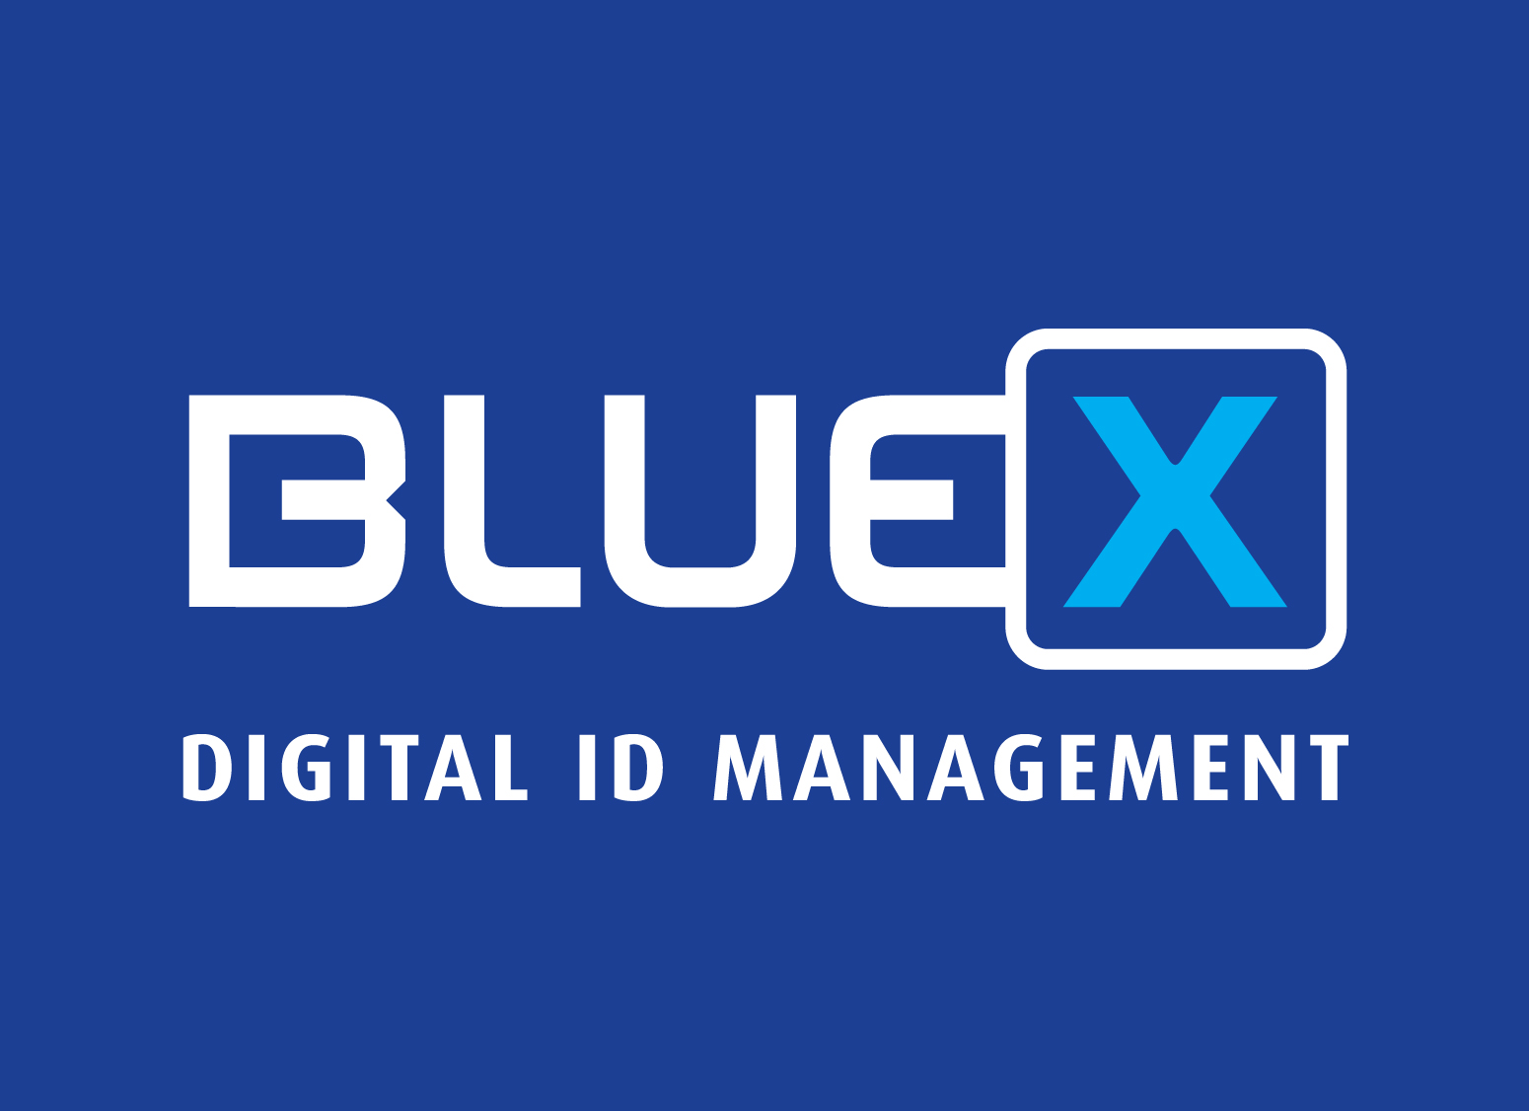
Enrollment/RA interfaces
Web clients
Routers/vpn
Other clients
HTTP/SSL certificates
SCEP/VPN certificates
CMP
Logon certificates
XKMS
EJBCA
SignServer MRTD
Inspection system
DS Certificate
IS Certificate (CVC)
ExtRA API
CMP
WebService
Smart card personalization
External RA
External RA
Notes:
Feel free to ask questions...

Slide 6

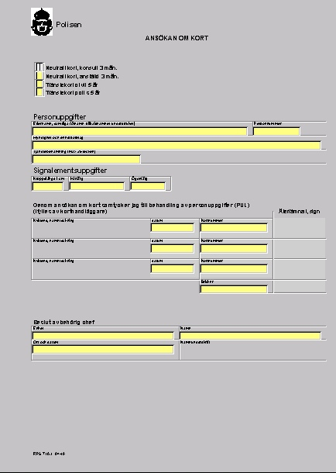
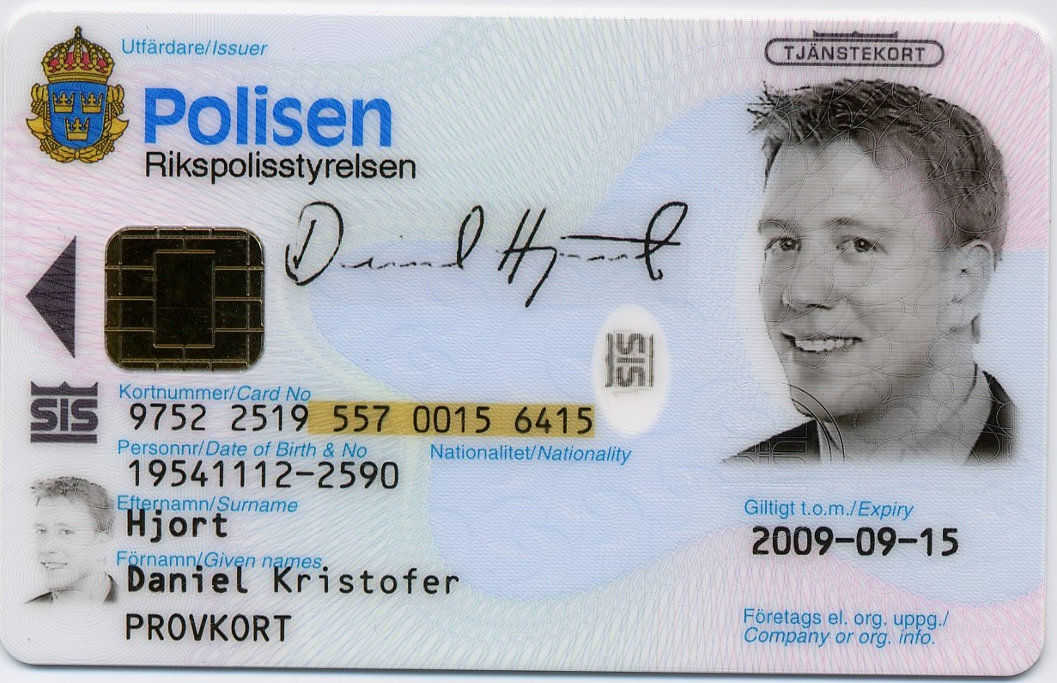

Smart card system
CA
HSM
Smart cards on two ends, HSM and user token.
HSM protects CA private keys
  HSM token creation/key ceremony
Issuance = provision the user with a usable token
  Personalize token with certificates from the CA
Notes:
Clustering and stress testing work is high on our agenda. We now have good stress testing tools for most importand interfaces. Ocsp, webservice, cmp. A recent addition to the test platform is a test server constantly running builds and tests on all our major supported platforms. Continous integration commonly referred to when talking about agile development methods.

Slide 7
Issuance, raw OpenSC
CA
HSM
cardos-tool -i
cardos-tool -f
pkcs15-init -EC
pkcs15-init -P -a 01 -l test01
pkcs15-init -G RSA1024 -a 01 -l test01
OpenSSL>req -engine pkcs11 -new -key id_45 -keyform engine -out req.pem \
-text -subj "/CN=Open SC"
pkcs15-init --store-certificate cert.pem -v -i 45
Notes:
Clustering and stress testing work is high on our agenda. We now have good stress testing tools for most importand interfaces. Ocsp, webservice, cmp. A recent addition to the test platform is a test server constantly running builds and tests on all our major supported platforms. Continous integration commonly referred to when talking about agile development methods.

Slide 8
Issuance, enterprise
Admin
Data capture
CA
CMS
HSM
Legacy
LDAP
Card Management Systems (CMS) are widely used by large-scale organisations;
to enrol, issue and manage the lifecycle of token based identities.
A secure, scalable and configurable CMS solution is able to meet virtually any
requirement from various processes and software components.
Notes:
Clustering and stress testing work is high on our agenda. We now have good stress testing tools for most importand interfaces. Ocsp, webservice, cmp. A recent addition to the test platform is a test server constantly running builds and tests on all our major supported platforms. Continous integration commonly referred to when talking about agile development methods.

Slide 9
Issuance, enterprise
Admin
Data capture
DB
CA
CMS
HSM
DB
Keep a database of issued card and card holders in order to easily manage
token lifecycle.
A CMS based on OpenSC could easily be implemented in any programming language.
Notes:
Clustering and stress testing work is high on our agenda. We now have good stress testing tools for most importand interfaces. Ocsp, webservice, cmp. A recent addition to the test platform is a test server constantly running builds and tests on all our major supported platforms. Continous integration commonly referred to when talking about agile development methods.

Slide 10
Card Management Systems
Aventra
EAT Europe
SecMaker
Gemalto
Oberthur
Hard Token Management Framework
…
Only one is open source, and it currently depends on
proprietary/commercial PKCS#11 library.
Notes:
Clustering and stress testing work is high on our agenda. We now have good stress testing tools for most importand interfaces. Ocsp, webservice, cmp. A recent addition to the test platform is a test server constantly running builds and tests on all our major supported platforms. Continous integration commonly referred to when talking about agile development methods.

