Slide 1
Decision Neuroscience Summer School
3-hour tutorial
Using Large Language Models to Understand Human Decision-Making
Prediction, representation, explanation, and model discovery
Hanbo Xie
Georgia Institute of Technology
Notes:
Introduce one running risky-choice example. The first half builds prediction step by step; the second half asks what improved prediction can support scientifically.

Slide 2
INTRODUCTION
02
My research and why this tutorial
Selected work behind this tutorial
Hanbo Xie
Georgia Institute of Technology
ICLR 2026
Zhu*, Xie* et al.
Using Reinforcement Learning to Train Large Language Models to Explain Human Decisions
I study how people and AI think, decide, and learn.
CCN 2026
Xie et al.
Think-Aloud Reshapes Automated Cognitive Model Discovery Beyond Behavior
Cognitive modeling | behavioral experiments
Think-aloud data | large language models
COLM 2024
Xie et al.
From Strategic Narratives to Code-Like Cognitive Models
TODAY'S FOCUS
NeurIPS 2023 AI4Science
Xie, Xiong, & Wilson
Prediction | Representation | Explanation | Discovery
Text2Decision: Decoding Latent Variables in Risky Decision Making from Think Aloud Text
Notes:
Introduce the broader research program: how people and AI think, decide, and learn, studied through cognitive modeling, behavioral experiments, think-aloud data, and language models.
Then narrow to today's tutorial. The four selected papers motivate the progression from prediction to representation, explanation, and model discovery.
[Sources]
- https://xhb120633.github.io/#about
- https://openreview.net/forum?id=coJPBEZ9Te
- https://arxiv.org/abs/2605.05091 (conference status: CCN 2026, confirmed by the presenter)
- https://openreview.net/forum?id=1Tny4KgGO2
- https://openreview.net/forum?id=fEoemPDicz
[/Sources]

Slide 3
OPENING QUESTION
Please choose one option.
You will receive the outcome of the option you choose.
( ) Option A
100% chance of receiving $40
( ) Option B
50% chance of receiving $100; otherwise $0
Click Continue after making your choice.
Vote first. Explain later.
Notes:
Run a quick vote. Keep the choice visible as the running example.

Slide 4
Tutorial scope
04
Scope of this tutorial
SCOPE
LEVEL OF ANALYSIS
WHAT THAT MEANS HERE
Not covered
Model implementation
Transformer architecture, training systems, and engineering details
Not covered
Broad philosophy
Consciousness, world models, or whether language models will replace scientists
First bracket adjacent engineering and philosophical questions.
Notes:
First reveal only the two neighboring topics that the tutorial brackets.
The foundations section gives only the minimal functional data flow needed for later prediction and representation analyses; it does not teach Transformer implementation.
The tutorial also brackets broader debates about consciousness, world models, and replacement of scientists.

Slide 5
Tutorial scope
05
Scope of this tutorial
SCOPE
LEVEL OF ANALYSIS
WHAT THAT MEANS HERE
Not covered
Model implementation
Transformer architecture, training systems, and engineering details
Not covered
Broad philosophy
Consciousness, world models, or whether language models will replace scientists
Our focus
Scientific use
How language models help us describe, predict, represent, explain, and model human decisions
Next, define testable levels of what it means to understand a human decision.
Notes:
Advance to reveal the scientific target, then move directly to the understanding ladder.
The foundations section gives only the minimal functional data flow needed for later prediction and representation analyses; it does not teach Transformer implementation.
The tutorial also brackets broader debates about consciousness, world models, and replacement of scientists.

Slide 6
Core question
06
What would count as understanding a human decision?
Claim
Question
Evidence required
1
Description
What happened?
Summarize regularities in observed choices or reports.
2
Prediction
What will happen next?
Forecast held-out behavior with calibrated uncertainty.
3
Representation
What information organizes behavior?
Identify variables or geometry that generalize beyond the fitted data.
4
Explanation
Why does the pattern occur?
Derive discriminative and counterfactual predictions.
5
Mechanism
What process generates it?
Specify an executable process that survives intervention and transfer.
We start with prediction because it is testable, but prediction is not the endpoint of understanding.
Notes:
Use this as the conceptual map for the entire tutorial.
Each level supports a stronger scientific claim and therefore needs stronger evidence.
Prediction supplies a disciplined starting point; representation, explanation, and mechanism require additional tests.

Slide 7
Running example
07
One held-out choice will anchor the tutorial
Evidence added at each step
P025 / held-out Trial 21
Modeling step
Evidence available
Please choose one option.
Zero-shot prediction
Current trial only
A 75%: -16; 25%: 40
Participant history
Same person's past trials
B -3 for sure
Fine-tuned prediction
Training participants
Observed choice is hidden until evaluation.
Beyond prediction
Report or diagnostic test
Public teaching slice; participant pseudonymized
Notes:
P025 is an anonymized participant in the bundled public teaching slice. Trial 21 stays fixed through the worked example.

Slide 8
Part 1
A minimal mental model of language models
Follow the data flow once, then watch the same next-token prediction step repeat.
Foundations
Prediction
Representation
Explanation
Discovery
Notes:
Transition into section 1. Keep the focus on one question and one example at a time.

Slide 9
Language model foundations
09
Generation repeats one next-token prediction step
Risky-choice prompt
Tokenizer
Token identifiers
Token embeddings
Model blocks
Logits
options + task context
split text into tokens
integer labels
vectors for the tokens
combine options and context
raw scores for choice labels
One forward pass turns the current context into scores for the next token.
Foundations
Prediction
Representation
Explanation
Discovery
Conceptual overview
Notes:
Pause after the forward data flow. Advance once to reveal how generation repeats the same prediction step.
Treat the model blocks as a black box here; the teaching goal is the data flow, not Transformer internals.
[Sources]
- Vaswani et al. (2017), Attention Is All You Need.
- Holtzman et al. (2020), The Curious Case of Neural Text Degeneration.

Slide 10
Language model foundations
10
Generation repeats one next-token prediction step
Risky-choice prompt
Tokenizer
Token identifiers
Token embeddings
Model blocks
Logits
options + task context
split text into tokens
integer labels
vectors for the tokens
combine options and context
raw scores for choice labels
Generation routine
Normalize logits
Choose one token
Append the token
Run the model again
probabilities (softmax)
choice label A or B
update the context
new context, new logits
← updated context changes the next prediction
Repeat until a stop token
After generation stops
token sequence → tokenizer decodes → readable text
Foundations
Prediction
Representation
Explanation
Discovery
Conceptual overview
Notes:
The second build reveals the autoregressive generation routine.
Treat the model blocks as a black box here; the teaching goal is the data flow, not Transformer internals.
[Sources]
- Vaswani et al. (2017), Attention Is All You Need.
- Holtzman et al. (2020), The Curious Case of Neural Text Degeneration.

Slide 11
Language model foundations
11
A tokenizer turns text into discrete model inputs
Human-readable prompt
Possible token pieces
A: 75% chance of -16
B: -3 for sure
"A"
":"
" 75"
"%"
" chance"
" of"
" -"
"16"
Each piece is mapped to an integer token identifier.
Why this matters for decision research
A token is not necessarily a word: numbers, signs, spaces, and labels may split differently.
A, space+A, and Option A can be different tokens; this changes which log probability must be read.
For a clean choice task, verify that the response labels have stable tokenization.
The tokenizer defines the model's measurement units before any prediction is made.
Foundations
Prediction
Representation
Explanation
Discovery
Illustrative tokenization; exact pieces depend on the model
Notes:
Demonstrate that tokenization is model-specific. Do not imply that the illustrative pieces are DeepSeek's exact output.
Connect directly to later A/B probability extraction: a label that spans multiple tokens requires sequence probability rather than one next-token log probability.
[Sources]
- Sennrich, Haddow, & Birch (2016), Neural Machine Translation of Rare Words with Subword Units. arXiv:1508.07909.
- Kudo & Richardson (2018), SentencePiece. EMNLP 2018.
[/Sources]

Slide 12
Language model foundations
12
An embedding converts each token identifier into a vector
Token identifier
Embedding table
Dense vector
vector row
id(75)
vector row
[0.18, -0.42, ..., 0.07]
selected row
lookup
vector row
vector row
What the vector does
Decision-research implication
It gives the model a continuous starting representation for that token. Position information is added so the same token can be interpreted differently across the sequence.
Probabilities, payoffs, labels, and instructions all enter as learned vectors. Their geometry may support prediction, but it is not automatically a human psychological representation.
Embeddings are learned coordinates for computation, not ready-made cognitive constructs.
Foundations
Prediction
Representation
Explanation
Discovery
Conceptual example
Notes:
The numbers in the vector are illustrative.
Clarify the distinction between the input embedding table here and later use of sentence embeddings as research features.
[Sources]
- Vaswani et al. (2017), Attention Is All You Need. arXiv:1706.03762.
[/Sources]

Slide 13
Language model foundations
13
The residual stream carries an evolving representation
For each token position
r0
r1
r2
rL
token + position
after block 1
after block 2
final state
Each model block reads the current state and adds an update:
r(l+1) = r(l) + delta(l)
Attention mixes information across tokens; feed-forward layers transform each position. Both write updates into the same residual stream.
Residual means an additive information pathway, not a prediction error or unexplained variance.
Foundations
Prediction
Representation
Explanation
Discovery
Simplified view of a decoder-only language model
Notes:
Keep attention and feed-forward layers at the black-box level. The instructional target is the residual stream as the evolving carrier of information.
Use the risky-choice connection verbally: later states can combine payoff, probability, task instruction, and participant history before producing next-token scores.
[Sources]
- Vaswani et al. (2017), Attention Is All You Need. arXiv:1706.03762.
- Elhage et al. (2021), A Mathematical Framework for Transformer Circuits.
[/Sources]

Slide 14
Language model foundations
14
A language model returns a distribution over next tokens
top_logprobs
A: 75% chance of -16; 25% chance of 40
B: -3 for sure
Reply with A or B only:
token
logprob
"B"
-0.289
"A"
-1.383
"Based"
-14.395
"The"
-14.960
"Let"
-15.220
The model interface returns vocabulary log probabilities; a choice probability is constructed later.
Foundations
Prediction
Representation
Explanation
Discovery
Live DeepSeek response / 2026-07-21
Notes:
Show this as an illustrative top-five model response. The values shown are from the live zero-shot call used in Notebook 1; tokens and values vary by model and prompt. The later probability slide keeps only the A and B label tokens and re-normalizes them.

Slide 15
Language model foundations
15
Sampling controls which token is chosen from the scores
Temperature reshapes the distribution
Other generation controls
p(token i) is proportional to exp(logit i / T)
Top-k
Keep the k highest-scoring tokens.
T = 0.5
A 81%
B 16%
other 3%
Top-p
Keep the smallest set whose cumulative mass reaches p.
more concentrated
T = 1.0
A 61%
B 27%
other 12%
Penalties
Lower scores for tokens that have already appeared.
original scale
T = 2.0
A 47%
B 32%
other 21%
Random seed
Reproduce a sampled path when the service supports seeding.
flatter
For A/B behavioral prediction, read and re-normalize the label log probabilities; report generation settings separately.
Foundations
Prediction
Representation
Explanation
Discovery
Illustrative probabilities from one fixed set of logits
Notes:
Explain the distinction between the model scores and the procedure used to sample a completion.
Temperature probabilities are illustrative and rounded; they show the qualitative effect of applying different temperatures to a fixed logit vector.
Top-k and top-p truncate the candidate set before sampling. Penalties modify token scores based on prior output.
[Sources]
- Holtzman et al. (2020), The Curious Case of Neural Text Degeneration. ICLR 2020.
- Fan, Lewis, & Dauphin (2018), Hierarchical Neural Story Generation. ACL 2018.
[/Sources]

Slide 16
Part 2
Improve choice prediction with decision-relevant evidence
Start with option information, then test whether the person's history or task-specific training adds predictive value.
Foundations
Prediction
Representation
Explanation
Discovery
Notes:
Transition into section 2. Keep the focus on one question and one example at a time.

Slide 17
Prediction overview
17
Prediction methods test different decision questions
Decision question
Evidence available
Technical move
What the result can support
Can option attributes predict a new choice?
Current trial only
Use the base model as-is
(zero-shot)
A population-level baseline and sensitivity to task framing
Start with the current trial: can option information alone predict a new choice?
Foundations
Prediction
Representation
Explanation
Discovery
Notes:
Begin with the current-trial baseline. Advance once to reveal personal history and parameter updating.

Slide 18
Prediction overview
18
Prediction methods test different decision questions
Decision question
Evidence available
Technical move
What the result can support
Can option attributes predict a new choice?
Current trial only
Use the base model as-is
(zero-shot)
A population-level baseline and sensitivity to task framing
Do this person's earlier choices improve later predictions?
The same participant's prior trials
Add history to the context
(in-context learning)
Within-person adaptation and evidence for individual differences
Can labeled choices teach a stable task mapping?
Training choices from other participants
Fine-tune parameters
on labeled choices
Task-level population regularities that generalize to held-out people
These methods are not a ladder of understanding; they test different sources of predictive information.
Foundations
Prediction
Representation
Explanation
Discovery
Notes:
Each technique tests a different source of predictive information: option-level regularities, within-person adaptation, or task-level population regularities.

Slide 19
Prediction / one example
19
Begin with one real held-out choice
Available before prediction
Hidden until evaluation
Task instruction
Option A: 75% of -16; 25% of 40
Option B: -3 for sure
P025's observed choice
No history, no rationale, no future trials.
First make one prediction under a clean observation contract.
Foundations
Prediction
Representation
Explanation
Discovery
Public teaching slice / P025 / trial 21
Notes:
This exact anonymized trial is used in Notebook 1. Keep the observed human choice hidden until after probability extraction.

Slide 20
Prediction / one example
20
The first prompt contains only the current trial
SYSTEM
Answer with exactly one token: A or B.
USER
Predict this participant's choice on a new trial.
TRIAL
A: 75% of -16; 25% of 40 B: -3 for sure
TARGET
Answer: [next token]
Zero-shot asks what the base model predicts before seeing P025's history.
Foundations
Prediction
Representation
Explanation
Discovery
Exact structure used in Notebook 1
Notes:
Show that the output interface is part of the measurement. The target is the next-token distribution, not a self-reported probability.

Slide 21
Prediction / step 1/3
21
A choice-prediction study needs a fixed interface
Prompt
Task wording and current trial are frozen before evaluation
Valid labels
The allowed answers are exactly A and B
Probability
Use token log probabilities, then normalize over valid labels
Record
Save model version, prompt, tokenization, and output
A prediction is reproducible only when its interface is reproducible.
Foundations
Prediction
Representation
Explanation
Discovery
Notes:
A choice-prediction study needs a fixed interface

Slide 22
HANDS-ON / NOTEBOOK 1A
Run one held-out prediction
OPEN
DO IN THE NOTEBOOK
notebooks/01_prediction_from_zero_shot_to_icl.ipynb
1
Call the DeepSeek API
START AT
2
Inspect completion and token log probabilities
Section 1: Begin with one real held-out choice
3
Re-normalize probability over A and B
4
Reveal the choice and compute log loss
STOP
After Section 4: optional reasoning trace
Return to PPT: Map token surface forms to labels, then normalize
Foundations
Prediction
Representation
Explanation
Discovery
Notes:
Switch from the slide deck to Notebook 1.
Resume the deck at: Map token surface forms to labels, then normalize

Slide 23
Prediction / probability
23
Map token surface forms to labels, then normalize
Top-token logprobs
Aggregate valid forms
Normalize over {A, B}
"B" -0.289
"A" -1.383
"Based" -14.395
log P(label B) =
logsumexp(-0.289, -15.284)
log P(label A) =
logsumexp(-1.383, -16.229)
P(A) = 0.251
also among lower-ranked tokens:
" B" -15.284
" A" -16.229
P(B) = 0.749
Do not let token stripping overwrite probability mass; aggregate with log-sum-exp.
Foundations
Prediction
Representation
Explanation
Discovery
Live DeepSeek response / P025 trial 21
Notes:
The sampled label was B. For behavioral modeling, use argmax or the normalized probability, not one stochastic sample.

Slide 24
Prediction / one example
24
Reveal the human choice and compute one loss
Model distribution
Reveal
Score
P(A) = 0.251
P(B) = 0.749
P025 chose B
loss = -log P(B)
= -log 0.749
= 0.289
Accuracy says correct; log loss also records how much probability supported the observation.
Foundations
Prediction
Representation
Explanation
Discovery
Live DeepSeek response / human choice from public slice
Notes:
This is the complete measurement for one trial: prompt, label logprobs, normalized choice probability, held-out human choice, and loss.

Slide 25
Prediction / optional audit
25
The reasoning trace is inspectable, but it is another output
Model-generated trace
Useful for
"Expected value of A = 0.75(-16) + 0.25(40) = -2.
Option B is a sure -3. So A has the higher expected value.
But we need to consider risk preferences..."
Audit
Hypothesis generation
Ablation design
A trace can suggest tests; it is not the participant's reasoning or a validated causal mechanism.
Foundations
Prediction
Representation
Explanation
Discovery
Live DeepSeek thinking-mode excerpt / same trial
Notes:
The same call consumed a long reasoning budget. Treat trace length and final-answer completion as part of the model-calling protocol, not as hidden ground truth.

Slide 26
Prediction / scale-up
26
From one choice to a behavioral prediction experiment
1
1 trial
one probability and one loss
2
many targets
mean loss and calibration
3
many participants
generalization and uncertainty
4
vary history length
a learning curve, not an anecdote
Scaling changes the claim from one anecdote to generalization across trials and people.
Foundations
Prediction
Representation
Explanation
Discovery
Notes:
Use this slide as the conceptual bridge from a demonstration to behavioral modeling.

Slide 27
Prediction / Step 2 of 3
Test whether personal history reveals individual differences
Add earlier choices from the same person to predict later choices, without changing model parameters.
Foundations
Prediction
Representation
Explanation
Discovery
Notes:
Prediction step 2: Test whether personal history reveals individual differences

Slide 28
Prediction / in-context learning
28
Use personal history to predict later choices
Earlier trial
Options
Choice
1
A: 5% of -36; otherwise -18 | B: 1% of 1; otherwise -8
A
2
A: 10% of -7; otherwise 32 | B: 29 for sure
B
3
A: 50% of -49; otherwise 47 | B: 11 for sure
A
4
A: 40% of 1; otherwise 3 | B: 25% of 11; otherwise -12
B
5
A: 90% of 20; otherwise 36 | B: 25 for sure
A
The target remains trial 21; history length controls how many earlier P025 trials enter context.
Foundations
Prediction
Representation
Explanation
Discovery
Public teaching slice / P025 trials 1-5
Notes:
These are different earlier trials from P025, not repeats of the target trial. The notebook varies history length across 0, 1, 2, 5, 10, and 20 earlier trials.

Slide 29
Prediction / in-context learning diagnosis
29
A control matrix identifies why examples helped
Trial-choice pairing intact
Choices shuffled across trials
P025's other trials
same person + correct links
same choices, links broken
Another participant's trials
person changed
person + links changed
Column contrast: trial-choice correspondence
Row contrast: participant specificity
Separate control
Swap A/B positions → test label or position bias
Foundations
Prediction
Representation
Explanation
Discovery
Participant-level in-context learning controls
Notes:
This 2x2 matrix asks whether improvement depends on the participant identity and on correct trial-choice correspondence. The target trial and response remain held out in every condition.

Slide 30
Prediction / evaluation
30
The split determines the personalization claim
Temporal split
Future P025 choices after earlier P025 history
Participant split
Entirely new people never seen in training
Task split
New risky-choice environments or formats
Trial split
New trials for already observed participants
Participant leakage can make personalization look stronger than it is.
Foundations
Prediction
Representation
Explanation
Discovery
Notes:
The split determines the personalization claim

Slide 31
HANDS-ON / NOTEBOOK 1B
Try participant history, then check label balance
OPEN
DO IN THE NOTEBOOK
notebooks/01_prediction_from_zero_shot_to_icl.ipynb
1
Keep all 40 future choices
START AT
2
Compare 6A/2B with 4A/4B history
Section 6: An unbalanced history can bias the probability estimate
3
Score the same model with log loss
STOP
After: balancing repairs the probability shift
Return to PPT: Unbalanced history can bias the model toward one label
Foundations
Prediction
Representation
Explanation
Discovery
Notes:
Switch from the slide deck to Notebook 1.
Resume the deck at: Unbalanced history can bias the model toward one label

Slide 32
Prediction / in-context learning
32
Unbalanced history can bias the model toward one label
Held-out targets
Unbalanced history
Balanced history
40 future choices
6 A / 2 B
4 A / 4 B
19 A / 21 B
The context supplies an A-heavy prior.
Now option content can carry more of the signal.
Keep the model, target choices, history length, and score fixed; change the label balance.
Foundations
Prediction
Representation
Explanation
Discovery
DeepSeek V4 Pro / P025 and P026 / trials 21-40
Notes:
All forty future trials are retained, giving 19 A and 21 B targets. Each participant's first eight history trials contain six A and two B choices. The balanced condition resamples eight earlier trials as four A and four B. Option order is counterbalanced in scoring. [Sources] - notebooks/results/clean_icl_balance_demo/summary.csv [/Sources]

Slide 33
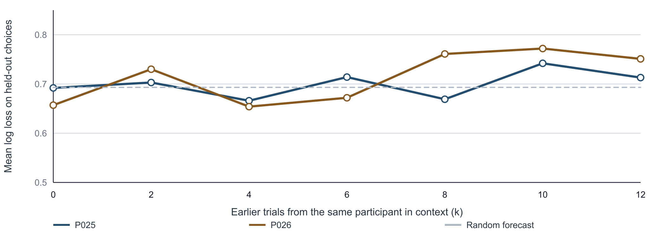
Prediction / in-context learning curve
33
Natural history can make in-context learning worse
As k grows, the natural histories become A-heavy; neither participant shows a stable improvement.
Foundations
Prediction
Representation
Explanation
Discovery
Same 20 future targets per participant / natural order of earlier trials
Notes:
Both curves evaluate the same twenty future choices for each participant. The x-axis changes only the number of earlier same-participant trials placed in context. The y-axis is mean log loss, so lower is better. The dashed reference is the random binary forecast, ln(2) = 0.693. Natural histories use the first k earlier trials and become increasingly A-heavy. [Sources] - notebooks/results/clean_icl_balance_demo/curve_by_participant.csv [/Sources]

Slide 34
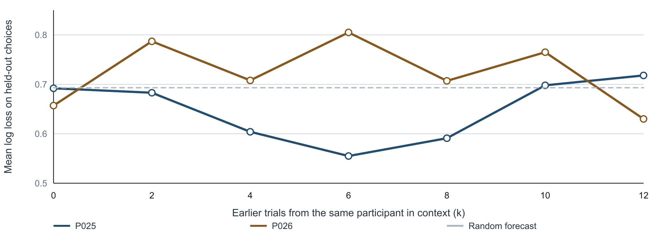
Prediction / in-context learning curve
34
Balanced histories remain participant-specific
Balancing removes the label confound, but the useful history length differs across participants.
Foundations
Prediction
Representation
Explanation
Discovery
Same targets and k values / equal A and B demonstrations at every non-zero k
Notes:
This slide keeps the model, targets, and k values matched to the previous slide but balances the history labels. P025 improves most at k=6; P026 is noisier and improves at k=12. The y-axis is mean log loss, so lower is better. The dashed reference is the random binary forecast, ln(2) = 0.693. The curves support a teaching claim about experimental control, not a stable population estimate. [Sources] - notebooks/results/clean_icl_balance_demo/curve_by_participant.csv [/Sources]

Slide 35
Prediction / in-context learning result
35
Balancing the history restores probability quality
Condition
Mean P(B)
Log loss
Current trial only
0.499
0.675
Unbalanced history / 6 A + 2 B
0.430
0.715
Balanced history / 4 A + 4 B
0.571
0.649
Observed B rate = 0.525 | Random log loss = 0.693
No clear personalization gain may mean weak individual regularity, or a model that cannot use it.
Foundations
Prediction
Representation
Explanation
Discovery
40 held-out choices / lower log loss is better
Notes:
Unbalanced history pushes mean P(B) below the observed target rate and yields log loss 0.715, worse than an uninformative binary forecast. Balanced history reduces log loss to 0.649, better than the current-trial baseline of 0.675. Accuracy does not improve in parallel, which is why this section evaluates token probabilities with log loss. The participant curves show that the average masks heterogeneous and non-monotonic responses to history. The remaining uncertainty is compatible with at least two explanations: the participant history may not contain a strong stable individual regularity, or the current model and prompt may be too weak to extract and use it. [Sources] - notebooks/results/clean_icl_balance_demo/summary.csv - notebooks/results/clean_icl_balance_demo/curve_by_participant.csv [/Sources]

Slide 36
Prediction / Step 3 of 3
Test whether training participants reveal task-level regularities
Update parameters on labeled risky choices, then test whether the learned mapping generalizes to held-out people.
Foundations
Prediction
Representation
Explanation
Discovery
Notes:
Prediction step 3: Test whether training participants reveal task-level regularities

Slide 37
Prediction / step 3/3
37
Fine-tuning targets task-level choice regularities
Step 1
Step 2
Step 3
Pretraining
Instruction tuning
Risky-choice fine-tuning
Learn broad statistical structure
Learn general task following
Learn a population mapping from options to choices
Its decision-science claim is task adaptation; personalization still requires within-person evidence.
Foundations
Prediction
Representation
Explanation
Discovery
Ouyang et al. (2022)
Notes:
Fine-tuning targets task-level choice regularities

Slide 38
Prediction / comparison
38
History and task training test different claims
Same-person evidence
Training-participant evidence
Predict later choices for the same person
Tests within-person adaptation
Sensitive to history order and identity
Easy to shuffle or ablate as a control
Learn from labeled choices across people
Tests task-level population regularities
Requires data, compute, and version control
Must protect held-out participants
The two methods are complementary: training adapts the task, while context can adapt to the person.
Foundations
Prediction
Representation
Explanation
Discovery
Notes:
History and task training test different claims

Slide 39
Prediction / comparison
39
Evaluate every method on the same held-out data
Zero-shot
Base parameters + target trial
Add personal history
Base parameters + P025 history + target trial
Fine-tune the model
Adapted parameters + target trial
Combine both
Adapted parameters + P025 history + target trial
One test split turns four techniques into a fair scientific comparison.
Foundations
Prediction
Representation
Explanation
Discovery
Notes:
Evaluate every method on the same held-out data

Slide 40
Prediction / decision
40
Choose the next lever from the failure pattern
Prompt-sensitive
Test robust prompts and constrained labels before training
History helps
Keep personal history and test shuffle, identity, and order controls
Stable repeated task
Test supervised fine-tuning or low-rank adaptation on training participants
Population + person matter
Combine fine-tuning with personal history in context
Method choice should follow an observed prediction failure, not a technology checklist.
Foundations
Prediction
Representation
Explanation
Discovery
Notes:
Choose the next lever from the failure pattern

Slide 41
Prediction checkpoint
41
A correct prediction can still have competing explanations
Current-trial prediction, participant history, and fine-tuning can agree on the same held-out choice.
Candidate driver
Decisive manipulation
Expected diagnostic change
Certainty cue
Remove certainty or change the worst outcome
Prediction should move
History correspondence
Shuffle choices across P025's trials or use another person
the history-based gain should shrink
Concave utility
Vary probability and payoff systematically
Choice curve should change
Prediction creates candidates; diagnostic manipulations separate them.
Foundations
Prediction
Representation
Explanation
Discovery
Notes:
This is the bridge from prediction to representation and mechanism. Every candidate driver implies a different manipulation.

Slide 42
Break / 10 minutes
Prediction complete. Next: what information supported the prediction?
Foundations
Prediction
Representation
Explanation
Discovery
Notes:
Ten-minute break.

Slide 43
Part 3
What information supports a decision?
Four questions guide the chapter: Is information present? How does it evolve? What does it mean? Does it predict behavior?
Foundations
Prediction
Representation
Explanation
Discovery
Notes:
Transition into section 3. Keep the focus on one question and one example at a time.

Slide 44
Representation / motivation
44
One choice, different internal states
Observed behavior
Possible state 1
Possible state 2
Chooses the risky option
Its expected value is higher.
The large payoff is worth the gamble.
Representation
Information carried by a system state that a later computation can use.
h(t) = f(question + reasoning up to t)
Next question: what observations could constrain these unobserved states?
Foundations
Prediction
Representation
Explanation
Discovery
Why move beyond prediction?
Notes:
Use the two routes to separate behavioral equivalence from representational equivalence. Define representation functionally: information in a state that downstream computation can use. This does not yet imply interpretation or causality. [Sources] - Local tutorial framework.

Slide 45
Representation / setup
45
What does one choice-and-reasoning record look like?
QUESTION PROMPT
THINK-ALOUD RESPONSE
Which option do you prefer?
"To make this decision, I'll calculate the expected value of each option."
Option A: 25% chance of $1,000; otherwise $0
Option B: $240 for sure
Option A: 0.25 x $1,000 = $250
Option B: 1.00 x $240 = $240
"Option A has a higher expected value than Option B."
PERSONA
Probability-Weighted Decision-Maker
ACTION CLAIM
"I will choose Option A."
For analysis, the final claim becomes "Option X" and the persona label is hidden.
Next question: how can this observable record constrain an unobserved representation?
Foundations
Prediction
Representation
Explanation
Discovery
One synthetic GPT-4 record from the tutorial dataset
Notes:
This is one record from the local synthetic dataset, lightly reformatted for readability. Choice 0 corresponds to Option A. Be explicit that these are synthetic GPT-4 data, not human observations. For representation analysis, the action claim is masked as Option X and the persona label is withheld. [Sources] - notebooks/results/representation/text2decision_multiscale_log_trajectories/sentence_decision_states.csv, trial_row 0.

Slide 46
Representation / measurement
46
Representation must be inferred from observations
Observe: We record choices, language, eye movements, physiology, or neural signals - not the representation itself.
Infer: A measurement model maps those observations to a candidate latent state.
A measurement model supplies the bridge from observations to a candidate latent state.
Foundations
Prediction
Representation
Explanation
Discovery
A three-step measurement argument
Notes:
Reveal the argument in order: observations are available, a measurement model supplies the inferential bridge, and the result remains model-dependent. The final build specializes the argument to language and Qwen. [Sources] - Local tutorial framework. - docs/qwen35_sentence_states.md.

Slide 47
Representation / measurement
47
Representation must be inferred from observations
Observe: We record choices, language, eye movements, physiology, or neural signals - not the representation itself.
Infer: A measurement model maps those observations to a candidate latent state.
Interpret cautiously: The inferred state depends on the model and its assumptions; it is not ground truth.
Why use Qwen here?
The observation is think-aloud language.
An open model provides contextual hidden states that we can inspect.
masked think-aloud → frozen Qwen → candidate state h(t)
Qwen provides a model-dependent measurement of information expressed in the text - not ground truth about GPT-4 or a human.
Foundations
Prediction
Representation
Explanation
Discovery
A three-step measurement argument
Notes:
Reveal the argument in order: observations are available, a measurement model supplies the inferential bridge, and the result remains model-dependent. The final build specializes the argument to language and Qwen. [Sources] - Local tutorial framework. - docs/qwen35_sentence_states.md.

Slide 48
Representation / measurement task
48
Use masked reasoning to recover choice and expose hidden states
MODEL INPUT
Direct choice readout
Instruction
Infer which option the reasoning supports.
output P(A), P(B)
Question
Frozen Qwen
evaluate held-out choice
with balanced accuracy
A: 25% of $1,000; otherwise $0
B: $240 for sure
one forward pass
Cumulative reasoning
Representation readout
A gives $250; B gives $240.
A has the higher value. I choose Option X.
save h(l, t)
probe choice information
and analyze geometry
Withheld: persona label and original A/B conclusion
Choice recovery tests whether information is present; hidden-state analysis asks where and how it is represented.
Foundations
Prediction
Representation
Explanation
Discovery
One input supports two behaviorally anchored readouts
Notes:
Make the relationship explicit. The same masked input supports two linked analyses. First, Qwen's output probabilities provide a direct A/B prediction that is evaluated on held-out questions. Second, the forward pass exposes layerwise hidden states h(l,t); a separate probe tests whether the original choice is linearly readable from those states. The next slide explains state extraction, the following slide defines the probe, and the result slide reports balanced accuracy. Neither readout establishes that Qwen shares GPT-4's or a human's latent mechanism. [Sources] - scripts/extract_qwen35_sentence_states.py. - notebooks/results/representation/text2decision_multiscale_log_trajectories/sentence_decision_states.csv, trial_row 0.

Slide 49
Representation / state extraction
49
Sample Qwen states at sentence boundaries
Tokens in the Qwen prompt
choice question
sentence 1
sentence 2
sentence 3
t1
t2
t3
At each sentence-ending token ts, save
33 states per boundary
h(l, ts) = Qwen layer l state at that token
layer 00: input embedding / initial residual
layers 01-32: successive block outputs
each state: 4,096 numbers
This is Qwen's contextual hidden state - not GPT-4's embedding and not an isolated sentence vector.
Foundations
Prediction
Representation
Explanation
Discovery
One causal forward pass over each question + masked reasoning trace
Notes:
Sentence 2 is not embedded by itself: its state includes the instruction, question, sentence 1, and sentence 2. Advance once to reveal the saved boundaries and layerwise state. [Sources] - docs/qwen35_sentence_states.md. - scripts/extract_qwen35_sentence_states.py.

Slide 50
Representation / choice probe
50
Can the hidden state recover the masked choice?
final sentence-end state h_l(T)
standardize +
logistic regression
predict A versus B
Training unit
one masked GPT-4 reasoning trace
Target
the original A/B choice
Generalization test
hold out entire risky-choice questions
Leakage controls
persona label and explicit conclusion withheld
Success would show linearly accessible choice information - not that the model uses a linear decision rule.
Foundations
Prediction
Representation
Explanation
Discovery
A held-out linear readout anchors the state to behavior
Notes:
Introduce one evidence gate at a time. The choice probe asks whether the masked choice is linearly decodable from Qwen's final state at each layer. Standardization and logistic regression are fitted inside the training split, and complete questions are held out. A successful probe establishes accessibility, not mechanism or causal use. [Sources] - scripts/analyze_layerwise_choice_decoding.py. - notebooks/results/representation/layerwise_choice_decoding/layerwise_probe_report.json.

Slide 51
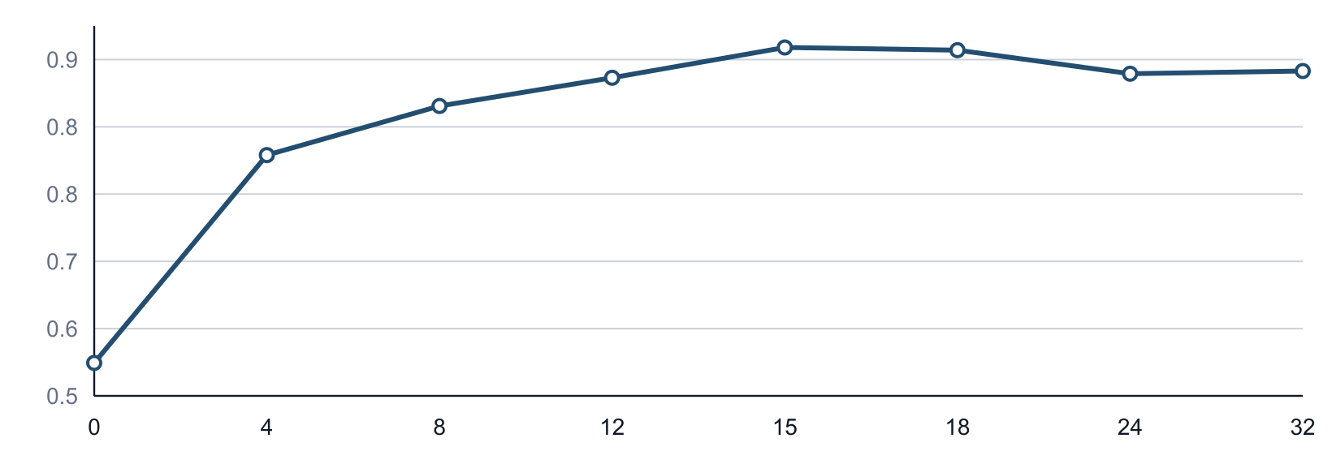
Representation / first test
51
Choice signal peaks near layer 15
Balanced accuracy on held-out risky-choice questions
Qwen output
0.934
balanced accuracy
Layer 15 readout
0.968
held-out questions
Layer 15 provides a behaviorally anchored state; now trace how that information forms across the answer.
Foundations
Prediction
Representation
Explanation
Discovery
Choice word masked / questions held out during evaluation
Notes:
This is the first evidence gate. The masked reasoning is informative about choice. Layer 15 is selected because its linear readout generalizes best to held-out questions; it is not a universal decision layer. [Sources] - notebooks/results/representation/qwen35_choice_recovery/qwen35_bf16_choice_eval_report.json. - notebooks/results/representation/layerwise_choice_decoding/layerwise_probe_report.json.

Slide 52
Representation / trajectory
52
Cumulative states show how information forms over time
t = 0
question only
h(0)
t = 1
question + sentence 1
h(1)
t = 2
question + sentences 1-2
h(2)
t = 3
question + sentences 1-3
h(3)
At h(2), the model has seen sentence 1 and sentence 2 - never sentence 3.
Next question: do different personas follow different paths through the same question?
Foundations
Prediction
Representation
Explanation
Discovery
One causal forward pass; states sampled at sentence boundaries
Notes:
Clarify cumulative rather than isolated sentence embeddings. Because the model is causal, each sentence-end state summarizes only the question and reasoning available so far. [Sources] - docs/qwen35_sentence_states.md.

Slide 53
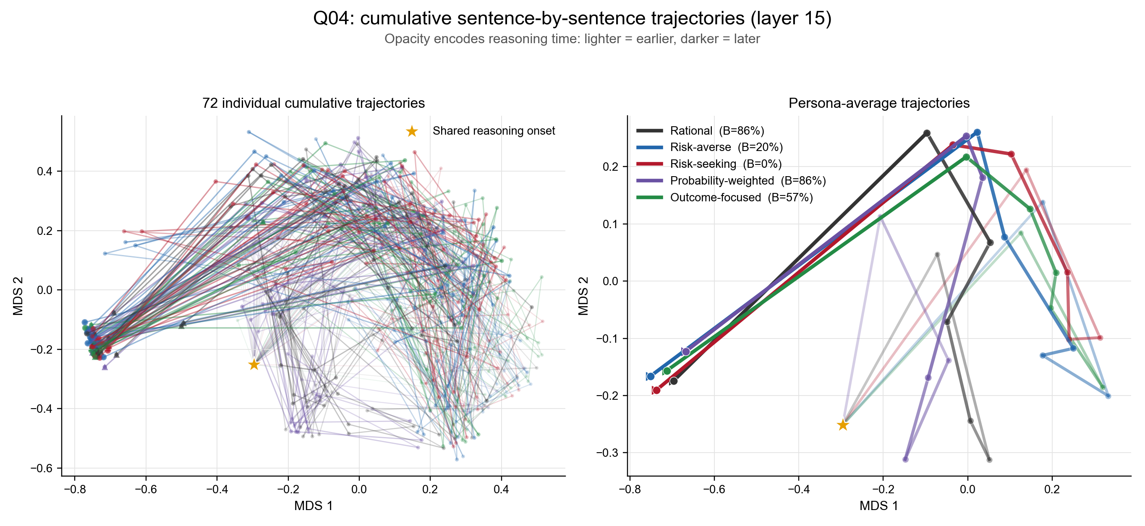
Representation / geometry
53
Persona trajectories diverge within the same problem
Foundations
Prediction
Representation
Explanation
Discovery
Q04 / Qwen layer 15 / 72 individual traces and persona averages
Notes:
This slide embeds the exact PNG generated by the analysis script rather than reconstructing the MDS paths as a PowerPoint scatter chart. The left panel shows all 72 cumulative trajectories; the right panel shows the five persona averages. The orange star is the identical question-only onset. MDS is descriptive rather than a cognitive coordinate system, so the next slide validates separation in the original high-dimensional space. [Sources] - notebooks/results/representation/sentence_trajectories_q04/Q04_sentence_trajectories.png. - notebooks/results/representation/sentence_trajectories_q04/Q04_trajectory_report.json.

Slide 54
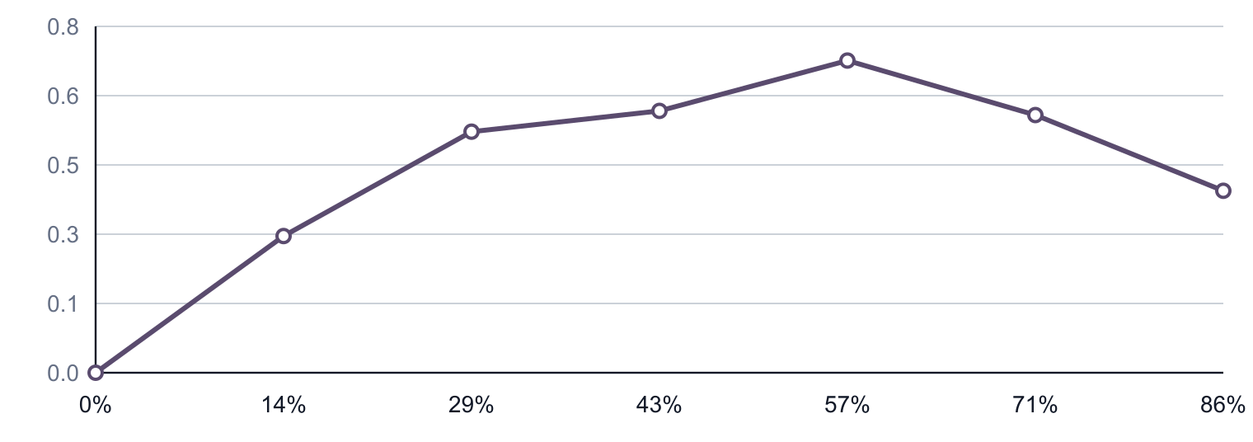
Representation / geometry to interpretation
54
Distance reveals divergence, not meaning
Mean pairwise distance between persona trajectories
Validated
Distance increases in the original 4,096D state space. The MDS pattern is not only a projection artifact.
Still missing
Distance does not label the paths as outcome-, probability-, value-, or uncertainty-related.
h_t in R^4096
g(h_t) in R^12
Text2Decision
Next: learn a task-defined coordinate system, then validate the map before interpreting trajectories.
Foundations
Prediction
Representation
Explanation
Discovery
Question 4 / layer 15 / original-state distance before semantic interpretation
Notes:
This slide now performs two jobs that belong together. First, validate the preceding MDS visualization in the original layer-15 state space. Second, state the unresolved interpretive problem: distance reveals separation but not decision semantics. This creates the need for Text2Decision without repeating the divergence claim on a separate slide. [Sources] - notebooks/results/representation/sentence_trajectories_q04/Q04_trajectory_report.json. - scripts/prepare_c13k_text2decision.py.

Slide 55
Representation / method
55
Train the map on known decision variables
TRAINING
Feed-forward network
Choice13K option text
Frozen Qwen state
layer 15 / 4096D
12 decision
variables
4096
512
128
64
12
Targets are computed from each lottery: five outcome summaries, five probabilities, expected value, and entropy.
TRANSFER AFTER TRAINING
GPT-4 masked reasoning prefix
Qwen layer-15 state h_t
Frozen Text2Decision
12D trajectory
Train on stimuli with known variables; apply the frozen map to reasoning states whose content is unknown.
Foundations
Prediction
Representation
Explanation
Discovery
Choice13K option descriptions → frozen Qwen layer 15 → feed-forward network → 12 targets
Notes:
The first build contains only the supervised training contract. Advance once to reveal the out-of-domain transfer to cumulative reasoning states. [Sources] - scripts/train_qwen_text2decision.py. - artifacts/text2decision/qwen35_layer15_text2decision_multiscale_log/training_report.json.

Slide 56
Representation / validation
56
Validate the readout before transferring it to reasoning
test R2 (%)
max gain
90.4
min gain
95.2
max loss
88.9
0.949
min loss
89.3
top-2 gains
88.0
mean test R2
P(max gain)
99.4
P(min gain)
98.9
P(max loss)
99.4
P(min loss)
99.3
11,656 test options
held out by problem ID
P(top-2)
99.4
expected value
91.6
entropy
99.4
Strong held-out performance validates the mapping task - not its out-of-domain interpretation of reasoning.
Foundations
Prediction
Representation
Explanation
Discovery
Choice13K test split grouped by problem ID / mean test R2 = 0.949
Notes:
Report performance on the held-out problem split, not the training set. Every target reaches test R2 above 0.879 and the mean is 0.949. This establishes that the readout performs its training task. It does not yet validate applying the map to GPT-4 reasoning states. [Sources] - artifacts/text2decision/qwen35_layer15_text2decision_multiscale_log/training_report.json.

Slide 57
Representation / interpretation
57
The map reveals partial persona signatures
persona | max gain | min gain | max loss | min loss | top-2 gains | P(max gain) | P(min gain) | P(max loss) | P(min loss) | P(top-2) | expected value | entropy
Outcome-focused | -0.02 | -0.02 | 0.05 | 0.08 | -0.02 | 0.00 | 0.01 | -0.06 | 0.04 | -0.00 | 0.04 | -0.09
Probability-weighted | -0.05 | -0.03 | -0.07 | -0.11 | -0.00 | 0.02 | -0.01 | 0.04 | -0.03 | 0.01 | -0.06 | -0.01
Rational | -0.06 | -0.04 | -0.02 | -0.05 | -0.02 | -0.00 | -0.01 | 0.07 | -0.01 | -0.01 | -0.03 | 0.00
Risk-averse | -0.03 | -0.05 | 0.02 | 0.07 | -0.02 | -0.03 | -0.03 | -0.03 | 0.03 | -0.03 | 0.01 | -0.02
Risk-seeking | 0.15 | 0.13 | 0.01 | 0.02 | 0.06 | 0.01 | 0.04 | -0.02 | -0.03 | 0.03 | 0.03 | 0.10
blue = lower than other personas
red = higher than other personas
Risk-seeking shows the clearest gain-oriented signature; other labels are only partly recovered.
Foundations
Prediction
Representation
Explanation
Discovery
Endpoint change relative to other personas on the same question
Notes:
Each cell is the persona's endpoint change after subtracting the question-by-progress mean, so comparisons are within the same decision problem and stage. Risk-seeking has strong positive changes in maximum gain, minimum gain, and entropy. Outcome-focused and risk-averse partly emphasize loss-related coordinates. Rational and probability-weighted do not cleanly reduce to their labels. Treat this as an exploratory semantic signature rather than a recovered mechanism. [Sources] - notebooks/results/representation/text2decision_multiscale_log_trajectories/persona_dimension_trends/persona_dimension_endpoint.csv. - notebooks/results/representation/text2decision_multiscale_log_trajectories/persona_dimension_trends/persona_dimension_report.json.

Slide 58
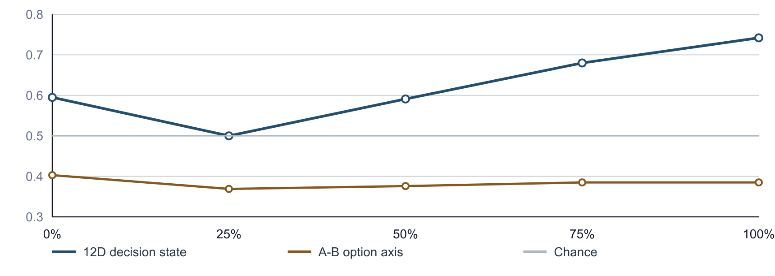
Representation / downstream test
58
Does the 12D interpretation retain behavioral information?
AUC
0.742
12D state at the
end of reasoning
The scalar A-to-B option axis remains near chance.
The interpretable projection retains cross-question choice signal; unlike the raw-state probe, this tests information preserved after mapping.
Foundations
Prediction
Representation
Explanation
Discovery
Held-out questions / explicit choice statement masked
Notes:
This is the external test for the interpreted representation. The 12-dimensional state contains cross-question choice information. The simple distance to isolated option anchors is weak, so do not interpret the trajectory as moving directly toward A or B. [Sources] - notebooks/results/representation/text2decision_multiscale_log_trajectories/choice_prediction_by_progress.csv. - notebooks/results/representation/text2decision_multiscale_log_trajectories/analysis_report.json.

Slide 59
HANDS-ON / NOTEBOOK 2
What you should now be able to do
OPEN
DO IN THE NOTEBOOK
notebooks/02_representation_from_
hidden_states_to_reasoning_trajectories.ipynb
1
Test whether choice information is decodable
START AT
2
Trace how states evolve through reasoning
Use Notebook 2 to reproduce the same four questions
3
Map state movement into decision variables
4
Validate the mapped state against behavior
STOP
Stop before calling a predictive representation a causal mechanism
Return to PPT: Next: turn representational hypotheses into discriminative explanations
Foundations
Prediction
Representation
Explanation
Discovery
Notes:
Switch from the slide deck to Notebook 2.
Resume the deck at: Next: turn representational hypotheses into discriminative explanations

Slide 60
Part 4
Turn verbal explanations into testable process evidence
Define an annotation codebook, validate it against held-out evidence, and only then decide whether it should constrain a model search.
Foundations
Prediction
Representation
Explanation
Discovery
Notes:
Transition into section 4. Keep the focus on one question and one example at a time.

Slide 61
Explanation / evidence
61
An explanation is another observation channel
What the text can provide
What it cannot provide
Attended attributes and comparisons
Candidate computations and conflicts
Hypotheses for new diagnostic trials
Direct access to a true latent state
Proof that the stated reason caused the choice
A substitute for held-out behavioral tests
Treat explanations as process data to be coded and tested, not as verdicts about mechanism.
Foundations
Prediction
Representation
Explanation
Discovery
Notes:
An explanation is another observation channel

Slide 62
Explanation / annotation
62
Annotate one reasoning trace sentence by sentence
1
I'll calculate the expected value of each option.
expected value · compute
2
A averages $250; B gives $240 for sure.
EV + certainty · compare
3
I would choose Option A.
explicit action claim · exclude
The unit, codebook, and leakage rule must be fixed before scaling annotation.
Foundations
Prediction
Representation
Explanation
Discovery
Synthetic GPT-4 trace; action claim masked
Notes:
Walk through one record. The final preference statement is excluded before downstream tests.

Slide 63
Explanation / annotation
63
A codebook separates information, operations, and roles
Information
Expected value, probability, downside, upside, certainty, and risk
Operation
Describe, compute, compare, threshold, or consider a counterfactual
Role
Supports A, supports B, neither, or an explicit preference claim
A restricted codebook makes human and language-model annotations comparable and auditable.
Foundations
Prediction
Representation
Explanation
Discovery
Notes:
A codebook separates information, operations, and roles

Slide 64
Explanation / validation
64
Can preference-free annotations identify the synthetic persona?
1 INPUT + LEAKAGE CONTROL
2 BUILD ONE 7D PROFILE PER TRIAL
3 PREDICT PERSONA ON NEW QUESTIONS
1,368 synthetic reasoning trials
5 prompted personas; 19 questions
Keep only text before the first explicit
A/B preference claim.
Mark whether each retained sentence
mentions:
EV, probability, weighting, downside,
upside, certainty, or risk.
Average the 7 indicators across sentences.
Standardize features + logistic regression
5-fold cross-validation grouped by question
All versions of a question remain in one
fold.
Balanced accuracy = mean recall across the five persona classes
0.519
0.200
Target: prompted persona - not behavioral choice
cross-validated
chance = 1 / 5
The annotation profile carries persona information across held-out questions; this is not choice accuracy or evidence of a human mechanism.
Foundations
Prediction
Representation
Explanation
Discovery
Notebook 3 · 1,368 trials · 5 personas · 19 question groups · grouped cross-validation
Notes:
Method: remove explicit A/B preference claims, average seven transparent lexical annotation indicators within each trial, and predict the five prompted personas with standardized logistic regression. Evaluation uses five-fold grouped cross-validation with question_id as the group. Balanced accuracy is the macro-average recall across persona classes. The 0.519 score is persona classification, not choice prediction.

Slide 65
Representation → Explanation
65
Continuous states and annotations test each other
Hidden-state readout
Text annotation
Continuous trajectory in a learned 12D space
Sensitive to information not explicitly verbalized
Interpretation depends on the trained readout
Discrete claims about attended variables and operations
Auditable against the original sentence
Incomplete and vulnerable to rationalization
Convergence strengthens a hypothesis; disagreement identifies the next control.
Foundations
Prediction
Representation
Explanation
Discovery
Notes:
Continuous states and annotations test each other

Slide 66
Explanation / optional bridge
66
Annotations can nominate computational ingredients
Observed annotations
Approved specification
expected value
downside / minimum outcome
certainty threshold
{
"rule": "downside_threshold_then_EV",
"features": ["worst_diff", "ev_diff"],
"parameters": ["threshold", "sensitivity"]
}
This optional constraint did not win: balanced accuracy 0.555 versus 0.609 for EV-only.
Foundations
Prediction
Representation
Explanation
Discovery
Restricted candidate specification
Notes:
This slide shows one optional bridge from validated annotation to a bounded model specification. Discovery can instead begin from behavior or prior theory. In the offline result, the annotation-guided option model did not outperform EV-only.

Slide 67
Explanation / evaluation
67
Annotations predict choice; simple fusion does not help
Input to the readout
Balanced accuracy
Log loss
Option features only
0.529
0.738
Preference-free annotation profile
0.619
0.673
Options + annotation
0.587
0.720
The text contains behavioral information; concatenating two channels is not automatically better.
Foundations
Prediction
Representation
Explanation
Discovery
Notebook 3 transparent lexical baseline; API annotation not used
Notes:
All three readouts hold out entire questions. Explicit preference claims were removed before annotation. This is predictive evidence, not causal recovery.

Slide 68
Break / 10 minutes
Explanation complete. Next: search for executable models and design tests that distinguish them.
Foundations
Prediction
Representation
Explanation
Discovery
Notes:
Ten-minute break.

Slide 69
Part 5
Search for executable models
Generate candidate processes, fit them to behavior, and design diagnostic trials that separate the surviving accounts.
Foundations
Prediction
Representation
Explanation
Discovery
Notes:
Transition into section 5. Keep the focus on one question and one example at a time.

Slide 70
Model discovery / boundary
70
Model discovery is a separate search problem
Explanation / annotation
Model discovery
Question
What information or operation appears in a report?
Question
Which executable account survives new evidence?
Output
Validated observation variables
Can start from
Behavior · theory · process data · intervention
Evidence + candidate space
Propose executable models
Fit and evaluate
Design diagnostic tests
Annotation can constrain discovery, but discovery neither requires annotation nor inherits its validity.
Foundations
Prediction
Representation
Explanation
Discovery
Annotation is one optional input
Notes:
Draw the boundary explicitly. Annotation converts reports into testable variables. Model discovery searches over executable accounts and may begin from behavior, theory, process data, or interventions. Notebook 3 demonstrates an annotation-guided route, not a required pipeline.

Slide 71
Model discovery / experimental setup
71
Freeze evidence roles before asking the model to search
TRAIN
VALIDATION
TEST
Q01-Q11 · 11 trials
Q12-Q15 · 4 trials
Q16-Q19 · 4 trials
Evidence exposed
Evidence exposed
Evidence exposed
Behavior + preference-free think-aloud
Predictions and errors
Hidden during proposal and revision
Scientific role
Scientific role
Scientific role
DeepSeek proposes candidate structures; Python fits parameters
Rank candidates and guide two revisions
Open once after selecting the candidate
The split is part of the claim: validation may steer search; test evidence may not.
Foundations
Prediction
Representation
Explanation
Discovery
Notebook 3 · synthetic participant 69576 · 19 risky-choice problems
Notes:
This teaching-scale example mirrors the participant-level logic of the CCN study while reducing the search to one participant and two validation-guided revisions. The explicit choice conclusion is removed from think-aloud before it enters the proposal prompt. Four validation and four test trials are too small for a substantive scientific conclusion. [Sources] - https://arxiv.org/abs/2605.05091 [/Sources]

Slide 72
Model discovery / minimal loop
72
DeepSeek proposes; trusted Python controls the search
1 · PROPOSE
2 · SEARCH
3 · REVISE + TEST
DeepSeek V4 Pro
Python evaluator
Two feedback rounds
Reads training choices and masked think-aloud; returns four JSON model specifications.
Checks allowed variables, fits coefficients on training behavior, and ranks candidates by validation log loss.
DeepSeek sees validation errors twice. Python stops at the plateau, selects one candidate, refits, then opens test once.
Allowed candidate
{ "features": ["ev_diff", "p_zero_diff"] }
No arbitrary code execution
The language model searches a bounded hypothesis language; it does not score itself.
Foundations
Prediction
Representation
Explanation
Discovery
Three DeepSeek V4 Pro calls / restricted seven-variable model language
Notes:
This is the minimal executable loop implemented in Notebook 3 and scripts/minimal_discovery_loop.py. DeepSeek proposes feature sets and process hypotheses in JSON. Trusted code performs validation, fitting, selection, and testing. [Sources] - https://api-docs.deepseek.com/api/create-chat-completion - https://arxiv.org/abs/2605.05091 [/Sources]

Slide 73
Model discovery / comparison contract
73
Each baseline rules out a different easy explanation
BASELINE
QUESTION IT ANSWERS
Random probability
Can the workflow beat an uninformative 50/50 forecast?
Training choice rate
Does it beat a constant forecast based only on A/B prevalence?
Expected value
Does the discovered structure improve on a canonical decision rule?
Best single feature
Does combining variables add value beyond one selected cue?
All approved features
How much prediction is lost by restricting the candidate language?
A candidate is informative only if we know which simpler explanation it beats.
Foundations
Prediction
Representation
Explanation
Discovery
Fix comparison models before opening the test set
Notes:
These baselines are evaluated by trusted Python on the same frozen test trials. The all-feature model is an upper-capacity comparison, not a cognitive theory; with only four test trials its estimate is highly unstable. [Sources] - notebooks/results/minimal_discovery_loop/test_results.csv [/Sources]

Slide 74
Model discovery / result
74
More search rounds plateau before the test is opened
Best validation log loss
Frozen test comparison
0.663 -> 0.663 -> 0.663
Model
Log loss
Bal. acc.
ev_diff + p_zero_diff
All-feature baseline
0.248
1.000
Expected-value baseline
0.453
0.750
Initial proposal
Revision 1
Revision 2
DeepSeek-selected
0.534
0.500
Stop: no validation improvement
Best single feature
0.607
0.750
Random probability
0.693
0.500
More iterations did not improve validation, and the selected candidate still lost to expected value on test.
Foundations
Prediction
Representation
Explanation
Discovery
Cached DeepSeek V4 Pro run / four validation trials / four test trials
Notes:
The initial proposal and both validation-guided revisions selected the same two-feature structure with validation log loss 0.663. The test set remained closed until selection. On four test questions the selected candidate underperformed the expected-value and all-feature baselines. The all-feature baseline has eight fitted parameters and only four test trials, so its perfect balanced accuracy is descriptive, not a stable estimate. [Sources] - notebooks/results/minimal_discovery_loop/minimal_discovery_run.json - notebooks/results/minimal_discovery_loop/validation_results.csv - notebooks/results/minimal_discovery_loop/test_results.csv [/Sources]

Slide 75
Model discovery / active test
75
A diagnostic trial separates the surviving candidates
A / $35 for sure
B / 90% chance of $50; otherwise $0
Expected value
Choose B
EV(A) = $35; EV(B) = $45
Safety-first
Choose A
Minimum(A) = $35; Minimum(B) = $0
Threshold then EV
Depends on threshold
Vary the downside while holding EV fixed
Choose trials where candidate predictions diverge, then update both behavioral and process evidence.
Foundations
Prediction
Representation
Explanation
Discovery
Toy active-design example
Notes:
The hybrid is only one candidate. The scientific value comes from choosing a trial on which surviving executable accounts disagree.

Slide 76
Model discovery / limit
76
A good fit is still not mechanism recovery
Observed task region
New diagnostic region
Ground-truth and surrogate
make nearly identical predictions
The same models diverge
under a targeted manipulation
No discovery entry point guarantees mechanism recovery; intervention and transfer are still needed for a causal claim.
Foundations
Prediction
Representation
Explanation
Discovery
Conceptual illustration
Notes:
Keep the surrogate lesson, but express it with two task regions rather than a decorative hand-drawn curve.

Slide 77
Model discovery / claims
77
Define the level of success before running discovery
Predictive success
Held-out likelihood improves
Process consistency
Model operations agree with independent process evidence
Primitive recovery
The generating computational components are recovered
Mechanistic recovery
The process survives intervention and transfer
A system can succeed at one level and fail at every stronger level.
Foundations
Prediction
Representation
Explanation
Discovery
Notes:
Define the level of success before running discovery

Slide 78
Final synthesis
78
Return to the original choice with stronger questions
Prediction
Which option will P025 choose?
Representation
What information improves the prediction?
Explanation
Which counterfactuals follow from that information?
Discovery
Which executable process survives diagnostic trials?
The technical ladder comes first; stronger scientific claims require stronger evidence.
Notes:
Return explicitly to the opening vote and show how each later question was motivated.

Slide 79
Take-home messages
79
Four ideas to take back to your research
1
Define prediction by its observation set, output labels, and held-out split.
2
Improve prediction in a controlled order: current trial, participant history, then fine-tuning.
3
Use representations and explanations only when they support external tests.
4
Use model discovery to separate mechanisms, not to bypass identifiability.
Notes:
End with four practical rules that map directly onto the tutorial sequence.

Slide 80
What additional evidence would convince you
that a language model had discovered a real human
decision mechanism?
Discussion / Questions / Applications
Notes:
Use the final minutes for discussion and application to participants' own tasks.

Slide 81
Appendix
81
Selected references
Vaswani et al. (2017). Attention Is All You Need. arXiv:1706.03762
Brown et al. (2020). Language Models are Few-Shot Learners. arXiv:2005.14165
Ouyang et al. (2022). Training language models to follow instructions with human feedback. arXiv:2203.02155
Aher, Arriaga, & Kalai (2023). Using LLMs to Simulate Multiple Humans. arXiv:2208.10264
Argyle et al. (2023). Out of One, Many. Political Analysis, 31(3), 337-351
Binz & Schulz (2023). Using cognitive psychology to understand GPT-3. PNAS, 120(6)
Li et al. (2024). Automated Statistical Model Discovery with Language Models. PMLR 235
Xie, Xiong, & Wilson (2023). Text2Decision. NeurIPS 2023 AI for Science Workshop
Notes:
Selected references

