Slide 1

WELCOME
history
National Rural Employment Guarantee Act (NREGA)
follow
services
teams
timeline
about
BY THOMAS MOSES

Slide 2
PROBLEM STATEMENT
NREGA is a vital initiative to alleviate rural unemployment and poverty. This project seeks to address several key questions and challenges associated with NREGA:
How effective is NREGA in providing employment opportunities to rural households?
Are there regional disparities in the implementation and outcomes of the scheme?
What is the utilization of the allocated budget, and how does it correlate with employment generation?
What are the key factors contributing to the completion of NREGA works, and are there any roadblocks to its success?
Can data-driven insights guide policymakers and administrators in optimizing the scheme's impact?
history
about
follow
teams
services
timeline

Slide 3
DATASET INFORMATION
Dataset Information: The dataset used for this analysis is sourced from official government records and contains information related to NREGA implementation across various states and districts in India. It comprises 28 columns, encompassing data on job cards, worker details, budget allocation, work completion statistics, expenditure, and more. This dataset offers a comprehensive view of the progress and challenges faced by the NREGA program.
history
about
follow
teams
services
timeline

Slide 4
How effective is NREGA in providing employment opportunities to rural households?
The top 5 states based on different metrics of employment generation are:
Average person-days of employment per household:
Mizoram (39.21 days)
Odisha (38.77 days)
Chhattisgarh (37.11 days)
MADHYA PRADESH (36.41 days)
Jharkhand (35.91 days)
history
Insight
follow
teams
services
timeline
Percentage of households completing 100 days of employment:
Mizoram (0.00%)
Puducherry (0.02%)
Chandigarh (0.03%)
Dadra & Nagar Haveli (0.06%)
Daman & Diu (0.08%)

Slide 5
How effective is NREGA in providing employment opportunities to rural households?
Average number of days of employment per active job card:
Mizoram (39.13 days)
Sikkim (38.42 days)
Odisha (19.92 days)
Tripura (19.85 days)
Chhattisgarh (19.38 days)
history
Insight
follow
teams
services
timeline
Percentage of active job cards utilized:
Mizoram (99.80%)
Dadra & Nagar Haveli (99.54%)
Puducherry (98.96%)
Chandigarh (98.89%)
Sikkim (98.66%)

Slide 6
Overall Effectiveness
While NREGA has been successful in providing some employment opportunities, as indicated by the average person-days of employment per household and the utilization of active job cards, there is significant room for improvement.
The very low percentage of households completing 100 days of employment suggests that the program is not fully meeting its objective of guaranteeing 100 days of employment to rural households.
history
Insight
follow
timeline

Slide 7
Observation Regional disparities exist in NREGA implementation, with the Southern region leading in expenditure and average employment duration, while the Western region excels in the percentage of households completing 100 days of employment.
Are there regional disparities in the implementation and outcomes of the scheme?
follow
history
Insight
about

Slide 8
What is the utilization of the allocated budget, and how does it correlate with employment generation?
The analysis reveals that there is no clear correlation between budget utilization rate and the number of person-days generated per lakh of rupees spent. At the national level, the budget utilization rate is 24.76%, and 30.25 million person-days are generated per lakh of rupees spent.
However, there is a wide variation in budget utilization rates across states, ranging from 0.01% to values exceeding 100% due to the inclusion of expenditures from the previous fiscal year. The top 5 states with the highest budget utilization rates are all above 100%, while the bottom 5 states have utilization rates of 0.16% or lower.
history
Insight
follow
teams
services
timeline

Slide 9
Key Factors Contributing to the Completion of NREGA works
Based on the correlation analysis, the key factors contributing to the completion of NREGA works are:
Total No. of Works Takenup (New+Spill Over): This has the strongest positive correlation (0.69) with the number of completed works, indicating that initiating more works is crucial for completing them.
Total Households Worked (0.47) and Total Individuals Worked (0.46): These have moderate positive correlations, suggesting that higher participation of households and individuals leads to more completed works.
Total No. of Active Job Cards (0.41) and Total No. of Active Workers (0.37): These also show moderate positive correlations, implying that a larger active workforce contributes to work completion.
Total Exp(Rs. in Lakhs.) (0.49) and Number of Ongoing Works (0.48): These have moderate positive correlations, indicating that increased expenditure and ongoing works are associated with more completed projects.
history
Insight
follow
teams
services
timeline

Slide 10
Data-driven insights guide policymakers and administrators in optimizing the scheme's impact?
Data-driven insights can indeed guide policymakers and administrators in optimizing the NREGA scheme's impact. The analysis reveals several key findings:
Expenditure and Outcomes: There's a strong positive correlation between total expenditure and both the number of completed works (0.49) and person-days generated (0.97). This suggests that increasing the overall budget allocation can significantly improve the scheme's outcomes. Additionally, wages have the highest correlation with person-days generated (0.99), indicating that a larger share of the budget allocated towards wages can directly boost employment.
Natural Resource Management (NRM) Expenditure: While the correlation between NRM expenditure and the number of completed works is weak (0.07), there's a moderate positive correlation with person-days generated (0.39). This implies that NRM activities might not necessarily lead to more completed projects but can contribute to increased employment duration.
Category B Works: The percentage of Category B works shows a moderate positive correlation with the number of completed works (0.48) but a weak correlation with person-days generated (0.12). This suggests that focusing on individual beneficiary schemes might lead to more completed projects but may not significantly impact overall employment generation.
Agricultural Expenditure: There's a negligible correlation between expenditure on agriculture and allied activities and both the number of completed works (0.02) and person-days generated (-0.12). This indicates that allocating more funds to agriculture might not directly translate to improved NREGA outcomes.
history
Insight
follow
teams
services
timeline

Slide 11
CONCLUSION AND RECOMMENDATIOS
Increase Budget Allocation: Policymakers should consider increasing the overall budget allocation for NREGA, with a particular focus on wages, to enhance employment generation and project completion.
Prioritize NRM Activities: While NRM activities might not directly lead to more completed projects, they can contribute to sustained employment. Therefore, policymakers should continue to support and promote NRM activities under NREGA.
Balance Category B Works: While focusing on individual beneficiary schemes can lead to project completion, policymakers should ensure a balanced approach that also prioritizes projects with higher employment generation potential.
Re-evaluate Agricultural Expenditure: Given the weak correlation between agricultural expenditure and NREGA outcomes, policymakers should re-evaluate the effectiveness of such spending and explore alternative avenues for promoting agricultural development and employment.
history
Insight
follow
teams
services
timeline

Slide 12
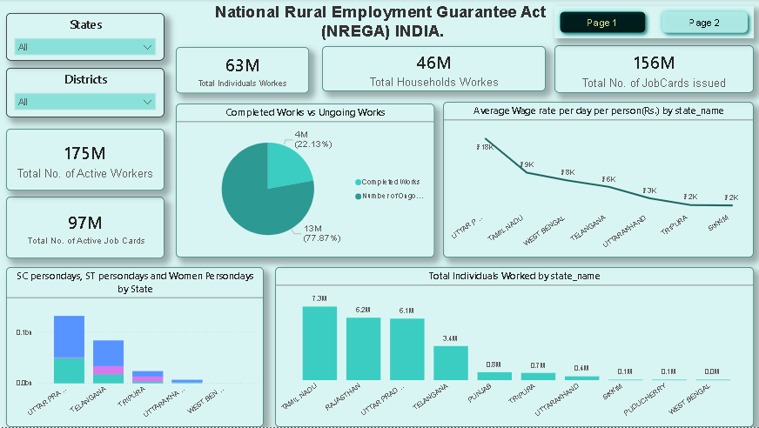
Chart
history
services
timeline
about

Slide 13
THANKS
Subscribe, Like and share.
Thanks
history
services
timeline
about

