Slide 1
Predicting Chemotherapy Resistance from Proteomics using Attention mechanism
Integrative Data Analysis
Institute of Computer Science
WiSe 24/25
Xhemal Kodragjini
February 2025

Slide 2
Table of Contents
Background
Data
Methodology
Results
Conclusion and Future Work
01
02
03
04
05

Slide 3
Background
PROBLEM
APPROACH
Some cancer types resistant to standard chemotherapy
Analyse protein expression in cells and biological pathways to detect resistance
?
How can it be early detected?
Can AI techniques help predict resistance?

Slide 4
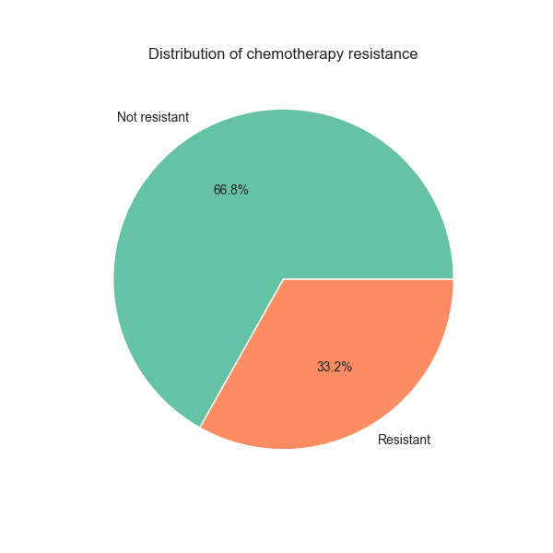
Data
3 datasets: chemotherapy resistance, proteomics, and proteomics pathways
1889 cancer cell lines
9 unique pathways
23 unique proteins

Slide 5
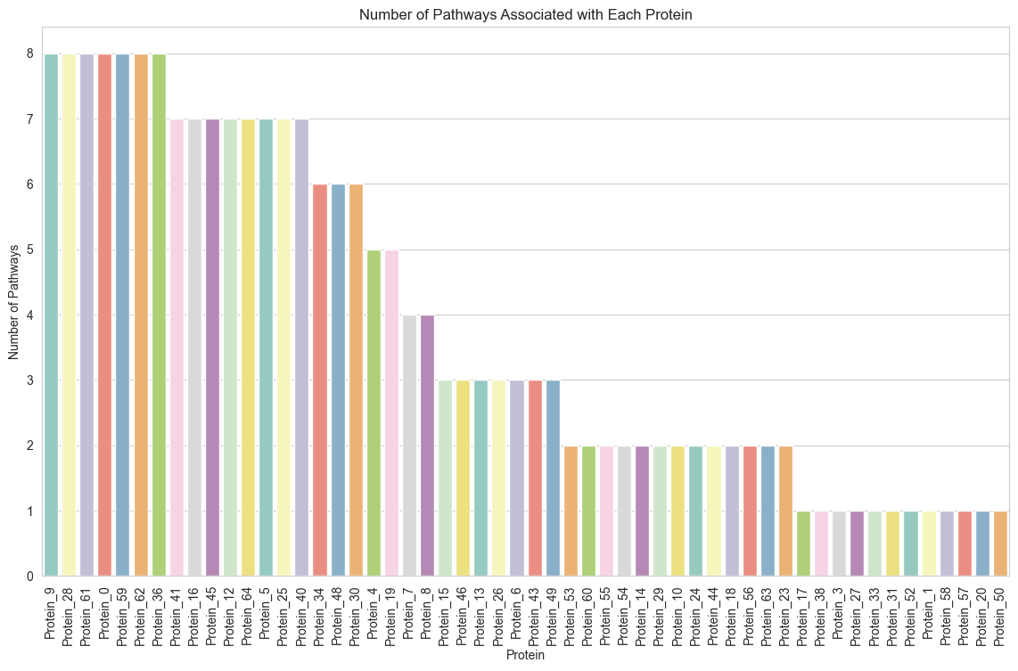
Data

Slide 6
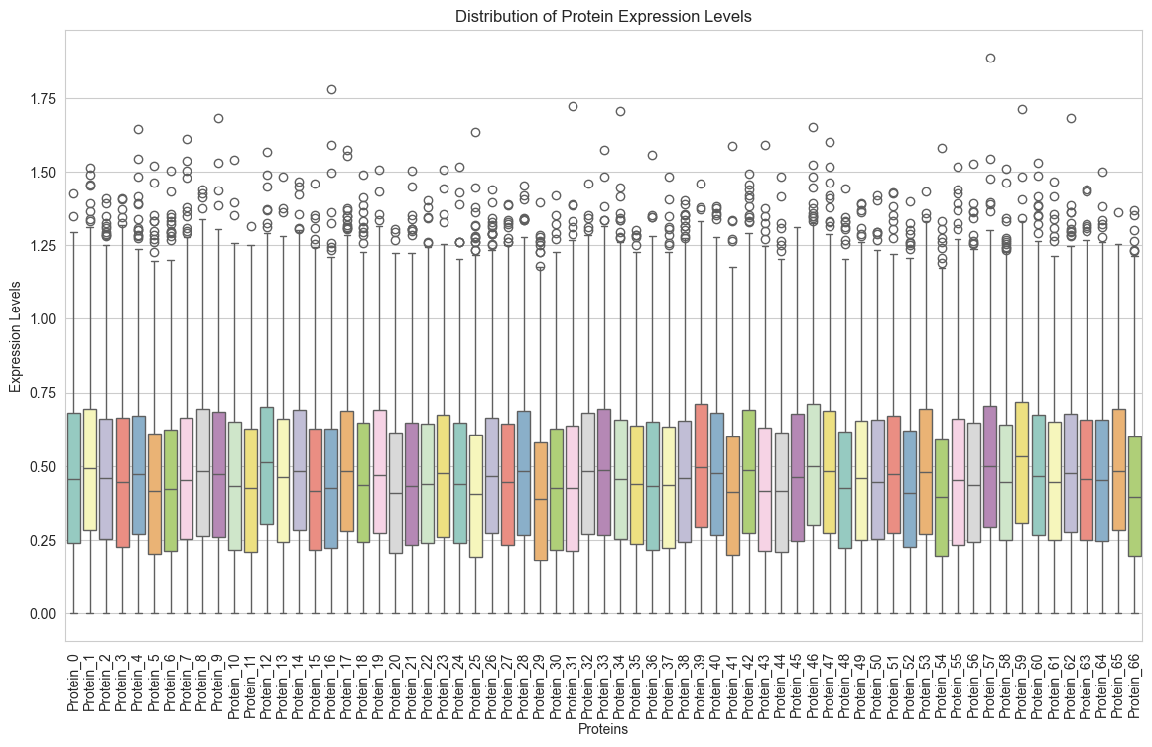
Data

Slide 7
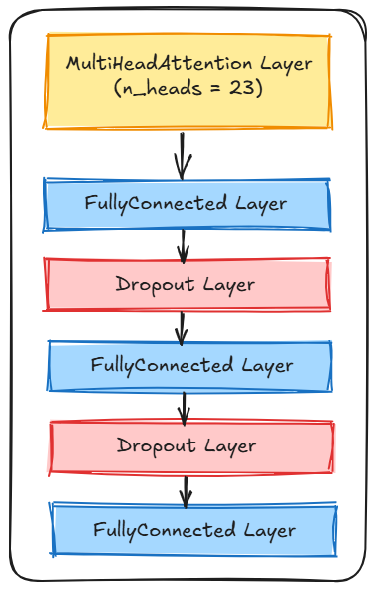
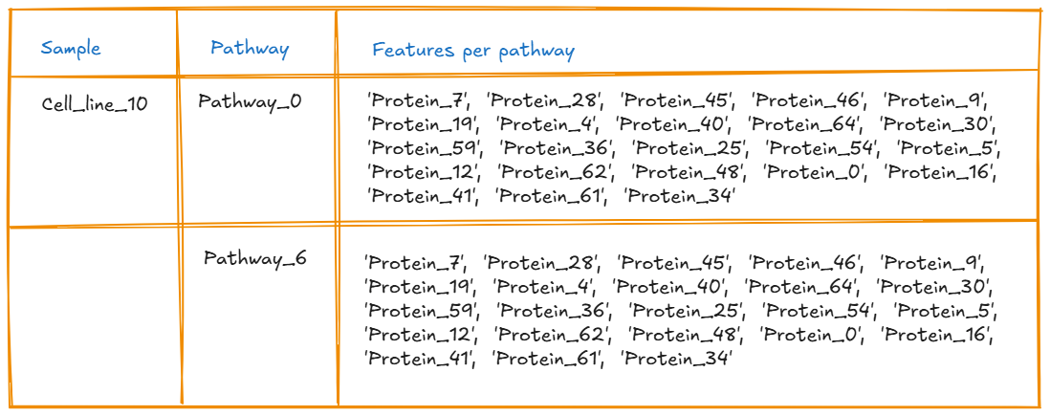
Methodology
Multi-Head Attention Network
Architecture Input data

Slide 8
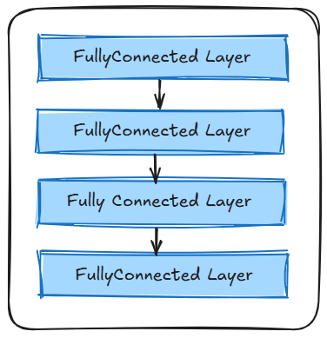
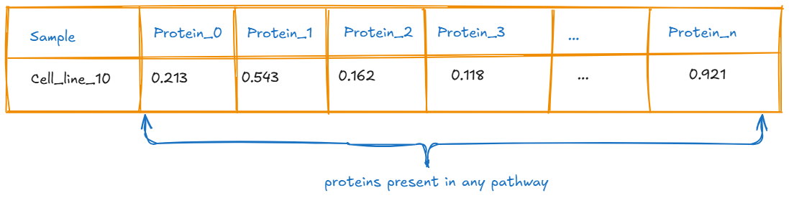
Methodology
Comparison with baseline model – Standard neural network
Architecture Input data

Slide 9
Results
Imbalanced data requires careful selection of metrics
Selected Metrics:
F1-Score (precision and recall both important)
Matthews Correlation Coefficient (considers true negatives)
 | F1-Score | MCC
MultiHeadAttention Network | 0.38 | 0.15
Standard Neural Network | 0.35 | 0.12

Slide 10
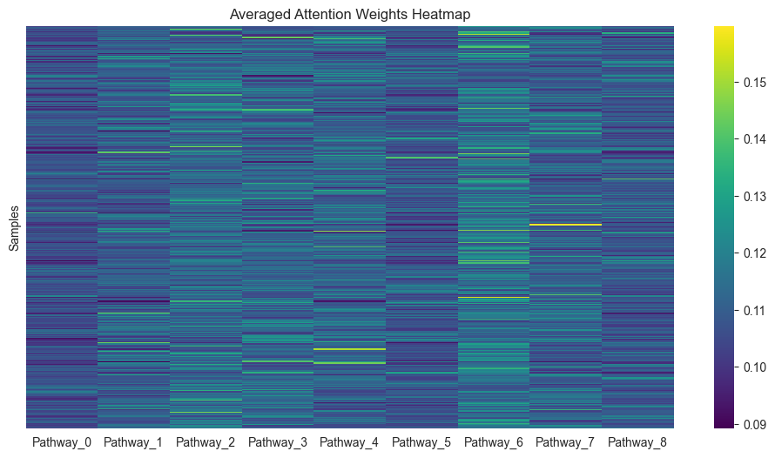
Results

Slide 11
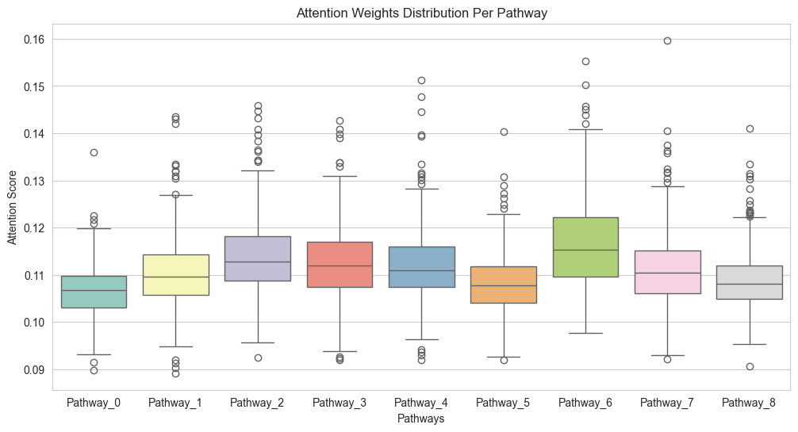
Results

Slide 12
Conclusion
Very low performance due to small and noisy dataset.
Attention-based model performs slightly better than baseline.
Model not capable of deriving chemotherapy resistance from protein expressions.

Slide 13
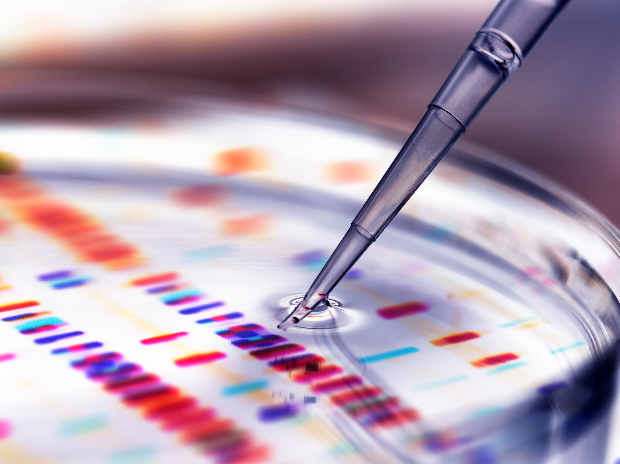
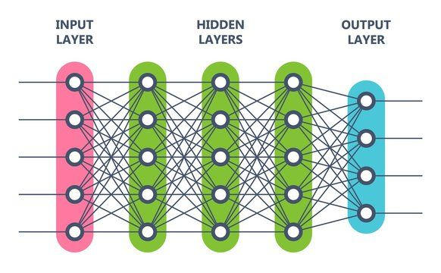
Future Work
DATA
Larger dataset
Balancing the dataset labels
Identifying confounding factors
MODEL
Hyperparameter tuning
Increase model complexity
Layer normalization
Additional layers

Slide 14
References
Sample Reference

Slide 15
Declaration of originality
I hereby declare that I prepared and performed the work that I submitted (code and slides) on my own and only using the sources as indicated. I take full responsibility for any plagiarism and errors that were introduced using AI tools.
Feb 27, 2025 Xhemal Kodragjini

