Slide 1

Intracranial hemorrhage segmentation in axial CT slices
Dokoupilová, Heřmánková, Vargová

Slide 2
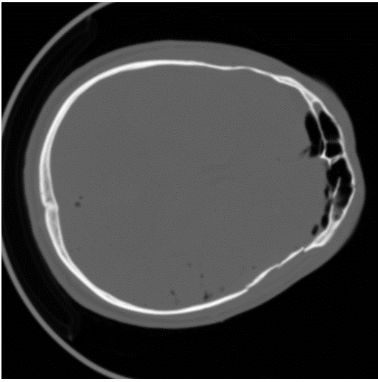
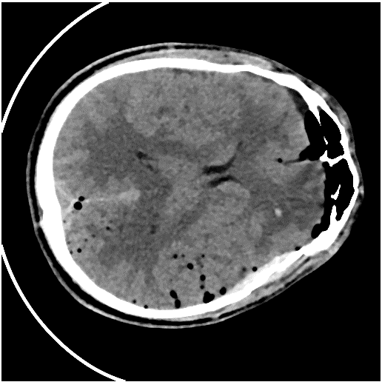
Introduction
CT scan
Windowing

Slide 3
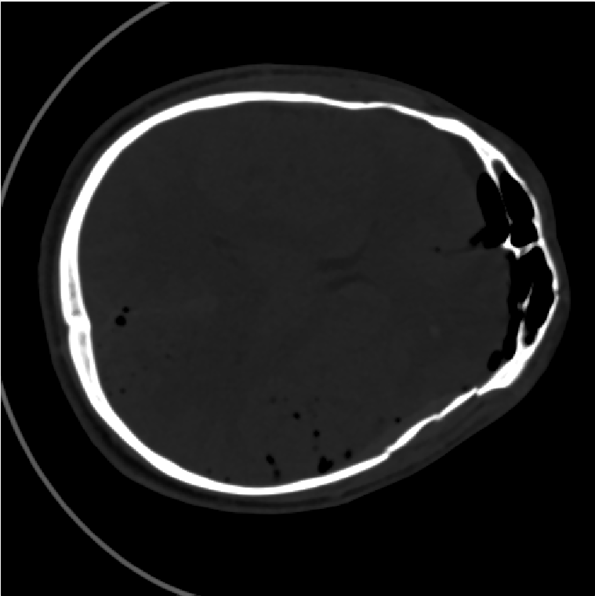
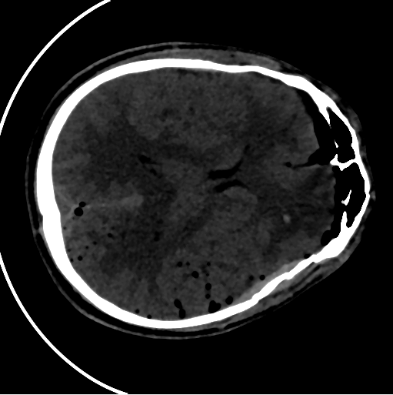
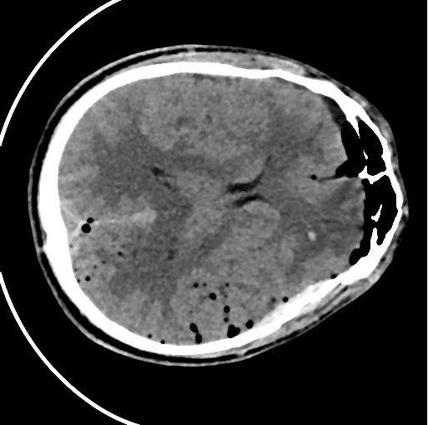
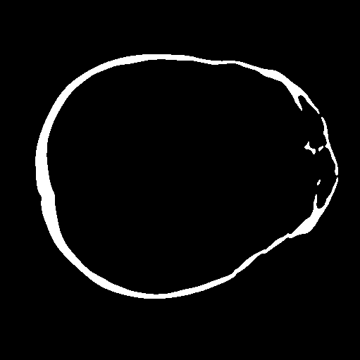

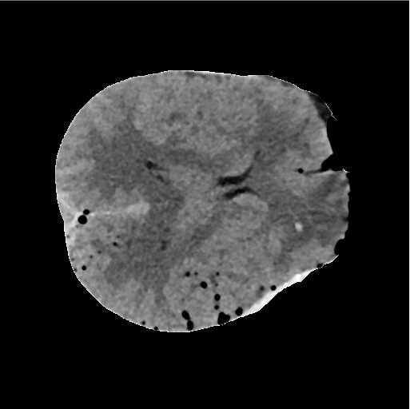
Skull removal
Hemorrhage enhancement
Bone enhancement
Mask refinement
‘Snakes’
Skull and outer environment removal

Slide 4
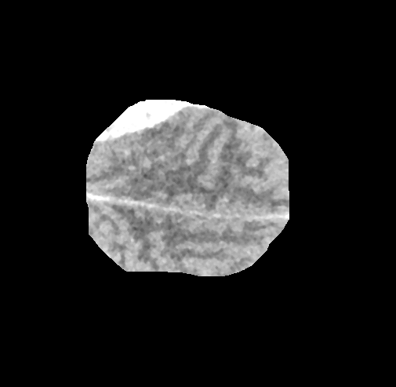
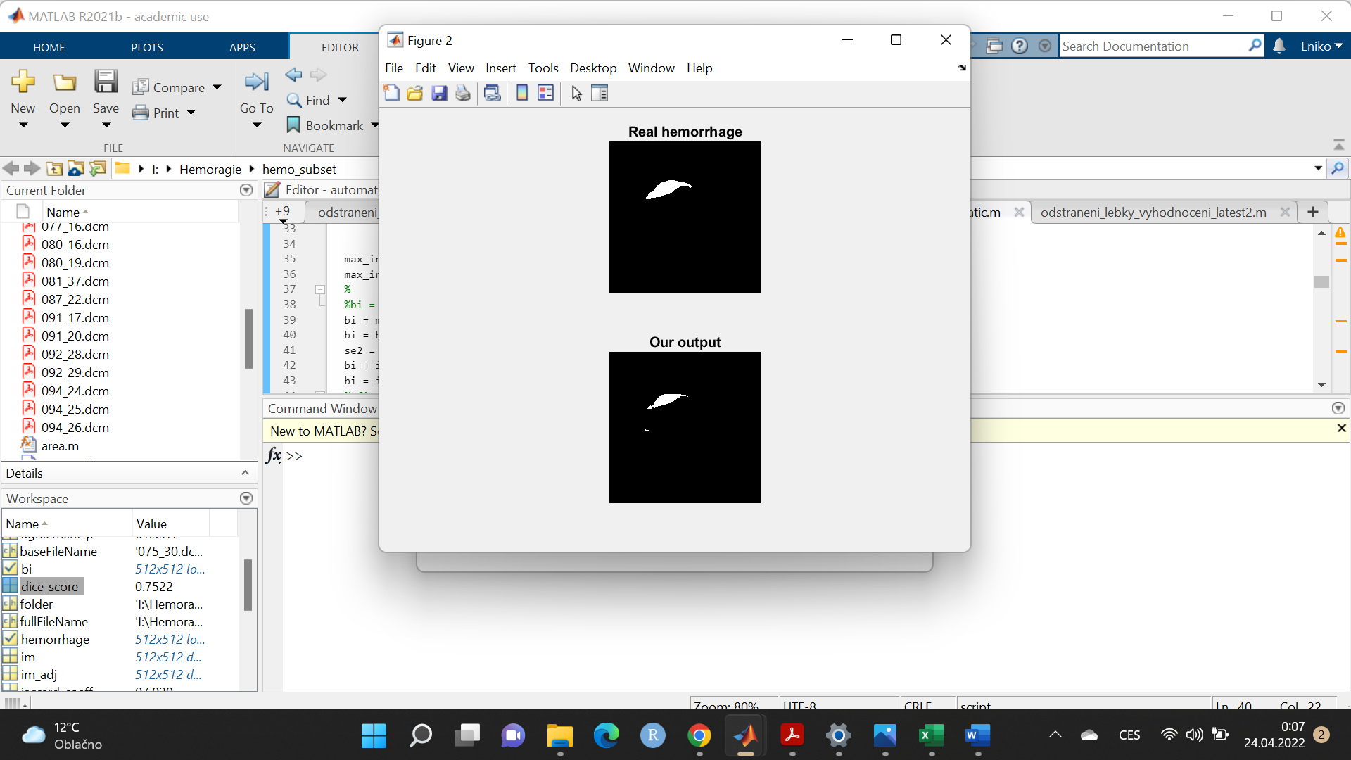
Automatic detection
Original mask
Our output
Notes:
Dice coefficient = 0.7785
Jaccard index = 0.6374

Slide 5
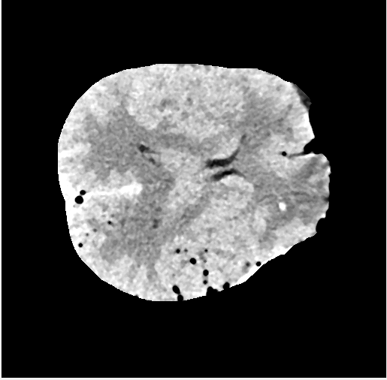
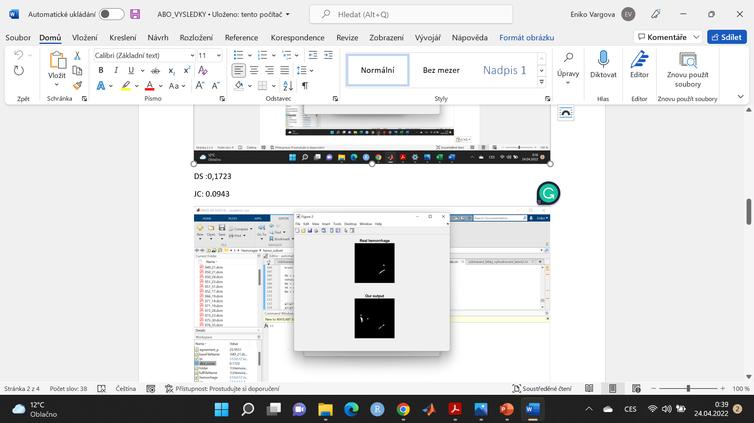
Automatic detection
Original mask
Our output
Mean Dice coefficient = 0.4725
Mean Jaccard index = 0.3387
Notes:
Dice coefficient = 0.1723
Jaccard index = 0.0943

Slide 6
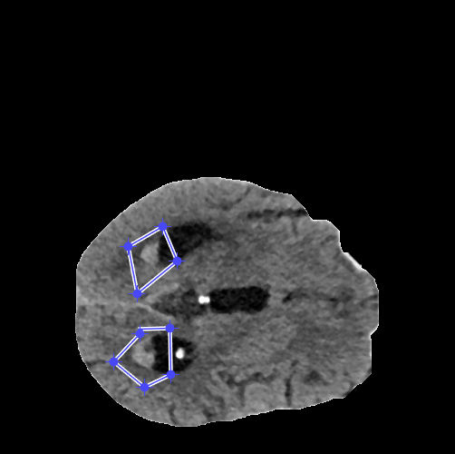
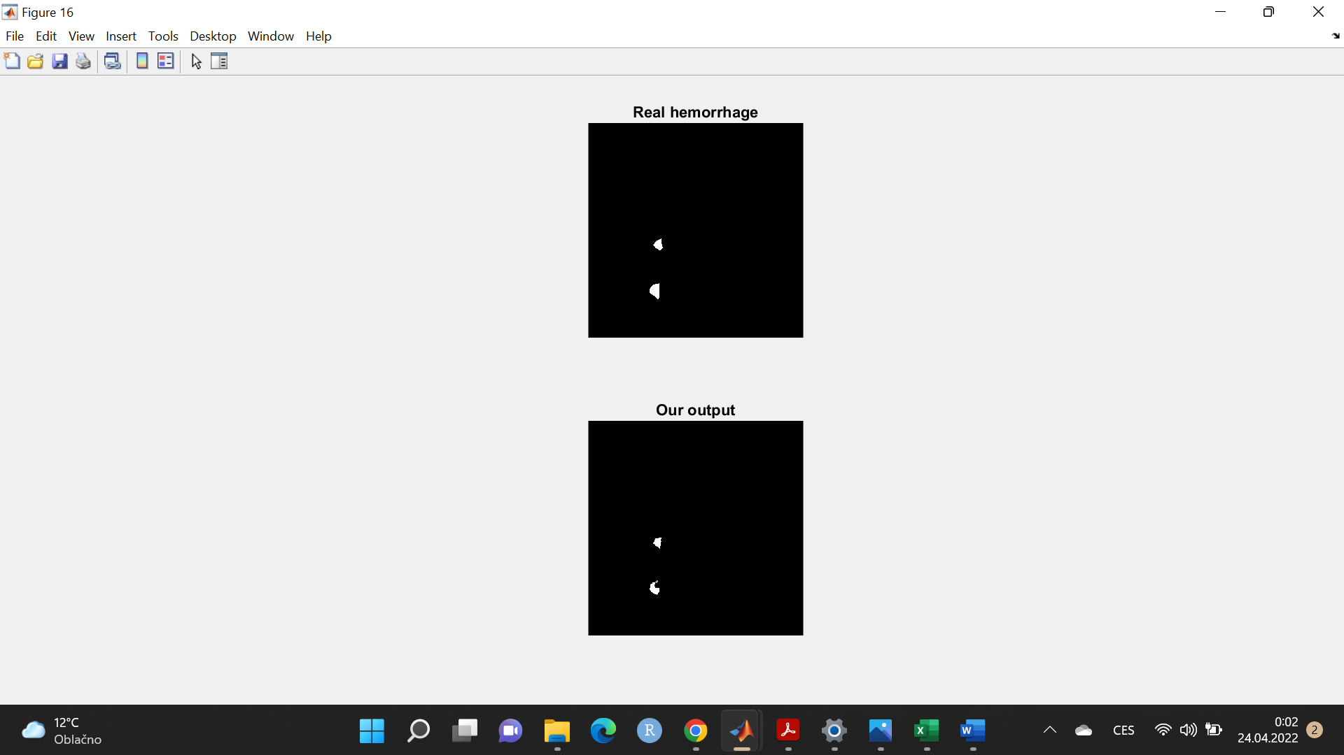
Manual approach
Original mask
Our output
Mean Dice coefficient = 0.7537
Mean Jaccard index = 0.6292
Notes:
Dice coefficient = 0.806 , Jaccard index = 0.6747

Slide 7
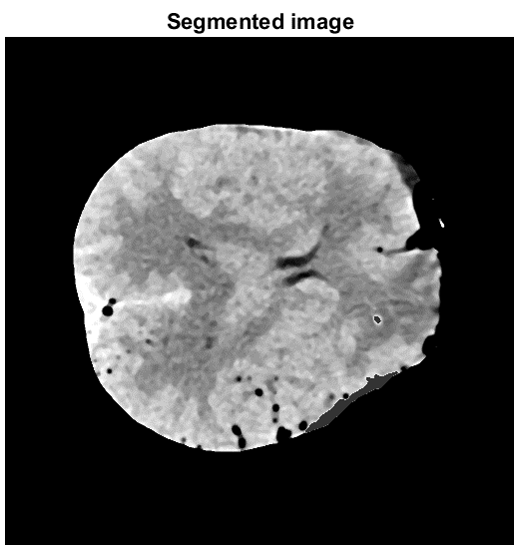
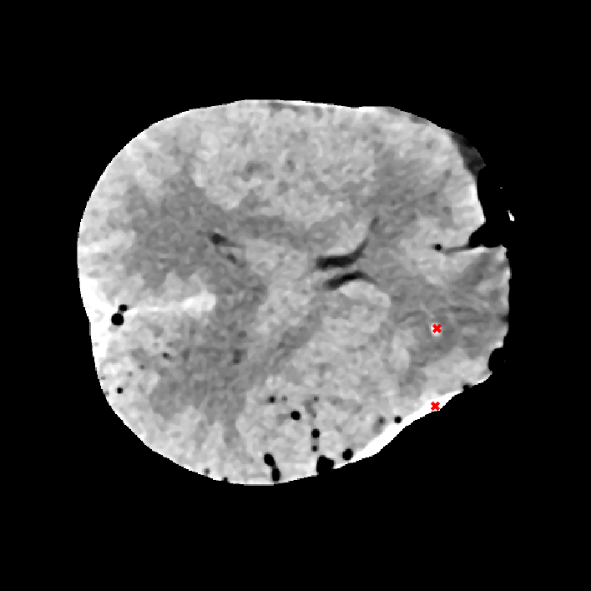
Semi-automatic approach - seed method

Slide 8
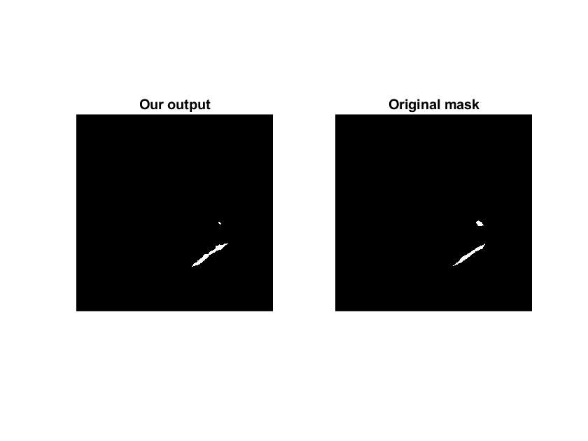
Mean Dice coefficient = 0.7808
Mean Jaccard index = 0.6501

Slide 9

Time for questions

