Slide 1
Residency Group Project Presentation -
Collaborative To-Do List Application
Xhon Pelushi
Sikun Peng
University of the Cumberlands
MSCS-632-M30: Advanced Programming Languages
Dr. Jay Thom
June 2026

Slide 2
Collaborative To-Do List Application
Project objective
Core features:
Multi-user
Add/Edit/Delete tasks
Assign tasks
Filter tasks
Concurrency support

Slide 3

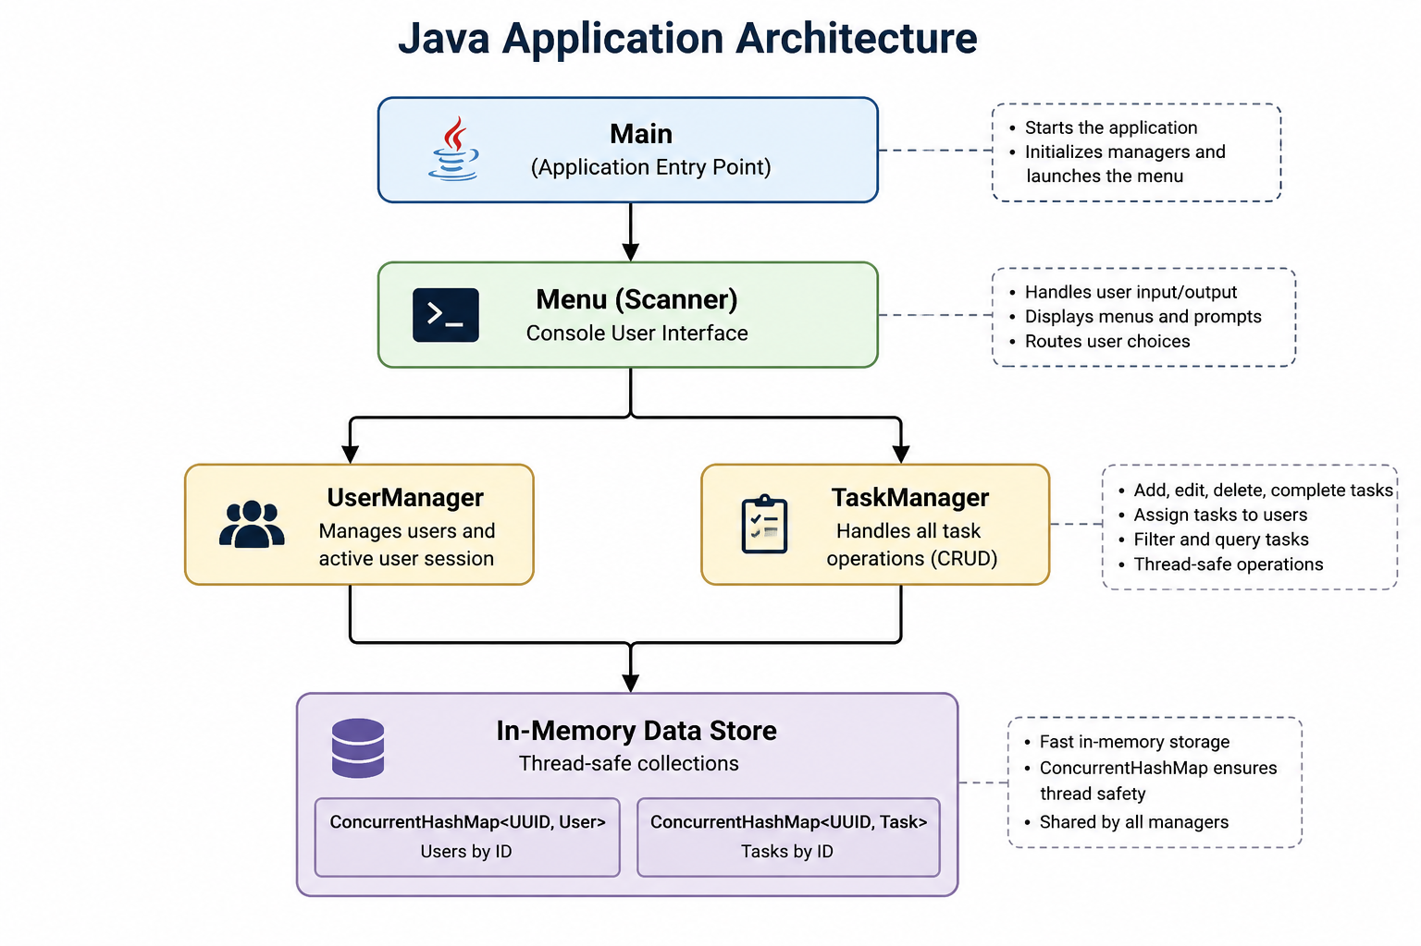
Java Architecture
Object-Oriented Design – Uses separate classes (Task, User, TaskManager, UserManager) to encapsulate data and business logic.
Layered Architecture – Separates the console UI, business logic, and in-memory data storage for better maintainability.
Strong Type Safety – Uses Java classes, enums, and generics to catch errors at compile time.
Thread-Safe Data Management – Uses ConcurrentHashMap and synchronized operations to support concurrent access.
Modular Structure – Components are organized into models, services, UI, and utility classes to improve readability and scalability.

Slide 4
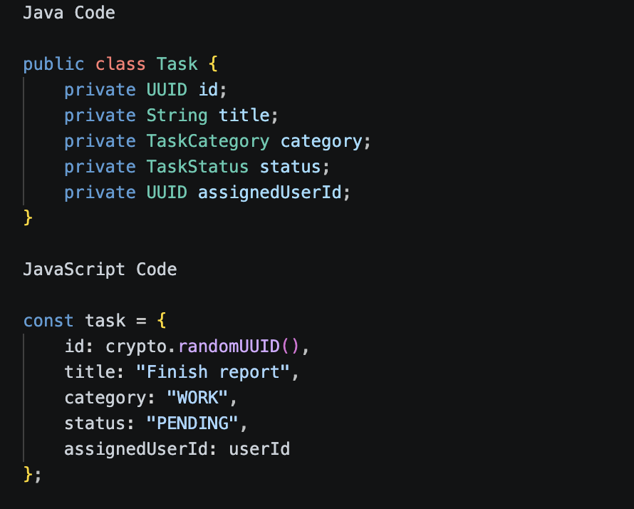
Data Model Difference
In Java, the Task entity is defined as a class with fixed field types. The compiler checks that id is a UUID, title is a String, and status is a TaskStatus. This provides compile-time safety and makes the structure predictable.
In JavaScript, the task is represented as a flexible object. This is easier to create and modify, but the language does not prevent mistakes such as assigning "DONE" instead of "COMPLETED" unless we add manual validation.

Slide 5
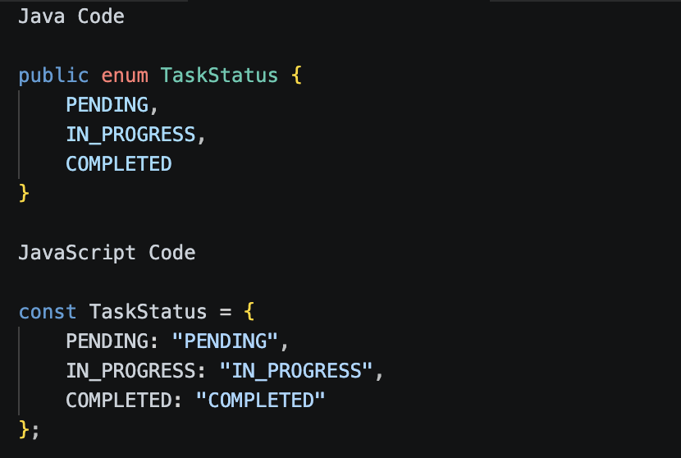
Status and Category Difference
Java has built-in enum support. This prevents invalid task statuses at compile time.
JavaScript does not have the same traditional enum system, so we use an object with string constants. This is flexible, but it depends more on developer discipline and runtime validation.

Slide 6
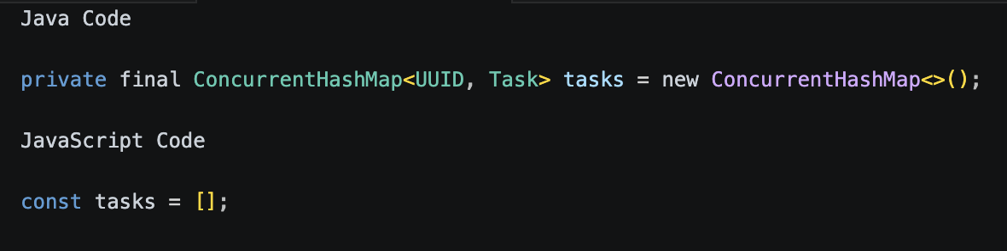
Collection and Storage Difference
Java uses ConcurrentHashMap, which is designed for safe access when multiple threads read and write data at the same time. This fits Java’s thread-based concurrency model.
JavaScript uses an array of task objects. Since Node.js runs JavaScript mainly on a single-threaded event loop, the concurrency risk is different. Instead of multiple threads modifying memory at the exact same time, JavaScript handles asynchronous operations through the event loop.

Slide 7
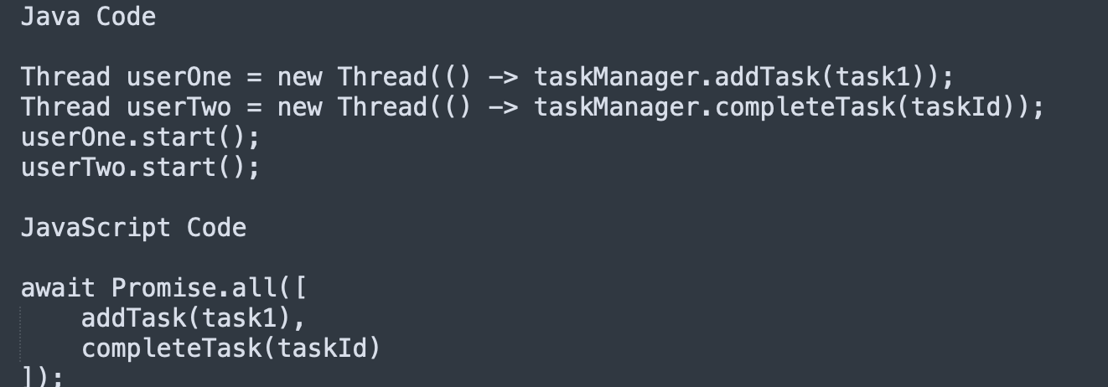
Concurrency Difference
Java supports true multithreading. Two threads can run at the same time, so shared data must be protected with thread-safe collections or synchronization.
JavaScript uses asynchronous programming with Promise.all() and async/await. The operations appear concurrent from the application perspective, but they are coordinated through the event loop rather than traditional shared-memory threads.

Slide 8
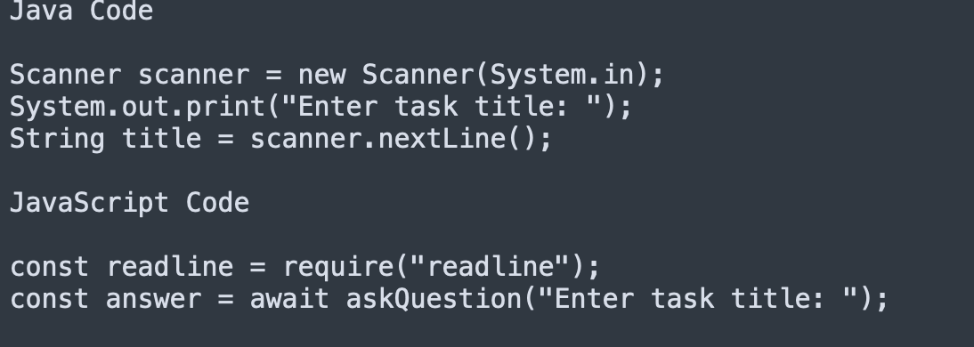
Input Handling Difference
Java’s console input with Scanner is blocking and synchronous. The program waits until the user enters input before continuing.
Node.js readline is asynchronous. To make the menu feel sequential, the JavaScript version uses async/await. This makes asynchronous input easier to read and closer to a normal step-by-step program.

Slide 9
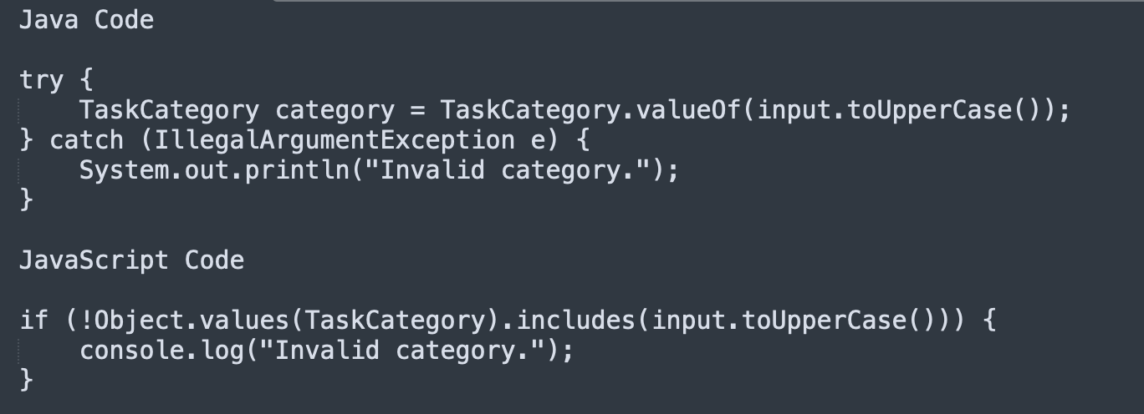
Error Handling Difference
Java can use enums and exceptions to handle invalid values. If the input does not match a valid enum, Java throws an exception.
JavaScript usually requires manual validation because strings are flexible. The code checks whether the input exists in the allowed list before using it.

Slide 10
Overall Language Experience
Java required more structure upfront. We had to define classes, enums, types, and managers before the application could run. However, this structure made the code safer, easier to organize, and better for larger systems.
JavaScript allowed faster development with less setup. Objects and arrays were easy to create, and async/await made simulated concurrent operations readable. However, because JavaScript is dynamically typed, the implementation needed more manual validation to avoid inconsistent task data.
Both languages implemented the same Collaborative To-Do List features, but the language design influenced the solution. Java emphasized safety, structure, and thread-based concurrency. JavaScript emphasized flexibility, lightweight objects, and asynchronous programming.

