Slide 1
Recommendation for Gas Station Locations
Geomarketing Analysis by Sara Lienau
Notes:
First, I will present the requested information:
Recommendation for areas within KC for a new gas station (based in part on the potential for growth)
Identify competitors in the recommended areas and
Present the median income in those areas
Then I peel back the onion a bit and discuss the factors that contributed to my recommendation.

Slide 2
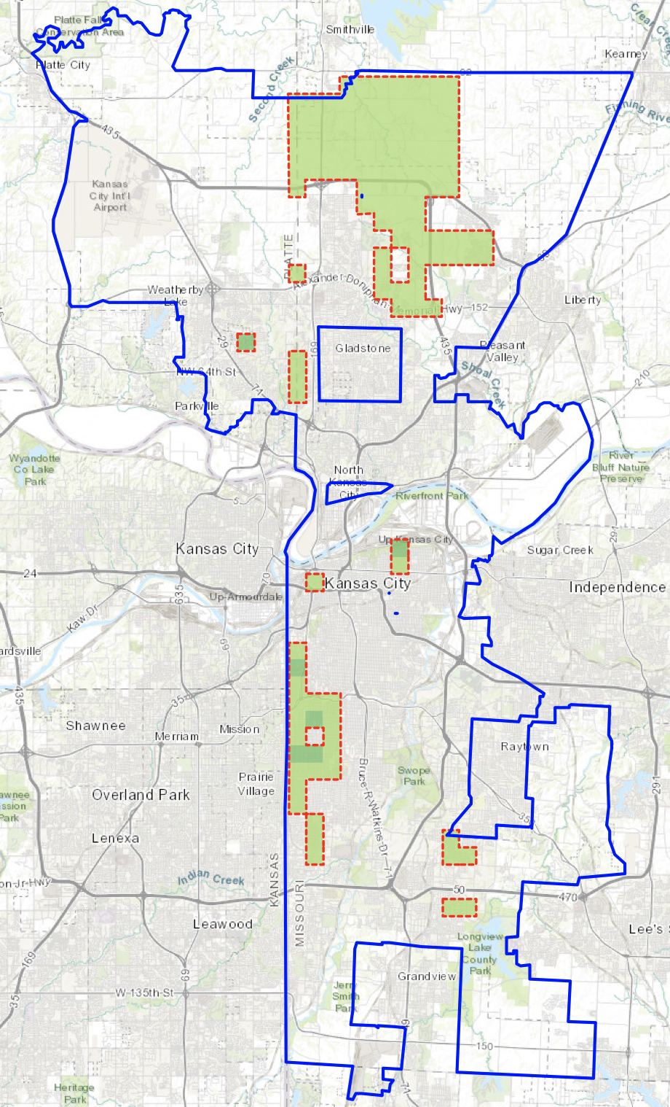
Recommended Locations
Notes:
The map highlights (shaded in green & outlined in red) the highest potential areas in Kansas City for a new gas station
The sizeable northern region is my first choice for further research. This area is growing with a lot of new construction, is high-income and has little competition from existing gas stations.
Next, I would consider opportunities along the state line south from 31st Street to about the Ward Parkway Mall. This area has the highest density of vehicles as well has contains upper-income neighborhoods. However, there are existing gas stations sprinkled throughout the area and its surroundings.
The recommendations are based on a geomarketing analysis which includes data from:
2016 KC Market Value Analysis by the Reinvestment Fund (https://www.kcmo.gov/city-hall/departments/city-planning-development/market-value-analysis-kansas-city-Missouri)
The Census Bureau’s American Community Survey 2014-2018 5-year Estimates.
Gas station locations extracted from OpenStreetMap based on information available as of Feb 5, 2020.

Slide 3
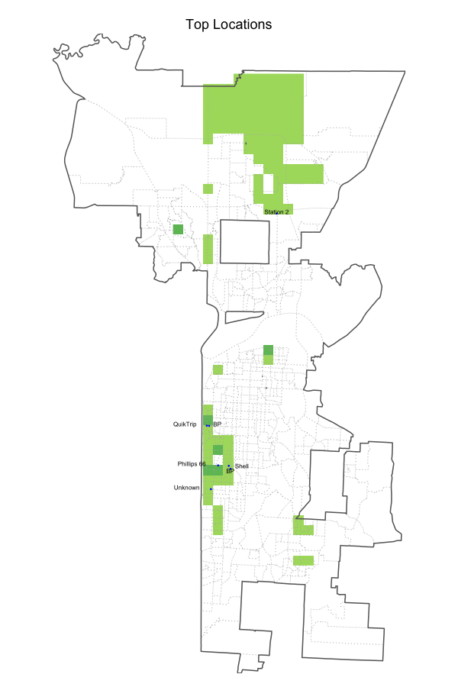
Competition at Top Locations
Notes:
The map identifies the existing gas stations located in the high potential areas.
There is only one gas station in the northern region (a vendor identified as “Station 2”).
In the state line region, there are six existing gas stations – 2 BP and one each for QuikTrip, Phillips 66, Shell, and an unknown vendor.
Although this analysis is focused on recommending a location for a new gas station within the KC boundary, I also considered gas stations ½ mile outside the boundary as competitors.
The data on gas stations was extracted from OpenStreetMap based on information available as of Feb 5, 2020.

Slide 4
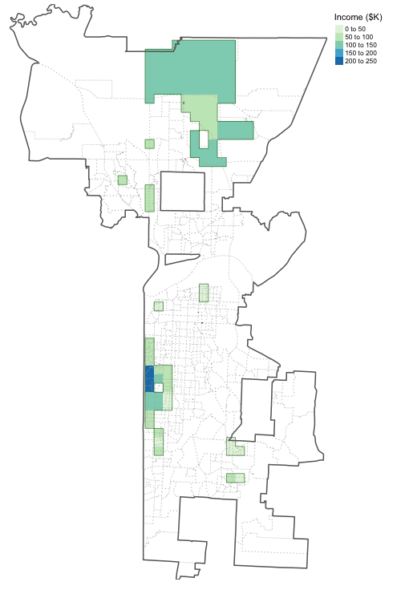
Median Income at Top Locations
Notes:
The map shows an estimate of the median income in the high potential areas.
The state line region contains the highest income neighborhoods in Kansas City (along Ward Parkway). The northern region falls well above average with a median income over $100K.

Slide 5
What factors contributed to the recommendation?

Slide 6
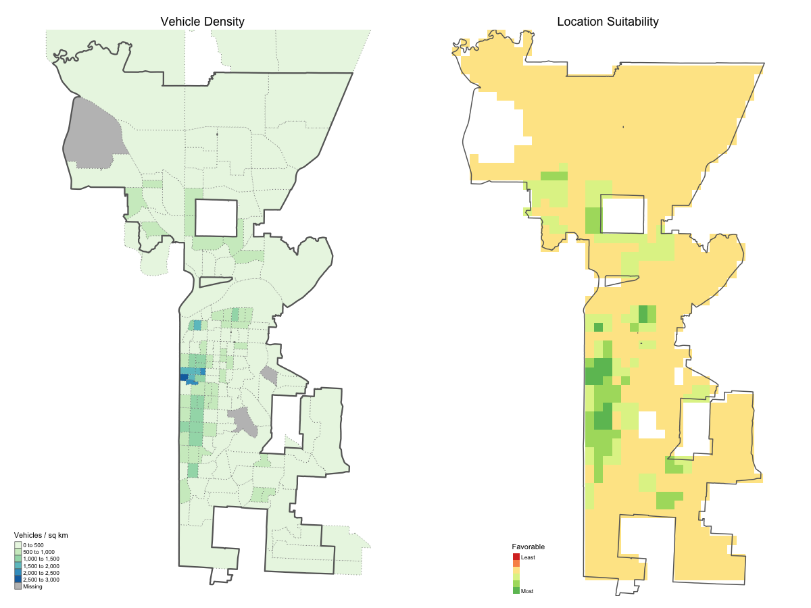
Where are vehicles located in KC?
Notes:
The first factor I considered is the location of vehicles throughout Kansas City.
The following illustrates the vehicles used in commuting (as a density per sq. km) from the Census Bureau’s American Community Survey 2014-2018 5-year Estimates.
The data is available at the census tract level. In a few cases, the census tracts extend beyond the boundaries of KC.
The median is about 420 vehicles per sq. km and census tracts typically range from 275 to 620 vehicles/sq. km. However, a quarter of the census tracts are well above 620, in the 1000s, 1500s, and the highest density is a little over 2700 vehicles (in a sq. km!) around the Plaza area. There is a high density of vehicles in the residential areas to the south of the Plaza, north to Crown Center, and a pocket in downtown.
Considering just this factor, the map on the right estimates the suitability of different areas around the city for gas stations. The greens are more favorable given the proximity to large concentrations of vehicles used for commuting. Note: The white sections are areas where the census did not collect data (e.g., the KCI airport and Swope Park).
Details on the Census/ACS variable
AGGREGATE NUMBER OF VEHICLES (CAR, TRUCK, OR VAN) USED IN COMMUTING BY WORKERS 16 YEARS AND OVER BY SEX
B08015_001 - Estimate!!Aggregate number of vehicles (car, truck, or van) used in commuting

Slide 7
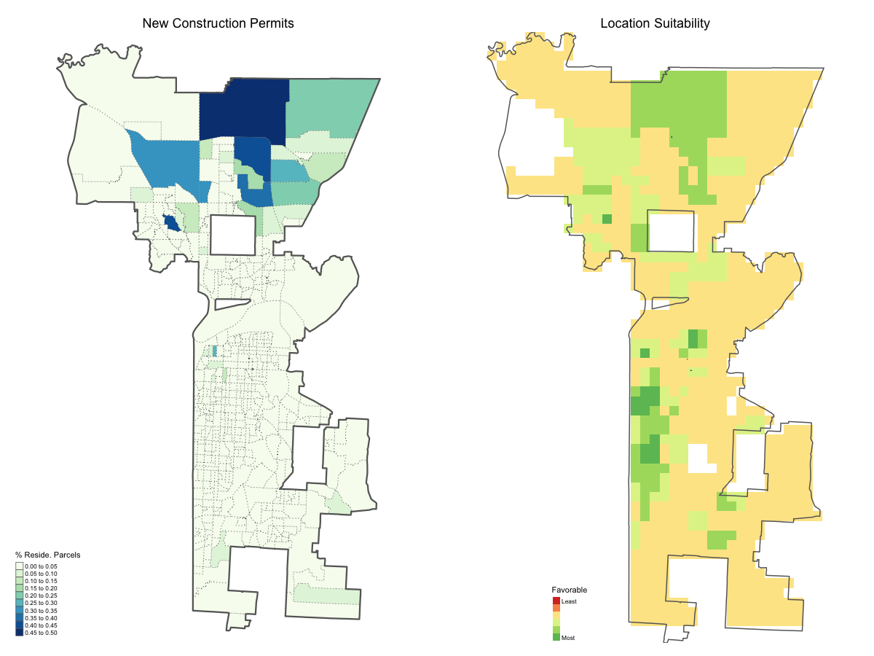
Where is KC growing?
Notes:
Next, I considered where Kansas City is growing.
The map illustrates growth in terms of new construction permits issued as a percentage of residential parcels. This data was obtained from the 2016 KC Market Value Analysis.
For the vast majority of KC, there is very little, if any, new construction (as a percentage of residential parcels). But up north, there are new subdivisions being developed where new construction permits range from 25 to up to 50% of the residential parcels. That is significant new construction and growth!
Including considerations for growth, areas with a lot of new residential construction in the northern census block groups are now included as more favorable locations for additional gas stations.

Slide 8
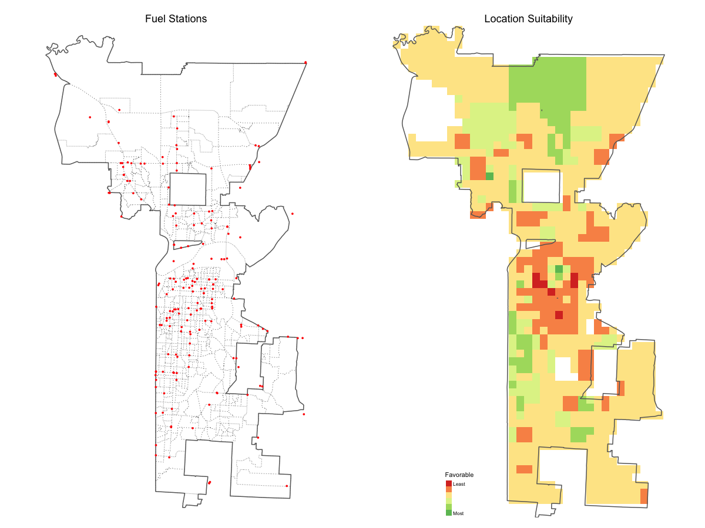
Where are existing Gas Stations?
Notes:
The third factor I considered is the location of existing fuel stations in Kansas City.
The map illustrates the location of the 182 gas stations within ½ mile perimeter around KC. This information was extracted from OpenStreetMap based on data available as of Feb 5, 2020.
I penalized areas based on the degree of existing competition. Specifically, the number of stations (0-6) within 2 sq. km (or about 1.25 miles). Now, we start to see that less desirable areas are colored in orange and red.

Slide 9
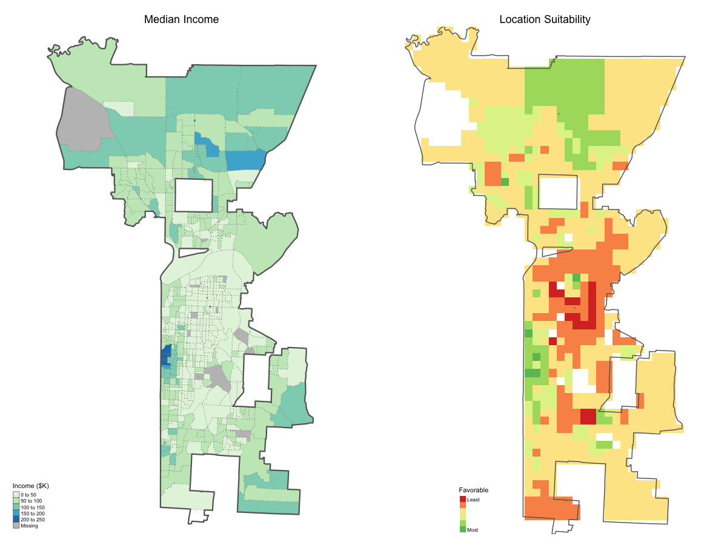
What is the socio-economic status across KC?
Notes:
And finally, I considered the socioeconomic status of different areas of Kansas City.
The map illustrates the median household income by census block groups from the Census Bureau’s American Community Survey 2014-2018 5-year Estimates.
The median household income (for the past 12 months in 2018 dollars) is about $50K. Half the census blocks fall in a range of median income from $34K to 70K. The maximum value (of median income) is about $248K along Ward Parkway.
Gas is purchased by both high- and low-income individuals, so I made only a slight adjustment for socioeconomic status.
There is a slight penalty for areas in the lowest quartile (median income < $34K).
There is no adjustment for areas where median income falls in the IQR (> $34K and < $70 K)
There is a small bonus for areas in the top quartile
The socioeconomic adjustment makes the low-income sections in the middle of the city a little less desirable (shift from yellow to orange). As well, the higher-income areas (in the north and along Ward Parkway) become a bit more favorable.

Slide 10
Assignment Highlights
Notes:
(For inspiration …) I worked through the Geomarketing Case Study in Chapter 13 of Geocomputation with R (https://geocompr.robinlovelace.net/location.html).
It was valuable to spend time digging into the data variables available from the Census Bureau. Most of the information I was interested in was available at the census block group (which matched the KC MVA study). But the key vehicle density data was not, so I gathered that information at the census tract level. Kansas City stretches across three counties – Jackson, Clay and Platte. I extracted data for all three counties and then tossed out areas beyond the KC boundary.
It was also useful to gain experience pulling data from OpenStreetMap. I needed to define the bounding box that matched the area of the KC MVA study to include gas stations in the northernmost region of the city. OSM’s definition for “Kansas City” was slightly different. OSM returned both points and polygons for the location of fuel station amenities. I discovered that many of the points, but not all, were vertices of the polygon locations of gas stations. This presented an opportunity to exercise my spatial wrangling skills to sort that out and create a consolidated list of the point location of gas stations within KC. I also included gas stations within ½ mile perimeter of the boundary of KC. I did not want to ignore competition that might be across the street but just outside of KC.
And finally, I gained more experience working with the raster representation of spatial data. It was handy to convert different metrics to a raster representation and essentially stack the layers on top of one another. It was a convenient method to consolidate data at varying levels of granularity - vehicle density at the census tract level, new construction & median income at the census block group level and locations of gas stations at a given location (which I counted per 2 sq. km).
All and all, a challenging and fun project to exercise my newfound spatial analysis skills!

