Slide 1
Recurrent Chunking Mechanisms for
Long-Text Machine Reading Comprehension
ACL 2020

Slide 2
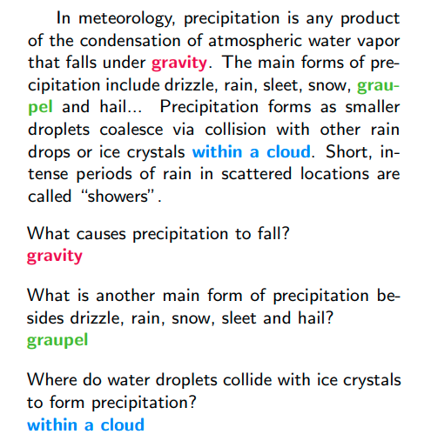

Slide 3
CLS
question
SEP
document
SEP
BERT
CLS
question
SEP
document
SEP

Slide 4
start=32,end=32
CLS
question
SEP
document
SEP
BERT
CLS
question
SEP
document
SEP
What causes precipitation to fall?

Slide 5
CLS
question
SEP
document
SEP
整个序列长度不能超过512个单词

Slide 6
The Vatican Apostolic Library, more commonly called the Vatican Library or simply the Vat, is the library of the Holy See, located in Vatican City. Formally established in 1475, although it is much older, it is one of the oldest libraries in the world and contains one of the most significant collections of historical texts. It has 75,000 codices from throughout history, as well as 1.1 million printed books, which include some 8,500 incunabula. The Vatican Library is a research library for history, law, philosophy, science and theology. The Vatican Library is open to anyone who can document their qualifications and research needs. Photocopies for private study of pages from books published between 1801 and 1990 can be requested in person or by mail. In March 2014, the Vatican Library began an initial four-year project of digitising its collection of manuscripts, to be made available online. The Vatican Secret Archives were separated from the library at the beginning of the 17th century; they contain another 150,000 items. Scholars have traditionally divided the history of the library into five periods, Pre-Lateran, Lateran, Avignon, Pre-Vatican. dated from the earliest days of the Church. Only a handful of volumes survive from this period, though some are very significant.
CLS
question
SEP
document
SEP
整个序列长度不能超过512个单词

Slide 7
假如question的长度为9,整个document的长度是700
512-9-3=500
CLS
question
SEP
document
SEP
最长是500个单词

Slide 8
假如question的长度为9,整个document的长度是700
512-9-3=500
CLS
question
SEP
document
SEP
最长是500个单词

Slide 9
假如question的长度为9,整个document的长度是700
512-9-3=500
segment1 segment2 segment3
CLS
question
SEP
segment1
SEP
CLS
question
SEP
segment2
SEP
CLS
question
SEP
segment3
SEP

Slide 10
缺点１：各个segment之间是独立的，每一个segment和question作为一个独立的example输入到BERT

Slide 11
start=105,end=110
CLS
question
SEP
segment3
SEP
start=60,end=65
BERT
CLS
question
SEP
segment2
SEP
start=10,end=15
CLS
question
SEP
segment3
SEP
BERT
CLS
question
SEP
segment1
SEP
CLS
question
SEP
segment2
SEP
BERT
CLS
question
SEP
segment1
SEP

Slide 12
缺点１：各个segment之间是独立的，每一个segment和question作为一个独立的example输入到BERT
缺点２：固定切分窗口大小会导致某些segment中，答案的上下文不足

Slide 13
The Vatican Apostolic Library (), more commonly called the Vatican Library or simply the Vat, is the library of the H oly See, located in Vatican City. Formally established in 1475, although it is much older, it is one of the oldest libraries in the w orld and contains one of the most significant collections of historical texts. It has 75,000 codices from throughout history, as well as 1.1 million printed books, which include some 8,500 incunabula. The Vatican Library is a research library for history, law, philosophy, science and theology. The Vatican Library is open to anyone who can document their qualifications and research needs. Phot ocopies for private study of pages from books published between 1801 and 1990 can be requested in person or by mail. In March 201 4, the Vatican Library began an initial four-year project of digitising its collection of manuscripts, to be made available online. The Vatican Secret Archives were separated from the library at the beginning of the 17th century; they contain another 150,000 ite ms. Scholars have traditionally divided the history of the library into five periods, Pre-Lateran, Lateran, Avignon, Pre-Vatican and Vatican. The Pre-Lateran period, comprising the initial days of the library, dated from the earliest days of the Church. Only a handful of volumes survive from this period, though some are very significant.

Slide 14
The Vatican Apostolic Library (), more commonly called the Vatican Library or simply the Vat, is the library of the H oly See, located in Vatican City. Formally established in 1475, although it is much older, it is one of the oldest libraries in the w orld and contains one of the most significant collections of historical texts. It has 75,000 codices from throughout history, as well as 1.1 million printed books, which include some 8,500 incunabula. The Vatican Library is a research library for history, law, philosophy, science and theology. The Vatican Library is open to anyone who can document their qualifications and research needs. Phot ocopies for private study of pages from books published between 1801 and 1990 can be requested in person or by mail. In March 201 4, the Vatican Library began an initial four-year project of digitising its collection of manuscripts, to be made available online. The Vatican Secret Archives were separated from the library at the beginning of the 17th century; they contain another 150,000 ite ms. Scholars have traditionally divided the history of the library into five periods, Pre-Lateran, Lateran, Avignon, Pre-Vatican and Vatican. The Pre-Lateran period, comprising the initial days of the library, dated from the earliest days of the Church. Only a handful of volumes survive from this period, though some are very significant.

Slide 15
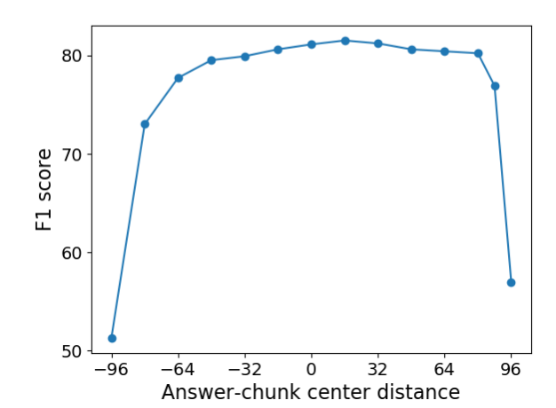

Slide 16
Recurrent Chunking Mechanisms for
Long-Text Machine Reading Comprehension

Slide 17
Learning to Chunk
{-16,16,32,64,128}

Slide 18
Learning to Chunk
{-16,16,32,64,128}
The Vatican Apostolic Library (), more commonly called the Vatican Library or simply the Vat, is the library of the H oly See, located in Vatican City. Formally established in 1475, although it is much older, it is one of the oldest libraries in the w orld and contains one of the most significant collections of historical texts. It has 75,000 codices from throughout history, as well as 1.1 million printed books, which include some 8,500 incunabula. The Vatican Library is a research library for history, law, philosophy, science and theology. The Vatican Library is open to anyone who can document their qualifications and research needs. Phot ocopies for private study of pages from books published between 1801 and 1990 can be requested in person or by mail. In March 201 4, the Vatican Library began an initial four-year project of digitising its collection of manuscripts, to be made available online. The Vatican Secret Archives were separated from the library at the beginning of the 17th century; they contain another 150,000 ite ms. Scholars have traditionally divided the history of the library into five periods, Pre-Lateran, Lateran, Avignon, Pre-Vatican and Vatican. The Pre-Lateran period, comprising the initial days of the library, dated from the earliest days of the Church. Only a handful of volumes survive from this period, though some are very significant.

Slide 19
Learning to Chunk
{-16,16,32,64,128}
The Vatican Apostolic Library (), more commonly called the Vatican Library or simply the Vat, is the library of the H oly See, located in Vatican City. Formally established in 1475, although it is much older, it is one of the oldest libraries in the w orld and contains one of the most significant collections of historical texts. It has 75,000 codices from throughout history, as well as 1.1 million printed books, which include some 8,500 incunabula. The Vatican Library is a research library for history, law, philosophy, science and theology. The Vatican Library is open to anyone who can document their qualifications and research needs. Phot ocopies for private study of pages from books published between 1801 and 1990 can be requested in person or by mail. In March 201

Slide 20
Learning to Chunk
{-16,16,32,64,128}
32
The Vatican Library is a research library for history, law, philosophy, science and theology. The Vatican Library is open to anyone who can document their qualifications and research needs. Phot ocopies for private study of pages from books published between 1801 and 1990 can be requested in person or by mail. In March 201 4, the Vatican Library began an initial four-year project of digitising its collection of manuscripts, to be made available online. The Vatican Secret Archives were separated from the library at the beginning of the 17th century; they contain another 150,000 ite ms. Scholars have traditionally divided the history of the library into five periods, Pre-Lateran, Lateran, Avignon, Pre-Vatican and Vatican. The Pre-Lateran period, comprising the initial days of the library, dated from the earliest days of the Church. Only a handful of volumes survive from this period, though some are very significant.
分类任务？

Slide 21
state
Agent
action
Enviroment

Slide 22
state
Agent
action
reward
Enviroment

Slide 23
Policy-based RL
state
Policy
action
reward
Enviroment
在某个state下，根据policy输出action，希望获得较大的reward.目的是学习策略函数

Slide 24

Policy-based RL
输入给NN一个state s,NN根据自身的策略输出一个action a.
NN
state
action
状态，行为，奖励，策略

Slide 25
Policy-based RL
action space={-16,16,32,64,128}
输入给NN一个state s,NN根据自身的策略输出一个action a.
The Vatican Library is a research library for history, law, philosophy, science and theology. The Vatican Library is open to anyone who can document their qualifications and research needs. Phot ocopies for private study of pages from books published between 1801 and 1990 can be requested in person or by mail. In March
NN
state
action
-16
状态，行为，奖励，策略

Slide 26
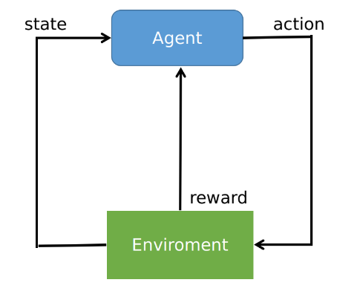
定义目标函数（从trajectory的角度）

Slide 27


定义目标函数（从trajectory的角度）

Slide 28

定义目标函数（从trajectory的角度）

Slide 29
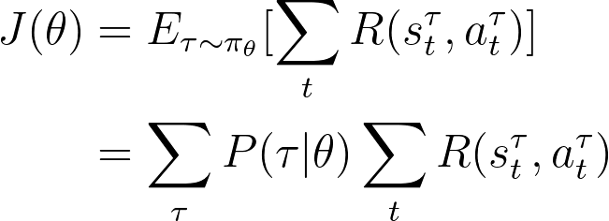

Slide 30
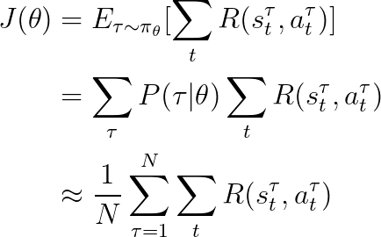

Slide 31
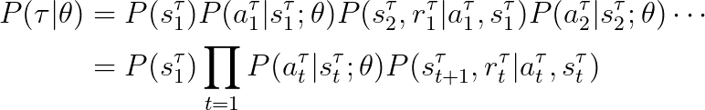

Slide 33


Slide 35
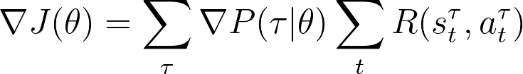

Slide 36
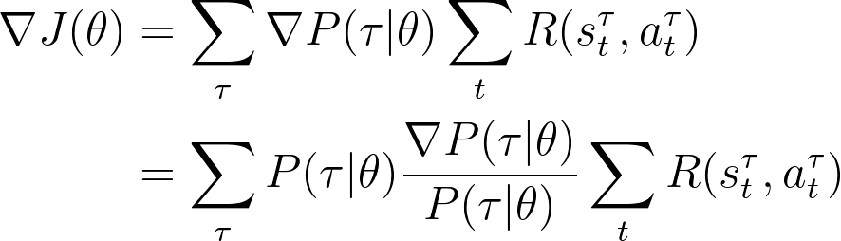

Slide 37
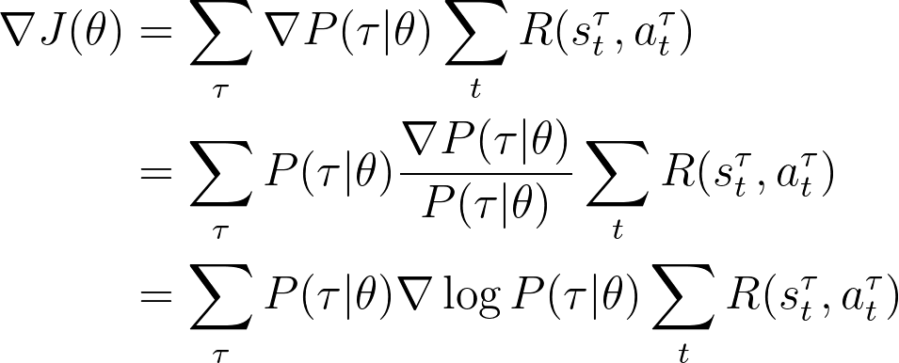

Slide 38
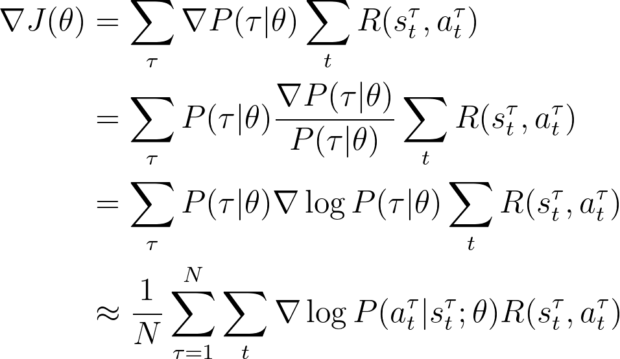

Slide 39


Slide 40
输入给NN一个state s,NN根据自身的策略输出一个action a.
NN
state
action
状态，行为，奖励，策略

Slide 41
The Vatican Apostolic Library (), more commonly called the Vatican Library or simply the Vat, is the library of the H oly See, located in Vatican City. Formally established in 1475, although it is much older, it is one of the oldest libraries in the w orld and contains one of the most significant collections of historical texts. It has 75,000 codices from throughout history, as well as 1.1 million printed books, which include some 8,500 incunabula. The Vatican Library is a research library for history, law, philosophy, science and theology. The Vatican Library is open to anyone who can document their qualifications and research needs. Phot ocopies for private study of pages from books published between 1801 and 1990 can be requested in person or by mail. In March 201 4, the Vatican Library began an initial four-year project of digitising its collection of manuscripts, to be made available online. The Vatican Secret Archives were separated from the library at the beginning of the 17th century; they contain another 150,000 ite ms. Scholars have traditionally divided the history of the library into five periods, Pre-Lateran, Lateran, Avignon, Pre-Vatican and Vatican. The Pre-Lateran period, comprising the initial days of the library, dated from the earliest days of the Church. Only a handful of volumes survive from this period, though some are very significant.

Slide 42
The Vatican Apostolic Library (), more commonly called the Vatican Library or simply the Vat, is the library of the H oly See, located in Vatican City. Formally established in 1475, although it is much older, it is one of the oldest libraries in the w orld and contains one of the most significant collections of historical texts. It has 75,000 codices from throughout history, as well as 1.1 million printed books, which include some 8,500 incunabula. The Vatican Library is a research library for history, law, philosophy, science and theology. The Vatican Library is open to anyone who can document their qualifications and research needs. Phot ocopies for private study of pages from books published between 1801 and 1990 can be requested in person or by mail.
CLS
question
SEP
segment c
SEP

Slide 43

CLS
question
SEP
segment c
SEP
BERT
CLS
question
SEP
segment c
SEP

Slide 44

CLS
question
SEP
segment c
SEP
BERT
CLS
question
SEP
segment c
SEP

Slide 45

sigmoid
CLS
question
SEP
segment c
SEP
BERT
CLS
question
SEP
segment c
SEP

Slide 46

softmax
sigmoid
{-16,16,32,64,128}
CLS
question
SEP
segment c
SEP
BERT
CLS
question
SEP
segment c
SEP

Slide 47
softmax
sigmoid
{-16,16,32,64,128}
CLS
question
SEP
segment c
SEP
BERT
CLS
question
SEP
segment c
SEP

Slide 48
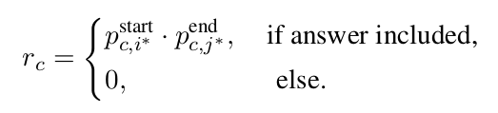
softmax
sigmoid
{-16,16,32,64,128}
out_dim=2
CLS
question
SEP
segment c
SEP
BERT
CLS
question
SEP
segment c
SEP

Slide 49

softmax
sigmoid
{-16,16,32,64,128}
out_dim=2
CLS
question
SEP
segment c
SEP
BERT
CLS
question
SEP
segment c
SEP

Slide 50
softmax
sigmoid
{-16,16,32,64,128}
out_dim=2
CLS
question
SEP
segment c
SEP
BERT
CLS
question
SEP
segment c
SEP

Slide 51
softmax
sigmoid
out_dim=2
CLS
question
SEP
segment c
SEP
BERT
CLS
question
SEP
segment c
SEP

Slide 52
softmax
sigmoid
out_dim=2
CLS
question
SEP
segment c
SEP
BERT
CLS
question
SEP
segment c
SEP

Slide 53
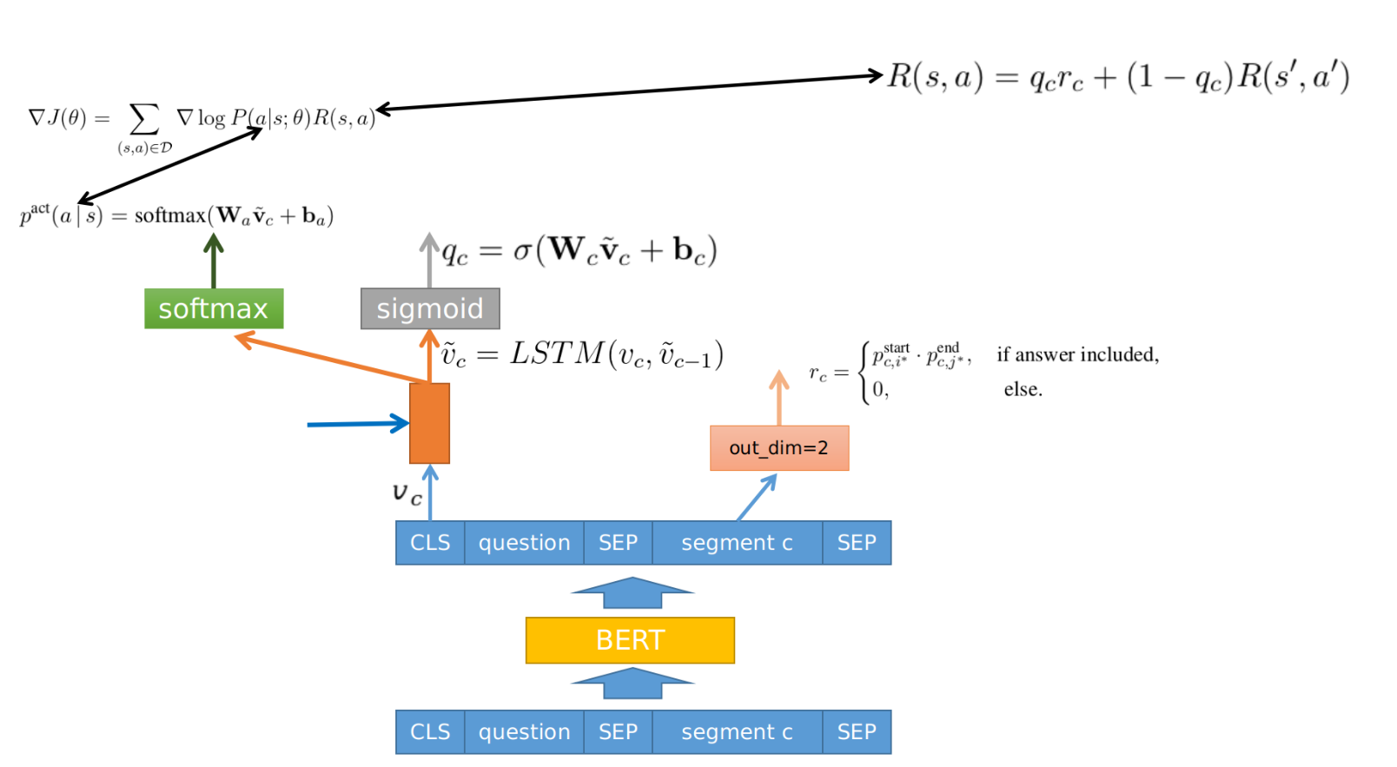

Slide 54
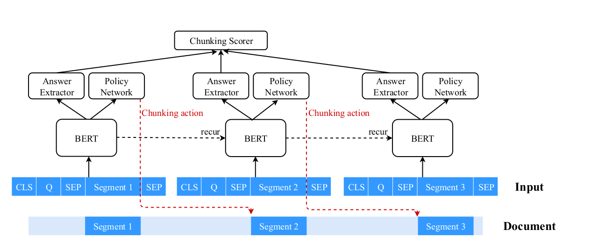

Slide 55


Slide 56
模型预测当前的segment包含答案的概率

Slide 57
模型预测当前的segment包含答案的概率
模型从当前segment提取出答案位置的概率

Slide 58
模型预测当前的segment包含答案的概率
未来的累计奖励
模型从当前segment提取出答案位置的概率

Slide 59
AE: Answer Extractor
CS: Chunking Scorer
CP: Chunking Policy

Slide 60
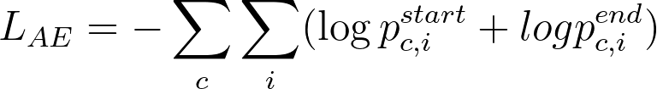
AE: Answer Extractor
CS: Chunking Scorer
CP: Chunking Policy

Slide 61
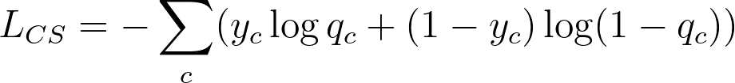
AE: Answer Extractor
CS: Chunking Scorer
CP: Chunking Policy

Slide 62
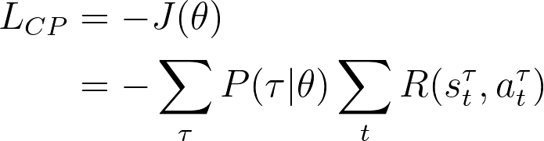
AE: Answer Extractor
CS: Chunking Scorer
CP: Chunking Policy

Slide 64
