Slide 1

SIG Algothon 2021
The Astronauts
Shane | David | Thejan | Annie

Slide 2



Data Analysis
Significant Division in Behaviour Between the First and Last 50 stocks
High Volatility in the Last 50 Stocks
Repetitive Triangular Pattern in High Volatility Stocks
Add the histograms????

Slide 3
Strategy Overview
1.
Calculate theoretical prices using different signals as inputs
2.
Compute edge as the difference between theoretical and real prices
3.
Determine stock position based on the calculated edge and edge threshold daily
Add diagrams and equations/..??/./?

Slide 4
Moving Average
Strategy applied for stocks with high volatility

Slide 5
Momentum

Slide 6
Optimisation

Slide 7
Results and Potential Improvements

Slide 8
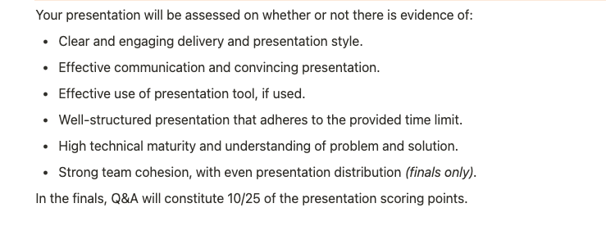
Criteria

