Slide 1

SIG Algothon 2021
The Astronauts
Shane | David | Thejan | Annie

Slide 2



Data Analysis
Significant Division in Behaviour Between the First and Last 50 stocks
High Volatility in the Last 50 Stocks
Repetitive Triangular Pattern in High Volatility Stocks

Slide 3
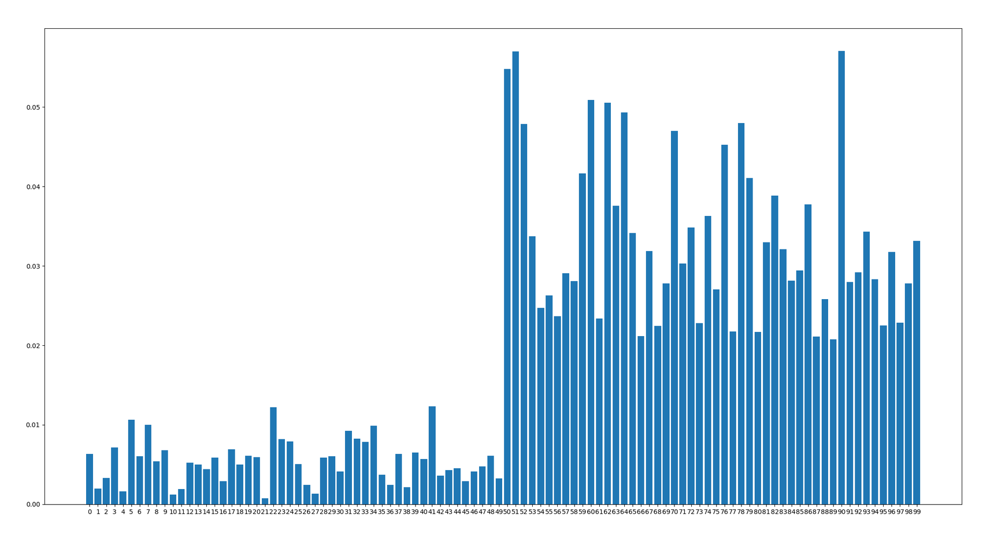
Volatility - Average Percentage Change Per Day
Stock 50 - 99
Volatility

Slide 4
Day Trading Cost Evaluation
Insert the excel spreadsheet of green and red things

Slide 5
Repetitive Triangular Pattern
Insert the excel spreadsheet of green and red things

Slide 6
Strategy Overview
1.
Calculate theoretical prices using different signals as inputs
2.
Compute edge as the difference between theoretical and real prices
3.
Determine stock position based on the calculated edge and edge threshold daily
Add diagrams and equations/..??/./?

Slide 7
Moving Average
Strategy applied for stocks with high volatility

Slide 8
Momentum

Slide 9
Optimisation

Slide 10
Results and Potential Improvements

Slide 11
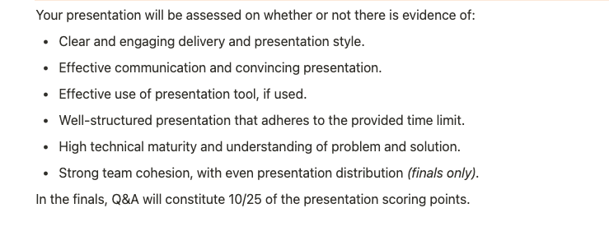
Criteria

