Slide 1
Predicting Cardiovascular disease
AcerR
2019/12/3

Slide 2
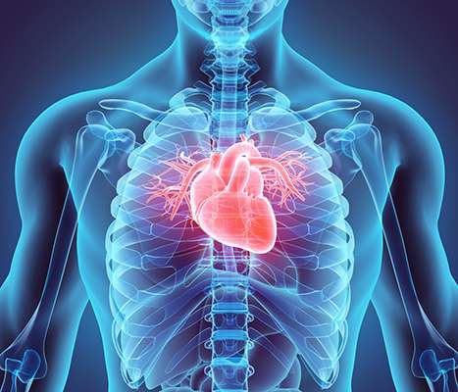
Introduction
Cardiovascular disease (CVD):
Disorders related to the heart and blood vessels
Remains the leading cause of death in the United States. Around 80% of CVD deaths are a heart attack and stroke

Slide 3
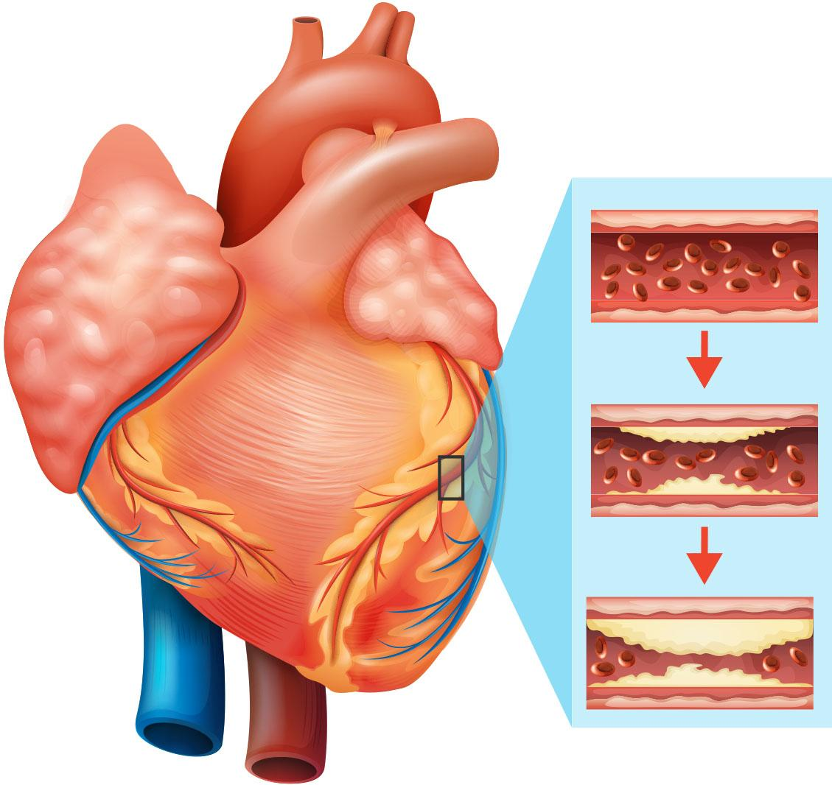
Introduction
Cause: Fatty deposits plaque builds up on the inner walls of the blood vessels which prevent prevents blood from flowing to the heart or brain.
Risk factor: Unhealthy diet, obesity, physical inactivity, tobacco use and harmful use of alcohol.

Slide 4
Dataset selection
Kaggle: https://www.kaggle.com/sulianova/cardiovascular-disease-dataset
70000 observations with 13 variables
Variables | Type
Age | Int
gender | Factor
height | Num
weight | Num
ap_hi/low (blood pressure) | Factor
cholesterol | Factor
gluc | Factor
smoke | Factor
alco | Factor
active | Factor
cardio | Factor

Slide 5
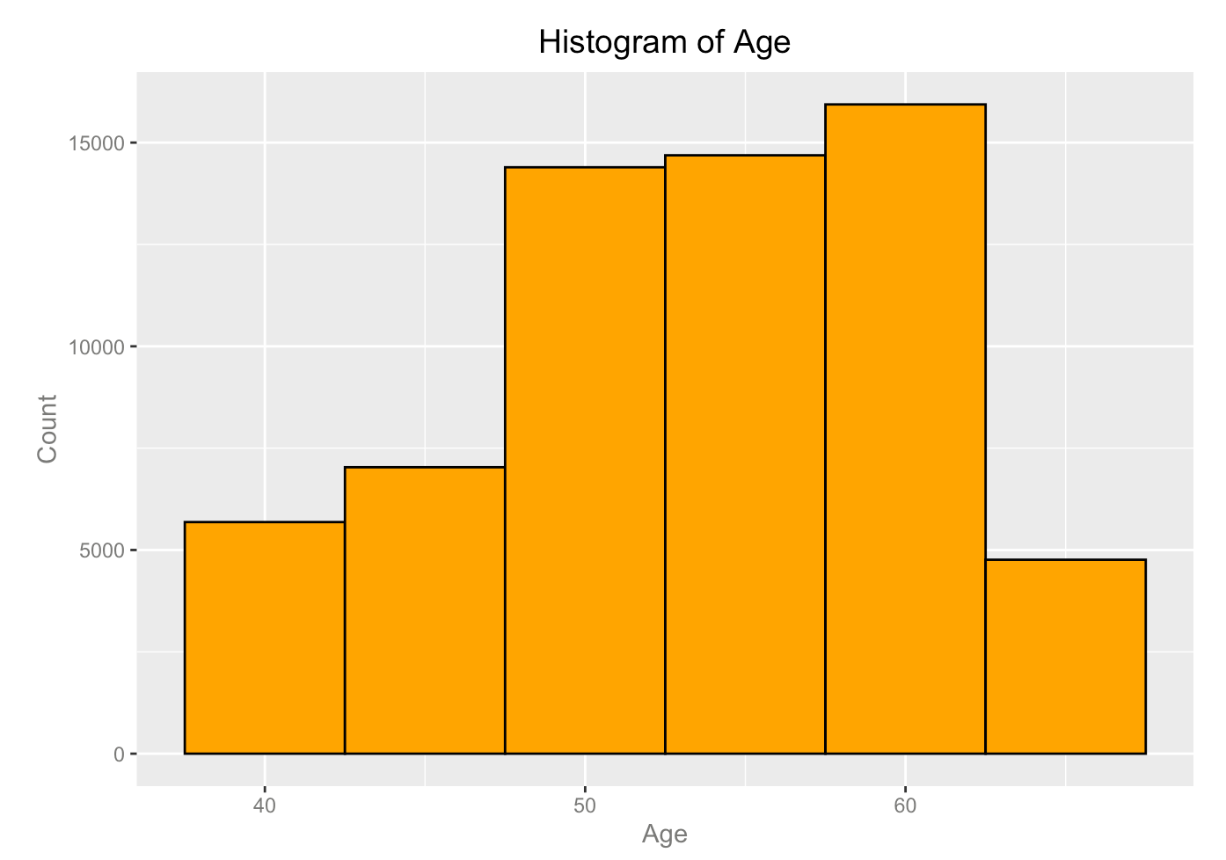
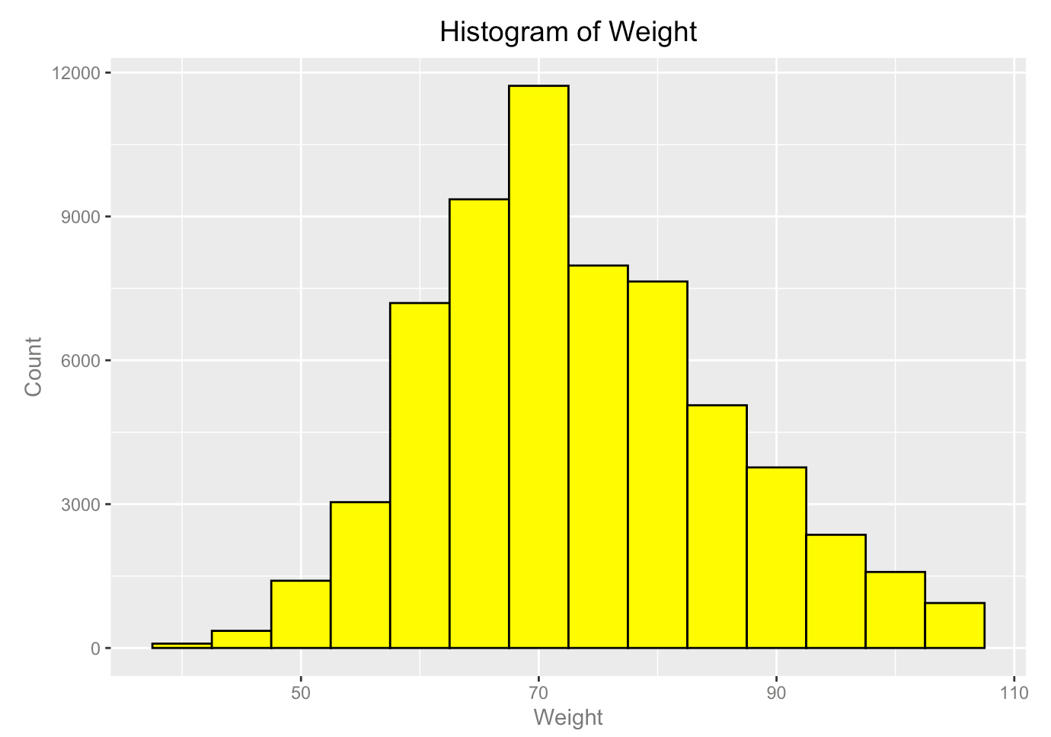
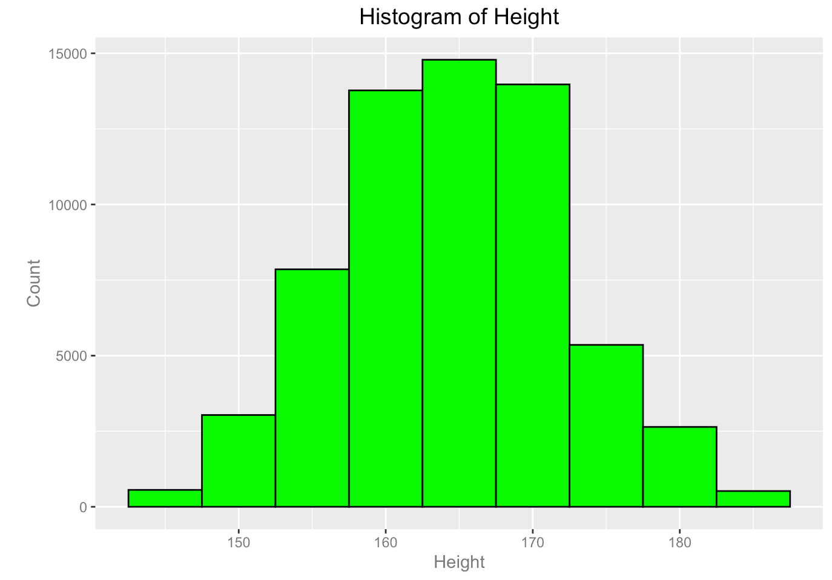
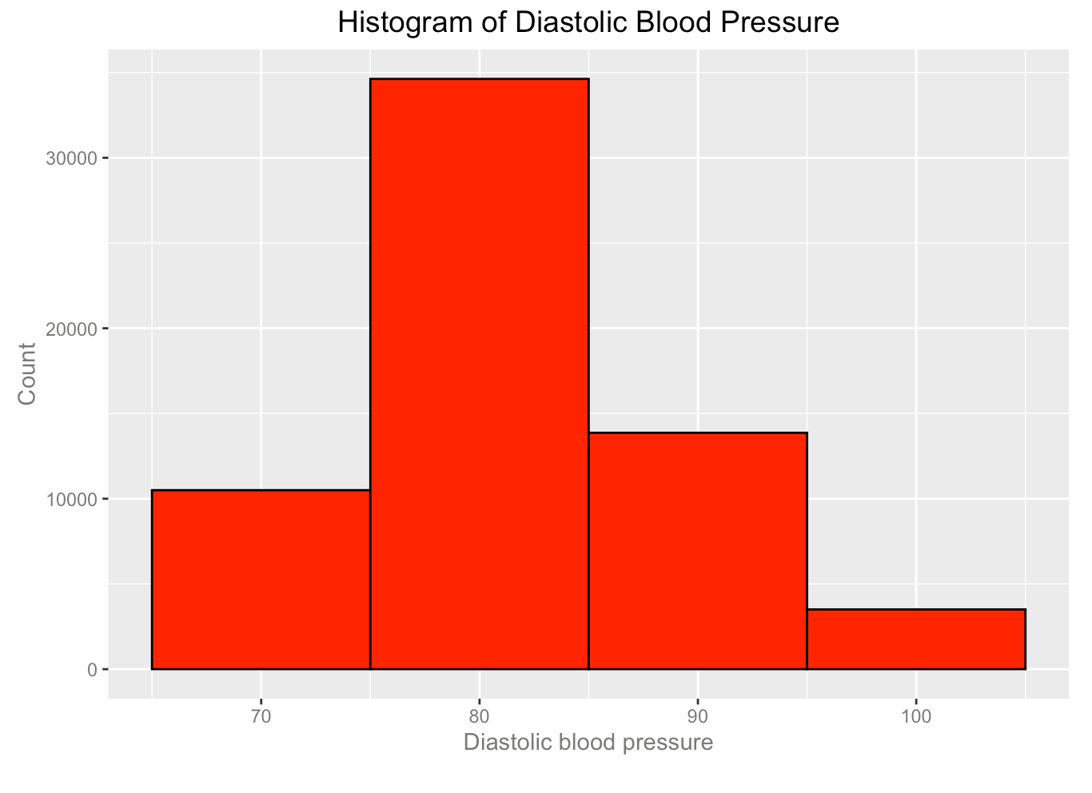
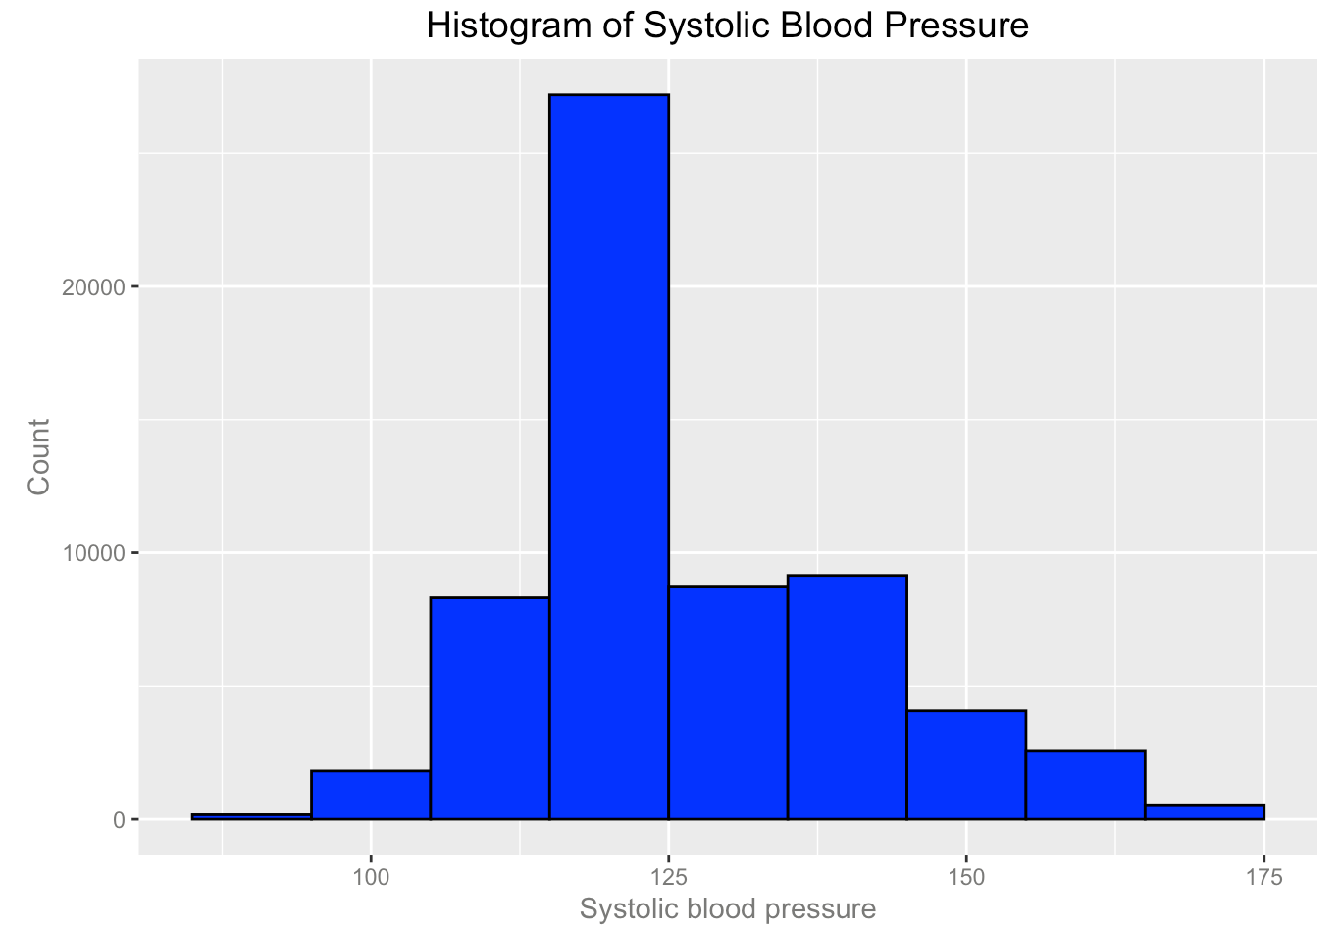
Data processing
Drop age<35
Drop outliers in for height, weight, ap_hi, and ap_low

Slide 6
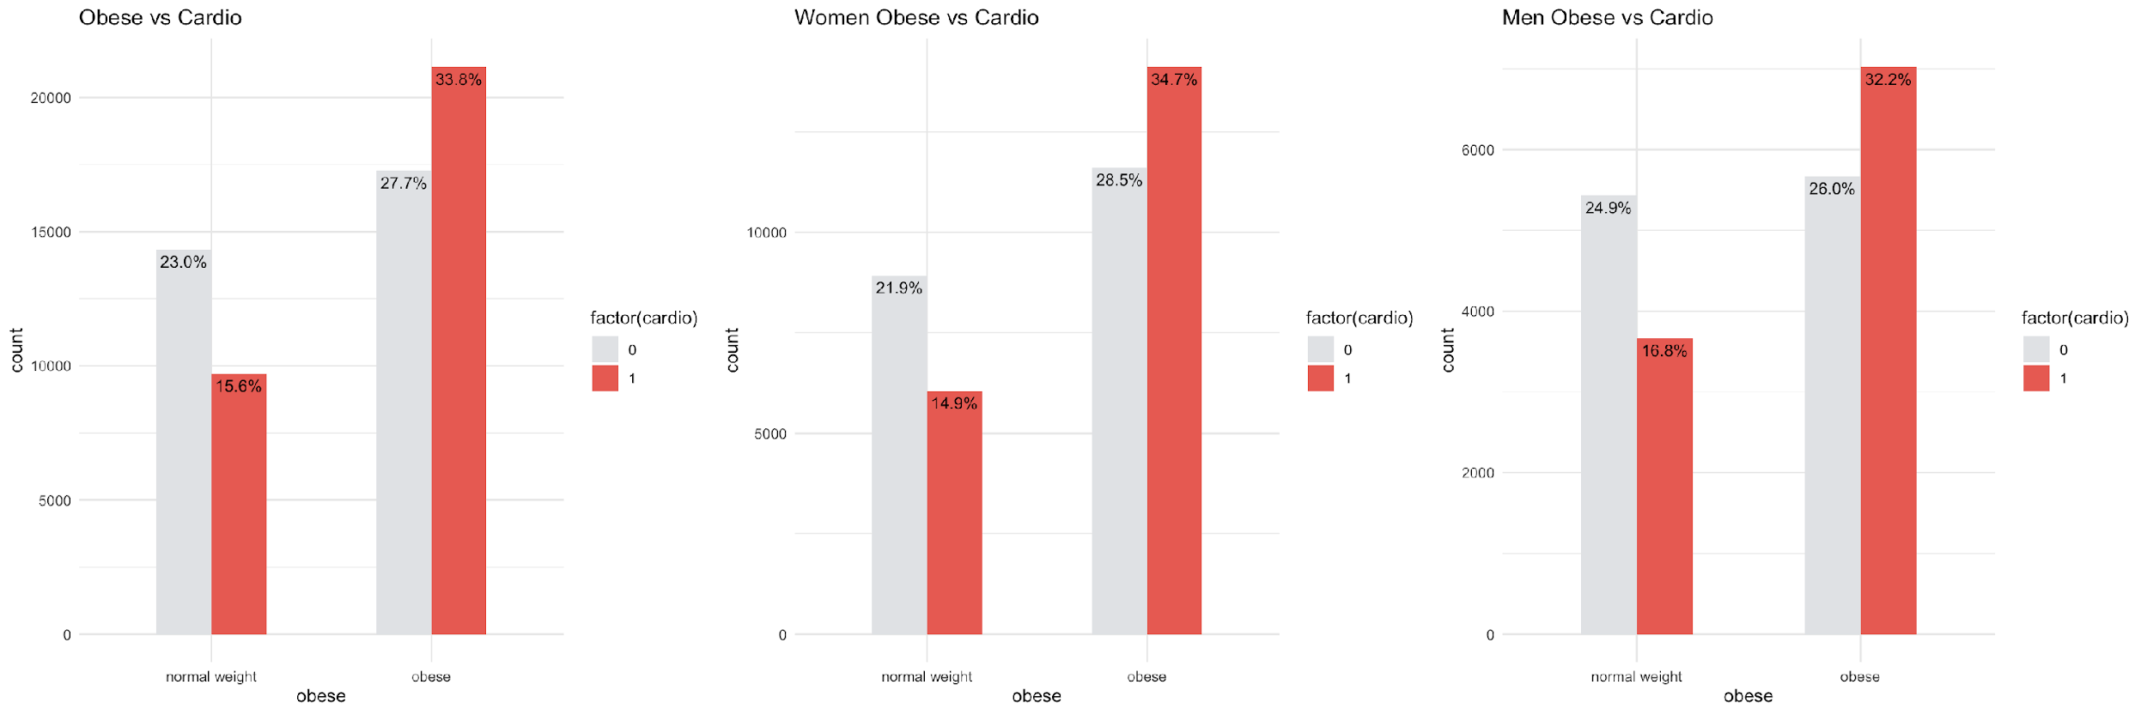
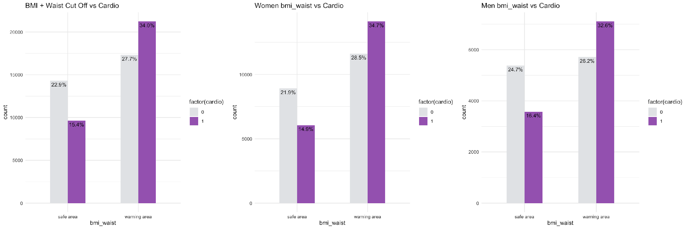
BMI and waist as predictors for cardiovascular diseases

Slide 7
Summary from part1
BMI values have a higher correlation with cardiovascular disease. Risk factors that contribute to high BMI value also contribute to the onset of cardiovascular disease
Smoking, age, gender, , blood glucose level, and alcohol use associated with the risk of cardiovascular diseases
Beside BMI value, waist circumference (WC) value is also a good variable for predicting cardiovascular diseases
Model building and evaluation

Slide 8
What are the risk factors of cardiovascular diseases? Are all the variables correlated to the development of cardiovascular disease?

Slide 9
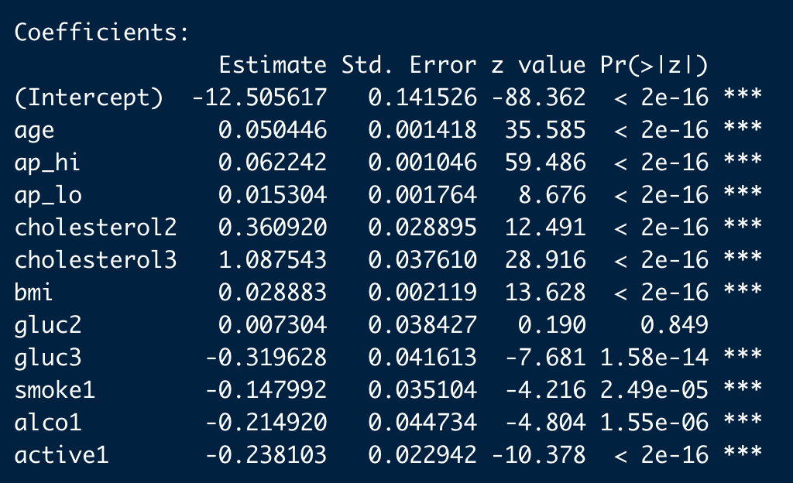
logistic regression model Glm() function
All the coefficients are found significant (small p-values) except gluc2. Age, ap_hi, ap_lo, cholesterol, bmi, glucose have positive effects on cardio diseases, while glucose, smoke, drinking alcohol and do exercise have negatively affect on cardio diseases. These are reasonable results and confirms our common beliefs.

Slide 10
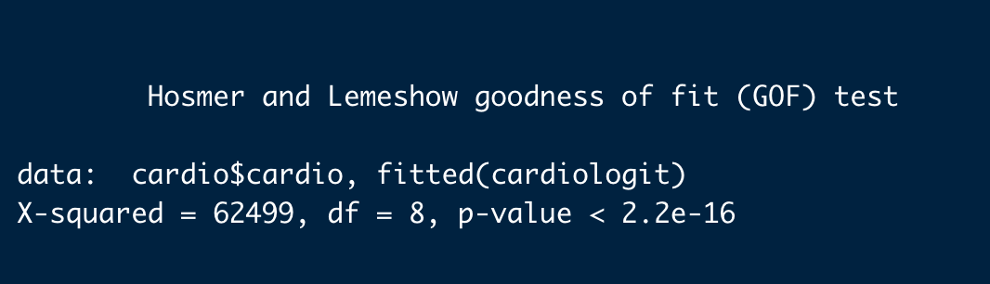
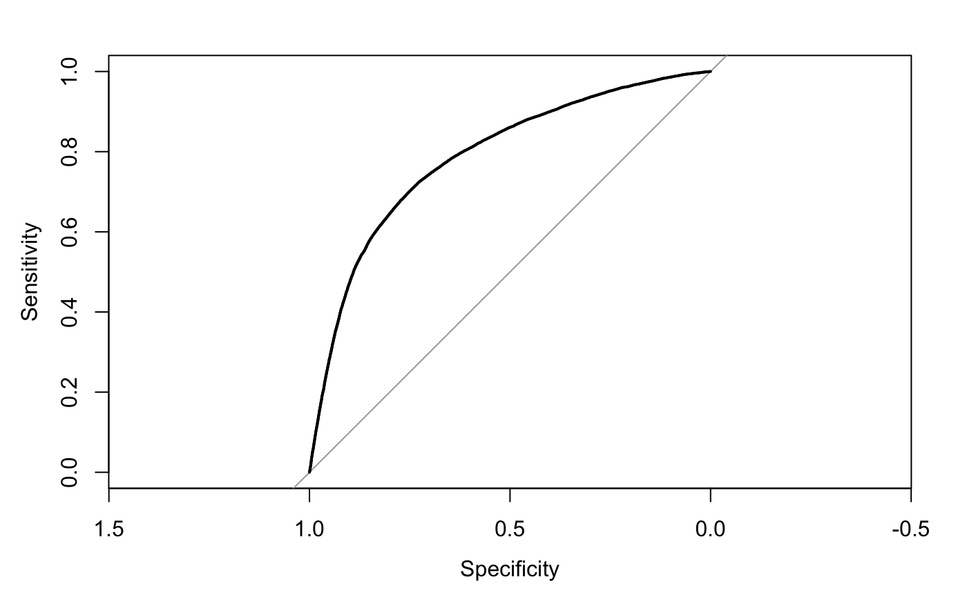
Model evaluation
Hosmer and Lemeshow test
p-value is smaller than 0.05. This indicates the model is a good fit
ROC curve and AUC
We have here the area-under-curve of 0.787, which is slightly less than 0.8. This test evaluates the model as a not so good fit.
McFadden evaluation
McFadden value is 0.1890877,
about 18.9% of the variations in cardio is explained by the explanatory variables in the model.

Slide 11
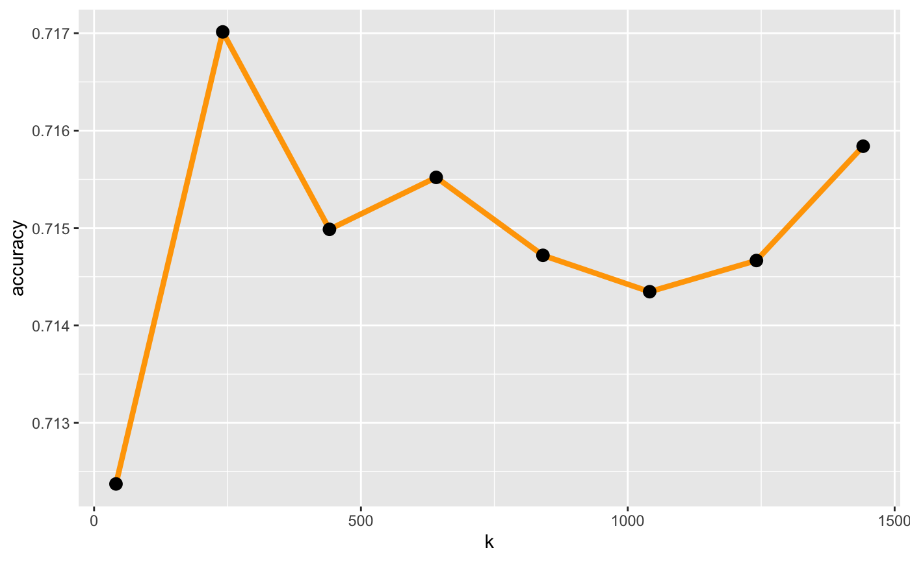
KNN clustering evaluation
Large k: Less sensitive to noise (particularly class noise)- Better probability estimates for discrete classes - Larger training sets allow larger values of k.
Small k: Captures fine structure of problem space better - High variability in decision boundaries (more complex models) - May be necessary with small training sets.
K value | accuracies
40 | 71.3%
250 | 71.8%
1575 | 71.6%
The peak is around 250, we would like to zoom into k around 250

Slide 12
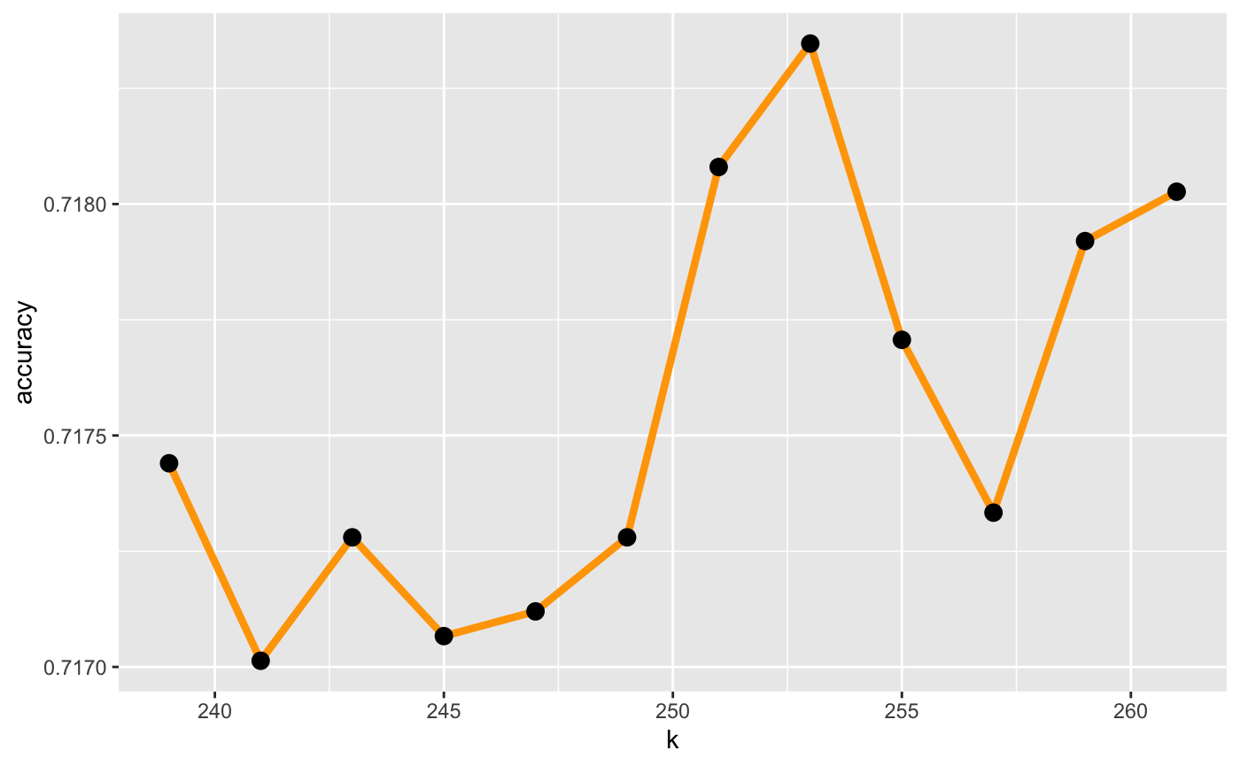
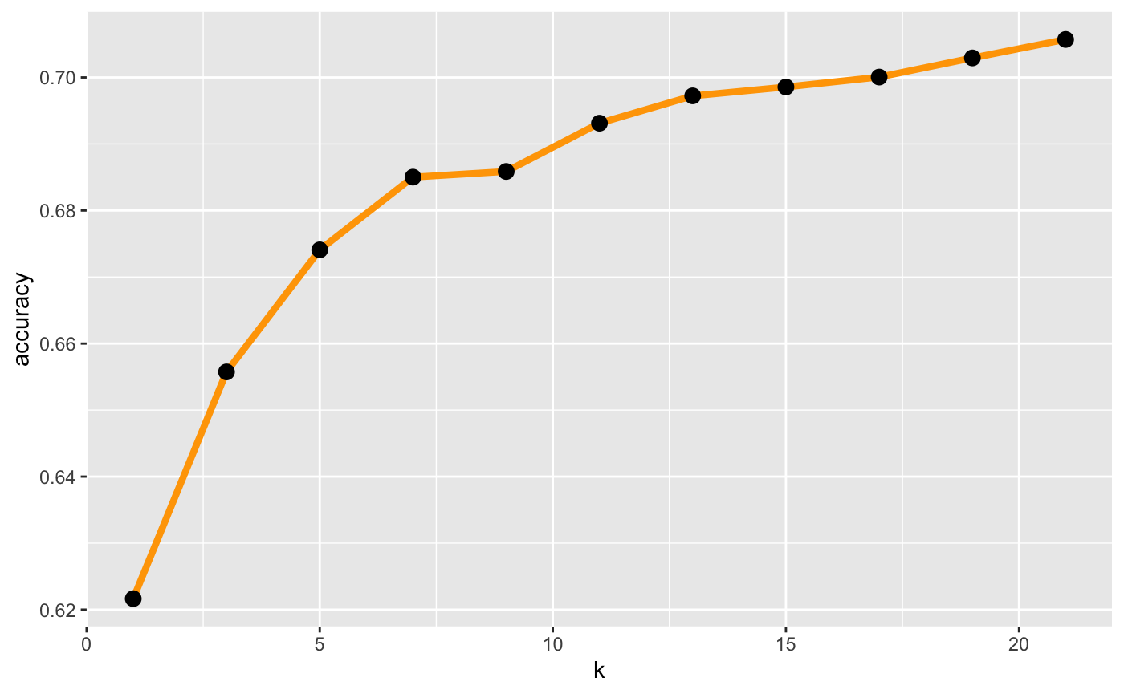
Calculating classification accuracy on the number of k
253-nearest neighbors has the best accuracy. However, it requires great amount of calculation
7-nearest neighbors is a efficient choice because that's the greatest improvement in predictive accuracy
253-nearest neighbors is a good choice, however, 7-nearest neighbors is a efficient choice

Slide 13
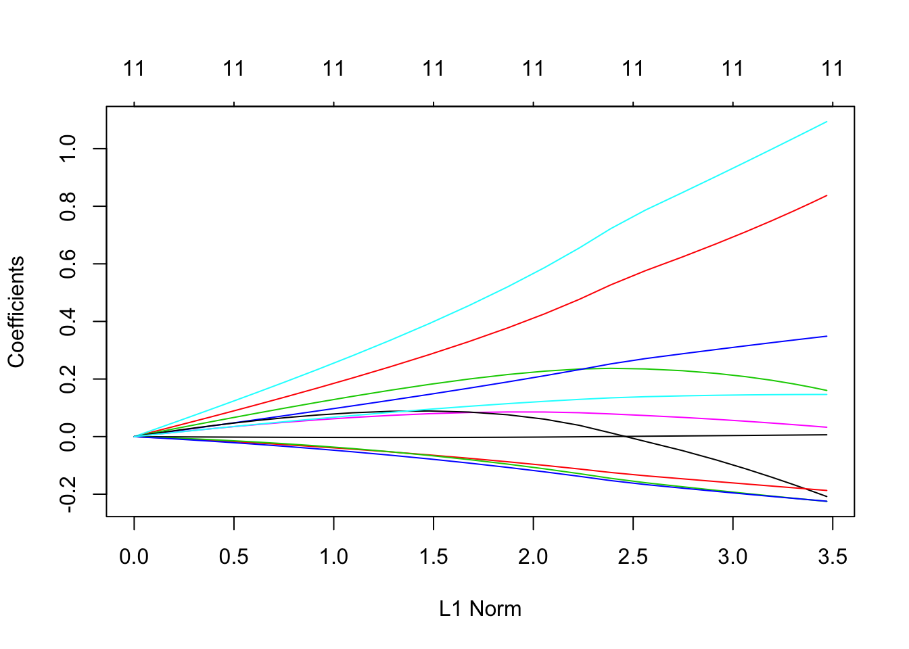
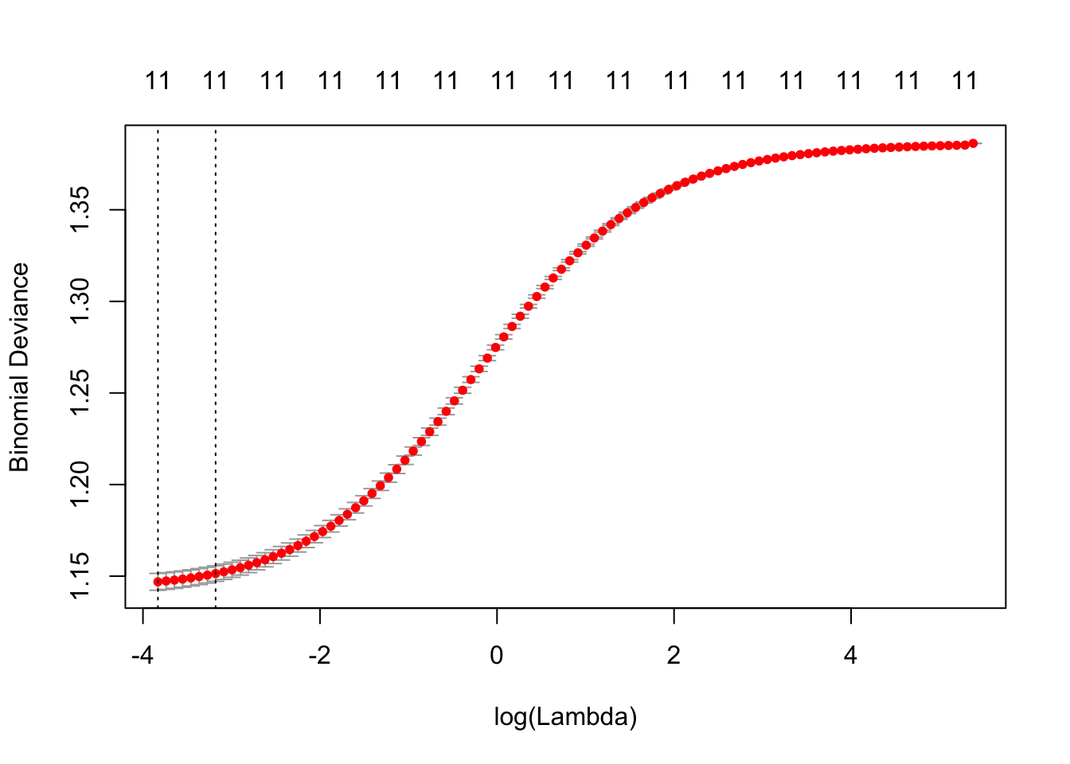
Ridge Regression
Purpose?
Regularization minimizes overfitting
The best λ for Ridge regression is almost 0, which gives the least square fit

Slide 14
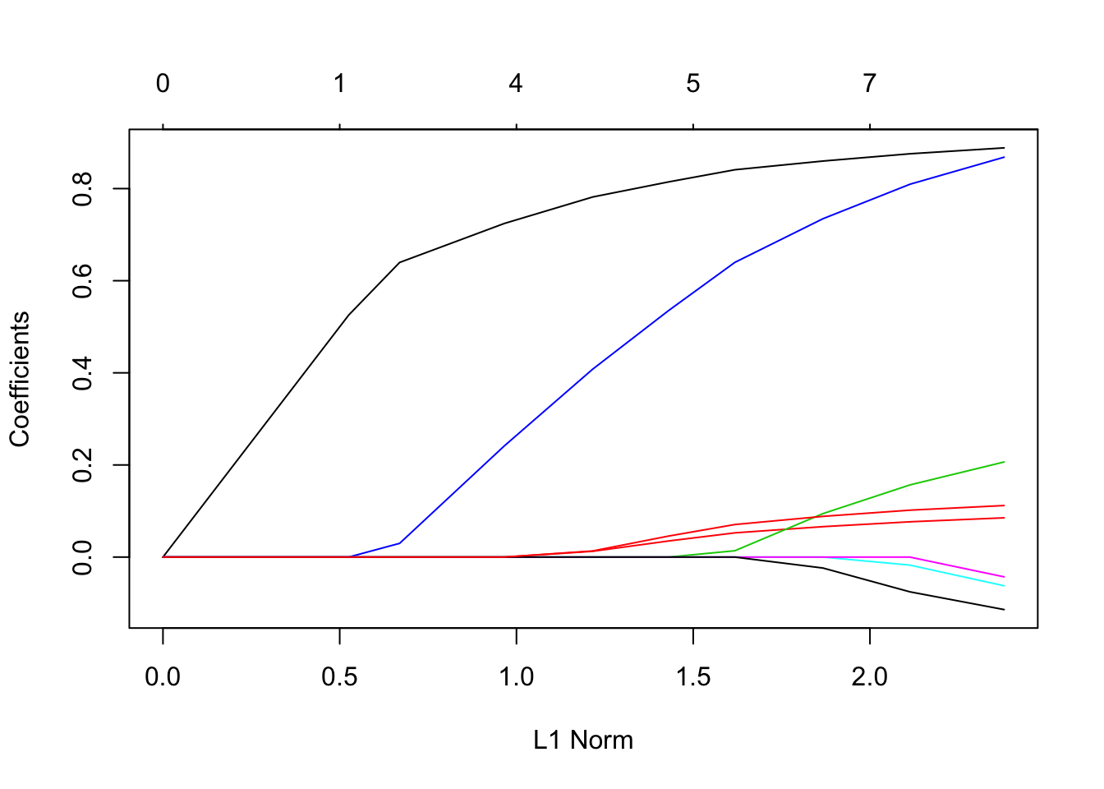
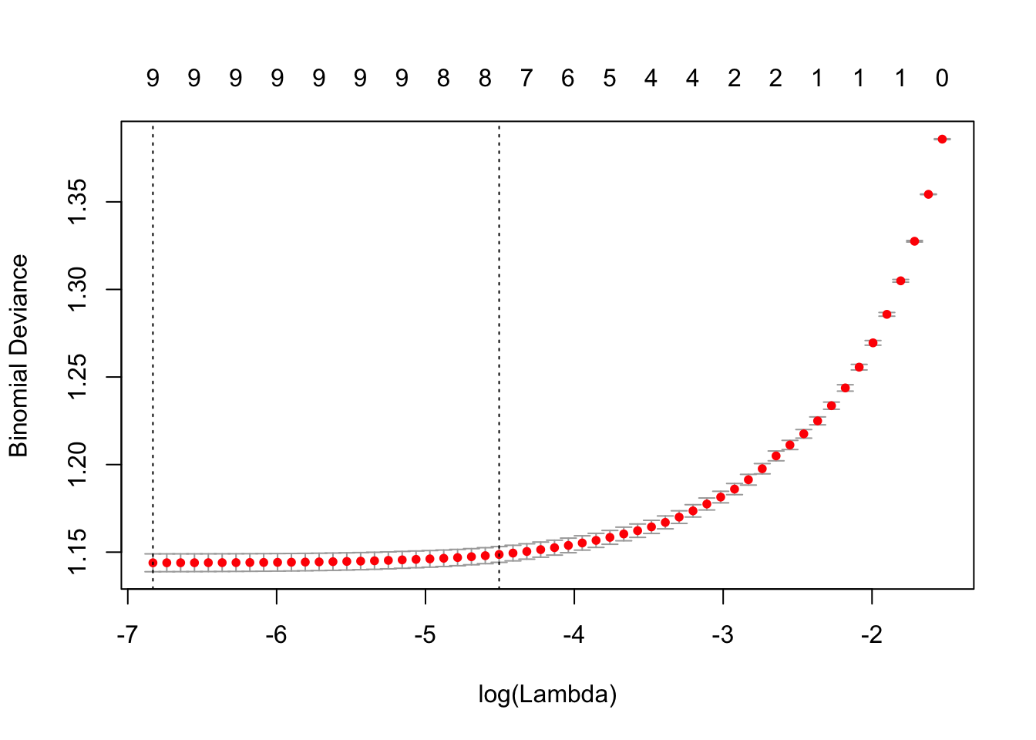
Lasso regression
The best λ for Lasso regression is almost 0, which gives the least square fit and agrees with Ridge Regression. However, gender and gluc are dropped from coefficients to avoid overfitting and this result match with the p-value calculated from full model of logistic regression

Slide 15
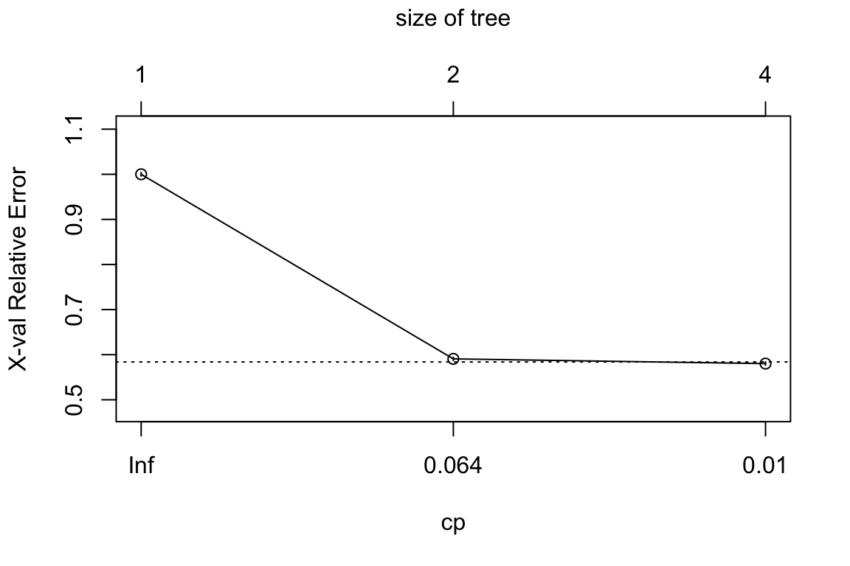
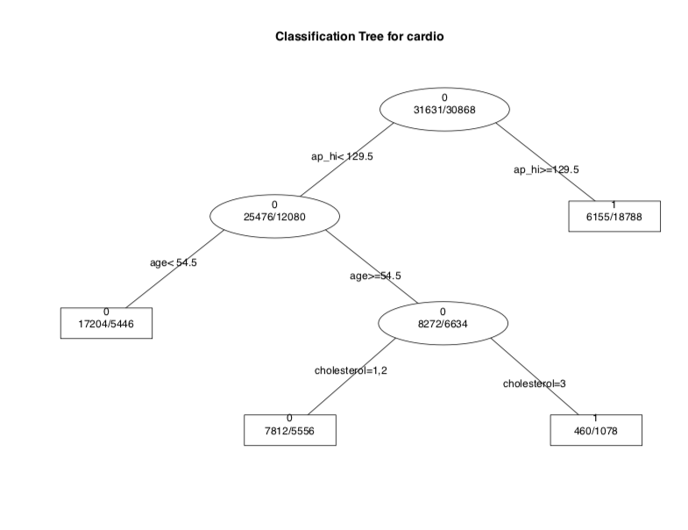
Decision Tree
Purpose?
To validate which variable will mostly cause cardiovascular diseases
Avoid overfitting the data based on the cp(complexity parameter).

Slide 16
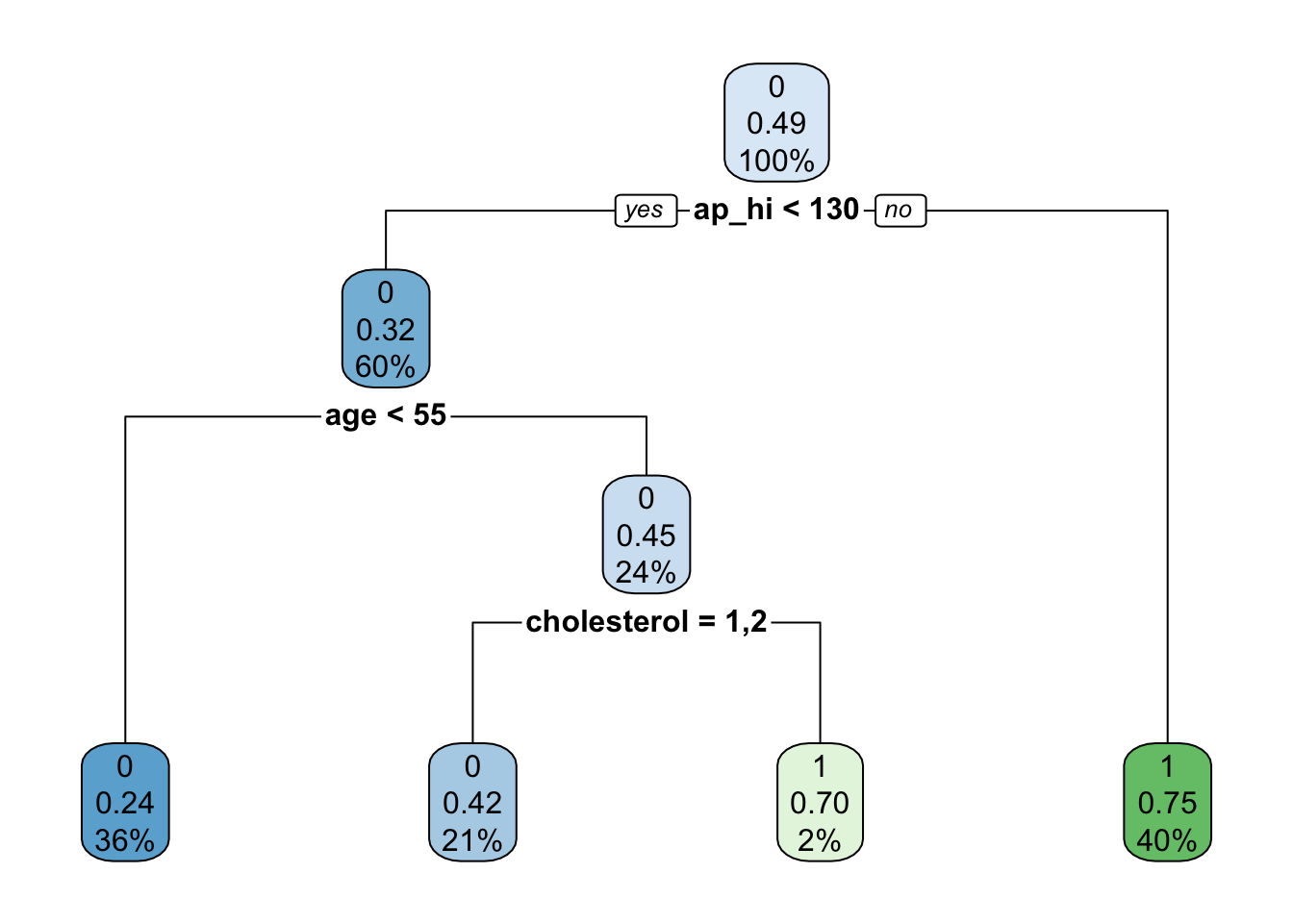
Decision Tree
Purpose?
To validate which variable will mostly cause cardiovascular diseases

Slide 17
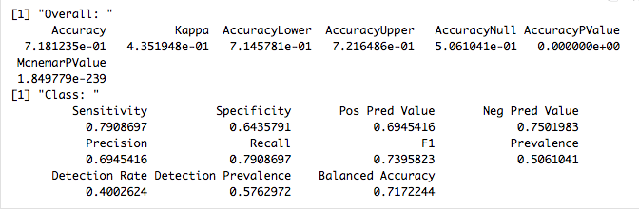
Decision Tree
The overall accuracy is 71.81%

Slide 18
Summary
Classification algorithm
Linear Regression
Logistic Regression
K-Nearest Neighbors
Decision Tree
Ridge Regression
Lasso Regression

Slide 19
Summary
Logistic Regression：
a machine learning method for solving binary (0 or 1) problems, which is used to estimate the likelihood of something.
Hosmer-Lemeshow test
AUC - ROC curve
McFadden’s R²

Slide 20
Summary
Ridge Regression and Lasso Regression:
Because overfit is an extremely common issue in many machine learning problems, there are different approaches to solving it. The main concept behind avoiding overfit is simplifying the models as much as possible.
The difference between ridge regression and Lasso regression is that ridge regression introduces the L2 norm penalty term, and Lasso regression introduces the L1 norm penalty term.
the biggest advantage of Lasso regression is that the features are sparse. Many θs can be changed to 0, which reduces the calculation of eigenvalues ​​and selects the more important features to avoid overfitting. At the same time, because the ridge regression requires all θ to exist, the calculation amount Lasso regression will be much smaller than the ridge regression. Also, if the sample has many eigenvalues, Lasso is better than Ridge.

Slide 21
Summary
K-Nearest Neighbors
By calculating the distance from each training sample to the sample to be classified and taking the K training samples closest to the sample to be classified, which category of the K samples has the majority of training samples, the sample to be classified belongs to which category.
Suitable for classification problems with large sample sizes.
Too much calculation.
For classification problems with a small sample size, misclassification will occur.
Decision Tree
A decision tree is a simple but widely used classifier that builds a decision tree from training data to classify unknown data.
No domain knowledge or parameter assumptions are required. Suitable for high-dimensional data, simple and easy to understand. A large amount of data is processed in a short time, and feasible and effective results are obtained.
For data with inconsistent sample numbers in each category, the information gain is biased toward those features with more numerical values.
Easy to overfit, ignoring correlations between attributes.

Slide 22
Summary
The regression model indicated that high level of cholesterol, blood pressure, age, and BMI are correlated with increasing risk of CVD
KNN clustering showed 253-nearest neighbors is a good choice, but 7-nearest neighbors is a efficient choice
Ridge and Lasso regression minimizes overfitting
Decision tree provided a classification system and used blood pressure, age, and cholesterol level for predicting CVD

Slide 23
Thank You! Questions?

