Slide 1
Visualization of countries spending
Xiaotian Huang

Slide 2
Introduction
GDP is of great significance for countries as a measure of economic well-being. It can be calculated using expenditure- which will be discussed in detail throughout this project- as well as production and incomes. The G20 (or Group of Twenty) is an international forum for the governments and central bank governors from 19 countries and the European Union (EU).
The GDP of G20 countries take an important place in the community of nations.
This project will analyze the correlation between GDP and the expenditure on education, healthcare, and military, among ten countries in G20, including Brazil, Canada, China, France, Germany, Italy, Japan, India, the United Kingdom, and the United States.

Slide 3
Dataset
All data in this project were retrieve from word bank database.
For healthcare dataset
2018 data is missing, the value for 2018 it is the averaged 2016 and 2017.

Slide 4
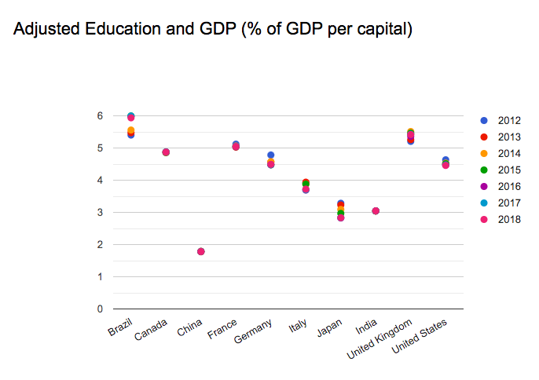
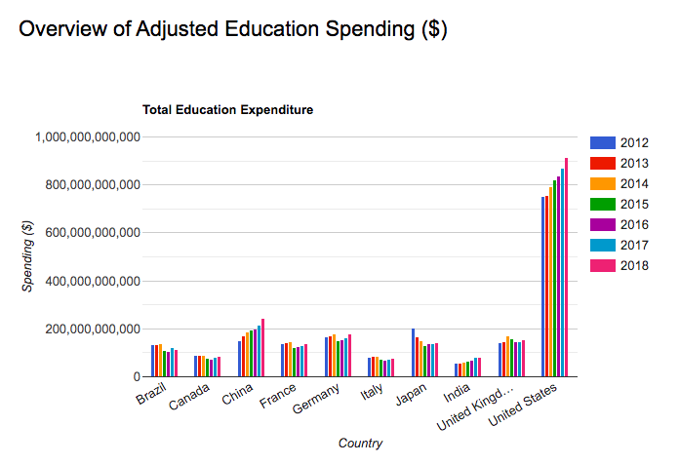
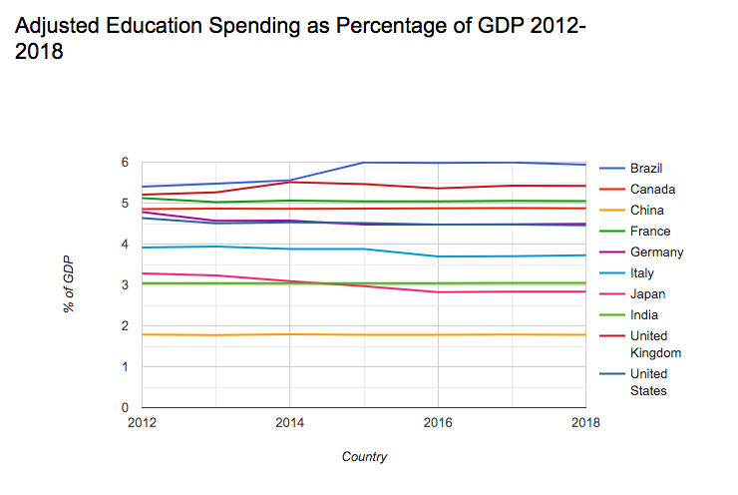
Education Spending

Slide 5
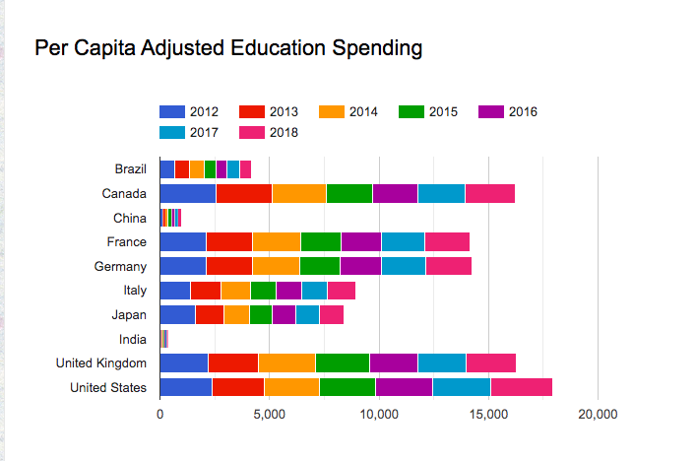
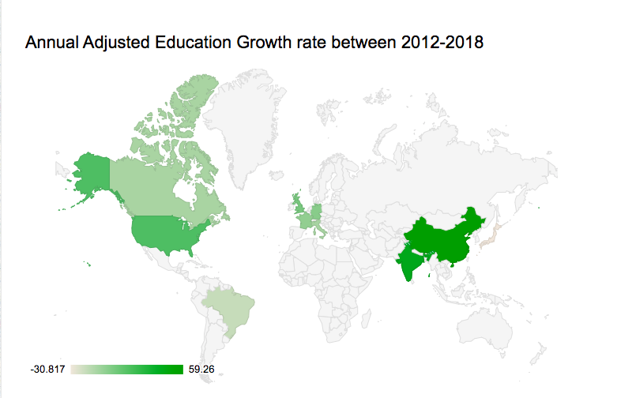

Slide 6
Conclusion
From 2012 to 2018,
The United States ranked top on overall educational expenditure.
Brazil ranked top on per capita educational expenditure.
Brazil spent the highest percentage of GDP on education.
China had the highest annual growth rate in education expenditure.

Slide 7
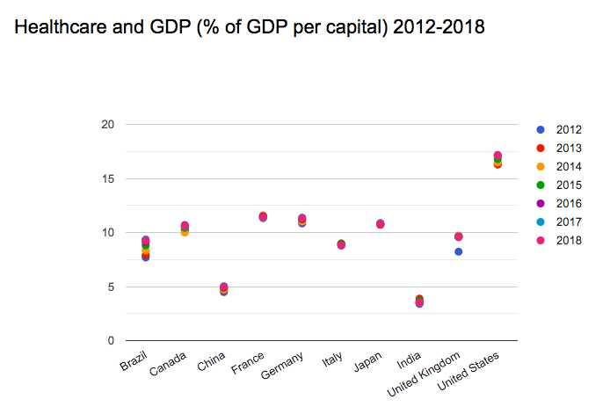
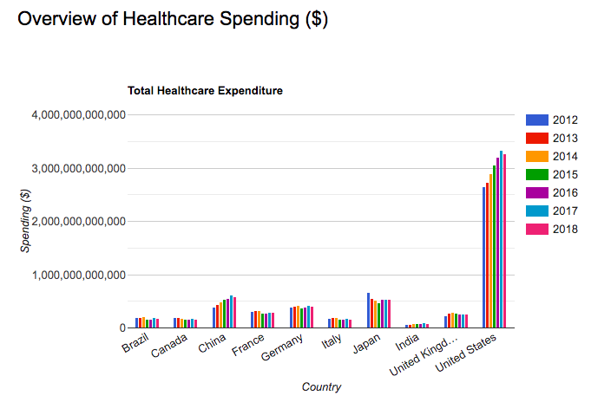
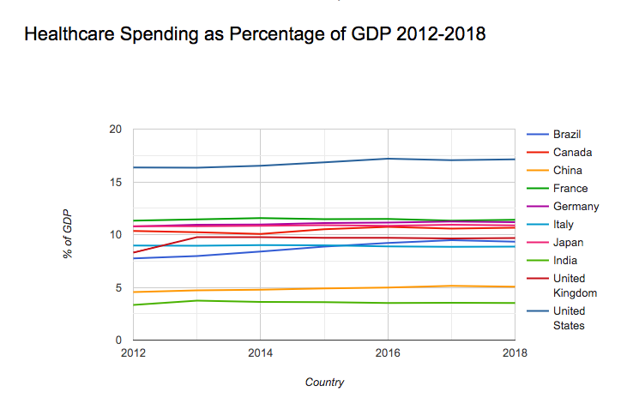
Healthcare Spending

Slide 8
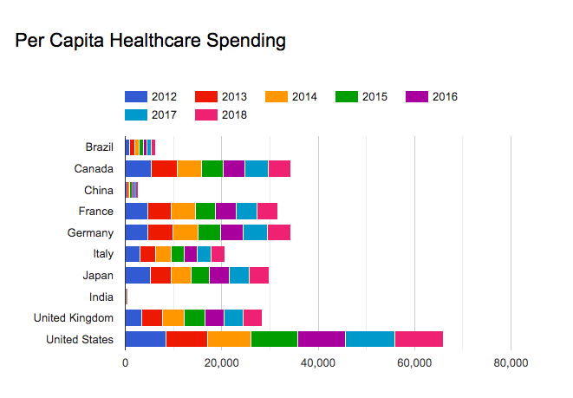
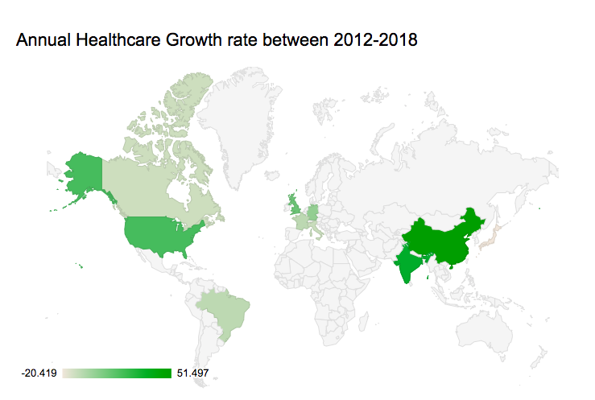

Slide 9
Conclusion
From 2012 to 2018,
The United States ranked top on overall healthcare expenditure.
The United States ranked top on per capita educational expenditure.
China had the highest annual growth rate in healthcare expenditure.

Slide 10
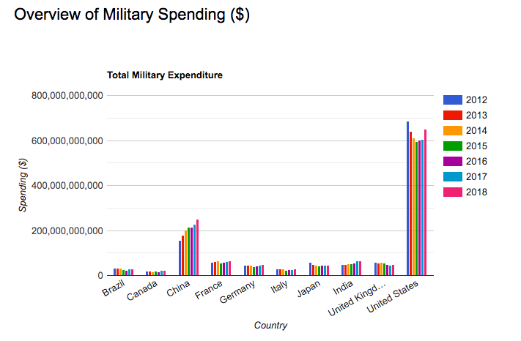
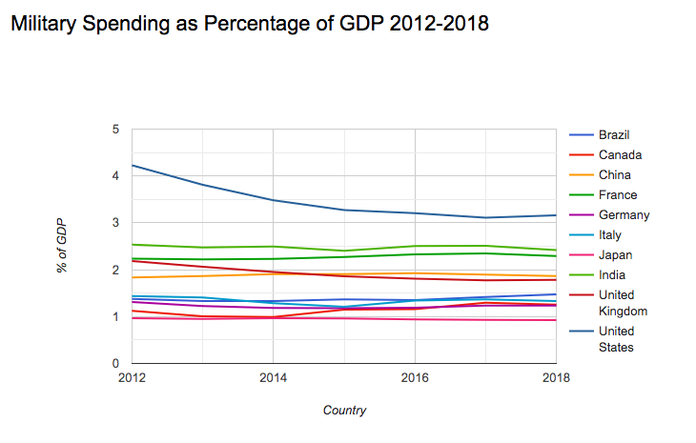
Military Spending

Slide 11
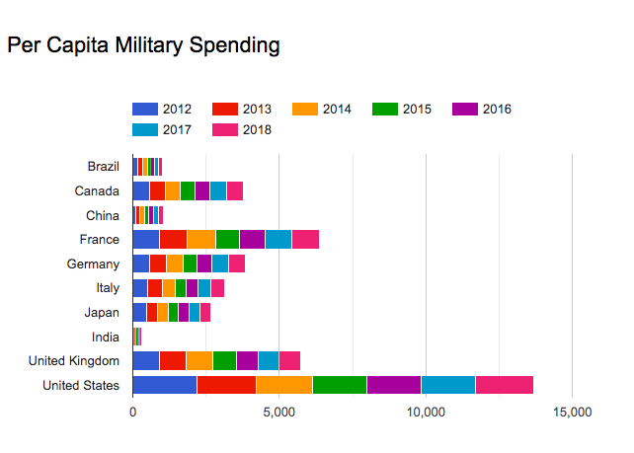
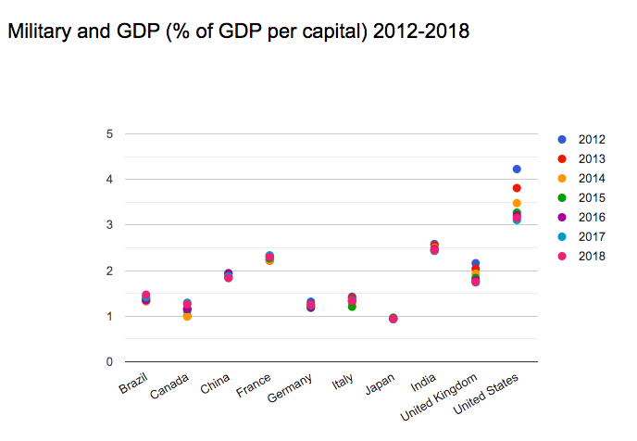

Slide 12
Conclusion
From 2012 to 2018,
The United States ranked top on overall military expenditure.
The United States ranked top on per capita military expenditure.
In 2016, the United States spent more on healthcare than on education and military.
Brazil decreased military expenditure.

Slide 13
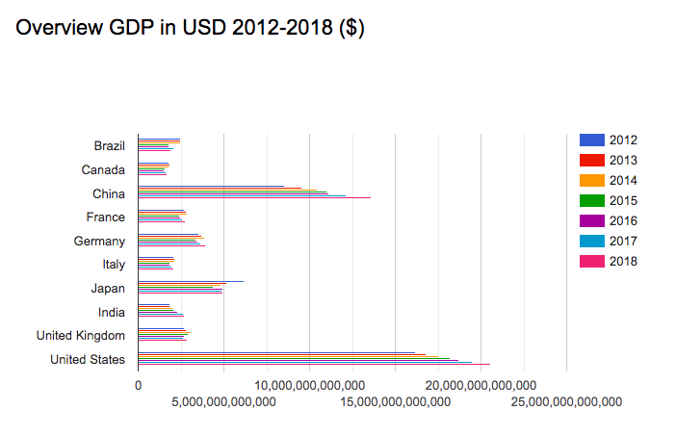
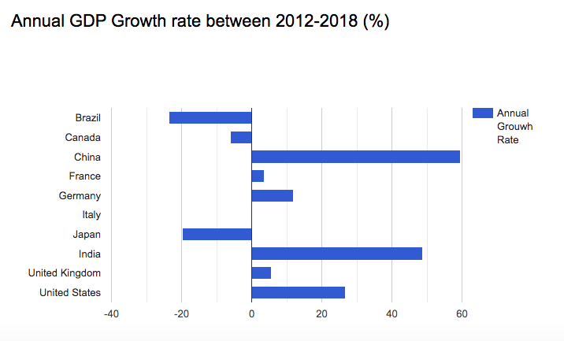
More analysis -GDP

Slide 14
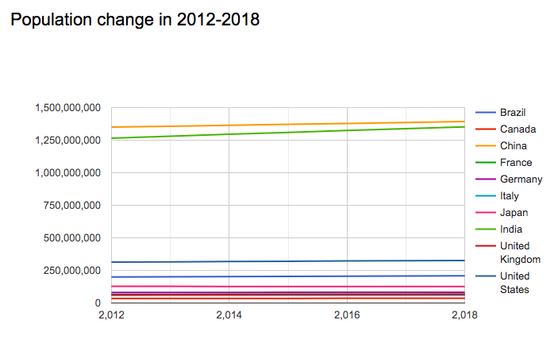
Population

Slide 15
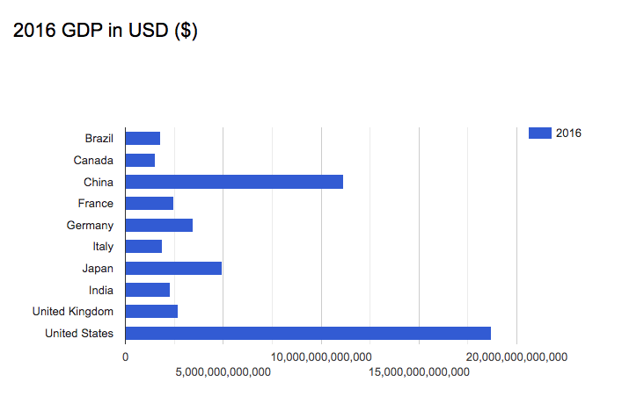
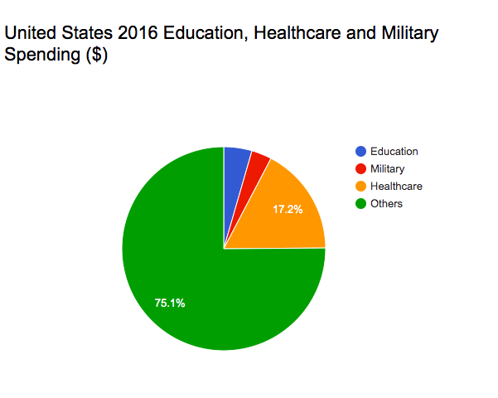
2016 GDP and United States spending

Slide 16
Published
Github
https://xhuang222.github.io/G20-spending-analysis/project/index.html
Zenodo
https://zenodo.org/record/3883436#.Xt23D2pKjBJ

Slide 17
Thank you !

