Slide 1
CHAPTER 2: THE RELATIONAL DATA MODEL
数据库原理与实践
Database Systems-
Principle and Practice

Slide 2
CHAPTER 2: THE RELATIONAL DATA MODEL
Definition: A data model is a tool that can be used to specify (describe) the
real-world objects (entities),
relationships among them,
constraints on them, and
the manipulation of them.

Slide 3
Relational Database Model
started:1970 "A Relational Model of Data for Large Shared Data Banks".
topics:
  relation and relational database,
  realworld objects and relational representation
  integrity and constraints

Slide 4
Terminologies of a Relation
relation name
Attr1 Attr2 Attr3 Attr4
v11 v12 v13 v14
v21 v22 v23 v24
v31 v32 v33 v34
Relation name
Attributes
head
Records
(tuples,rows)
columns

Slide 5
Schema
An attribute corresponds to a column heading.
the schema of the relation is a description the structure of the table.
Head (Students) = (SID, Name, Age, GPA)
Students(SID, Name, Age, GPA)

Slide 6
Schema and State
Two aspects of a relation:
Schema --- the set of attributes of R.
State (or contents) --- the CURRENT set of tuples of R .

Slide 7
Schema and State
Once the schema of a relation is decided, it will be very costly to change
Some possible changes are:
delete an attribute
insert an attribute
rename an attribute
delete the schema

Slide 8
Schema and State
Whereas the state of a relation changes frequently in most relations.
Some possible changes are:
  update some attribute values
  Insert a new tuple
  Delete an existing tuple
A given schema may have different states at different times.

Slide 9
A Relational Database
A relational database consists of a set of relations.
A relational database schema consists of a set of relation schemas.
A database state is the data that is currently present in the database.

Slide 10
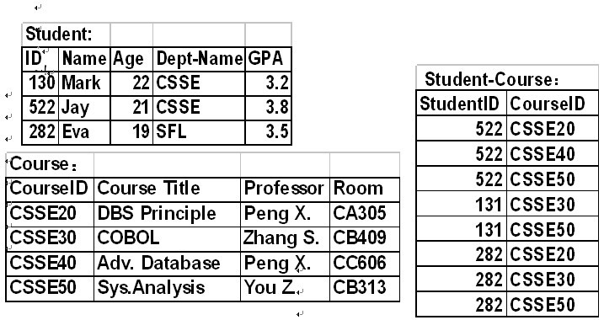
An Example Database

Slide 11
Characteristics of a Relation 1
1.Changing the order of attributes or tuples does not affect the meaning of the relation (columns and rows can be in any order)
name | age | ID | group
Smith | 34 | 45 | alpha
Patel | 29 | 88 | beta
Smith | 32 | 102 | alpha
Jones | 24 | 106 | alpha
ID | name | age | group
102 | Smith | 32 | alpha
106 | Jones | 24 | alpha
88 | Patel | 29 | beta
45 | Smith | 34 | alpha

Slide 12
Characteristic of a relation 2
2. There shouldn’t be any two identical rows within a relations - no duplicate rows
3 . There shouldn’t be any multi-value items in any cell( a row/column intersection) of a relation

Slide 13
Null Value (1)
For a given tuple t and a given attribute A of a relation R, the following cases may occur when t is to be inserted into R.
t[A] is unknown.
t[A] is yet to be assigned.
t[A] is inapplicable.
When one of the above cases occurs, assign a null value to t[A]: t[A] = null.

Slide 14
Null Value (2)
Note: A null value is different from either a 0 or a space!
In SQL, any arithmetic expression involving null will be evaluated to null.

Slide 15
Superkey (1)
Definition: A superkey of a relation is a set of attributes whose values can uniquely identify every potential tuple of the relation.
Examples:
Attribute ID is a superkey of relation Students .
The set of attributes {Name, Birthday, Home_Address} may be a superkey of Students in some cases.

Slide 16
Superkey (2)
Is the set of all attributes of a relation a superkey of the relation?
Is the set {ID, Name} a superkey of Students?
In the following relation, is attribute A a superkey? How about {B, C}? (Assumption?)
A B C D
a1 b1 c1 d1
a1 b2 c2 d1
a2 b2 c1 d1
a2 b1 c2 d1

Slide 17
Superkey (3)
Some claims:
Every relation has at least one superkey.
Any superset of a superkey is a superkey.
From a given state of a relation, we may determine whether a set of attributes of the relation does not form a superkey, but we can not determine if a set of attributes forms a superkey.

Slide 18
Key (1)
Definition: A set of attributes is a key of a relation if (1) it is a superkey of the relation, and (2) no proper subset of it is a superkey of the relation.
A key of a relation can uniquely identify every (potential) tuple of the relation.
If any attribute is removed from a key, then the remaining attributes no longer form a key (minimality property).

Slide 19
Key (2)
Example: For relation Students (ID, Name, Home_Address, Birthday, GPA),
ID is a key.
{ID, Name} is a superkey but not a key.
{Name, Home_Address, Birthdate} is also a key.

Slide 20
Key (3)
Every relation has at least one key.
A relation may have more than one key.
From a given state of a relation, we may determine whether a set of attributes of the relation does not form a key, but we can not determine if a set of attributes forms a key.
Keys of a relation are also known as candidate keys of the relation.

Slide 21
Candidate Key
Example: Find all possible candidate keys for the following relation based on its current tuples.
A B C D
a1 b1 c1 d1
a1 b2 c2 d1
a2 b2 c1 d1
a2 b1 c2 d1
Answer: {A, B}, {A, C}, {B, C}.

Slide 22
Primary Key (1)
Definition: A primary key of a relation is the candidate key chosen by the database designer for a particular application.
The primary key of each relation is chosen and declared at the time when the relation is defined. Once chosen, it cannot be changed.
The primary key is usually chosen to be the candidate key that has the smallest number of attributes to improve both storage efficiency and query processing efficiency.

Slide 23
Primary Key (2)
With the primary key defined, only the values under the attributes in the primary key need to be checked for identifying duplicate when new tuples are inserted (index is often used).
The primary key of a relation is often used in references from other relations.

Slide 24
Foreign Key (1)
Definition: A set of attributes FK of relation R1 is a foreign key in R1 if it satisfies the following two conditions:
There is a relation R2 with the primary key PK such that FK and PK have the same number of attributes with compatible domains.
For any tuple t1 in R1, either there exists a tuple t2 in R2 such that t1[FK] = t2[PK] or t1[FK] is null.

Slide 25
Foreign Key (2)
Employees EID Name Age Dept-Name
123456789 John 45 Sales
234567891 Mary 42 Service
345678912 Bob 39 null
Departments Name Location Manager
Sales Shanghai Bill
HR Shenzhen Charles
Service Beijing Maria
Dept_Name of Employees is a foreign key referencing Name of Departments

Slide 26
Foreign Key (4)
Using a foreign key of a relation to reference the (primary) key of another relation is THE WAY used by the relational data model to establish relationships among different relations.

Slide 27
Foreign Key (3)
Foreign keys need to be explicitly defined.
R1 and R2 in the definition could be the same relation, for eg.
Employees(ID, Age, Salary, Position, Manager_ID).
The primary key in the definition may be replaced by a candidate key.

Slide 28
Representing the Real World to Relation
from relational View :
real world=Objects(Entities) + Relationship
How to represent objects and relationships?

Slide 29
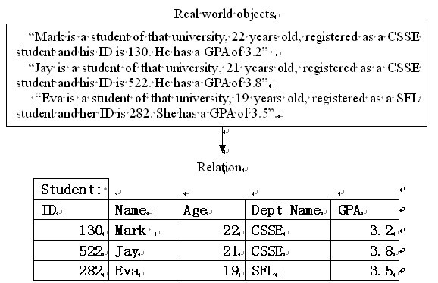
Objects to Relations

Slide 30
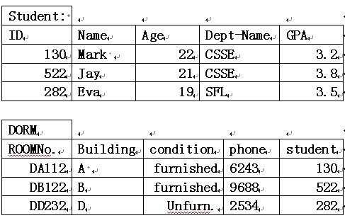
Relationships to Relations
1to1 mapping:

Slide 31
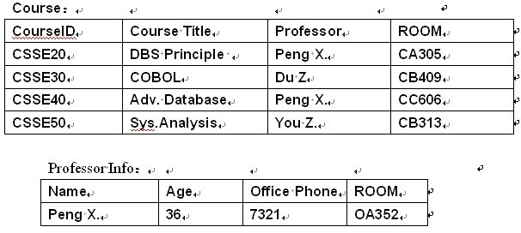
1 to many

Slide 32
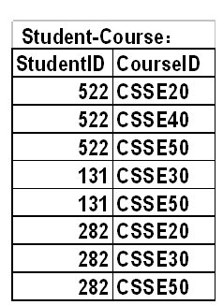
many to many

Slide 33
Database Integrity
Definition: | Data Integrity
 | Correctness and consistency of data against a stated set of constraints during the “normal” operation of the database.
DBMS cannot protect against all accidental errors
a date being entered incorrectly,
mistyping a name,
BUT
DBMS should protect against unreasonable entries, updates, deletions etc.
age > 120
salary > max_salary
making employees redundant without removing them from the payroll data.

Slide 34
Types of Integrity Constraints
1. The data model underlying the DBMS may have its own integrity constraints.
For example: the relational model has two forms of integrity rule which must be satisfied
Entity Integrity
Referential Integrity

Slide 35
constraints
There are also a set of constraints regarding “permitted” values for one or more attributes.
Domain Constraints
In addition most DBMS permit additional (general) constraints known as
user specified integrity constraints
(also known as enterprise constraints, or business rules)
Ideally the DBMS should enforce ALL the above types of constraint - however it often falls to the application program to protect against integrity violations.

Slide 36
Relational Model: Entity Integrity
1. a database reflects some part of “reality”
2. unique objects in the "real" world must be identifiable and unique within the database
3. objects are identified using identifiers (keys) made from 1 or more attributes
4. identifiers must be
unique (for a given object type)
minimal (have no spurious attributes)
That is the reason why PRIMARY KEY is NEEDED

Slide 37
Entity Integrity Rule No component of the primary key of a base relation is allowed to accept nulls.
Justification
a null valued key implies a missing, or unknown, identity.
If the identity is missing then the object in the real world is not identifiable.
If the identity is unknown then you cannot know if the object is already in the database - therefore you cannot tell that if the identity is unique.

Slide 38
Referential integrity rule The database must not contain any unmatched foreign key values.
During update or delete
Restricted
Update/Delete only if no foreign key exists
Cascades
Update/Delete operation cascades to update/delete the foreign key entries
Nullifies (or set default value)
Update/Delete primary key values &
Null (or default value) in the foreign key entry.

Slide 39
Domain Constraints
Each value appearing in a particular place in the database should come from a specific domain of values appropriate to the use of the value.
Defn: Domain a set of all possible correct values
These can be defined as an explicit set of values:
supplier code domain = (S1, S2, S3, S4, S5)
a range of valid values:
age domain = (0 .. 120)
or a pattern which values must satisfy:
employee code domain = ( AAAA9999AAA)
(4 letters followed by 4 digits followed by 3 letters)
or (sometimes) just a datatype:
size domain = integer
or combinations of the above.

Slide 40
SQL for domain constrain
Create TABLE t (
attributeA DATE,
attributeB VARCHAR2(30) NOT NULL,
attributeC CHAR(5) NOT NULL,
)

Slide 41
User Specified Integrity Constraints
Categories of User Specified Integrity Constraints
Relation rules
record constraints
set constraints
which may be
static
dynamic (before and after alterations)

Slide 42
Relation Rules
What combination of attribute values are acceptable in a relation?
Record constraints
Set constraints
treat the relation one row at a time
For all
Vehicle.Type = CAR
then Vehicle.Wheels = (3,4)
Vehicle.Type = CYCLE
then Vehicle.Wheels = (2,3)
Vehicle.Type = HOVERCRAFT
then Vehicle.Wheels = null
This prevents meaningless combinations of data for an individual object in the database.
apply to the relation as a whole, that is all data in the table
SUM(employee.salary) < limit
COUNT(distinct dept.car) < 10
AVG(staff.overtime) IN [+/- 10% of 6]

Slide 43
Relation rules may be Static or Dynamic
Static constraints
must hold between data items at ALL times.
employee.salary < manager.salary
IN employee, manager
WHERE
employee.mgr# = manager.mgr#
Dynamic constraints
must hold between database states before AND after changes to the relation or relations
the total achieved credits of each student must not decrease in consecutive semesters

