Slide 1
数据库原理与实践
Database Systems-
Principle and Practice

Slide 2
Relational Algebra
Chapter Outline:
3.1 Relational Algebra(RA)
3.2 Simple and Complex Queries using RA
3.3 Structure Query Language(SQL)
3.4 Creating SQL Database and Tables
3.5 Selecting Data
3.6 Data Insertion、Updating and Deletion
An Introduction to Database System

Slide 3
Relational Algebra
What is relational algebra?
Relational algebra is a collection of operations that are used to manipulate the entire set of relations. The output of any relational algebra operation is always a relation.
What are the Operations?
  Set operations like union, intersection, difference, and Cartesian product.
  Selection, Projection, and Joining.

Slide 4
Union (∪)
The result of this operation, i.e. R ∪ S, is a relation that includes all tuples that are either in R or in S or in both. Duplicate tuples will not appear in the output.
Formally: R ∪ S = { t | t ∈ R or t ∈ S }
Union Compatibility: Let R and S are two relations with attributes (A1, A2, …, An) and (B1, B2, ….., Bn) respectively. If R and S are to be unioned, it should satisfy the following two rules:
Rule 1: The relations R and S must have the same degree.
Rule 2: The domain of the ith attribute of R and the domain of the ith attribute of S must be same.
dom(Ai) = dom(Bi), where, 1 ≤ i ≤ n.

Slide 5
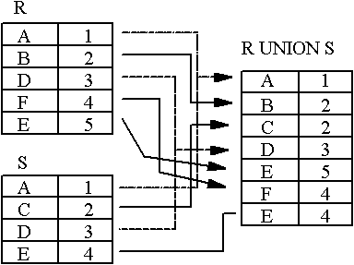
Example
An Introduction to Database System

Slide 6
Relational Difference (-)
Like union, the relational difference operator also requires its operands to be of the same type.
Format: R - S
Formally: R - S = { t | t ∈ R and t ∉ S}
Semantics: Given two relations R and S of the same type, the difference between those two relations, R- S, is the relation containing all tuples of R that do not appear in S.
An Introduction to Database System

Slide 7
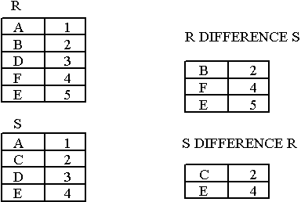
Example
Notice that Difference has a directionality to it, e.g. R-S and S-R are not the same thing.
An Introduction to Database System

Slide 8
Intersection(∩)
The expression R ∩ S returns all tuples that appear in both the relations R and S.
Like union and difference, the relational intersection operator requires its operands to be of the same type.
Formally: R ∩ S = { t | t ∈ R and t ∈ S}
Derivation from existing operators:
R ∩ S = R - (R - S) = S – (S - R)
An Introduction to Database System

Slide 9
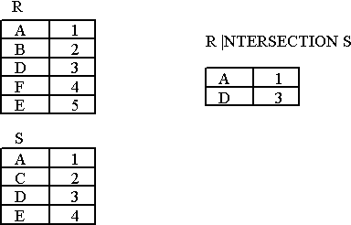
Example
An Introduction to Database System

Slide 10
Cartesian Product (×)
The Cartesian product or cross-product is a binary operation that is used to combine two relations. Assuming R and S as relations with n and m attributes respectively, the Cartesian product, R × S can be written as,
R (A1, A2, …, An) × S (B1, B2, …, Bm)
The result of the above set operation is,
Q (A1, A2, …, An, B1, B2, …, Bm)
Where,
Degree (Q) = n + m
count(Q) = Number of tuples in R * Number of tuples in S.

Slide 11
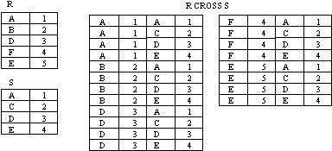
Example
An Introduction to Database System

Slide 12
Special Relational Operations-Sample Relations
Figure 3.5 Student
SSN | SNAME | GPA | AGE | DEPARTMENTID
2007001003 | CHENGLICHONG | 3.33 | 20 | 31
2007001005 | ZHONGWEILONG | 3.62 | 20 | 33
2007001006 | WUYUANLANG | 4.01 | 20 | 33
2006001001 | LUOZI | 3.12 | 20 | 34
2006001002 | GUOHUAXIAN | 3.21 | 21 | 34
2006001004 | LELINGBING | 3.75 | 21
2007002001 | ZHUJIANGUO | 3.05 | 19
An Introduction to Database System

Slide 13
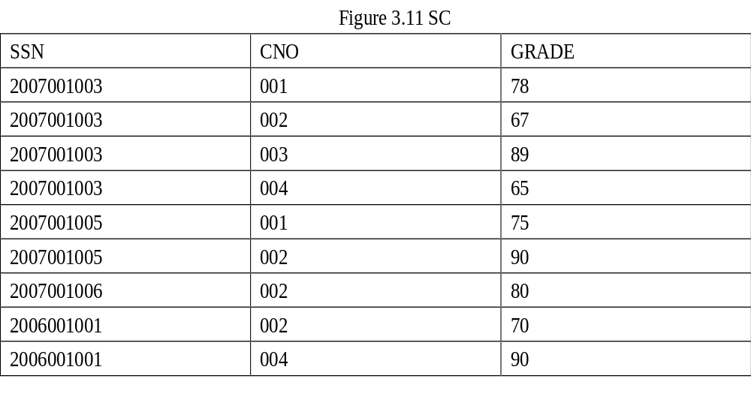
An Introduction to Database System

Slide 14
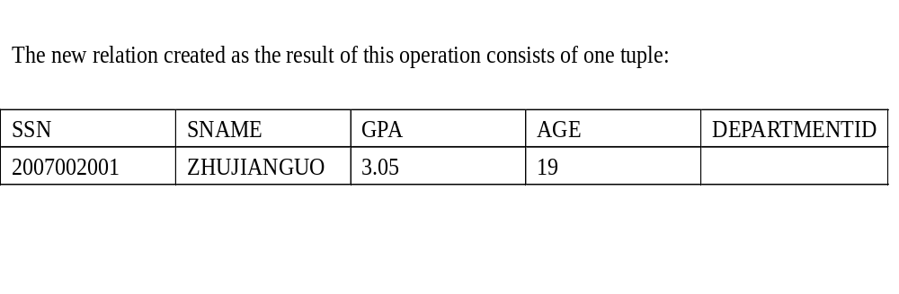
The SELECT operation (σ)
The select operation retrieves a subset of tuples in a relation that satisfy a selection condition.
σ_{<selection-condition>} (Relation)
Query-1: Find the students whose age is 19.
σ

Slide 15
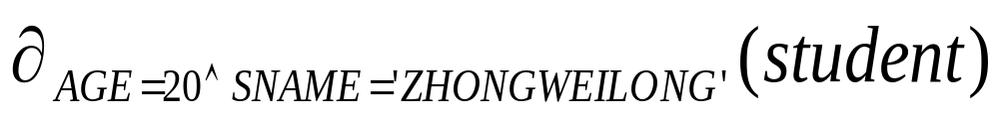
The SELECT operation (σ)
Query-2: Select tuples (rows) of the student relation where the AGE is 20 and Name is ZHONGWEILONG, we could write:
An Introduction to Database System

Slide 16
One of the interesting properties of the selection operation is that it is commutative. Therefore, all the expressions shown below are equivalent,
  σ_{condition-1} (σ_{condition-2} (R))
  σ_{(condition-1 AND condition-2)} (R)
  σ_{condition-2} (σ_{condition-1} (R))

Slide 17

The Projection Operation (π)
The projection operation is used to select only few columns from a relation.
π_{<attributes>} (Relation)
Query-3: List the age of all the students.
π_{age}(student)
π

Slide 18
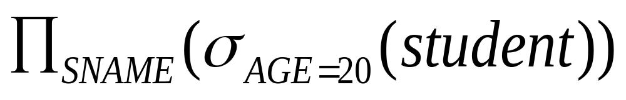
Select and Project
We can perform these operations on the relations resulting from other operations. To get the names of students having the AGE as 20, we write:
An Introduction to Database System

Slide 19
Join (∞)
Join (∞)
  Theta Join
  EquiJoin
    Natural Join
    Left Outer Join
    Right Outer Join
    Full Outer Join

Slide 20
Join (∞)
Format: R ∞ join-condition S
Semantics: Return all tuples in R × S which satisfy the join condition.
Derivation from existing operators:
R ∞ _{join-condition} S = σ_{join-condition}(R × S)
Format of join condition:
R.A op S.B
R.A1 op S.B1 and R.A2 op S.B2 . . .

Slide 21
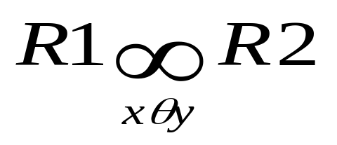
Theta Join (Θ) or NonEqui Join
Let R and S are two relations. Consider an attribute x in R, and an attribute y in S. The theta join of these two relations can be written as,
where Θ indicates any valid relational operator other than =.

Slide 22
Example
B
E
b₁
3
A
B
C
b₂
7
a₁
b₁
5
b₃
10
a₁
b₂
6
a₂
b₃
8
b₃
2
a₂
b₄
12
b₅
2
R
S

Slide 23
Theta Join
R ∞ S
C＜E
A
R.B
C
S.B
E
a₁
b₁
5
b₂
7
a₁
b₁
5
b₃
10
a₁
b₂
6
b₂
7
a₁
b₂
6
b₃
10
a₂
b₃
8
b₃
10

Slide 24
Equijoin (∞ )
A join is called an equijoin if only equality operator is used in all join conditions.
The general form for this kind of join is,
  <Join_condition> must always have = operator

Slide 25
Equijoin
R S R ∞R.B = S.B S
A B B C A R.B S.B C
a b b c a b b c
d b c d d b b c
b c a d b c c d
Most joins in practice are equijoins.

Slide 26
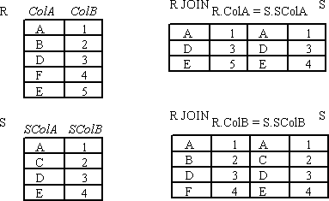
Example
An Introduction to Database System

Slide 27
Natural Join (*)
When we omit the condition during joining of two relations, then it is called as natural join (*):
Let relations R1 has attributes(x1,x2,x3,M) and R2 has attributes(y1,y2,y3,y4,y5,M) respectively. That is ,the M attribute is common to the two relations. Then the natural join of R1 and R2 is a relation with heading(x1,x2,x3,M, y1,y2,y3,y4,y5) and body consisting of all tuples that the duplicated attributed M are removed.

Slide 28

Natural Join
R ∞ S
A
B
C
E
a₁
b₁
5
3
a₁
b₂
6
7
a₂
b₃
8
10
a₂
b₃
8
2

Slide 29
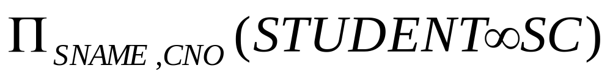
Example
To find all students name and selected courses NO, we need student and SC relations
1.
2. We can rewrite the previous query as:
An Introduction to Database System

Slide 30
Outer Joins (Special Case of EquiJoin)
Usually, only a subset of tuples of each relation will actually participate in a join, i.e. only tuples that match with the joining attributes. Tuples of a relation not participating in a join are called dangling tuples.
How do we keep dangling tuples in the result of a join? Use null values to indicate a no-join situation.
There are three types of outer joins
  - left outer join
  - right outer join and
  - full outer join.

Slide 31
Left outer-join
R1 R2 is similar to a natural join but keep all dangling tuples of R1.
Right Outer-Join
R1 R2 is similar to a natural join but keep all dangling tuples of R2.
Outer Join (full outer-join)
R1 R2 is similar to a natural join but keep all dangling tuples of both R1 and R2.
The advantages of outer join is to take the union of tuples from two relations that are not union compatible.

Slide 32
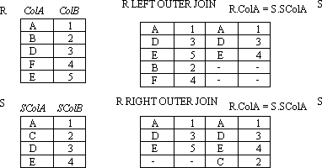
Example:LEFT OUTER JOIN, RIGHT, OUTER JOIN
An Introduction to Database System

Slide 33
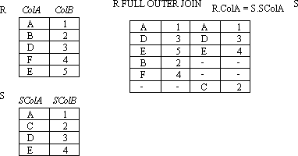
Example:FULL OUTER JOIN
An Introduction to Database System

Slide 34
Division
Not supported as a primitive operator, but useful for expressing queries like: Find students who have taken all courses.
Precondition: in A/B, the attributes in B must be included in the schema for A. Also, the result has attributes A-B..
Notes:
13

Slide 35
R
÷
S

Slide 36
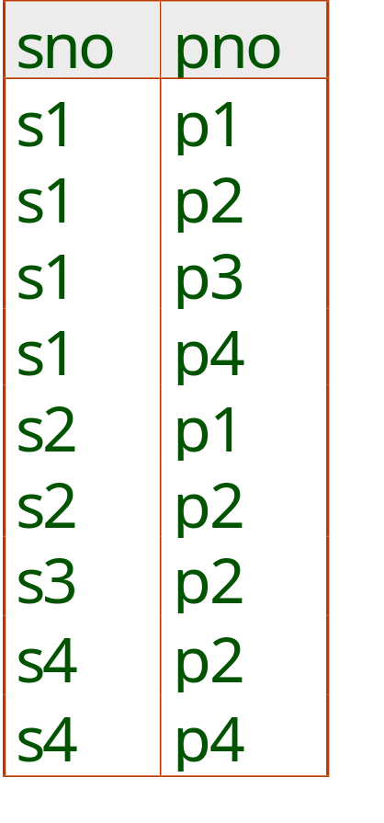
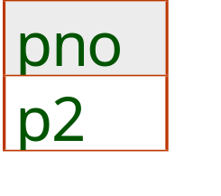
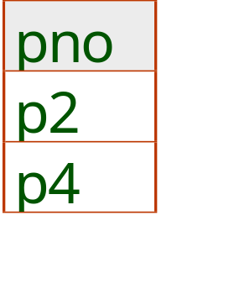
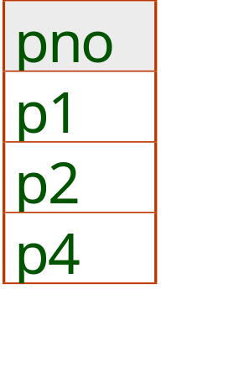
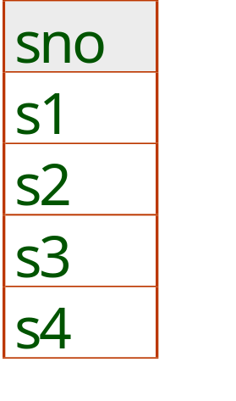
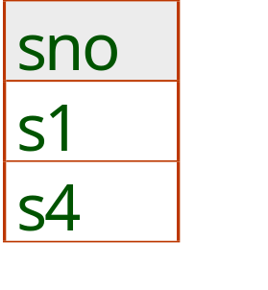
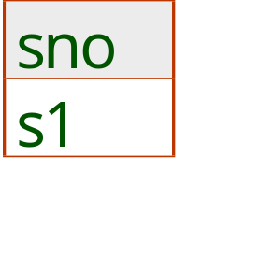
Examples of Division A/B
B1
B2
B3
A
A/B1
A/B2
A/B3
Notes:
14

Slide 37
Another Example
Another example is: Suppose we want to find all the students who have selected all courses (See Figure 3.19 Course Table ) provided by the school.
CNO | CNAME | CREDIT
001 | Math | 3
002 | Multimedia | 3
003 | Computer network | 4
004 | Software engineering | 4
005 | Bioinformatics | 3
An Introduction to Database System

Slide 38
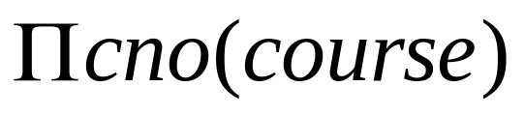
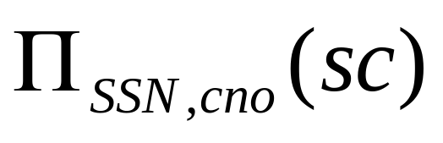
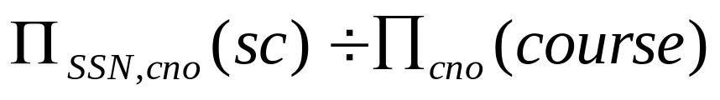
We can think of it as three steps:
1.We can obtain the NO. of all courses provided by the school by:
2.We can also find all SSN, cno pairs for which the student has selected courses by:
3.Now we need to find all students who selected all the courses. The divide operation provides exactly those students:
An Introduction to Database System

Slide 39
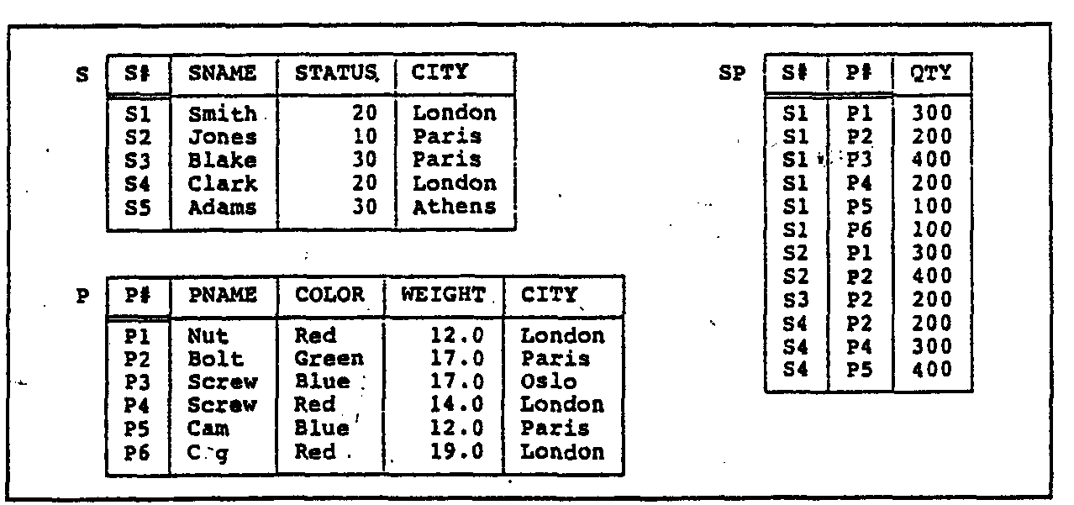
3.2 Simple and Complex queries using RA
An Introduction to Database System

Slide 40
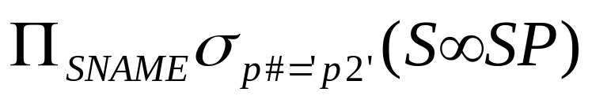
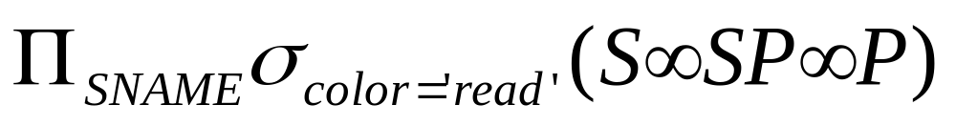
Example
Example 1: Get supplier names for suppliers who supply part P2:
Example 2:Get supplier names for suppliers who supply at least one red part:
An Introduction to Database System

Slide 41
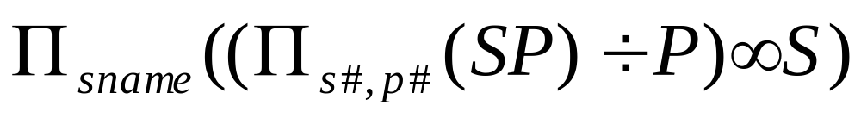
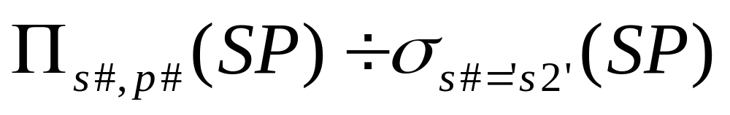
CON…
Example 3:Get supplier names for suppliers who supply all parts:
Example 4:Get supplier numbers for suppliers who supply at least all those parts supplied by supplier S2:
An Introduction to Database System

Slide 42
3.3 Structure Query Language (SQL)
Full name of SQL --- Structural Query Language
Old name --- SEQUEL (Structural English QUEry Language)
First developed at IBM's San Jose (now Almaden) Research Lab. in 1974.
Over 100 SQL-based products in the market.
E.g.: Oracle, Sybase, Ingres, Informix, DB2.
An Introduction to Database System

Slide 43
Cont…
The first SQL standard (SQL-86) was published in 1986 by ANSI. (about 100 pages).
SQL1 was also adopted by ISO in 1987.
A major revision made in 1989 (SQL-89).
The second SQL standard (SQL2) was announced in 1992. It has about 600 pages.
The third SQL standard (SQL3) is under discussion. Expected release time: 20??

Slide 44
Major Components of SQL
DDL --- Data Definition Language used to define tables.
DML --- Data Manipulation Language (Interactive DML, ISQL) used to manipulate data directly.
Embedded DML (Embedded SQL) which supports the manipulation of data from a program in a high-level programming language.
View Definition used to create different ways to look at a database.
Authorization (DCL).
Integrity Constraints which defines various constraints on the data.
Transaction Definition which defines which group of commands should be treated as an atomic command.

Slide 45
3.4.1 Defining Database
CREATE DATABASE
The SQL CREATE DATABASE statement is the SQL command that adds a new database.
A database is the outer container for other SQL objects: tables, columns, views, indexes, etc.
An Introduction to Database System

Slide 46
CON…
The SQL CREATE DATABASE statement is used as follows:
CREATE DATABASE <database_name>
Example: creates a new database named STUDENT_DB.
CREATE DATABASE STUDENT_DB
The CREATE DATABASE implementation and syntax varies substantially between different RDBMS implementations.
An Introduction to Database System

Slide 47
DROP DATABASE
The SQL DROP DATABASE statement is the SQL command that removes an existing database.
The SQL DROP DATABASE statement is used as follows:
DROP DATABASE <database_name>
The following example drops an existing database named STUDENT_DB.
DROP DATABASE STUDENT_DB
An Introduction to Database System

Slide 48
3.4.2 Defining tables and views
CREATE
  Create new objects (tables, views, etc.) in the database
ALTER
  Change the structure of an existing object
DROP
  Remove the object from the database, (all its data plus any reference to it in the data dictionary)

Slide 49
CREATE TABLE
The CREATE TABLE statement is used to create tables to store data.
Integrity Constraints like primary key, unique key, foreign key can be defined for the columns while creating the table.
An Introduction to Database System

Slide 50
CON...
The create table statement does exactly that:
CREATE TABLE <table name> (
<attribute name 1> <data type 1>,
...
<attribute name n> <data type n>);
The data types that you will use most frequently are VARCHAR or CHAR for variable or fixed length strings; numeric types such as NUMBER or INTEGER; and DATE or related types. Data type syntax is variable from system to system.
An Introduction to Database System

Slide 51
Example
If we have a table for recording students information, then the columns may include information such as student’s number(SSN), name(SNAME), birth date(BirthDate), depart number(DEPTNO).
  CREATE TABLE student
  (SSN NUMBER NOT NULL,
  SNAME CHAR(10) ,
  BirthDate DATE ,
  DEPTNO NUMBER);
Note that: The NOT NULL constraint enforces the field of SSN to always contain a value.
An Introduction to Database System

Slide 52
ALTER TABLE
The SQL ALTER TABLE command is used to modify the definition (structure) of a table by modifying the definition of its columns. The ALTER command is used to perform the following functions.
    1) Add, drop, modify table columns
    2) Add and drop constraints
    3) Enable and Disable constraints
An Introduction to Database System

Slide 53
ADD COLUMN
To add a new column
ALTER TABLE <tablename>
ADD (column_name datatype);
For Example: To add a column "Address" to the student table:
ALTER TABLE student ADD Address CHAR(30);
An Introduction to Database System

Slide 54
DROP COLUMN
To drop a column
ALTER TABLE table_name DROP column_name;
For Example: To drop the column "Address" from the student table:
ALTER TABLE student DROP Address;
An Introduction to Database System

Slide 55
MODIFY COLUMN
To modify a column
ALTER TABLE table_name MODIFY column_name datatype;
For Example: To modify the column Address in the student table:
  ALTER TABLE student
  MODIFY Address CHAR(50);
An Introduction to Database System

Slide 56
DROP TABLE
The DROP TABLE command allows you to destroy an existing table.
If we want to permanently remove the student table that we created:
DROP TABLE student
An Introduction to Database System

Slide 57
Using and Defining Views
Views provide users controlled access to tables
Base Table – table containing the raw data
Dynamic View
  A “virtual table” created dynamically upon request by a user
  No data actually stored; instead data from base table made available to user
  Based on SQL SELECT statement on base tables or other views

Slide 58
CREATE VIEW
The Syntax to create a view is
  CREATE VIEW view_name
  AS
  SELECT column_list
  FROM table_name [WHERE condition];
The SELECT statement is used to define the columns and rows that you want to display in the view

Slide 59
Example
To create a view on the student table the SQL statement would be like:
      CREATE VIEW view_student
      AS
      SELECT SSN, SNAME
      FROM student;
      Where SNAME LIKE ‘ZHANG%’
      With CHECK_OPTION
View has a name
CHECK_OPTION works only for updateable views and prevents updates that would create rows not included in the view

Slide 60
create table table1
(bm float
)
insert into table1 values(5000)
create view TestViewCheckOption
AS
select * from Table1 where Bm < 5003
with check option
update TestViewCheckOption set Bm = 5005
go
－－－执行结果
服务器: 消息 550，级别 16，状态 1，行 1
试图进行的插入或更新已失败，原因是目标视图或者目标视图所跨越的某一视图指定了 WITH CHECK OPTION，而该操作的一个或多个结果行又不符合 CHECK OPTION 约束的条件。

Slide 61
ALTER VIEW
By the ALTER VIEW Statement we can change the definition of a view. This statement is useful to modify a view without dropping it.
The general syntax of ALTER VIEW Statement is :
ALTER VIEW view_name [(column_list)] [WITH ENCRYPTION] AS select_statement [WITH CHECK OPTION]

Slide 62
Example
A one more column by the name of Address of student table.
ALTER VIEW view_student
AS
SELECT sno, sname,Address
FROM student;

Slide 63
DROP VIEW
For dropping a view you can use the DROP VIEW Statement.
The general syntax of DROP VIEW Statement is :
DROP VIEW view_name;
  When view is dropped but it has no effect on the underlying tables.
  After dropping a view if you issue any query that reference a dropped view then you get an error message.
  But dropping a table that reference any view does not drop the view automatically. You have to dropt the view explicitly.

Slide 64
Oracle view
CREATE [OR REPLACE] [FORCE|NOFORCE] VIEW view_name [(alias[, alias]...)]
AS subquery
[WITH CHECK OPTION [CONSTRAINT constraint]]
[WITH READ ONLY]
其中：
OR REPLACE：若所创建的试图已经存在，ORACLE自动重建该视图；
FORCE：不管基表是否存在ORACLE都会自动创建该视图；
NOFORCE：只有基表都存在ORACLE才会创建该视图：
alias：为视图产生的列定义的别名；
subquery：一条完整的SELECT语句，可以在该语句中定义别名；
WITH CHECK OPTION ： 插入或修改的数据行必须满足视图定义的约束；
WITH READ ONLY ： 该视图上不能进行任何DML操作。

Slide 65
Oracle_Ceate view example
CREATE OR REPLACE VIEW dept_sum_vw(name,minsal,maxsal,avgsal)
AS SELECT d.dname,min(e.sal),max(e.sal),avg(e.sal) FROM EMP2015150090 e,DEPT2015150090 d
WHERE e.deptno=d.deptno
GROUP BY d.dname;

Slide 66
Oracle view text
SELECT view_name,text from user_views;

Slide 67
Oracle with check option
CREATE OR REPLACE VIEW vw_emp20
AS SELECT * FROM EMP2015150090
WHERE deptno=20
WITH CHECK OPTION constraint vw_emp20_ck;
UPDATE vw_emp20 SET deptno=10 WHERE empno=7788;
将产生错误：
UPDATE vw_emp20 SET deptno=10 WHERE empno=7788 *
ERROR 位于第 1 行:
ORA-01402: 视图 WITH CHECK OPTIDN 违反 where 子句

Slide 68
Advantages of Views
Simplify query commands
Assist with data security (but don't rely on views for security, there are more important security measures)
Enhance programming productivity
Contain most current base table data
Use little storage space
Provide customized view for user
Establish physical data independence

Slide 69
Disadvantages of Views
Use processing time each time view is referenced
May or may not be directly updateable

Slide 70
Not be updateable views
在视图出现下列情况时 不可通过视图修改基表数据或插入数据：
a.视图中包含GROUP 函数，GROUP BY子句，DISTINCT关键字；
b.使用表达式定义的列；
c.ROWNUM伪列。
d.基表中未在视图中选择的其他列定义为非空且无默认值。
WITH CHECK OPTION 子句
通过视图执行的INSERTS和UPDATES操作不能创建该视图检索不到的数据行， 因为它会对插入或修改的数据行执行完整性约束和数据有效性检查。 （也就是说在执行INSERTS、UPDATES时，WHERE条件中除需要INSERT、UPDATE本身的限制条件之外，还需要加上视图创建时的WHERE条件。）

Slide 71
CREATE OR REPLACE VIEW vw_emp20
AS SELECT rownum id,ename,job
FROM EMP2015150090
WHERE deptno=20 WITH CHECK OPTION constraint vw_emp20_ck;
UPDATE vw_emp20 SET job='test' WHERE trim(ename)=‘JONES’;
UPDATE vw_emp20 SET job='test' WHERE trim(ename)=‘JONES’
* ERROR 位于第 1 行:
ORA-01732: 此视图的数据操纵操作非法

Slide 72
Specifying constraints
Constraints offer the advantages of defining controls in one step during the table creation process (as defined by the SQL standards) and of simplifying the process to create those integrity controls.
Constraints can be specified when a table is created
  CREATE TABLE statement
  ALTER TABLE statement

Slide 73
NOT NULL Constraint
The NOT NULL constraint enforces a field to always contain a value. This means that you cannot insert a new record, or update a record without adding a value to this field.
The following SQL enforces the "SSN" column and the "SNAME" column to not accept NULL values:
CREATE TABLE student
    (SSN NUMBER NOT NULL,
    SNAME CHAR(10) NOT NULL ,
    BirthDate DATE ,
    DEPTNO NUMBER);

Slide 74
UNIQUE Constraint
The UNIQUE constraint uniquely identifies each record in a database table.
The following SQL creates a UNIQUE constraint on the "SSN" column when the "student" table is created:
    CREATE TABLE student
    (SSN NUMBER NOT NULL UNIQUE,
    SNAME CHAR(10) NOT NULL ,
    BirthDate DATE ,
    DEPTNO NUMBER);
Note that you can have many UNIQUE constraints per table, but only one PRIMARY KEY constraint per table.

Slide 75
PRIMARY KEY Constraint
The PRIMARY KEY constraint uniquely identifies each record in a database table.
A primary key must contain unique values and cannot contain NULL values.
Each table should have a primary key, and each table can have only ONE primary key

Slide 76
CON…
The following SQL creates a PRIMARY KEY on the " SSN " column when the " student " table is created:
    CREATE TABLE student
    (SSN NUMBER PRIMARY KEY,
    SNAME CHAR(10) NOT NULL ,
    BirthDate DATE ,
    DEPTNO NUMBER);

Slide 77
CON…
To allow naming of a PRIMARY KEY constraint, and for defining a PRIMARY KEY constraint on multiple columns, use the following SQL syntax:
    CREATE TABLE student
    (SSN NUMBER NOT NULL,
    SNAME CHAR(10) NOT NULL ,
    BirthDate DATE ,
    DEPTNO NUMBER,
    CONSTRAINT pk_studentNo PRIMARY KEY (SSN, SNAME)
    );

Slide 78
FOREIGN KEY Constraint
A foreign key is a referential constraint between two tables. The foreign key identifies a column or a set of columns in one (referencing) table that refers to a set of columns in another (referenced) table.
The columns in the referencing table must be the primary key or other candidate key in the referenced table.
The values in one row of the referencing columns must occur in a single row in the referenced table.
A row in the referencing table cannot contain values that don't exist in the referenced table

Slide 79
Example
To create a SC table,SC(ssn,cno,grade)，the primary key is (ssn, cno) .
    CREATE TABLE SC(
    ssn NUMBER,
    cno NUMBER,
    Grade NUMBER,
    Primary key (ssn , Cno),
    FOREIGN KEY(ssn ) REFERENCES student(ssn ),
    FOREIGN KEY(Cno) REFERENCES Course(Cno))

Slide 80
CHECK Constraint
The CHECK constraint is used to limit the value range that can be placed in a column.
  CREATE TABLE student
  (SSN NUMBER PRIMARY KEY CHECK (SSN >0),
  SNAME CHAR(10) NOT NULL ,
  BirthDate DATE ,
  DEPTNO NUMBER);

Slide 81
DEFAULT Constraint
The DEFAULT constraint is used to insert a default value into a column. The default value will be added to all new records, if no other value is specified.
      CREATE TABLE student
      (SSN NUMBER PRIMARY KEY CHECK (sno >0),
      SNAME CHAR(20) NOT NULL ,
      BirthDate DATE ,
      DEPTNO NUMBER DEFAULT 00);

Slide 82
CON…
The DEFAULT constraint can also be used to insert system values, by using functions like GETDATE():
    CREATE TABLE SC
    (
    CNO NUMBER NOT NULL,
    SSN NUMBER NOT NULL,
    GRADE NUMBER,
    TakeCourseDate date DEFAULT GETDATE(),
    PRIMARKY KEY(SSN,CNO)
    FOREIGN KEY (SSN) REFERENCES student(SSN)
    )

Slide 83
ALTER TABLE ADD CONSTRAINTS
Add constraints to an existing table by using the ALTER TABLE statement. The following example adds a pk_employee primary key constraint on an student table:
ALTER TABLE employee
ADD CONSTRAINT pk_student PRIMARY KEY (SSN)
You can add the primary or unique key constraint into an existing table only when there are no duplicate rows in the table.

Slide 84
CON…
Drop constraints in an existing table by using the ALTER TABLE statement. The following example drops the pk_student primary key constraint in the student table:
    ALTER TABLE student
    DROP CONSTRAINT pk_student

Slide 85
SHOW,ALTER.RENAME CONSTRAINTS
1.SELECT * FROM ALL_CONSTRAINTS
WHERE TABLE_NAME=‘EMP’
2.ALTER TABLE EMP
ADD CONSTRAINT CK_EMP_SAL CHECK(SAL > 0 AND SAL <20000);
3.ALTER TABLE EMP
RENAME CONSTRAINT SYS_C0059699 TO PK_T1

Slide 86
Creating indexes
Indexes can be created against a table to make searches more efficient.
A book index allows you to find information without having to read through the whole book.
A database index enables the database application to find data quickly without having to scan the whole table.

Slide 87
CON…
For example, if users of your application often search against the name field then that field is a great candidate for an index.
the CREATE INDEX command:
    CREATE INDEX index_name
    ON table_name (column_name)
Example
    CREATE INDEX StudentIndex
    ON student (SNAME)

Slide 88
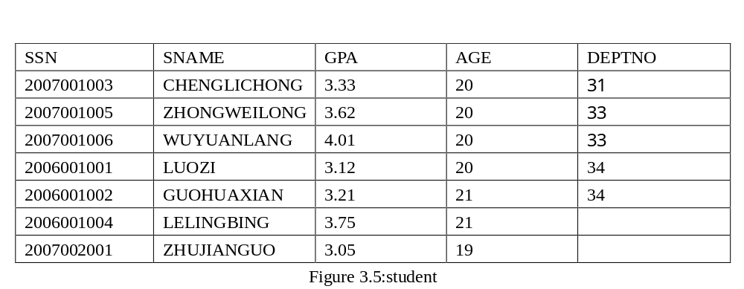
3.5 Selecting Data

Slide 89
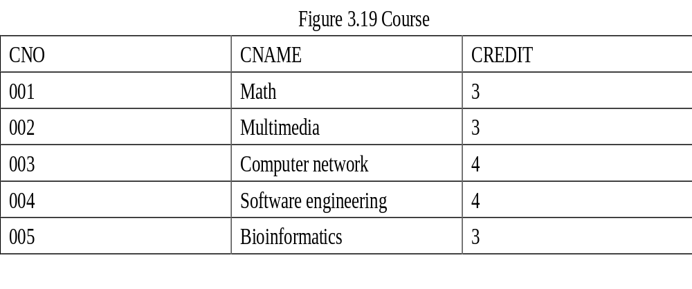

Slide 90


Slide 91
Queries: SELECT Statement
The basic SELECT statement has three clauses: SELECT ,FROM and WHERE.
SELECT: Specify the table columns that are retrieved
FROM : Specify the tables accessed.
WHERE: Specify which table rows are used.
The WHERE clause is optional; if missing, all table rows are used. An asterisk ("*") can also be used to specify that the query should return all columns of the queried tables.

Slide 92
CON…
The full syntax of the SELECT statement is complex as follows:
    SELECT select_list
    FROM table_source
    [ WHERE search_condition ]
    [ GROUP BY group_by_expression ]
    [ HAVING search_condition ]
    [ ORDER BY order_expression [ ASC | DESC ] ]

Slide 93
CON…
The SELECT clause lists what columns to return.
The FROM clause which indicates the table(s) from which data is to be retrieved.
The WHERE clause specifies which rows to retrieve.
The GROUP BY clause groups rows sharing a property so that an aggregate function can be applied to each group. The WHERE clause is applied before the GROUP BY clause.
The HAVING clause selects among the groups defined by the GROUP BY clause. Because it acts on the results of the GROUP BY clause, aggregation functions can be used in the HAVING clause predicate.
The ORDER BY clause specifies an order in which to return the rows. Without an ORDER BY clause, the order of rows returned by an SQL query is undefined.

Slide 94
Single Table
1)．Retrieve specific columns, all rows
(1)Retrieve specific columns
  The query retrieves a subset of columns and all rows from a table.
[Example 1]
Find the SSN, SName and GPA of all students
  select SSN, SName, GPA
  from Student

Slide 95
CON…
(2)Retrieve all columns, all rows
The query retrieves all columns and rows from a table
[Example 2]
  Query all the information of all the students.
  Select * from Students
Or
  select SSN, SName, GPA,AGE,DEPTNO
  from Student

Slide 96
CON…
(3)Retrieve calculated columns
The query retrieves some columns by computing.
[Example 3]
Query the name and the birthday of students.
  Select SName,2017-AGE
  From Student

Slide 97
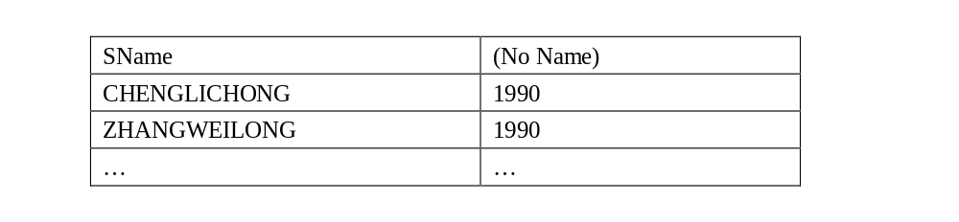
CON…
The results will be shown in Fig.21:
Figure 21 Query Result of Example 3

Slide 98
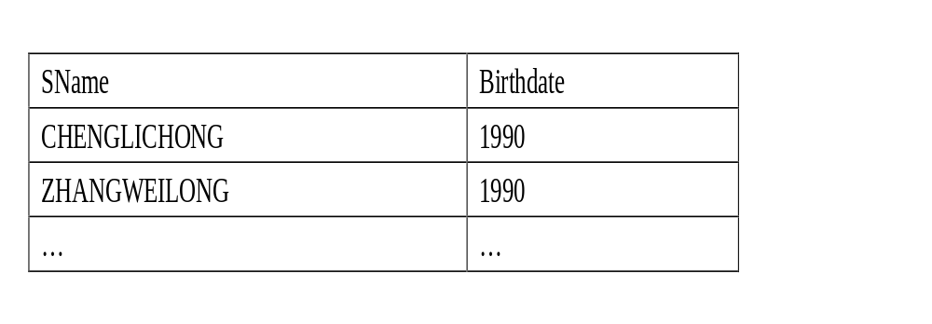
Alias
[Example 4]
Select SName,2011-AGE as Birthdate
From Student
The results will be shown in Fig.21:

Slide 99

CON…
(4)Use of Distinct
The DISTINCT keyword can be used to return only distinct (different) values.
[Example 5]
If we list the AGE of all students from the above table.
Select AGE
From Student

Slide 100

CON…
[Example 6]
Rewriting the query as:
    SELECT DISTINCT AGE
    From Students
We get the result table shown in Fig.23 with the duplicates eliminated.

Slide 101
2). Row selection (where clause)
The SQL WHERE clause is used to select data conditionally, by adding it to already existing SQL SELECT query.
There are six basic search conditions as follows:
Comparison
Range
Set membership
Pattern match
Null
Compound comparison

Slide 102
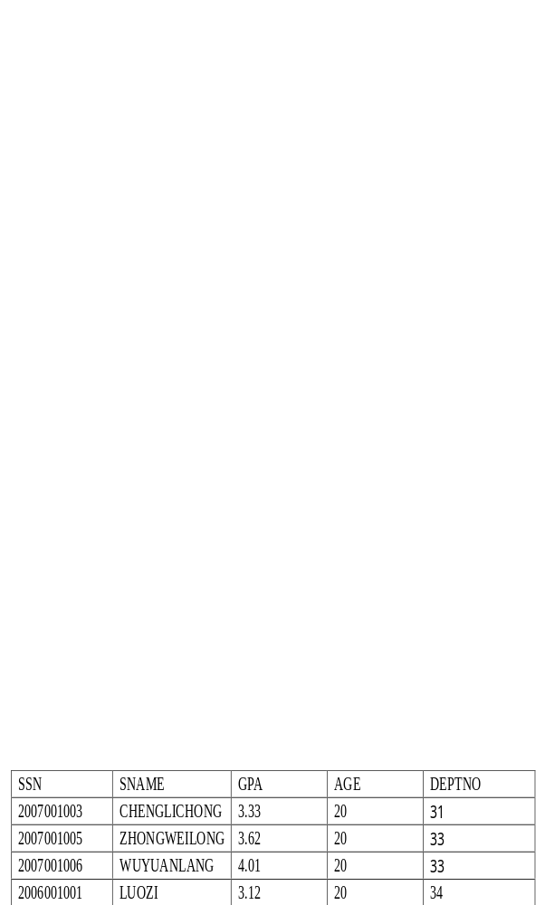
Comparison search condition
[Example 7]
If we want to select all students from our database table, having AGE ‘20’ we need to use the following SQL syntax:
    Select * from Student where AGE=20

Slide 103
Range search condition (BETWEEN /NOT BETWEEN)
The SQL BETWEEN… AND keywords define a range of data between 2 values. The 2 values defining the range for SQL BETWEEN clause can be dates, numbers or just text.
[Example 8]
If we want list all students with a GPA between 3 and 3.5.
    Select *
    From student
    Where GPA BETWEEN 3 AND 3.5
    Any members of students with a GPA of 3 or 3.5 would be included in the result.

Slide 104
[Example 9]
We would use the negated version to retrieve any members of students with a GPA outside between 3 and 3.5 as:
    Select *
    From student
    Where GPA NOT BETWEEN 3 AND 3.5

Slide 105
Set membership search condition(IN/NOT IN)
The set membership search condition IN allows you to specify multiple values in a WHERE clause.
It tests whether a data value matches one of a list values.
[Example 10]
We want to select the students with an AGE equal to 19 or 20 in the table above.
    Select * from student
    Where AGE IN (19, 20)

Slide 106
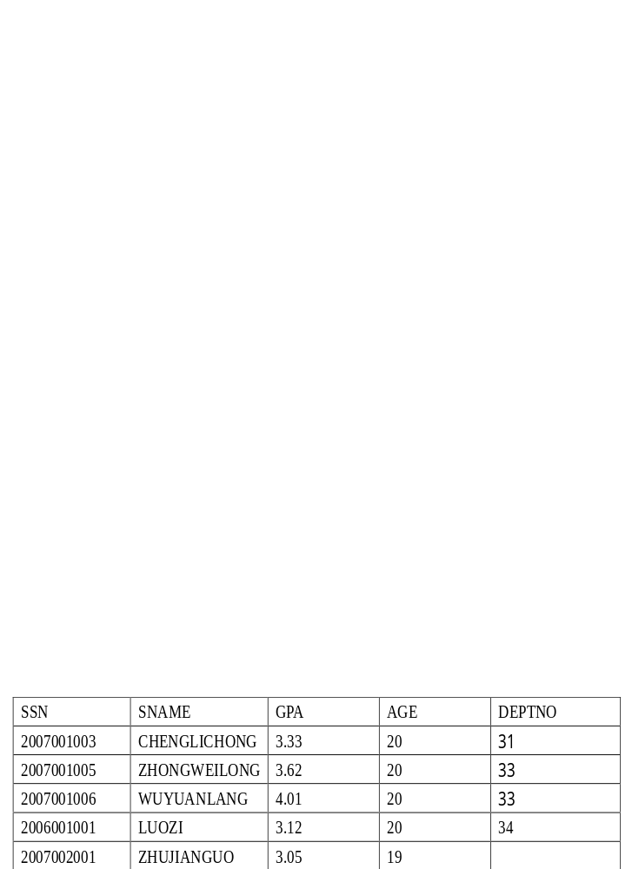
Figure 25 Query Result of Example 10
The operator NOT IN can be used to check for data values that don’t lie in a specific list of values.

Slide 107
Pattern match search condition(LIKE/NOT LIKE)
The LIKE operator allows you create a SQL query that performs inexact pattern matching through the use of wildcard characters.
The % wildcard matches zero or more characters of any type.
The _ wildcard matches exactly one character of any type.

Slide 108
CON...
[Example 11]
To match all strings that begin with the word 'zhang', you would use the pattern 'zhang%':
    SELECT SNAME
    FROM STUDENT
    WHERE SNAME LIKE 'zhang%';

Slide 109
CON...
[Example 12]
To match all strings that end with 'ZHANG', the pattern would look like: '%zhang':
    SELECT SNAME
    FROM STUDENT
    WHERE SNAME LIKE '%zhang';

Slide 110
CON...
[Example 13]
To match all strings where the word 'zhang' occurs somewhere: '%zhang%':
    SELECT SNAME
    FROM STUDENT
    WHERE SNAME LIKE '%zhang%';

Slide 111
CON...
[Example 14]
To match strings with that begin with ‘zhang’ consisting of exactly eight characters
SELECT SNAME
    FROM STUDENT
    WHERE SNAME LIKE 'zhang _ _ _’;

Slide 112
CON...
[Example 15]
To match strings that there are must be exactly four characters in the string, the END of which must be an ‘g’
    SELECT SNAME
    FROM STUDENT
    WHERE SNAME LIKE ' _ _ _g’;

Slide 113
CON...
[Example 16]
To match strings that there are at least one character between 'a' and 'c' .
SELECT SNAME
    FROM STUDENT
    WHERE SNAME LIKE 'a_%c';
If the search strings can include the wildcards(%,_) itself, we can use an escape character to represent the wildcards.
For example, to match the string ‘20%’, we can use :
Like ‘20#%’ ESCAPE ‘#’

Slide 114
NULL search condition
The operator NULL means the data value for the column is unknown or not available.
NULL is not synonymous with
zero (numeric or binary value)
a zero-length string,
blank (character value)

Slide 115
CON...
Suppose that the "DEPTNO" column in the "STUDENT" table is optional. This means that if we insert a record with no value for the " DEPTNO " column, the " DEPTNO " column will be saved with a NULL value.
We can select only the records with NULL values in the " DEPTNO " column by using the IS NULL operator:
[Example 17]
    SELECT * FROM student
    WHERE DEPTNO IS NULL

Slide 116
CON...
[Example 18]
If we select only the records with no NULL values in the " DEPTNO " column, we will have to use the IS NOT NULL operator:
    SELECT * FROM student
    WHERE DEPTNO IS NOT NULL

Slide 117
Compound search condition
The AND & OR operators are used to filter records based on more than one condition.
The AND operator displays a record if both the first condition and the second condition is true.
The OR operator displays a record if either the first condition or the second condition is true.

Slide 118
CON...
[Example 19]
If we want to select only the persons with AGE equal to "20" AND GPA greater than "3", we use the following SELECT statement:
    SELECT *
    FROM student
    WHERE AGE=20 AND GPA>3

Slide 119
Sorting Results (Order by Clause )
SQL ORDER BY clause is used to sort the result-set by a specified column or more columns.
[Example 20]
If we want to sort our Users table by the GPA column, we have to use the following ORDER BY SQL statement:
    SELECT * FROM student
    ORDER BY GPA
If you want to sort the records in a descending order, you can use the DESC keyword.

Slide 120
CON...
[Example 21]
Now we want to select all the persons from the table above, however, we want to sort the students descending by age.
SELECT *
    FROM student
    ORDER BY AGE DESC

Slide 121
SQL Aggregate Functions
SQL aggregate functions are used to sum, count, get the average, get the minimum and get the maximum values from a column or from a sub-set of column values.
COUNT
AVG
MAX
MIN
SUM

Slide 122
COUNT function
The COUNT function counts the number of rows in a table, or the number of distinct values for a given column. It can operate, therefore, at the column or row level.
[Example 22]
To count the number of students’ names in the Student table :
    SELECT COUNT(SNAME)
    FROM Student

Slide 123
CON...
[Example 23]
To count the number of distinct students’ names represented in the students table, issue the following:
    SELECT COUNT(DISTINCT SNAME)
    FROM Student
The keyword DISTINCT is not considered an argument of the function. It simply specifies an operation to be performed before the function is applied. When DISTINCT is coded, duplicate values are eliminated.
If DISTINCT is not specified, then ALL is implicitly specified. ALL also can be explicitly specified in the COUNT function. When ALL is specified, duplicate values are not eliminated.

Slide 124
AVG function
The AVG function computes the average of the values for the column or expression specified as an argument. This function operates only on numeric arguments.
[Example 24]
The following example calculates the average GPA of the students table:
    SELECT AVG(GPA)
    FROM Student

Slide 125
CON...
[Example 25]
If you want to get the average GPA for a particular set students you can do it this way:
    SELECT AVG(GPA)
    FROM Student
    WHERE DEPTNO=’33’

Slide 126
MIN function
The MIN function returns the smallest value in the specified column or expression.
[Example 26]
To retrieve the smallest GPA given to any student, issue this SQL statement:
    SELECT MIN(GPA)
    FROM Student

Slide 127
CON...
The MAX function returns the largest value in the specified column or expression.
[Example 27]
The following SQL statement determines the largest GPA :
    SELECT MAX(GPA)
    FROM Student

Slide 128
CON...
[Example 28]
It returns the highest GPA belongs to a student in DEPTNO 32:
    SELECT MAX(GPA)
    FROM student
    WHERE DEPTNO=’32’

Slide 129
SUM function
The accumulated total of all values in the specified column or expression are returned by the SUM column function.
[Example 29]
For example, the following SQL statement calculates the total GPA for the students:
    SELECT SUM(GPA)
    FROM Student

Slide 130
GROUP BY
The GROUP BY statement is used in conjunction with the aggregate functions to group the result-set by one or more columns.
SQL GROUP BY Syntax
SELECT column_name, aggregate_function(column_name)
    FROM table_name
    WHERE column_name operator value
    GROUP BY column_name

Slide 131
CON...
[Example 30]
Want to find the average grade of each student.
    SELECT Avg(grade)
    FROM SC
    GROUP BY SSN

Slide 132
HAVING Clause
The HAVING clause was added to SQL because the WHERE keyword could not be used with aggregate functions.
SQL HAVING Syntax:
  SELECT column_name, aggregate_function(column_name)
  FROM table_name
  WHERE column_name operator value
  GROUP BY column_name
  HAVING aggregate_function(column_name) operator value

Slide 133
CON...
[Example 31]
Now we want to find if any of the students have an average grade of more than 81.
    SELECT Avg(grade)
    FROM student
    GROUP BY SSN
    HAVING Avg(grade)>81

Slide 134
CON...
[Example 32]
Now we want to find if the students " '2007001006 " or " 2006001001 " have an average grade of less than 81.
    SELECT SSN,Avg(grade)
    FROM student
    WHERE SSN='2007001006' OR SSN =‘2006001001’
    GROUP BY SSN
    HAVING Avg(grade)<81

Slide 135
Some rules for the aggregate functions
1). An aggregate function must be specified for an explicitly named column or expression.
2). Each aggregate function returns only one value for the set of selected rows.
3). If you apply an aggregate function to one column in a SELECT statement, you must apply column functions to any other columns specified in the same SELECT statement, unless you also use the GROUP BY clause.
4). Use GROUP BY to apply an aggregate function to a group of named columns. Any other column named in the SELECT statement must be operated on by an aggregate function.

Slide 136
CON...
5). When using the AVG, MAX, MIN and SUM functions on nullable columns, all occurrences of NULL are eliminated before applying the function.
6). You can use the DISTINCT keyword with all aggregate functions to eliminate duplicates before applying the given function. DISTINCT has no effect, however, on the MAX and MIN functions.
7). You can use the ALL keyword to indicate that duplicates should not be eliminated. ALL is the default.
8). An aggregate function can be specified in a WHERE clause only if that clause is part of a sub query of a HAVING clause. Additionally, every column name specified in the expression of the aggregate function must be a correlated reference to the same group.

Slide 137
Multiple Tables
SQL allows us to query multiple tables in one SELECT-FROM-WHERE statement.
The SELECT and WHERE can refer to the attributes of any of the tables once we list each table in the FROM clause.
ANSI standard SQL specifies four types of JOINs: INNER, OUTER, LEFT, and RIGHT.
a table (base table, view, or joined table) can JOIN to itself in a self-join.

Slide 138
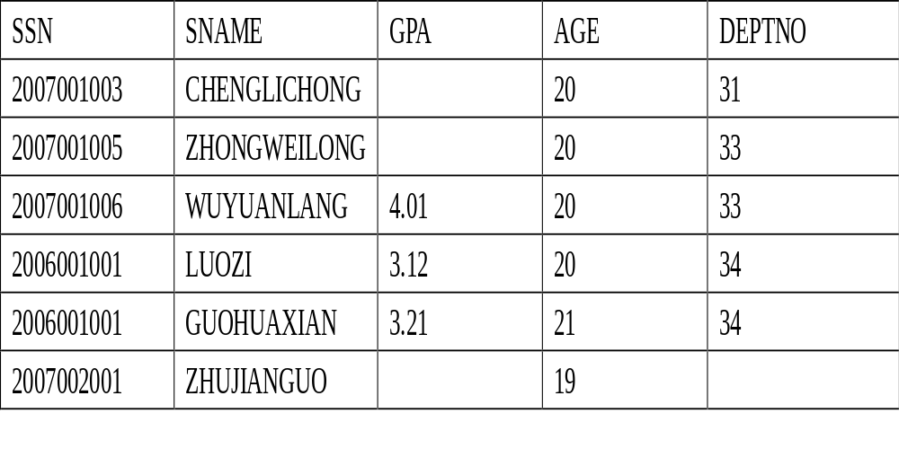
CON...

Slide 139
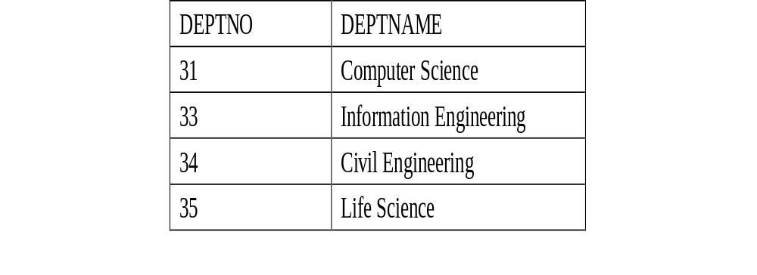
CON...
Note: The " Life Science " Department currently has no listed students. Also, student " ZHUJIANGUO " has not been assigned to any Department yet.

Slide 140
INNER JOIN
Inner join creates a new result table by combining column values of two tables (A and B) based upon the join-predicate.
The query compares each row of A with each row of B to find all pairs of rows which satisfy the join-predicate.
When the join-predicate is satisfied, column values for each matched pair of rows of A and B are combined into a result row.

Slide 141
CON...
The "implicit join notation" simply lists the tables for joining (in the FROM clause of the SELECT statement), using commas to separate them.
It specifies a cross-join, and the WHERE clause may apply additional filter-predicates (which function comparably to the join-predicates in the explicit notation).

Slide 142
CON...
[Example 33]
The following example shows a query using the inner join statement:
    SELECT *
    FROM student, department
    WHERE student.DeptID = department.DeptID

Slide 143
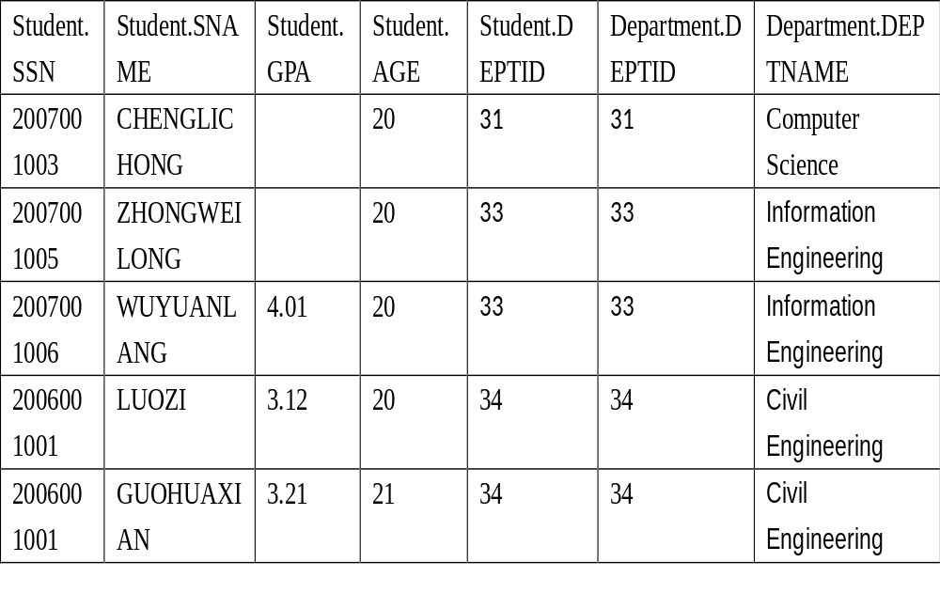
CON...

Slide 144
OUTER JOIN
The OUTER JOIN clause differs from the standard JOIN clause (also known as the INNER JOIN clause) in that rows are returned even when there are no matches through the JOIN critieria.
LEFT OUTER JOIN
RIGHT OUTER JOIN
FULL OUTER JOIN

Slide 145
LEFT OUTER JOIN
Select all the rows from the first table listed after the FROM clause, no matter if they have matches in the second table.
[Example 33]
If we slightly modify our last SQL statement to:
SELECT *
    FROM student LEFT OUTER JOIN department ON student.DEPTID = department.DEPTID

Slide 146
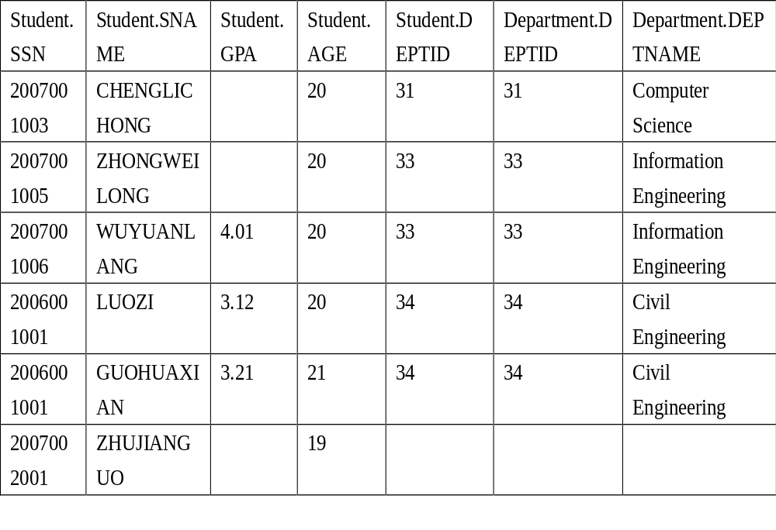
CON...

Slide 147
RIGHT OUTER JOIN
The RIGHT OUTER JOIN returns all rows from the second table.
[Example 34]
For example, this allows us to find each student and his or her department, but still show departments that have no student.
    SELECT *
    FROM student RIGHT OUTER JOIN department
    ON student.DEPTID = department. DEPTID;

Slide 148
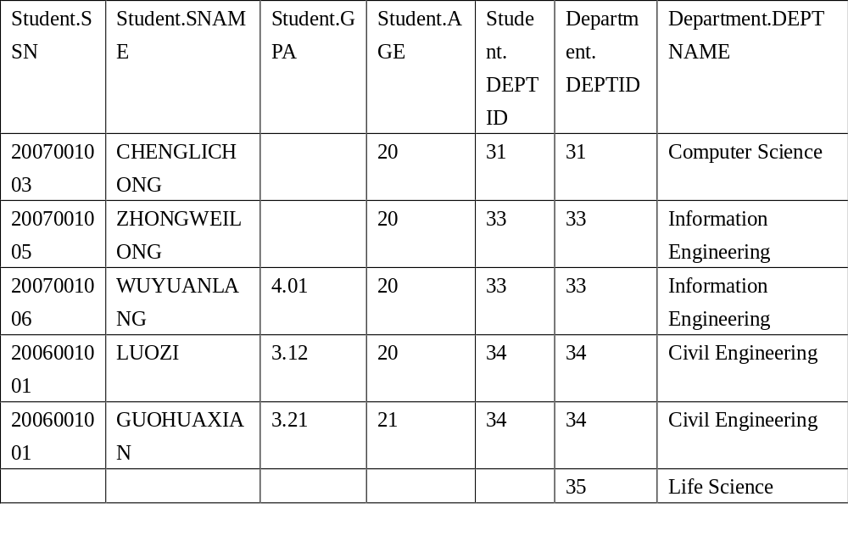
CON...

Slide 149
FULL OUTER JOIN
A full outer join combines the effect of applying both left and right outer joins.
[Example 35]
To see each student who is in a department and each department that has an student, but also see each student who is not part of a department and each department which doesn't have an student.
SELECT *
FROM student FULL OUTER JOIN student
ON student.DEPTID = department.DEPTID;

Slide 150
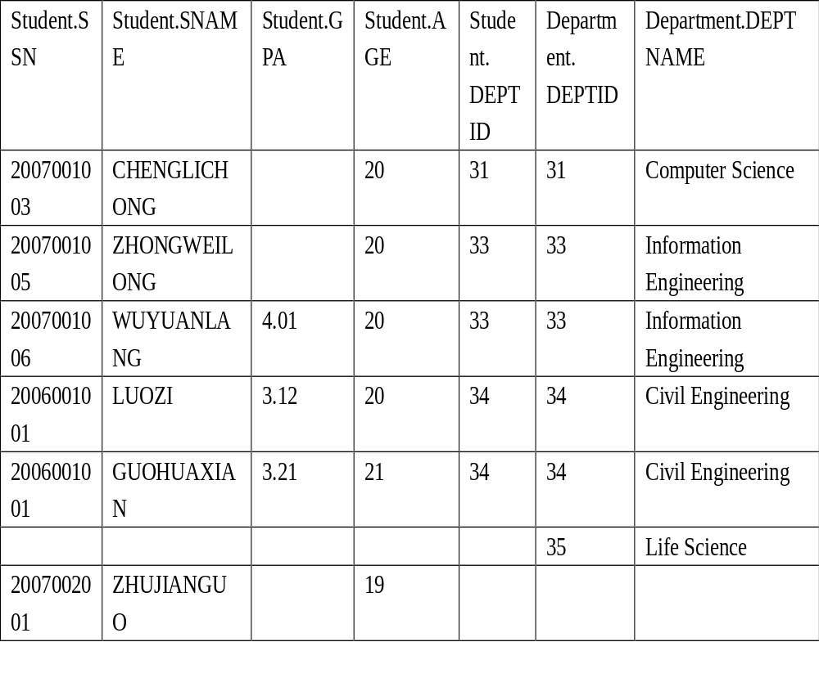

Slide 151
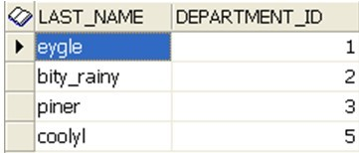
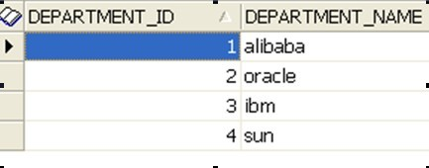
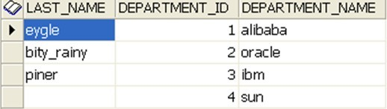
ORACLE RIGHT OUTTER JOIN
select e.last_name,e.department_id,d.department_name
from employees e
right outer join departments d
on (e.department_id = d.department_id);
select e.last_name, d.department_id,d.department_name
from employees e, departments d
where e.department_id(+) = d.department_id;

Slide 152
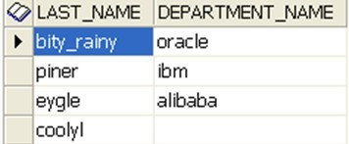
ORACLE LEFT OUTTER JOIN
select e.last_name,e.department_id,d.department_name
from employees e
left outer join departments d
on (e.department_id = d.department_id);
select e.last_name, d.department_name
from employees e, departments d
where e.department_id = d.department_id(+)

Slide 153
Alias
Table names can be abbreviated in order to simplify what is typed in with the query.
[Example 36]: Find the names and GPAs of all students who take CourseA.
select SName, GPA
from Students s, SC e, Courses c
where cname= 'CourseA'
and s.SSN = e.SSN
and e.Course_no = c.Course_no
s, e and c are (relational) tuple variables (aliases, correlation names) for relations Students, Enrollment and Courses.
Tuple variables can be used to simplify query specification and save time.
Tuple variables are also useful when tuples from the same relation need to be compared.

Slide 154
JOIN A TABLE TO ITSELF
[Example 37]: Find all pairs of students who have the same GPA.
select s1.SSN, s2.SSN
from Students s1, Students s2
where s1.GPA = s2.GPA
and s1.SSN < s2.SSN

Slide 155
Cont…
[Example 38]: Find the names of all students whose GPA is higher than CHENSHI 's GPA.
select s1.SName
from Student s1, Student s2
where s2.SName = 'CHENGSHI'
and s1.GPA > s2.GPA

Slide 156
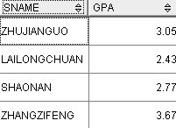
JOIN THREE TABLES
[Example 39]Find the names and GPAs of all students who take database systems.
select SName, GPA from Student, sc, Course
where cname= `DBS‘ and Student.ssn = sc.ssn and sc.cno= Course.cn

Slide 157
Set Operation :Union Intersect & Minus
SQL supports three set operations: union, intersect, minus
Union compatibility is required.
Consider the following two relations:
      G_Students(ssn, Name, GPA, GRE, Dept_Name)
      Instructors(ssn, Name, Office, Salary, Dept_Name)

Slide 158
Union
[Example 40]: Find the names of those people who are either select lesson 21001001 or lesson 22003002
(select SName from student
where ssn=any (select ssn from sc
where cno=21001001) )
union
(select SName from students
where ssn=any (select ssn from sc
where cno=22003002) )

Slide 159
Cont…
union removes duplicate rows.
union all keeps duplicate rows.

Slide 160
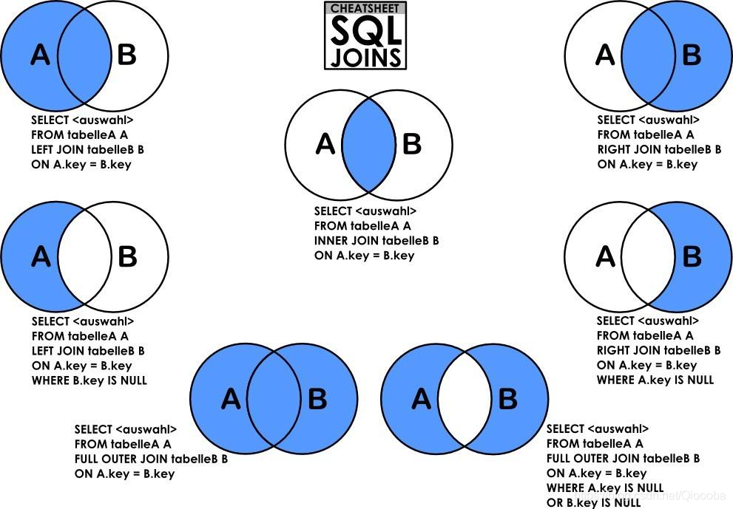

Slide 161
Set Operation: Intersect
[Example 41]: Find the names of those people who select lesson 21001001 and lesson 22003002
(select SName from student
where ssn=any (select ssn from sc
where cno=21001001) )
intersect
(select SName from student
where ssn=any (select ssn from sc
where cno=22003002) )

Slide 162
Set Operation: Minus
[Example 42]: : Find the names of those who select lesson 21001001 but has not select the lesson 22003002
(select SName from student
where ssn=any (select ssn from sc
where cno=21001001) )
minus
(select SName from student
where ssn=any (select ssn from sc
where cno=22003002) )

Slide 163
Set Operation: IN & NOT IN
[Example 43]: : Find all students who are 20, 21, or 19 years old.
select * from Student
where Age in (19, 20, 21)
NOT IN is the opposite of IN.

Slide 164
Sub queries
A subquery is a SELECT statement that is nested within another SQL statement.
Return any number of values
Can be found in, the column list of a SELECT statement, a FROM, GROUP BY, HAVING clauses of a SQL statement.

Slide 165
CON…
[Example 48]
To find the names of every student who studies in the same department as a person called Jones .
SELECT SNAME
    FROM student
    WHERE DEPTNO =
    (SELECT DEPTNO
    FROM student
    WHERE SNAME = 'JONES')

Slide 166
CON…
Or as a join statement, like this:
  SELECT e1. SNAME
  FROM student e1,student e2
  WHERE e1. DEPTNO = e2. DEPTNO AND e2. SNAME = 'JONES'

Slide 167
CON…
[Example 49]: Find the names of all students who take at least one course titled ‘multimedia’.
select sName
from Student s, SC e
where s.ssn = e.ssn and e.cno in
(select cno from Course
where Cname = ' multimedia')

Slide 168
Non Nested Equivalent
The previous query is equivalent to:
(1)
  select SName
  from Student s, sc e, Course c
  where s.ssn = e.ssn
  and e.cno= c.cno and c.cname =‘multimedia'

Slide 169
Cont…
(2)
select SName
from Student where ssn in
        (select ssn from sc
        where Cno in
        (select Cno from Course
        where cname = multimidea'))

Slide 170
comparison-operator:
ALL -- the comparison must be true for all returned values.
ANY -- The comparison need only be true for one returned value.
IN may be used in place of = ANY.
NOT IN may be used in place of != ALL.

Slide 171
Other set comparison operators:
<some, <=some, >=some, =some, <>some, >any, <any, <=any, >=any, =any, <>any, >all, <all, <=all, >=all, =all, <>all
some and any have identical meaning.
=some is equivalent to in
<>some is not equivalent to not in.
<>all is equivalent to not in.
Let x = a and S = {a, b}.
Then x <>some S is true but x not in S is false.
x <>all S is also false.

Slide 172
Definition of Some Clause
0
(5 < some
5
) = true
(read: 5 < some tuple in the relation)
6
0
(5 < some
5
) = false
0
(5 = some
) = true
5
0
(5 ≠ some
5
) = true (since 0 ≠ 5)
(= some) ≡ in
However, (≠ some) ≡ not in

Slide 173
CON…
Find the names of all students that have greater gpa than some female students.
select sname
from student
where gpa> some
(select gpa
from student
where sex = ‘female')

Slide 174
Definition of all Clause
0
(5 < all
5
) = false
6
6
(5 < all
) = true
10
4
(5 = all
) = false
5
4
(5 ≠ all
) = true (since 5 ≠ 4 and 5 ≠ 6)
6
(≠ all) ≡ not in
However, (= all) ≡ in

Slide 175
CON…
Find the names of all students that have greater gpa than all female students
select sname
from student
where gpa> all
(select gpa
from student
where sex = ‘female')

Slide 176
Cont…
=
<>或!=
<
<=
>
>=
ANY
IN
--
<MAX
<=MAX
>MIN
>= MIN
ALL
--
NOT IN
<MIN
<= MIN
>MAX
>= MAX

Slide 177
Cont…
[Example 50]: : Find the names of those students who are 18 or younger and whose GPA is higher than the GPA of some students who are 20 or older.
select sName from Student
where Age <= 18 and GPA >some
(select GPA from Student
where Age >= 20)

Slide 178
[example 51] Find the names and age of students in other departments that have smaller age than any a student in the department 33.
    SELECT Sname，Sage
    FROM Student
    WHERE Sage < ANY (SELECT Sage
    FROM Student
    WHERE deptid= ' 33 ')
    AND deptid <> ' 33 ' ;

Slide 179
[example 51']：Using aggregate function to implement [example 50]
SELECT Sname，Sage
FROM Student
WHERE Sage <
(SELECT MAX(Sage)
FROM Student
WHERE deptid= ' 33 ')
  AND deptid <> ' 33’;

Slide 180
[example 51] Find the names and age of other departments that have smaller age than all the students in the department 33
  SELECT Sname，Sage
  FROM Student
  WHERE Sage < ALL
  (SELECT Sage
  FROM Student
  WHERE deptid= ' 33 ')
  AND deptid <> ' 33’;

Slide 181
[example 51’] Aggregate function
SELECT Sname，Sage
FROM Student
WHERE Sage <
(SELECT MIN(Sage)
FROM Student
WHERE deptid= ' 33 ')
AND deptid <>' 33 ’;

Slide 182
Correlated Query
Definition: If some attributes of a relation declared in the from clause of an outer query are referenced in the where clause of an inner query, then the two queries are said to be correlated, and the inner query is called a correlated inner query.

Slide 183
Exists and not Exists
exists ( ) is true if the set ( ) is not empty.
exists ( ) is false if the set ( ) is empty.
not exists ( ) is true if the set ( ) is empty.
not exists ( ) is false if the set ( ) is not empty.

Slide 184
Exists
[Example 52]: Find all students who take at least one course.
select * from Student s
where exists
(select * from sc
Where ssn= s.ssn)

Slide 185
Cont…
The previous query is equivalent to:
(1) select s.*
from Student s, sc e
where s.SID = e.SID
select * from Student
where ssn in
(select ssn from sc)

Slide 186
EXISTS
[Example 53]:
Find the names of all students who has select a Course with CNO=1.
SELECT Sname
FROM Student
WHERE EXISTS
(SELECT *
FROM SC
WHERE SSN = Student.SSN AND Cno=1)；

Slide 187
Using of Jonning table:
  SELECT Sname
  FROM Student, SC
  WHERE Student.Sno=SC.Sno AND
  SC.Cno= '1';

Slide 188
CON…
[Example 54]:
Find the names of all students who has NOT select a Course with CNO=1.
SELECT Sname
FROM Student
WHERE NOT EXISTS
(SELECT *
FROM SC
WHERE SSN = Student.SSN AND Cno=1)；

Slide 189
create table t1(c1 int,c2 int);
create table t2(c1 int,c2 int);
insert into t1 values(1,2);
insert into t1 values(1,3);
insert into t2 values(1,2);
insert into t2 values(1,null);
select * from t1 where t1.c2 not in (select c2 from t2);
-->执行结果：无
select * from t1 where not exists (select * from t2 where t2.c2=t1.c2);
-->执行结果：1 3

Slide 190
[例]找出每个学生超过他选课课程平均成绩的课程号
Select sno,cno
From sc x
Where grade>=(select avg(grade)
From sc y
Where y.sno=x.sno)

Slide 191
[例]找出每个学生超过该选课课程平均成绩的课程号
Select sno,cno
From sc x
Where grade>=(select avg(grade)
From sc y
Where y.cno=x.cno)

Slide 192
Cont…
Evaluation of correlated queries: for each tuple in the outer query, evaluate the inner query once.
The scoping rule of attribute names:
select ... from R1, ..., Rk where ...
(select ... from S1, ..., Sm
where S1.A = R2.B and C = D and ... )
(1) If attribute C is not an attribute in S1, ..., Sm, and C is an attribute in some Ri, then C = Ri.C.
(2) If C is in both Sj and Ri, then C = Sj.C.

Slide 193
Cont…
[Example 55]: Find all students who do not take 21003001.
    select * from Student s where not exists
    (select * from sc
    where ssn= s.ssn
    and Cno = '21003001.')
    This query is equivalent to:
    select * from Student where ssn not in
    (select ssn from sc
    where Cno = '21003001.')

Slide 194
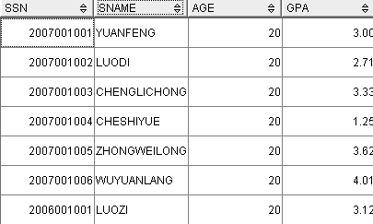

Slide 195
[Example 56]:
Find the names of all students who study in the same department with a student with sname= ‘liucheng’ .
  SELECT ssn，Sname，DEPTNO
  FROM Student S1
  WHERE EXISTS
  SELECT *
  FROM Student S2
  WHERE S2.DEPTNO = S1.DEPTNO AND
  S2.Sname = ‘ liucheng '；

Slide 196
Cont…
[Example 57]: Find all the students who take all courses
select * from Student s
where not exists
(select * from Course c
where not exists
(select * from sc
where ssn= s.ssn
and Cno = c.Cno))

Slide 197
Cont…
[Example 58] : Find the names and GPAs of those students who take all courses taken by a student with SID = 2015002001.
select Name, GPA from Student s
where not exists
(select * from Course c
where Cno in
(select Cno from sc
where ssn= 2015002001) and not exists
(select * from sc e
where ssn=e.ssn and Cno =
c.Cno))

Slide 198
Cont…
[Example 58’]:
SELECT Name, GPA
FROM student SX
WHERE NOT EXISTS
(SELECT *
FROM SC SCY
WHERE SCY.Ssn = 2006002001 AND
NOT EXISTS
(SELECT *
FROM SC SCZ
WHERE SCZ.Ssn=SX.Ssn AND
SCZ.Cno=SCY.Cno))；

Slide 199
Exercises: Consider relations:
Employees(Eid, Name, Age, Salary)
Projects(Proj_no, Name, Manager_name)
Works(Eid, Proj_no, Start_Date)
Find the names of those employees who participate in all projects.
Find the names of those projects managed by Smith that are participated in by all employees under 40.

Slide 200
Answer to Exercise 1
Find the names of those employees who participate all projects.
select name from Employees e
where not exists
(select * from Projects p where not exists
(select * from Works w
where e.Eid = w.Eid
and w.Proj_no = p.Proj_no))

Slide 201
Answer to Exercise 2
Find the names of those projects managed by Smith that are participated by all employees under 40.
select name from Projects p where manager_name = ‘Smith’ and not exists
(select * from Employees e
where Age < 40 and not exists
(select * from Works w where
e.Eid = w.Eid and w.Proj_no = p.Proj_no))

Slide 202
DML modifying contents
INSERT allows insertion of records into a table
UPDATE updates existing rows in a table
DELETE removes unwanted rows from a table

Slide 203
Insert
INSERT INTO emp (empno, ename, job, mgr, hiredate, sal, comm, deptno)
VALUES(7500, 'CAMPBELL', 'ANALYST', 7566, ‘1992-3-5', 24500,0, 40);

Slide 204
CON…
[EXAMPLE] Find each department with average age, and put the results into the database.
1. CREATE TABLE Deptage
(Sdept CHAR(15) /* depart name*/
Avgage SMALLINT)； /*average age*/
2. INSERT
INTO Deptage(Sdept，Avgage)
SELECT Sdept，AVG(Sage)
FROM Student
GROUP BY Sdept；

Slide 205
CON…
[EXAMPLE] Create a table from another table.
Create table emp
as select * from EMP2015150213

Slide 206
Update Command
1)UPDATE emp SET comm = 0;
To give a 15% raise to all Analysts and Clerks in department 20 :
UPDATE emp
SET sal = sal* 1.15
WHERE (job = 'ANALYST' OR job = 'CLERK')AND deptno = 20;

Slide 207
CON…
Increase all students with GPA over 3.5 by 6%, all other students receive 5%.
  update student
  set gpa= gpa∗ 1.06
  where gpa> 3.5
  update student
  set gpa = gpa ∗ 1.05
  where gpa ≤ 3.5

Slide 208
Delete command
i.e. To remove from EMP all sales staff who made less than 100 commission last month enter:
DELETE FROM emp
WHERE job = 'SALESMAN'
AND comm < 100;
To delete everything in a table :
DELETE FROM <tablename>;

Slide 209
CON…
Delete the record of all students with gpa below the average at the school.
delete from student
where gpa< (select avg (gpa)
from student)
  Problem: as we delete tuples from student, the average gpa changes
  Solution used in SQL:
  1. First, compute avg gpa and find all tuples to delete
  2. Next, delete all tuples found above (without recomputing avg or retesting the tuples)

Slide 210
某关系数据库:
R（Rno,Rname,Sex,AGE）表示读者
B(Bno,Bname,Writer,Publisher) 表示书籍
RB（Rno,Bno,Date）表示借阅，Date为应还日期。
分别用关系代数和SQL表示以下查询：
（1）列出”人民出版社”所出版的书名和作者。
（2）列出有书籍超期未还的读者姓名，书名，应还日期。
（3）列出借阅“莫言”所有书籍的读者姓名。
2.建立视图Female,反映女性读者的姓名和年龄。
3.写出建R和RB的SQL语句。

Slide 211
Scalar Functions of DB2
Scalar functions are applied to a column or expression and operate on a single value.
The result of a scalar function is a transformed version of the column or expression being operated on.
The transformation of the value is based on the scalar function being applied and the value itself.

Slide 212
Cont…
TRUNCATE or TRUNC
Converts the first numeric argument by truncating it to the right of the decimal place by the integer number specified in the second numeric argument.
SELECT TRUNC(3.014015,2)
FROM SYSIBM.SYSDUMMY1;
This SQL statement returns the number 3.010000, because the second argument specified that only 2 significant digits are required. The rest was truncated.

Slide 213
Cont…
ROUND
Rounds the first numeric argument to the number of places specified in the second argument.
UPPER or UCASE
Converts a character string into all uppercase characters
LOWER or LCASE
Converts a character string into all lowercase characters.

Slide 214
Cont…
SUBSTR
Returns the specified portion of a character column from any starting point to any ending point.
SNAME is a CHAR(20) column in sample table STUDENT. When SNAME has the value ‘ZHONGWEILONG’:
Function: Returns:
-----------------------------------
SUBSTR(SNAME,2,3) -- 'HON'
SUBSTR(SNAME,2) -- ' HONGWEILONG'
SUBSTR(SNAME,2,12) -- ' HONGWEILONG ' followed by one blank
SUBSTR(SNAME,13) -- a zero-length string
SUBSTR(SNAME,13,4) -- four blanks

Slide 215
Cont…
LTRIM
The LTRIM function removes blanks or hexadecimal zeros from the beginning of a string expression.
RTRIM
The RTRIM function removes blanks or hexadecimal zeros from the end of a string expression.

Slide 216
Cont…
CHAR
The CHAR function returns a fixed-length character string representation of the argument .
SELECT CHAR(CURRENT DATE)
CURRENT DATE is a DATE type which displays current date time of the system server. When it represents the date 15 March 2011, the example returns the string value '3/15/2011’ in character string .

Slide 217
Cont…
CONCAT
The CONCAT function combines two compatible string arguments.
[Example ]
Using sample table DSN8910.EMP, concatenate column FIRSTNME with column LASTNAME. Both columns are defined as varying-length character strings.
SELECT CONCAT(FIRSTNME, LASTNAME)
FROM DSN8910.EMP;

Slide 218
Cont…
WEEK
The WEEK function returns an integer in the range of 1 to 54 that represents the week of the year. The week starts with Sunday, and January 1 is always in the first week.
DAY
The DAY function returns the day part of a value. If the argument is a date, timestamp, or string representation of either, the result is the day part of the value, which is an integer between 1 and 31

Slide 219
Cont…
DATE
The DATE function converts a value representing a date to a DB2 date. The value to be converted can be a DB2 timestamp, a DB2 date, a positive integer, or a character string.
MONTH
The MONTH function returns the month part of a value. If the argument is a date, timestamp, or string representation of either, the result is the month part of the value, which is an integer between 1 and 12.

Slide 220
Cont…
TIME
The TIME function Converts a value representing a valid time to a DB2 time. The value to be converted can be a DB2 timestamp, a DB2 time, or a character string.
YEAR
The YEAR function returns the year part of a value that is a character or graphic string. The value must be a valid string representation of a date or timestamp.

