Slide 1
Useful 2D and 3D Mathematics

Slide 2
Reading
Hearn Baker (2E)/(3E). 5.1, 5.4, 5.6, 6.1, 6.3, 6.5,
Foley van Dam. 5.2, 5.6
Further reading:
Hearn Baker. A.1-2, A.5, A.8-9

Slide 3
Lecture outline:
Coordinate systems
Points and Vectors
Useful 2D Mathematics for Computer Graphics
Useful 3D Mathematics for Computer Graphics
2D and 3D Transformations
Useful site: http://mathworld.wolfram.com
(Check math. terminology)

Slide 4
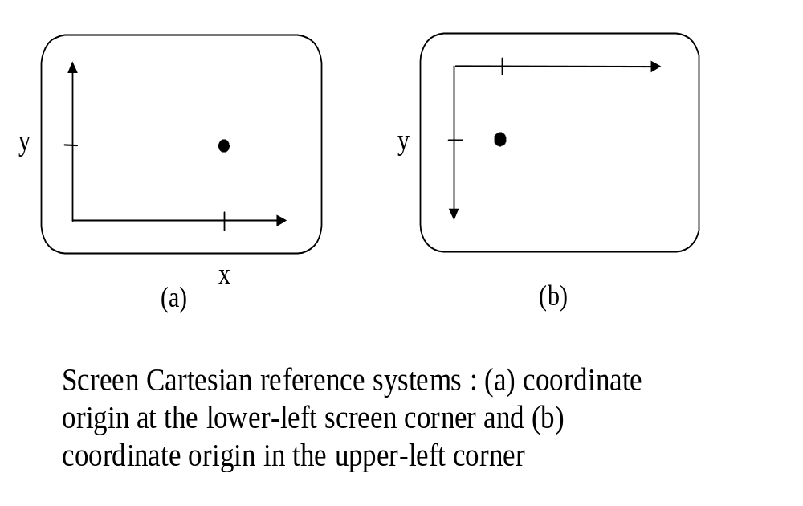
Coordinate Systems
(1) 2D Cartesian Reference Frames

Slide 5
(2) Polar Coordinates in the XY plane
A coordinate position is specified with a radial distance r from the coordinate origin, and an angular displacement θ from the horizontal.
Y
r
θ
X
A polar coordinate
reference
frame, formed
with concentric circles
and radial lines.

Slide 6
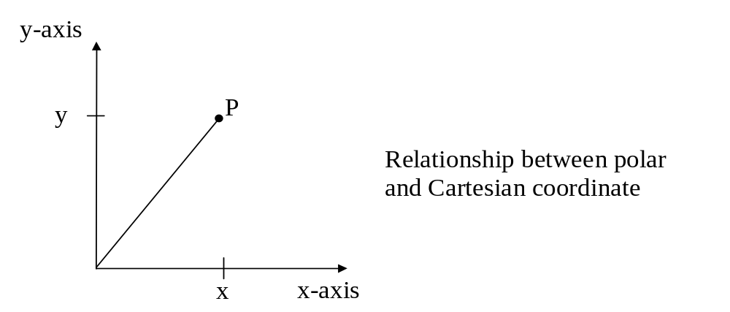
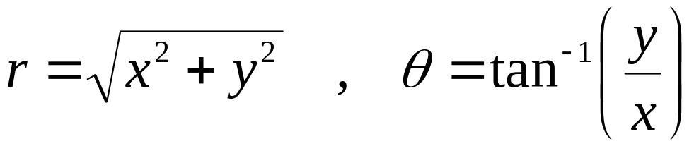
Relationship between Polar and Cartesian coordinates.
x = r cos θ , y = r sin θ
0
The inverse transformation from Cartesian to Polar coordinates is:
Note: see atan2() in math.h
It maps (x,y) to (- π,+ π ]

Slide 7
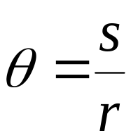
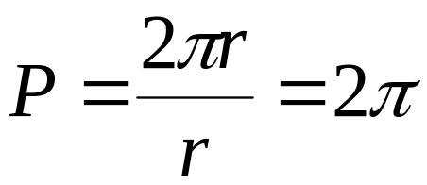
Definition of angle θ (in radian) :
s
θ
Definition:
P
r
An angle
θ
subtended by a
circular arc of length s and r.
Total angular distance around point P

Slide 8
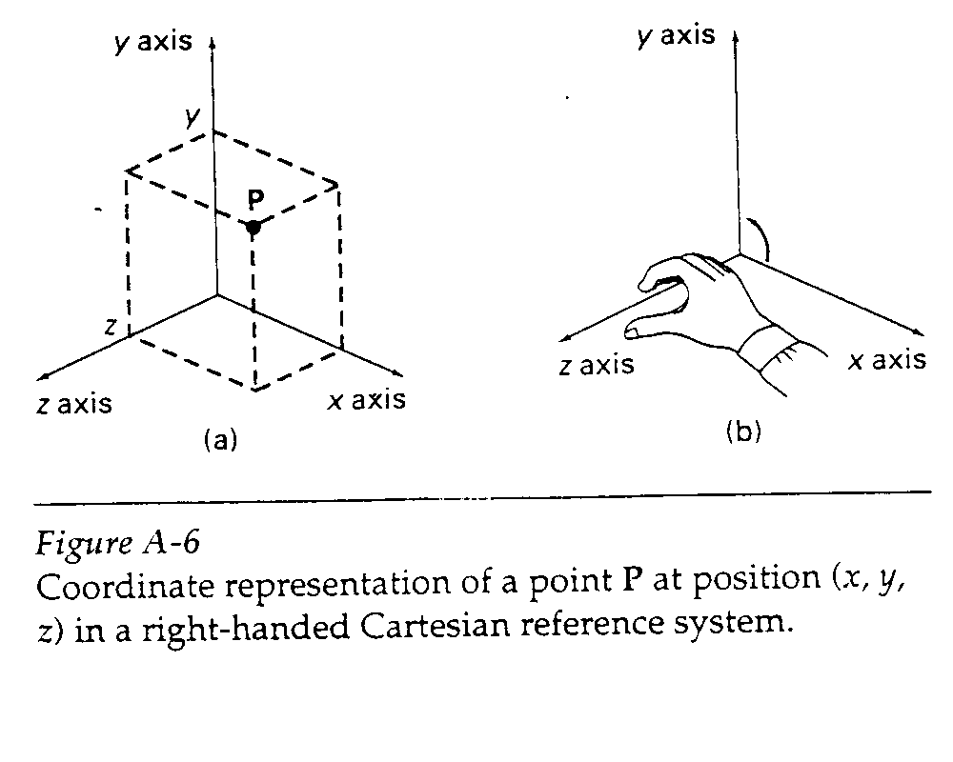
(3) 3D Cartesian Reference Frames
Right-handed System
Y
X
Z

Slide 9
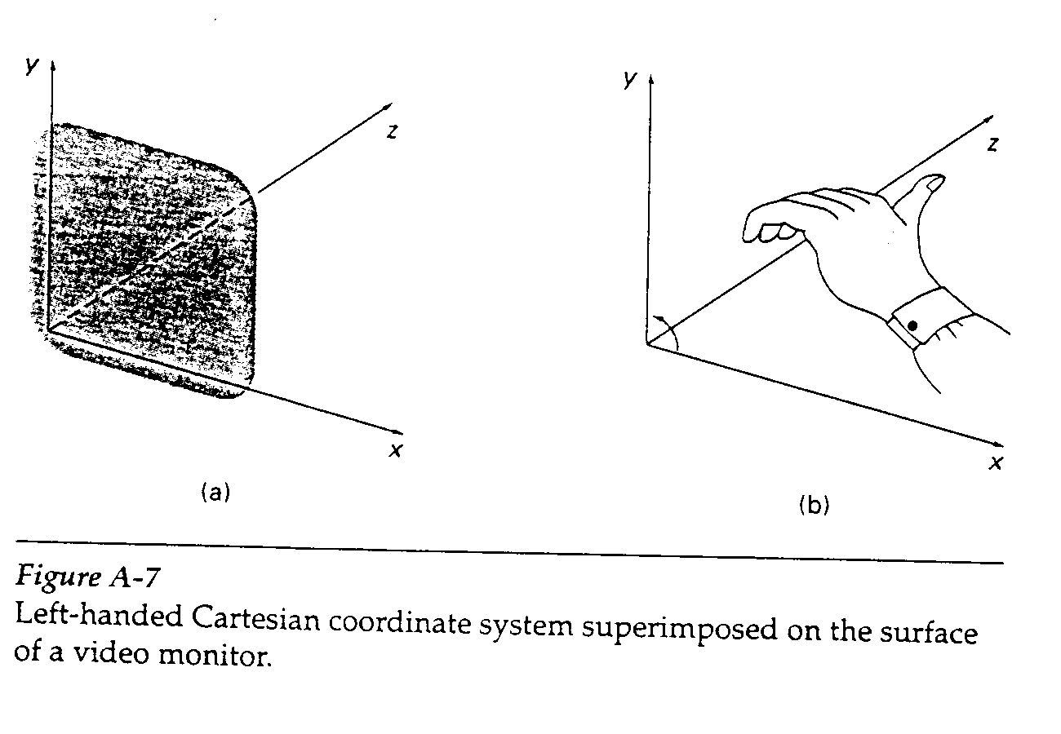
Left-handed System
In OpenGL (and most graphics people), all 3D reference frames
are right handed while DirectX allows programmers to choose.

Slide 10
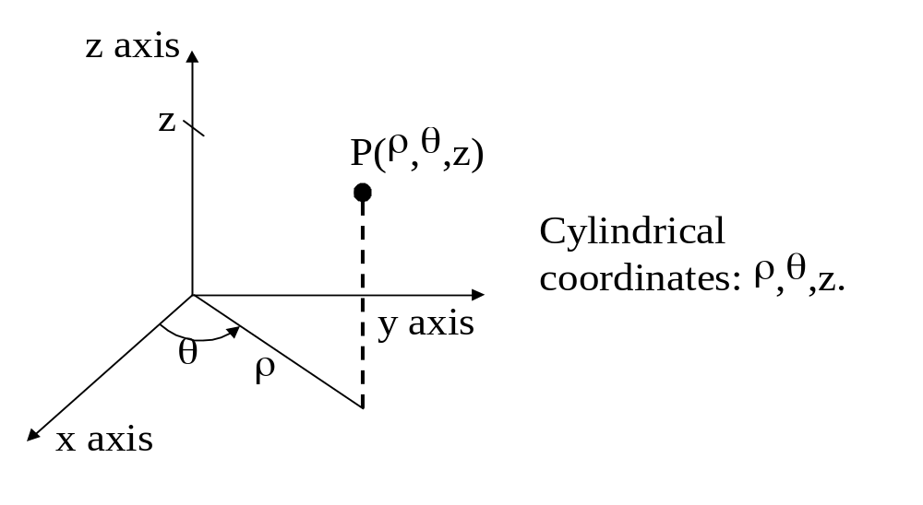
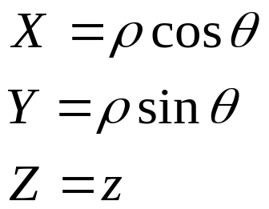
(4) Cylindrical-coordinate System
The surface of constant ρ is a vertical cylinder
The surface of constant θ is a vertical plane containing the Z-axis
The surface of constant z is a horizontal plane parallel to the Cartesian XY plane
Transformation from a cylindrical coordinate specification to a Cartesian
reference system

Slide 11
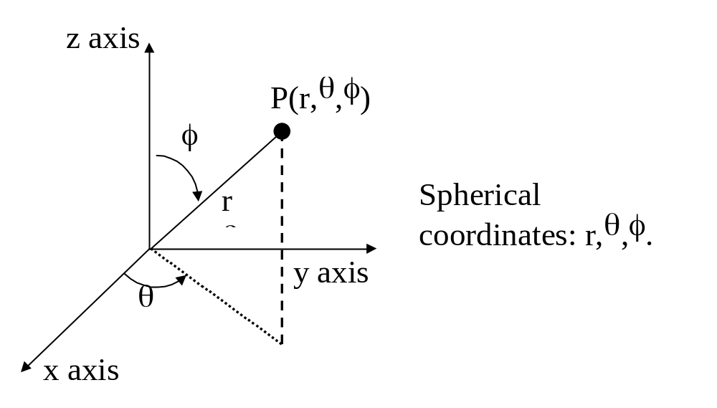
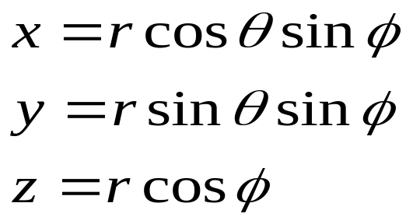
(5) Spherical-coordinate System
( or Polar coordinates in 3D space )

Slide 12
Solid Angle w (unit : steradian)
A
Definition:
ω
=
r
2
r
A
A solid angle
ω
ω
subtended by a
spherical surface
patch of area A
with radius r.
4
π
r
2
Total
solid
angle
about
a
point
=
=
4
π
r
2

Slide 13
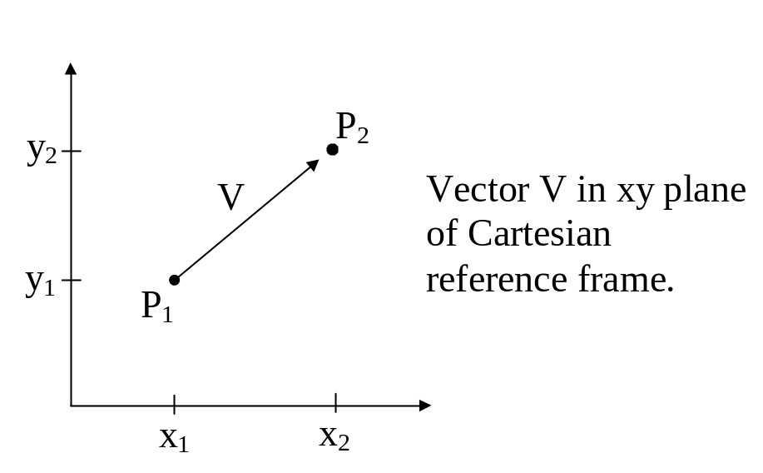
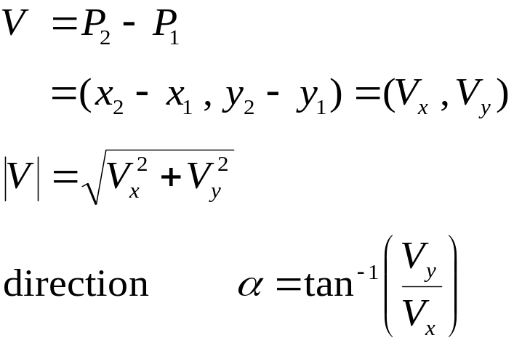
Points and Vectors
2D Vector
Change = “New – Old”
Note: see atan2() in math.h
It maps ( x , y ) to (- π,+ π ]

Slide 14
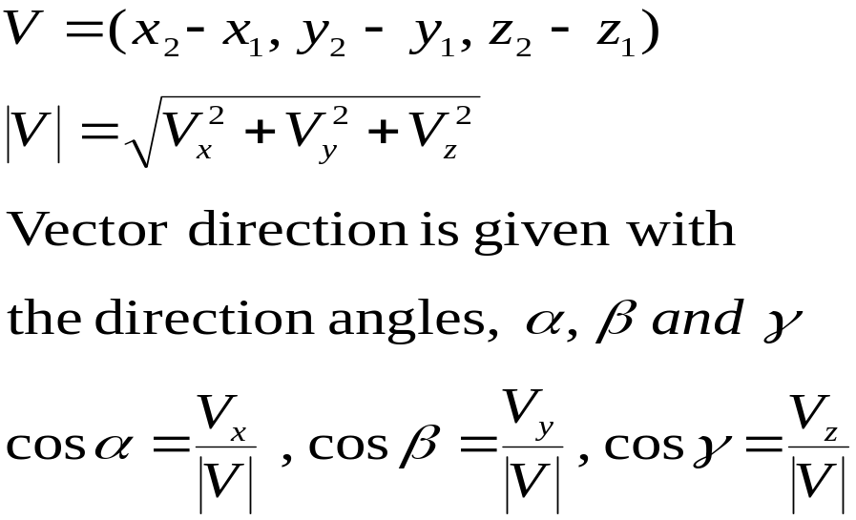
z
3D Vector
V
γ
β
α
y
x
Direction angles
α
,
β,
and
γ
.

Slide 15

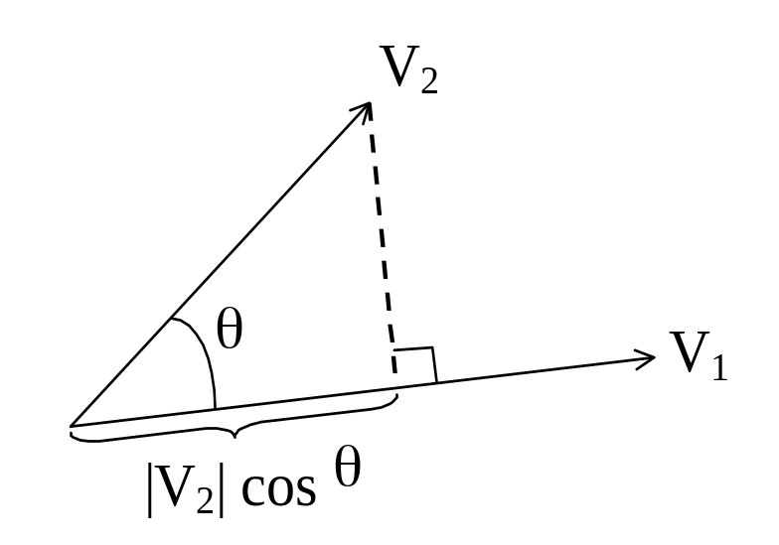

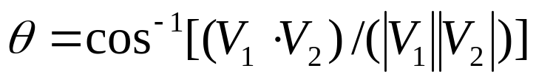
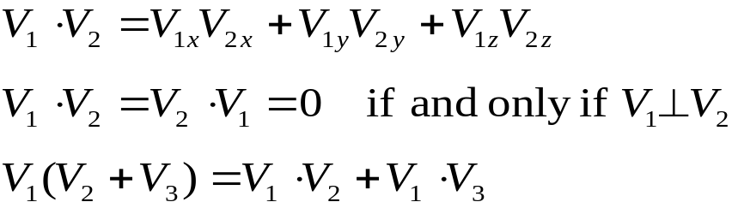
1. Vector Addition
2. Scalar Multiplication
3. Scalar Product ( Dot product )
where θ is the angle
between the two vectors

Slide 16
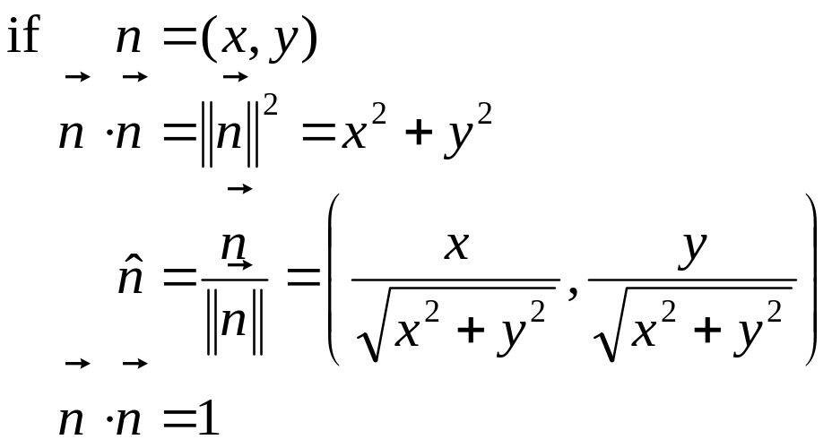
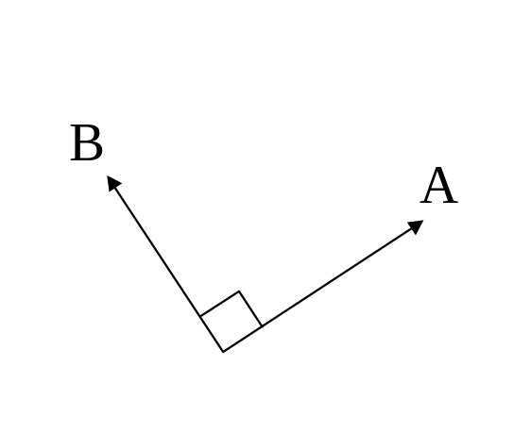
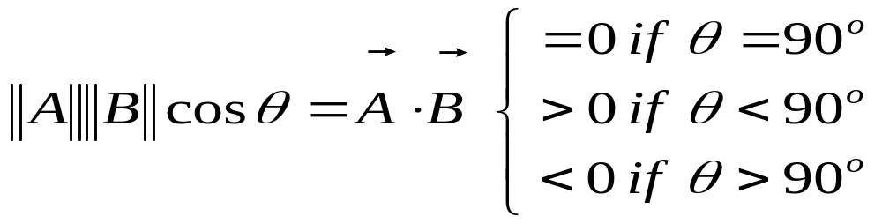
4. Normalization
5. Perpendicular

Slide 17
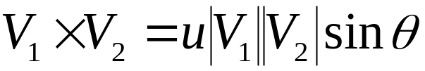
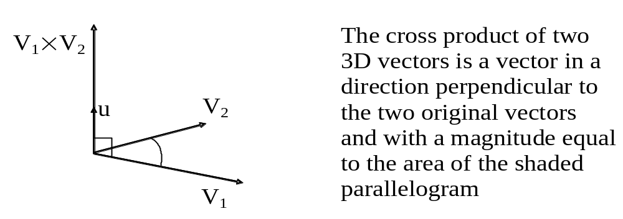
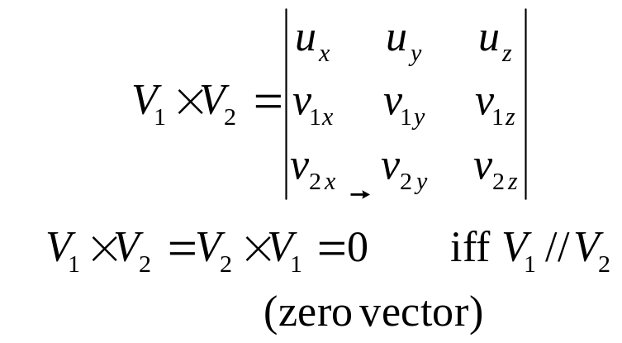
6. Cross Product of Two 3D Vectors
Multiplication of two vectors to produce another vector.
where u is the unit vector that is perpendicular to both V₁ and V₂
OR

Slide 18
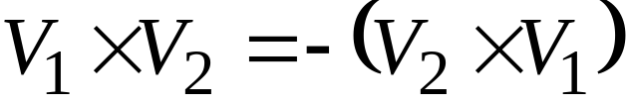
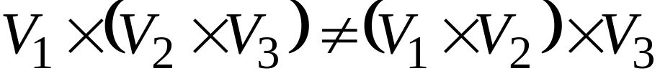
Properties of Vector Cross Product
Anti-commutative:
Not associative :
Distributive with respect to vector addition

Slide 19
7. Basis Vectors / Base Vectors
We can specify the coordinate axes in any reference frame
with a set of vectors, one for each axis.
For examples:
for 2D Cartesian system : U_{x}=(1,0) , U_{y}=(0,1)
for 3D Cartesian system : U_{x}=(1,0,0) , U_{y}=(0,1,0) , U_{z}=(0,0,1)
Orthonormal basis if : U_{k} . U_{k} = 1 for all k
U_{j} . U_{k} = 0 for all j ≠ k

Slide 20
Useful 2D Mathematics for Computer Graphics
Proximity
  Point and Line
  Point and Line Segment
Line-Line Intersection
Which Side Test
Triangle or Polygon areas
Inside-Outside Test
d
d

Slide 21
Useful 2D Mathematics for Computer Graphics
P(x,y)
n
h
B(x2,y2)
A(x1,y1)
To find distance from P to Line AB
1. Find line direction
v = ( x2 - x1 , y2 - y1 ) = ( dx , dy )
2. Find normal of line by swapping elements in v
n = ( -dy , dx ) = ( y1 - y2 , x2 - x1 )

Slide 22
Useful 2D Mathematics for Computer Graphics
P(x,y)
h
B(x2,y2)
P-A
ˆ
n
A(x1,y1)
l
To find distance from P to Line AB
3. Normalize n and v as n and v
4. Use dot product to find h and l
h = | ( P - A ) . n | = | n . (x - x1 , y - y1) |
l = ( P - A ) . v = v . (x - x1 , y - y1)
ˆ
ˆ
ˆ
ˆ
ˆ
ˆ

Slide 23
Useful 2D Mathematics for Computer Graphics
P(x,y)
B(x2,y2)
P-A
ˆ
n
A(x1,y1)
l
To find distance from P to Line Segment AB
1. Need to check l against length of AB
Note: l is signed.
2. If l < 0 or l > |AB|, compute point-point distance

Slide 24
Useful 2D Mathematics for Computer Graphics
A(x1,y1)
D(x4,y4)
C(x3,y3)
B(x2,y2)
Line-Line Intersection
1. Express as parametric forms:
AB: ( x1 , y1 ) + t_{AB} ( x2-x1 , y2-y1 )
CD: ( x3 , y3 ) + t_{CD} ( x4-x3 , y4-y3 )
Note: varying t_{AB} and t_{CD} trace the whole line (same for 3D)

Slide 25
Useful 2D Mathematics for Computer Graphics
Line-Line Intersection
2. Two equations with Two unknowns (t_{AB} and t_{CD})
x1 + t_{AB} ( x2-x1 ) = x3 + t_{CD} ( x4-x3 )
y1 + t_{AB} ( y2-y1 ) = y3 + t_{CD} ( y4-y3 )
3. Solve this equation for t_{AB} or t_{CD} (Crammer’s Rule)
Note: if no solution, AB and CD are parallel
4. Substitute back to the parametric form

Slide 26
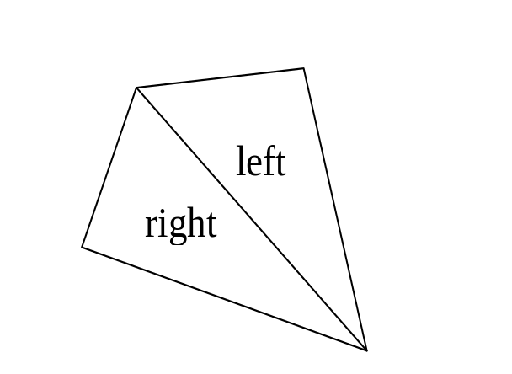

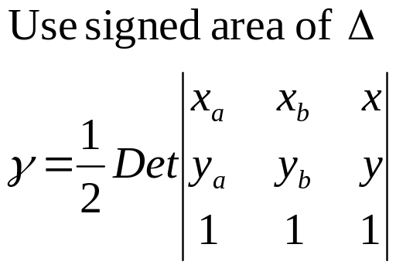


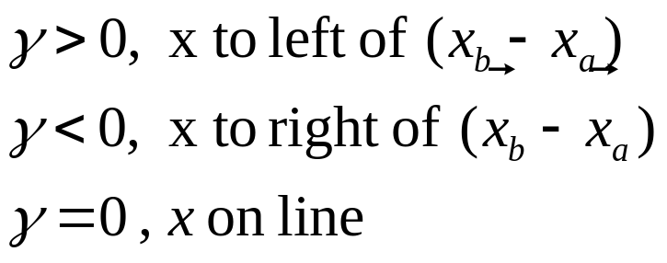
Useful 2D Mathematics for Computer Graphics
Which-side Test: Given a point and a line
We first look at triangle area
Note:
- use right-hand rule
anti-clockwise gives +ve
In Graphics, sometimes we assume
anti-clockwise order gives front face

Slide 27
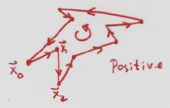
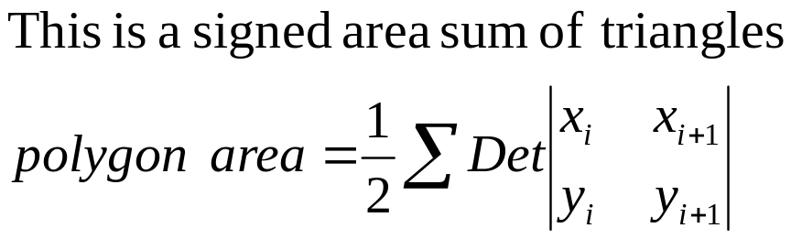
Useful 2D Mathematics for Computer Graphics
Area of Arbitrary Polygons
Order of vertices gives sign!!!
Note: do not miss the last vertex and the first vertex

Slide 28
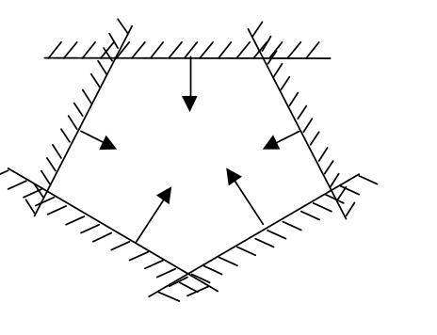

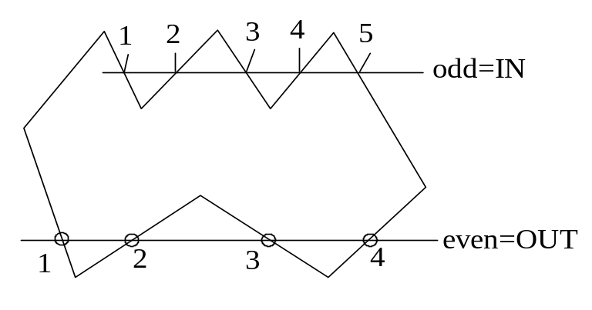
Useful 2D Mathematics for Computer Graphics
Inside-Outside Test
Method 1: Repeat the which-side test for each edge in order
Method 2: Odd-intersection Count
Note: this works for convex polygons only
number = 0 or even ⇒ outside
number = odd ⇒ inside

Slide 29
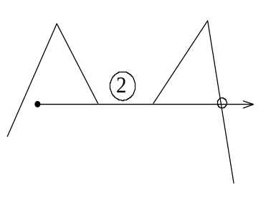
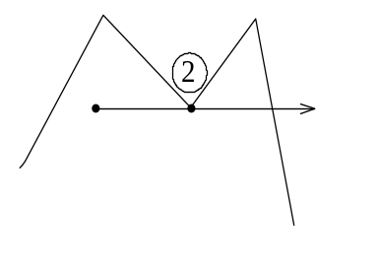
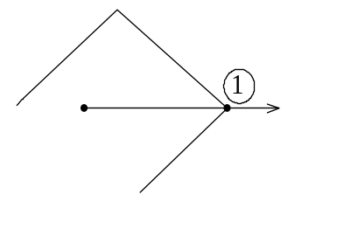
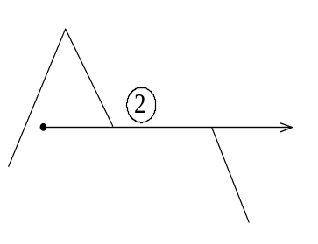
Useful 2D Mathematics for Computer Graphics
Inside-Outside Test
Weird cases in Odd-intersection Count
Direction change vertex must
count 0 or 2
Horizontal direction-change
line must count 0 or 2
No-direction-change
vertex must count 1
Horizontal no direction-change
line must count 1
Note: a quick way to implement this is to check along x or y direction

Slide 30
Useful 3D Mathematics for Computer Graphics
Linear Interpolation (lerp)
Barycentric Coordinate
Spherical Linear Interpolation (slerp)
Face Normal and Vertex Normal

Slide 31
Useful 3D Mathematics for Computer Graphics
y
Linear Interpolation (lerp)
V
1
y
1
V
=
V
+
t
(
V
−
V
)
0
1
0
V
y
Vary t moves along line V₀ - V₁
V
0
y
0
x
z
x
x
x
1
0

Slide 32
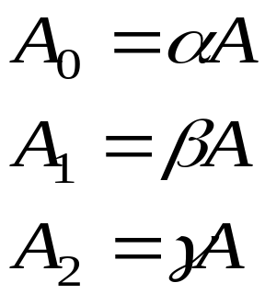
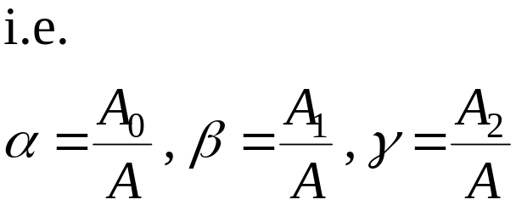
Useful 3D Mathematics for Computer Graphics
P
2
Barycentric Coordinate
- by means of area ratios
P
P
0
P
1
Note: varying α,β, andγ moves inside the triangle
useful for color mixing

Slide 33
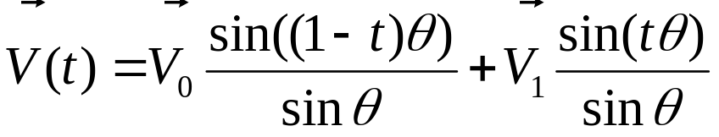
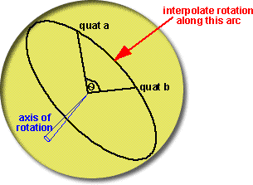
Useful 3D Mathematics for Computer Graphics
Spherical Linear Interpolation (slerp)
V₀
V₁
Vary t moves along arc between V₀ and V₁
This is a linear interpolation in the angular domain
V(t) is always a unit vector if V₀ and V₁ are unit vectors
Want to know more?
http://www.euclideanspace.com/maths/algebra/realNormedAlgebra/quaternions/slerp

Slide 34

Useful 3D Mathematics for Computer Graphics
Normal of a Triangle (Face Normal)
n
Given vertices V₀ , V₁ , and V₂
in anti-clockwise order
use right hand rule
V₂
n
V₀
front side
Normal n = ( V₁ - V₀ ) cross ( V₂ - V₀ )
V₁
OR
( V₁ – V₀ ) cross ( V₂ - V₁ ) ……
Note: many ways to do this and this normal is assumed to the
front face normal (in OpenGL and many graphics API)

Slide 35
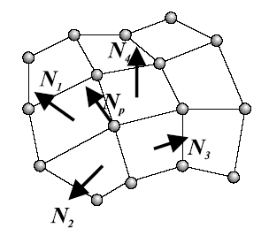
Useful 3D Mathematics for Computer Graphics
Approximate Normal at a Vertex (Vertex Normal)
Average the face normals of
neighboring faces

Slide 36
2D and 3D Transformations
What is a Transformation?
> Mapping points from one location to another
Basic Transformations:
  Identity (mapping every point to itself)
  Translation
  Scaling
  Rotation
  Shearing
  Reflection

Slide 37
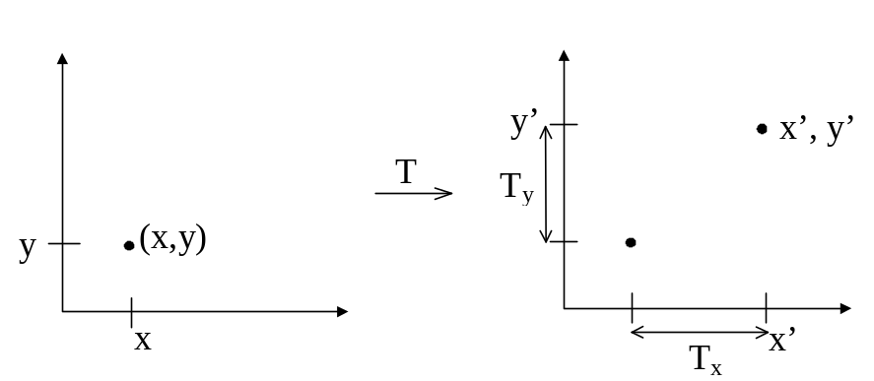
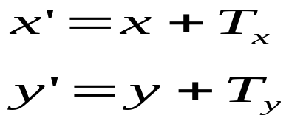
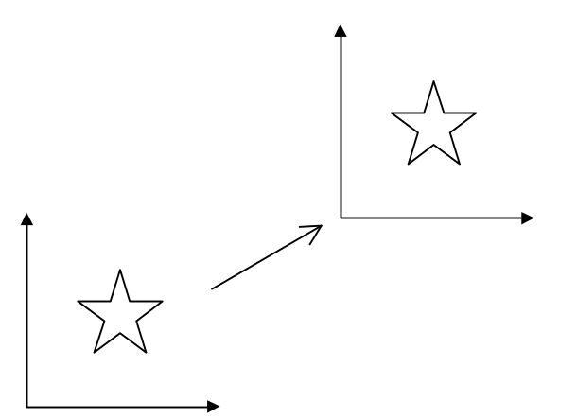
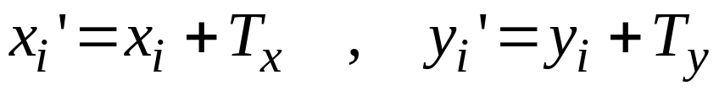
2D Translation
Move points of an object to a new place
Many Points { (x_{i} , y_{i}) } by adding same constant

Slide 38
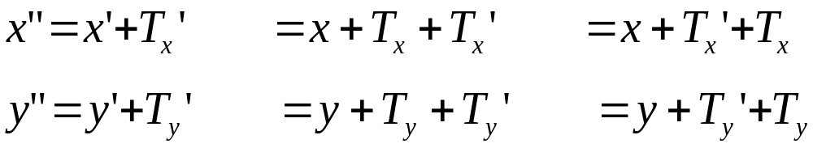
Properties
1. No Fixed points under translation.
- all points move
2. Multiple translations are order-independent

Slide 39
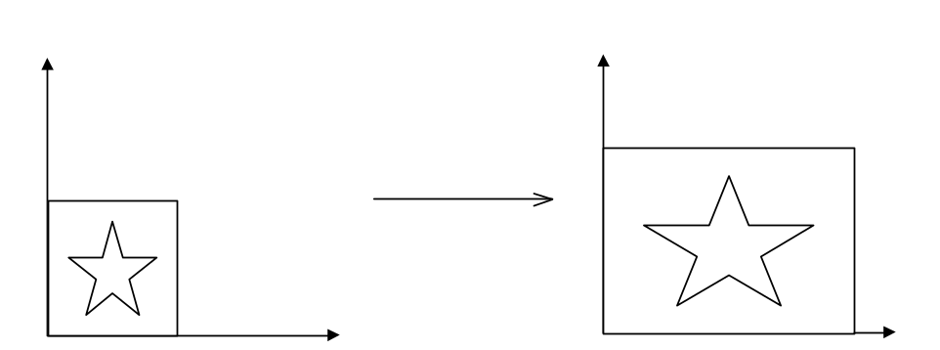

2D Scaling
Changes the size of an object
Properties :
Origin fixed : x’ = 0 if x = 0 ( fixed point is origin )
Order independent : x” = x’• S_{x}’ = x • S_{x} • S_{x}’ = x • S_{x}’ • S_{x}

Slide 40
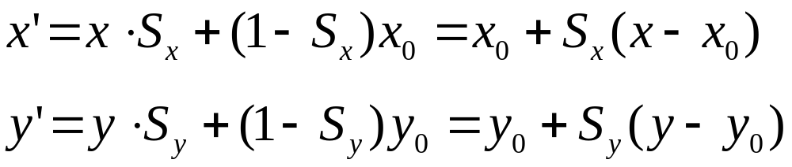
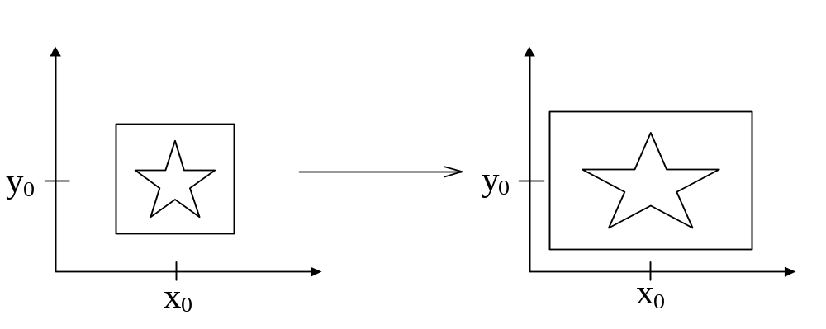
Single out arbitrary Fixed point scaling at (x₀,y₀) as follows :

Slide 41
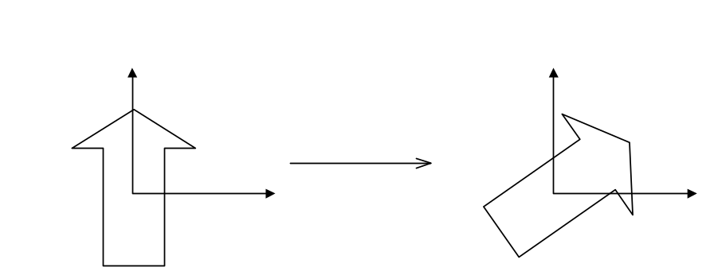

2D Rotation
Change angle :
Simple Proof
x = r cos φ
y = r sin φ
Note: r is fixed during rotation

Slide 42



Rotate by θ (always anti-clockwise in CG) :

Slide 43



Multiple 2D Rotations is Order Independent
θ" = θ + θ’
= θ’ + θ order independence

Slide 44


Fixed point: Origin dependent
but
General rotation about Fixed point ( x₀ , y₀ )

Slide 45

Check limits : x₀ = y₀ = 0 ⇒ usual.
Things rotates in orbits about fixed point!

Slide 46
Other 2D Transformations
Reflection (about X/Y-axis)
y
y
x
x’=-x , y’=y
OR
y
y
x
x’=x , y’=-y
Note: about arbitrary axis is possible

Slide 47

Reflection about X or Y is NOT equivalent to a rotation
But reflect about both x & y , i.e. x’ = - x, y’ = -y, is a rotation.
Note: reflection can be treated as a scaling with -1

Slide 48



2D Shearing
Along x
Along y
So we see Fixed point at the origin
General fixed point at ( x₀ , y₀ ) :

Slide 49


Multiple Shearing is order dependent !!
x shear then y shear
y shear then x shear

Slide 50


Using Matrix Representation for Transformations
We need to use homogeneous coordinates to loft
2-space to 3-space by adding one more component
such that
2D coordinate
Note:
1. r = 0 implies points at infinity
2. r is usually “one” for our case
2D homogeneous coordinate

Slide 51




Homogeneous Representations
Revisit 2D Translation (2 parameters)
Inverse:
Revisit 2D Scaling (2 parameters)
Inverse:
Reflection can be treated as S_{x}/S_{y} = +1/-1

Slide 52
Homogeneous Representations
Note:
Translation cannot be represented using 2 x 2 matrices
and homogeneous coordinates help.
(2) We are left-multiplying the Matrix on the vector/point
(some old textbooks may use right-multiply)

Slide 53





Homogeneous Representations
Revisit 2D Rotation (1 parameter)
Inverse:
Revisit 2D Shearing (2 parameters)
Along X
General
Inverse:
Along Y

Slide 54

General Treatment of Origin Dependence (3 steps)
1) Pre-transform P to reference position / orientation

Slide 55

2) Do transform T (e.g. reflect in y)

Slide 56

3) invert the pre-transform P⁻¹ ( post transform)

Slide 57

Derive : Fixed Point Rule for Scale/Rotate/Shear
Using:
1. Translate Fixed point to origin
2. Scale, Rotate, Shear,
3. Translate origin back to fixed point

Slide 58

All the above transformations are Affine Transformations
Definition: Transformations that preserve parallelism
such that we have the following properties:
Lines are still lines
Parallel lines remain parallel
Midpoints map to midpoint (ratios are always preserved)
But angle/length not preserved
General form:

Slide 59

Summary for 2D
Transformations:
[Levoy]

Slide 60


How about 3D Transformations
Use 4 x 4 matrices for 3D transformations.
Use homogeneous coordinate representation
represents (x,y,z) as (x,y,z,w)
a standard representation of a point (x,y,z,w) with w≠0 is given by
3D right-handed coordinate system
Note: left-multiplication of vector/point

Slide 61


3D Translations (3 parameters)
3D Scaling (3 parameters)

Slide 62



Rotation about X-axis
(1 parameters)
Rotation about Y-axis
(1 parameters)
Rotation about Z-axis
(1 parameters)
Note: left-multiplication of vector/point

Slide 63

Arbitrary Rotation (4 parameters)
  Unit vector for the axis of rotation ( n_{x} , n_{y} , n_{z} )
  Rotation angle θ
where c = cosθ and s = sinθ
Rotation by Eular angles (3 parameters)
  three angles -> apply Rx, Ry, Rz sequentially

Slide 64
Note:
In R_{x}(θ) , Ry(θ) , Rz(θ), and R(n,θ) upper left 3x3
sub-matrices are special orthogonal
* their column (and the row) vectors are mutually perpendicular unit vectors.
* the sub-matrix has a determinant of 1
Inverse of any orthogonal matrix B = Its Transpose
B⁻¹ = B^{T}
In 2D, Translation, Rotation, Scaling are commutative
(order independent) whereas in 3D, rotation is not.

Slide 65




A very useful method to know: Rotation as Frames
  Given three orthogonal unit vectors u , v , and w
  If you want to rotate the coordinates such that
    x-axis becomes u
    y-axis becomes v
    z-axis becomes w
  - You can construct a rotation matrix:
  - Check:

Slide 66


General Transformation Rule (TRS) with Fixed-Point for S/R
Orders of
Operations
3. Translate
2. Rotate
1. scale
Note: always stick to left-multiplication

Slide 67
Preview: Mapping this to OpenGL is like:
glTranslatef ( tx , ty , tz ) ;
glTranslatef (xR , yR, zR ) ;
glRotatef ( theta , xdir, ydir, zdir ) ;
glTranslatef ( -xR , -yR, -zR ) ;
glTranslatef (xF , yF, zF ) ;
glScalef ( Sx , Sy , Sz ) ;
glTranslatef ( -xF , -yF, -zF ) ;
drawObj();
Orders of
matrix Multiplications
on vertices in drawObj()

