Slide 1
Outdoor Channel Model Candidates for HEW
Date: 2013-09-18
Authors:

Slide 2
Abstract
Evaluation methodology discussions in the HEW SG have centred around two outdoor channel models for Urban Micro Environment:
ITU [1] (discussed in contributions)
Winner II [2] (discussed in contributions)
We articulate the differences between the two models, make some empirical observations and propose next steps.

Slide 3
Interest in an “Outdoor” Channel Model
To cover high density deployments:
Planned Hotspots
Joint Pico-Wi-Fi Base Stations
Co-located Pico BSs with Wi-Fi APs
Expected Attributes of such deployments
Below Roof top APs
Interference Limited Scenarios
Heavy Traffic
Outdoor –to-indoor and indoor-to-outdoor scenarios

Slide 4
Scenario of Interest
For HEW, the Urban Micro-cellular environment defined in [1] is likely to fit well:
Text from [1]
“The microcellular test environment focuses on small cells and high user densities and traffic loads in city centers and dense urban areas. The key characteristics of this test environment are high traffic loads, outdoor and outdoor-to-indoor coverage. This scenario will therefore be interference-limited, using micro cells. A continuous cellular layout and the associated interference shall be assumed. Radio access points shall be below rooftop level.”
Other models could also be considered depending on the evaluation scenario
Indoor to outdoor and Outdoor to Indoor
For now, let’s focus on Urban Micro environment.

Slide 5
Different Urban Micro Models
Starting from the oldest
3GPP/3GPP2 SCM [3]
Winner II [2]
ITU [1]
Different contributions[3], [4] have expressed preference for Winner II and ITU in the evaluation methodology for HEW
Does it matter which one we use?
Two part answer to the question
Outline the differences between Winner and ITU Urban Micro Channels
Compute outage capacity to see if they give very different channel realizations

Slide 6
Nomenclature in Winner and ITU
Since they were developed at different times, the naming for the different scenarios are different. A one-to-one map between Winner II and ITU names can be identified for many scenarios
Winner II model
Metropolitan (C2)
Typical Urban (B1, B4)
Indoor to outdoor (A2)
Rural macro (D1)
ITU model
Urban macro (UMa)
Urban micro (UMi)
Indoor (InH)
High speed (RMa)
Comments
WINNER II model contains more sub-types than ITU model
For HEW related scenarios, ITU model is only a sub-set of Winner II model; [6, 7]

Slide 7
Path Loss Model comparison

Slide 8
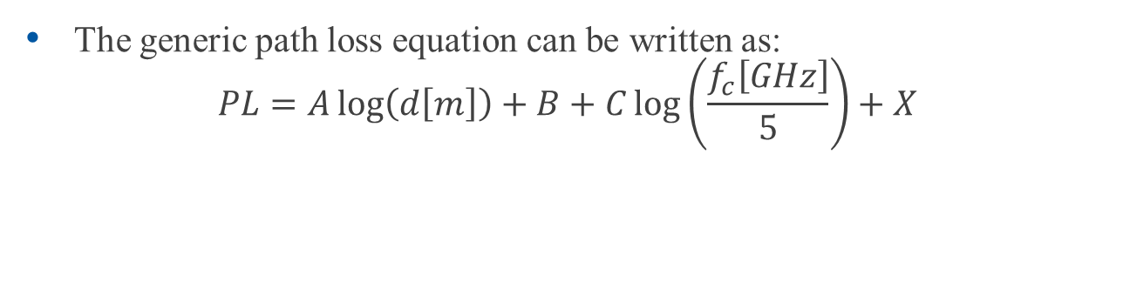
Path-Loss Model Differences
Equivalence between the two models
Penetration Loss (dB)
The generic path loss equation can be written as:
$$PL=A\log\left(d\left[m\right]\right)+B+C\log\left(\frac{f_{c}\left[GHz\right]}{5}\right)+X$$
Shadowing factor Standard Deviation
 |  | WINNER II |  |  |  | ITU IMT.EVAL
 |  | A | B | C | σ | A | B | C | σ
Indoor | LOS⁽¹⁾ | 18.7 | 46.8 | 20 | 3 | 16.9 | 46.8 | 20 | 3
 | NLOS⁽¹⁾ | 36.8 | 43.8 | 20 | 4 | 43.3 | 25.5 | 20 | 4
Urban Micro | LOS⁽²⁾ | 22.7 | 41 | 20 | 3 | 22 | 42 | 20 | 3
 | LOS^{(2,3)} (>b) | 40 | 9.45 | 2.7 | 3 | 40 | 9.2 | 2 | 3
 | Manh.⁽⁴⁾ | - | 20 | 3 | 4 | - | 20 | 3 | 4
O-I | Manh.⁽⁵⁾ | - Using the same model function

Slide 9
Path-Loss Model Differences
1: may be due to different antenna heights
3-6m in ITU model; 1-2.5m in WINNER II model
2: not clear where the difference comes from
Same antenna height and break point distance
3: using different coefficient for antenna height adjustment
17.3 for WINNER II model; 18 for ITU model
4: same model function for both models
5: for WINNER II model, same model for I-to-O and O-to-I except antenna height;

Slide 10
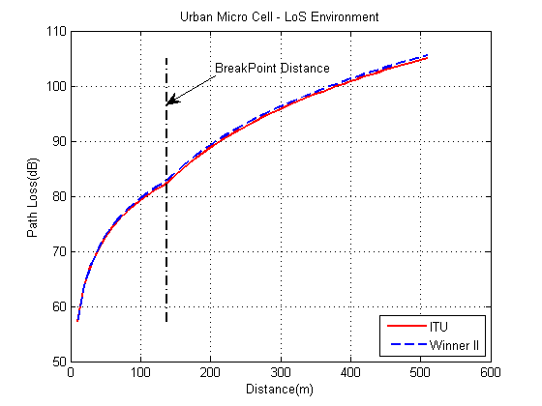
Experimental Verification
Path Loss Model differences are very small between WINNER II and ITU for Urban Micro (LOS and NLOS conditions) that performance differences are likely to be “minor”

Slide 11
Spatial Channel Impulse Response comparison between the two models

Slide 12
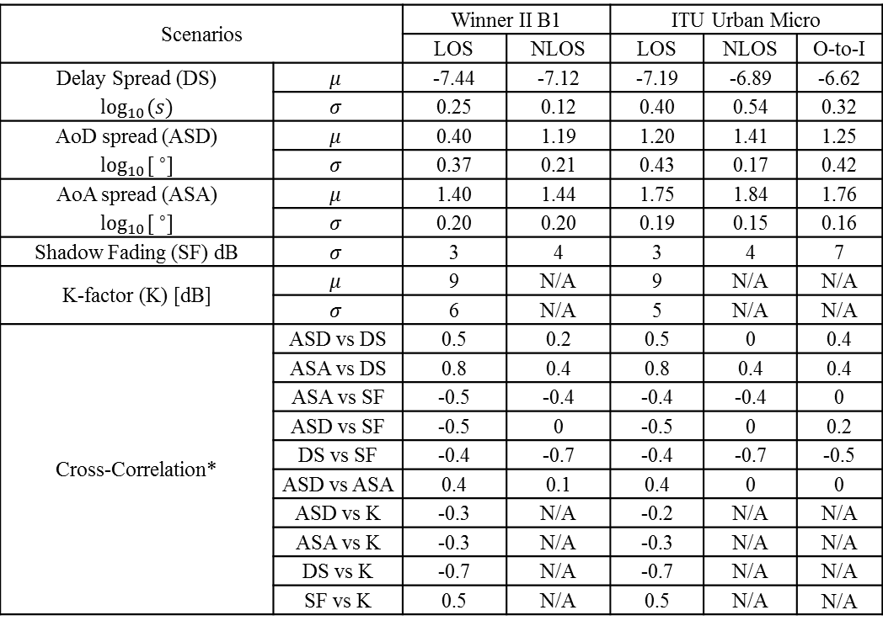
Side-by-side Parameter Comparison
Scenarios |  | Winner II B1 |  | ITU Urban Micro
 |  | LOS | NLOS | LOS | NLOS | O-to-I
Delay Spread (DS) $$\log_{10}{(s)}$$ | $$μ$$ | -7.44 | -7.12 | -7.19 | -6.89 | -6.62
 | $$σ$$ | 0.25 | 0.12 | 0.40 | 0.54 | 0.32
AoD spread (ASD) $$\log_{10}{[ ^{∘}]}$$ | $$μ$$ | 0.40 | 1.19 | 1.20 | 1.41 | 1.25
 | $$σ$$ | 0.37 | 0.21 | 0.43 | 0.17 | 0.42
AoA spread (ASA) $$\log_{10}{[ ^{∘}]}$$ | $$μ$$ | 1.40 | 1.44 | 1.75 | 1.84 | 1.76
 | $$σ$$ | 0.20 | 0.20 | 0.19 | 0.15 | 0.16
Shadow Fading (SF) dB | $$σ$$ | 3 | 4 | 3 | 4 | 7
K-factor (K) [dB] | $$μ$$ | 9 | N/A | 9 | N/A | N/A
 | $$σ$$ | 6 | N/A | 5 | N/A | N/A
Cross-Correlation* | ASD vs DS | 0.5 | 0.2 | 0.5 | 0 | 0.4
 | ASA vs DS | 0.8 | 0.4 | 0.8 | 0.4 | 0.4
 | ASA vs SF | -0.5 | -0.4 | -0.4 | -0.4 | 0
 | ASD vs SF | -0.5 | 0 | -0.5 | 0 | 0.2
 | DS vs SF | -0.4 | -0.7 | -0.4 | -0.7 | -0.5
 | ASD vs ASA | 0.4 | 0.1 | 0.4 | 0 | 0
 | ASD vs K | -0.3 | N/A | -0.2 | N/A | N/A
 | ASA vs K | -0.3 | N/A | -0.3 | N/A | N/A
 | DS vs K | -0.7 | N/A | -0.7 | N/A | N/A
 | SF vs K | 0.5 | N/A | 0.5 | N/A | N/A

Slide 13
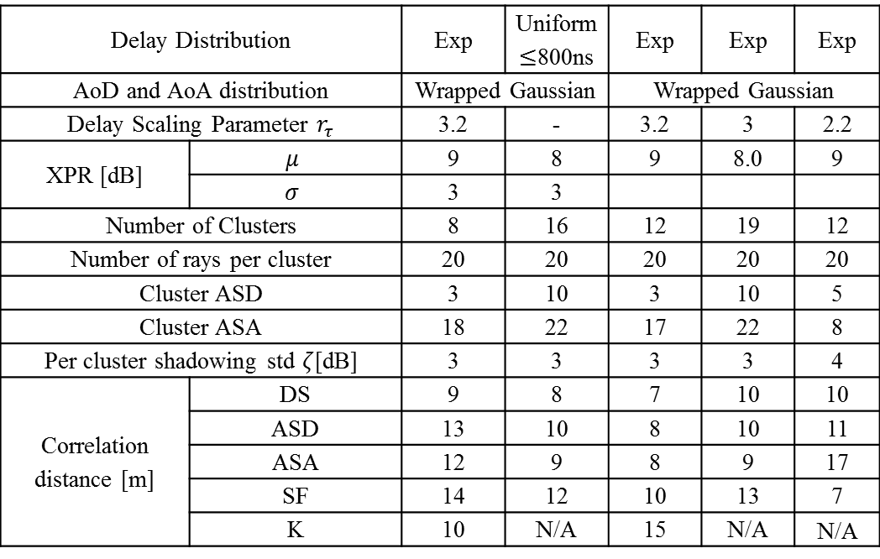
Side-by-side Parameter Comparison
Scenarios | Winner II B1 |  | ITU Urban Micro
 | LOS | NLOS | LOS | NLOS | O-to-I
Delay Distribution |  | Exp | Uniform $≤$800ns | Exp | Exp | Exp
AoD and AoA distribution |  | Wrapped Gaussian |  | Wrapped Gaussian
Delay Scaling Parameter $r_{τ}$ |  | 3.2 | - | 3.2 | 3 | 2.2
XPR [dB] | $$μ$$ | 9 | 8 | 9 | 8.0 | 9
 | $$σ$$ | 3 | 3
Number of Clusters |  | 8 | 16 | 12 | 19 | 12
Number of rays per cluster |  | 20 | 20 | 20 | 20 | 20
Cluster ASD |  | 3 | 10 | 3 | 10 | 5
Cluster ASA |  | 18 | 22 | 17 | 22 | 8
Per cluster shadowing std $ζ$[dB] |  | 3 | 3 | 3 | 3 | 4
Correlation distance [m] | DS | 9 | 8 | 7 | 10 | 10
 | ASD | 13 | 10 | 8 | 10 | 11
 | ASA | 12 | 9 | 8 | 9 | 17
 | SF | 14 | 12 | 10 | 13 | 7
 | K | 10 | N/A | 15 | N/A | N/A

Slide 14
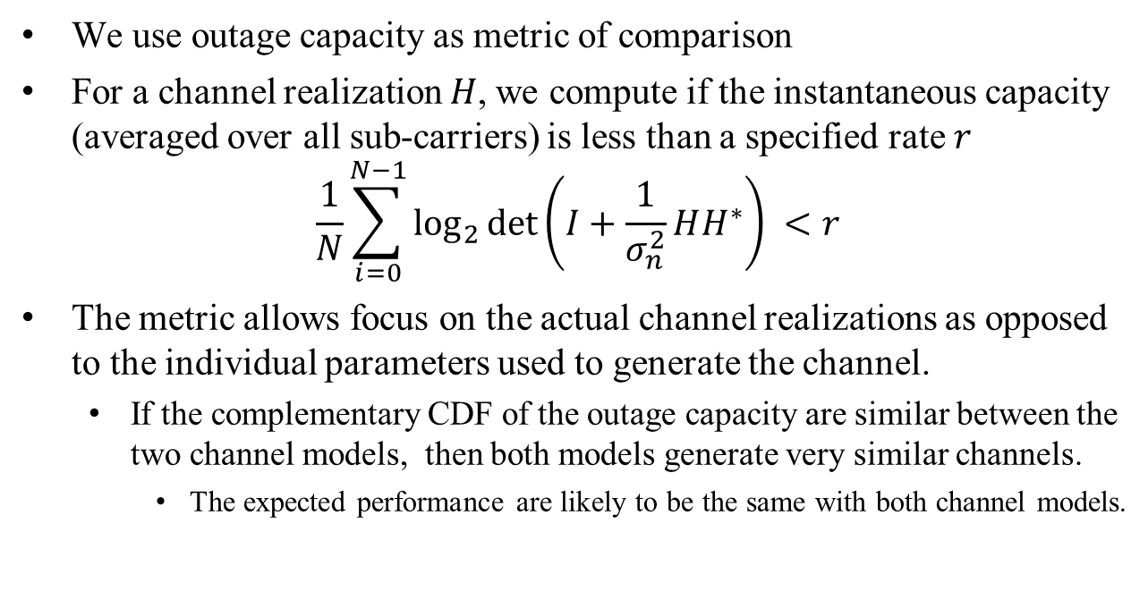
Experimental Comparison
We use outage capacity as metric of comparison
For a channel realization $H$, we compute if the instantaneous capacity (averaged over all sub-carriers) is less than a specified rate $r$
$$\frac{1}{N}\sum_{i=0}^{N−1}{\log_{2}{\det\left(I+\frac{1}{σ_{n}^{2}}HH^{∗}\right)} }<r$$
The metric allows focus on the actual channel realizations as opposed to the individual parameters used to generate the channel.
If the complementary CDF of the outage capacity are similar between the two channel models, then both models generate very similar channels.
The expected performance are likely to be the same with both channel models.

Slide 15
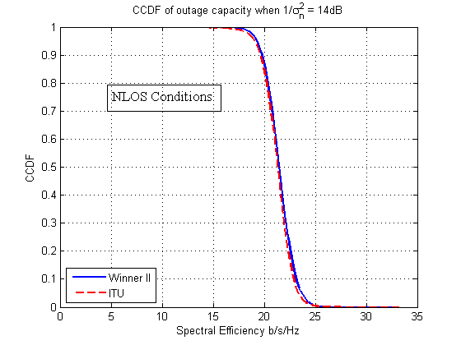
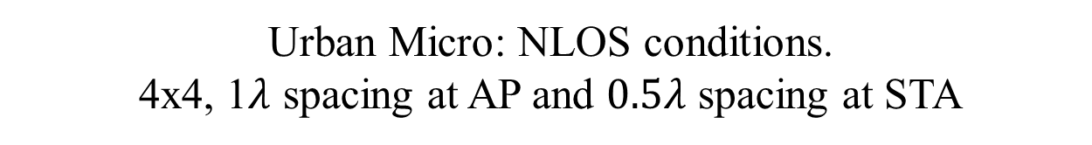
Complementary CDF of the outage Capacity
Urban Micro: NLOS conditions.
4x4, 1$λ$ spacing at AP and $0.5λ$ spacing at STA

Slide 16
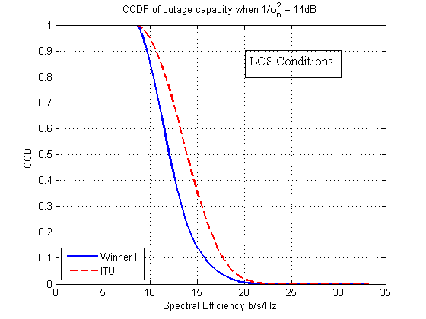
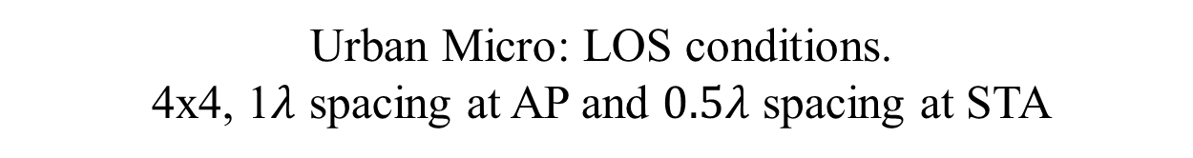
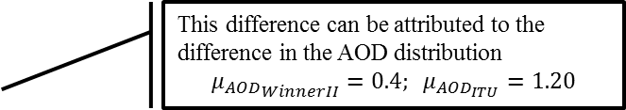
Complementary CDF of the outage Capacity
Urban Micro: LOS conditions.
4x4, 1$λ$ spacing at AP and $0.5λ$ spacing at STA
This difference can be attributed to the difference in the AOD distribution
$${μ_{AOD}}_{WinnerII}=0.4; μ_{AOD_{ITU}}=1.20$$

Slide 17
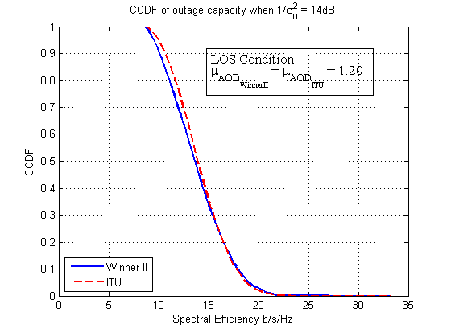
Complementary CDF of the outage Capacity
Urban Micro: LOS conditions.
4x4, 1$λ$ spacing at AP and $0.5λ$ spacing at STA
All other parameters are as in the respective channel models

Slide 18
Key Observations
The modeling methodology and channel construction between WINNER II and ITU are the same
They use same definitions for parameters and use them in the channel generation the same way
The values for the parameters are different.
For Urban Micro NLOS scenario, there seems to be little quantitative difference in the outage capacity.
For Urban Micro LOS, the statistics of the AoD distribution are sufficiently different to give different results.
Since we understand the difference, the difference in results from using either of these models can also be understood
We can use either ITU or Winner II channel models for evaluating outdoor dense “cellular like” Wi-Fi deployments

Slide 19
Next steps
The logic for using outdoor models in simulation should come from evaluation methodology
Should be based on the scenarios identified in the evaluation methodology.
Depending on the evaluation scenarios considered, other outdoor models may have to be considered
Indoor to Outdoor
Outdoor to Indoor
Urban Macro(?)
ITU has good support for Outdoor to Indoor, Urban Macro and has no support for Indoor to outdoor.
Winner II has a model for Indoor to Outdoor called A2 in the specificaton

Slide 20
References
Report ITU-R M.2135-1 (12/2009) Guidelines for evaluation of radio interface technologies for IMT Advanced
WINNER II Channel Models, Part I Channel Models, Deliverable D1.1.2, v 1.1, 2007 (http://www.ist-winner.org/WINNER2-Deliverables/D1.1.2.zip)
TR 25.996 – 3GPP Evaluation Methodology
11-13-0722-01-0hew-hew-evaluation-methodology.docx
11-13-0756-01-0hew-channel-model.docx
Software implementation of IMT.EVAL channel model, doc num: IST-4-027756
Matlab SW documentation of WIM2 model

