Slide 1
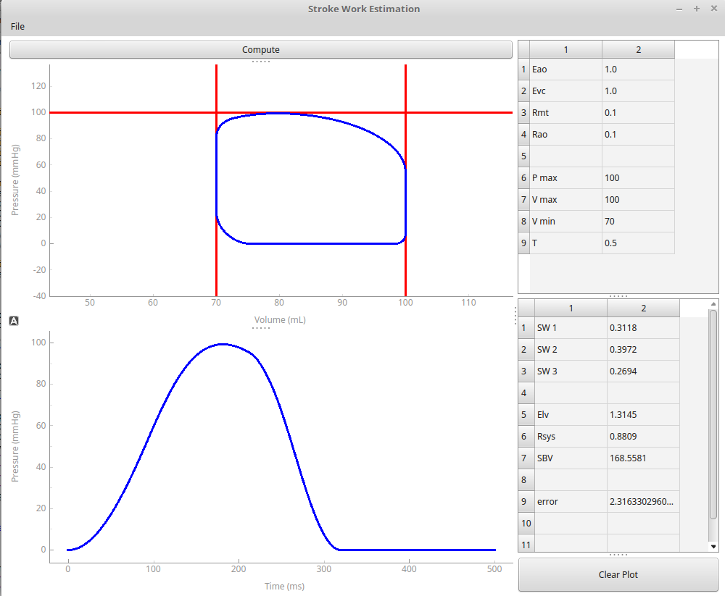
Predefined
parameters
Estimated PV loop
Estimated pressure
Stroke work estimation
Model parameter
estimation

Slide 2
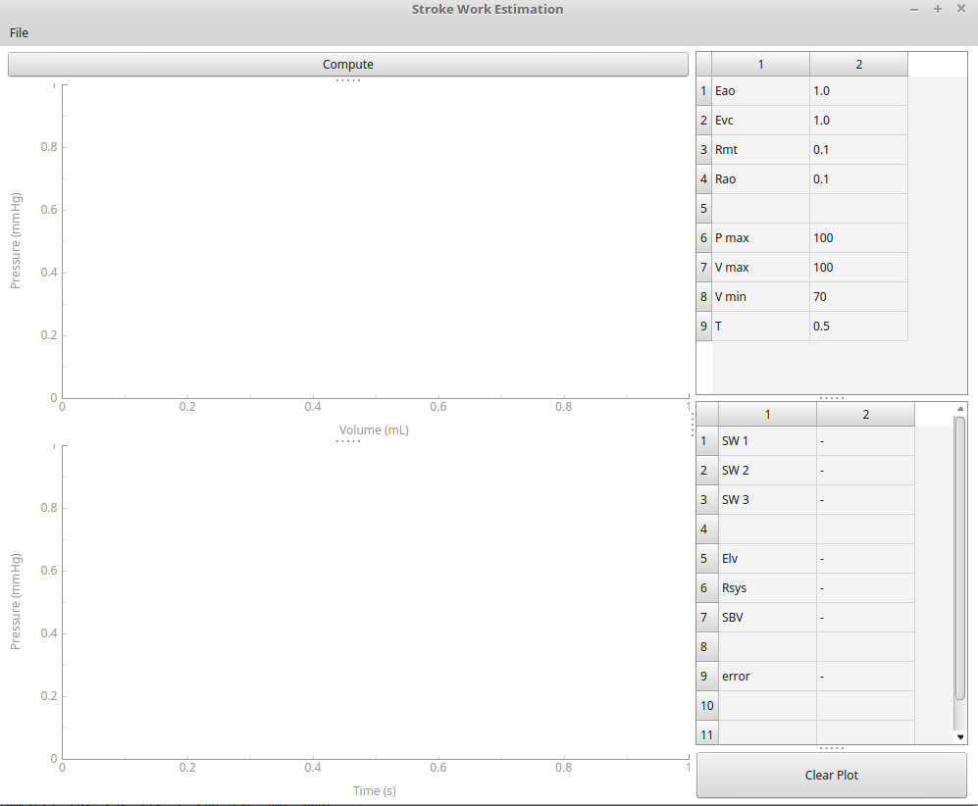

Slide 4
Pmax
Estimated PV loop
Vmin
Vmax
Estimated pressure
Stroke work estimation
Model parameter
estimation

