Slide 1
Metabolomic Data Analysis by MetaboAnalyst Pro
Enrichment Analysis

Slide 2
Metabolite Set Enrichment Analysis (MSEA)
Identifies biologically meaningful patterns significantly enriched in metabolomic data.
Utilizes over-representation analysis (ORA) to check for enrichment in a given list of compounds.
Applies GlobalTest to examine if metabolite sets’ abundance profiles are associated with the study condition directly from a compound concentration table.
Input: A list of compound names.
Analysis Aim: To analyze enrichment from a predefined set of compounds.

Slide 3
Name Mapping
Objective: Standardize compound labels for consistency.
Importance: Essential for comparing compounds with metabolite set libraries.
Tools Supported: Converts between common names, synonyms, identifiers (e.g., HMDB ID, PubChem, ChEBI).
Outcome: Table 1 shows conversion results.
  1: Exact match
  2: Approximate match
  0: No match
Results File: name_map.csv

Slide 4
Enrichment Analysis
Conducts analysis to identify significantly enriched metabolite sets.
Utilizes chosen library to match against study data for biological relevance.
Results aid in understanding metabolic pathways or functions impacted.
Selected Library: ` smpdb_pathway

Slide 5
Over Representation Analysis (ORA)
ORA investigates biologically meaningful patterns in a provided compound list.
Utilizes hypergeometric test to check if metabolite sets are more represented than expected by chance.
P-values are adjusted for multiple testing to highlight significant findings.

Slide 6
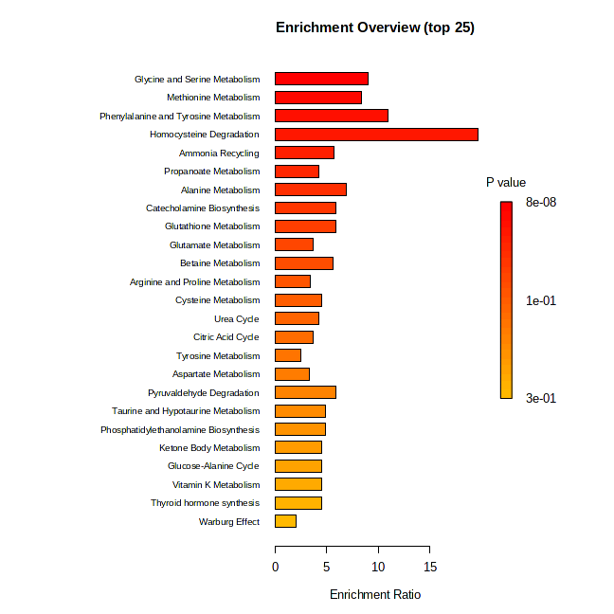
Figure 1: Summary of Over Representation Analysis results showing significant metabolite sets.

Slide 7
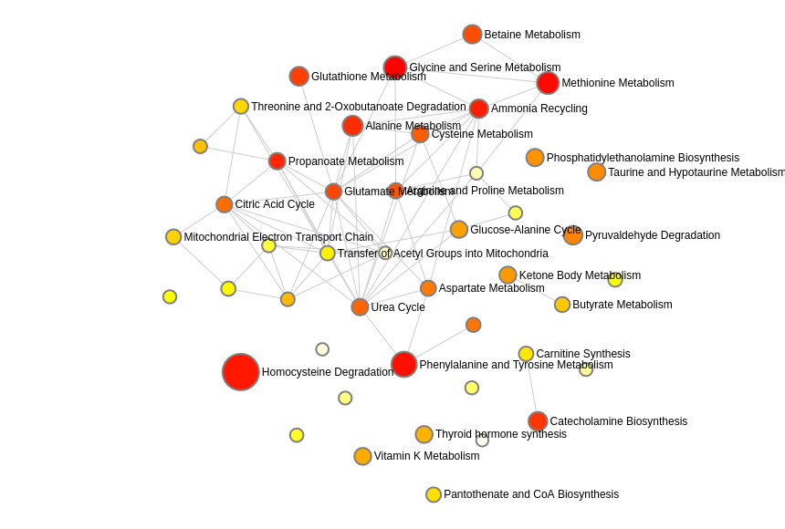
Figure 2: Enrichment network from ORA showing the interconnectedness of significant metabolite sets.

Slide 8
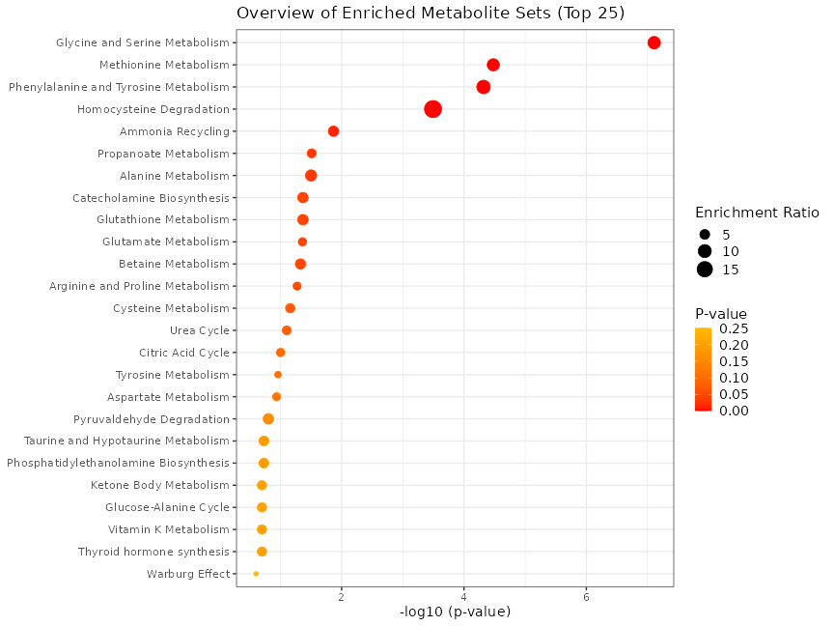
Figure 3: Dot plot summary from ORA indicating the significance and impact of each metabolite set.

Slide 9
Table 1: Results from Over Representation Analysis showing enriched metabolite sets.

Slide 10
——————————– The report was generated on Mon Feb 19 15:53:59 2024 with OS system: Linux, version: ~22.04.1-Ubuntu SMP PREEMPT_DYNAMIC Tue Jan 16 14:32:32 UTC 2

