Slide 1
ETCD
Part 1

Slide 2
What is ETCD？
ETCD is an opensource, strongly consistent, distributed key-value store
ETCD provides a reliable way to store data that needs to be accessed by a distributed system or cluster of machines.
It gracefully handles leader elections during network partitions and can tolerate machine failure, even in the leader node.

Slide 3
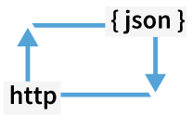
Simple interface
Read and write values using standard HTTP tools, such as curl

Slide 4
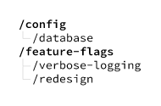
Key-value storage
Store data in hierarchically organized directories, as in a standard filesystem

Slide 5
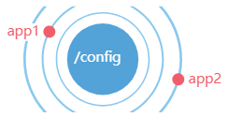
Watch for changes
Watch specific keys or directories for changes and react to changes in values

Slide 6
Architecture - ETCD
Instances can be either leader or follower
Leader
Follower
Follower
Follower
Follower
C
C
C
C
C
C

Slide 7
Architecture – ETCD (Cont.)
Quorum = (n+1) / 2
There must be an intersection between any two Quorums
At any given time there must be one leader
Operations are sent to only one at a given time

Slide 8
ACI ETCD Overview
Managed etcd service for kube and plb teams
ETCD instances runs on bare metal only, configured by puppet
All clusters are size 5

Slide 9
ETCD APIs
Put(key, value)/Delete(key)
Get(key)/Get(keyFrom, keyEnd)
Watch(key/keyprefix)
Transactions(if/ then / else ops.).Commit()
Leases: Grant / Revoke / KeepAlive

Slide 10
ETCD data
Term: 64bits Global monotonic increment
Revision: 64bits Global monotonic increment
KeyValue:
Create_revision
Mod_revision
version

Slide 11
ETCD data
Keys store multiple revision values
Compaction is the process of pruning old revisions

Slide 12

ETCD lease
Lease = createLease(60s)
Put(key1, val1,lease)
Put(key2, val2,lease)
…
lease.keepalive()
Lease.revoke()
Key1,val1
lease
Key2,val2
…

Slide 13
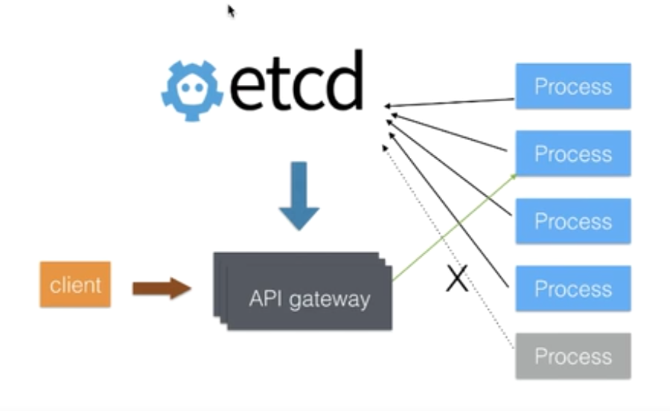
Service Discovery

