Slide 1


Kaizen Destination Part System Using New Technique
Nguyen Thi Quynh Anh - 455472
LBP IT - Application Group
Plan & IT Div

Slide 2
1. The Problems
2. The Solutions
Content
3. The Difficulties
4. The Results
5. Demo
6. Plan & Skill map

Slide 3
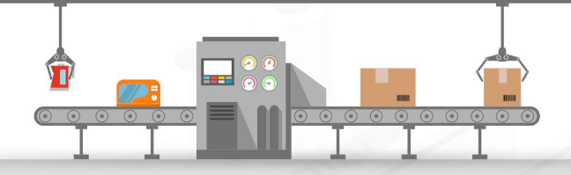

Slide 4

1. Mistakes

Slide 5
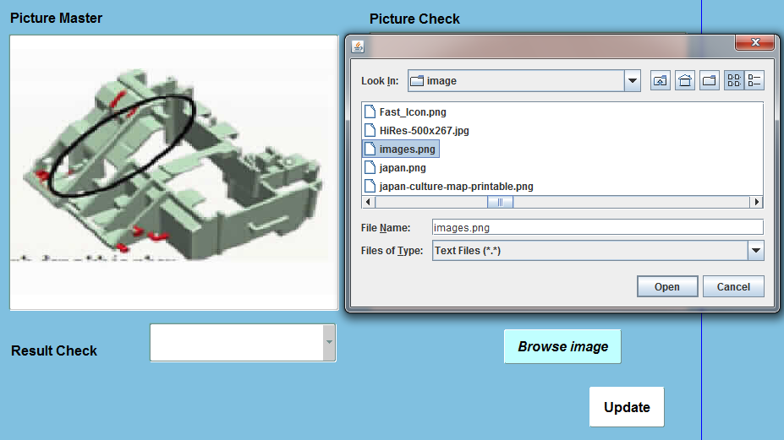
1. Problems
1.1 Comparison process is too slow
Take a photo & Pick that photo
Compare with Picture Master
by eyes → Judge: OK/NG
Click Update
1
2
3

Slide 6
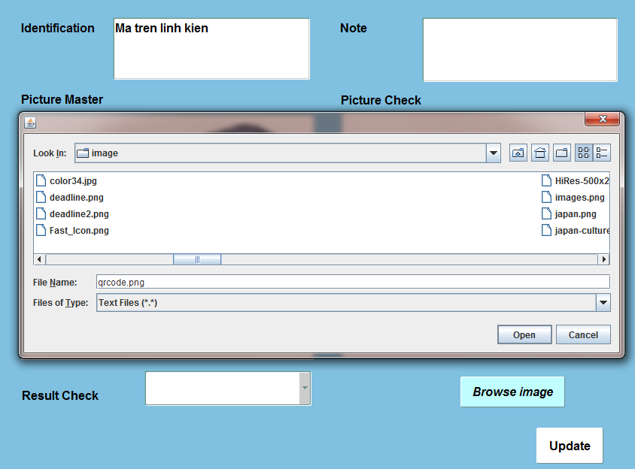
1. Problems
1.2
Take a photo & Pick that photo
If Identification is like the image below → On part have barcode the
Click Update
The barcode is printed on the part
1
2
3

Slide 7
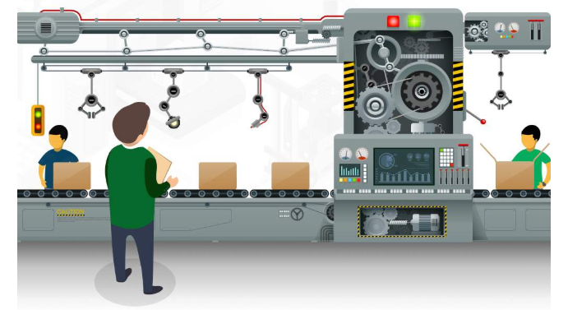

Slide 8
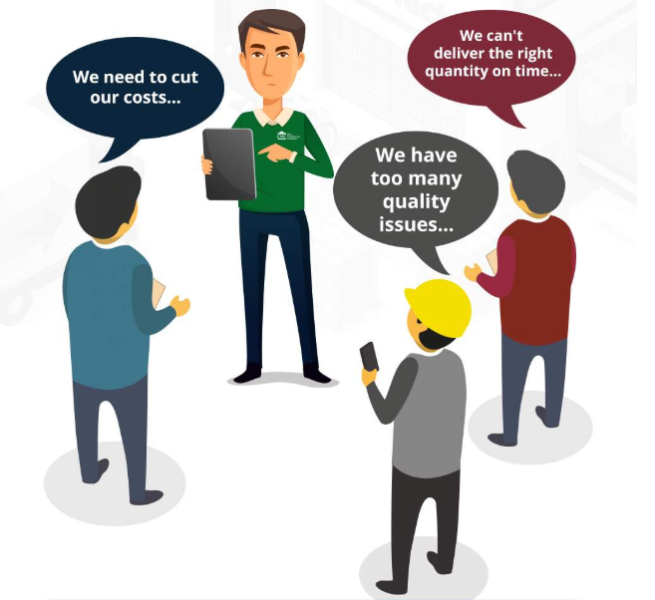
1. The Problems

Slide 9



month
3. The Difficulties & Solutions
Have no experience
Have no guider
Don’t understand the workflow of this system
1

Slide 10
month
3. The Difficulties
Have no experience
Have no guider
Don’t understand the workflow of this system
1

Slide 11


3. The Difficulties & Solutions
Have no experience
Have no guider
Don’t understand the workflow of this system

Slide 12
month
3. The Difficulties & Solutions
1
Break the problem down
Arrange the priority
Check result immediately
Track the process

Slide 13
2. The Solution
Break the problem down
Arrange the priority
Check immediately result
Track the process
Concentrate and keep going
Self-learning

Slide 14



21.000
4. The Results
3
Faster Process
times
50%
Improve Quality
USD for
first year
Save Money
4.620
USD for each next year

Slide 15
21.000
4. The Results
50%
Improve Quality
USD for
first year
Faster Process
3
4.620
times
USD for each next year
Save Money

Slide 16



Intergrate QR Code
5. Plan
5. Plan for Destination Part System
Automatically Detect Barcode Type
Vizualize Data

Slide 17


6. Plan
5. Plan for next year

Slide 18
6. Plan
5. Plan for next year
Learning Japanes
Ma

Slide 19
7. Skill Map

Slide 20
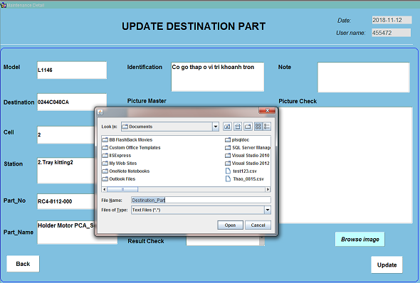
adas
8. Conclusion

