Slide 1


Kaizen Destination Part System Using New Technique
Nguyen Thi Quynh Anh - 455472
LBP IT - Application Group
Plan & IT Div

Slide 2
1. The Problems
2. The Solutions
3. The Difficulties
Content
4. Results
5. Demo
6. Plan & Skill map

Slide 3
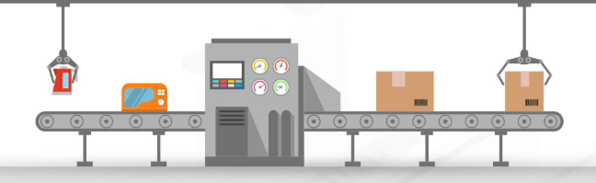

Slide 4
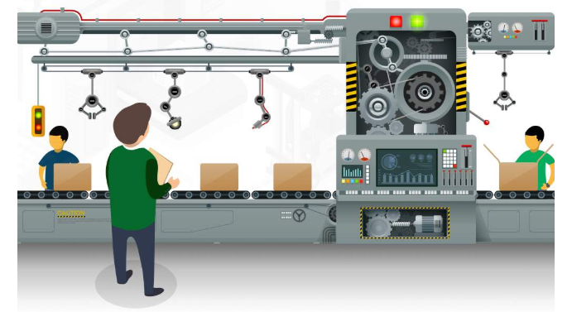

Slide 5


Slide 6
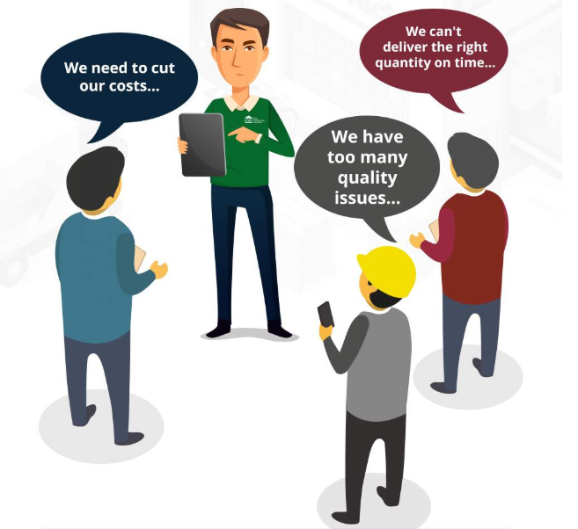
1. The Problems

Slide 7


2. The Solution
Break the problem down
Arrange the priority
Track the process
Concentrate and keep going
Self-learning

Slide 8
3. The Difficulties

Slide 9
5. Demo

Slide 10


đasdsdasdasd
4. The Results
đasdsdasdasd
Faster Process
đasdsdasdasd
Improve Quality
Save Money

Slide 11

6. Plan

Slide 12

COST spent on

Slide 13


