Slide 1


Kaizen Destination Part System Using New Technique
Nguyen Thi Quynh Anh - 455472
LBP IT - Application Group
Plan & IT Div

Slide 3


Slide 4
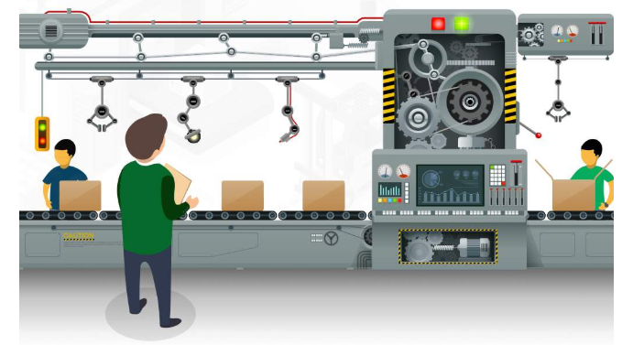

Slide 5



