Slide 1


Kaizen Destination Part System Using New Technique
Nguyen Thi Quynh Anh - 455472
LBP IT - Application Group
Plan & IT Div

Slide 2
1. The Problems
2. The Solutions
Content
3. The Difficulties
4. The Results
5. Demo
6. Plan & Skill map

Slide 3
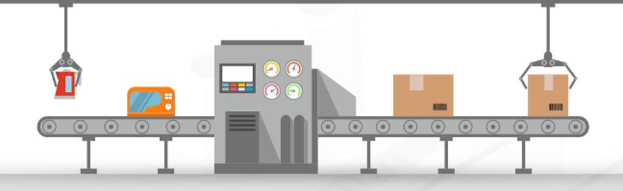

Slide 4
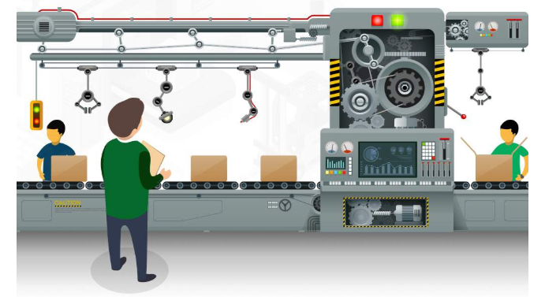

Slide 5
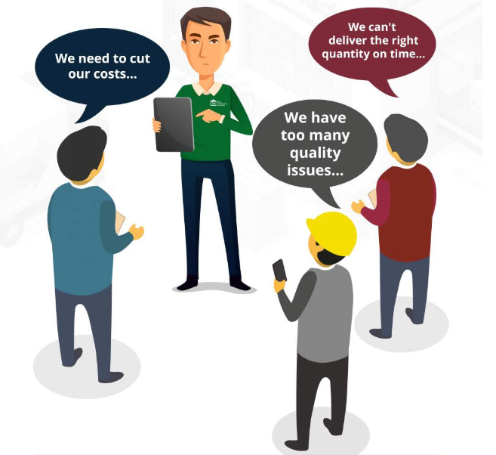
1. The Problems

Slide 6


2. The Solution
Break the problem down
Arrange the priority
Check immediately result
Track the process
Concentrate and keep going
Self-learning

Slide 7



month
3. The Difficulties
Bla bla bla bla !
1

Slide 8



.
4. The Results
.
Faster Process
.
Improve Quality
Save Money

Slide 9




Intergrate QR Code
5. Plan
5. Plan
Automatically Detect Barcode Type
Vizualize Data

Slide 10

6. Plan
5. Plan

Slide 11
7. Skill Map

Slide 13


