Slide 1



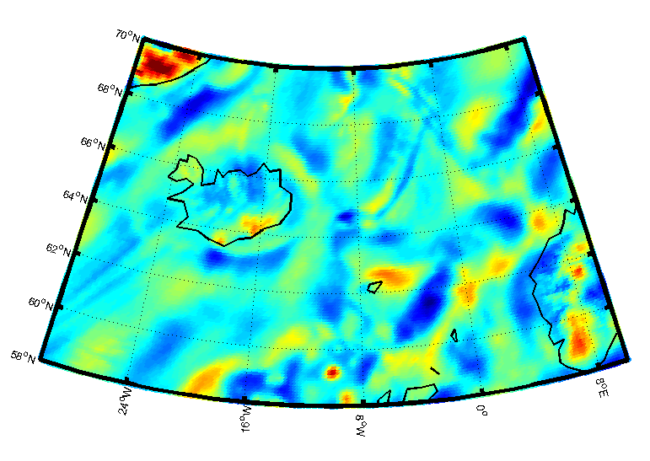
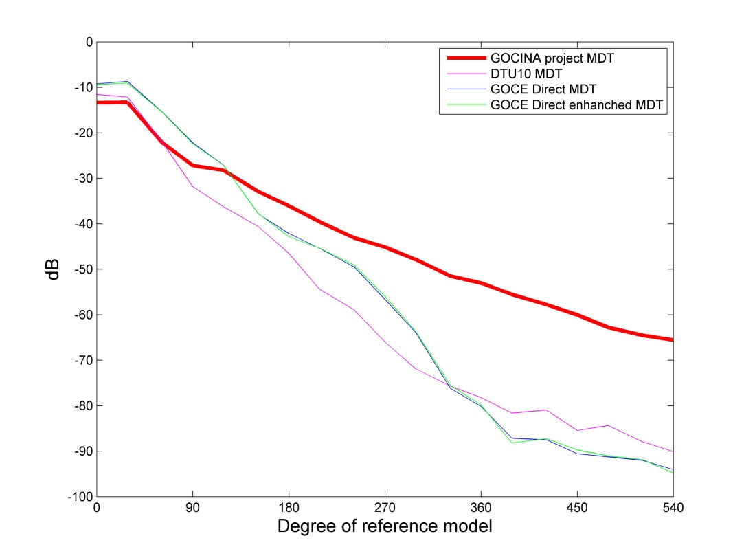
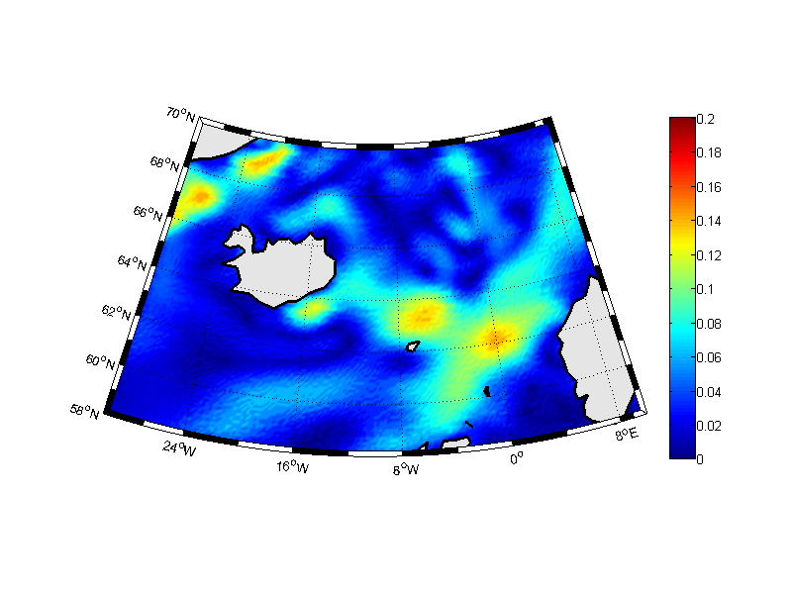
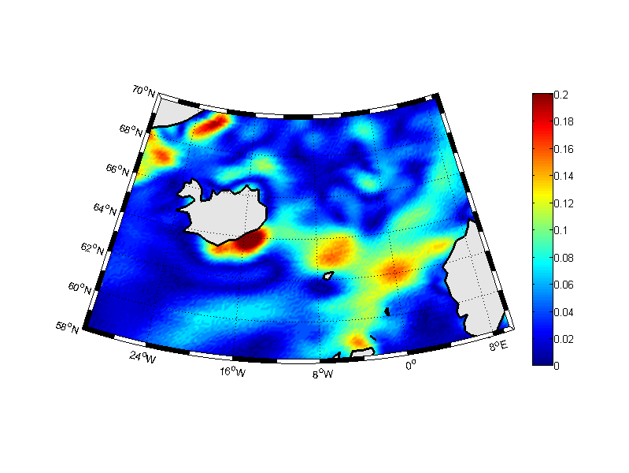
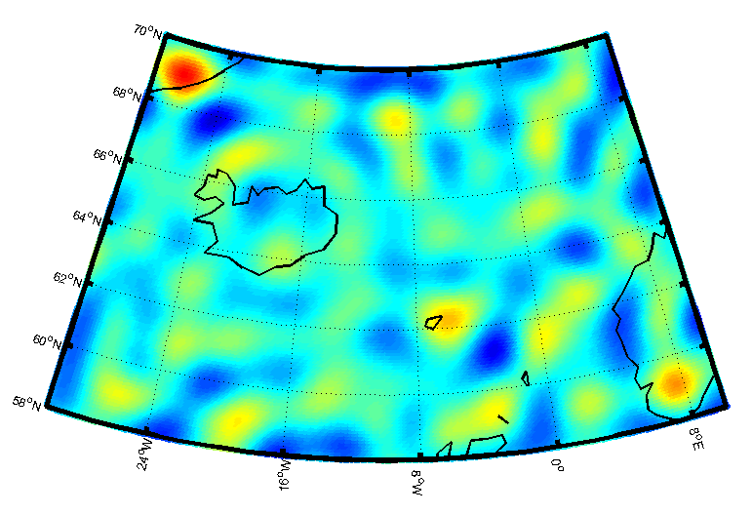
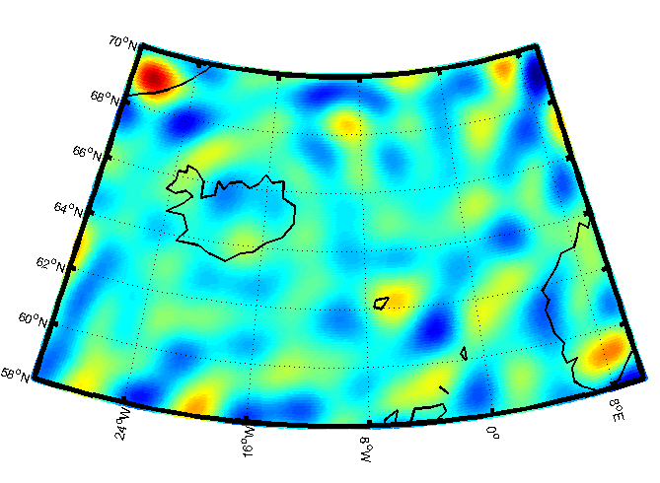
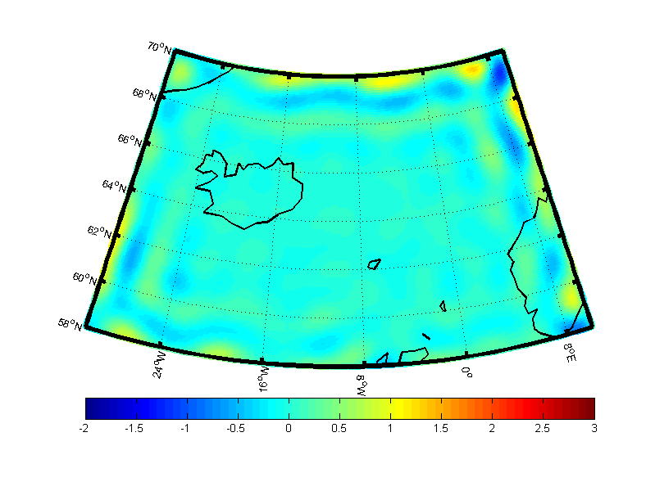
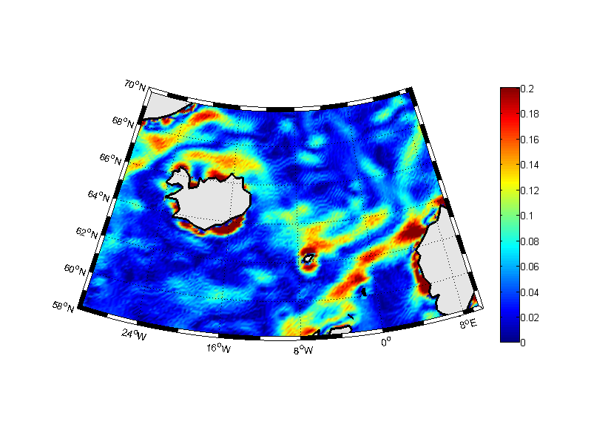
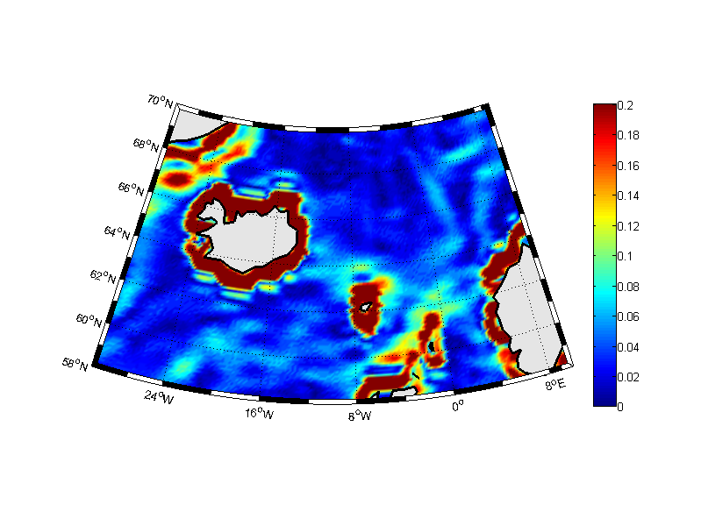
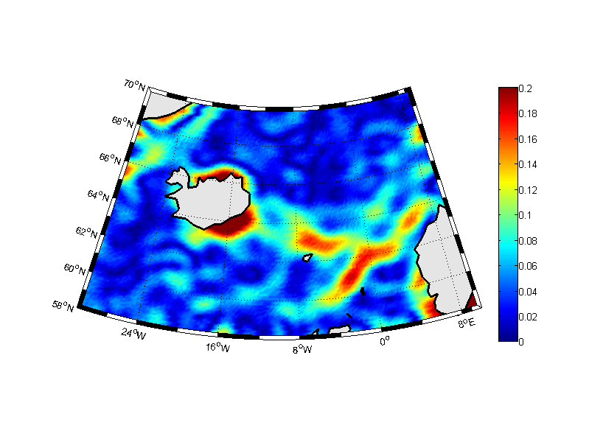

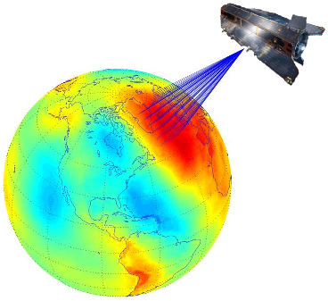
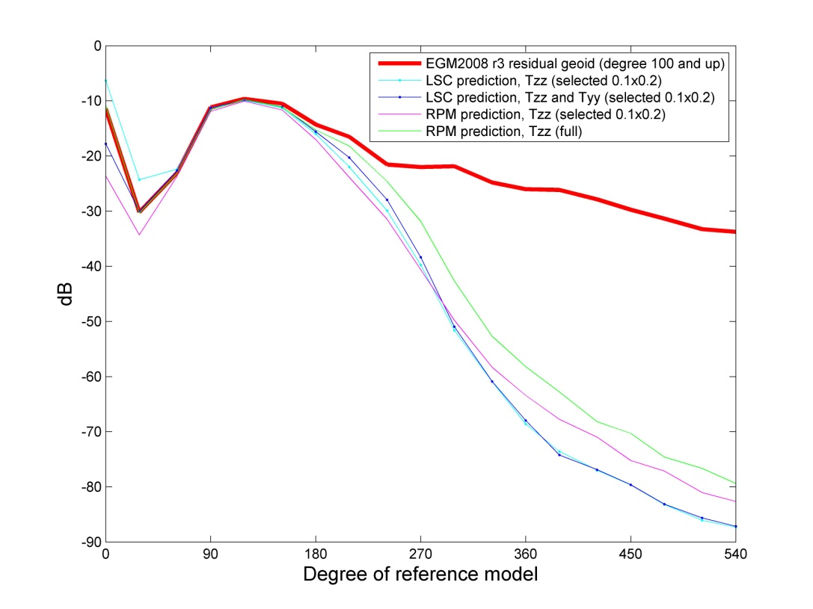
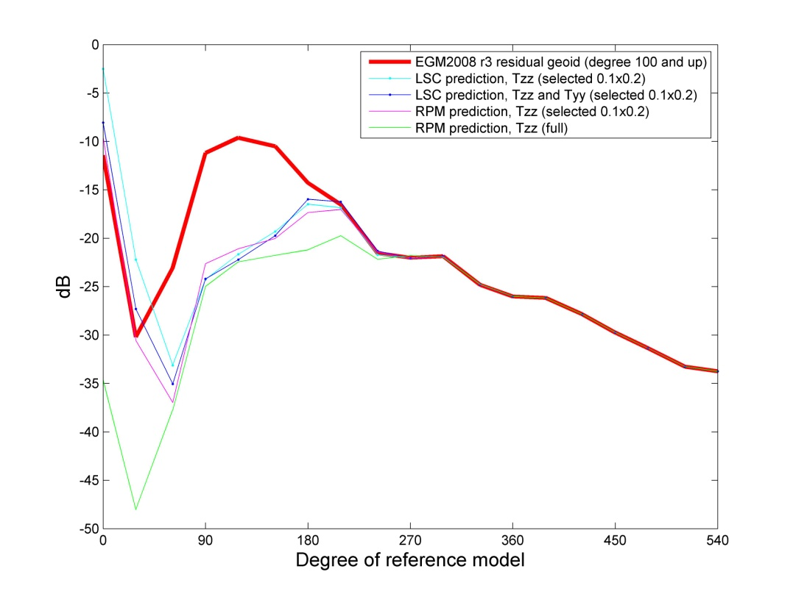
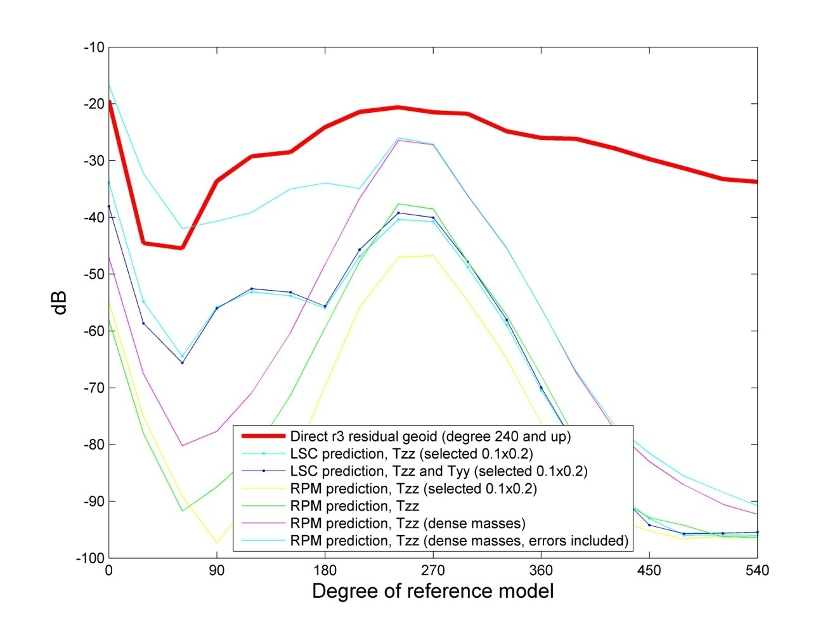
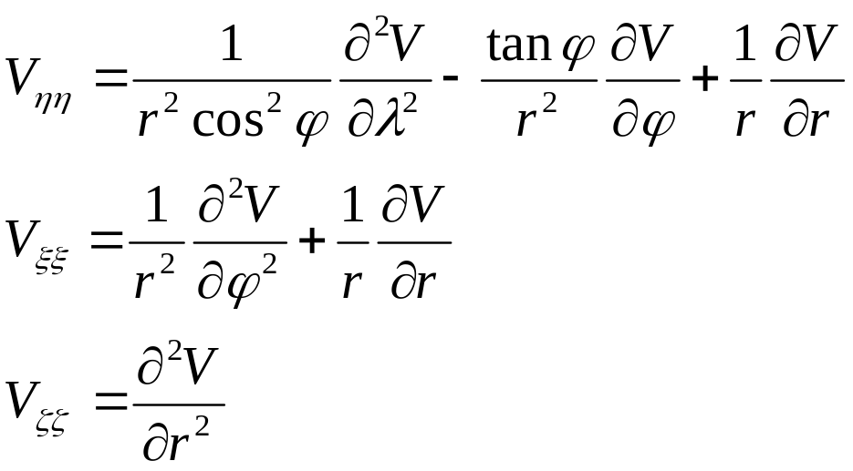
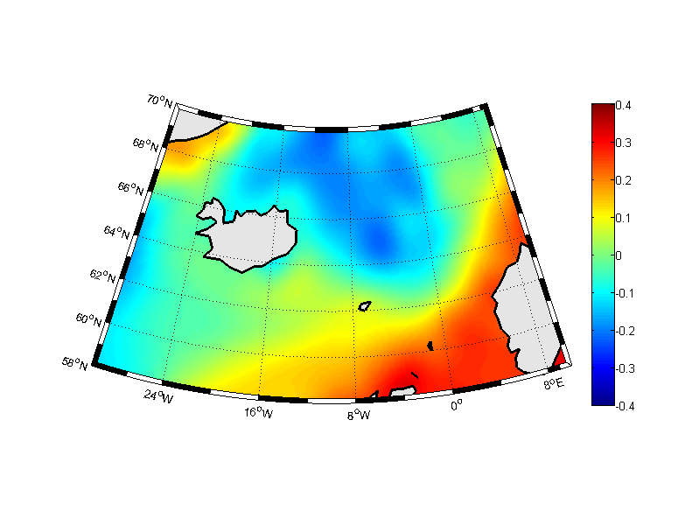
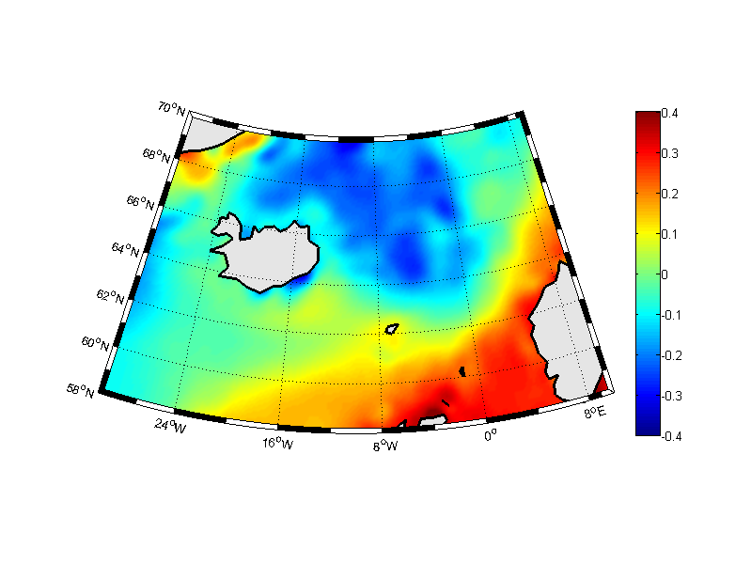
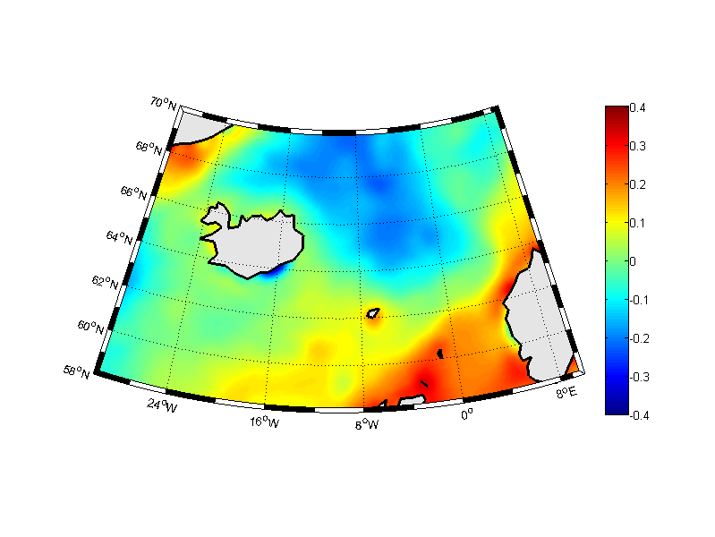
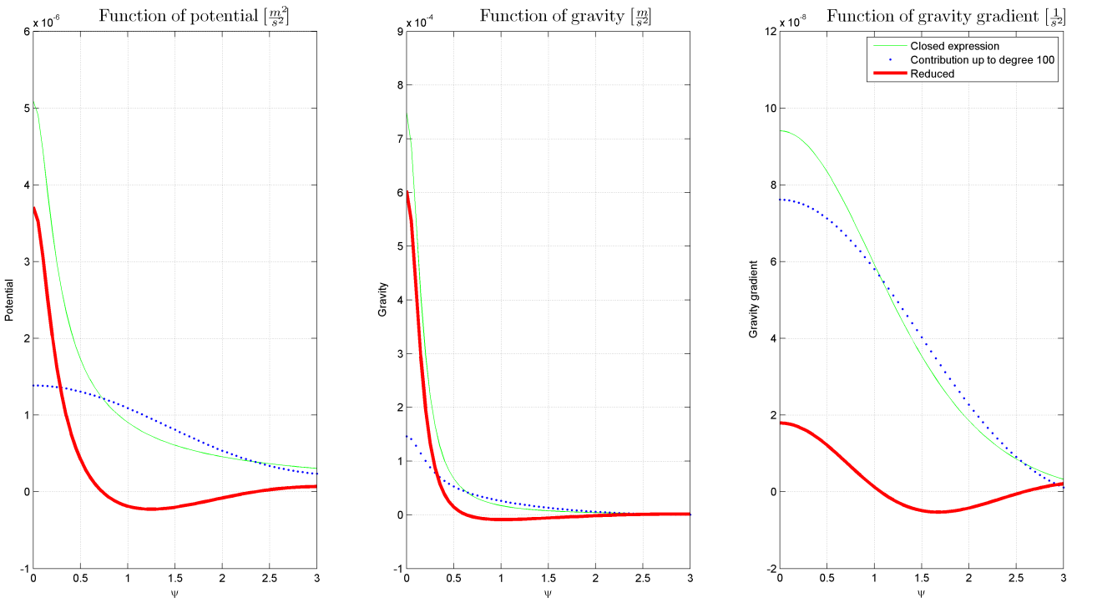
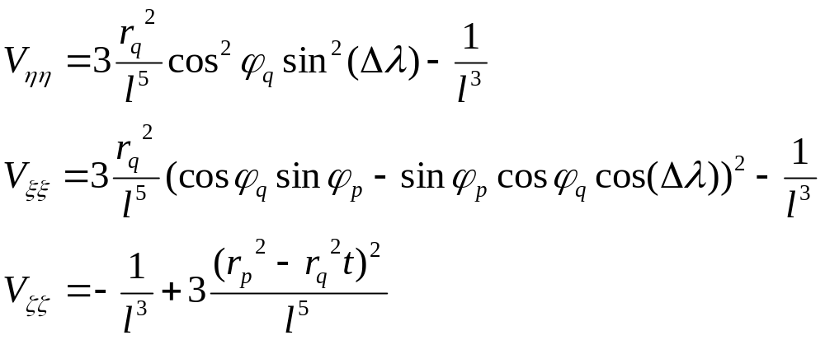
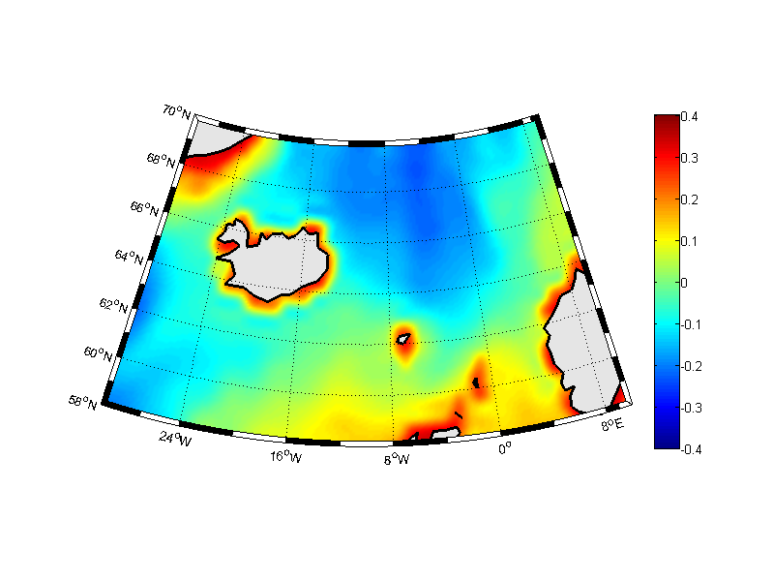
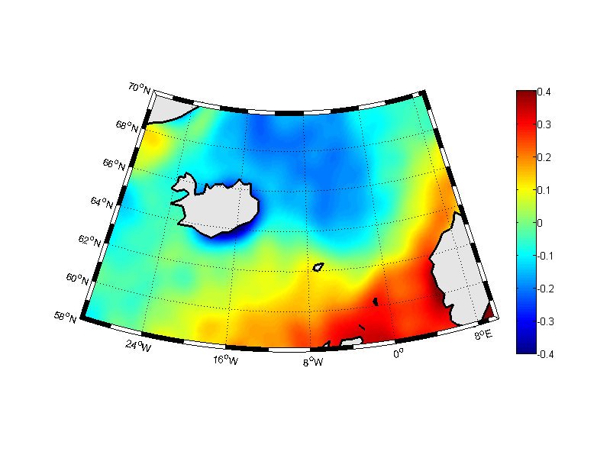
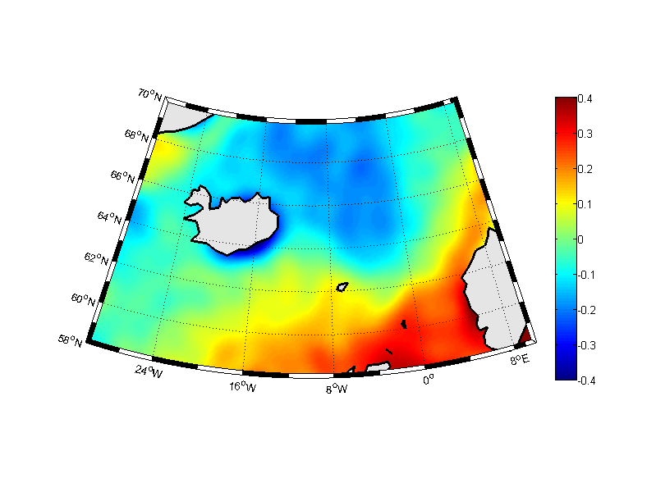
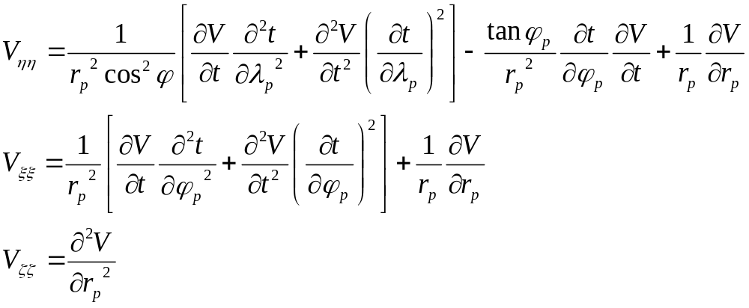
Regional Enhancement of the Mean Dynamic Topography using GOCE Gravity Gradients
Matija Herceg¹ and Per Knudsen¹
¹DTU Space, National Space Institute, Department of Geodesy, Copenhagen, Denmark
Poster number: EGU2012-9196 (XL148)
Introduction
The main objective of this study is to study how gradients can be used to extract more short wavelength information of the gravity field and to use this enhancement to improve modelling of ocean circulation, i.e. MDT in regional area. This is done by development of a method for regional gravity field recovery by using GOCE gradients in addition to the global models. The Least Squares Collocation method requires the solution of as many linear equations as the number of data, so GOCE gradient data needs to be thinned prior to applying the method. To overcome this thinning, a Reduced Point Mass (RPM) method is developed as a part of this study. The RPM is based on the reduced point mass response.
The results presented in this study are based on all available GOCE gradient data in the GOCINA region, i.e. 18 months of observations.
Results
Figures are showing geoid height anomaly predicted by the LSC and the RPM methods, when the EGM2008 up to harmonic degree and order 100 is subtracted.
GOCINA geoid (contribution from the EGM2008 up to harmonic degree and order 100 is subtracted)
DTU10 MDT current speed
DTU10 MDT 2 current speed
Power spectra of different MDT estimates
The GOCE Direct MDT current speeds reveal all of the gross features of the general circulation in the region are clear. However, the GOCE Direct enhanced MDT does not show improve-ment over the GOCE Direct MDT.
GOCINA project MDT current speed
Maximenko MDT
current speed
RPM method
Point-mass functions or multipole base-functions are harmonic functions, which may be used to represent the (anomalous) gravity potential T either globally or locally. The functions may be expressed by closed expressions or as sums of Legendre series. In both cases at least the two first terms must be removed since they are not present in T. For local applications the effect of a global gravity model is generally removed. This is later on restored. Then, more terms need to be removed or substituted by terms similar to the error-degree variances. The Earth anomalous gravity field at one point is modeled by a set of base functions, each obtained as the anomalous gravity potential from each point.
Geoid [m] predicted using
the LSC method
Geoid [m] predicted using
the RPM method
Difference between prediciton
GOCE Direct MDT current speed
GOCE Direct enhanced MDT current speed
Power spectrum of the geoid height anomaly prediction when EGM2008 up to harmonic degree and order 100 is subtracted. The prediction is done by the LSC and the RPM methods with different datasets
Power spectrum of the difference between geoid height anomaly prediction (when EGM2008 up to harmonic degree and order 100 is subtracted) and EGM2008 based geoid height anomaly
Power spectrum of the geoid height anomaly prediction when EGM2008 up to harmonic degree and order 240 is subtracted. The prediction is done by the LSC and the RPM methods with different datasets
Discussion
A comparison of the GOCE Direct MDT and the GOCE Direct enhanced MDT doesn’t show significant difference. Thus, even though GOCE data provides a better estimation of the MDT in the GOCINA region than any previously obtained using only satellite observations, it could not be concluded whether the regionally enhanced geoid model estimated using GOCE gradients contribute to a further improvement of the determination of the MDT in the GOCINA area.
The surface geostrophic currents calculated from the GOCE Direct MDT current speeds reveal that all of the gross features of the general circulation in the region are clear. However, the MDT calculated in the GOCINA project shows the smallest scale details, which makes it the best ocean circulation representation in this region.
Closed expressions for gravity
gradients when using point masses
Expressions for gravity gradients
when using reduced point masses
DTU10 MDT
DTU10 MDT 2: difference between DTU10 MSS and EGM2008
GOCINA project MDT
References
O. B. Andersen: The DTU10 Global Gravity field and Mean Sea Surface - improvements in the Arctic. 2011.
P. Knudsen: GOCINA: Geoid and Ocean Circulation in the North Atlantic. Technical report, 2005.
N. Maximenko, P. Niiler, M. H. Rio, O. Melnichenko, L. Centurioni, D. Chambers, V. Zlotnicki, and B. Galperin: Mean dynamic topography of the ocean derived from satellite and drifting buoy data using three different techniques. J. Atmos. Oceanic Tech., 26(9):1910–1919, 2009.
M. Herceg: GOCE data for Ocean Modelling, PhD thesis, 2012
Maximenko MDT
GOCE Direct MDT
GOCE Direct enhanced MDT
European Geosciences Union, General Assembly 2012, Vienna, Austria, 22 – 27 April 2012
mher@space.dtu.dk

