Slide 1

Large-Scale Path Planning in Maps: Research, Methods, and Applications
A comprehensive overview of current research, methodologies, and applications in large-scale pathfinding algorithms, with insights from leading researchers and practical implementations.

Slide 2
Research Landscape: Key Players and Milestones
1
2
3
Computer Science/Gaming Pioneers
Robotics Specialists
Distributed Computing Researchers
Adapting pathfinding algorithms for real-world robotic applications with unique constraints.
Research began approximately 15 years ago, largely driven by gaming industry requirements.
Focusing on parallelization and distribution of pathfinding workloads.
Maxim Likhachev: MRA (Multi-Resolution A*), AMRA
Map-Reduce A* implementations
Adi Botea: HPA* (Hierarchical Pathfinding A*), CPD
Parallel processing techniques
Specialized implementations: CFA* (Cooperative FA*)
Cloud-based pathfinding solutions
Nathan R. Sturtevant: PRA* family algorithms
WaveStar: Wave propagation techniques
Daniel Harabor: Polyanya, JPS (Jump Point Search)
Sven Koenig: Various contributions
Research identified through Google Scholar citation tracking, refined with "large map" queries, resulting in over 200 relevant publications.

Slide 3
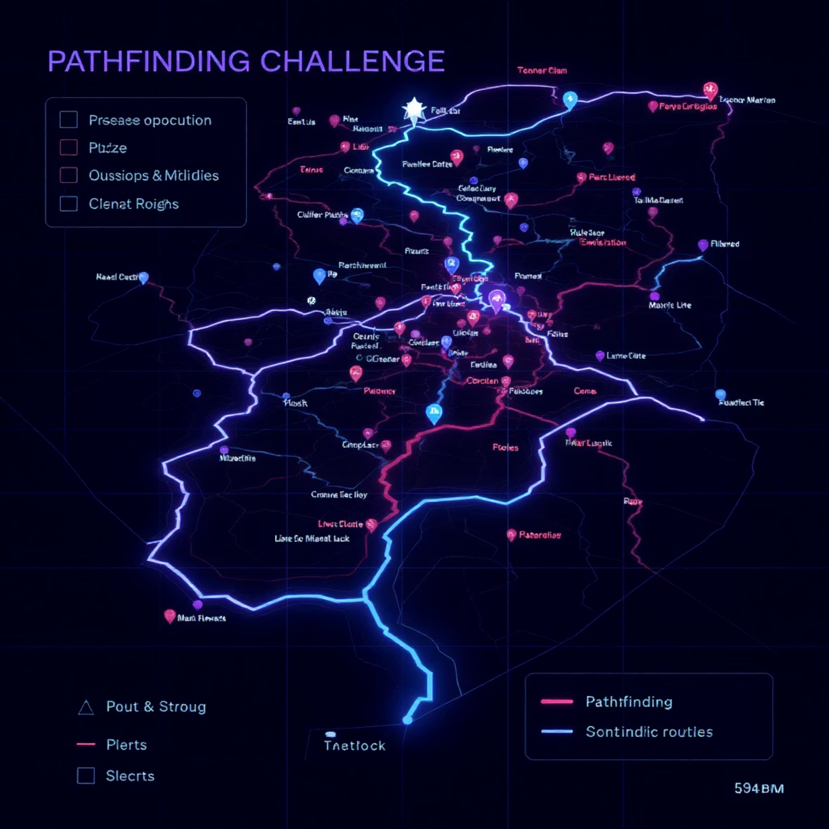
Current Benchmarks and Map Scales
MovingAI Dataset Dominance
Most current research relies on the MovingAI benchmark maps, which include:
Maps from StarCraft
Dragon Age: Origins environments
Various grid-based game worlds
These maps have become the de facto standard for algorithm comparison and evaluation.
GPPC (Grid-Based Path Planning Competition) defines "big maps" as 1024×1024 grids, which represents the current upper bound for most published research.

Slide 4



Methodological Approaches
Heuristic Improvements
Hierarchical Abstraction
Engineering Optimizations
Enhancing distance estimation functions
Reducing search space complexity
Implementation-level enhancements
D* and variants
HPA* (Hierarchical Pathfinding A*)
Memory management techniques
Any-angle pathfinding
JPS (Jump Point Search)
Cache optimization
Euclidean and Manhattan hybrid approaches
Multi-level abstraction techniques
Algorithmic refinements

Slide 5

Experimental Evaluations
Initial comparative testing was conducted using the python-motion-planning repository as a unified framework, evaluating seven distinct pathfinding methods:
A* (baseline algorithm)
Bidirectional search variants
D* (Dynamic A*)
Weighted A* implementations
JPS (Jump Point Search)
Hybrid approaches
THETA* (Any-angle pathfinding)
Monte Carlo experiments revealed no statistically significant performance differences between these methods when implemented in Python, suggesting that algorithmic changes alone are insufficient for large-scale improvements.

Slide 6
Implementation Language Impact
10-50x
PyBind11
BL_JPS
Speed Improvement
Integration Method
Best Performer
Switching from Python to C++/C# implementations yielded dramatic performance gains across all algorithms.
Python bindings allowed efficient utilization of native code performance while maintaining Python's flexibility for experimentation.
Without precomputation, BL_JPS (Boundary Labeling Jump Point Search) demonstrated superior performance across test scenarios.
For precomputation-enabled scenarios, Warthog's JPS2+ algorithm showed the best overall performance, consistent with GPPC 2014 competition results.

Slide 7
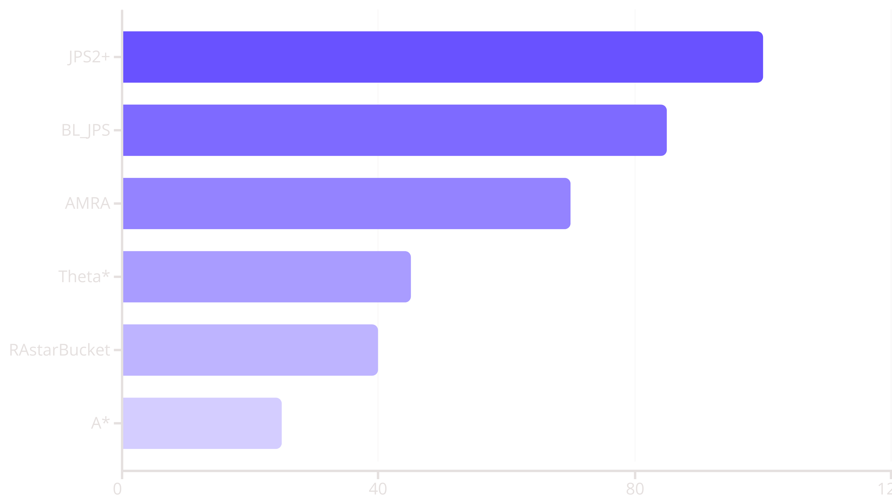
Comparative Algorithm Performance
Algorithm implementations evaluated include: JPS_planner_bindings, ThetaStarPlanner, BL_JPS, Warthog, RAstarBucket, and AMRA. Results broadly confirm the findings from the GPPC 2014 competition, with hierarchical and jump-point based methods consistently outperforming traditional approaches.

Slide 8
Future Research Directions
Navigation Mesh Approaches
Visibility Graph (VG) Techniques
Hybrid Approaches
Implementing and evaluating dynamic NavMesh construction and updates using Python's ctypes for C++ library integration. This approach shows promise for handling large, complex environments with fewer memory requirements than grid-based methods.
Combining the strengths of multiple algorithms: hierarchical decomposition for global planning, local techniques for fine-tuning, and precomputation strategies for runtime efficiency in large-scale scenarios.
Exploring visibility graph construction algorithms that can efficiently represent navigable space in large environments. This representation allows for optimal paths while reducing the computational complexity compared to grid-based approaches.
Next steps include benchmarking these approaches on significantly larger maps (beyond the current 1024×1024 standard) and evaluating their performance in dynamic environments with changing obstacles.

