Slide 1

Large-Scale Path Planning in Maps: Research, Methods, and Applications
A comprehensive overview of current research, methodologies, and applications in large-scale pathfinding algorithms, with insights from leading researchers and practical implementations.

Slide 2
Research Landscape: Key Players and Milestones
1
2
3
Computer Science/Gaming Pioneers
Robotics Specialists
Distributed Computing Researchers
Adapting pathfinding algorithms for real-world robotic applications with unique constraints.
Research began approximately 15 years ago, largely driven by gaming industry requirements.
Focusing on parallelization and distribution of pathfinding workloads.
Maxim Likhachev: MRA (Multi-Resolution A*), AMRA
Map-Reduce A* implementations
Adi Botea: HPA* (Hierarchical Pathfinding A*), CPD
Parallel processing techniques
Specialized implementations: CFA* (Cooperative FA*)
Cloud-based pathfinding solutions
Nathan R. Sturtevant: PRA* family algorithms
WaveStar: Wave propagation techniques
Daniel Harabor: Polyanya, JPS (Jump Point Search)
Sven Koenig: Various contributions
Research identified through Google Scholar citation tracking, refined with "large map" queries, resulting in over 200 relevant publications.

Slide 3
Research Landscape: Key Players and Milestones
1
Computer Science/Gaming Pioneers
Research began approximately 15 years ago, largely driven by gaming industry requirements.
Personal homepage： Moving AI Lab
Broad resources of community interest: Benchmark problems for:
2D grids
Voxel grids
Multi-agent Path Planning (MAPF)
Historical Grid-Based Path Planning Competition data。
Interactive heuristic search demos. These cover many basic and advanced heuristic
search algorithms. These demos and other research is implemented in the HOG2
platform.
Graduate lectures on Single Agent Search
Adi Botea: HPA* (Hierarchical Pathfinding A*), CPD
Nathan R. Sturtevant: PRA* family algorithms
Daniel Harabor: Polyanya, JPS (Jump Point Search)
Sven Koenig: Various contributions
After more than 20 years of continuous excavation, this research direction has been done very deeply, and the work in this direction requires strong mathematical theoretical skills, and there is little room for academic progress.

Slide 4
Research Landscape: Key Players and Milestones
2
Personal homepage： Maxim Likhachev
Robotics Specialists
Core Research Focus Areas​​
​​Real-Time High-Dimensional Planning​​
Novel graph search algorithms for complex state spaces.
​​Learning for Planning Efficiency​​
Algorithms that "learn how to plan" using experience.
​​Compact Representation Learning​​
Automated abstraction of planning problems.
​​Theoretically-Guaranteed Planning​​
Rigorous frameworks for real-world robotics.
Adapting pathfinding algorithms for real-world robotic applications with unique constraints.
Maxim Likhachev: MRA (Multi-Resolution A*), AMRA
Specialized implementations: CFA* (Cooperative FA*)
WaveStar: Wave propagation techniques
Compared with the previous research direction, the research difficulty of this direction is slightly lower, but it still requires rigorous mathematical theoretical argumentation。

Slide 5
Research Landscape: Key Players and Milestones
3
Distributed Computing Researchers
Focusing on parallelization and distribution of pathfinding workloads.
Map-Reduce A* implementations
Parallel processing techniques
Cloud-based pathfinding solutions
This research direction will have higher feasibility in engineering, and the specific parallel structure and solving problems need to be studied in the next step.

Slide 6
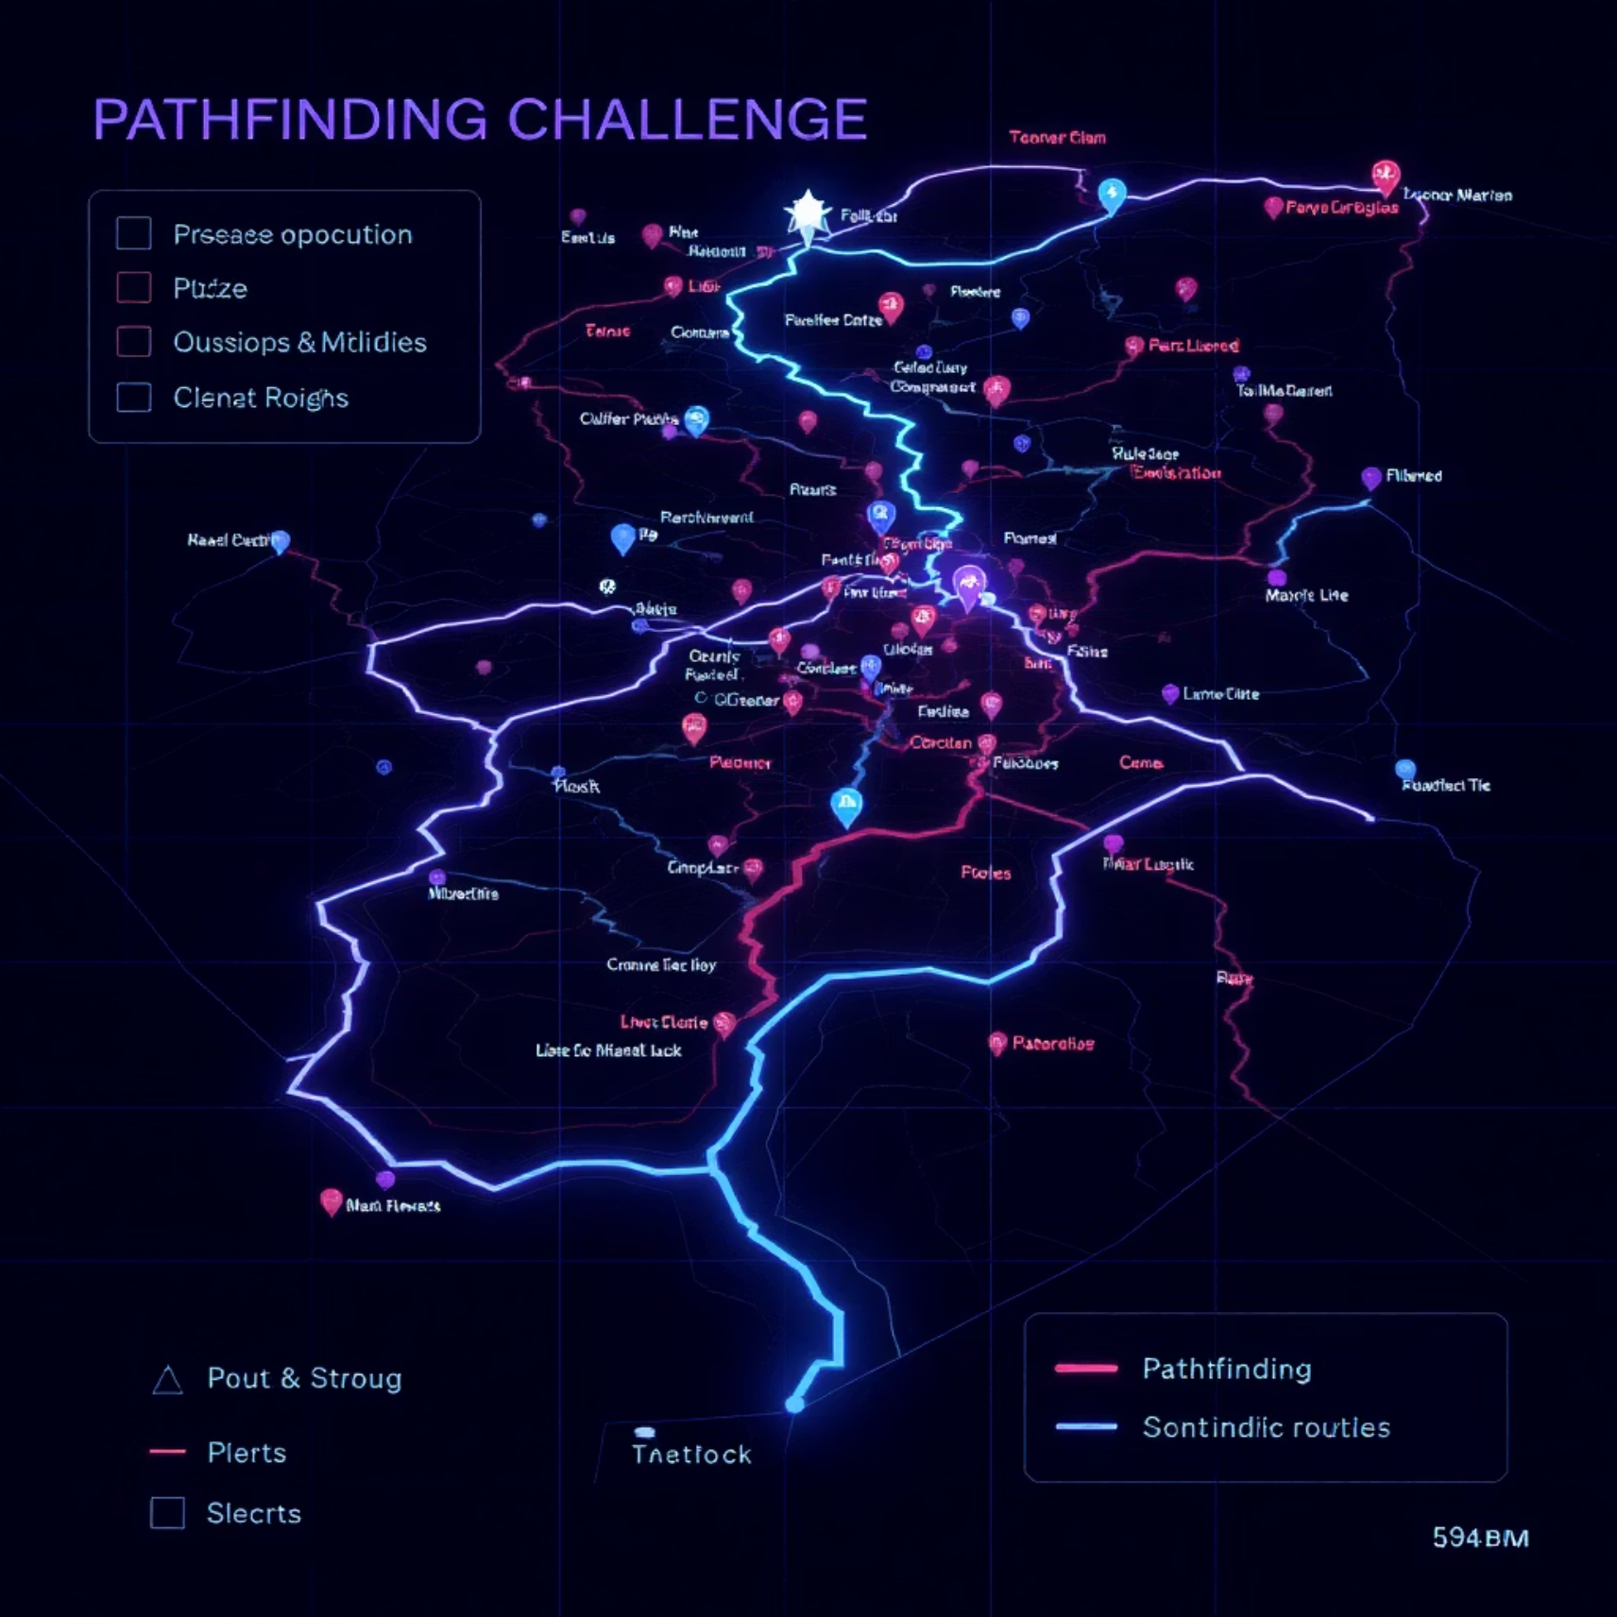
Current Benchmarks and Map Scales
MovingAI Dataset Dominance
Most current research relies on the MovingAI benchmark maps,
which include:
Maps from StarCraft
Dragon Age: Origins environments
Various grid-based game worlds
These maps have become the de facto standard for algorithm
comparison and evaluation.
GPPC Competition Platform
GPPC (Grid-Based Path Planning Competition) defines "big maps" as 1024×1024 grids, which represents the current upper bound for most published research.

Slide 7



Methodological Approaches
Heuristic Improvements
Hierarchical Abstraction
Engineering Optimizations
Enhancing distance estimation functions
Reducing search space complexity
Implementation-level enhancements
D* and variants
HPA* (Hierarchical Pathfinding A*)
Memory management techniques
Any-angle pathfinding
JPS (Jump Point Search)
Cache optimization
Euclidean and Manhattan hybrid approaches
Multi-level abstraction techniques
Algorithmic refinements

Slide 8
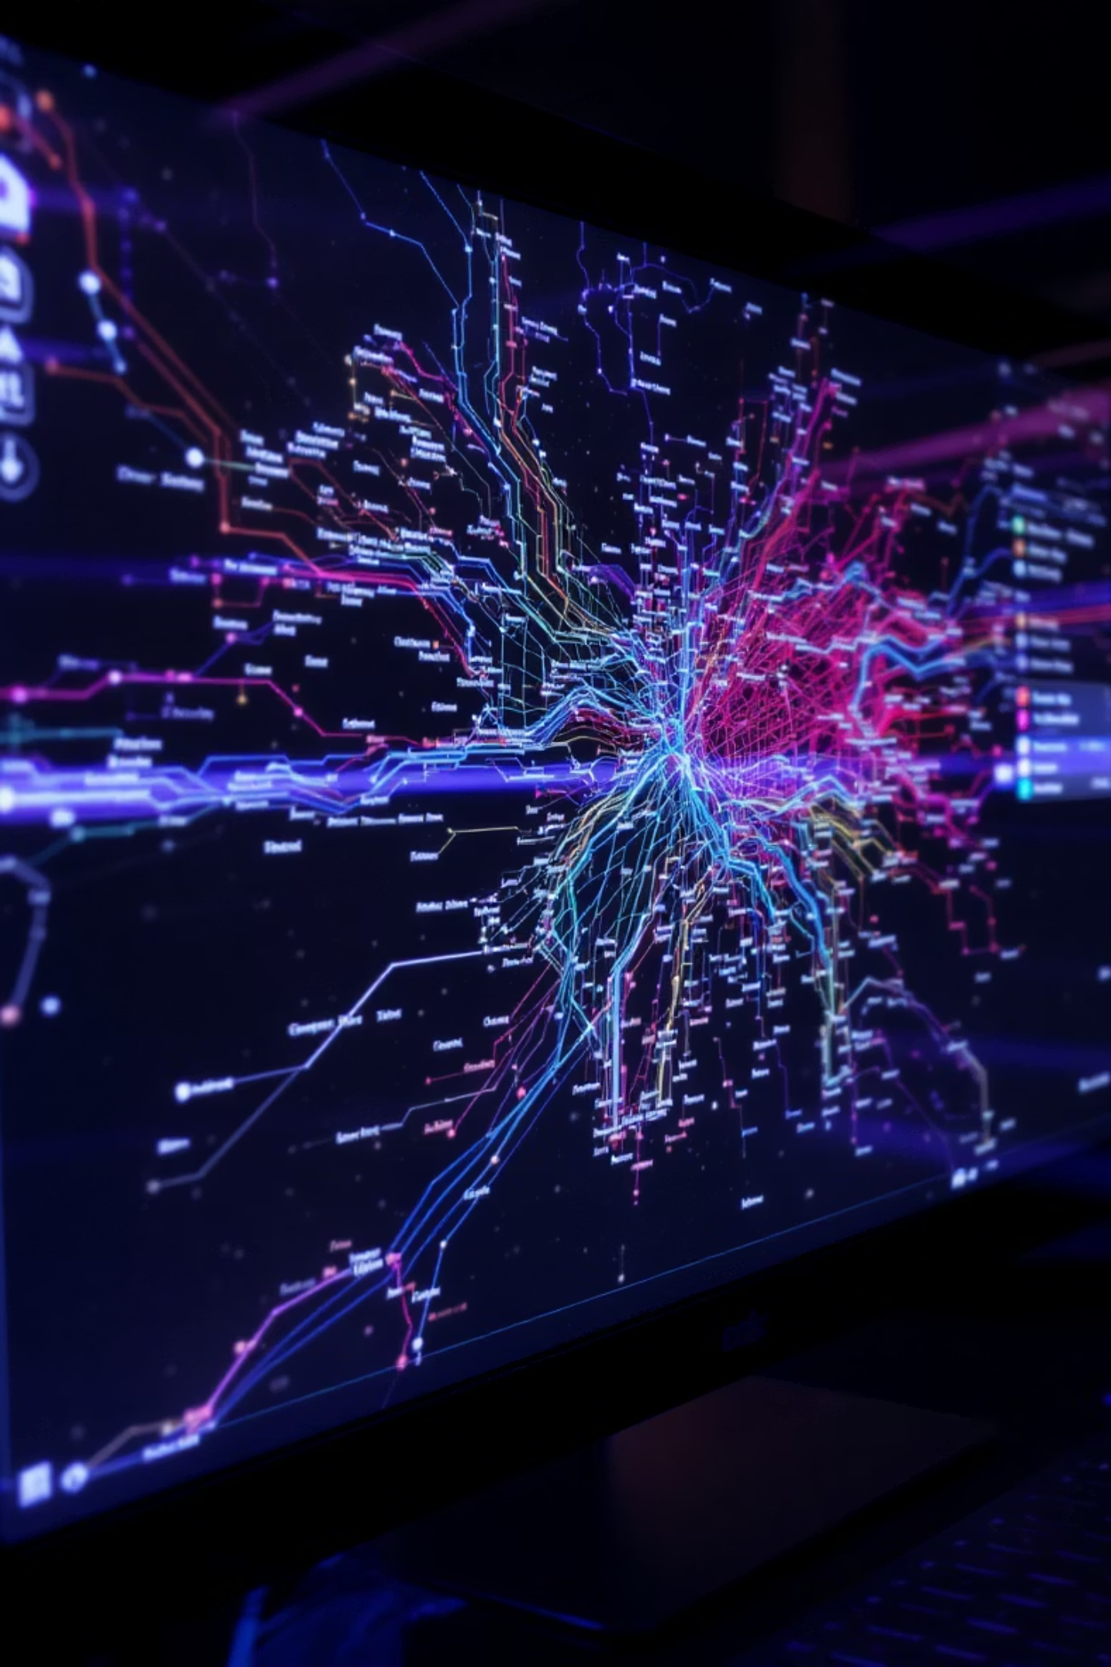
Experimental Evaluations
Initial comparative testing was conducted using the python-motion-planning repository as a unified framework, evaluating seven distinct pathfinding methods:
A* (baseline algorithm)
Bidirectional search variants
D* (Dynamic A*)
Weighted A* implementations
JPS (Jump Point Search)
Hybrid approaches
THETA* (Any-angle pathfinding)
Monte Carlo experiments revealed no statistically significant performance differences between these methods when implemented in Python, suggesting that algorithmic changes alone are insufficient for large-scale improvements.

Slide 9
Implementation Language Impact
10-50x
PyBind11
BL_JPS
Speed Improvement
Integration Method
Best Performer
Switching from Python to C++/C# implementations yielded dramatic performance gains across all algorithms.
Python bindings allowed efficient utilization of native code performance while maintaining Python's flexibility for experimentation.
Without precomputation, BL_JPS (Boundary Labeling Jump Point Search) demonstrated superior performance across test scenarios.
For precomputation-enabled scenarios, Warthog's JPS2+ algorithm showed the best overall performance, consistent with GPPC 2014 competition results.

Slide 10
Future Research Directions
Navigation Mesh Approaches
Visibility Graph (VG) Techniques
Hybrid Approaches
Implementing and evaluating dynamic NavMesh construction and updates using Python's ctypes for C++ library integration. This approach shows promise for handling large, complex environments with fewer memory requirements than grid-based methods.
Combining the strengths of multiple algorithms: hierarchical decomposition for global planning, local techniques for fine-tuning, and precomputation strategies for runtime efficiency in large-scale scenarios.
Exploring visibility graph construction algorithms that can efficiently represent navigable space in large environments. This representation allows for optimal paths while reducing the computational complexity compared to grid-based approaches.
Next steps include benchmarking these approaches on significantly larger maps (beyond the current 1024×1024 standard) and evaluating their performance in dynamic environments with changing obstacles.

