Slide 1
Virtual Memory: Concepts 15-213/15-513: Introduction to Computer Systems 16th Lecture, June 7, 2023
Instructors:
Brian Railing

Slide 2
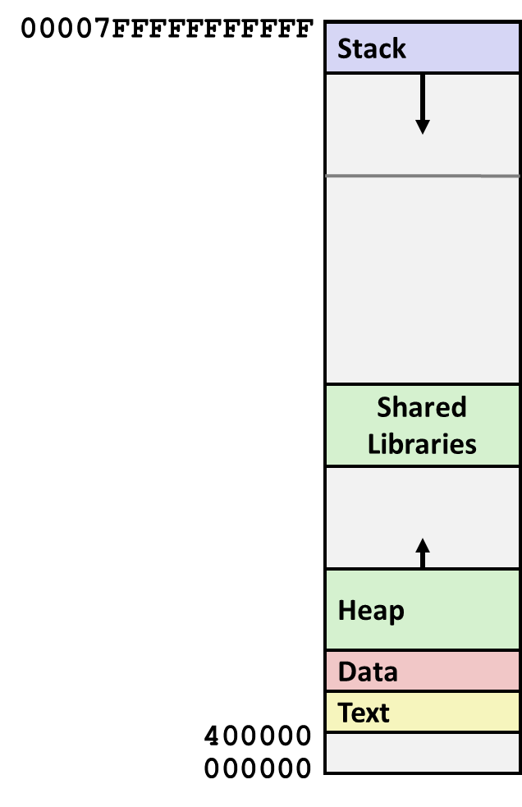
This Picture is a Lie
This is RAM, we said…
But the computer can run more than one program at a time!
Where are all the other programs?
Let’s investigate.

Slide 3
Processes (Teaser for Next Week)
Definition: A process is an instance of a running program.
One of the most profound ideas in computer science
Not the same as “program” or “processor”
Unix: A parent process creates a new child process by calling fork
Child is (sort of) a copy of the parent
fork returns twice—once in each process
Different return value in each
Parent can wait for child to finish by calling waitpid
For now, think of this as “what main returns to”

Slide 4
Activity Part 1
wget http://www.cs.cmu.edu/~213/activities/vm-concepts.tar
tar xf vm-concepts.tar
cd vm-concepts
less addrs.c
… further instructions in handout …
Stop after part 1 (end of page 2)
Caution: problems 3-5 involve deliberately running the sharks out of memory

Slide 5
Hmmm, How Does This Work?!
Process 1
Process 2
Process n
Solution: Virtual Memory (today and next lecture)

Slide 6
A System Using Physical Addressing
Main memory
0:
1:
Physical address
(PA)
2:
CPU
3:
4
4:
5:
6:
7:
...
8:
M-1:
Data word
Used in “simple” systems like embedded microcontrollers in devices like cars, elevators, and digital picture frames

Slide 7
A System Using Virtual Addressing
Main memory
0:
CPU Chip
1:
Virtual address
(VA)
Physical address
(PA)
2:
CPU
MMU
3:
4
4:
4100
5:
6:
7:
...
8:
M-1:
Data word
Used in all modern servers, laptops, and smart phones
One of the great ideas in computer science

Slide 8
VM as a Tool for Memory Management
Key idea: each process has its own virtual address space
It can view memory as a simple linear array
Mapping function scatters addresses through physical memory
Well-chosen mappings can improve locality
0
Address
translation
0
Virtual Address Space for Process 1:
Physical
Address
Space (DRAM)
VP 1
VP 2
PP 2
...
N-1
PP 6
(e.g., read-only
library code)
Virtual Address Space for Process 2:
0
PP 8
VP 1
VP 2
...
...
N-1
M-1

Slide 9
VM as a Tool for Memory Management
Simplifying memory allocation
Each virtual page can be mapped to any physical page
A virtual page can be stored in different physical pages at different times
Sharing code and data among processes
Map virtual pages to the same physical page (here: PP 6)
0
Address
translation
0
Virtual Address Space for Process 1:
Physical
Address
Space (DRAM)
VP 1
VP 2
PP 2
...
N-1
PP 6
(e.g., read-only
library code)
Virtual Address Space for Process 2:
0
PP 8
VP 1
VP 2
...
...
N-1
M-1

Slide 10
Simplifying Linking and Loading
Memory
invisible to
user code
Kernel virtual memory
Linking
Each program has similar virtual address space
Code, data, and heap always start at the same addresses.
Loading
execve allocates virtual pages for .text and .data sections & creates PTEs marked as invalid
The .text and .data sections are copied, page by page, on demand by the virtual memory system
User stack
(created at runtime)
%rsp
(stack
pointer)
Memory-mapped region for
shared libraries
brk
Run-time heap
(created by malloc)
Read/write segment
(.data, .bss)
Loaded
from
the
executable
file
Read-only segment
(.init, .text, .rodata)
0x400000
Unused
0

Slide 11
Address Spaces
Linear address space: Ordered set of contiguous non-negative integer addresses: {0, 1, 2, 3 … }
Virtual address space: Set of N = 2^{n} virtual addresses {0, 1, 2, 3, …, N-1}
Physical address space: Set of M = 2^{m} physical addresses {0, 1, 2, 3, …, M-1}

Slide 12
Why Virtual Memory (VM)?
Uses main memory efficiently
Use DRAM as a cache for parts of a virtual address space
Simplifies memory management
Each process gets the same uniform linear address space
Isolates address spaces
One process can’t interfere with another’s memory
User program cannot access privileged kernel information and code

Slide 13
VM Address Translation
Virtual Address Space
V = {0, 1, …, N–1}
Physical Address Space
P = {0, 1, …, M–1}
Address Translation
MAP: V → P U {∅}
For virtual address a:
MAP(a) = a’ if data at virtual address a is at physical address a’ in P
MAP(a) = ∅ if data at virtual address a is not in physical memory
Either invalid or stored on disk

Slide 14
Activity Part 2 through 4
Now you have some idea what is going on
Let’s look at how it’s done
Details aren’t supposed to be visible
We can get some clues via performance monitoring
Do activity part 2 through 4 now
Stop at the end of page 5

Slide 15
Enabling Data Structure: Page Table
A page table is an array of page table entries (PTEs) that maps virtual pages to physical pages.
Per-process kernel data structure in DRAM
Physical memory
(DRAM)
Physical page
number or
disk address
Valid
VP 1
PP 0
PTE 0
0
null
VP 2
1
VP 7
VP 4
PP 3
1
0
1
0
null
Virtual memory
(disk)
0
PTE 7
1
VP 1
Memory resident
page table
(DRAM)
VP 2
VP 3
VP 4
VP 6
VP 7

Slide 16
Address Translation With a Page Table
Virtual address
Page table base register (PTBR)
(CR3 in x86)
n-1
p
p-1
0
Virtual page number (VPN)
Virtual page offset (VPO)
Page table
Valid
Physical page number (PPN)
Physical page table
address for the current
process
Valid bit = 0:
Page not in memory
(page fault)
Valid bit = 1
m-1
p
p-1
0
Physical page number (PPN)
Physical page offset (PPO)
Physical address

Slide 17
Page Hit
Page hit: reference to VM word that is in physical memory (DRAM cache hit)
Physical memory
(DRAM)
Physical page
number or
disk address
Virtual address
Valid
VP 1
PP 0
PTE 0
0
null
VP 2
1
VP 7
VP 4
PP 3
1
0
1
0
null
Virtual memory
(disk)
0
PTE 7
1
VP 1
Memory resident
page table
(DRAM)
VP 2
VP 3
VP 4
VP 6
VP 7

Slide 18
Address Translation: Page Hit
CPU Chip
2
Cache/
Memory
MMU
PTEA
1
PTE
CPU
VA
3
PA
4
Data
5
1) Processor sends virtual address to MMU
2-3) MMU fetches PTE from page table in memory
4) MMU sends physical address to cache/memory
5) Cache/memory sends data word to processor

Slide 19
Page Fault
Page fault: reference to VM word that is not in physical memory (DRAM cache miss)
Physical memory
(DRAM)
Physical page
number or
disk address
Virtual address
Valid
VP 1
PP 0
PTE 0
0
null
VP 2
1
VP 7
VP 4
PP 3
1
0
1
0
null
Virtual memory
(disk)
0
PTE 7
1
VP 1
Memory resident
page table
(DRAM)
VP 2
VP 3
VP 4
VP 6
VP 7

Slide 20
Address Translation: Page Fault
Exception
Page fault handler
4
CPU Chip
2
Cache/
Memory
Disk
MMU
PTEA
Victim page
1
5
CPU
VA
PTE
7
3
New page
6
1) Processor sends virtual address to MMU
2-3) MMU fetches PTE from page table in memory
4) Valid bit is zero, so MMU triggers page fault exception
5) Handler identifies victim (and, if dirty, pages it out to disk)
6) Handler pages in new page and updates PTE in memory
7) Handler returns to original process, restarting faulting instruction

Slide 21
Handling Page Fault
Page miss causes page fault (an exception)
Physical memory
(DRAM)
Physical page
number or
disk address
Virtual address
Valid
VP 1
PP 0
PTE 0
0
null
VP 2
1
VP 7
VP 4
PP 3
1
0
1
0
null
Virtual memory
(disk)
0
PTE 7
1
VP 1
Memory resident
page table
(DRAM)
VP 2
VP 3
VP 4
VP 6
VP 7

Slide 22
Handling Page Fault
Page miss causes page fault (an exception)
Page fault handler selects a victim to be evicted (here VP 4)
Physical memory
(DRAM)
Physical page
number or
disk address
Virtual address
Valid
VP 1
PP 0
PTE 0
0
null
VP 2
1
VP 7
VP 4
PP 3
1
0
1
0
null
Virtual memory
(disk)
0
PTE 7
1
VP 1
Memory resident
page table
(DRAM)
VP 2
VP 3
VP 4
VP 6
VP 7

Slide 23
Handling Page Fault
Page miss causes page fault (an exception)
Page fault handler selects a victim to be evicted (here VP 4)
Physical memory
(DRAM)
Physical page
number or
disk address
Virtual address
Valid
VP 1
PP 0
PTE 0
0
null
VP 2
1
VP 7
VP 3
PP 3
1
1
0
0
null
Virtual memory
(disk)
0
PTE 7
1
VP 1
Memory resident
page table
(DRAM)
VP 2
VP 3
VP 4
VP 6
VP 7

Slide 24
Handling Page Fault
Page miss causes page fault (an exception)
Page fault handler selects a victim to be evicted (here VP 4)
Offending instruction is restarted: page hit!
Physical memory
(DRAM)
Physical page
number or
disk address
Virtual address
Valid
VP 1
PP 0
PTE 0
0
null
VP 2
1
VP 7
VP 3
PP 3
1
1
0
0
null
Virtual memory
(disk)
0
PTE 7
1
VP 1
Memory resident
page table
(DRAM)
VP 2
VP 3
Key point: Waiting until the miss to copy the page to DRAM is known as demand paging
VP 4
VP 6
VP 7

Slide 25
Allocating Pages
Allocating a new page (VP 5) of virtual memory.
Physical memory
(DRAM)
Physical page
number or
disk address
Valid
VP 1
PP 0
PTE 0
0
null
VP 2
1
VP 7
VP 3
PP 3
1
1
0
0
Virtual memory
(disk)
0
PTE 7
1
VP 1
Memory resident
page table
(DRAM)
VP 2
VP 3
VP 4
VP 5
VP 6
VP 7

Slide 26
Activity Part 5 and 6
So far we’ve only been looking at well-behaved programs
What if they misbehave?
Wouldn’t it be nice if a misbehaving process couldn’t interfere with any other processes?

Slide 27
VM as a Tool for Memory Protection
Extend PTEs with permission bits
MMU checks these bits on each access
Physical
Address Space
Process i:
SUP
READ
WRITE
EXEC
Address
VP 0:
No
Yes
No
Yes
PP 6
VP 1:
No
Yes
Yes
Yes
PP 4
VP 2:
Yes
Yes
Yes
No
PP 2
PP 2
•
•
•
PP 4
PP 6
Process j:
SUP
READ
WRITE
EXEC
Address
PP 8
VP 0:
No
Yes
No
Yes
PP 9
PP 9
VP 1:
Yes
Yes
Yes
Yes
PP 6
VP 2:
No
Yes
Yes
Yes
PP 11
PP 11

Slide 28
VM as a Tool for Caching
Conceptually, virtual memory is an array of N contiguous bytes stored on disk.
The contents of the array on disk are cached in physical memory (DRAM cache)
These cache blocks are called pages (size is P = 2^{p} bytes)
Virtual memory
Physical memory
VP 0
Unallocated
0
VP 1
Cached
0
Empty
PP 0
Uncached
PP 1
Unallocated
Empty
Cached
Uncached
Empty
Cached
M-1
PP 2^{m-p}-1
VP 2^{n-p}-1
Uncached
N-1
Virtual pages (VPs)
stored on disk
Physical pages (PPs)
cached in DRAM

Slide 29
Remember: Set Associative Cache
Block
offset
E = 2: Two lines per set
Assume: cache block size 8 bytes
Address :
2 lines per set
t bits
0…01
100
v
tag
0
1
2
3
4
5
6
7
v
tag
0
1
2
3
4
5
6
7
v
tag
0
1
2
3
4
5
6
7
v
tag
0
1
2
3
4
5
6
7
Index to
find set
v
tag
0
1
2
3
4
5
6
7
v
tag
0
1
2
3
4
5
6
7
v
tag
0
1
2
3
4
5
6
7
v
tag
0
1
2
3
4
5
6
7
S sets

Slide 30
DRAM Cache Organization
DRAM cache organization driven by the enormous miss penalty
DRAM is about 10x slower than SRAM
Disk is about 10,000x slower than DRAM
Consequences
Large page (block) size: typically 4 KB, sometimes 4 MB
Fully associative
Any VP can be placed in any PP
Requires a “large” mapping function – different from cache memories
Highly sophisticated, expensive replacement algorithms
Too complicated and open-ended to be implemented in hardware
Write-back rather than write-through

Slide 31
Integrating VM and Cache
PTE
CPU Chip
PTE
MMU
PTEA
hit
Memory
PTEA
PTEA
miss
PTEA
CPU
VA
PA
PA
PA
miss
PA
hit
Data
L1
cache
Data
VA: virtual address, PA: physical address, PTE: page table entry, PTEA = PTE address

Slide 32
Locality to the Rescue Again!
Virtual memory seems terribly inefficient, but it works because of locality.
At any point in time, programs tend to access a set of active virtual pages called the working set
Programs with better temporal locality will have smaller working sets
If (working set size < main memory size)
Good performance for one process after compulsory misses
If ( SUM(working set sizes) > main memory size )
Thrashing: Performance meltdown where pages are swapped (copied) in and out continuously

Slide 33
Speeding up Translation with a TLB
Page table entries (PTEs) are cached in L1 like any other memory word
PTEs may be evicted by other data references
PTE hit still requires a small L1 delay
Solution: Translation Lookaside Buffer (TLB)
Small set-associative hardware cache in MMU
Maps virtual page numbers to physical page numbers
Contains complete page table entries for small number of pages

Slide 34
Accessing the TLB
MMU uses the VPN portion of the virtual address to access the TLB:
T = 2^{t} sets
VPN
TLBT matches tag of line within set
n-1
p+t
p+t-1
p
p-1
0
TLB tag (TLBT)
TLB index (TLBI)
VPO
Set 0
v
tag
PTE
v
tag
PTE
TLBI selects the set
Set 1
v
tag
PTE
v
tag
PTE
…
Set T-1
v
tag
PTE
v
tag
PTE

Slide 35
TLB Hit
CPU Chip
TLB
2
PTE
VPN
3
Cache/
Memory
1
MMU
CPU
VA
PA
4
Data
5
A TLB hit eliminates a memory access

Slide 36
TLB Miss
CPU Chip
TLB
4
2
PTE
VPN
Cache/
Memory
1
MMU
3
CPU
VA
PTEA
PA
5
Data
6
A TLB miss incurs an additional memory access (the PTE) Fortunately, TLB misses are rare. Why?

Slide 37
Summary of Address Translation Symbols
Basic Parameters
N = 2^{n} : Number of addresses in virtual address space
M = 2^{m} : Number of addresses in physical address space
P = 2^{p} : Page size (bytes)
Components of the virtual address (VA)
TLBI: TLB index
TLBT: TLB tag
VPO: Virtual page offset
VPN: Virtual page number
Components of the physical address (PA)
PPO: Physical page offset (same as VPO)
PPN: Physical page number

Slide 38
Multi-Level Page Tables
Suppose:
4KB (2¹²) page size, 48-bit address space, 8-byte PTE
Problem:
Would need a 512 GB page table!
2⁴⁸ * 2⁻¹² * 2³ = 2³⁹ bytes
Common solution: Multi-level page table
Example: 2-level page table
Level 1 table: each PTE points to a page table (always memory resident)
Level 2 table: each PTE points to a page (paged in and out like any other data)
Level 2
Tables
Level 1
Table
...
...

Slide 39
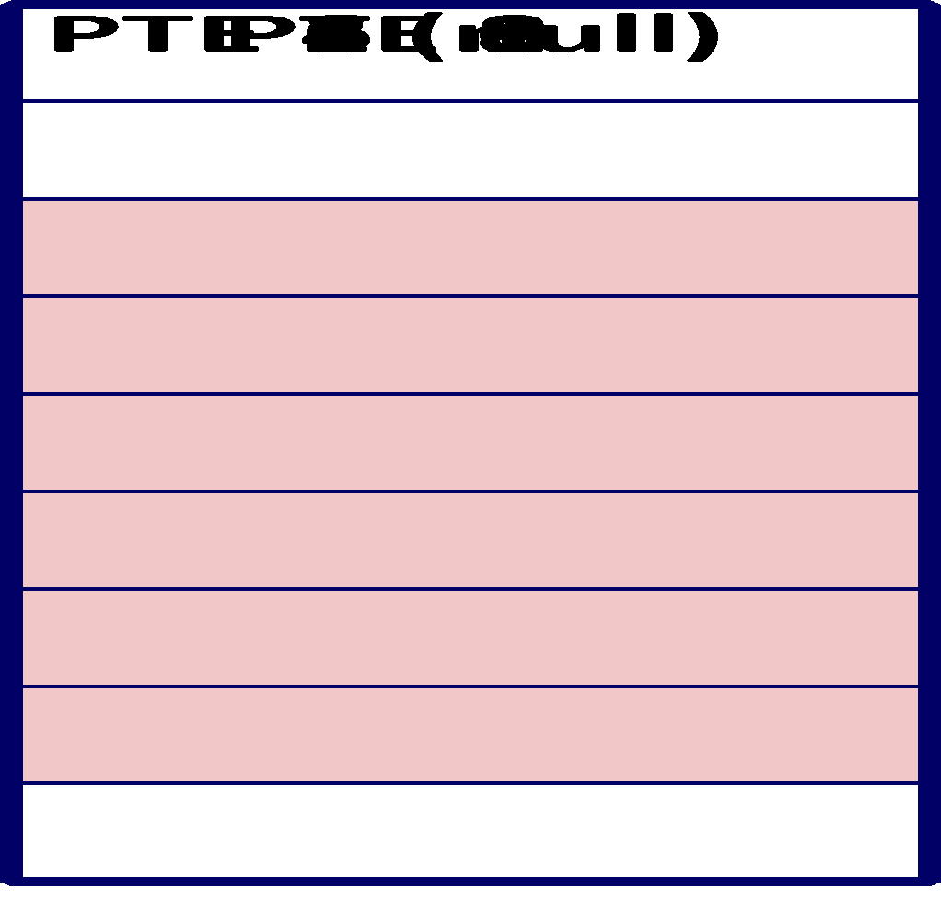
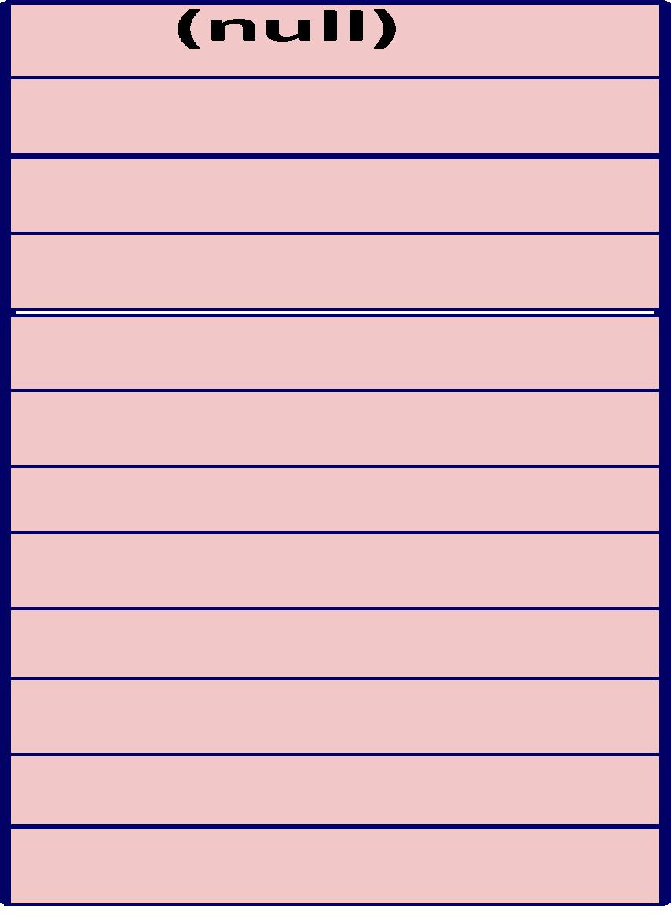

We have a problem
Virtual
memory
0
VP 0
2²⁰ Entries of
4 bytes each
...
VP 1023
2K allocated VM pages
for code and data
VP 1024
...
VP 2047
Gap
6K unallocated VM pages
1023
unallocated
pages
1023 unallocated pages
VP 9215
1 allocated VM page
for the stack
32 bit addresses, 4KB pages, 4-byte PTEs
...

Slide 40
A Two-Level Page Table Hierarchy
Level 1
page table
Level 2
page tables
Virtual
memory
0
VP 0
PTE 0
...
PTE 0
...
VP 1023
2K allocated VM pages
for code and data
PTE 1
PTE 1023
VP 1024
PTE 2 (null)
...
PTE 3 (null)
VP 2047
PTE 4 (null)
PTE 0
Gap
PTE 5 (null)
...
PTE 6 (null)
PTE 1023
PTE 7 (null)
6K unallocated VM pages
PTE 8
1023 null
PTEs
(1K - 9)
null PTEs
PTE 1023
1023
unallocated
pages
1023 unallocated pages
VP 9215
1 allocated VM page
for the stack
32 bit addresses, 4KB pages, 4-byte PTEs
...

Slide 41
Translating with a k-level Page Table
Page table base register
(PTBR)
n-1
VIRTUAL ADDRESS
p-1
0
VPN 1
VPN 2
...
VPN k
VPO
the Level 1
page table
a Level 2
page table
a Level k
page table
...
...
PPN
m-1
p-1
0
PPN
PPO
PHYSICAL ADDRESS

Slide 42
Summary
Programmer’s view of virtual memory
Each process has its own private linear address space
Cannot be corrupted by other processes
System view of virtual memory
Uses memory efficiently by caching virtual memory pages
Efficient only because of locality
Simplifies memory management and programming
Simplifies protection by providing a convenient interpositioning point to check permissions

