Slide 1
Virtual Memory: Details 15-213/14-513/15-513: Introduction to Computer Systems 17th Lecture, July 11, 2023
Instructors:
Brian Railing

Slide 2
Review: Virtual Addressing
Each process has its own virtual address space
Page tables map virtual to physical addresses
Physical memory can be shared among processes
0
Address
translation
0
Virtual Address Space for Process 1:
Physical
Address
Space (DRAM)
VP 1
VP 2
PP 2
...
N-1
PP 6
(e.g., read-only
library code)
Virtual Address Space for Process 2:
0
PP 8
VP 1
...
...
N-1
VP k
M-1

Slide 3
Review: Memory Accesses without VM
CPU sends physical address to cache
Cache sends data to CPU

Slide 4
Review: Memory Accesses with VM
CPU sends virtual address to MMU
MMU looks up physical address in page table
MMU sends physical address to cache
Cache sends data to CPU

Slide 5
Review: Memory Accesses with VM
CPU sends virtual address to MMU
MMU looks up physical address in page table
Present?
No
MMU triggers page fault
OS takes control and does stuff we’ll discuss in next 2 classes
Yes
MMU sends physical address to cache
Cache sends data to CPU

Slide 6
Review: Memory Accesses with VM
CPU sends virtual address to MMU
MMU looks up physical address in page table
OS recovers, tells
MMU to retry
Present?
No
MMU triggers page fault
OS takes control and tries to recover
Yes
MMU sends physical address to cache
OS cannot recover
OS terminates malfunctioning process
Cache sends data to CPU

Slide 7
Today
Multi-level page tables
Translation lookaside buffers
Conceptual Quiz
Concrete examples of virtual memory systems
“Simple memory system” from CSAPP 9.6.4
Intel Core i7
Nifty things virtual memory makes possible
Paging/swapping (disk as extra RAM)
Memory-mapped files (RAM as cache for disk)
Copy-on-write sharing

Slide 8
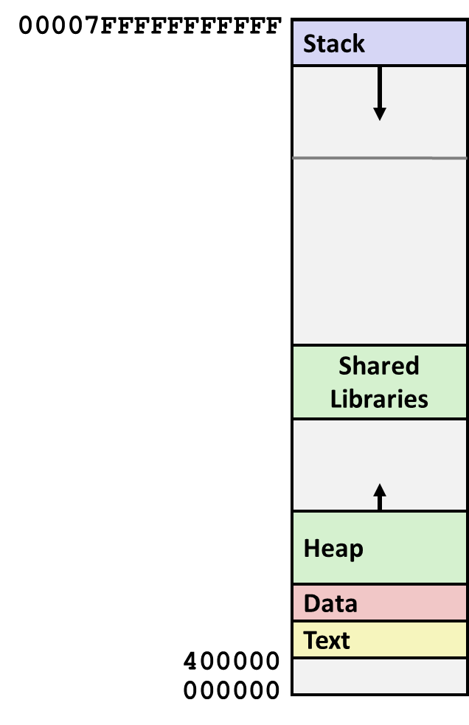
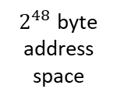
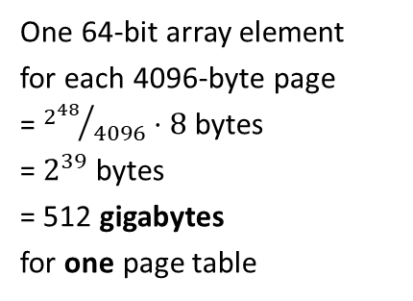
The problem (with one-level page tables)
One 64-bit array element for each 4096-byte page
= ${2^{48}}/{4096}⋅8$ bytes = $2^{39}$ bytes = 512 gigabytes for one page table
$2^{48}$ byte address space

Slide 9
A Two-Level Page Table Hierarchy
32-bit address space, 4-byte PTEs, 4096-byte pages
(one-level page table: 4MB)
Virtual
memory
PTE 0 (null)
PTE 0
VP 0…1023 (unmapped)
PTE 1
...
1024 unallocated pages
PTE 2
PTE 1023
1020 more
null PTEs
VP 1024
PTE 0
...
...
VP 2047
2048 allocated pages
for code and data
PTE 1023
VP 2048
...
VP 3072
1023 null PTEs
VP 3073… 1048575 (unmapped)
PTE 1023
PTE 1023
1021 · 1024 + 1023 unallocated pages
Level 1
page table
Level 2
page tables
1 allocated page
for the stack
VP 1048576

Slide 10
Translating with a two-level page table
CPU sends virtual address to MMU
MMU divides VA into VPN top, VPN bottom, and VPO
MMU looks up VPN top half in 1st-level page table
Not present
Page fault
Present
MMU looks up VPN bottom half in 2nd-level page table
Not present
Page fault
Present
MMU sends physical address to cache

Slide 11
Translating with a k-level Page Table
Page table base register
(PTBR)
n-1
VIRTUAL ADDRESS
p-1
0
VPN 1
VPN 2
...
VPN k
VPO
the Level 1
page table
a Level 2
page table
a Level k
page table
...
...
PPN
m-1
p-1
0
PPN
PPO
PHYSICAL ADDRESS

Slide 12
The problem (with k-level page tables)
Page table base register
(PTBR)
n-1
VIRTUAL ADDRESS
p-1
0
VPN 1
VPN 2
...
VPN k
VPO
the Level 1
page table
a Level 2
page table
a Level k
page table
...
...
PPN
Cache miss!
Cache miss!
Cache miss!
Cache miss!
Cache miss!
PPN
PPO

Slide 13
Speeding up Translation with a TLB
Page table entries (PTEs) are cached like any other memory word
PTEs may be evicted by other data references
PTE hit still costs cache delay
Solution: Translation Lookaside Buffer (TLB)
Dedicated cache for page table entries
TLB hit = page table not consulted
Can be fairly small: one TLB entry covers 4k or more

Slide 14
Translating with a TLB
CPU sends virtual address to MMU
MMU divides VA into VPN and VPO
MMU looks up VPN in TLB
Not present
MMU looks up VPN in page table
Not present
Page fault
Present
Present
MMU sends physical address to cache

Slide 15
Accessing the TLB
MMU uses the VPN portion of the virtual address to access the TLB:
T = 2^{t} sets
VPN
TLBT matches tag of line within set
n-1
p+t
p+t-1
p
p-1
0
TLB tag (TLBT)
TLB index (TLBI)
VPO
Set 0
v
tag
PTE
v
tag
PTE
TLBI selects the set
Set 1
v
tag
PTE
v
tag
PTE
…
Set T-1
v
tag
PTE
v
tag
PTE

Slide 16
TLB Hit
CPU Chip
TLB
2
PTE
VPN
3
Cache/
Memory
1
MMU
CPU
VA
PA
4
Data
5
A TLB hit eliminates memory accesses to the page table

Slide 17
TLB Miss
CPU Chip
TLB
4
2
PTE
VPN
Cache/
Memory
1
MMU
3
CPU
VA
PTEA
PA
5
Data
6
A TLB miss incurs additional memory accesses (PTE lookup) Fortunately, TLB misses are rare. Why?

Slide 18
Today
Multi-level page tables
Translation lookaside buffers
Conceptual Quiz
Concrete examples of virtual memory systems
“Simple memory system” from CSAPP 9.6.4
Intel Core i7
Nifty things virtual memory makes possible
Paging/swapping (disk as extra RAM)
Memory-mapped files (RAM as cache for disk)
Copy-on-write sharing

Slide 19
Conceptual Quiz: 1
For a simple system with a one-level page table, what sub-steps does the MMU take when it fetches a PTE from a page table?
The MMU has to split the virtual address into VPN and VPO. The VPN can then be used to index directly into the page table.

Slide 20
Conceptual Quiz: 2
The MMU must know the physical address of the page table in order to read page table entries from memory. Why does it need a physical address?
If the MMU knew only a virtual address for the page table, then, in order to read from the page table, it would first need to look up the physical address of the page table, in the page table, …

Slide 21
Conceptual Quiz: 3
Why are one-level page tables impractical and how do multi-level page tables fix this problem?
A single-level page table covering the entire address space of a typical system would be much too large. For instance, with 4kB pages, a 48-bit address space, and a 8-byte PTE, a single-level page table would occupy 512 gigabytes, which is more RAM than most computers have.

Slide 22
Conceptual Quiz: 4
Why is memory access slower with a multi-level page table than with a single-level page table?
A k-level page table requires k memory loads in order to determine the physical address. There is no spatial locality to these loads.

Slide 23
Conceptual Quiz: 5
What is the Translation Lookaside Buffer (TLB), what problem does it solve, and when is it used?
The TLB is a small cache dedicated to storing mappings from virtual to physical addresses. It avoids the cost of lookups in a multi-level page table. The MMU consults the TLB for each address as its first action; if there is a TLB hit, it does not need to fetch anything from the page table.

Slide 24
Conceptual Quiz: 6
How does virtual memory interact with the memory cache(s)?
The cache’s function is to speed up access to whatever data is most frequently used. The MMU sits “in between” the CPU and the cache; the cache works only with physical addresses. This means data from multiple processes may coexist in the cache (or compete for cache space).

Slide 25
Today
Multi-level page tables
Translation lookaside buffers
Conceptual Quiz
Concrete examples of virtual memory systems
“Simple memory system” from CSAPP 9.6.4
Intel Core i7
Nifty things virtual memory makes possible
Paging/swapping (disk as extra RAM)
Memory-mapped files (RAM as cache for disk)
Copy-on-write sharing

Slide 26
Simple Memory System Example
Addressing
14-bit virtual addresses
12-bit physical address
Page size = 64 bytes
13
12
11
10
9
8
7
6
5
4
3
2
1
0
VPN
VPO
Virtual Page Number
Virtual Page Offset
11
10
9
8
7
6
5
4
3
2
1
0
PPN
PPO
Physical Page Number
Physical Page Offset

Slide 27
Simple Memory System TLB
16 entries
4-way associative
TLBT
TLBI
13
12
11
10
9
8
7
6
5
4
3
2
1
0
0
0
0
0
1
1
0
1
VPN
VPO
VPN = 0b1101 = 0x0D
Translation Lookaside Buffer (TLB)
Set
Tag
PPN
Valid
Tag
PPN
Valid
Tag
PPN
Valid
Tag
PPN
Valid
Set
Tag
PPN
Valid
Tag
PPN
Valid
Tag
PPN
Valid
Tag
PPN
Valid
0
03
–
0
09
0D
1
00
–
0
07
02
1
0
03
–
0
09
0D
1
00
–
0
07
02
1
1
03
2D
1
02
–
0
04
–
0
0A
–
0
1
03
2D
1
02
–
0
04
–
0
0A
–
0
2
02
–
0
08
–
0
06
–
0
03
–
0
2
02
–
0
08
–
0
06
–
0
03
–
0
3
07
–
0
03
0D
1
0A
34
1
02
–
0
3
07
–
0
03
0D
1
0A
34
1
02
–
0

Slide 28
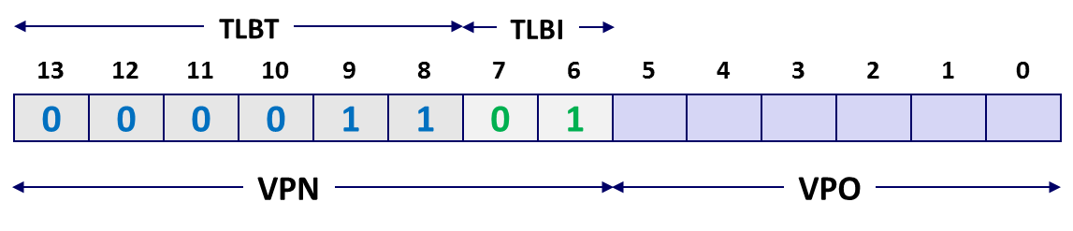
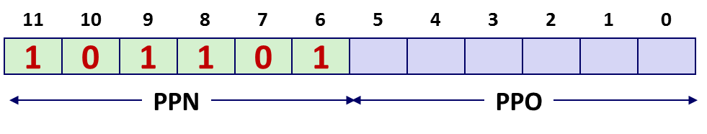
Simple Memory System Page Table
Only showing the first 16 entries (out of 256)
VPN
PPN
Valid
VPN
PPN
Valid
00
28
1
08
13
1
01
–
0
09
17
1
02
33
1
0A
09
1
03
02
1
0B
–
0
04
–
0
0C
–
0
05
16
1
0D
2D
1
0x0D → 0x2D
06
–
0
0E
11
1
07
–
0
0F
0D
1

Slide 29
Simple Memory System Cache
16 lines, 4-byte cache line size
Physically addressed
Direct mapped
V[0b00001101101001] = V[0x369]
P[0b101101101001] = P[0xB69] = 0x15
CT
CI
CO
11
10
9
8
7
6
5
4
3
2
1
0
1
0
1
1
0
1
1
0
1
0
0
1
PPN
PPO
Idx
Tag
Valid
B0
B1
B2
B3
Idx
Tag
Valid
B0
B1
B2
B3
Idx
Tag
Valid
B0
B1
B2
B3
Idx
Tag
Valid
B0
B1
B2
B3
0
19
1
99
11
23
11
8
24
1
3A
00
51
89
0
19
1
99
11
23
11
8
24
1
3A
00
51
89
1
15
0
–
–
–
–
9
2D
0
–
–
–
–
1
15
0
–
–
–
–
9
2D
0
–
–
–
–
2
1B
1
00
02
04
08
A
2D
1
93
15
DA
3B
2
1B
1
00
02
04
08
A
2D
1
93
15
DA
3B
3
36
0
–
–
–
–
B
0B
0
–
–
–
–
3
36
0
–
–
–
–
B
0B
0
–
–
–
–
4
32
1
43
6D
8F
09
C
12
0
–
–
–
–
4
32
1
43
6D
8F
09
C
12
0
–
–
–
–
5
0D
1
36
72
F0
1D
D
16
1
04
96
34
15
5
0D
1
36
72
F0
1D
D
16
1
04
96
34
15
6
31
0
–
–
–
–
E
13
1
83
77
1B
D3
6
31
0
–
–
–
–
E
13
1
83
77
1B
D3
7
16
1
11
C2
DF
03
F
14
0
–
–
–
–
7
16
1
11
C2
DF
03
F
14
0
–
–
–
–

Slide 30
Address Translation Example
Virtual Address: 0x03D4
VPN ___ TLBI ___ TLBT ____ TLB Hit? __ Page Fault? __ PPN: ____
Physical Address
TLBT
TLBI
13
12
11
10
9
8
7
6
5
4
3
2
1
0
0
0
0
0
1
1
1
1
0
1
0
1
0
0
VPN
VPO
0x0F
0x3
0x03
Y
N
0x0D
TLB
Set
Tag
PPN
Valid
Tag
PPN
Valid
Tag
PPN
Valid
Tag
PPN
Valid
0
03
–
0
09
0D
1
00
–
0
07
02
1
1
03
2D
1
02
–
0
04
–
0
0A
–
0
2
02
–
0
08
–
0
06
–
0
03
–
0
3
07
–
0
03
0D
1
0A
34
1
02
–
0
11
10
9
8
7
6
5
4
3
2
1
0
0
0
1
1
0
1
0
1
0
1
0
0
PPN
PPO

Slide 31
Intel Core i7 Memory System
Processor package
Core x4
Registers
Instruction
fetch
MMU
(addr translation)
L1 d-cache
32 KB, 8-way
L1 i-cache
32 KB, 8-way
L1 d-TLB
64 entries, 4-way
L1 i-TLB
128 entries, 4-way
L2 unified cache
256 KB, 8-way
L2 unified TLB
512 entries, 4-way
QuickPath interconnect
4 links @ 25.6 GB/s each
To other
cores
To I/O
bridge
L3 unified cache
8 MB, 16-way
(shared by all cores)
DDR3 Memory controller
3 x 64 bit @ 10.66 GB/s
32 GB/s total (shared by all cores)
Main memory

Slide 32
End-to-end Core i7 Address Translation
CPU
32/64
L2, L3, and
main memory
Result
Virtual address (VA)
36
12
VPN
VPO
L1
hit
L1
miss
32
4
TLBT
TLBI
L1 d-cache
(64 sets, 8 lines/set)
TLB
hit
TLB
miss
...
...
L1 TLB (16 sets, 4 entries/set)
9
9
9
9
40
12
40
6
6
VPN1
VPN2
VPN3
VPN4
PPN
PPO
CT
CI
CO
Physical
address
(PA)
CR3
PTE
PTE
PTE
PTE
Page tables

Slide 33
Core i7 Level 1-3 Page Table Entries
63
62
52
51
12
11
9
8
7
6
5
4
3
2
1
0
XD
Unused
Page table physical base address
Unused
G
PS
A
CD
WT
U/S
R/W
P=1
Available for OS (page table location on disk)
P=0
Each entry references a 4K child page table. Significant fields:
P: Child page table present in physical memory (1) or not (0).
R/W: Read-only or read-write access access permission for all reachable pages.
U/S: user or supervisor (kernel) mode access permission for all reachable pages.
WT: Write-through or write-back cache policy for the child page table.
A: Reference bit (set by MMU on reads and writes, cleared by software).
PS: Page size either 4 KB or 4 MB (defined for Level 1 PTEs only).
Page table physical base address: 40 most significant bits of physical page table address (forces page tables to be 4KB aligned)
XD: Disable or enable instruction fetches from all pages reachable from this PTE.
Notes:
Reference bit – used in LRU

Slide 34
Core i7 Level 4 Page Table Entries
63
62
52
51
12
11
9
8
7
6
5
4
3
2
1
0
XD
Unused
Page physical base address
Unused
G
D
A
CD
WT
U/S
R/W
P=1
Available for OS (page location on disk)
P=0
Each entry references a 4K child page. Significant fields:
P: Child page is present in memory (1) or not (0)
R/W: Read-only or read-write access permission for child page
U/S: User or supervisor mode access
WT: Write-through or write-back cache policy for this page
A: Reference bit (set by MMU on reads and writes, cleared by software)
D: Dirty bit (set by MMU on writes, cleared by software)
G: Global page (don’t evict from TLB on task switch)
Page physical base address: 40 most significant bits of physical page address (forces pages to be 4KB aligned)
XD: Disable or enable instruction fetches from this page.

Slide 35
Core i7 Page Table Translation
9
9
9
9
12
Virtual
address
VPN 1
VPN 2
VPN 3
VPN 4
VPO
L1 PT
Page global
directory
L2 PT
Page upper
directory
L3 PT
Page middle
directory
L4 PT
Page
table
40
40
40
40
CR3
/
/
/
/
Physical
address
of L1 PT
Offset into
physical and
virtual page
/
L4 PTE
12
L1 PTE
L2 PTE
L3 PTE
Physical
address
of page
512 GB
region
per entry
1 GB
region
per entry
2 MB
region
per entry
4 KB
region
per entry
40
/
40
12
Physical
address
PPN
PPO

Slide 36
Cute Trick for Speeding Up L1 Access
CT
Tag Check
40
6
6
Physical
address
(PA)
CT
CI
CO
PPN
PPO
Address
Translation
No
Change
Virtual
address
(VA)
CI
VPN
VPO
L1 Cache
36
12
Observation
Bits that determine CI identical in virtual and physical address
Can index into cache while address translation taking place
Generally we hit in TLB, so PPN bits (CT bits) available quickly
“Virtually indexed, physically tagged”
Cache carefully sized to make this possible

Slide 37
Today
Multi-level page tables
Translation lookaside buffers
Conceptual Quiz
Concrete examples of virtual memory systems
“Simple memory system” from CSAPP 9.6.4
Intel Core i7
Nifty things virtual memory makes possible
Paging/swapping (disk as extra RAM)
Memory-mapped files (RAM as cache for disk)
Copy-on-write sharing

Slide 38
Paging (aka Swapping)
Use (part of) disk as additional working memory
Adds another layer to the memory hierarchy, but…
“Main memory” is 10–1000x slower than the caches
Disk is 10,000x slower than main memory
Enormous miss penalty drives design
Consequences
Large page (block) size: 4KB and bigger
Always write-back and fully associative
Managed entirely in software
Plenty of time to execute complex replacement algorithms

Slide 39
Locality to the Rescue Again!
Paging is terribly inefficient
Only works because of locality
At any point in time, programs tend to access a set of active virtual pages called the working set
Programs with good temporal locality will have small working sets
If working set size < main memory size
Good performance after compulsory misses
If working set size > main memory size
Thrashing: Performance meltdown, computer spends most of its time copying pages in and out of RAM
In the worst case, no forward progress at all (livelock)

Slide 40
Memory-Mapped Files
Paging = every page of a program’s physical RAM is backed by some page of disk*
Normally, those pages belong to swap space
But what if some pages were backed by … files?
* This is how it used to work 20 years ago. Nowadays, not always true.

Slide 41
Memory-Mapped Files
Process
virtual memory
Physical
memory
Swap space
File on disk

Slide 42
Memory-Mapped Files
Process 2
virtual memory
Process 1
virtual memory
Physical
memory
Swap space
File on disk

Slide 43
Copy-on-write sharing
fork creates a new process by copying the entire address space of the parent process
That sounds slow
It is slow
Parent
virtual memory
Physical
memory
Swap space
File on disk
Clever trick:
Just duplicate the page tables
Mark everything read only
Copy only on write faults

Slide 44
Copy-on-write sharing
Child
virtual memory
Parent
virtual memory
Physical
memory
Swap space
File on disk
Clever trick:
Just duplicate the page tables
Mark everything read only
Copy only on write faults

Slide 45
Copy-on-write sharing
Child
virtual memory
Parent
virtual memory
Physical
memory
Child wrote to this page
Swap space
File on disk
Clever trick:
Just duplicate the page tables
Mark everything read only
Copy only on write faults

Slide 46
Summary
Multi-level page tables reduce total memory consumption of page tables
Translation lookaside buffers reduce time cost of translation
Real systems have 3 to 5 levels of page table
Virtual memory makes nifty things possible
Memory protection and process isolation
Paging/swapping (disk as extra RAM)
Memory-mapped files (RAM as cache for disk)
Copy-on-write sharing

