Slide 1
System-Level I/O: Supplemental Slides 15-213/14-513/15-513: Introduction to Computer Systems 20th Lecture, November 10, 2022
Instructors:
Dave Andersen (15-213)
Zack Weinberg (15-213)
Brian Railing (15-513)
David Varodayan (14-513)

Slide 2
Contents
The RIO package (very helpful for proxy lab)
More file descriptor examples
Books with more detail (lots more detail)

Slide 3
The RIO Package (15-213/CS:APP Package)
RIO is a set of wrappers that provide efficient and robust I/O in apps, such as network programs that are subject to short counts
RIO provides two different kinds of functions
Unbuffered input and output of binary data
rio_readn and rio_writen
Buffered input of text lines and binary data
rio_readlineb and rio_readnb
Buffered RIO routines are thread-safe and can be interleaved arbitrarily on the same descriptor
Download from http://csapp.cs.cmu.edu/3e/code.html
→ src/csapp.c and include/csapp.h

Slide 4
Unbuffered RIO Input and Output
Same interface as Unix read and write
Especially useful for transferring data on network sockets
rio_readn returns short count only if it encounters EOF
Only use it when you know how many bytes to read
rio_writen never returns a short count
Calls to rio_readn and rio_writen can be interleaved arbitrarily on the same descriptor
#include "csapp.h"
ssize_t rio_readn(int fd, void *usrbuf, size_t n);
ssize_t rio_writen(int fd, void *usrbuf, size_t n);
Return: num. bytes transferred if OK, 0 on EOF (rio_readn only), -1 on error

Slide 5
Implementation of rio_readn
/*
* rio_readn - Robustly read n bytes (unbuffered)
*/
ssize_t rio_readn(int fd, void *usrbuf, size_t n)
{
size_t nleft = n;
ssize_t nread;
char *bufp = usrbuf;
while (nleft > 0) {
if ((nread = read(fd, bufp, nleft)) < 0) {
if (errno == EINTR) /* Interrupted by sig handler return */
nread = 0; /* and call read() again */
else
return -1; /* errno set by read() */
}
else if (nread == 0)
break; /* EOF */
nleft -= nread;
bufp += nread;
}
return (n - nleft); /* Return >= 0 */
}
csapp.c

Slide 6
Buffered RIO Input Functions
Efficiently read text lines and binary data from a file partially cached in an internal memory buffer
rio_readlineb reads a text line of up to maxlen bytes from file fd and stores the line in usrbuf
Especially useful for reading text lines from network sockets
Stopping conditions
maxlen bytes read
EOF encountered
Newline (‘\n’) encountered
#include "csapp.h"
void rio_readinitb(rio_t *rp, int fd);
ssize_t rio_readlineb(rio_t *rp, void *usrbuf, size_t maxlen);
ssize_t rio_readnb(rio_t *rp, void *usrbuf, size_t n);
Return: num. bytes read if OK, 0 on EOF, -1 on error

Slide 7
Buffered RIO Input Functions (cont)
#include "csapp.h"
void rio_readinitb(rio_t *rp, int fd);
ssize_t rio_readlineb(rio_t *rp, void *usrbuf, size_t maxlen);
ssize_t rio_readnb(rio_t *rp, void *usrbuf, size_t n);
Return: num. bytes read if OK, 0 on EOF, -1 on error
rio_readnb reads up to n bytes from file fd
Stopping conditions
maxlen bytes read
EOF encountered
Calls to rio_readlineb and rio_readnb can be interleaved arbitrarily on the same descriptor
Warning: Don’t interleave with calls to rio_readn

Slide 8
Buffered I/O: Implementation
For reading from file
File has associated buffer to hold bytes that have been read from file but not yet read by user code
Layered on Unix file:
rio_cnt
Buffer
already read
unread
rio_buf
rio_bufptr
Buffered Portion
not in buffer
already read
unread
unseen
Current File Position

Slide 9
Buffered I/O: Declaration
All information contained in struct
rio_cnt
Buffer
already read
unread
rio_buf
rio_bufptr
typedef struct {
int rio_fd; /* descriptor for this internal buf */
int rio_cnt; /* unread bytes in internal buf */
char *rio_bufptr; /* next unread byte in internal buf */
char rio_buf[RIO_BUFSIZE]; /* internal buffer */
} rio_t;

Slide 10
RIO Example
Copying the lines of a text file from standard input to standard output
#include "csapp.h"
int main(int argc, char **argv)
{
int n;
rio_t rio;
char buf[MAXLINE];
Rio_readinitb(&rio, STDIN_FILENO);
while((n = Rio_readlineb(&rio, buf, MAXLINE)) != 0)
Rio_writen(STDOUT_FILENO, buf, n);
exit(0);
}
cpfile.c

Slide 11
Fun with File Descriptors (1)
#include "csapp.h"
int main(int argc, char *argv[])
{
int fd1, fd2, fd3;
char c1, c2, c3;
char *fname = argv[1];
fd1 = Open(fname, O_RDONLY, 0);
fd2 = Open(fname, O_RDONLY, 0);
fd3 = Open(fname, O_RDONLY, 0);
Dup2(fd2, fd3);
Read(fd1, &c1, 1);
Read(fd2, &c2, 1);
Read(fd3, &c3, 1);
printf("c1 = %c, c2 = %c, c3 = %c\n", c1, c2, c3);
return 0;
}
ffiles1.c
What would this program print for file containing “abcde”?

Slide 12
Fun with File Descriptors (2)
#include "csapp.h"
int main(int argc, char *argv[])
{
int fd1;
int s = getpid() & 0x1;
char c1, c2;
char *fname = argv[1];
fd1 = Open(fname, O_RDONLY, 0);
Read(fd1, &c1, 1);
if (fork()) { /* Parent */
sleep(s);
Read(fd1, &c2, 1);
printf("Parent: c1 = %c, c2 = %c\n", c1, c2);
} else { /* Child */
sleep(1-s);
Read(fd1, &c2, 1);
printf("Child: c1 = %c, c2 = %c\n", c1, c2);
}
return 0;
}
ffiles2.c
What would this program print for file containing “abcde”?

Slide 13
Fun with File Descriptors (3)
#include "csapp.h"
int main(int argc, char *argv[])
{
int fd1, fd2, fd3;
char *fname = argv[1];
fd1 = Open(fname, O_CREAT|O_TRUNC|O_RDWR, S_IRUSR|S_IWUSR);
Write(fd1, "pqrs", 4);
fd3 = Open(fname, O_APPEND|O_WRONLY, 0);
Write(fd3, "jklmn", 5);
fd2 = dup(fd1); /* Allocates descriptor */
Write(fd2, "wxyz", 4);
Write(fd3, "ef", 2);
return 0;
}
ffiles3.c
What would be the contents of the resulting file?

Slide 14
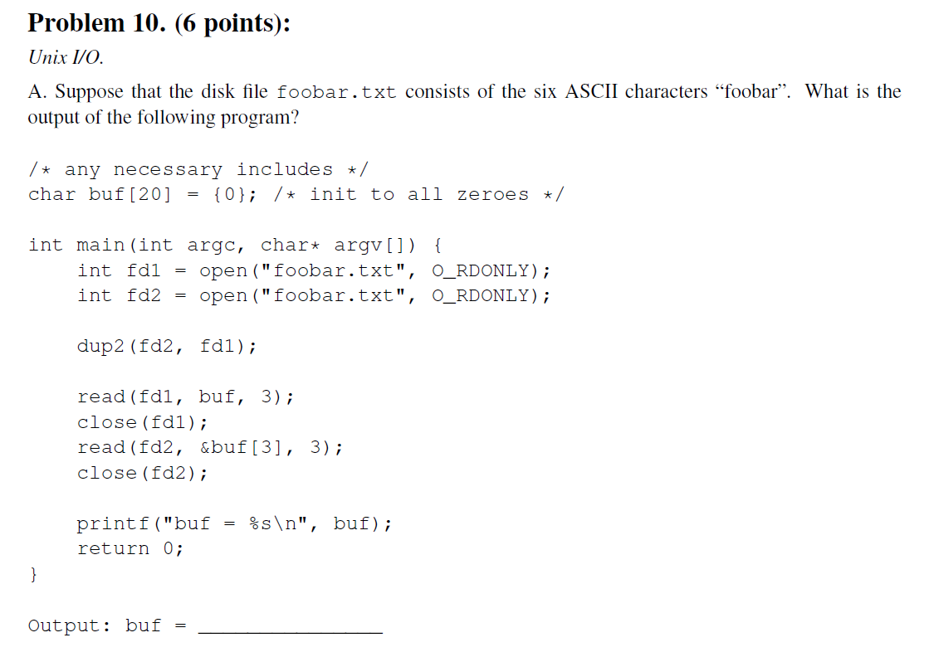
I/O Questions in Exams
**********
Problem 10
********** A. Output: buf = foobar
Fall 2011 (model solution)

Slide 15
Accessing Directories
Most Unix I/O calls will fail if applied to a directory
You can open() with special flags, but you can’t read() or write()!
There’s a special API in dirent.h just for directories
#include <sys/types.h>
#include <dirent.h>
{
DIR *directory;
struct dirent *de;
...
if (!(directory = opendir(dir_name)))
error("Failed to open directory");
...
while (0 != (de = readdir(directory))) {
printf("Found file: %s\n", de->d_name);
}
...
closedir(directory);
}

Slide 16
For Further Information
The Unix bible:
W. Richard Stevens & Stephen A. Rago, Advanced Programming in the Unix Environment, 2nd Edition, Addison Wesley, 2005
Updated from Stevens’s 1993 classic text
The Linux bible:
Michael Kerrisk, The Linux Programming Interface, No Starch Press, 2010
Encyclopedic and authoritative
The GNU C Library Reference Manual
https://www.gnu.org/software/libc/manual/html_node/index.html
Encyclopedic, well-written
Not updated recently, but most of this stuff is old so it doesn’t matter

