Slide 1
Synchronization: Basics 15-213/15-513: Introduction to Computer Systems 24th Lecture, July 26, 2023
Instructors:
Brian Railing

Slide 2
Today
Threads review
Sharing and Data Races
Fixing Data Races
Mutexes
Semaphores
Atomic memory operations

Slide 3
Traditional View of a Process
Process = process context + code, data, and stack
Process context
Code, data, and stack
Program context:
Data registers
Condition codes
Stack pointer (SP)
Program counter (PC)
SP
Stack
Shared libraries
brk
Run-time heap
Kernel context:
VM structures
Descriptor table
brk pointer
Read/write data
PC
Read-only code/data
0

Slide 4
Alternate View of a Process
Process = thread + (code, data, and kernel context)
Thread (main thread)
Code, data, and kernel context
Shared libraries
SP
Stack
brk
Run-time heap
Thread context:
Data registers
Condition codes
Stack pointer (SP)
Program counter (PC)
Read/write data
PC
Read-only code/data
0
Kernel context:
VM structures
Descriptor table
brk pointer

Slide 5
A Process With Multiple Threads
Multiple threads can be associated with a process
Each thread has its own logical control flow
Each thread shares the same code, data, and kernel context
Each thread has its own stack for local variables
but not protected from other threads
Each thread has its own thread id (TID)
Thread 1 (main thread)
Thread 2 (peer thread)
Shared code and data
shared libraries
stack 1
stack 2
run-time heap
Thread 1 context:
Data registers
Condition codes
SP₁
PC₁
Thread 2 context:
Data registers
Condition codes
SP₂
PC₂
read/write data
read-only code/data
0
Kernel context:
VM structures
Descriptor table
brk pointer

Slide 6
Don’t let picture confuse you!
Thread 1 (main thread)
Thread 2 (peer thread)
Shared code and data
shared libraries
stack 1
stack 2
run-time heap
Thread 1 context:
Data registers
Condition codes
SP₁
PC₁
Thread 2 context:
Data registers
Condition codes
SP₂
PC₂
read/write data
read-only code/data
0
Kernel context:
VM structures
Descriptor table
brk pointer
Memory is shared between all threads

Slide 7
Today
Threads review
Sharing and Data Races
Fixing Data Races
Mutexes
Semaphores
Atomic memory operations

Slide 8
Shared Variables in Threaded C Programs
Question: Which variables in a threaded C program are shared?
The answer is not as simple as “global variables are shared” and “stack variables are private”
Def: A variable x is shared if and only if multiple threads reference some instance of x.
Requires answers to the following questions:
What is the memory model for threads?
How are instances of variables mapped to memory?
How many threads might reference each of these instances?

Slide 9
Threads Memory Model: Conceptual
Multiple threads run within the context of a single process
Each thread has its own separate thread context
Thread ID, stack, stack pointer, PC, condition codes, and GP registers
All threads share the remaining process context
Code, data, heap, and shared library segments of the process virtual address space
Open files and installed handlers
Thread 1
(private)
Thread 2
(private)
Shared code and data
stack 1
stack 2
shared libraries
Thread 1 context:
Data registers
Condition codes
SP₁
PC₁
Thread 2 context:
Data registers
Condition codes
SP₂
PC₂
run-time heap
read/write data
read-only code/data

Slide 10
Threads Memory Model: Actual
Separation of data is not strictly enforced:
Register values are truly separate and protected, but…
Any thread can read and write the stack of any other thread
The mismatch between the conceptual and operation model is a source of confusion and errors
stack 1
stack 2
Virtual Address Space
Shared code and data
Thread 1
(private)
Thread 2
(private)
shared libraries
Thread 1 context:
Data registers
Condition codes
SP₁
PC₁
Thread 2 context:
Data registers
Condition codes
SP₂
PC₂
run-time heap
read/write data
read-only code/data

Slide 11
Three Ways to Pass Thread Arg
Malloc/free
Producer malloc’s space, passes pointer to pthread_create
Consumer dereferences pointer, frees space
Always works; necessary for passing large amounts of data
Cast of int
Producer casts an int/long to void*, passes to pthread_create
Consumer casts void* argument back to int/long
Works for small amounts of data (one number)
INCORRECT: Pointer to stack slot
Producer passes address to producer’s stack in pthread_create
Consumer dereferences pointer
Why is this unsafe?

Slide 12
Passing an argument to a thread
int hist[N] = {0};
int main(int argc, char *argv[]) {
long i;
pthread_t tids[N];
for (i = 0; i < N; i++)
Pthread_create(&tids[i],
NULL,
thread,
&hist[i]);
for (i = 0; i < N; i++)
Pthread_join(tids[i], NULL);
check();
}
void *thread(void *vargp)
{
*(int *)vargp += 1;
return NULL;
}
Each thread receives a unique pointer
void check(void) {
for (int i=0; i<N; i++) {
if (hist[i] != 1) {
printf("Failed at %d\n", i);
exit(-1);
}
}
printf("OK\n");
}

Slide 13
Passing an argument to a thread – Also OK
int hist[N] = {0};
int main(int argc, char *argv[]) {
long i;
pthread_t tids[N];
for (i = 0; i < N; i++)
Pthread_create(&tids[i],
NULL,
thread,
(void *)i);
for (i = 0; i < N; i++)
Pthread_join(tids[i], NULL);
check();
}
void *thread(void *vargp)
{
hist[(long)vargp] += 1;
return NULL;
}
Each thread receives a unique array index
Casting from long to void* and back is safe

Slide 14
Passing an argument to a thread – Also OK
int hist[N] = {0};
int main(int argc, char *argv[]) {
long i;
pthread_t tids[N];
for (i = 0; i < N; i++) long* p = Malloc(sizeof(long));
*p = i;
Pthread_create(&tids[i],
NULL,
thread,
p);
for (i = 0; i < N; i++)
Pthread_join(tids[i], NULL);
check();
}
void *thread(void *vargp)
{
hist[*(long *)vargp] += 1;
free(vargp);
return NULL;
}
Each thread receives a unique array index
Malloc in parent, free in thread
Necessary if passing structs

Slide 15
Passing an argument to a thread – WRONG!
int hist[N] = {0};
int main(int argc, char *argv[]) {
long i;
pthread_t tids[N];
for (i = 0; i < N; i++)
Pthread_create(&tids[i],
NULL,
thread,
&i);
for (i = 0; i < N; i++)
Pthread_join(tids[i], NULL);
check();
}
void *thread(void *vargp)
{
hist[*(long *)vargp] += 1;
return NULL;
}
Each thread receives the same pointer, to i in main
Data race: each thread may or may not read a unique array index from i in main

Slide 16
Shared Variables in Threaded C Programs
Question: Which variables in a threaded C program are shared?
The answer is not as simple as “global variables are shared” and “stack variables are private”
Def: A variable x is shared if and only if multiple threads reference some instance of x.
Requires answers to the following questions:
What is the memory model for threads?
How are instances of variables mapped to memory?
How many threads might reference each of these instances?

Slide 17
Mapping Variable Instances to Memory
Global variables
Variable declared outside of a function
Virtual memory contains exactly one instance of any global variable
Local automatic variables
Variable declared inside function without static attribute
Each thread stack contains one instance of each local variable
Local static variables
Variable declared inside function with the static attribute
Virtual memory contains exactly one instance of any local static variable.
errno is special
Declared outside a function, but each thread stack contains one instance

Slide 18
Mapping Variable Instances to Memory
char **ptr; /* global var */
int main(int main, char *argv[])
{
long i;
pthread_t tid;
char *msgs[2] = {
"Hello from foo",
"Hello from bar"
};
ptr = msgs;
for (i = 0; i < 2; i++)
Pthread_create(&tid,
NULL,
thread,
(void *)i);
Pthread_exit(NULL);
}
void *thread(void *vargp)
{
long myid = (long)vargp;
static int cnt = 0;
printf("[%ld]: %s (cnt=%d)\n",
myid, ptr[myid], ++cnt);
return NULL;
}
sharing.c

Slide 19
Mapping Variable Instances to Memory
Global var: 1 instance (ptr [data])
Local auto vars: 1 instance (i.m, msgs.m, tid.m)
char **ptr; /* global var */
int main(int main, char *argv[])
{
long i;
pthread_t tid;
char *msgs[2] = {
"Hello from foo",
"Hello from bar"
};
ptr = msgs;
for (i = 0; i < 2; i++)
Pthread_create(&tid,
NULL,
thread,
(void *)i);
Pthread_exit(NULL);
}
Local auto var: 2 instances (
myid.p0 [peer thread 0’s stack],
myid.p1 [peer thread 1’s stack]
)
void *thread(void *vargp)
{
long myid = (long)vargp;
static int cnt = 0;
printf("[%ld]: %s (cnt=%d)\n",
myid, ptr[myid], ++cnt);
return NULL;
}
Local static var: 1 instance (cnt [data])
sharing.c

Slide 20
Shared Variable Analysis
Which variables are shared?
Answer: A variable x is shared iff multiple threads reference at least one instance of x. Thus:
ptr, cnt, and msgs are shared
i and myid are not shared
Variable Referenced by Referenced by Referenced by
instance main thread? peer thread 0? peer thread 1?
ptr
cnt
i.m
msgs.m
myid.p0
myid.p1
yes
yes
yes
no
yes
yes
yes
no
no
yes
yes
yes
no
yes
no
no
no
yes
char **ptr; /* global var */
int main(int main, char *argv[]) {
long i; pthread_t tid;
char *msgs[2] = {"Hello from foo",
"Hello from bar" };
ptr = msgs;
for (i = 0; i < 2; i++)
Pthread_create(&tid,
NULL, thread,(void *)i);
Pthread_exit(NULL);}
void *thread(void *vargp)
{
long myid = (long)vargp;
static int cnt = 0;
printf("[%ld]: %s (cnt=%d)\n",
myid, ptr[myid], ++cnt);
return NULL;
}

Slide 21
Shared Variable Analysis
Which variables are shared?
Answer: A variable x is shared iff multiple threads reference at least one instance of x. Thus:
ptr, cnt, and msgs are shared
i and myid are not shared
Variable Referenced by Referenced by Referenced by
instance main thread? peer thread 0? peer thread 1?
ptr
cnt
i.m
msgs.m
myid.p0
myid.p1
yes
yes
yes
no
yes
yes
yes
no
no
yes
yes
yes
no
yes
no
no
no
yes

Slide 22
Synchronizing Threads
int main(int argc, char **argv) {
unsigned long niters = strtoul(argv[1], NULL, 10); pthread_t t1, t2;
Pthread_create(&t1, NULL, incr_thread, (void *)niters);
Pthread_create(&t2, NULL, incr_thread, (void *)niters); Pthread_join(&t1, NULL);
Pthread_join(&t2, NULL);
if (cnt != 2*niters) {
printf("FAIL: cnt=%lu not %lu\n",
cnt, 2*niters;
return 1;
} else {
printf("OK: cnt=%lu\n", cnt);
return 0;
}
}
Shared variables are handy...
…but you risk data races and synchronization errors.
static unsigned long cnt = 0;
void *incr_thread(void *arg) { unsigned long i; unsigned long niters = (unsigned long) arg;
for (i = 0; i < niters; i++) {
cnt++;
} }
Coding demo 1: Counting to 20,000 incorrectly (with threads)

Slide 23
Assembly Code for Counter Loop
C code for counter loop in thread i
for (i = 0; i < niters; i++)
cnt++;
Asm code for thread i
movq (%rdi), %rcx
testq %rcx,%rcx
jle .L2
movl $0, %eax
.L3:
movq cnt(%rip),%rdx
addq $1, %rdx
movq %rdx, cnt(%rip)
addq $1, %rax
cmpq %rcx, %rax
jne .L3
.L2:
H_{i} : Head
L_{i} : Load cnt
U_{i} : Update cnt
S_{i} : Store cnt
T_{i} : Tail

Slide 24
Concurrent Execution
Key idea: Any interleaving of instructions is possible, and some give an unexpected result!
I_{i} denotes that thread i executes instruction I
%rdx_{i} is the content of %rdx in thread i’s context
i (thread)
instr_{i}
%rdx₁
%rdx₂
cnt
1
H₁
-
-
0
Thread 1 critical section
1
L₁
0
-
0
1
U₁
1
-
0
1
S₁
1
-
1
Thread 2 critical section
2
H₂
-
-
1
2
L₂
-
1
1
2
U₂
-
2
1
2
S₂
-
2
2
2
T₂
-
2
2
1
T₁
1
-
2
OK

Slide 25
Concurrent Execution (cont)
Incorrect ordering: two threads increment the counter, but the result is 1 instead of 2
i (thread)
instr_{i}
%rdx₁
%rdx₂
cnt
1
H₁
-
-
0
1
L₁
0
-
0
1
U₁
1
-
0
2
H₂
-
-
0
2
L₂
-
0
0
1
S₁
1
-
1
1
T₁
1
-
1
2
U₂
-
1
1
2
S₂
-
1
1
2
T₂
-
1
1
Oops!

Slide 26
Concurrent Execution (cont)
How about this ordering?
We can analyze the behavior using a progress graph
i (thread)
instr_{i}
%rdx₁
%rdx₂
cnt
1
H₁
0
1
L₁
0
2
H₂
2
L₂
0
2
U₂
1
2
S₂
1
1
1
U₁
1
1
S₁
1
1
1
T₁
1
1
Oops!
2
T₂

Slide 27
Progress Graphs
Thread 2
A progress graph depicts
the discrete execution
state space of concurrent
threads.
Each axis corresponds to
the sequential order of
instructions in a thread.
Each point corresponds to
a possible execution state
(Inst₁, Inst₂).
E.g., (L₁, S₂) denotes state
where thread 1 has
completed L₁ and thread
2 has completed S₂.
T₂
(L₁, S₂)
S₂
U₂
L₂
H₂
Thread 1
H₁
L₁
U₁
S₁
T₁

Slide 28
Trajectories in Progress Graphs
Thread 2
A trajectory is a sequence of legal state transitions that describes one possible concurrent execution of the threads.
Example:
H1, L1, U1, H2, L2, S1, T1, U2, S2, T2
T₂
S₂
U₂
L₂
H₂
Thread 1
H₁
L₁
U₁
S₁
T₁

Slide 29
Trajectories in Progress Graphs
Thread 2
A trajectory is a sequence of legal state transitions that describes one possible concurrent execution of the threads.
Example:
H1, L1, U1, H2, L2, S1, T1, U2, S2, T2
T₂
S₂
U₂
L₂
H₂
Thread 1
H₁
L₁
U₁
S₁
T₁

Slide 30
Critical Sections and Unsafe Regions
Thread 2
L, U, and S form a critical section with respect to the shared variable cnt
Instructions in critical sections (wrt some shared variable) should not be interleaved
Sets of states where such interleaving occurs form unsafe regions
T₂
S₂
critical section wrt cnt
U₂
Unsafe region
L₂
H₂
Thread 1
H₁
L₁
U₁
S₁
T₁
critical section wrt cnt

Slide 31
Critical Sections and Unsafe Regions
Thread 2
safe
T₂
Def: A trajectory is safe iff it does not enter any unsafe region
Claim: A trajectory is correct (wrt cnt) iff it is safe
S₂
critical section wrt cnt
U₂
Unsafe region
L₂
unsafe
H₂
Thread 1
H₁
L₁
U₁
S₁
T₁
critical section wrt cnt

Slide 32
Quiz time!
https://canvas.cmu.edu/courses/34989/quizzes/103068

Slide 33
Today
Threads review
Sharing and Data Races
Fixing Data Races
Mutexes
Semaphores
Atomic memory operations

Slide 34
Enforcing Mutual Exclusion
Question: How can we guarantee a safe trajectory?
Answer: We must synchronize the execution of the threads so that they can never have an unsafe trajectory.
Need to guarantee mutually exclusive access to each critical section.
static unsigned long cnt = 0;
static pthread_mutex_t lock = PTHREAD_MUTEX_INITIALIZER;
void *incr_thread(void *arg) { unsigned long i; unsigned long niters = (unsigned long) arg;
for (i = 0; i < niters; i++) {
pthread_mutex_lock(&lock);
cnt++;
pthread_mutex_unlock(&lock);
} }
Coding demo 2: Counting to 20,000 correctly (with threads and a mutex)

Slide 35
MUTual EXclusion (mutex)
Mutex: opaque object which is either locked or unlocked
Boolean value, but cannot do math on it
Starts out unlocked
Two operations:
lock(m)
If the mutex is currently not locked, lock it and return
Otherwise, wait until it becomes unlocked, then retry
unlock(m)
Can only be called when mutex is locked, by the code that locked it
Change mutex to unlocked

Slide 36
Mutex implementation (partial)
/** * void pthread_mutex_lock(pthread_mutex_t *mtx) * Lock the mutex pointed to by MTX. If it is already locked, * first sleep until it becomes unlocked. */
pthread_mutex_lock: call gettid // current thread ID now in %eax mov $1, %edx // increment lock xadd %edx, MUTEX_CONTENDERS(%rdi) // %edx now holds _previous_ value of mtx->contenders test %edx, %edx jne .Lcontended // The lock was unlocked, and now we hold it. mov %eax, MUTEX_HOLDER(%rdi) ret
.Lcontended: // Sleep until another thread calls pthread_mutex_unlock // (30 more machine instructions and a system call)
Just one of many ways to implement (discussed in 15-410, -418, etc) All require assistance from the CPU (special instructions)

Slide 37
Why Mutexes Work
Thread 2
Provide mutually exclusive access to shared variable by surrounding critical section with lock and unlock operations
Mutex invariant creates a forbidden region that encloses unsafe region and that cannot be entered by any trajectory.
T₂
un(m)
S₂
U₂
Unsafe region
L₂
-1
lo(m)
0
H₂
1
0
0
0
Thread 1
H₁
lo(m)
L₁
U₁
S₁
un(m)
T₁
Initially
m = 1

Slide 38
Why Mutexes Work
Thread 2
Provide mutually exclusive access to shared variable by surrounding critical section with lock and unlock operations
Mutex invariant creates a forbidden region that encloses unsafe region and that cannot be entered by any trajectory.
T₂
un(m)
S₂
U₂
Unsafe region
L₂
0
lo(m)
0
1
0
H₂
1
0
0
0
Thread 1
H₁
lo(m)
L₁
U₁
S₁
un(m)
T₁
Initially
m = 1

Slide 39
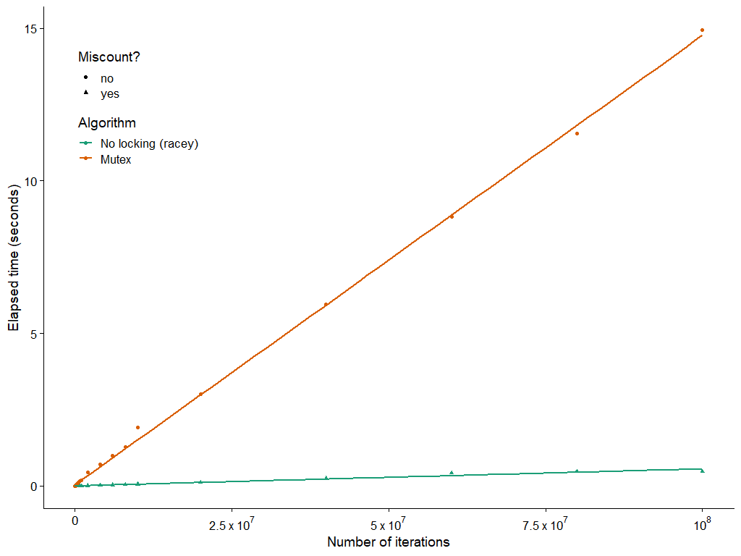
The Cost of Mutexes
15 s
0.48 s
Notes:
30x slower

Slide 40
Today
static unsigned long cnt = 0;
static sem_t lock;
void *incr_thread(void *arg) { unsigned long i; unsigned long niters = (unsigned long) arg;
for (i = 0; i < niters; i++) {
sem_wait(&lock);
cnt++;
sem_post(&lock);
} }
Threads review
Sharing and Data Races
Fixing Data Races
Mutexes
Semaphores
Atomic memory operations
int main(int argc, char **argv) {
unsigned long niters = strtoul(argv[1], NULL, 10); sem_init(&lock, 0, 1);
// ...
}
Coding demo 3: Counting to 20,000 correctly (with threads and a semaphore)

Slide 41
Semaphores
Semaphore: generalization of mutex
Unsigned integer value, but cannot do math on it.
Created with some value >= 0
Two operations:
P(s) [“Prolaag,” Dutch shorthand for “try to reduce”]
If s is zero, wait for a V operation to happen.
Then subtract 1 from s and return.
V(s) [“Verhogen,” Dutch for “increase”]
Add 1 to s.
If there are any threads waiting inside a P operation, resume one of them
Unlike mutexes, no requirement to call P before calling V
Notes:
Just like with mutexes, the implementation requires

Slide 42
C Semaphore Operations
Pthreads functions:
#include <semaphore.h>
int sem_wait(sem_t *s); /* P(s) */
int sem_post(sem_t *s); /* V(s) */
int sem_init(sem_t *s, int pshared, unsigned int val);
Share among processes? (normally you want to pass zero, see manpage for details)
Initial semaphore value

Slide 43
Semaphore implementation (partial)
/** * void sem_wait(sem_t *sem) * Decrement the count of the semaphore pointed to by SEM. If this * would make the count negative, first sleep until it is possible to * decrement the count without making it negative. */
sem_wait: mov $-1, %edx // decrement lock xadd %edx, SEM_COUNT(%rdi) // %edx now holds _previous_ value of sem->count test %edx, %edx jle .Lclosed // The semaphore was open.
ret
.Lclosed: // Sleep until another thread calls sem_post // (30 more machine instructions and a system call)
Suspiciously similar to a mutex, huh? (This implementation makes sem_post do most of the work)

Slide 44
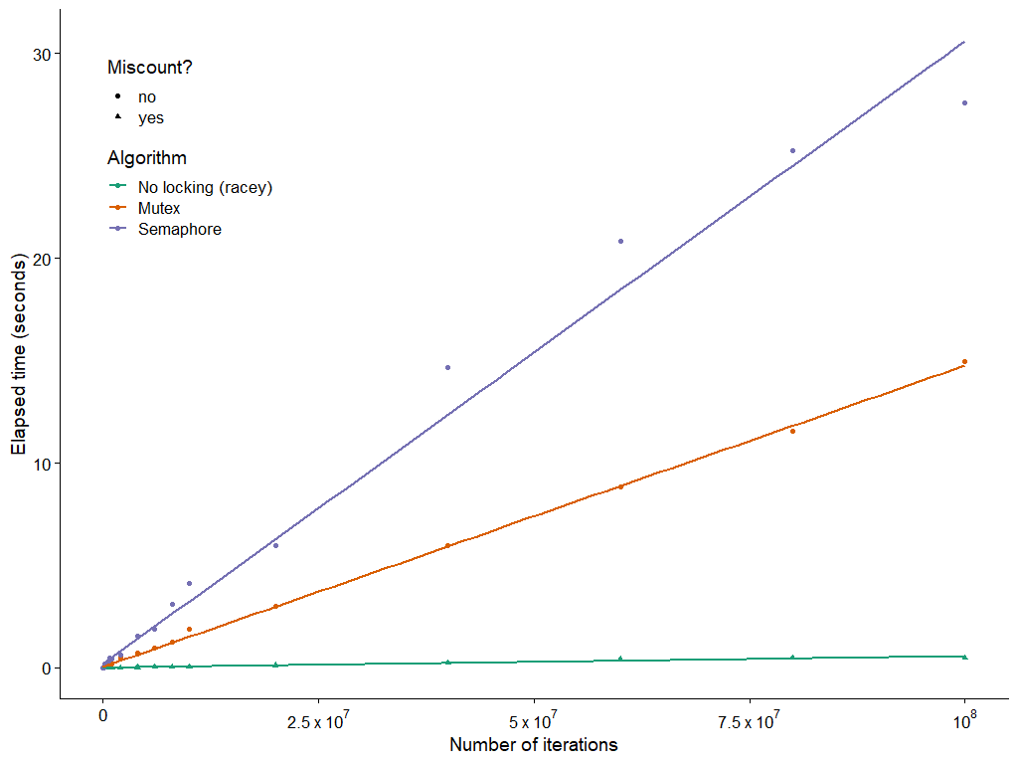
The cost of semaphores
27.6 s
15 s
0.48 s
Notes:
Oh no, it’s even slower with a semaphore.

Slide 45
Today
Threads review
Sharing and Data Races
Fixing Data Races
Mutexes
Semaphores
Atomic memory operations

Slide 46
Atomic memory operations
Special hardware instructions
“Test and set,” “compare and swap”, “exchange and add”, …
Do a read-modify-write on memory; hardware prevents data races
Used to implement mutexes, semaphores, etc.
Not going to get into details, but…
Wouldn’t it be nice if we could use them directly?
Especially when we just want to increment a counter?
static _Atomic unsigned long cnt = 0;
void *incr_thread(void *arg) { unsigned long i; unsigned long niters = (unsigned long) arg;
for (i = 0; i < niters; i++) {
cnt++;
} }
Coding demo 4: Counting to 20,000 correctly (with threads and C2011 atomics)

Slide 47
Assembly Code for Counter Loop
C code
for (i = 0; i < niters; i++)
cnt++;
Assembly (unsigned long)
Assembly (_Atomic unsigned long)
movq (%rdi), %rcx
testq %rcx,%rcx
jle .L2
movl $0, %eax
.L3:
movq cnt(%rip),%rdx
addq $1, %rdx
movq %rdx, cnt(%rip)
addq $1, %rax
cmpq %rcx, %rax
jne .L3
.L2:
movq (%rdi), %rcx
testq %rcx,%rcx
jle .L2
movl $0, %eax
.L3:
lock addq $1, cnt(%rip)
addq $1, %rax
cmpq %rcx, %rax
jne .L3
.L2:
Notes:
The three instructions that were so troublesome are replaced with a single instruction that does the same thing, but the hardware promises no data races. Each thread’s lock addq waits for the other thread’s lock addq, as part of the process of accessing the cache.
X86 has lots of atomic memory operations. Other ISAs are not so generous. Traditional RISC would make you write a loop with two special memory access instructions plus the ADD.

Slide 48
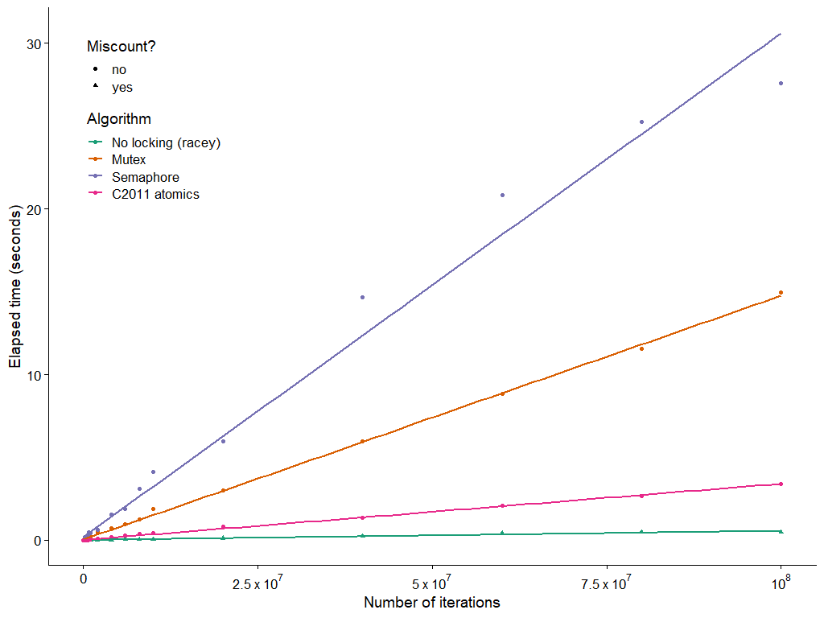
The cost of atomic memory operations
27.6 s
15 s
3.41 s
0.48 s

Slide 49
Summary
Access shared variables with care to avoid data races.
Crucial to understand which variables are shared in the first place
Avoid sharing, if you can
Avoid writing from multiple threads, if you can
Mutexes help, but…
They’re slow
(Next time: They can cause problems as well as solve them)
Don’t use a semaphore when a mutex will do
They’re even slower
(Next time: When is a semaphore actually useful?)
Atomic memory ops are handy, but…
The hardware might not provide the operation you need
(Later courses: Tricky to use correctly)

