Slide 1
Thread-Level Parallelism 15-213/15-513: Introduction to Computer Systems 26th Lecture, July 28, 2023
Instructors:
Brian Railing

Slide 2
Logistics
Proxy final due Friday August 11 at 11:59pm
NO late submissions
No extensions except for exceptional circumstances
Final Exam
Final will be on Thursday, August 10 at 1-4pm
Unless 8/26 at 1-4pm
Unless 12/? at ?
Exam is on Gradescope. Bring a laptop to do the exam.
You can bring two 8.5”x11” / A4 cheat sheets, written or printed

Slide 3
Disclaimer
We do not have time to fully cover the following content
Take -346, -410, -418 …
Valuable to know as you start writing parallel programs
More practice through SFSLab (see appendix)

Slide 4
Today
Parallel Computing Hardware
Multicore
Multiple separate processors on single chip
Hyperthreading
Efficient execution of multiple threads on single core
Consistency Models
What happens when multiple threads are reading & writing shared state
Thread-Level Parallelism
Splitting program into independent tasks
Example: Parallel summation
Examine some performance artifacts
Divide-and conquer parallelism
Example: Parallel quicksort

Slide 5
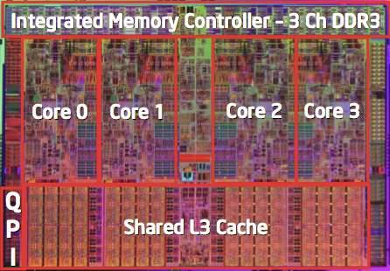
Typical Multicore Processor
Core 0
Core n-1
Regs
Regs
L1
d-cache
L1
i-cache
…
L1
d-cache
L1
i-cache
L2 unified cache
L2 unified cache
L3 unified cache
(shared by all cores)
Main memory
Multiple processors operating with coherent view of memory

Slide 6
Out-of-Order Processor Structure
Instruction Control
Instruction
Cache
Instruction Decoder
Registers
Op. Queue
PC
Functional Units
Data Cache
Int
Arith
Int
Arith
FP
Arith
Load /
Store
Instruction control dynamically converts program into stream of operations
Operations mapped onto functional units to execute in parallel

Slide 7
Hyperthreading Implementation
Instruction Control
Instruction
Cache
Instruction Decoder
Reg A
Op. Queue A
Reg B
Op. Queue B
PC A
PC B
Functional Units
Data Cache
Int
Arith
Int
Arith
FP
Arith
Load /
Store
Replicate instruction control to process K instruction streams
K copies of all registers
Share functional units

Slide 8
Benchmark Machine
Get data about machine from /proc/cpuinfo
Shark Machines
Intel Xeon E5520 @ 2.27 GHz
Nehalem, ca. 2010
8 Cores
Each can do 2x hyperthreading

Slide 9
Exploiting parallel execution
So far, we’ve used threads to deal with I/O delays
e.g., one thread per client to prevent one from delaying another
Multi-core CPUs offer another opportunity
Spread work over threads executing in parallel on N cores
Happens automatically, if many independent tasks
e.g., running many applications or serving many clients
Can also write code to make one big task go faster
by organizing it as multiple parallel sub-tasks
Shark machines can execute 16 threads at once
8 cores, each with 2-way hyperthreading
Theoretical speedup of 16X
never achieved in our benchmarks

Slide 10

Powerful, Parallel Computing Is
Two threads, X and Y initialized to 0
X = 1
if (Y == 0) print Hello
Y = 1
if (X == 0) print World

Slide 11
Memory Coherence / Consistency
int a = 1;
int b = 100;
Thread consistency
constraints
Wa
Rb
Thread1:
Wa: a = 2;
Rb: print(b);
Thread2:
Wb: b = 200;
Ra: print(a);
Wb
Ra
What are the possible values printed?
Depends on memory consistency model
Abstract model of how hardware handles concurrent accesses
How do the two threads really see the writes?

Slide 12
Non-Coherent Cache Scenario
int a = 1;
int b = 100;
Write-back caches, without coordination between them
Thread1:
Wa: a = 2;
Rb: print(b);
Thread2:
Wb: b = 200;
Ra: print(a);
Thread1 Cache
Thread2 Cache
a: 2
b:100
a:1
b:200
print 1
print 100
Main Memory
At later points, a:2 and b:200
are written back to main memory
a:1
b:100

Slide 13
Snoopy Caches
int a = 1;
int b = 100;
Tag each cache block with state
Invalid Cannot use value
Shared Readable copy
Modified Writeable copy
Thread1:
Wa: a = 2;
Rb: print(b);
Thread2:
Wb: b = 200;
Ra: print(a);
Thread1 Cache
Thread2 Cache
M
a: 2
M
b:200
Main Memory
a:1
b:100

Slide 14
Snoopy Caches
int a = 1;
int b = 100;
Tag each cache block with state
Invalid Cannot use value
Shared Readable copy
Modified Writeable copy
Thread1:
Wa: a = 2;
Rb: print(b);
Thread2:
Wb: b = 200;
Ra: print(a);
Thread1 Cache
Thread2 Cache
M
S
a: 2
a: 2
S
a:2
print 2
S
b:200
M
S
b:200
b:200
print 200
Main Memory
When cache sees request for one of its M-tagged blocks
Supply value from cache (Note: value in memory may be stale)
Set tag to S
a:1
b:100

Slide 15
Memory Consistency
int a = 1;
int b = 100;
Thread consistency
constraints
Wa
Rb
Thread1:
Wa: a = 2;
Rb: print(b);
Thread2:
Wb: b = 200;
Ra: print(a);
Wb
Ra
What are the possible values printed?
Depends on memory consistency model
Abstract model of how hardware handles concurrent accesses

Slide 16
Memory Consistency
int a = 1;
int b = 100;
Thread consistency
constraints
Wa
Rb
Thread1:
Wa: a = 2;
Rb: print(b);
Thread2:
Wb: b = 200;
Ra: print(a);
Wb
Ra
What are the possible values printed?
Depends on memory consistency model
Abstract model of how hardware handles concurrent accesses
Sequential consistency
As if only one operation at a time, in an order consistent with the order of operations within each thread
Thus, overall effect consistent with each individual thread but otherwise allows an arbitrary interleaving

Slide 17
Sequential Consistency Example
Thread consistency
constraints
int a = 1;
int b = 100;
Wa
Rb
Thread1:
Wa: a = 2;
Rb: print(b);
Thread2:
Wb: b = 200;
Ra: print(a);
Wb
Ra
Rb
Wb
Ra
100, 2
Wa
Rb
Ra
200, 2
Wb
Ra
Rb
2, 200
Ra
Wa
Rb
1, 200
Wb
Ra
Rb
2, 200
Wa
Rb
Ra
200, 2
Impossible outputs
100, 1 and 1, 100
Would require reaching both Ra and Rb before either Wa or Wb

Slide 18
Non-Coherent Cache Scenario
int a = 1;
int b = 100;
Write-back caches, without coordination between them
Thread1:
Wa: a = 2;
Rb: print(b);
Thread2:
Wb: b = 200;
Ra: print(a);
Thread1 Cache
Thread2 Cache
a: 2
b:100
a:1
b:200
print 1
print 100
Main Memory
Sequentially consistent?
No!
a:1
b:100

Slide 19
Non-Sequentially Consistent Scenario
Coherent caches, but thread consistency constraints violated due to operation reordering
int a = 1;
int b = 100;
Thread1:
Wa: a = 2;
Rb: print(b);
Thread2:
Wb: b = 200;
Ra: print(a);
a:2
b:200
3
4
2
1
Thread1 Cache
Thread2 Cache
b:100
a:1
print 1
print 100
Main Memory
a:1
b:100
Architecture lets reads finish before writes because single thread accesses different memory locations
Notes:
Note: OoO execution is actually not the cause of this (on x86 and often elsewhere) it is compiler reordering or buffering in the memory system post-retirement.

Slide 20
Non-Sequentially Consistent Scenario
int a = 1;
int b = 100;
Thread1 Write Buffer
Thread2 Write Buffer
a:2
b:200
Thread1:
Wa: a = 2;
Rb: print(b);
Thread2:
Wb: b = 200;
Ra: print(a);
Thread1 Cache
Thread2 Cache
3
4
2
1
b:100
a:1
Why Reordered? Writes take long time. Buffer write, let read go ahead. Instruction-level parallelism
Main Memory
a:1
b:100
Fix: Add SFENCE instructions between Wa & Rb and Wb & Ra
Fix: Use synchronization (properly written, it fences)
Notes:
Note: OoO execution is actually not the cause of this (on x86 and often elsewhere) it is compiler reordering or buffering in the memory system post-retirement.

Slide 21
Memory Models
Sequentially Consistent:
Each thread executes in proper order, any interleaving
To ensure, requires
Proper cache/memory behavior
Proper intra-thread ordering constraints
Thread ordering constraints
Use synchronization to ensure the program is free of data races

Slide 22
Today
Parallel Computing Hardware
Multicore
Multiple separate processors on single chip
Hyperthreading
Efficient execution of multiple threads on single core
Consistency Models
What happens when multiple threads are reading & writing shared state
Thread-Level Parallelism
Splitting program into independent tasks
Example: Parallel summation
Examine some performance artifacts
Divide-and conquer parallelism
Example: Parallel quicksort

Slide 23
Summation Example
Sum numbers 0, …, N-1
Should add up to (N-1)*N/2
Partition into K ranges
⎣N/K⎦ values each
Each of the t threads processes 1 range
Accumulate leftover values serially
Method #1: All threads update single global variable
1A: No synchronization
1B: Synchronize with pthread semaphore
1C: Synchronize with pthread mutex
“Binary” semaphore. Only values 0 & 1

Slide 24
Accumulating in Single Global Variable: Declarations
typedef unsigned long data_t;
/* Single accumulator */
volatile data_t global_sum;
/* Mutex & semaphore for global sum */
sem_t semaphore;
pthread_mutex_t mutex;
/* Number of elements summed by each thread */
size_t nelems_per_thread;
/* Keep track of thread IDs */
pthread_t tid[MAXTHREADS];
/* Identify each thread */
int myid[MAXTHREADS];

Slide 25
Accumulating in Single Global Variable: Declarations
typedef unsigned long data_t;
/* Single accumulator */
volatile data_t global_sum;
/* Mutex & semaphore for global sum */
sem_t semaphore;
pthread_mutex_t mutex;
/* Number of elements summed by each thread */
size_t nelems_per_thread;
/* Keep track of thread IDs */
pthread_t tid[MAXTHREADS];
/* Identify each thread */
int myid[MAXTHREADS];

Slide 26
Accumulating in Single Global Variable: Declarations
typedef unsigned long data_t;
/* Single accumulator */
volatile data_t global_sum;
/* Mutex & semaphore for global sum */
sem_t semaphore;
pthread_mutex_t mutex;
/* Number of elements summed by each thread */
size_t nelems_per_thread;
/* Keep track of thread IDs */
pthread_t tid[MAXTHREADS];
/* Identify each thread */
int myid[MAXTHREADS];

Slide 27
Accumulating in Single Global Variable: Operation
nelems_per_thread = nelems / nthreads;
/* Set global value */
global_sum = 0;
/* Create threads and wait for them to finish */
for (i = 0; i < nthreads; i++) {
myid[i] = i;
Pthread_create(&tid[i], NULL, thread_fun, &myid[i]);
}
for (i = 0; i < nthreads; i++)
Pthread_join(tid[i], NULL);
result = global_sum;
/* Add leftover elements */
for (e = nthreads * nelems_per_thread; e < nelems; e++)
result += e;
Thread ID
Thread routine
Thread arguments
(void *p)

Slide 28
Thread Function: No Synchronization
void *sum_race(void *vargp)
{
int myid = *((int *)vargp);
size_t start = myid * nelems_per_thread;
size_t end = start + nelems_per_thread;
size_t i;
for (i = start; i < end; i++) {
global_sum += i;
}
return NULL;
}

Slide 29
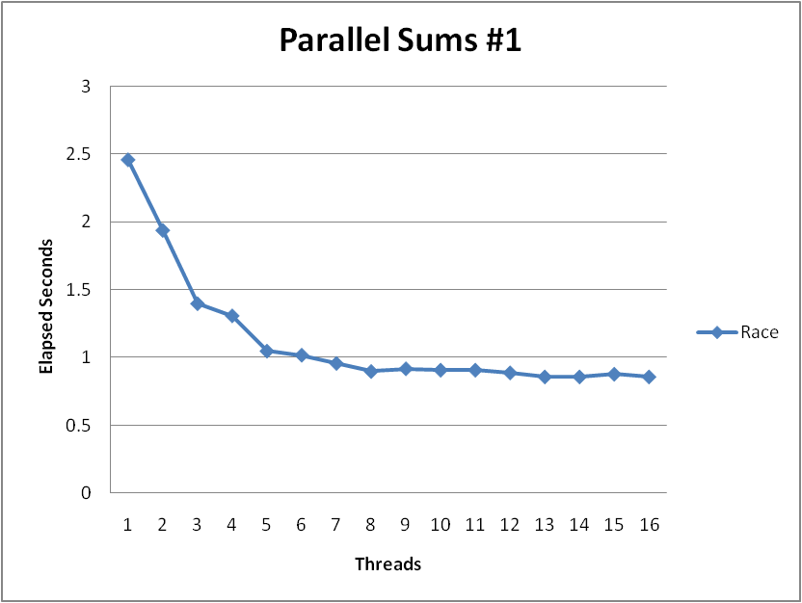
Unsynchronized Performance
N = 2³⁰
Best speedup = 2.86X
Gets wrong answer when > 1 thread!
Why?

Slide 30
Thread Function: Semaphore / Mutex
Semaphore
void *sum_sem(void *vargp)
{
int myid = *((int *)vargp);
size_t start = myid * nelems_per_thread;
size_t end = start + nelems_per_thread;
size_t i;
for (i = start; i < end; i++) {
sem_wait(&semaphore);
global_sum += i;
sem_post(&semaphore);
}
return NULL;
}
sem_wait(&semaphore);
global_sum += i;
sem_post(&semaphore);
Mutex
pthread_mutex_lock(&mutex);
global_sum += i;
pthread_mutex_unlock(&mutex);

Slide 31
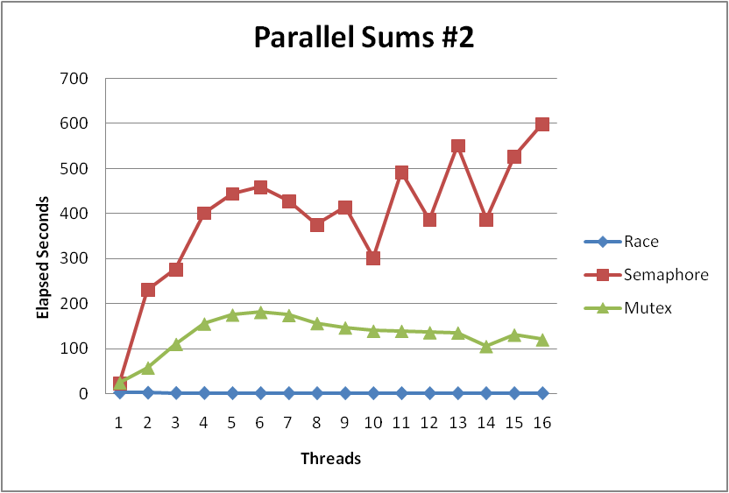
Semaphore / Mutex Performance
What is main reason for poor performance?
Terrible Performance
2.5 seconds ➔ ~10 minutes
Mutex 3X faster than semaphore
Clearly, neither is successful

Slide 32
Separate Accumulation
Method #2: Each thread accumulates into separate variable
2A: Accumulate in contiguous array elements
2B: Accumulate in spaced-apart array elements
2C: Accumulate in registers
/* Partial sum computed by each thread */
data_t psum[MAXTHREADS*MAXSPACING];
/* Spacing between accumulators */
size_t spacing = 1;

Slide 33
Separate Accumulation: Operation
nelems_per_thread = nelems / nthreads;
/* Create threads and wait for them to finish */
for (i = 0; i < nthreads; i++) {
myid[i] = i;
psum[i*spacing] = 0;
Pthread_create(&tid[i], NULL, thread_fun, &myid[i]);
}
for (i = 0; i < nthreads; i++)
Pthread_join(tid[i], NULL);
result = 0;
/* Add up the partial sums computed by each thread */
for (i = 0; i < nthreads; i++)
result += psum[i*spacing];
/* Add leftover elements */
for (e = nthreads * nelems_per_thread; e < nelems; e++)
result += e;

Slide 34
Thread Function: Memory Accumulation
Where is the mutex?
void *sum_global(void *vargp)
{
int myid = *((int *)vargp);
size_t start = myid * nelems_per_thread;
size_t end = start + nelems_per_thread;
size_t i;
size_t index = myid*spacing;
psum[index] = 0;
for (i = start; i < end; i++) {
psum[index] += i;
}
return NULL;
}

Slide 35
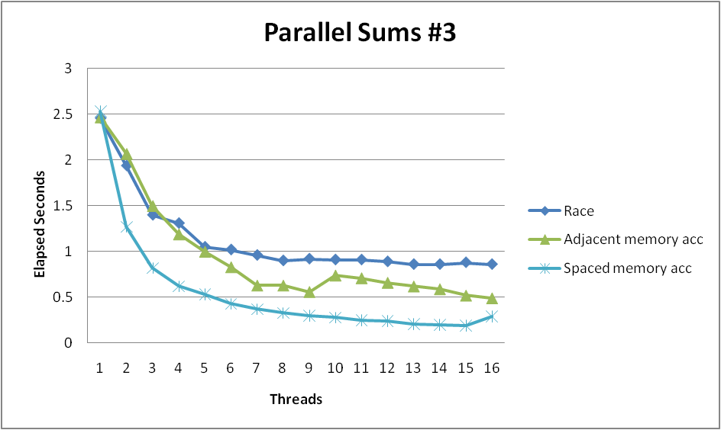
Memory Accumulation Performance
Clear threading advantage
Adjacent speedup: 5 X
Spaced-apart speedup: 13.3 X (Only observed speedup > 8)
Why does spacing the accumulators apart matter?

Slide 36
False Sharing
0
7
8
15
psum
…
…
Cache Block m
Cache Block m+1
Coherence maintained on cache blocks
To update psum[i], thread i must have exclusive access
Threads sharing common cache block will keep fighting each other for access to block

Slide 37
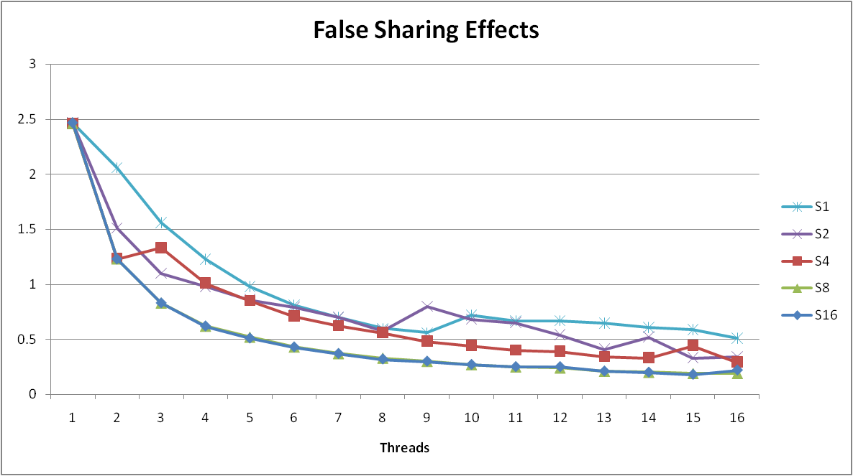
False Sharing Performance
Best spaced-apart performance 2.8 X better than best adjacent
Demonstrates cache block size = 64
8-byte values
No benefit increasing spacing beyond 8

Slide 38
Thread Function: Register Accumulation
void *sum_local(void *vargp)
{
int myid = *((int *)vargp);
size_t start = myid * nelems_per_thread;
size_t end = start + nelems_per_thread;
size_t i;
size_t index = myid*spacing;
data_t sum = 0;
for (i = start; i < end; i++) {
sum += i;
}
psum[index] = sum;
return NULL;
}

Slide 39
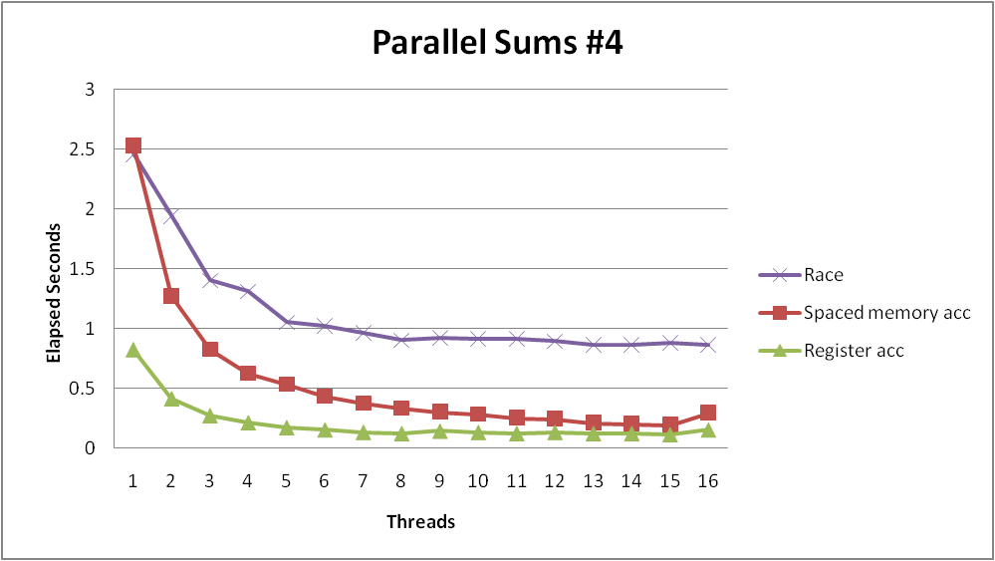
Register Accumulation Performance
Clear threading advantage
Speedup = 7.5 X
2X better than fastest memory accumulation
Beware the speedup metric!
Notes:
Speedup *over what*?

Slide 40
Lessons learned
Sharing memory can be expensive
Pay attention to true sharing
Pay attention to false sharing
Use registers whenever possible
(Remember cachelab)
Use local cache whenever possible
Deal with leftovers
When examining performance, compare to best possible sequential implementation

Slide 41
A More Substantial Example: Sort
Sort set of N random numbers
Multiple possible algorithms
Use parallel version of quicksort
Sequential quicksort of set of values X
Choose “pivot” p from X
Rearrange X into
L: Values ≤ p
R: Values ≥ p
Recursively sort L to get L′
Recursively sort R to get R′
Return L′ : p : R′

Slide 42
Sequential Quicksort Visualized
X
p
L
p
R
p2
L2
p2
R2
•
•
•
L′

Slide 43
Sequential Quicksort Visualized
X
L′
p
R
p3
L3
p3
R3
•
•
•
R′
L′
p
R′

Slide 44
Sequential Quicksort Code
void qsort_serial(data_t *base, size_t nele) {
if (nele <= 1)
return;
if (nele == 2) {
if (base[0] > base[1])
swap(base, base+1);
return;
}
/* Partition returns index of pivot */
size_t m = partition(base, nele);
if (m > 1)
qsort_serial(base, m);
if (nele-1 > m+1)
qsort_serial(base+m+1, nele-m-1);
}
Sort nele elements starting at base
Recursively sort L or R if has more than one element

Slide 45
Parallel Quicksort
Parallel quicksort of set of values X
If N ≤ Nthresh, do sequential quicksort
Else
Choose “pivot” p from X
Rearrange X into
L: Values ≤ p
R: Values ≥ p
Recursively spawn separate threads
Sort L to get L′
Sort R to get R′
Return L′ : p : R′

Slide 46
Parallel Quicksort Visualized
X
p
L
p
R
p2
p3
L2
p2
R2
p
L3
p3
R3
•
•
•
•
•
•
L′
p
R′

Slide 47
Thread Structure: Sorting Tasks
X
• • •
Task Threads
Task: Sort subrange of data
Specify as:
base: Starting address
nele: Number of elements in subrange
Run as separate thread

Slide 48
Small Sort Task Operation
X
• • •
Task Threads
Sort subrange using serial quicksort

Slide 49
Large Sort Task Operation
X
L
p
R
Partition Subrange
• • •
X
L
p
R
Spawn 2 tasks
• • •

Slide 50
Top-Level Function (Simplified)
void tqsort(data_t *base, size_t nele) {
init_task(nele);
global_base = base;
global_end = global_base + nele - 1;
task_queue_ptr tq = new_task_queue();
tqsort_helper(base, nele, tq);
join_tasks(tq);
free_task_queue(tq);
}
Sets up data structures
Calls recursive sort routine
Keeps joining threads until none left
Frees data structures

Slide 51
Recursive sort routine (Simplified)
/* Multi-threaded quicksort */
static void tqsort_helper(data_t *base, size_t nele,
task_queue_ptr tq) {
if (nele <= nele_max_sort_serial) {
/* Use sequential sort */
qsort_serial(base, nele);
return;
}
sort_task_t *t = new_task(base, nele, tq);
spawn_task(tq, sort_thread, (void *) t);
}
Small partition: Sort serially
Large partition: Spawn new sort task

Slide 52
Sort task thread (Simplified)
/* Thread routine for many-threaded quicksort */
static void *sort_thread(void *vargp) {
sort_task_t *t = (sort_task_t *) vargp;
data_t *base = t->base;
size_t nele = t->nele;
task_queue_ptr tq = t->tq;
free(vargp);
size_t m = partition(base, nele);
if (m > 1)
tqsort_helper(base, m, tq);
if (nele-1 > m+1)
tqsort_helper(base+m+1, nele-m-1, tq);
return NULL;
}
Get task parameters
Perform partitioning step
Call recursive sort routine on each partition (if size of part > 1)

Slide 53
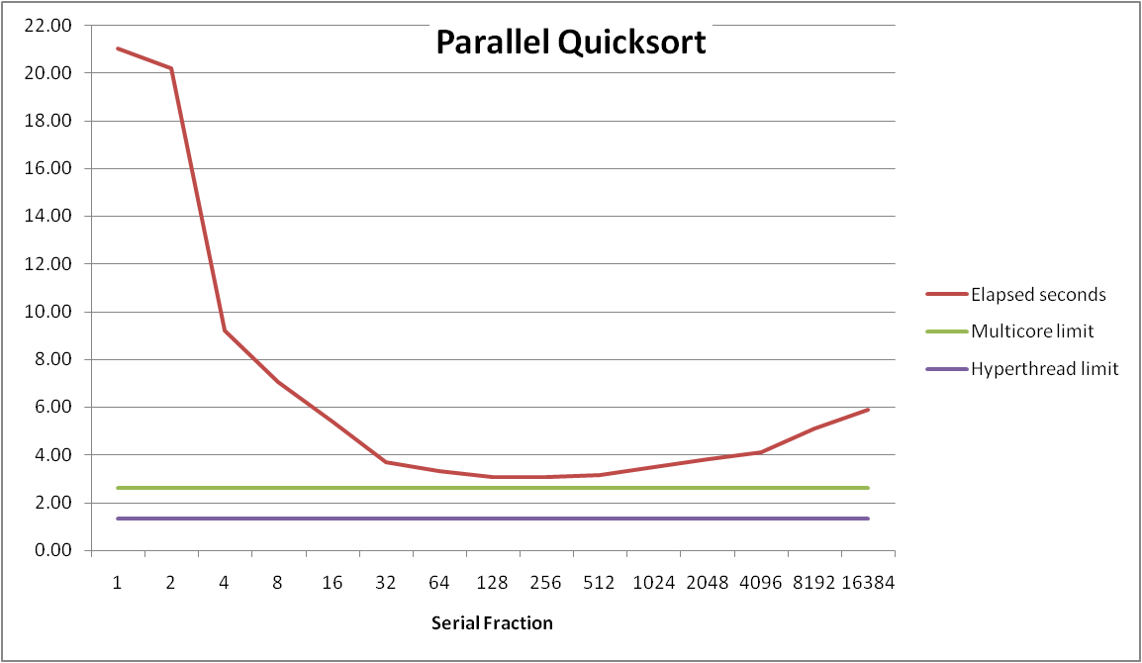
Parallel Quicksort Performance
Serial fraction: Fraction of input at which do serial sort
Sort 2²⁷ (134,217,728) random values
Best speedup = 6.84X

Slide 54
Parallel Quicksort Performance
Good performance over wide range of fraction values
F too small: Not enough parallelism
F too large: Thread overhead too high

Slide 55
Amdahl’s Law (Travel Analogy)
Speed-Up
Flying jet non-stop from PIT -> LHR: 7.5 Hours 1
Or, old fashioned SST way:
Fly jet from PIT -> JFK: 1.5 Hours
Fly SST from JFK -> LHR: 3.5 Hours 5 Hours 1.5x
Or, Using FTL:
Fly jet from PIT -> JFK: 1.5 Hours
Fly FTL from JFK -> LHR: .01 Hours 1.51 Hours ~5x
Best possible speed up is 5X, even with FTL because have to get to New York.

Slide 56
Amdahl’s Law
Overall problem
T Total sequential time required
p Fraction of total that can be sped up (0 ≤ p ≤ 1)
k Speedup factor
Resulting Performance
T_{k} = pT/k + (1-p)T
Portion which can be sped up runs k times faster
Portion which cannot be sped up stays the same
Maximum possible speedup
k = ∞
T∞ = (1-p)T

Slide 57
Amdahl’s Law (Travel Analogy)
Speed-Up
Flying jet non-stop from PIT -> LHR: 7.5 Hours 1
Or, old fashioned SST way:
Fly jet from PIT -> JFK: 1.5 Hours
Fly SST from JFK -> LHR: 3.5 Hours 5 Hours 1.5x
Or, Using FTL:
Fly jet from PIT -> JFK: 1.5 Hours
Fly FTL from JFK -> LHR: .01 Hours 1.51 Hours ~5x
Best possible speed up is 5X, even with FTL because have to get to New York.
T=7.5, p=6/7.5=.8, k= ∞ ⇒ T∞ = (1-p)T=1.5 max speed-up =5x

Slide 58
Amdahl’s Law Example
Overall problem
T = 10 Total time required
p = 0.9 Fraction of total which can be sped up
k = 9 Speedup factor
Resulting Performance
T₉ = 0.9 * 10/9 + 0.1 * 10 = 1.0 + 1.0 = 2.0 (a 5x speedup)
Maximum possible speedup
T∞ = 0.1 * 10.0 = 1.0 (a 10x speedup)
With infinite parallel computing resources!
Limit speedup shows algorithmic limitation

Slide 59
Amdahl’s Law & Parallel Quicksort
Sequential bottleneck
Top-level partition: No speedup
Second level: ≤ 2X speedup
k^{th} level: ≤ 2^{k-1}X speedup
Implications
Good performance for small-scale parallelism
Would need to parallelize partitioning step to get large-scale parallelism
Parallel Sorting by Regular Sampling
H. Shi & J. Schaeffer, J. Parallel & Distributed Computing, 1992

Slide 60
Lessons Learned
Must have parallelization strategy
Partition into K independent parts
Divide-and-conquer
Inner loops must be synchronization free
Synchronization operations very expensive
Watch out for hardware artifacts
Need to understand processor & memory structure
Sharing and false sharing of global data
Beware of Amdahl’s Law
Serial code can become bottleneck
You can do it!
Achieving modest levels of parallelism is not difficult
Set up experimental framework and test multiple strategies

Slide 61
Appendix: SFS Lab - Experimental
Parallelism: Key idea in modern computing
Make the computer do more than one thing at the same time
Many tricky details
Are we teaching it as effectively as we could be?
Shell lab, Proxy lab – some parallelism involved, but mostly about other things
Course staff have been developing a new lab
It’s not done, but we think we’d like to show it to you anyway
[?] Only for 213 students (to keep things small scale)

Slide 62

Shark File System
Requin wants somewhere to store all of his files!
…so, he wrote a file system.
Problem: He has multiple programs, all sharing the file system
How can he make sure that his file system is safe/correct?
How can he make it faster?
Multithreading!
Requin hard at work.

Slide 63
SFS Lab
Make Requin’s file system concurrent
Able to handle concurrent accesses safely
->able to look at separate files simultaneously
-> further concurrency improvements?
Lab handout will be available via Autolab and GitHub Classroom
The same way you have done all labs since cache
NOT FOR CREDIT (Just for fun)
We will not judge you if you turn in something incomplete
We appreciate any and all submissions!
Might be good practice for the exam…
More detail on Tuesday

