Slide 1
An Improved Machine Learning-driven Patient's Sickness or Health Status Prediction System
Submitted in the partial fulfillment for the award of the degree of
BACHELOR OF ENGINEERING
IN
Artificial Intelligence and Machine Learning
Submitted by:
Kunal (20BCS6278)
Hitesh Kumar (20BCS6157)
Shreya Jadon (20BCS6769)
Under the Supervision of:
Mr.Siddharth Kumar
Department of AIT-CSE
DISCOVER . LEARN . EMPOWER

Slide 2
Outline
Introduction to Project
Problem Formulation
Objectives of the work
Methodology used
Results and Outputs
Conclusion
Future Scope
References

Slide 3
Introduction to Project:-
The goal of this project is to develop an improved machine learning-driven system for predicting a patient's sickness or health status. The system will use various data sources such as medical records, lifestyle data, genetic information, and demographic information to make accurate predictions about a patient's health.
The system will be designed to address several key challenges that exist in current health prediction systems. One of the primary challenges is the lack of comprehensive data on patients. Often, health prediction systems only use a limited set of data, which can result in inaccurate predictions. The proposed system will use a wide range of data sources to ensure that predictions are as accurate as possible.

Slide 4
Another challenge is the lack of transparency in health prediction systems. Patients and healthcare providers often do not understand how the prediction algorithms work, which can lead to distrust and confusion. The proposed system will use transparent algorithms that are easy to understand, providing patients and healthcare providers with greater confidence in the system's predictions.
The system will also incorporate feedback from healthcare providers to improve the accuracy of predictions over time. As patients receive treatment and their health status changes, the system will update its predictions based on this new data. This will ensure that the system remains accurate and up-to-date, providing patients with the most useful and relevant information possible.
Overall, the improved machine learning-driven patient health status prediction system will help healthcare providers make more informed decisions about patient care. By using a wide range of data sources, transparent algorithms, and incorporating feedback from healthcare providers, the system will provide accurate and actionable predictions that can help patients maintain their health and wellbeing.

Slide 5
Problem Formulation:-
The problem formulation for an improved machine learning-driven patient's sickness or health status prediction system involves developing a model that accurately predicts a patient's health status or diagnoses illnesses based on their electronic health records, lab results, medical imaging, and other health-related information. The objective of this project is to improve the accuracy and efficiency of the machine learning-driven system.
To accomplish this objective, advanced machine learning techniques such as deep learning, natural language processing (NLP), and reinforcement learning will be employed. The dataset will be preprocessed and cleaned to remove any errors or inconsistencies. The variables for the model include patient demographics, medical history, medications, lab results, medical imaging, and other health-related information. The evaluation metrics for the model will be based on accuracy, sensitivity, specificity, and precision.

Slide 6
However, privacy concerns regarding patient data and regulatory compliance with healthcare laws and regulations are constraints that need to be addressed in this project. Overall, the problem formulation requires developing a machine learning model that accurately predicts a patient's health status while ensuring compliance with healthcare laws and regulations and respecting patient privacy concerns.

Slide 7
Objectives of the Work :-
Accurately predict a patient's sickness or health status based on their medical history, symptoms, and other relevant data.
Process large amounts of data quickly and efficiently which will help doctors and healthcare professionals make decisions in a timely manner and improve patient care.
Personalize predictions based on individual patient characteristics, such as age, gender, medical history, and lifestyle factors.
Ensure patient data privacy and security throughout the entire process, from data collection to prediction generation, to prevent any unauthorized access or misuse of patient data.

Slide 8
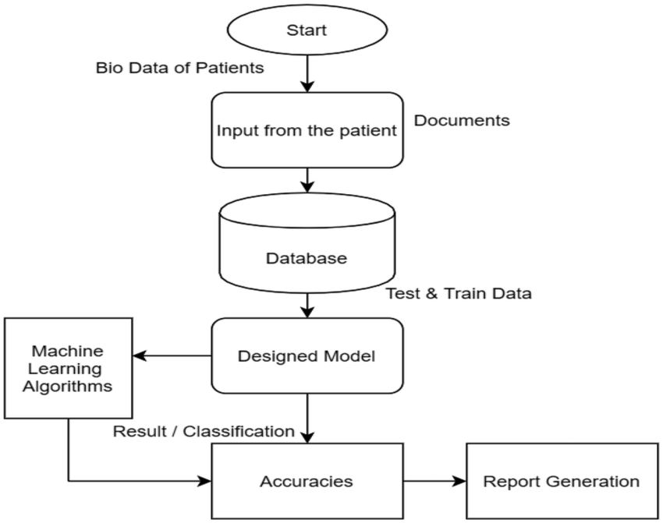
Flowchart:-

Slide 9
Methodology:-
1.Data Collection: Collecting high-quality, representative data is crucial for developing an accurate prediction system. The data can come from various sources, such as electronic health records, medical imaging, wearable devices, and patient self-reports.
2.Data Pre-processing: Raw data collected from different sources may be incomplete, noisy, or inconsistent. Therefore, pre-processing the data to remove outliers, handle missing values, and standardize the format is necessary to ensure the data is suitable for analysis.
3.Feature Selection: Feature selection involves identifying the most relevant variables or features that influence the outcome of the prediction. This step can help improve the accuracy and efficiency of the prediction system.

Slide 10
4.Model Selection: Selecting the most appropriate machine learning model is crucial for the success of the prediction system. Different models, such as decision trees, random forests, logistic regression, and deep learning, may be suitable for different types of data and prediction tasks.
5.Model Training and Evaluation: The selected model needs to be trained on the pre-processed data and evaluated to ensure that it is accurate and robust. This step involves splitting the data into training and testing sets, tuning the model parameters, and assessing its performance metrics, such as accuracy, precision, recall, and F1 score.
6.Deployment and Monitoring: Once the prediction system is developed, it needs to be deployed in a real-world setting and monitored for its performance over time. This step involves ensuring that the prediction system is integrated with the existing clinical workflow, and the predictions generated are useful and reliable for clinical decision-making.

Slide 11
Conclusion:-
Improve the accuracy and speed of predicting patient health outcomes.
Using a combination of different types of data, such as medical records, lifestyle factors, and environmental data, can provide a more comprehensive picture of a patient's health status.
Help healthcare providers make more informed decisions about patient care, leading to better health outcomes and potentially reducing healthcare costs.
A machine learning-driven system can be trained on large datasets to continuously improve its predictions and adapt to new trends and patterns.

Slide 12
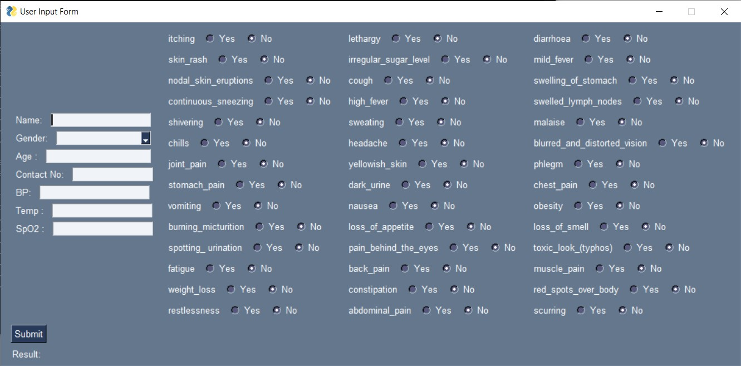
Output

Slide 13
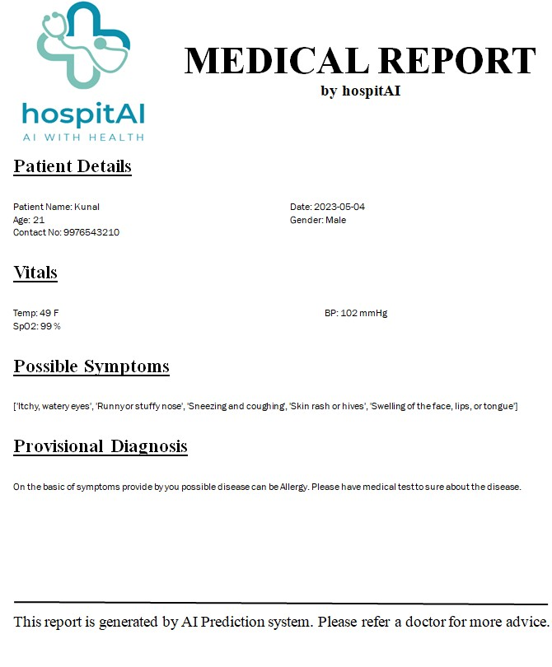
Output

Slide 14
Future Scope:-
Real-time monitoring of patients' vital signs and medical records to detect any potential health risks, such as adverse reactions to medication, before they become serious.
Integration with other healthcare systems, such as electronic medical records, to provide a more comprehensive view of a patient's health status and history.
Identify potential outbreaks or epidemics, enabling healthcare providers and public health officials to take proactive measures to contain them.
Detect potential health risks early, the system could help reduce the cost of care by avoiding expensive hospitalizations and treatments.

Slide 15
References :-
Improving Disease Prediction by Machine Learning by Dinesh Bhagwan Hanchate
Machine-Learning-Based Disease Diagnosis: A Comprehensive Review Md Manjurul Ahsan, Shahana Akter Luna, and Zahed Siddique
Intelligent health risk prediction systems using machine learning: A review Santosh Shinde
Intelligent Health Risk and Disease Prediction Using Optimized Naive Bayes Classifier Latifah Alamer
McPhee S.J., Papadakis M.A., Rabow M.W., editors. Current Medical Diagnosis & Treatment. McGraw-Hill Medical; New York, NY, USA: 2010
Ahsan M.M., Ahad M.T., Soma F.A., Paul S., Chowdhury A., Luna S.A., Yazdan M.M.S., Rahman A., Siddique Z., Huebner P. Detecting SARS-CoV-2 From Chest X-ray Using Artificial Intelligence. IEEE Access. 2021;9:35501–35513. doi: 10.1109/ACCESS.2021.3061621.
Coon E.R., Quinonez R.A., Moyer V.A., Schroeder A.R. Overdiagnosis: How our compulsion for diagnosis may be harming children. Pediatrics. 2014;134:1013–1023. doi: 10.1542/peds.2014-1778.
Balogh E.P., Miller B.T., Ball J.R. Improving Diagnosis in Health Care. National Academic Press; Washington, DC, USA: 20
Artificial intelligence in disease diagnosis: a systematic literature review, synthesizing framework and future research agenda by Yogesh Kumar , Apesksha Koul , Ruchi

