Slide 1

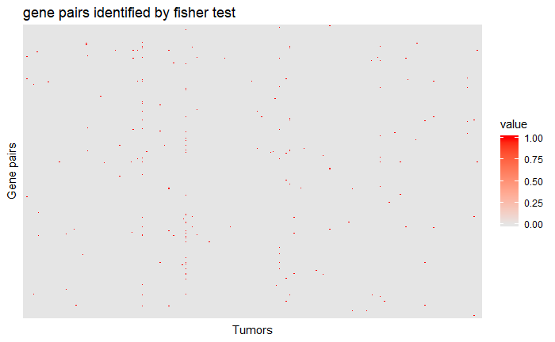

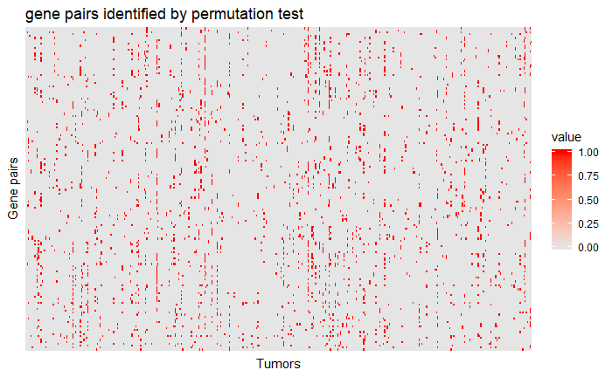
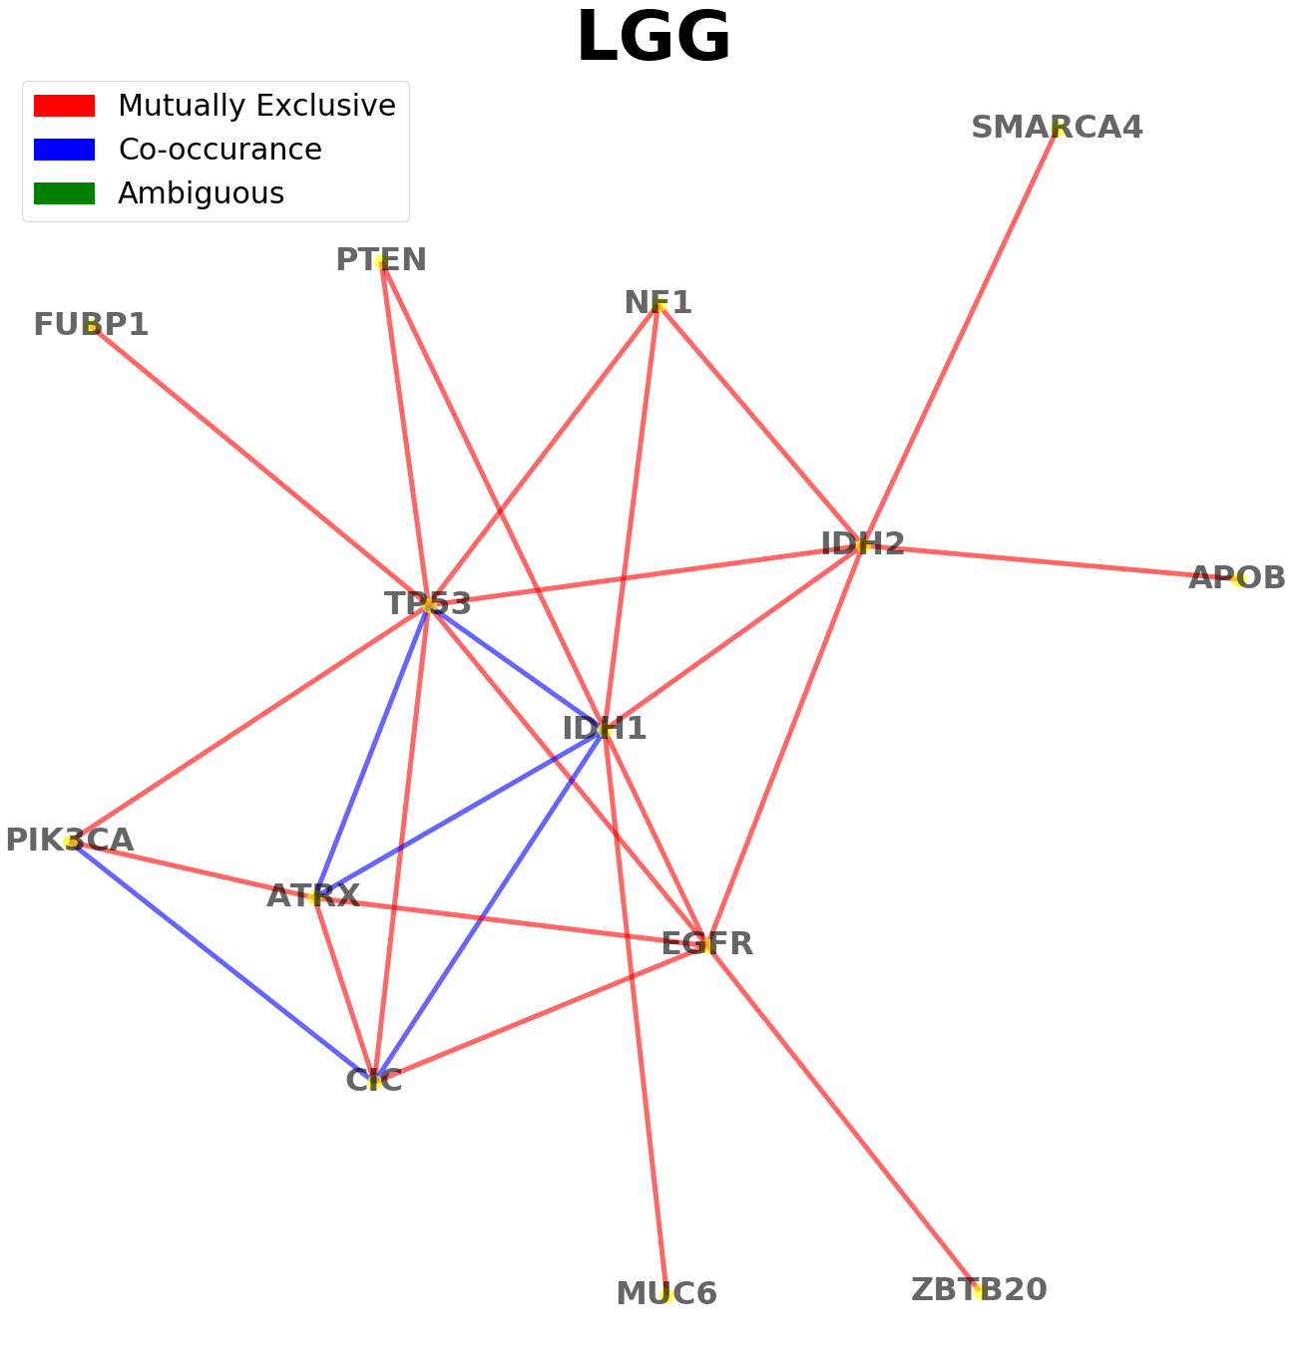
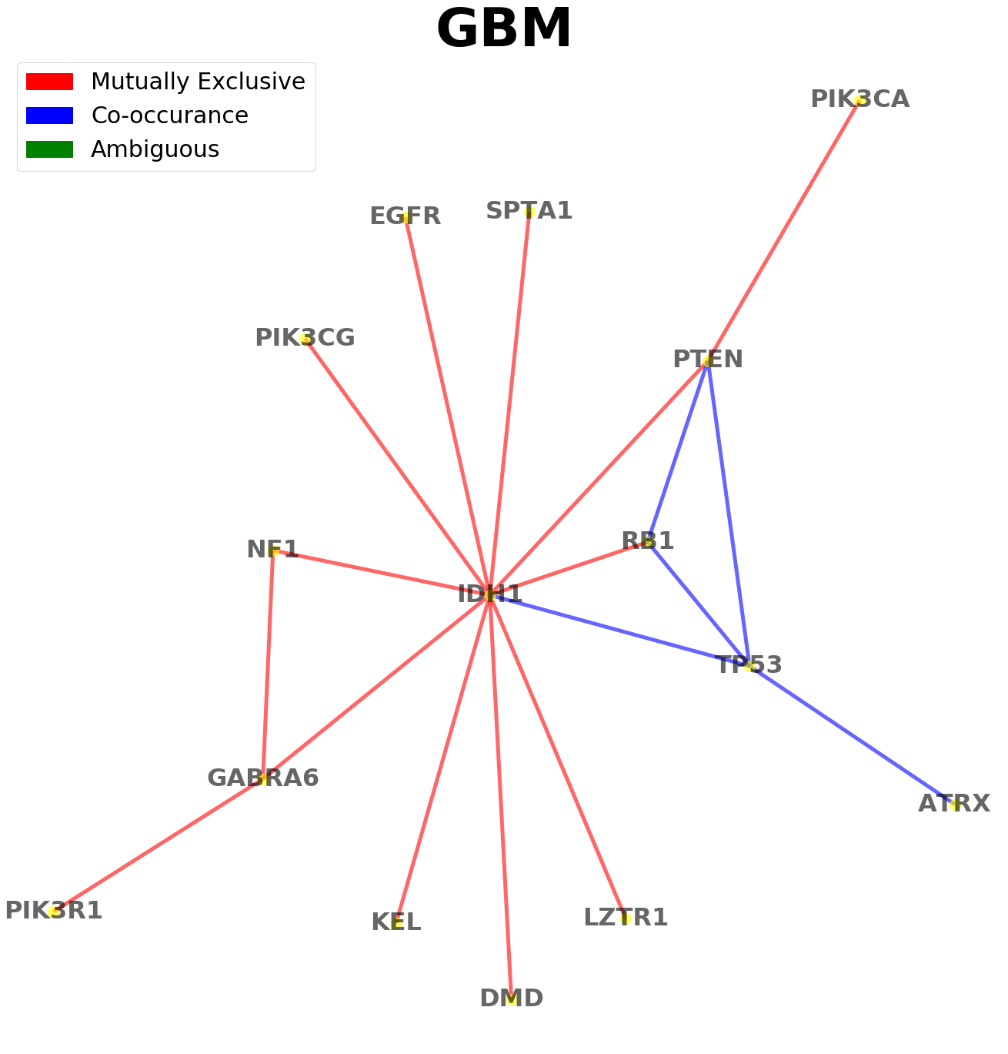
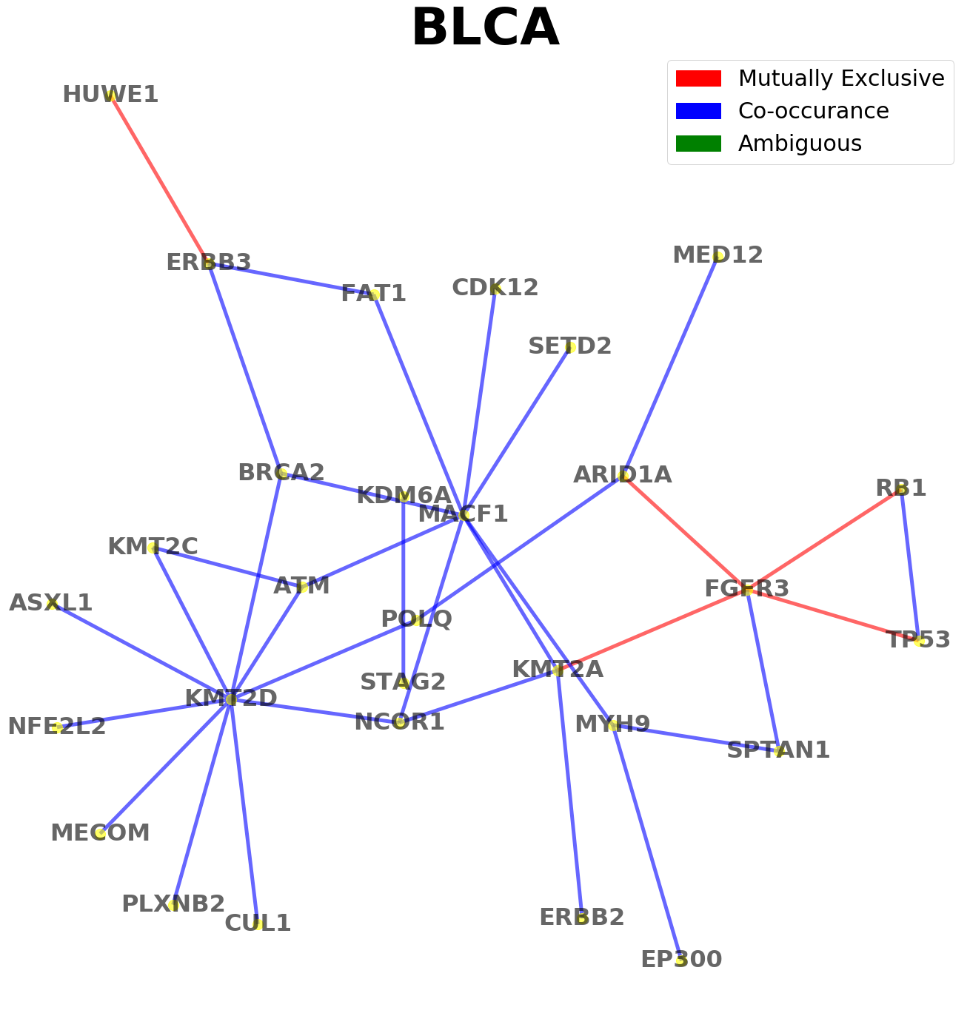
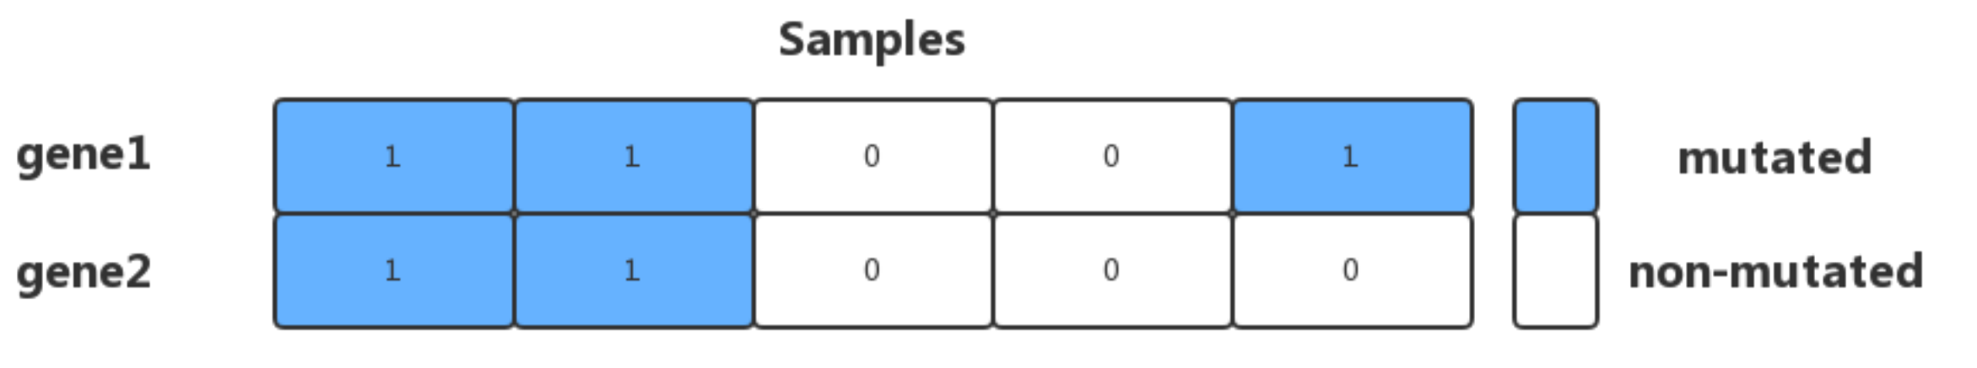
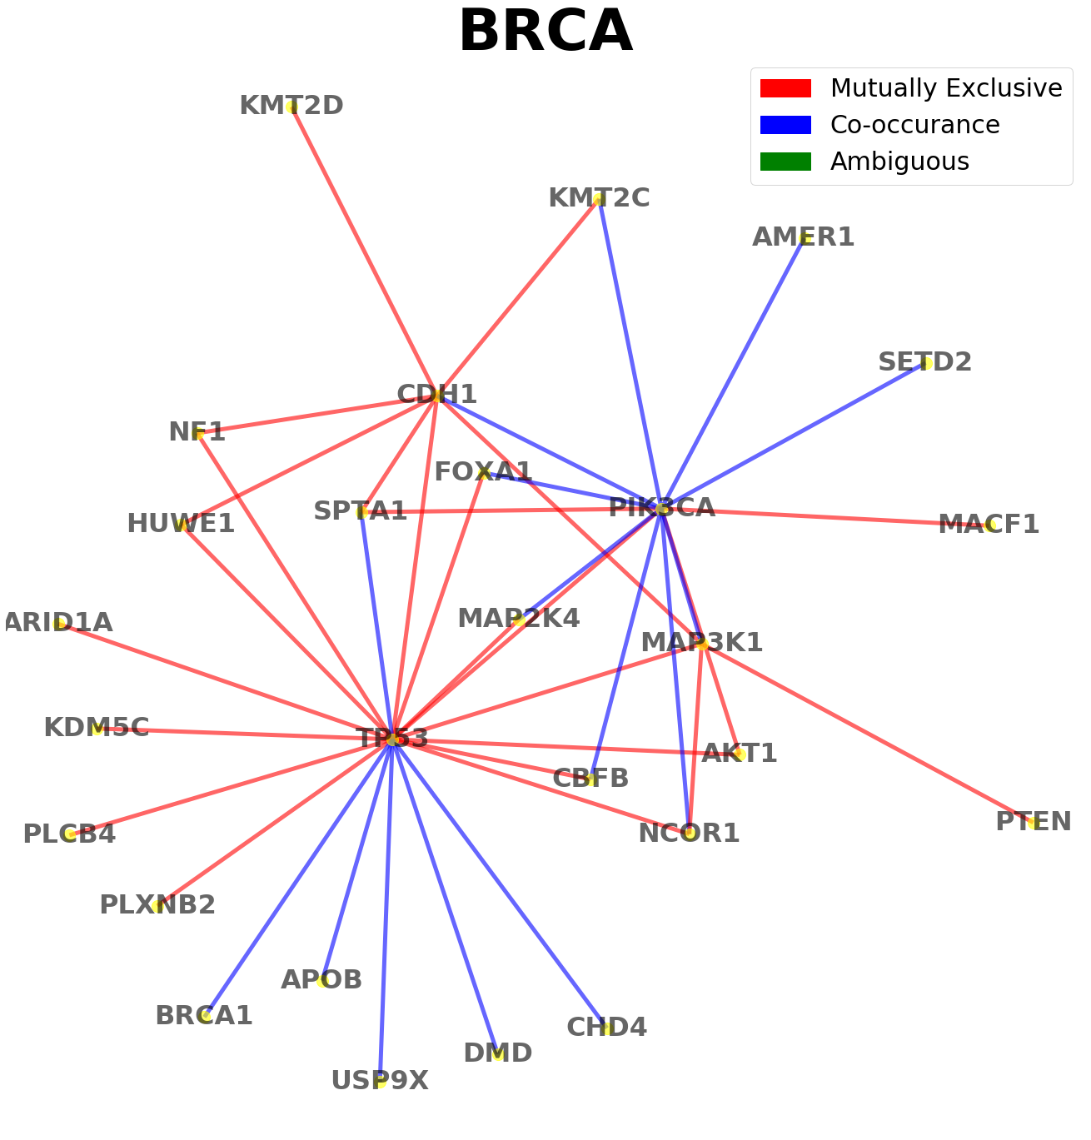
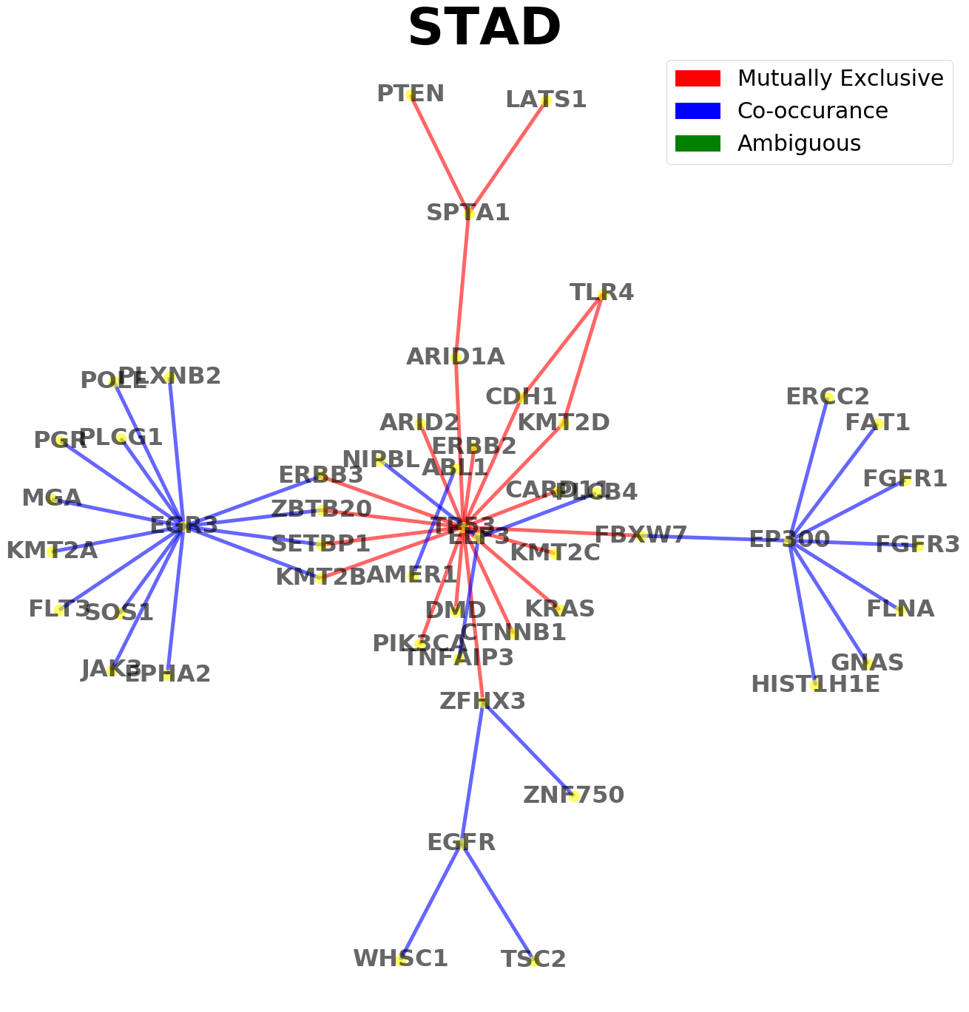
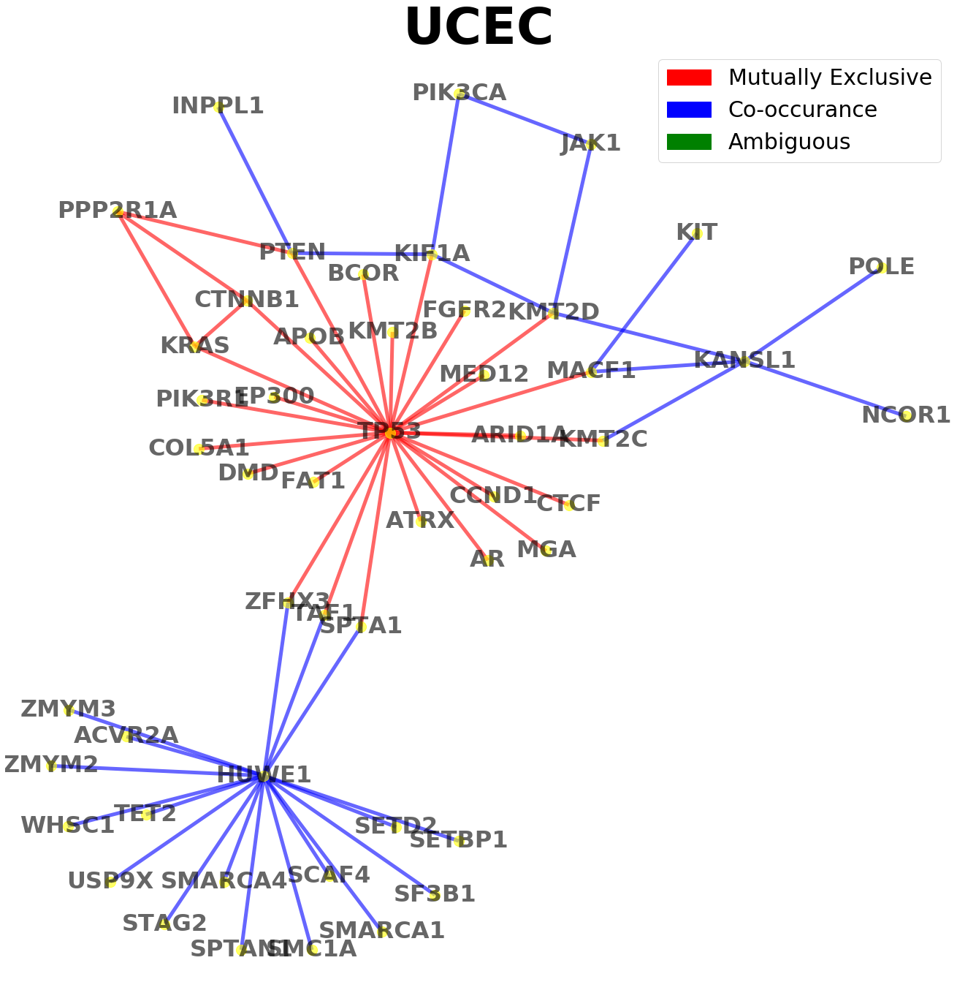
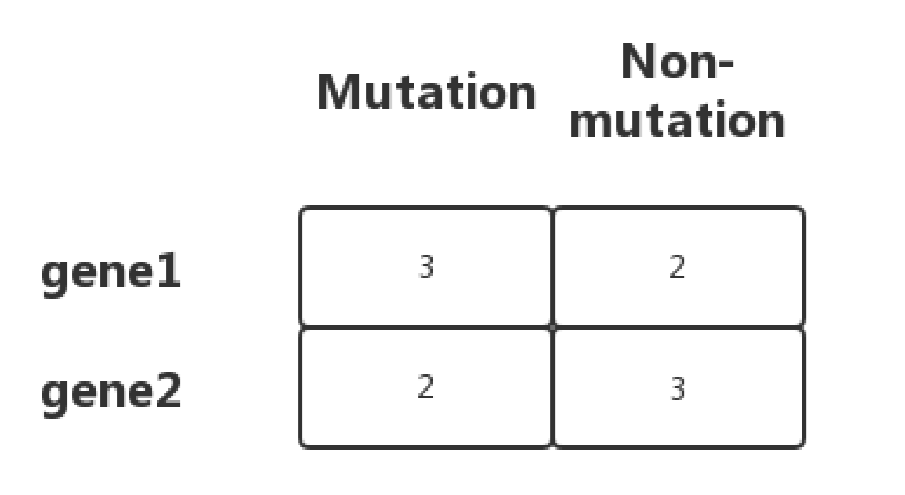
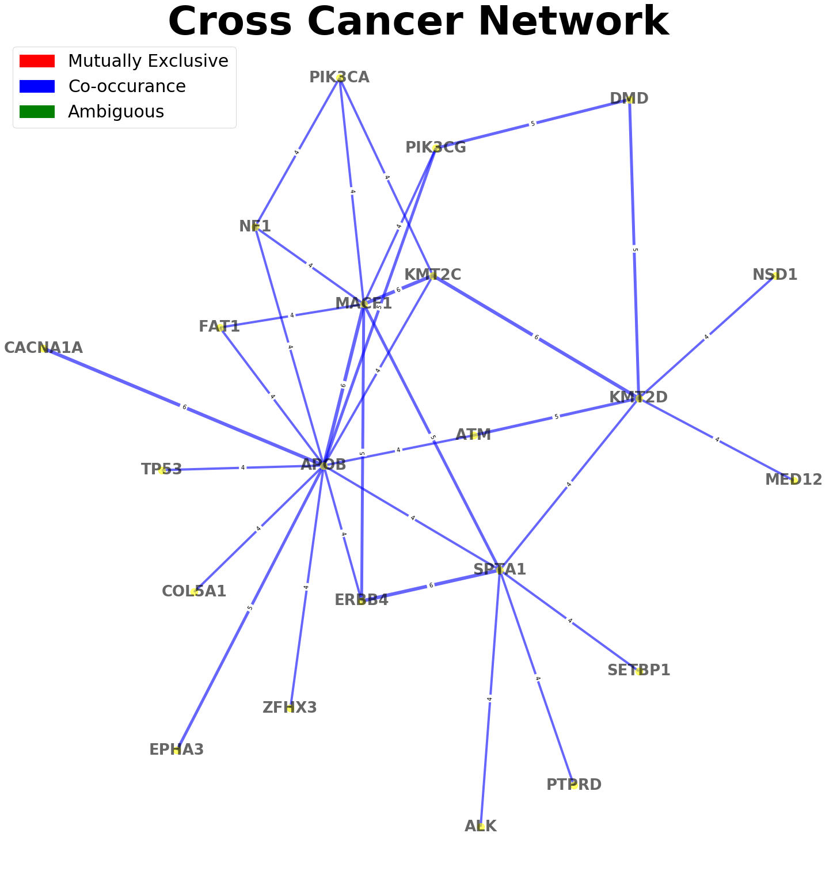
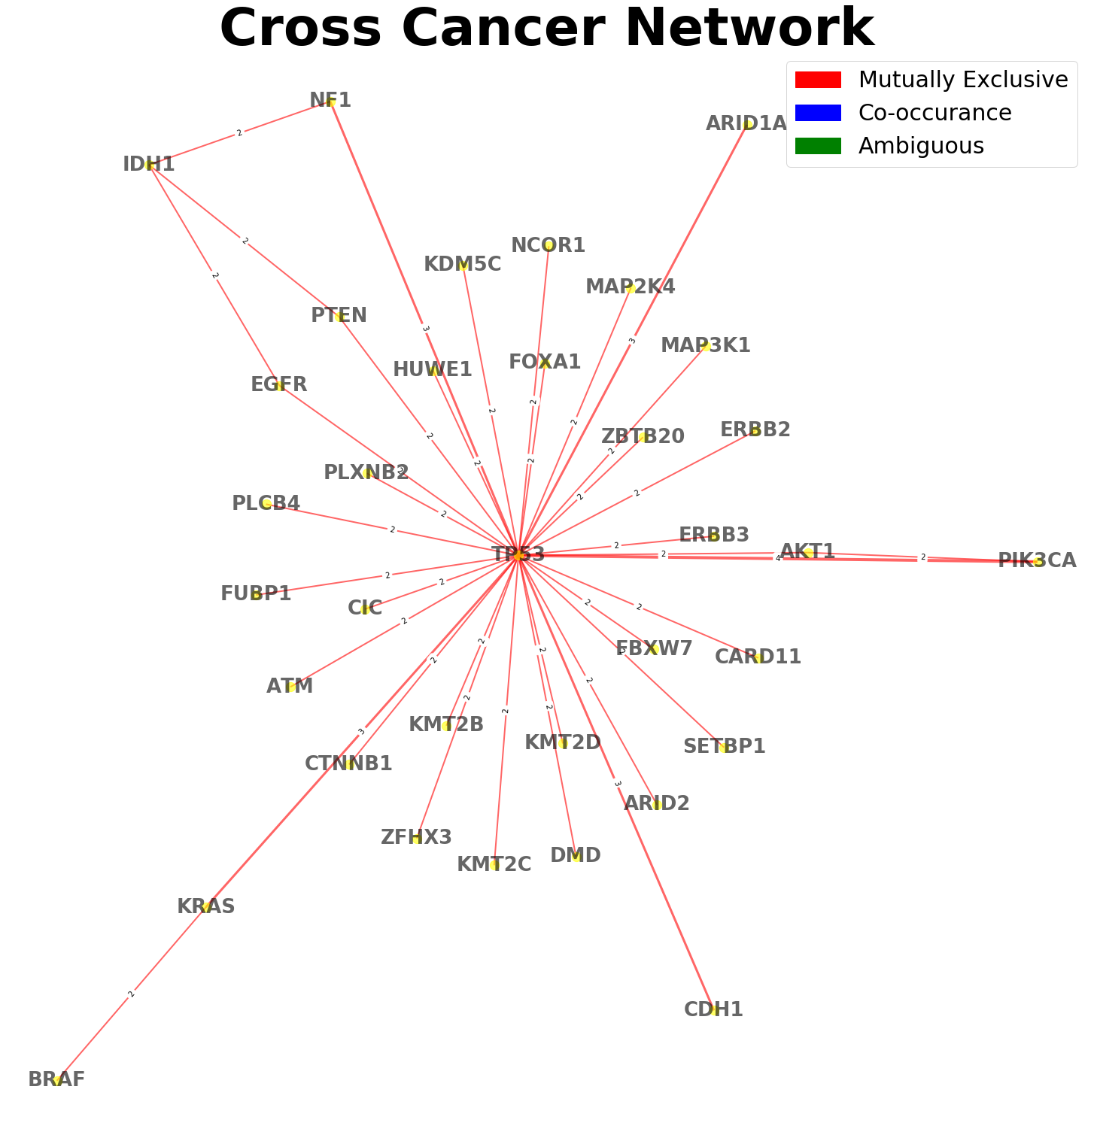
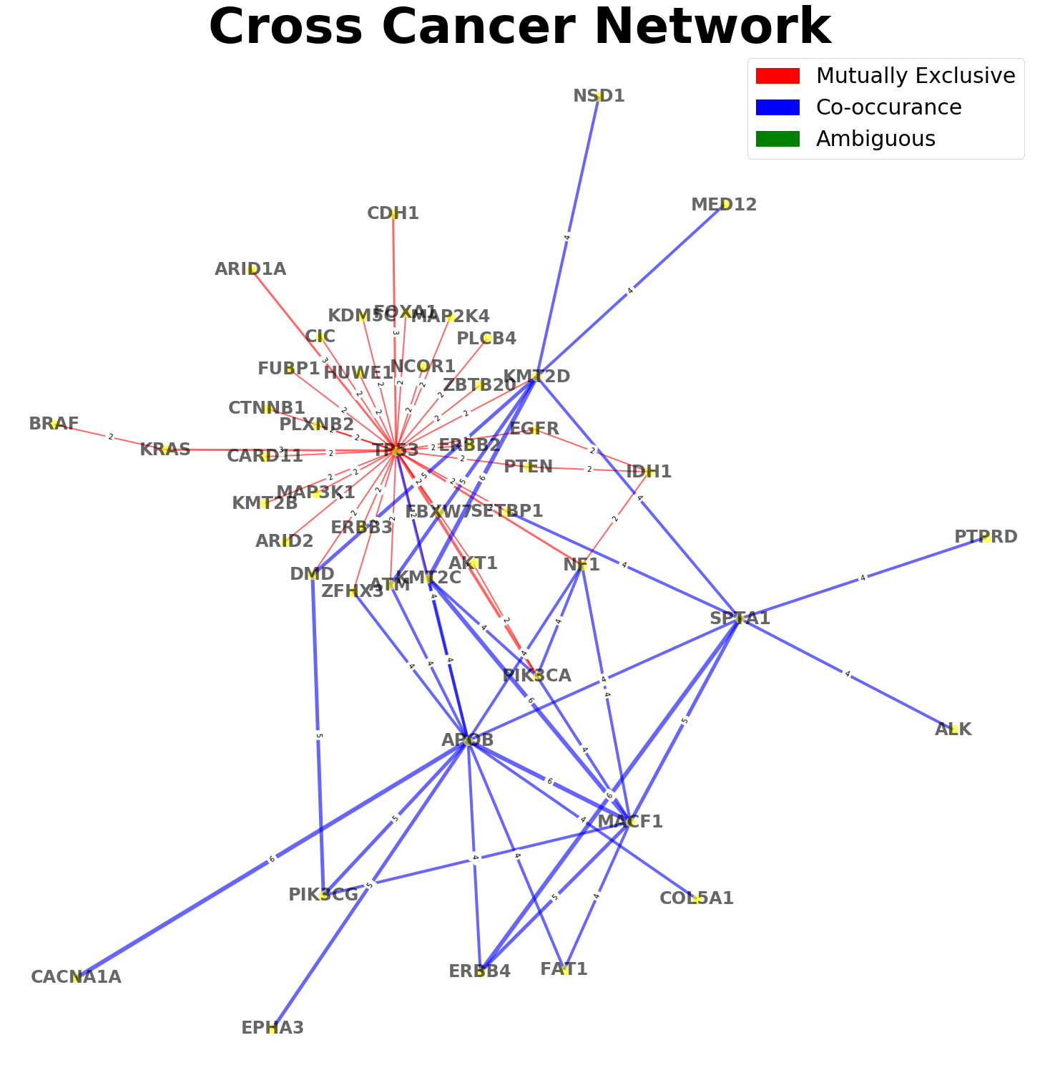
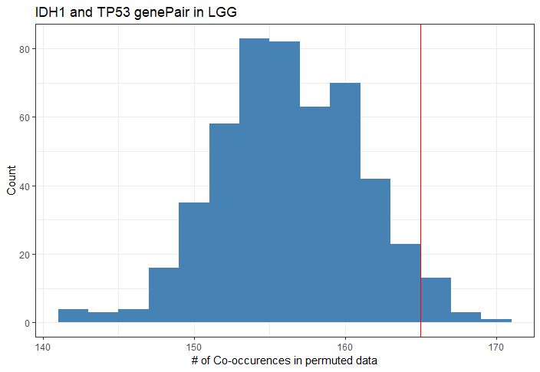
Identify significant co-occurring or mutually exclusive mutated driver genes across cancer types
Da Peng; Luchao Qi; Xi Wang; R. KARCHIN, PhD
Johns Hopkins University | Whiting School of Engineering | Baltimore, MD
Introduction
Results
Figure 4. Heatmap representing the co-occurrence of observed mutated gene pairs identified by the results of fisher’s exact test, chi-square test and permutation test
Selected Results
Driver mutations are mutations within a gene that confers a selective growth advantages thus causing cancer. Knowing the co-occurence or mutually exclusive relationships between driver mutations can provide valuable information in studying the aberrant pathways in the formation of tumors.
To test the mutually exclusive relationship, we utilized an existing R package tool called DISCOVER. However, currently there are no good tool to compute the co-occurrence between sample tests. As a result, we developed our own method of permutation test for finding significant co-occurring pairs.
LGG: Most of the genes identified from the publication are also discovered with our methods [1].The co-occurrence gene-pair triangle ATRX-IDH1-TP53 is accurately detected by our network. Additionally we found other important gene hubs such as IDH2 which is a very important drive gene in glioma formation.
GBM: The significant genes documented in published papers are accurately identified by our network. In addition, the network captures some mutually exclusive edges that are disconnected compared to LGG, including EGFR-ATRX [2].
BLCA: The mutually exclusive relationship between FGFR3-TP53 and FGFR3-RB1, as well as the co-occurrence relationship between RB1-TP53 is captured by the network [3]. In addition, the network found potential hubs like KMT2D and MACF1.
Results
Data Exploration and Methods
Data downloaded from TCGA are encoded as shown in below:
Figure 1. Sample encoded data matrix
Fisher’s exact test, chi-square test and permutation test are performed to test the null hypothesis: P(mutation | gene1) = P(mutation | gene2), In fisher’s exact test and chi-square test, we use contingency matrix to perform analysis:
Figure 2. Contingency matrix indicating the number of mutations and non-mutations
In permutation test, we permute the encoded sequences for 500 times and simulate a distribution of number of co-occurrences. The distribution is shown below:
Figure 3. Distribution of number of co-occurrences after permutation
Conclusion & Future Directions
Our results have decent amount of overlap with existing literatures. Also, we should perform PubMed mining of unexplained gene hubs identified using our methods to find biological significance. At the meantime, we do identify some other key gene hub in each cancer types that are not mentioned in those literatures. For example, HUWE1 in UCEC, APOB in cross cancer comparisons.
Acknowledgements
This is for you Karl.
Thanks to the DISCOVER TOOL provided by Netherlands Cancer Institute.
Thanks to Dr. Rachel Karchin for her insights and support in completing this project
References
Canisius, Sander et al. “A novel independence test for somatic alterations in cancer shows that biology drives mutual exclusivity but chance explains most co-occurrence.” Genome biology vol. 17,1 261. 16 Dec. 2016, doi:10.1186/s13059-016-1114-x
A Modeling Approach to Explain Mutually Exclusive and Co-Occurring Genetic Alterations in Bladder Tumorigenesis Elisabeth Remy, Sandra Rebouissou, Claudine Chaouiya, Andrei Zinovyev, François Radvanyi and Laurence Calzone
A global assessment of cancer genomicalterations in epigenetic mechanisms Muhammad A Shah1†, Emily L Denton1,4†, Cheryl H Arrowsmith1,2, Mathieu Lupien2and Matthieu Schapira1,3*
Figure 5. The network relations between driver genes among different cancer types

