Slide 1
Understanding Injury Risk on the Road: A Cluster-Based Analysis of Behavioural and Structural Factors
Tianrui Chen,Xinping Ouyang, Kunze Lyu, Na Yu

Slide 2
Introduction
Research question:
How do the use of seat belts, seat positions and vehicle types affect the severity of injuries? Which high-risk road users can be identified through clustering?
This report investigates how the use of seat belts—such as whether they were worn or not—relates to injury outcomes.
It also analyses how the position of the passenger within the vehicle, for example, sitting in the front versus sitting in the rear, affects injury severity.
Additionally, we examine the role of various vehicle types in accidents, including common passenger cars, taxis, utilities, station wagons, panel vans, prime movers, heavy vehicles, and other light commercial vehicles.
By combining these factors, we aim to identify patterns that help pinpoint high-risk road users.
Clustering techniques are also applied to detect groups of individuals who share similar characteristics and face higher injury risks in crashes.

Slide 3
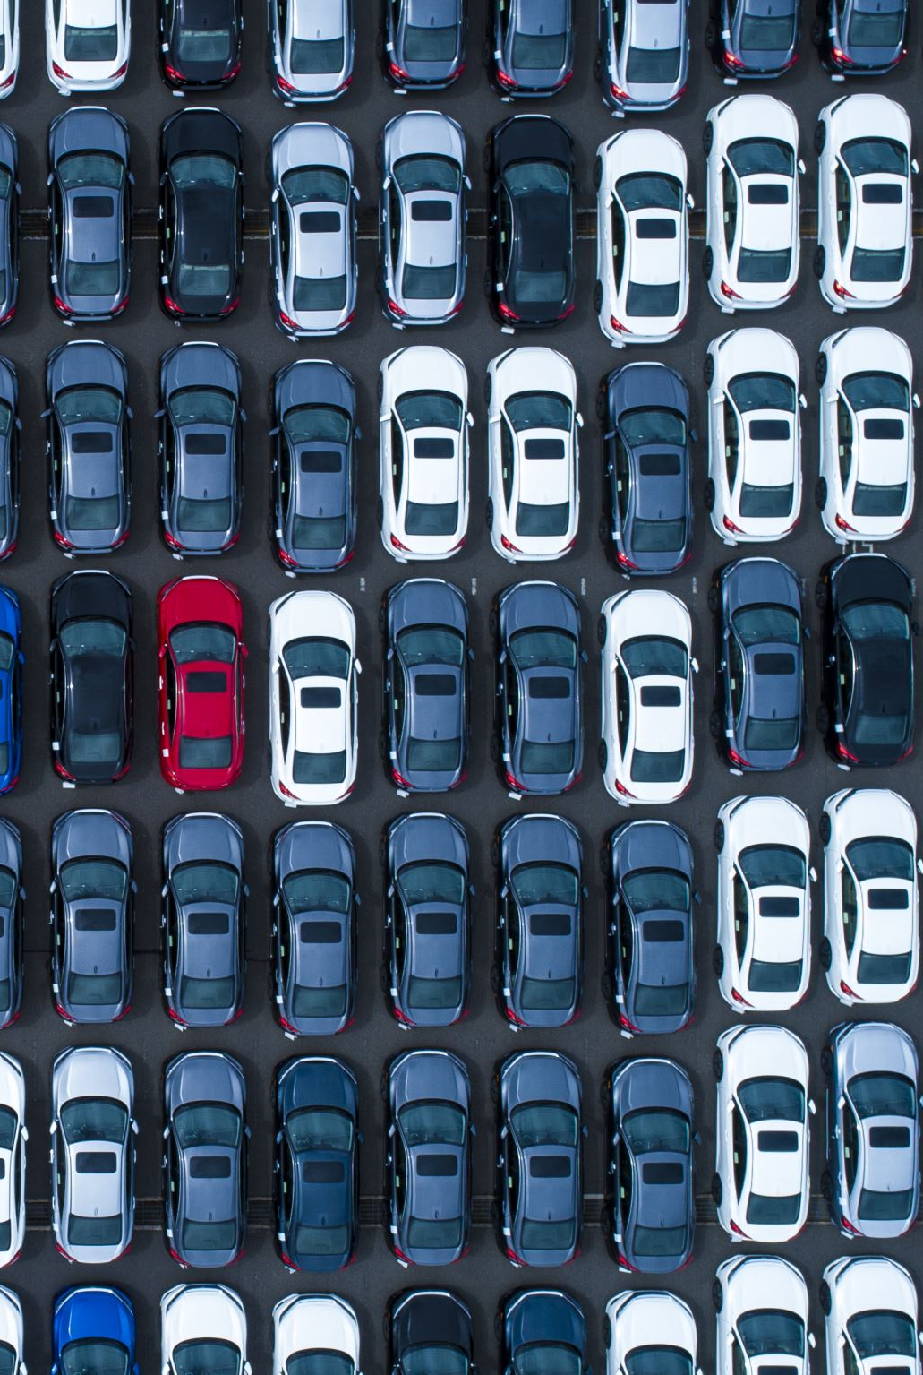
Correlation to road accident policy makers or implementor
Seating position: Most people wearing seat belts are likely divers or front-row passengers, and they were at a higher risk when the car crash occurred. Although they wore seat belts, they were close to common collision types, especially in the frontal collision, resulting in a higher injury rate. Our results provides empirical support for promoting rear seat occupancy, and explained why children and elder people are suggested to seat in the rear seats.
Vehicle type: the type of vehicle plays an important role in the severity of injuries. Passengers in large vehicles benefit from stronger structural protection and higher seat positions, reducing the risk of injury. In contrast, smaller vehicles offer less protection during collisions, resulting in a higher injury rate.
Seatbelt usage : The protective role of seat belts still cannot be ignored, especially in high-risk position and serious accidents, where seat belts can significantly reduce the degree of injury, Therefore, wearing a seat belt is one of the most effective ways to minimize the degree of injury.

Slide 4
Methodology overview
Data collection & Merging
Cleaning & Feature Engineering
EDA & Statistical Tasting
Clustering
Supervised Learning

Slide 5
Data collection & Merging
Merged person.csv and vehicle.csv by ACCIDENT_NO and VEHICLE_ID
Selected key variables(seatbelt, seat position, injury, vehicle type)
Cleaning & Feature Engineering
Missing values:
Mode imputation for seatbelt variable; 'Unknown' for seat position & vehicle type
categorised seatbelt, seating, and vehicle variables and Injury severity
One-Hot Encoding for categorical variables
Applied StandardScaler for feature normalisation

Slide 6
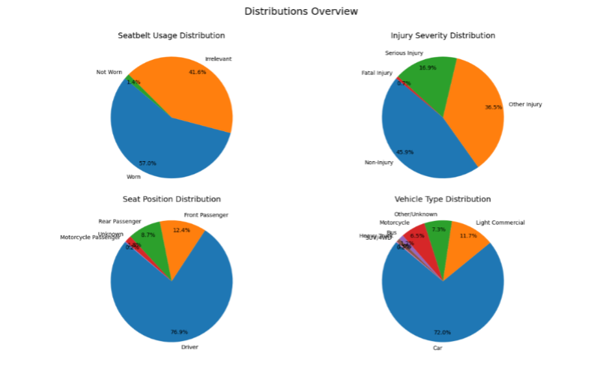
Exploratory Data Analysis - Distribution Analysis
57% of individuals wore seatbelts, only only 1.4% not wore seatbelts
Most injuries were none or other; only 0.7% were fatal
Most common seat position: Driver (76.9%)
Majority of vehicles is Cars (72%)

Slide 7
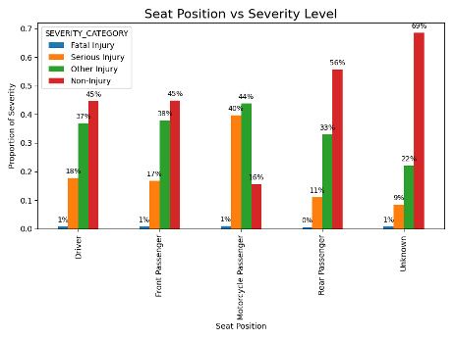
Exploratory Data Analysis - Relationship Analysis
Rear passengers had the highest proportion of non-injuries (56%)
Drivers and front passengers showed similar injury distributions
Motorcycle passengers had the lowest non-injury rate (13%) and the highest serious injury rate (44%)
Unknown seat positions had disproportionately high non-injury records (69%)
Notes:
Due to the distance from the frontal collision, the rear seats offer the best passive protection, and front and driver are less protection

Slide 8
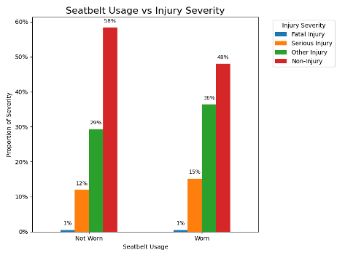
Exploratory Data Analysis - Relationship Analysis
Not wearing a seatbelt: 12% serious, 29% minor, 58% no injury
Wearing a seatbelt: 15% serious, 36% minor, 48% no injury
Notes:
Seatbelt use helps reduce serious injuries
Highlights the importance of contextual factors like seat position and vehicle type
Small sample size in “Not Worn” group may exaggerate injury rates

Slide 9
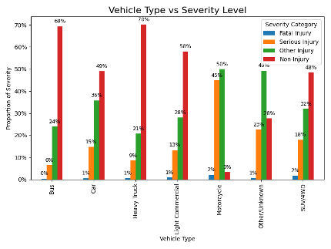
Exploratory Data Analysis - Relationship Analysis
Buses and heavy trucks had the highest non-injury rates (68–70%)
Cars ,SUVs, light commercial showed moderate risk levels
Motorcycles showed the highest rates of injuries
Notes:
Larger vehicles provide better protection and result in fewer injuries.
Passengers in exposed positions, like on motorcycles, face higher risks due to less physical shielding.

Slide 10
Chi-Square Independence Test - Statistical Testing
Verify whether the relationship between the variables is statistically significant
Result show: Both test results showed that p = 0 < 0.01
p-value less than 0.01 provides strong statistical evidence to reject the null hypothesis, indicating a significant association between the variables.
Whether to wear a seat belt is closely related to the degree of injury.
different seat positions can bring significantly different risks of injury
Passengers of different vehicle types also face different risks of injury.

Slide 11
Machine Learning Models
Logistic regression
Logistic Regression is a well-established baseline classifier that performs well when the relationship between features and the target is linear.
Random Forest
Random Forest is a robust, non-linear ensemble method that can capture complex patterns in the data. It builds multiple decision trees and combines their predictions to improve accuracy. It is less prone to overfitting than a single decision tree.
This combination of linear and non-linear models allows us to compare performance across different learning strategies and complexity levels.

Slide 12
Model performance overview
We used Stratified 80-20 train-test split and applied Cross-validation for model validation.
Model | Accuracy | Notes
Logistic Regression | 42% | These results indicate imbalanced classes and limited features may be key factors limiting performance.
Random Forest | 40%
Both models show limited predictive performance, with overall accuracies of 42% for Logistic Regression and 40% for Random Forest. Given the imbalanced class distribution (e.g. only 0.67% of cases fall into the “fatal injury” category), these accuracy values should be interpreted cautiously.

Slide 13
Model performance summary
Classification report (Logistic Regression)
Classification report (Random Forest)
 | precision | recall | f1-score | support
Fatal Injury | 0.01 | 0.29 | 0.03 | 539
Non-Injury | 0.51 | 0.79 | 0.62 | 36824
0ther Injury | 0.39 | 0.09 | 0.15 | 29252
Serious Injury | 0.28 | 0.10 | 0.15 | 13558
accuracy |  |  | 0.42 | 80173
macro avg | 0.30 | 0.32 | 0.24 | 80173
weighted avg | 0.42 | 0.42 | 0.36 | 80173
 | precision | recall | f1-score | support
Fatal Injury | 0.02 | 0.30 | 0.03 | 539
Non-Injury | 0.57 | 0.46 | 0.51 | 36824
Other Injury | 0.38 | 0.46 | 0.42 | 29252
Serious Injury | 0.28 | 0.10 | 0.15 | 13558
accuracy |  |  | 0.40 | 80173
macro avg | 0.31 | 0.33 | 0.28 | 80173
weighted avg | 0.45 | 0.40 | 0.41 | 80173

Slide 14
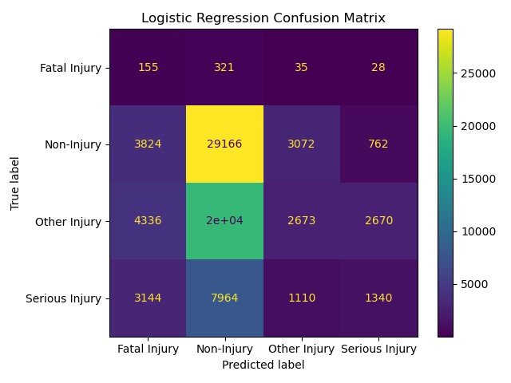
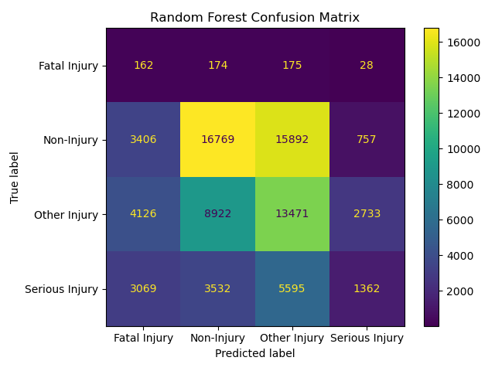
Model performance overview

Slide 15
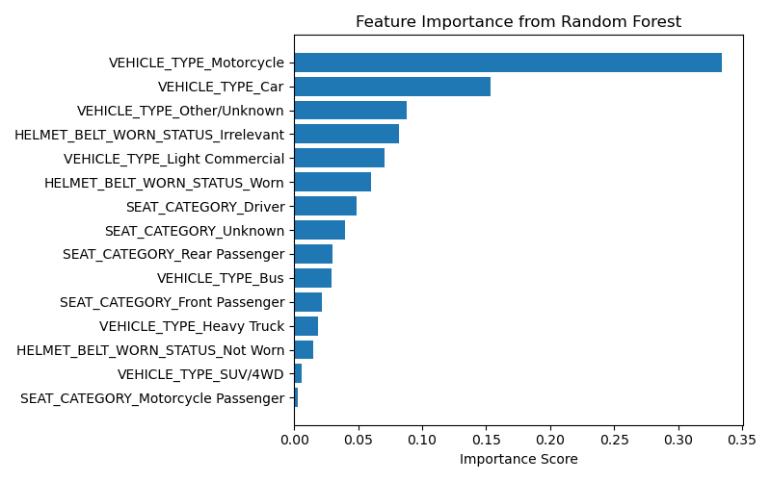
Feature Importance (Random Forest)
Random Forest's feature importance analysis shows vehicle type contributes more significantly to injury severity prediction than others. However, since these features alone are insufficient to distinguish between multiple injury levels, integrating additional variables—such as speed, weather, impact direction, or collision type may improve model discriminability.

Slide 16
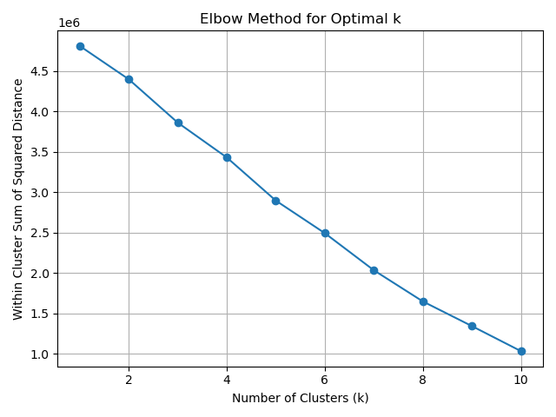
Evaluating Number of Clusters
Elbow Method
But no clear “Elbow”

Slide 17
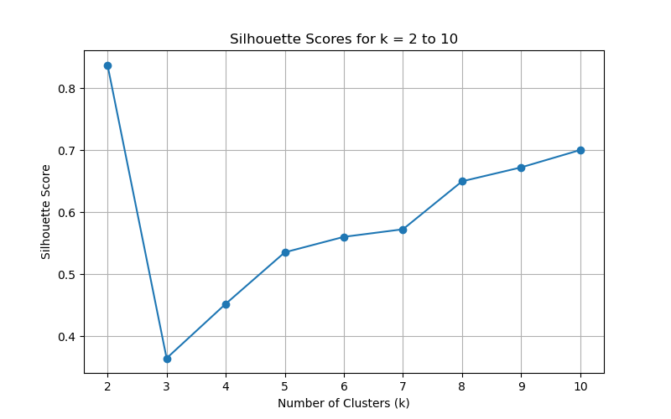
Silhouette Score: Evaluating Cluster Quality
What is Silhouette Score?
Scores how well points fit in their cluster (range: -1 to 1)
Silhouette Score = (cohesion − separation) / max
We observed:
Originally believed k=3 scored 0.83 (report)
But re-runs on sampled data show k=3 ~ 0.36–0.45
Why we still choose k = 3
Reveals meaningful risk profiles
Prioritized interpretability over score
Score varies with sampling; insight remains consistent

Slide 18
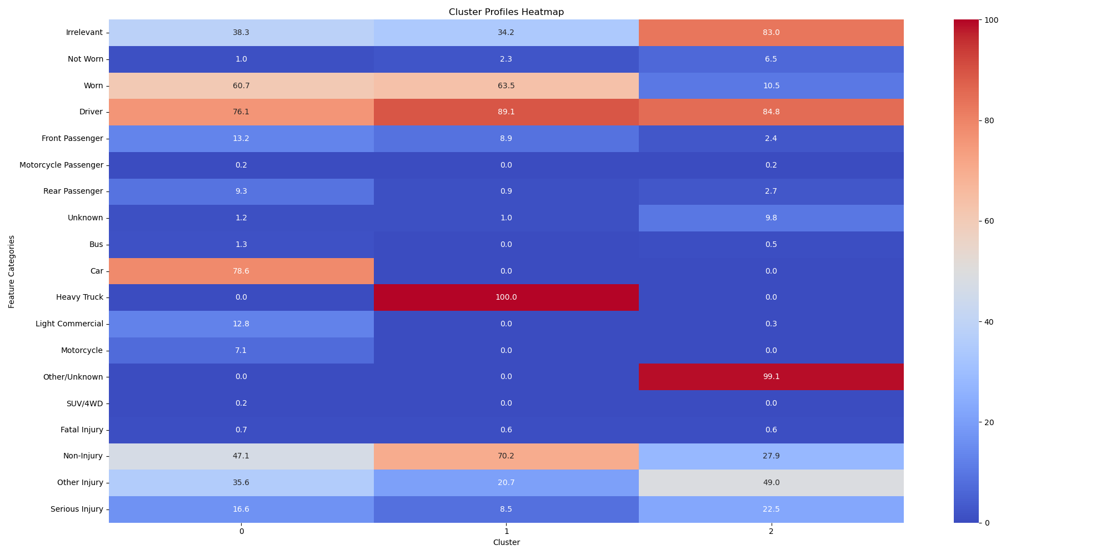
Cluster Profiles for k = 3

Slide 19
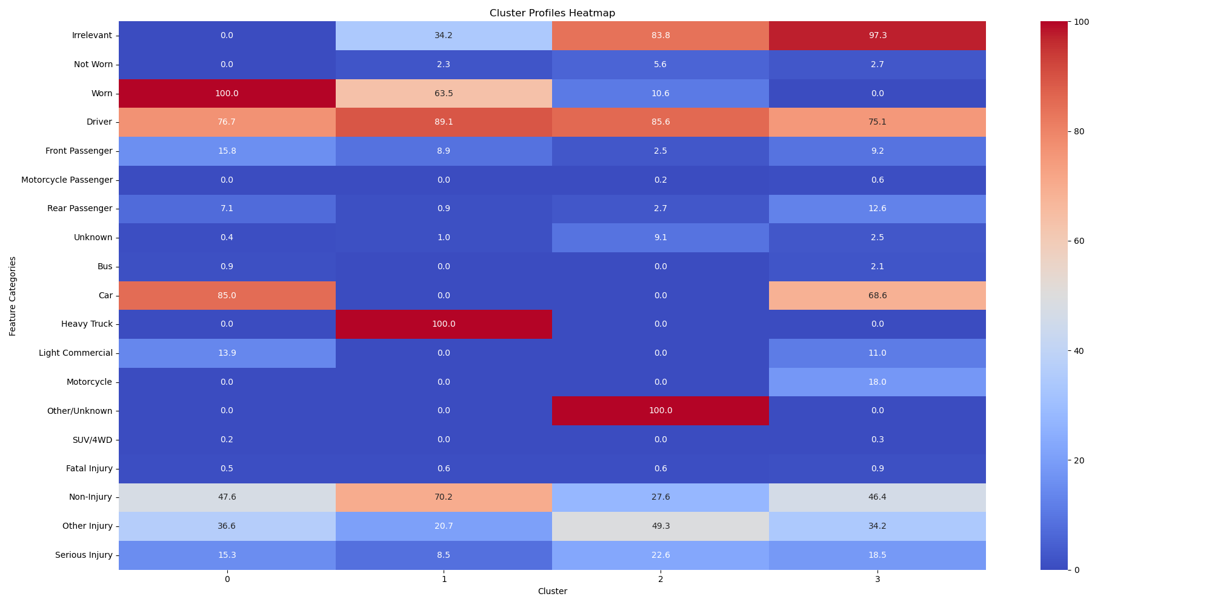
Further Exploration: 4-cluster Solution
Do not change the conclusion

Slide 20
Limitations:
1. Feature Simplification
Seatbelt, helmet, and airbag data were merged into a single column.
This reduced dimensionality but may have masked important protective effects.
2. KMeans with One-Hot Encoding
KMeans assumes spherical clusters and Euclidean distance.
One-hot encoding of categorical features may distort true behavioral similarity.
3. Cluster Imbalance and Overfitting Risk
Cluster 0 included over 90% of samples.
KMeans may overfit majority groups and compress or misclassify smaller, high-risk clusters.
4. Missed Feature Interactions
Potential interactions (e.g. front seat + no belt) were not explicitly modeled.
This may overlook compound risk effects.

Slide 21
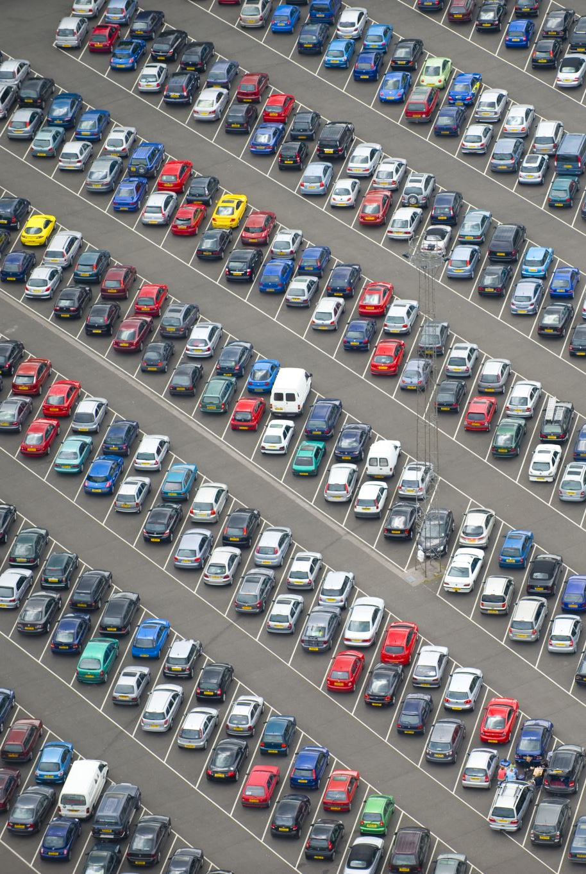
Conclusion
Key Findings
Rear seat positions are relatively safer
Seatbelt usage significantly reduces injury severity
Vehicle type strongly influences crash outcomes
We Recommend
Promote seatbelt use in all seats
Tailor safety messages by user type
Apply stricter rules for high-risk vehicles

